Slide 1
Dynamics 365 Online
Business in Dynamics 365

Slide 2
Dynamics 365
Master data.
Sales.
Service.
Marketing
Configuration.

Slide 3
Deployment
Online.
On premise (self host).
Partner hosted (3rd party host).
Hybrid hosted (self & online or self & 3rd party host).

Slide 4
Master data
Entity, attribute & record.
Account.
Contact.
Product.

Slide 5
Entity, Attribute & Record
Entity
Field
Record

Slide 6
Entity, Attribute & Record
Default Attributes
Status
Status Reason
Owner

Slide 7
Account Entity
Represent company.
Key fields:
Account Name.
Parent Account.
Primary Contact.
Can associate with many Contact.
Life cycle:
Active
Inactive
Deactivated
Activated

Slide 8
Contact Entity
Represent person.
Key fields:
Full Name.
Account Name (binding together with Company Name).
Recent Opportunities/Cases/Entitlements.
Life cycle:
Active
Inactive
Deactivated
Activated

Slide 9
Account & Contact
Connection
Account 1
Account 2
Contact 1
Contact 2
Contact 3
Contact 4

Slide 10
Product Entity
Represent something that can be sold.
Key fields:
Name.
Unit Group.
Default Unit.
Default Price List.
Life cycle:
Under Revision
Retired
Retired
Publish
Retired
Activate
Revision
Draft
Active
Publish

Slide 11
Product Entity
Related entities:
Product family.
Product bundle.
Price list.
Unit group.
Discount list.

Slide 12
Sales Process
Account
Contact
Lead
Opportunity
Competitor
Quote
Order
Invoice
Product
Sales Literature

Slide 13
Sales Process
Account
Lead
Contact
Invoice
Opportunity
Quote
Order

Slide 14
Lead Entity
Represent potential customer.
Key fields:
Topic.
Name.
Company.
Lead Source.
Life cycle:
Open (1)
(1): New, Contacted.
(2): Lost, Cannot Contact, No Longer Interested, Cancelled.
Qualify
Disqualify
Reactivate
Qualified
Closed (2)
Disqualify

Slide 15
Lead Entity
Qualify process:
Account
Qualify
Lead
Contact
Opportunity

Slide 16
Opportunity Entity
Represent potential sale.
Key attributes:
Topic.
Account.
Sales Stage.
Opportunity Contact.
Quote
Life cycle:
Open
Reopen
Opportunity
Close as won
Close as lost
Reopen
Opportunity
Lost
Won

Slide 17
Opportunity Entity
Create Quote process:
Close as won
Optional
Add Product Line
Add Quote
Opportunity
Quote
Closed
Opportunity
Close as lost

Slide 18
Competitor Entity
Represent competitor.
Key fields:
Name.
Strength.
Weakness.

Slide 19
Quote Entity
Proposed list of items and prices.
Key fields:
Name.
Products.
Potential Customer.
Life cycle:
Draft
Active
Activate
Revise/Close

Slide 20
Quote Entity
Create Order process
Customer Accept
Create Order
Draft Quote
Active Quote
Order

Slide 21
Order Entity
A list of items customer wants to buy.
Key fields:
Name.
Price List.
Products.
Total Amount.
Potential Customer.
Life cycle:
(1): Complete, Partial.
New
Cancel order
Fulfill order
No Money
Closed
(1)
Cancel order

Slide 22
Order Entity
Create Invoice process:
Create Invoice
Order
Invoice

Slide 23
Invoice Entity
(1): Billed, Partially Shipped, Booked, Installed.
(2): Completed, Partial.
Represent bill.
Key fields:
Name.
Price List.
Customer.
Products.
Life cycle:
Cancel invoice
Open
Confirmed
(1)
Confirm invoice
Cancel invoice
Invoice paid
Invoice paid
Canceled
Paid
(2)
Cancel invoice

Slide 24
Sales Literature Entity
Store sales information.
Key fields:
Title.
Subject.
Products.
Competitors.
Sales Attachments.

Slide 25
Service Process
Account
Contact
Product
Case
Knowledge Base
Queue
Service Management

Slide 26
Case Entity
(1): In progress, On Hold, Waiting for Details, Researching
(2): Canceled, Merged.
(3): Problem Solved, Information Provided
Represent an issue.
Key fields:
Case Title.
Customer.
Description.
Entitlements.
Subject.
Life cycle:
Open
(1)
Cancel case
Resolve case
Reactivate case
Reactivate case
Canceled
(2)
Closed
(3)

Slide 27
Knowledge Base
(1): Proposed, Draft, Needs Review, In Review
Documents for solving issues.
Key fields:
Title.
Keywords.
Content.
Subject.
Life cycle:
Open
(1)
Archived
Restore
Review rejected
Review approved
Update
Archive
Rejected
Approved
Published
Review approved
Publish

Slide 28
Queue Entity
A list of tasks need to be done and are assigned to a person or a team.
Key fields.
Name.
Type.
Public.
Private.
Incoming Email.
Life cycle:
Active
Inactive
Deactivated
Activated

Slide 29
Service Management
Routing Rule Sets
Automatic Record Creation and Update Rules
Subject
Service Level Agreements
Entitlements

Slide 30
Routing Rule Sets
Automatically assign cases to a specific member or service team.
Only one rule set can be active at a time.
If __
Rule item 1
If __
Routing Rule
If…
Then assign to __
Rule item…
Rule item 2

Slide 31
Automatic Record Creation and Update
(1): Phone Call, Email, Appointment, Task, Social Activity, Service Activity, Booking Alert, Approval.
Record C&U Detail 1
Record C&U Rule
Source Type
(1)
Record C&U Detail 2
Record C&U Detail…

Slide 32
Record Creation and Update Details
Conditions
If __
Record C&U Detail 1
Actions
Create
Update
Create
Send Email
Start child workflow
Other Actions
Action on entities: Quote, Order, Case, Account, Contact, etc.

Slide 33
Automatic Record Creation and Update
Life cycle:
Active
Inactive
Deactivated
Activated

Slide 34
Subject
To categorize cases, knowledge bases, products, sales literatures.

Slide 35
Service Level Agreements
Define deadline for an entity⁽¹⁾.
Calculate KPI⁽²⁾.
Pause the timer when needed⁽³⁾.
Send warnings and failures notification.
Execute actions on warning and failure.
Life Cycle:
(1): Case, Opportunity, Invoice, Lead, Quote, Order
(2): KPI is a unit to measure performance of a company.
(3): The paused time can also be able to track down.
Active
Draft
Deactivated
Activated

Slide 36
Service Level Agreements
Applicable When
Criteria
Success criteria
Success
SLA Detail 1
Success actions
SLA
Failure after __ (time)
Failure
SLA Detail…
Failure actions
Warning after __ (time)
Actions: Send Email, Create Record, Update Record, Assign Record, Change Status
Warning
Warning actions

Slide 37
Entitlement Entity
Represent contract.
Key fields:
Name.
Primary Customer.
Start/End Date.
Entitlement Terms.

Slide 38
Entitlement Entity
Life cycle:
Draft:
Active:
Waiting:
Expired:
Draft
Create
Draft
Active
Activate
Start Date
Today
End Date
Draft
Waiting
Activate
Today
Start Date
End Date
Start Date
End Date
Today

Slide 39
Entitlement Entity
Draft
Status | Edit | Associate with case | Renew
Draft |  |  | 
Canceled |  |  | 
Waiting |  |  | 
Active |  |  | 
Expired |  |  | 
Renew
Activate
Renew
Deactivate
Canceled
Active/
Waiting
Cancel
Cancel
Expired
Expire

Slide 40
Marketing Process
Marketing List.
Campaign & Quick Campaign.

Slide 41
Marketing List Entity
To grouping Accounts, Contacts, Leads for campaign purpose.
Key fields:
Name.
List Type.
Targeted At.
Member.
Campaign & Quick Campaign.
Life cycle:
Active
Inactive
Deactivated
Activated

Slide 42
Marketing List Entity
Marketing List
Type
Dynamic
Static
Targeted At
Lead
one of
Account
Contact

Slide 43
Add Member Process
Meet the criteria
Dynamic Marketing List
Manage Members
Entity
(Leads, Accounts, Contacts)
User choice
Static Marketing List

Slide 44
Copy to Static Process
Dynamic List 1
Copy to Static
Dynamic List 1
New Static List

Slide 45
Campaign & Quick Campaign
Used to manage marketing strategy, provide the result of marketing strategy.
 | Quick Campaign | Campaign
Campaign activity | Single | Multiple
Support planning | No | Yes
Marketing list | Single | Multiple
Campaign duration | Short | Long
Template | No | Yes
Associate with Entity | No | Price List, Product, Sale Literature
Creation | Only create from existed marketing list | Create like an entity

Slide 46
Campaign Entity
Key fields:
Name.
Campaign Type.
Marketing Lists.
Life cycle:
(1): Proposed, Ready to Launch, Launched, Completed, Canceled, Suspended
Active
(1)
Inactive
Deactivate
Activate

Slide 47
Quick Campaign
Key fields:
Subject.
No. of Successes.
No. of Failures.
Selected Members.
Excluded Members.

Slide 48
Dynamics 365 Settings
Security.
Email Configuration.

Slide 49
Security Settings
Business Unit
Users
Teams
Security Roles
Hierarchy Security
Positions

Slide 50
Business Unit
A group of user, represent a department or division.
Dynamics 365 must have one root business unit, can’t be renamed and deleted.
Must have only one parent, can have multiple child.

Slide 51
Users Settings
Manage user, license of a user, assign user to a team.
Each user must belongs to one business unit.
Add user note: add user in Office 365.

Slide 52
Teams Settings
Manage team, change team members.
Must belongs to only one business unit.
Team
Types
Owner Team
Access Team

Slide 53
Security Roles
Define privileges for roles.
Role
Privileges
Record-level
Task-based (Miscellaneous Privileges)

Slide 54
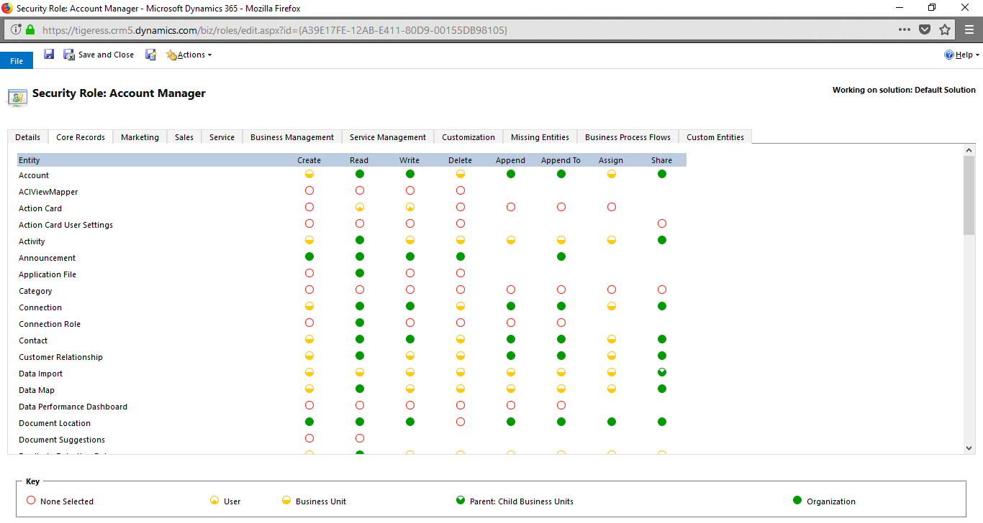
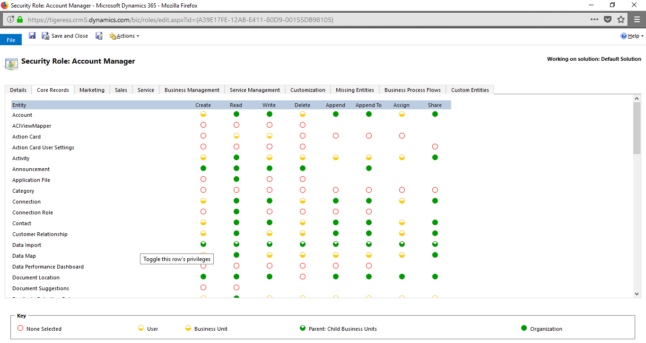
Privileges
Root Business Unit
Parent Business Unit
Parent Business Unit
Parent Business Unit
Child Business Unit
Child Business Unit
Child Business Unit
: Own and shared records

Slide 55
Hierarchy Security
An extension of Dynamics 365 security model.
Hierarchy Security
Hierarchy Model
Manager Hierarchy
Custom Position Hierarchy
Hierarchy Depth

Slide 56
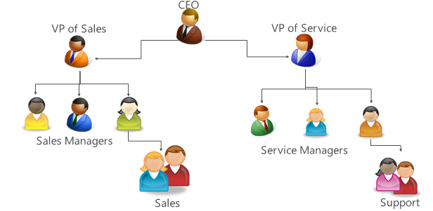
Manager Hierarchy
Direct reporting structure.
Managers may not have privileges to see report data.
If set Hierarchy Depth to 2, CEO can only see down 2 levels.

Slide 57
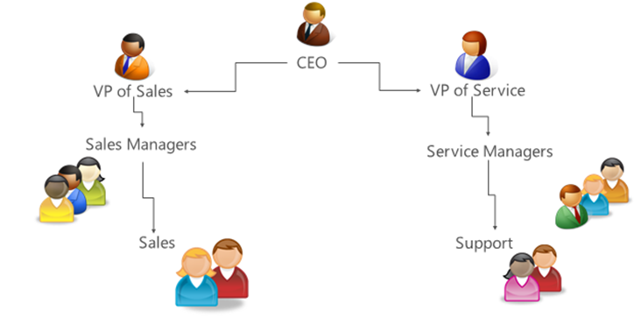
Custom Position Hierarchy
Higher position has access to lower position data.

Slide 58
Configurations
Email Server Profiles.
Mailboxes.
Migrate Email Router Data.
Email Configuration Settings: change sync and email processing settings, file size limit for attaching.
Server-Side Synchronization Monitoring: monitor sync.

Slide 59
Email Server Profiles
Manage email server profile.
Sync emails, appointments, contacts, tasks to email server.
Can only sync emails if email server is not Outlook.
Dynamics 365 can associate with Exchange/Exchange Online, POP3, SMTP email server.

Slide 60
Mailboxes
Test email.
Change sync settings.
Change email information.
Activate/Deactivate/Send confirm email to an email.

Slide 61
Migrate Email Router Data
Merge Email Router to Server-side synchronization.

Slide 62
Deprecated Components
Service Scheduling:
Service Calendar.
Resource.
Resource Group.
Work Hours.
Services.
Sites.

Slide 63
Deprecated Components
Contract:
Contract Template.
Contract.
Article:
Article.
Article Template.

