Slide 1
第十四章.面向对象建模
南京大学软件学院

Slide 2
主要内容
面向对象分析
用例模型
（行为模型）业务流程建模：活动图
（行为模型）用例实现（交互）：顺序图
（行为模型）行为建模：状态图
对象模型
对象约束语言OCL
面向对象建模

Slide 3
1. 面向对象分析
——现实世界的复杂模型
复杂总是简单部分的组合
简单部分又是更简单部分的组合
  简单组成复杂的过程存在层次性
每个最小简单部分独立负责完成一系列相关任务
相比较而言，每个组合内部各部分的关系比其内部与外部的关系都更紧密
各个部分通过一致的接口进行组合，即一个部分对其它部分的所知仅仅是接口

Slide 4
1. 面向对象分析
——映射现实模型的面向对象思想
任何系统都是能够完成一系列相关目标和任务的对象
对象完成一个任务时会请求一系列其他对象帮助其完成一些子目标
其他对象为了完成其任务又会请求将子目标更细分为子子目标，并请求其他对象帮助完成
子目标的分解和责任分担一直进行直到最后产生的子部分可以映射到计算实体
计算实体：对象
层次关系：聚合（组合）、继承、关联
组合接口：一个对象暴露的接口

Slide 5
1. 面向对象分析
——面向对象建模
面向对象建模：一种用于辨识系统环境中的对象及这些对象之间关系的技术
  OMT (James Rumbaugh)
  Booch方法(Grady Booch) UML
  OOSE (Ivar Jacobson)
  Coad-Yourdon
  Shlaer-Mellor
  Fusion

Slide 6
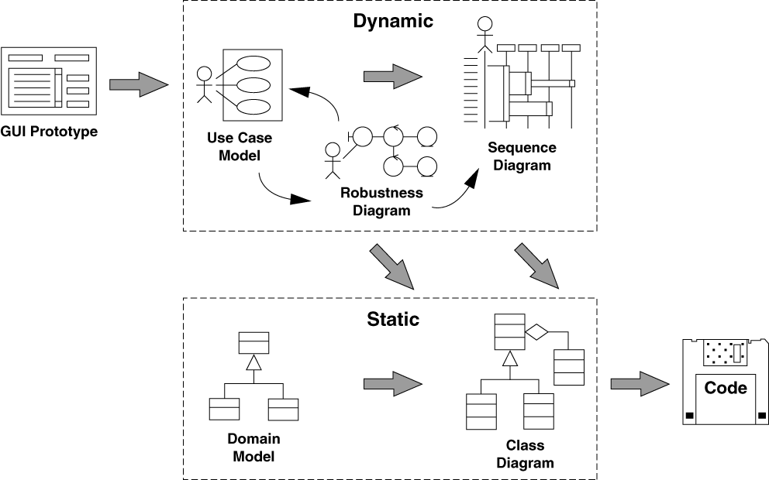
1. 面向对象分析
——UML
Jacobson
Jacobson
Booch
Rumbaugh

Slide 7
1. 面向对象分析
——UML
UML
  对象模型Object Model (Domain Model)
  用例模型Use Case Model
  行为模型Behavior Model
    状态机模型
  对象约束语言OCL

Slide 8
主要内容
面向对象分析
用例模型(ch6.5)
（行为模型）业务流程建模：活动图(ch5)
（行为模型）用例实现（交互）：顺序图
（行为模型）行为建模：状态图
对象模型
对象约束语言OCL
面向对象建模

Slide 9
2. 用例模型
用例模型就是以用例为基本单位建立的一个系统功能展示模型，它是系统所有用例的集合，以统一、图形化方式展示系统的功能和行为特性
用例是获取和组织用户需求的手段
基本元素
  用例（Use Case）
  参与者（Actor）
  关系（Relationship）
  系统边界（System Boundary）

Slide 10
2. 用例模型
Communication
Specialized
Use Case
Base Use Case
Actor
<<extend>>
General Use
Case
Extending Use
Case
Base Use Case
<<include>>
Special
Actor
Special
Actor
Included Use
Case

Slide 11
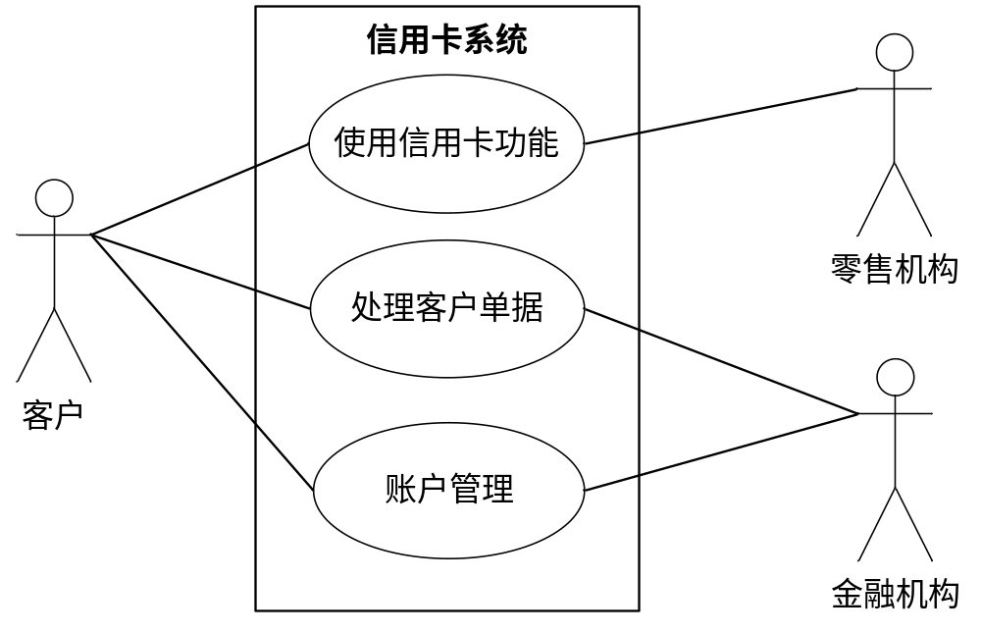
2. 用例模型

Slide 12
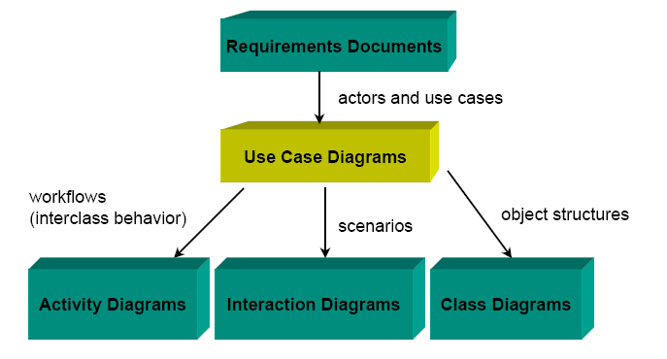
Role of Use Case Diagrams

Slide 13
主要内容
面向对象分析
用例模型
（行为模型）业务流程建模：活动图
（行为模型）用例实现（交互）：顺序图
（行为模型）行为建模：状态图
对象模型
对象约束语言OCL
面向对象建模

Slide 14
Business process diagram
A new form of data flow diagram
Appears with business process reengineering
Four types of elements:
  Flow objects
  Connecting objects
  Swimlanes
  Artifacts

Slide 15
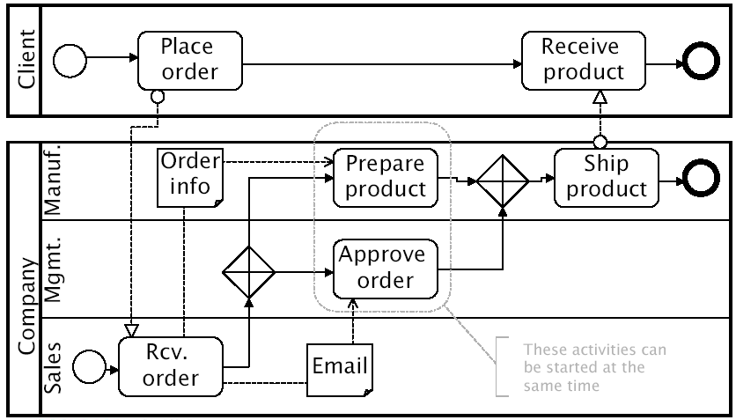

Business process diagram

Slide 16
Activity diagrams
Intended for applications that need control flow or object/data flow models …
  For example: business process modeling and workflow.
  It contents cover many use-cases and many classes
It’s adopted from BPM

Slide 17
Activity Diagrams: the notation
Action
Action/activity node: an action or an activity
Control flow
Class name
Object node: represent an object
Object flow
Initial node: beginning of a sequence of actions/activities
Final activity node: stop all control flows and object flows in an activity
Final flow node: stop a specific control flow or object flow
Swim lane: break up an activity diagram into parts to assign the activities or actions to the actors
Decision node
Fork node
Merge node
Join node

Slide 18
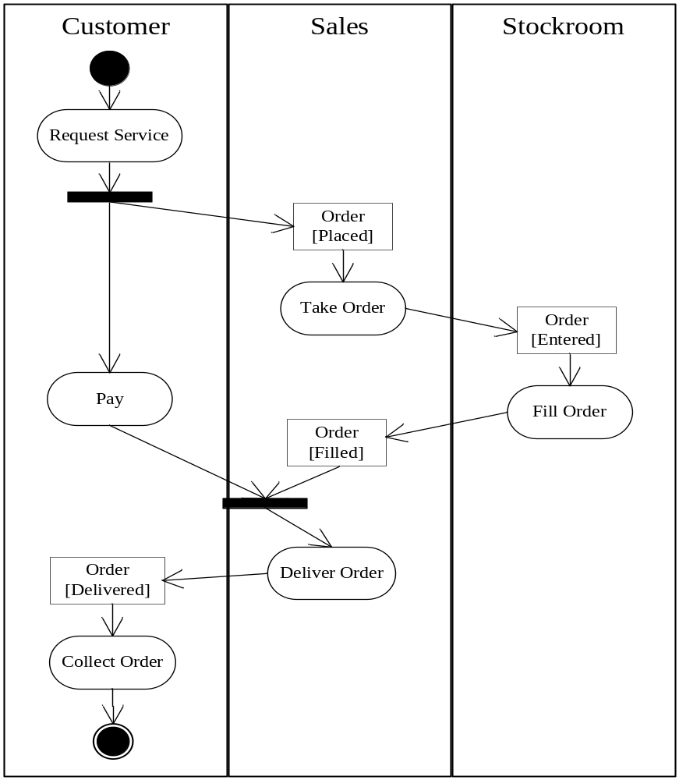
活动图
示例

Slide 19



Activity nodes
Three type of activity nodes:
  Action nodes: executable activity nodes; the execution of an action represents some transformations or processes in the modeled system (already seen)
  Control nodes: coordinate flows in an activity diagram between other nodes
  Object nodes: indicate an instance of a particular object, may be available at a particular point in the activity (i.e Pins are object nodes)

Slide 20





Activity edges (1)
Are directed connections
They have a source and a target, along which tokens may flow
Any number of tokens can pass along the edge, in groups at one time, or individually at different times
Weight: determines the minimum number of tokens that must traverse the edge at the same time
In this example we use a non-constant weight: an invoice for a particular job can only be sent when all of its tasks have been completed

Slide 21



Activity edges (2)
Two kinds of edges:
  Control flow edge - is an edge which starts an activity node after the completion of the previous one by passing a control token
  Object flow edge - models the flow of values to or from object nodes by passing object or data tokens
Notation without activity nodes
Notation without activity nodes

Slide 22

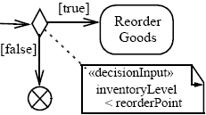
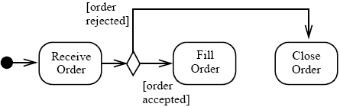

Control nodes – decision nodes
Route the flow to one of the outgoing edges (tokens are not duplicated)
Guards are specified on the outgoing edges or with the stereotype «decisionInput»
There is also the predefined guard [else], chosen only if the token is not accepted by all the other edges
If all the guards fail, the token remains at the source object node until one of the guards accept it

Slide 23

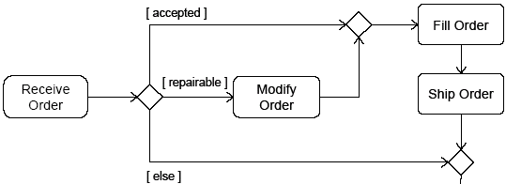

Control nodes – merge nodes
Bring together multiple alternate flows
All controls and data arriving at a merge node are immediately passed to the outgoing edge
There is no synchronization of flows or joining of tokens

Slide 24

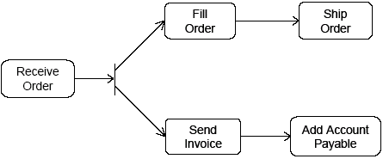
Control nodes – fork nodes
Fork nodes split flows into multiple concurrent flows (tokens are duplicated)

Slide 25

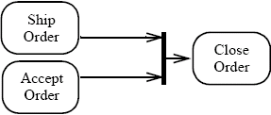
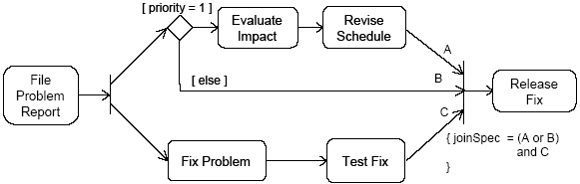
Control nodes – join nodes
Join nodes synchronize multiple flows
Generally, controls or data must be available on every incoming edge in order to be passed to the outgoing edge, but user can specify different conditions under which a join accepts incoming controls and data using a join specification

Slide 26

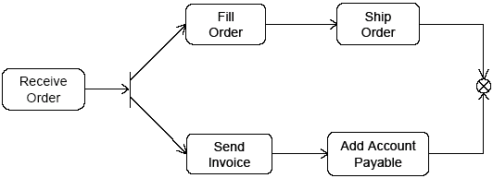
Control nodes – final nodes
Flow final:
  destroys the tokens that arrive into it
  the activity is terminated when all tokens in the graph are destroyed

Slide 27
行为模型建模
——建立活动图
确定活动图的上下文环境
  界定业务流程的处理界限
分析业务流程中的主要处理步骤
分析业务流程中的主要数据流
进行职责分配，将业务流程的处理步骤划分到不同的泳道，并将处理步骤和数据流的传递组织起来，建立活动图
添加活动图的详细信息，完善活动图描述

Slide 28
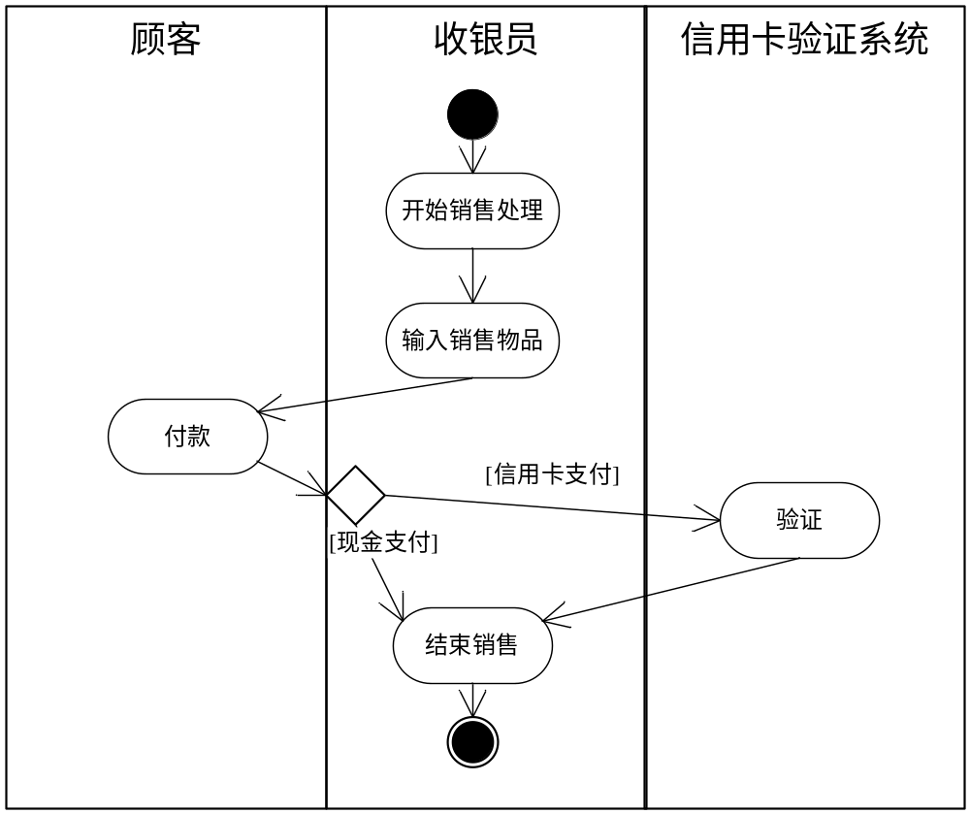
行为模型建模
——建立活动图
复杂流程

Slide 29
More Activity Diagram Elements
See <OMG Unified Modeling Language, Superstructure Version>

Slide 30

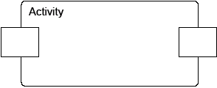
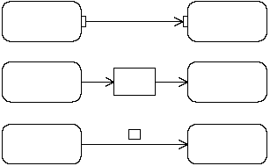



Object nodes
Hold data temporarily while they wait to move through the graph
Specify the type of values they can hold (if no type is specified, they can hold values of any type)
Can also specify the state of the held objects
There are four kinds of object nodes:
Central Buffer Nodes
Data Store Nodes
Activity Parameter Nodes
Pins
(three differents notations)

Slide 31
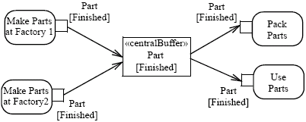

Object nodes – centralBuffer
A central buffer node is an object node that manages flows from multiple sources and destinations (as opposed to pins and parameters)
Acts as a buffer for multiple input flows and output flows
Is not tied to an action like pins, or to an activity like activity parameter nodes
The centralBuffer node collects the object Parts, and each Part can be used or packet (but not both)

Slide 32
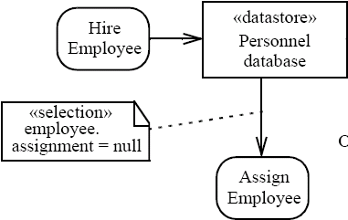

Object nodes – datastore
Is a specific central buffer node which stores objects persistently
Keeps all tokens that enter into it
Tokens chosen to move downstream are copied so that tokens never leave the data store
If arrives a token containing an object already present in the data store, this replaces the old one
Tokens in a data store node cannot be removed (they are removed when the activity is terminated)
Notes:
Hire = assumere

Slide 33

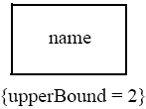
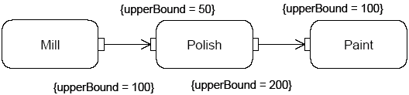
Object nodes - multiplicities and upperBound
Multiplicities: specify the minimum (≥0) and maximum number of values each pin accepts or provides at each invocation of the action:
  when is available the minimum number of values, the action can start
  if there is more values than the maximum, the action takes only the first maximum value
UpperBound: shows the maximum number of values that an object node can hold: at runtime, when the upper bound has been reached, the flow is stopped (buffering)

Slide 34



Object nodes – effect and ordering
Effect: pins can be notated with the effect that their actions have on objects that move through the pin
The effects can be: ‘create’ (only on output pins), ‘read’, ‘update’ or ‘delete’ (only on input pins)
Ordering: specifies the order in which the tokens of an object node are offered to the outgoing edges (FIFO, LIFO or modeler-defined ordering)

Slide 35




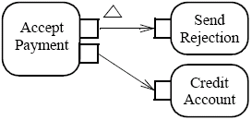

Special kind of pins (1)
Streaming Parameters (notated with {STREAM}): accept or provide one or more values while an action is executing
Exception Output Parameters (notated with a triangle)
  Provide values to the exclusion of any other output parameter or outgoing control of the action
  The action must immediately terminate, and the output cannot quit

Slide 36
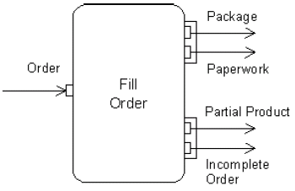


Special kind of pins (2)
Parameter Sets
  group of parameters
  the action can only accept inputs
    from the pins in one of the sets
  the action can only provide outputs
    to the pins in one of the sets
ValuePin: special kind of input pin defined to provide constant values (the type of specificated value must be compatible with the type of the value pin)
Output is provided only to the first or to the second set
Ray
value
Compute circumference
3.14
π

Slide 37




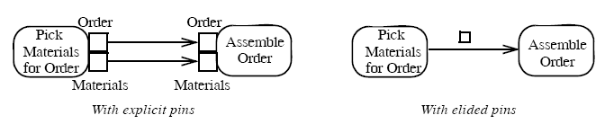
Activity edges – presentation options
An edge can also be notated using a connector
Every connector with a given label must be paired with exactly one other with the same label on the same activity diagram
is equivalent to
To reduce clutter in complex diagrams, object nodes may be elided
is equivalent to

Slide 38

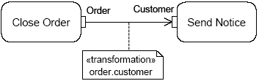

Activity edges - transformation
It is possible to apply a transformation of tokens as they move across an object flow edge (each order is passed to the transformation behaviour and replaced with the result)
<<transformation>>
transformation specification
In this example, the transformation gets the value of the attribute Customer of the Order object

Slide 39
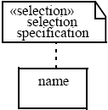
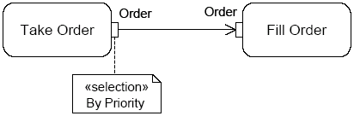
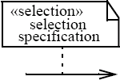
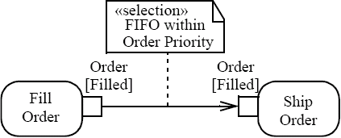
Selection
Specifies the order (FIFO, LIFO or modeler-defined ordering) in which tokens in the node are offered to the outgoing edges
Can be applied to:
  Object node - specifies the object node ordering, choosing what token offers to the outgoing edge whenever it asks a token
  Edge - chooses the order on which tokens are offered from the source object node to the edge (overrides any selection present on the object node, that is object node ordering)

Slide 40
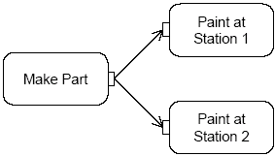
Token competition
A parameter node or pin may have multiple edges coming out of it, whereupon there will be competition for its tokens, because object nodes cannot duplicate tokens while forks can
Then there is indeterminacy in the movement of data in the graph

Slide 41
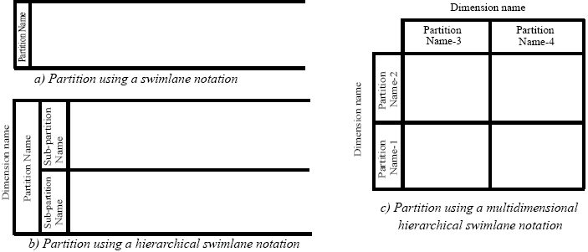
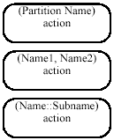

ActivityPartition (1)
Partitions divide the nodes and edges for identifying actions that have some characteristics in common
They often correspond to organizational units in a business model
Partitions can be hierarchical and multidimensional
Additional notation is provided: placing the partition name in parenthesis above the activity name

Slide 42
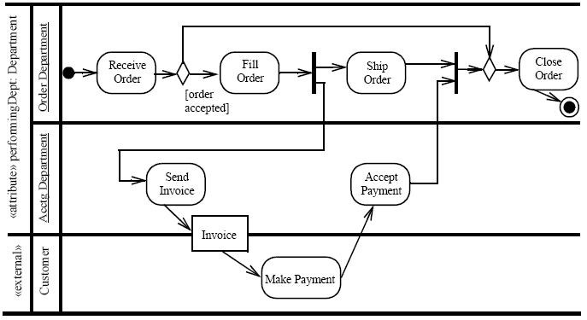
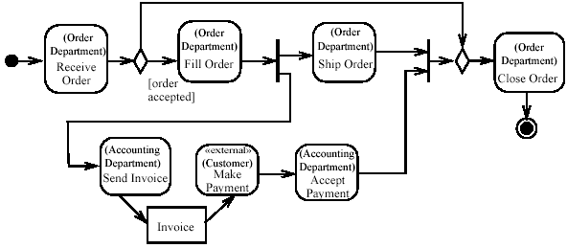
ActivityPartition (2)
Partition notated to occur outside the primary concern of the model

Slide 43
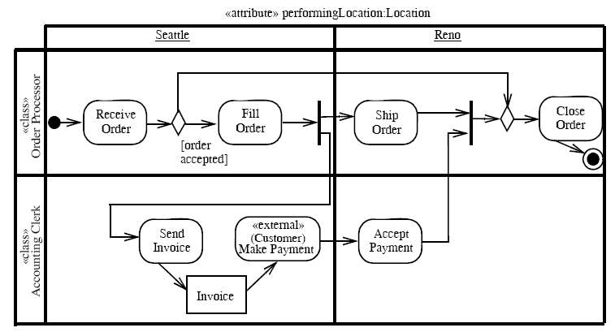

Slide 44
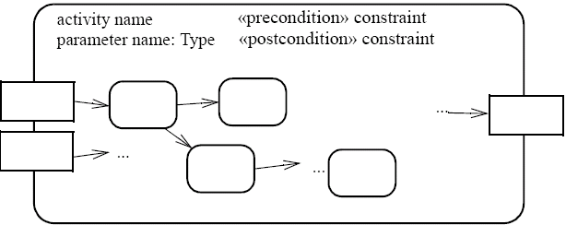
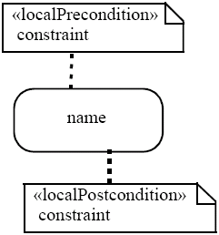
Pre & post condition (1)
Can be referred to an activity or to an action (local condition)

Slide 45
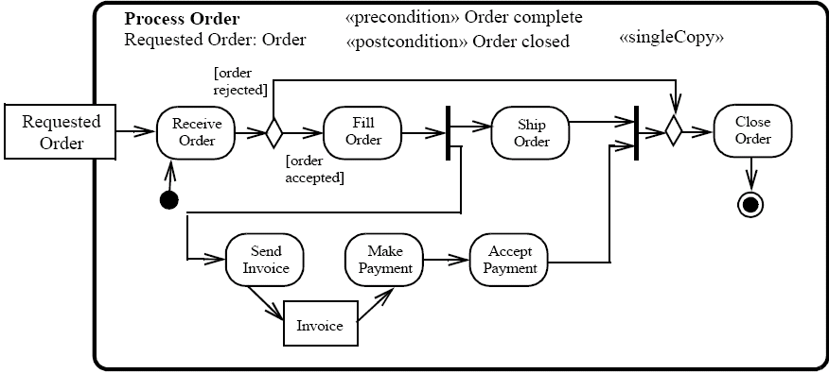
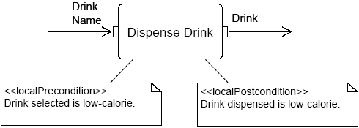
Pre & post condition (2)

Slide 46

SendSignalAction
Creates a signal instance from its inputs, and transmits it to the target object (local or remote)
A signal is an asynchronous stimulus that triggers a reaction in the receiver in an asynchronous way and without a reply
Any reply message is ignored

Slide 47
Time triggers and Time events
A Time trigger is a trigger that specifies when a time event will be generated
Time events occur at the instant when a specified point in time has transpired
This time may be relative or absolute
  Relative time trigger: is specified with the keyword ‘after’ followed by an expression that evaluates to a time value
  Absolute time trigger: is specified as an expression that evaluates to a time value
after (5 seconds)
Jan, 1, 2000, Noon
Relative time trigger
Absolute time trigger

Slide 48


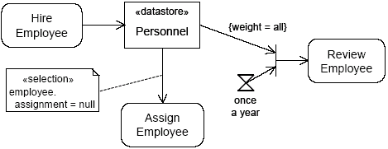
AcceptEventAction
Waits for the occurrence of an event meeting specified conditions
Two kinds of AcceptEventAction:
  Accept event action – accepts signal
    events generated by a SendSignalAction
  Wait time action – accepts time events
Accept event action
Wait time action
The objects stored in Personnel are only retrieved when the join succeeds (only once a year)

Slide 49
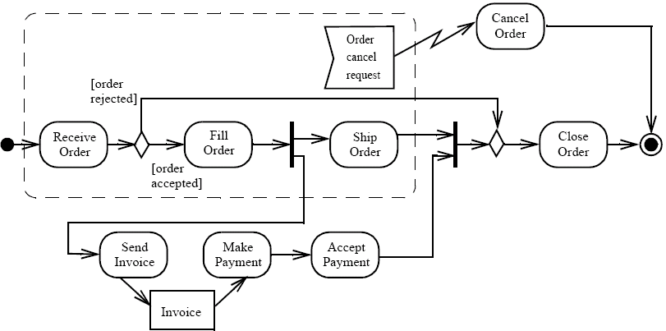

InterruptibleActivityRegion
Is an activity group (sets of nodes and edges) that supports termination of tokens flowing into it
When a token leaves an interruptible region via interrupting edges, all tokens and behaviours in the region are terminated
Token transfer is still atomic: a token transition is never partial; it is either complete or it does not happen at all (also for internal stream)
Interrupting edge

Slide 50
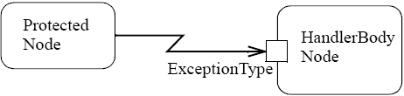
Exceptions
Exception handler - specifies the code to be executed when the specified exception occurs during the execution of the protected node
When an exception occurs the set of execution handlers on the action is examined to look for a handler that matches (catches) the exception
If the exception is not caught, it is propagated to the enclosing protected node, if one exists
If the exception propagates to the topmost level of the system and is not caught, the behaviour of the system is unspecified; profiles may specify what happens in such cases

Slide 51
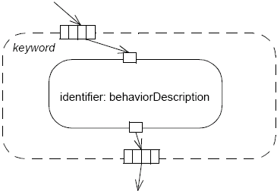
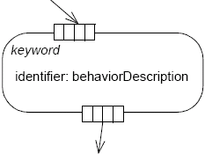
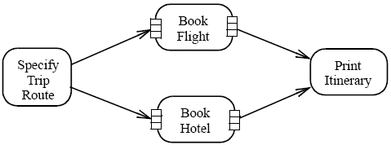
ExpansionRegion (1)
Nested region of an activity in which each input is a collection of values
The expansion region is executed once for each element (or position) in the input collection
On each execution of the region, an output value from the region is inserted into an output collection at the same position as the input elements

Slide 52
ExpansionRegion (2)
There are three ways of interaction between the executions:
  Parallel (concurrent): all the interactions are independent
  Iterative: the interactions occur in the order of the elements (the executions of the region must happen in sequence, with one finishing before another can begin)
  Stream (streaming): there is a single execution of the region, where the values in the input collection are extracted and placed into the execution of the expansion region as a stream (in order if the collection is ordered)

Slide 53
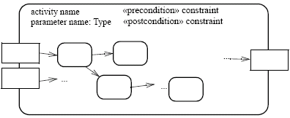


Activities
An activity is the specification of parameterized behaviour as the coordinated sequencing of subordinate units whose individual elements are actions
Uses parameters to receive and provide data to the invoker
Activity nodes
Parameter name
Activity edges
Output parameter
Input parameter
Parameter name
Parameter name
An action can invoke an activity to describe its action more finely
This action invokes the activity Fill Order

Slide 54
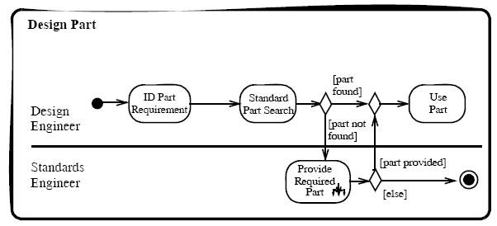
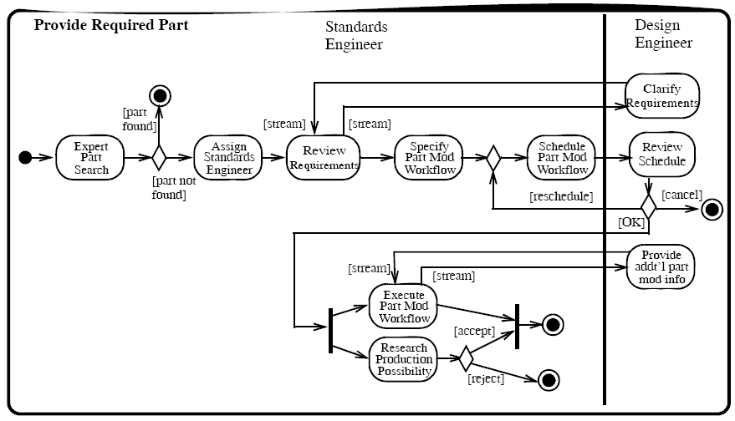

Slide 55
主要内容
面向对象分析
用例模型
（行为模型）业务流程建模：活动图
（行为模型）用例实现（交互）：顺序图
（行为模型）行为建模：状态图
对象模型
对象约束语言OCL
面向对象建模

Slide 56
4. 行为模型
——交互图
交互图
  以一组对象为中心的交互描述技术
  描述在特定上下文环境中一组对象的交互行为
  通常描述的是单个用例的典型场景
  交互图中的每一个交互都描述了环境中的对象为了实现某个目标而执行的一系列消息交换
  顺序图和通信图是最常用的 交互图
  交互图中出现的对象应该在领域模型中有相应的对象存在

Slide 57
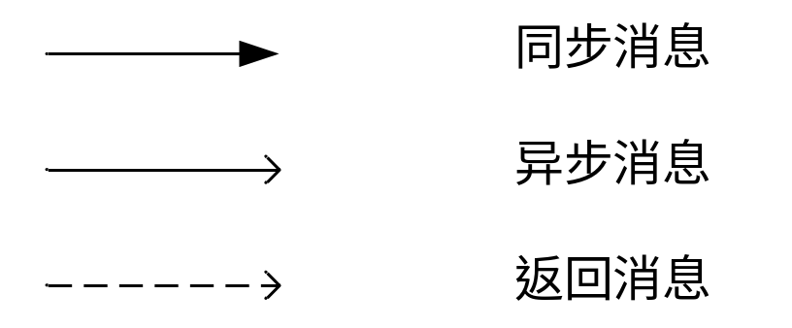
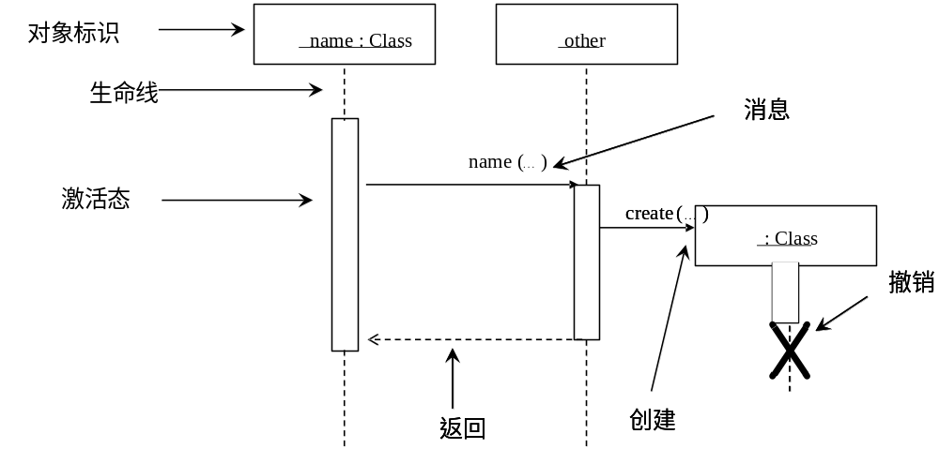
4. 行为模型
——交互图
顺序图

Slide 58
4. 行为模型
——交互图
通信图
  消息[sequence-expression:]message
    message＝[attribute=]name[(argument)][:return-value]
    sequence-expression ＝label [iteration-expression]
      iteration-expression ＝[*[iteration-clause]|[condition-clause] ]
object symbol
link symbol
standard stereotype
message
redisplay ()
window
: Controller
: Window
standard stereotype
standard constraint
window «parameter»
1: displayPositions (window)
1.1.3.1 add (self)
1.1 *[i := 1..n]: drawSegment (i)
wire
contents {new}
«local» line
{new}
: Line
wire :Wire
standard stereotype
1.1.2: create (r0, r1)
1.1.3: display (window)
«self»
standard constraint
1.1.1a: r0 := position ()
1.1.1b: r1 := position ()
left : Bead
right : Bead

Slide 59
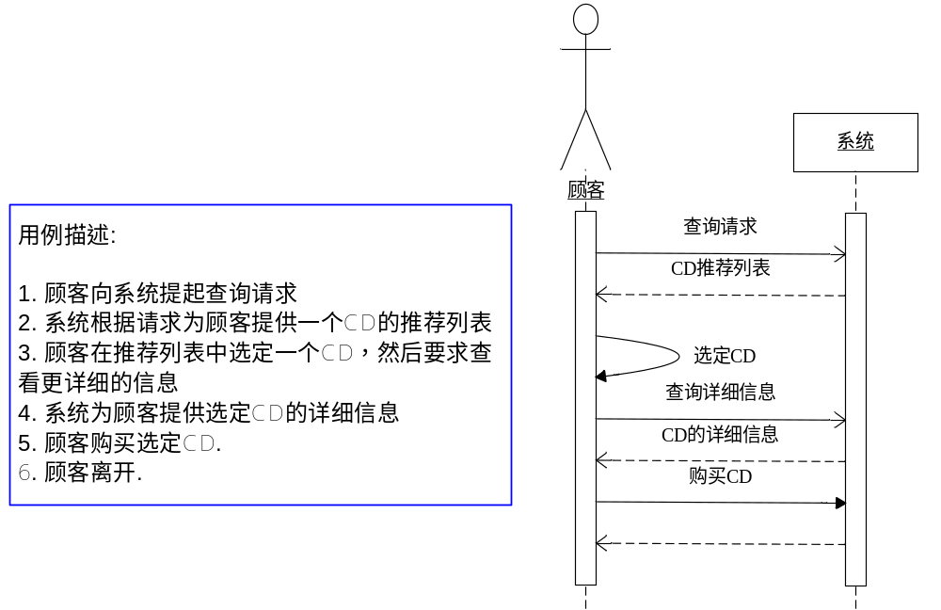
4. 行为模型
——交互图
系统顺序图
  将整个系统看作一个黑箱的对象，强调外部参与者和系统的交互行为，重点展示系统级事件

Slide 60
Depicting a Fragment Graphically
sd sample
client
order
inventory
Interaction
Fragment
req
operator
op1
Interaction
Fragment
Operation
Name:
(e.g. loop)
Interaction Fragment
Operand
Locate item

Slide 61
Options
Example
msg : Message
: Database
Fragment
opt
[msg.status=confirmed]
Condition
archive(msg)
Do something...
Used for modeling simple optional blocks.
Has one operand; no "else" guard.

Slide 62
Alternatives
msg : Message
: Database
: Admin
alt
Alternative Fragment group
[msg.status=confirmed]
archive(msg)
Condition
[msg.status=error]
notify(msg.getID())
[else]
wait()
Execution regions. At most one will execute.
Else condition
(optional)
Notes:
If no “else” alternative is available, an alt fragment may no execute any section at all.

Slide 63
Loops
: OS
: Folder
: File
loop
Loop Fragment
[for each Folder]
Display()
loop
Condition
[for each File]
Display()
Nested Loop Fragment

Slide 64
Breaks
: User
: User Manager
: Policy
isLooged = login(name,pass)
If the condition is met, the break fragment is executed, and the reminder of the sequence is ignored
break
[¬isLooged]
addBadLogin(name)
Do something…
Handy in model exception handling
Do something …

Slide 65
Referencing a diagram
: User
: User Manager
: Policy
login(name,pass)
ref
Login Handling(user,pass) :
bool
Reference Gate
Do something…
Do something …

Slide 66
Referenced Diagram
Diagram name
sd Login Handling
: User Manager
: UserAccount
loop
Input message
login(name,pass)
[for each UserAccount]
cName -= getUseNamer()
cName -= getUseNamer()
Output message
opt
[cName = name]
isInSystem(true)
true
false

Slide 67
Parallel Fragments
: User
: Checkout Handler
: Shipping Handler
: Transaction Handler
provideDetails(…)
provideDetails(…)
performCheckout()
par
Ship(address,products)
chargeMoney(CC,sum)

Slide 68
主要内容
面向对象分析
用例模型
（行为模型）业务流程建模：活动图
（行为模型）用例实现（交互）：顺序图
（行为模型）行为建模：状态图
对象模型
对象约束语言OCL
面向对象建模

Slide 69
4. 行为模型
——状态图
状态图
  以状态机理论为基础建立的对系统行为的描述手段
    状态机是以“状态”概念为基础解释系统行为的一种技术
    有限状态机FSM（Finite State Machine）是用于建模的最简单的状态机
    在FSM技术基础之上，发展出了多种分支技术(FSM,STD,Yourdon,SDL,STM,SC)，UML的状态图SD（State Diagram） 也是其中之一。
  主要用于描述重要而且复杂的对象的所有行为
    这个对象的行为通常要涉及很多（甚至大部分）的用例

Slide 70
4. 行为模型
——状态图
状态机理论
  状态机理论认为，系统总是处于一定的状态之中。而且，在某一时刻，系统只能处于一种状态之中。
  系统在任何一个状态中都是稳定的，如果没有外部事件触发，系统会一直持续维持该状态。
  如果发生有效的触发事件，系统将会响应事件，从一种状态转移到唯一的另一种状态。
如果能够罗列出系统所有可能的状态，并发现所有有效的外部事件，那么就能够从状态转移的角度完整的表达系统的所有行为
Definition
  A finite automata is a 5-tuple (Q, Σ, δ, q₀, F), where
  Q is a finite set called the states,
  Σ is a finite set called the alphabet (inputs),
  δ : Q × Σ → Q is the transition function,
  q₀ ∈ Q is the start state, and
  F ⊆ Q is the set of accept states (final states).

Slide 71
4. 行为模型
——状态图
简单示例
状态
开始状态
触发
Ready
转换
事件
Stop [normal]
/ctr := 0
Done
结束状态
行为
stop
监护条件

Slide 72
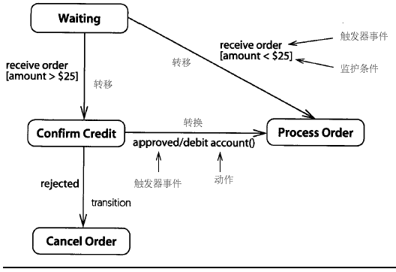
Example: UML State chart Diagrams

Slide 73


State Machine Diagrams
Compound States - A state machine diagram may include sub-machine diagrams, as in the example below.
Alternative way to show the same information
The ∞ symbol indicates that details of the Check PIN
sub-machine are shown in a separate diagram.

Slide 74


Slide 75

State Machine Diagrams
Entry Point - Sometimes you won’t want to enter a sub-machine at the normal initial state.
Exit Point - In a similar manner to entry points, it is possible to have named alternative exit points.

Slide 76



Slide 77

State Machine Diagrams
Choice Pseudo-State - A choice pseudo-state is shown as a diamond with one transition arriving and two or more transitions leaving.

Slide 78

State Machine Diagrams
Junction Pseudo-State - Junction pseudo-states are used to chain together multiple transitions. A single junction can have one or more incoming, and one or more outgoing, transitions;

Slide 79


State Machine Diagrams
Terminate Pseudo-State - Entering a terminate pseudo-state indicates that the lifeline of the state machine has ended.
History States - A history state is used to remember the previous state of a state machine when it was interrupted.
Notes:
In this state machine, when a washing machine is running, it will progress from "Washing" through "Rinsing" to "Spinning". If there is a power cut, the washing machine will stop running and will go to the "Power Off" state. Then when the power is restored, the Running state is entered at the "History State" symbol meaning that it should resume where it last left-off.

Slide 80
UML SD
详细的使用见：表14－2、UML的状态图表示法

Slide 81
主要内容
面向对象分析
用例模型
（行为模型）业务流程建模：活动图
（行为模型）用例实现（交互）：顺序图
（行为模型）行为建模：状态图
对象模型
对象约束语言OCL
面向对象建模

Slide 82
6.1 对象模型组成元素
——对象
对象
  对象是指在一个应用当中具有明确角色的独立可确认的实体
每个对象都要包含
  标识
    唯一的标识自己，引用
  状态
    对象的特征描述，包括对象的属性和属性的取值
  行为
    对象在其状态发生改变或者接收到外界消息时所采取的行动

Slide 83
6.1 对象模型组成元素
——对象
常见的事物都可以是对象
  和系统存在交互的外部实体，例如人、设备、其他的软件系统等；
  问题域中存在的事物，例如报表、信息展示、信号等；
  在系统的上下文环境中发生的事件，例如一次外部控制行为、一次资源变化等；
  人们在与系统的交互之中所扮演的角色，例如系统管理人员、用户管理人员、普通用户等；
  和应用相关的组织单位，例如分公司、部门、团队、小组等；
  问题域中问题发生的地点，例如车间、办公室等；
  事物组合的结构关系，例如部分与整体的关系等。

Slide 84
6.1 对象模型组成元素
——对象
但是也有事物不是对象
  无法界定的事物
  纯粹的值
  纯粹的行为

Slide 85
6.1 对象模型组成元素
——对象
一个对象维护其自身的状态需要对外公开一些方法，行使其职能也要对外公开一些方法，这些方法组合起来定义了该对象允许外界访问的方法，或者说限定了外界可以期望的表现，它们是对象需要对外界履行的协议（Protocol）
一个对象的整体协议可能会分为多个内聚的逻辑行为组，划分后的每一个逻辑行为组就描述了对象的一个独立职责，体现了对象的一个独立角色
对象职责
  职责是指对象持有、维护特定知识并基于知识行使固定职能的能力
如果一个对象拥有多个行为组，就意味着该对象拥有多个不同的职责，需要扮演多个不同的角色。
理想的单一职责对象应该仅仅扮演一个角色

Slide 86
6.1 对象模型组成元素
——链接
链接
  对象之间的物理或业务联系
链接通常是单向的，当然也有双向的链接存在
如果一个对象a存在指向b的链接，那就意味着a拥有对b的假设，关于b的行为和行为效果的假设。也就是说，b需要满足a的某些行为期望
导航和可见性
  由a指向b的链接除了包含假设和期望因素之外，还意味着a能够在链接的指引下，正确的找到并将消息发送给b，即a可以导航到b
  由a指向b的链接使得b对a可见，或者说a拥有b的可见性（Visibility）

Slide 87
6.1 对象模型组成元素
——类
类
  类是共享相同属性和行为的对象的集合，它为属于该类的所有对象提供统一的抽象描述和生成模板
    抽象描述称为接口（Interface），定义了类所含对象对外的（其他类和对象）的统一协议
    生成模板称为实现（Implementation），说明了类所含对象的生成机制和行为模式

Slide 88
6.1 对象模型组成元素
——类
类的分类
  类产生的关键是进行正确的分类
  人们认识和处理具体事物时总会有意识或无意识的对它们进行归类
数据驱动（Data-Driven）
  将具有相同属性的对象归为一类
  产生自哲学上传统的经典分类理论（Classical Categorization Theory）
    所有具有一个给定特性或共同特性集的实体组成一个类
职责驱动（Responsibility-Driven）
  会依据事物的相似性而不是完全的相同性来进行事物的分类
  产生自哲学上的概念聚类（Conceptual Clustering）
    使用概念描述而不是指定的特征来描述类别和事物，在进行事物分类时它会考虑概念之间的相似性，并将事物归入和其概念最为相似的类别

Slide 89

6.1 对象模型组成元素
——关联
关联
  指出了类之间的某种语义联系
  关联是类对其对象实例之间的无数潜在关系的描述

Slide 90


6.1 对象模型组成元素
——关联

Slide 91
6.2 对象模型重要概念
——继承
如果一个类A继承了对象B，那么A就自然具有B的全部属性和服务，同时A也会拥有一些自己特有的属性和服务，这些特有部分是B所不具备的
结构继承和语义继承

Slide 92
6.2 对象模型重要概念
——多态
广义多态
  一个对象在相似情景下表现出多个不同形态，或者多个对象在同一情景中表现出相同形态的现象
    一个对象在相似情景下表现出不同的形态
      重载（Overloading）
        依据参数或返回值的不同为协议定义不同的版本，每一个版本都可以表现出自己独特的行为
      泛型（Generality）
        使用同一个通用的实现处理不同的数据类型，然后根据数据类型的不同表现出不同的行为
狭义多态
  多个对象在同一情景中表现出相同形态的现象

Slide 93
6.3 领域模型
类大多是概念类（Concept Class），是一个能够代表现实世界事物的概念
概念类之间存在指明语义联系的关联，这些关联通常不标记方向，也不标记关联端的可见性
概念类会显式的描述自己的一些重要属性，但不是全部的详细属性，而且概念类的属性通常没有类型的约束
概念类不显式的标记类的行为，即概念类不包含明确的方法

Slide 94
6.3 领域模型
concept or
domain object
SalesLineItem
Records-sale-of
Item
quantity
0..1
1
1..*
*
association
Contained-in
Stocked-in
1
1
Sale
Store
attributes
date
time
1
address
name
1
1
Paid-by
Captured-on
Hosues
1
1
Payment
1
Register
amount
Notes:
The above diagram shows a partial domain model for the NextGen POS system. It illustrates that Payment and Sale are significant objects in this domain, where each Payment is related to exactly one Sale and that a Sale has a date and time as its attributes.
On one side the above diagram visualizes important issues of the domain, on the other side it is also an abstraction of the conceptual classes of the domain. A full description of the conceptual classes would contain much more information, but that is not important in this context.
„An abstraction is a reduction of information
to what is needed in the current context“
Trying to describe the above model in words would probably fill a full page, without being as clear as the above diagram. Thus Larman states, that „a domain model is a visual dictionary of abstractions“ [Lar02].

Slide 95
主要内容
面向对象分析
用例模型
（行为模型）业务流程建模：活动图
（行为模型）用例实现（交互）：顺序图
（行为模型）行为建模：状态图
对象模型
对象约束语言OCL
面向对象建模

Slide 96
7. 对象约束语言OCL
OCL并不是UML中单独的一个模型，而是被应用在其他的模型当中，丰富其他模型的语义
OCL是一种无副作用的规约语言
  以表达式的方式定义对其他模型元素的约束
  约束和限制其他模型元素的行为和状态变化
  不会修改任何其他模型元素的表述
OCL不是一种编程语言。
  OCL的首要定位是建模语言，因此它在保证一定表达能力的前提下，注重于语言的简洁性和抽象性
  它无法被用来描述程序的控制逻辑和工作流程，它的表达式定义也无法在程序中得到直接的执行

Slide 97
7. 对象约束语言OCL
示例
flights
1
Flight
Airplane
0..*
0..*
PassengerFlight
CargoFlight
0..*
1
PassengerPlane
CargoPlane
1
Notes:
Many facts about a software system that a modeller would like to express, can not be expressed, or can not easily be expressed in a visual model.

Slide 98
7. 对象约束语言OCL
示例
Flight
0..*
1
Airplane
type :
enum of cargo, passenger
flights
type :
enum of cargo, passenger
{context Flight
inv: type = #cargo implies airplane.type = #cargo
inv: type = #passenger implies airplane.type = #passenger}
Notes:
Using constraints simplifies the visual model and often points the way to a more flexible implementation.
Using constraints, we may explore many different variants of combining visual modeling with constraint modeling.

Slide 99
OCL expression
OCL expressions have a formal syntax and semantics, In an OCL expression these elements may be used:
  attributes
  operations and methods
  navigations that are derived from the associations
  enumerations defined as attribute types
Each OCL expression has a result
  the value that results by evaluating the expression
  The type of an OCL expression is the type of the result value
An OCL constraint is an OCL expression of type Boolean
Notes:
An OCL expression can be built using a great number of elements. There are the basic (predefined) types and their (predefined) operations, the classes, interfaces and datatypes from the model.
Because all OCL expressions must be side effect free, only operations that simply return a value but do not change the state of the system, the query operations, may be used. The non-query operations of all classes may not be used within an OCL expression. All attributes and class attributes can be used.

Slide 100
Example
Flight
departing
Flights
Airport
origin
departTime: Time
/arrivalTime: Time
duration : Interval
maxNrPassengers: Integer
*
name: String
*
desti-
nation
arriving
Flights
  context Flight
  inv: origin <> destination
  inv: origin.name = ‘Amsterdam’
  context Flight
  inv: airport.name = ‘KLM’
Notes:
In an OCL expression one may put constraints on the associated object or on attributes of the associated object.
The first constraint states that the airport from which a flight is leaving is different from the destination airport.
The second constraint states that for every flight the name of the airport from which it is leaving, must be “Amsterdam”.
The third constraint states that for every flight the name of the airline must be “KLM”.

Slide 101

OCL examples
A customer gets a gift of $10 if the number of transactions s/he started is more than 30

Slide 102
OCL examples
Solution
context Customer::getGift() : Integer
pre CustStartTransact:
self.bankaccount.costs->size() > 30
post TenDollarsGift:
gift = gift@pre + 10
and result = gift

Slide 103
7. 对象约束语言OCL
构成
  类型
  表达式
  保留关键字

Slide 104

7. 对象约束语言OCL
主要应用
  不变量
    不变量是可以对UML类元施加的约束
      类元需要保持它的表达式取值在指定的时间范围内或者指定的条件下始终为“真”
      最常见的是用来约束类的属性或者类的方法
{context Flight
inv: duration<4}

Slide 105
7. 对象约束语言OCL
前置条件和后置条件
  前置条件要求类元在执行操作之前必须保证前置条件的表达式为真
  后置条件要求类元在操作执行完成之后必须保证后置条件的表达式为真
LoyaltyAccount
class invariant
points: Integer
{ points >= 0 }
earn(i: Integer)
burn(i: Integer)
isEmpty(): Boolean
<<precondition>>
i >= 0
<<precondition>>
points >= i and i >= 0
precondition for burn operation
<<postcondition>>
points = points@pre + i
<<postcondition>>
points = points@pre - i
<<postcondition>>
result = (points=0)
postcondition for burn operation

Slide 106

7. 对象约束语言OCL
监护条件
  监护条件是对状态机模型中状态转移施加的约束
    在状态机到达转移点时，监护条件的表达式需要根据实际状态进行评估，并只有在表达式实际取值为“真”的情况下才进行转移

Slide 107
OCL usage tips
keep constraints simple
always combine natural language with OCL
use a tool to check your OCL
  FREE parser from IBM
    http://www.software.ibm.com/ad/ocl
  Cybernetics
    www.cybernetic.org
  University of Dresden
    www-st.inf.tu-dresden.de/ocl/
  Others … …

Slide 108
主要内容
面向对象分析
用例模型
（行为模型）业务流程建模：活动图
（行为模型）用例实现（交互）：顺序图
（行为模型）行为建模：状态图
对象模型
对象约束语言OCL
面向对象建模

Slide 109

8.1 面向对象建模技术路线
（1）从用例描述中识别出对象和类；
（2）分析用例的描述信息，添加类的属性和类之间的关联；
（3）从用例描述中识别系统行为；
（4）将系统行为分配给类；
（5）综合考虑类的属性与行为，细化类的职责，建立完全的对象模型。

Slide 110
8.1 面向对象建模技术路线
面向对象分析的结果：
  建立领域模型
  建立行为模型

Slide 111
8.2 领域模型建模
建立领域模型
  发现对象和类
    概念类分类列表
    名词分析
    行为分析
  建立类之间的关联
  添加类的重要属性

Slide 112
8.2 领域模型建模
——发现对象和类
如果候选对象既维持一定的状态，又依据状态表现一定的行为，那么它就应该是一个独立存在的对象
如果候选对象只有状态没有行为，那么就要分析它的状态是否是系统需要的数据。
  如果系统需要它的状态数据，那么该候选对象就应该作为其他对象的属性出现在最终的领域模型当中。
  否则，该候选对象应该被摈弃
如果候选对象只有行为没有状态，那么往往意味着需求信息的遗漏
需要注意实体关系建模思想带来的误区

Slide 113
8.2 领域模型建模
——发现对象和类
概念类分类列表
  这种方法事先给出一个概念类的分类列表，从中发现对象
方式来源 | Shlaer-Mellor[ShIaer1988] | Ross[Ross1987] | Coad-Yourdon[Coad1990]
分类列表 | 有形的事物 角色 事件 交互功能 | 人 地点 事物 组织：集合体 概念 事件：需要被记录 | 结构 其他系统 设备 事件：需要被记录 角色 地点 组织单位

Slide 114

8.2 领域模型建模
——发现对象和类
概念类分类列表示例

Slide 115

8.2 领域模型建模
——发现对象和类
名词分析
  从文本描述中识别出有关的名词和名词短语，然后从中发现对象

Slide 116
8.2 领域模型建模
——发现对象和类
用例描述 | 行为 | 候选对象 |  | 确定对象 | 概念类
 |  | 主动对象 | 被动对象
1.用户在第i层按下向上的楼层按钮 | 按下 | 用户 | 第i层向上楼层按钮 | 保留对象： 第i层的向上楼层按钮 第i层的向上楼层按钮灯 电梯 电梯门 计时器 到第j层的电梯按钮 到第j层的电梯按钮灯 | 楼层按钮 电梯按钮 按钮灯 电梯 电梯门 计时器
2.第i层的向上按钮灯亮 | 亮 | 第i层的向上楼层按钮灯
3.电梯到达第i层； | 到达 | 电梯 | 第i层
4.第i层的向上楼层按钮灯灭 | 灭 | 第i层的向上楼层按钮灯
5.电梯门开启 | 开启 | 电梯门
6.计时器开始计时 | 计时 | 计时器
7..用户进入电梯 | 无
8.用户按下到j层的电梯按钮 | 按下 | 用户 | 到第j层的电梯按钮
9.到第j层的电梯按钮灯亮 | 亮 | 到第j层的电梯按钮灯
10.计时时间到，电梯门关闭 | 到时 | 计时器 |  | 摈弃对象： 用户：系统外对象，既没有状态也没有行为； 第i层、第j层：只有状态没有行为
 | 关闭 | 电梯门
11.电梯到达第j层 | 到达
12.到达j层的电梯按钮灯灭 | 灭 | 到第j层的电梯按钮灯
13.电梯门开启 | 开启 | 电梯门
14.计时器开始计时 | 计时 | 计时器
15,用户走出电梯门 | 无
16.计时时间到，电梯门关闭 | 到时 | 电梯门
 | 关闭 | 计时器
行为分析
  从需求描述中搜寻动词，识别出系统行为，然后从中发现对象

Slide 117
8.2 领域模型建模
——建立类之间的关联
保证类之间协作所必需的可见性
适当使用问题域内的关联，增强领域模型的可理解性
  要适可而止
不要在关联的识别上花费太多的时间
  识别概念类比识别关联更加重要
避免显示冗余和导出的关联

Slide 118

8.2 领域模型建模
——添加类的重要属性
实现类协作时必要的信息，是协作的条件、输入、结果或者过程记录
使用用户的描述方式，不进行类型和约束的严格定义

Slide 119
8.2 CRC方法
CRC是Candidates、 Responsibilities和 Collaborators三者的缩写
基于CRC可以建立一种索引卡片，被称为CRC卡，每个卡片代表了一个被发现的候选对象
形式可能是多种多样的，卡片、纸张、黑板等等都可以作为CRC卡的介质载体
CRC卡简洁方便，可以随时被移动、修改或者丢弃，所以它特别适合于在复杂的系统当中进行对象的发现和设计思想的挖掘 ，即进行复杂情况下的面向对象分析与设计

Slide 120

8.2 CRC方法
——CRC卡示例

Slide 121

8.2 CRC方法
——技术路线

Slide 122
8.3 行为模型建模
建立行为模型
  建立系统顺序图
  在需要时
    建立详细的交互图
    建立用例的状态图或者重要类的状态图
    建立活动图
  为系统行为添加契约说明

Slide 123
8.3 行为模型建模
——建立交互图
确定交互图的上下文环境
  上下文环境的前置条件和后置条件应该被分配给交互图中的相应行为
找出参与交互的对象
  交互图中的参与对象（和对象之间的关联）应该和领域模型中的知识保持一致。
根据发现的对象（和关联）建立交互图框架
添加消息，描述交互行为
  考虑和系统相关的（系统内的、系统与外部对象之间的）交互行为，忽略那些与系统无关的（外部对象之间的）交互行为。如果建立的是系统顺序图，那么系统内的行为也可以被忽略。
进行消息标识、特化图示等详细信息的描述，将交互图的信息补充完整。

Slide 124

8.3 行为模型建模
——建立交互图

Slide 125
8.3 行为模型建模
——建立状态图
确定上下文环境
  搞清楚状态的主体常见的状态主体有：类、用例、多个用例和整个系统
识别状态，标记初始状态和结束状态
  可能会不存在确定的初始状态和结束状态
建立状态转换
补充详细信息，完善状态图

Slide 126

8.3 行为模型建模
——建立状态图
 | 授权 | 空闲 | 销售开始 | 商品信息显示 | 错误提示 | 列表显示 | 销售结束
授权 | Y | Y
空闲 | Y |  | Y | Y |  |  | Y
销售开始 |  |  |  | Y
商品信息显示 |  |  |  |  | Y | Y
错误提示 |  | Y
列表显示 |  | Y
销售结束 |  | Y

Slide 127
8.3 行为模型建模
——添加契约说明
不需要为所有的系统行为都定义操作契约，可以有选择的为其中的一部分系统行为定义操作契约
  涉及到很多状态变化的复杂行为
  因果关系比较微妙的模糊行为
可以从下面几个角度进行约束的发现工作：
  不变量：系统行为中所涉及的敏感状态，这些状态的改变往往会产生广泛的连锁反应
    不可改变的属性、不可改变的关联关系
  前置条件：行为发生和顺利完成所需要的系统的状态条件
    合法的参数
    有效的状态
      对象的存在状态、对象的属性取值、有效的关联关系
  后置条件：行为顺利完成之后引起的系统状态改变
    有效状态的改变
      对象的存在状态、对象的属性取值
    关联关系的改变

Slide 128

8.3 行为模型建模
——添加契约说明
示例
Contract: enterItem( itemID: ItemID, quantity: integer)
Cross References: Process Sale
Precondition:
  There is a sale underway
Post-condition:
  A SalesLineItem instances sli was created
  sli was associated with the current Sale
  sli.quantity become quantity
  sli was associated with a ProductSpecification, based on itemID match

Slide 129
本章小结
面向对象分析是90年代之后的主流分析方法，它以UML为基础，综合使用了多种不同的分析技术，主要有：
  对象模型Object Model (Domain Model)
  用例模型Use Case Model
  行为模型Behavior Model
    状态机模型
  对象约束语言OCL
面向对象分析任务的成功执行，除了要掌握多种面向对象分析技术之外，还需要掌握利用这些技术的建模方法
CRC方法是面向对象分析在处理复杂问题时的手段，但是它需要了解很多的建模知识才足以进行

Slide 130
思考题
在需求获取阶段，需求工程师收集了大量的样本，包括文档、表格和报告，解释这些样本对面向对象建模有哪些用处
分析你所在学校使用的选课系统，给出它的详细和完备的面向对象分析模型描述。

