Slide 1
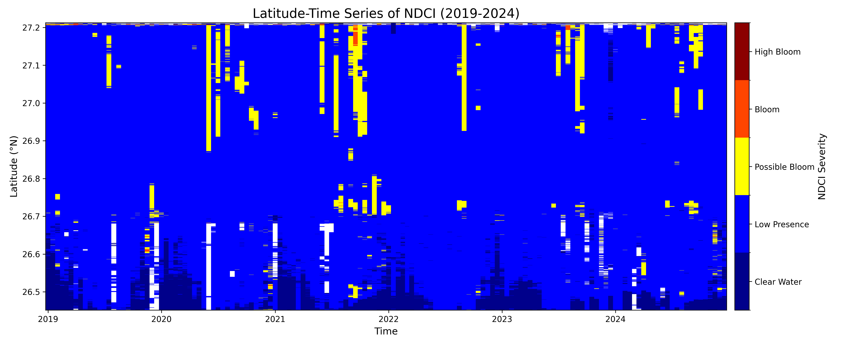
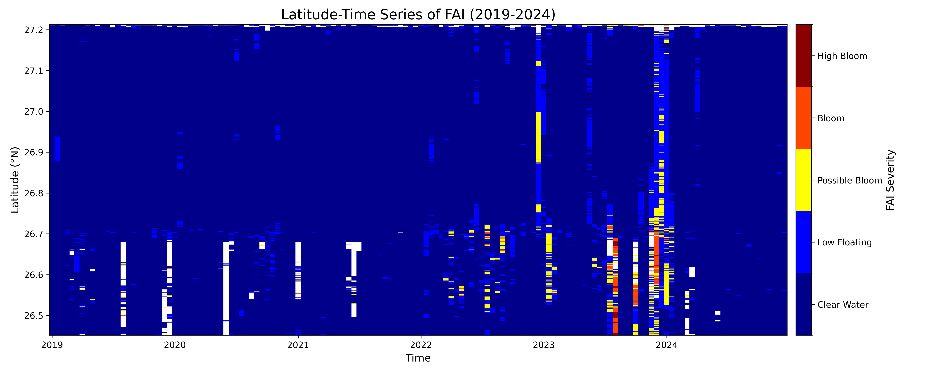

Slide 2
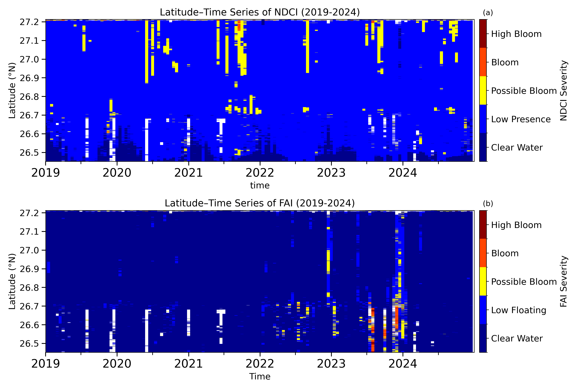
Date
Date

Slide 3
2019
2020
2021
2022
2023
2024
Year
2019
2020
2021
2022
2023
2024
Year

Slide 4
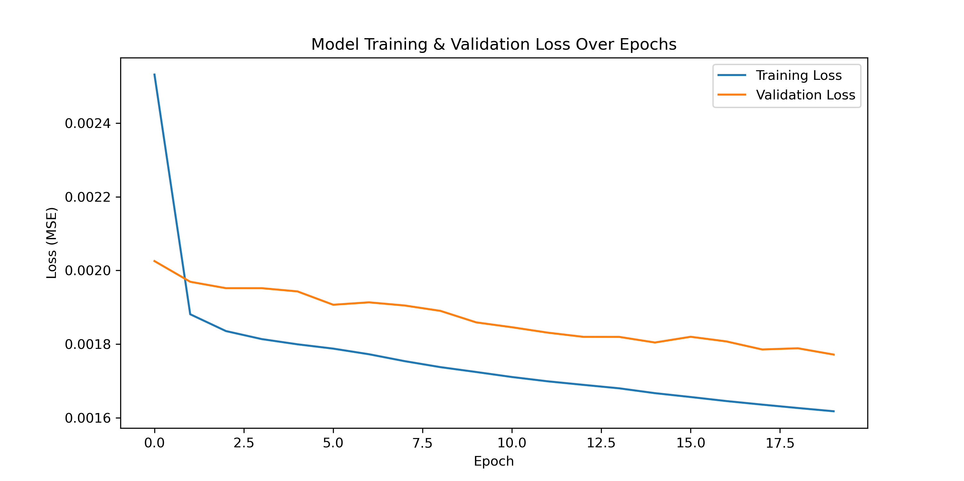
LSTM Model Training & Validation Loss (20 Epochs)
Training Loss
Validation Loss
0.0024
0.0022
Loss (MSE)
0.0020
0.0018
0.0016
0.0
2.5
5.0
7.5
10.0
12.5
15.0
17.5
Epoch

Slide 5
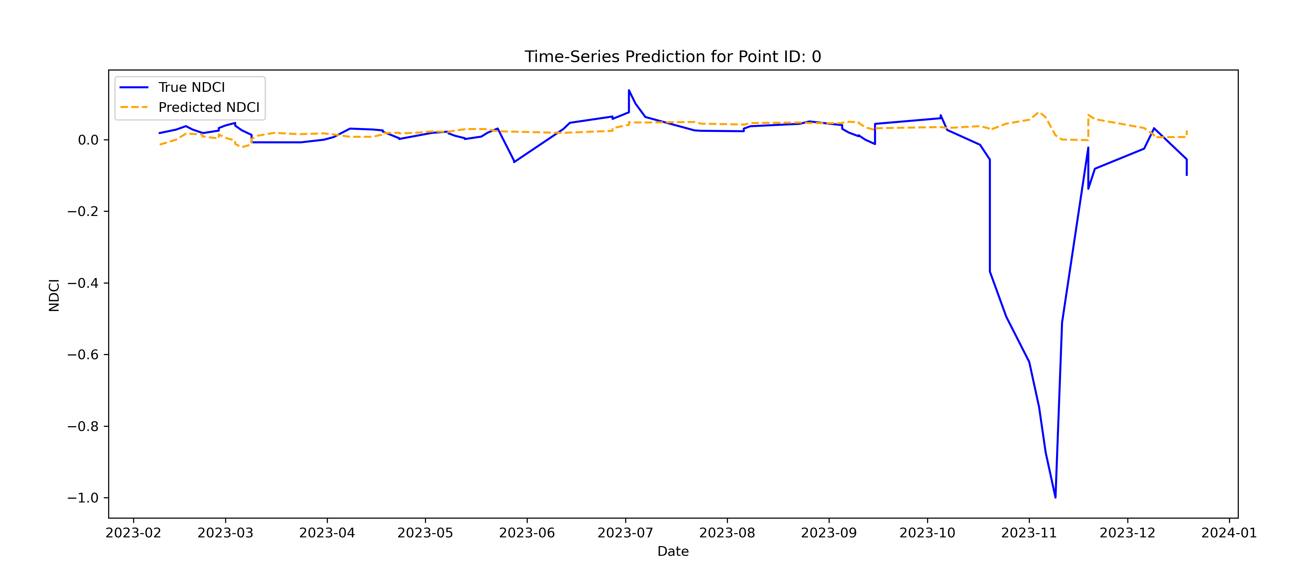
0.0
-0.2
-0.4
NDCI
-0.6
-0.8
-1.0
2023-02
2023-03
2023-04
2023-05
2023-06
2023-07
2023-08
2023-09
2023-10
2023-11
2023-12
2024-01
Date

Slide 6
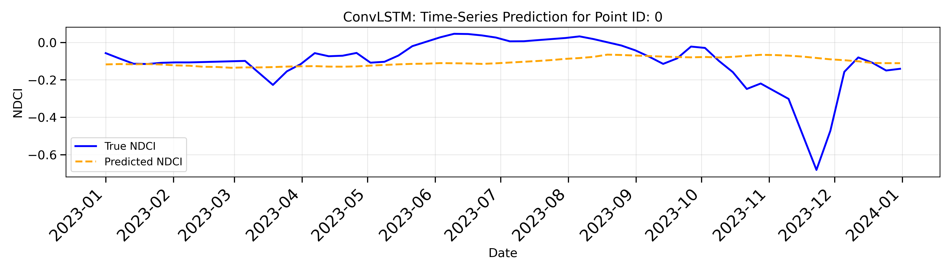
0.0
-0.2
-0.4
NDCI
-0.6
-0.8
-1.0
2023-02
2023-03
2023-04
2023-05
2023-06
2023-07
2023-08
2023-09
2023-10
2023-11
2023-12
2024-01
Date

Slide 7
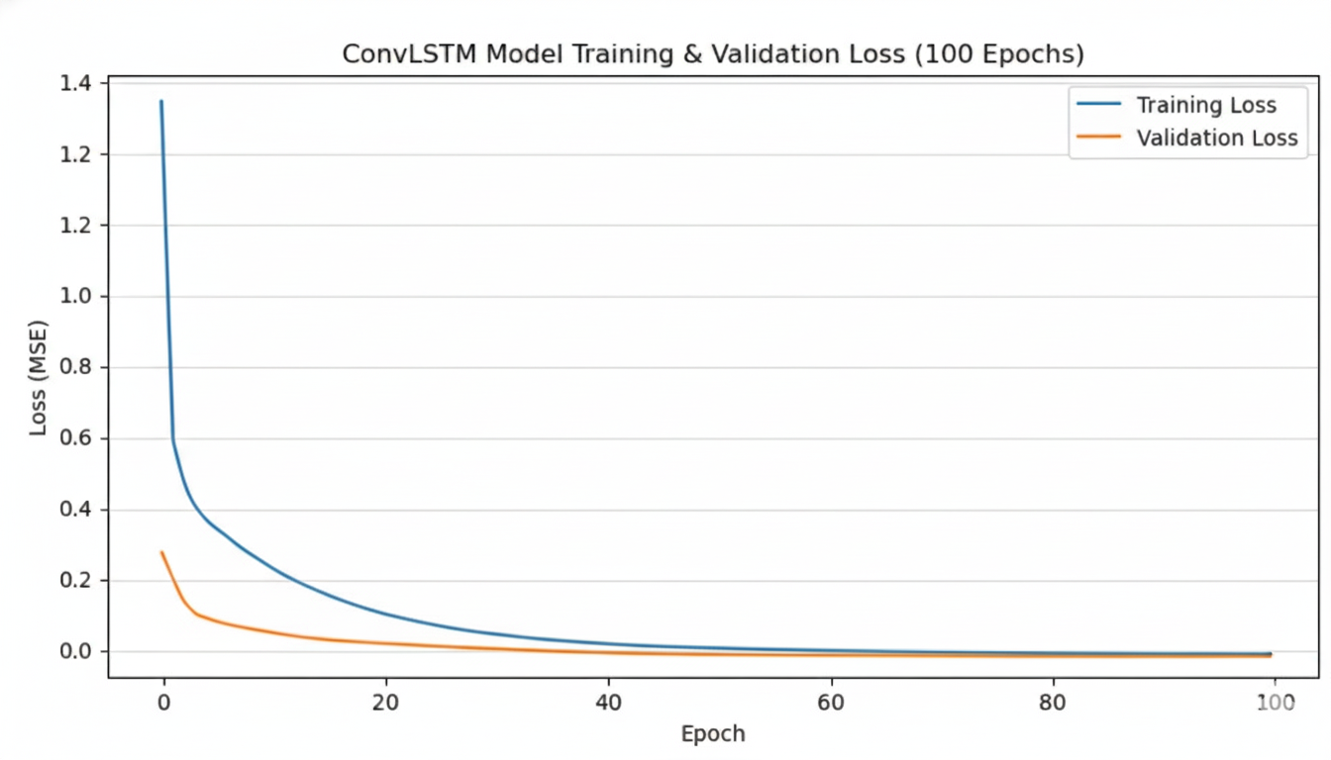
ConvLSTM Model Training & Validation Loss (100 Epochs)
1.6
Training Loss
1.4
Validation Loss
1.2
1.0
0.8
Loss (MSE)
0.6
0.4
0.2
0.0
0
20
40
60
80
100
Epoch

Slide 8
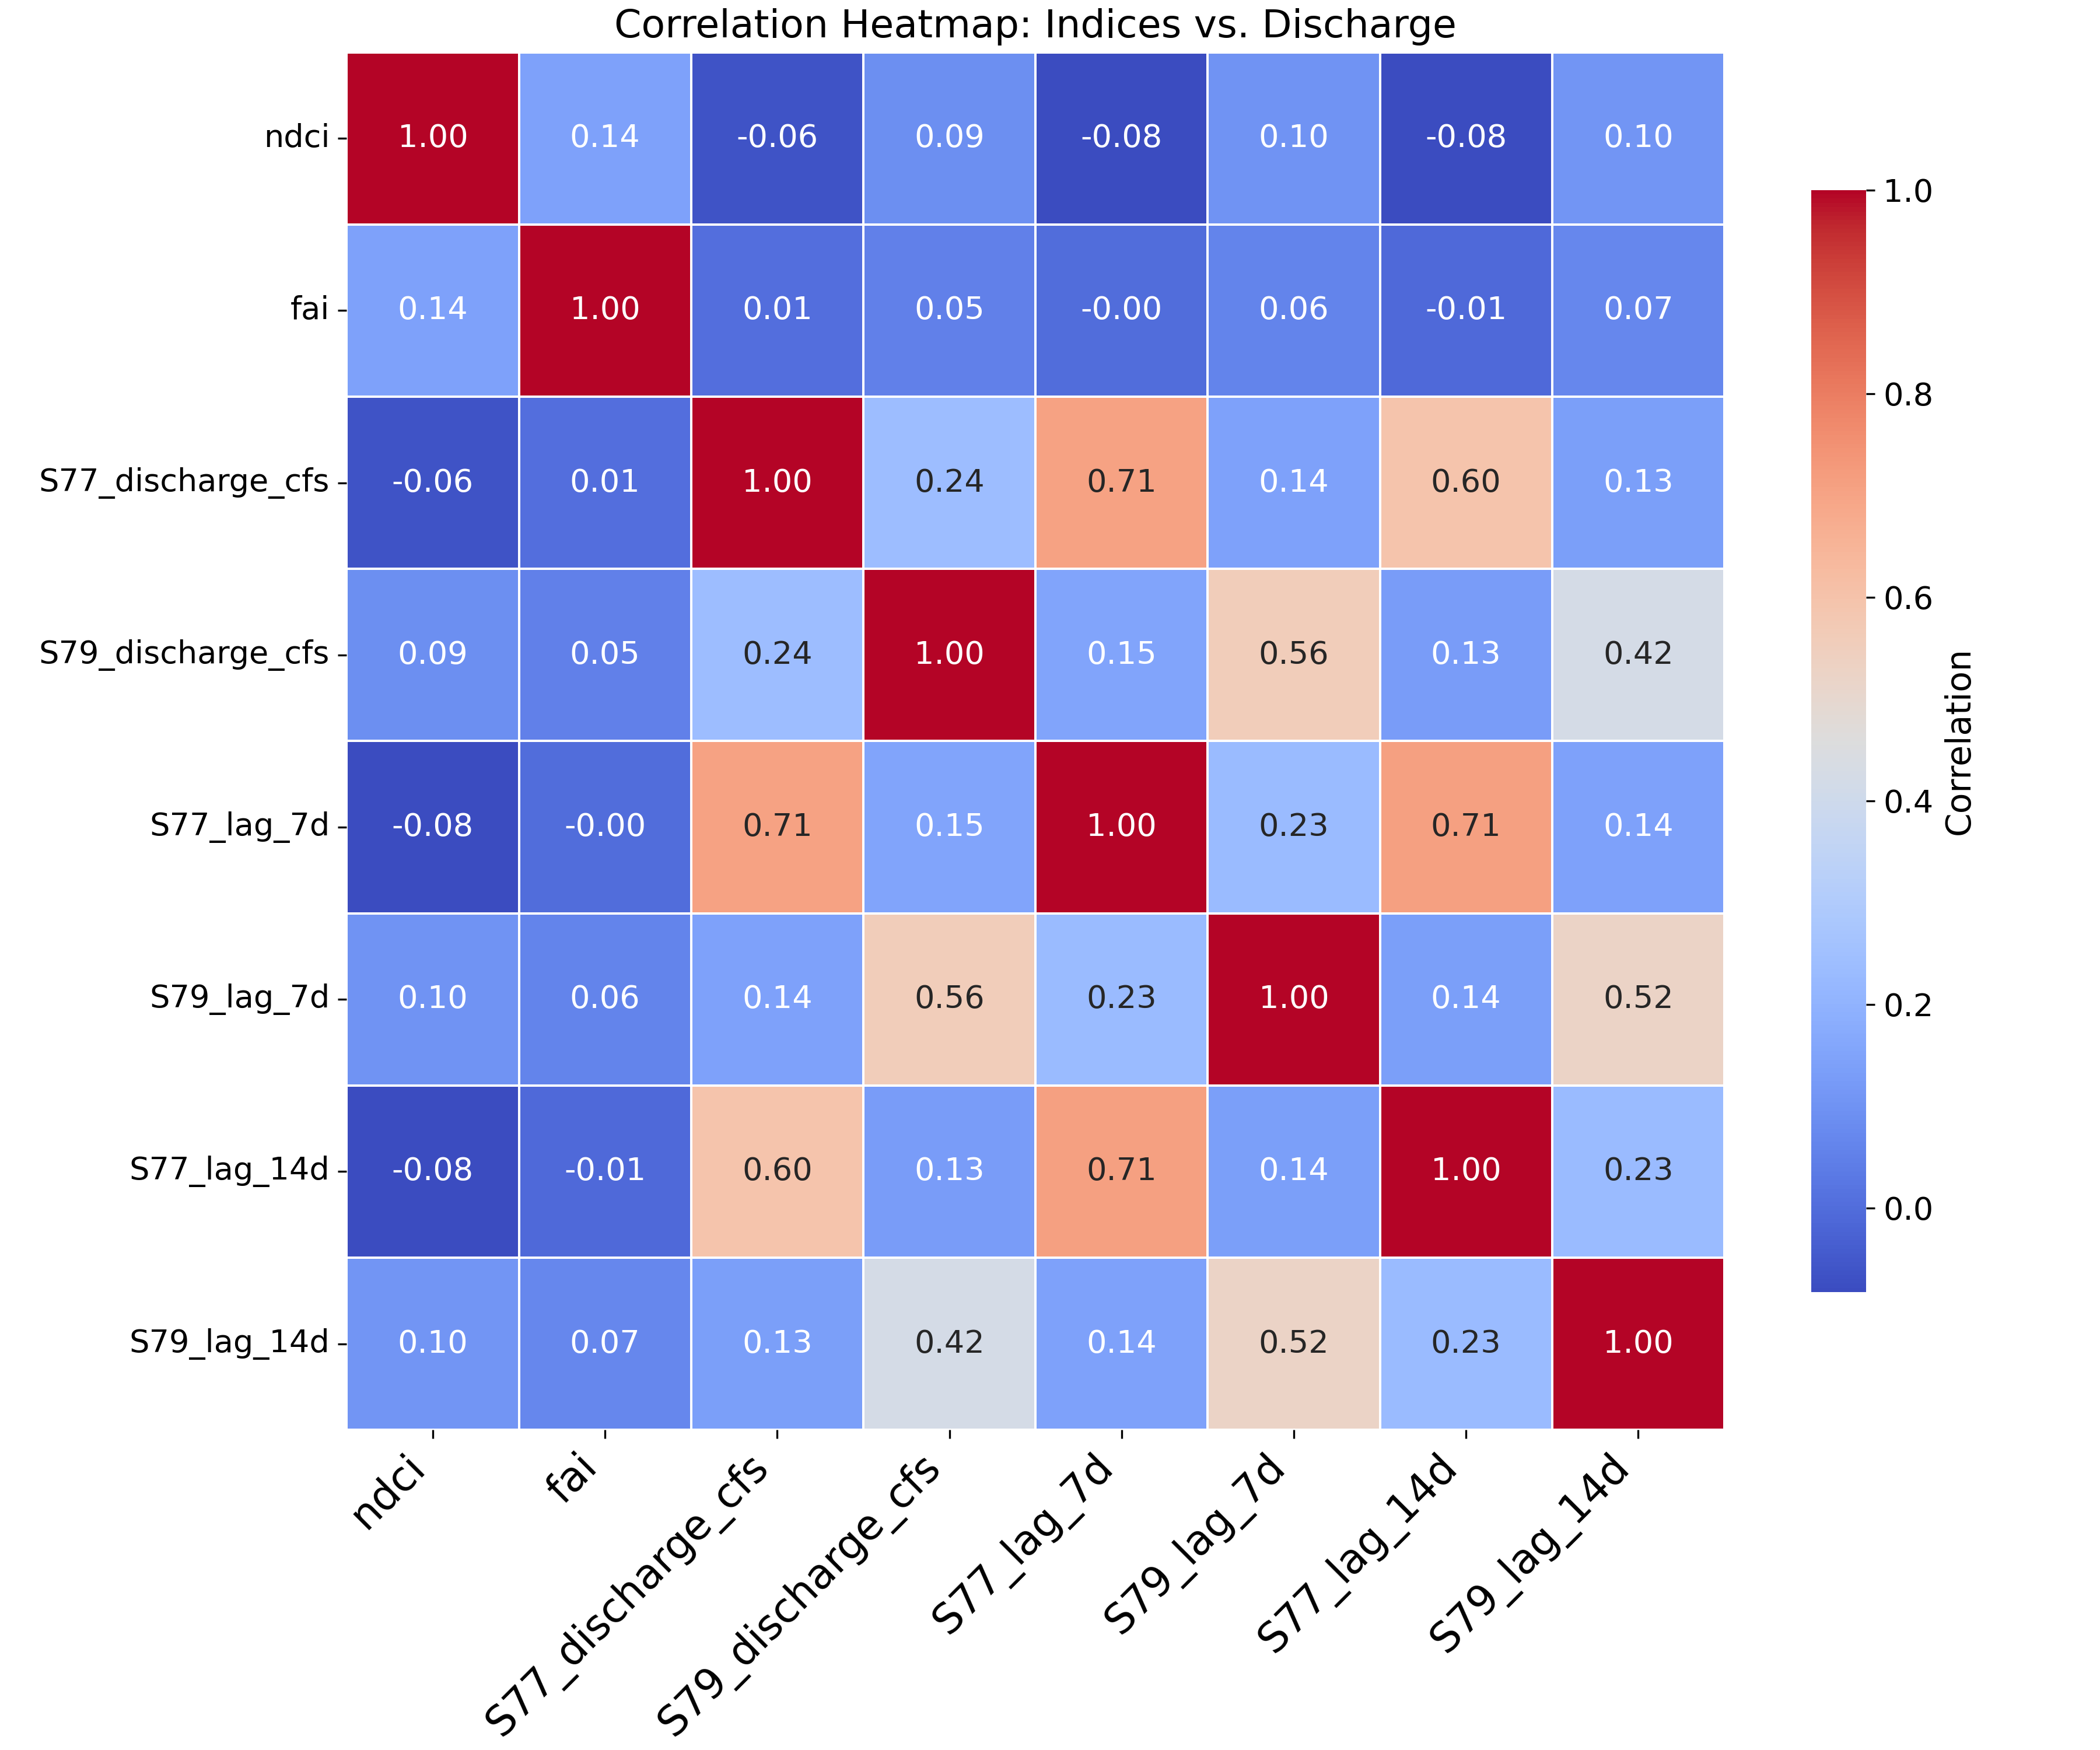
Correlation Heatmap: Indices, Discharge, and Lags
NDCI
1.0
FAI
0.8
S77 Discharge (cfs)
0.6
S79 Discharge (cfs)
Correlation
S77 Lag 7-day
0.4
S79 Lag 7-day
0.2
S77 Lag 14-day
0.0
S79 Lag 14-day
NDCI
FAI
S77 Lag 7-day
S79 Lag 7-day
S77 Lag 14-day
S79 Discharge (cfs)
S79 Lag 14-day
S77 Discharge (cfs)

Slide 9
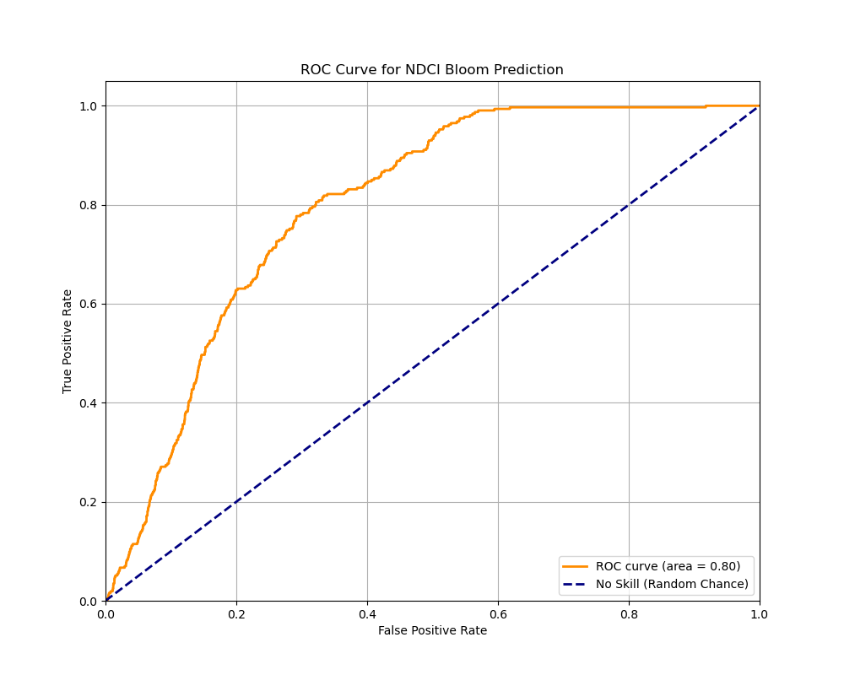
ROC Curve for NDCI Bloom Prediction
1.0
0.8
0.6
True Positive Rate
0.4
0.2
ROC Curve (area = 0.80)
No Skill (Random Chance)
0.0
0.0
0.2
0.4
0.6
0.8
1.0
False Positive Rate

Slide 10
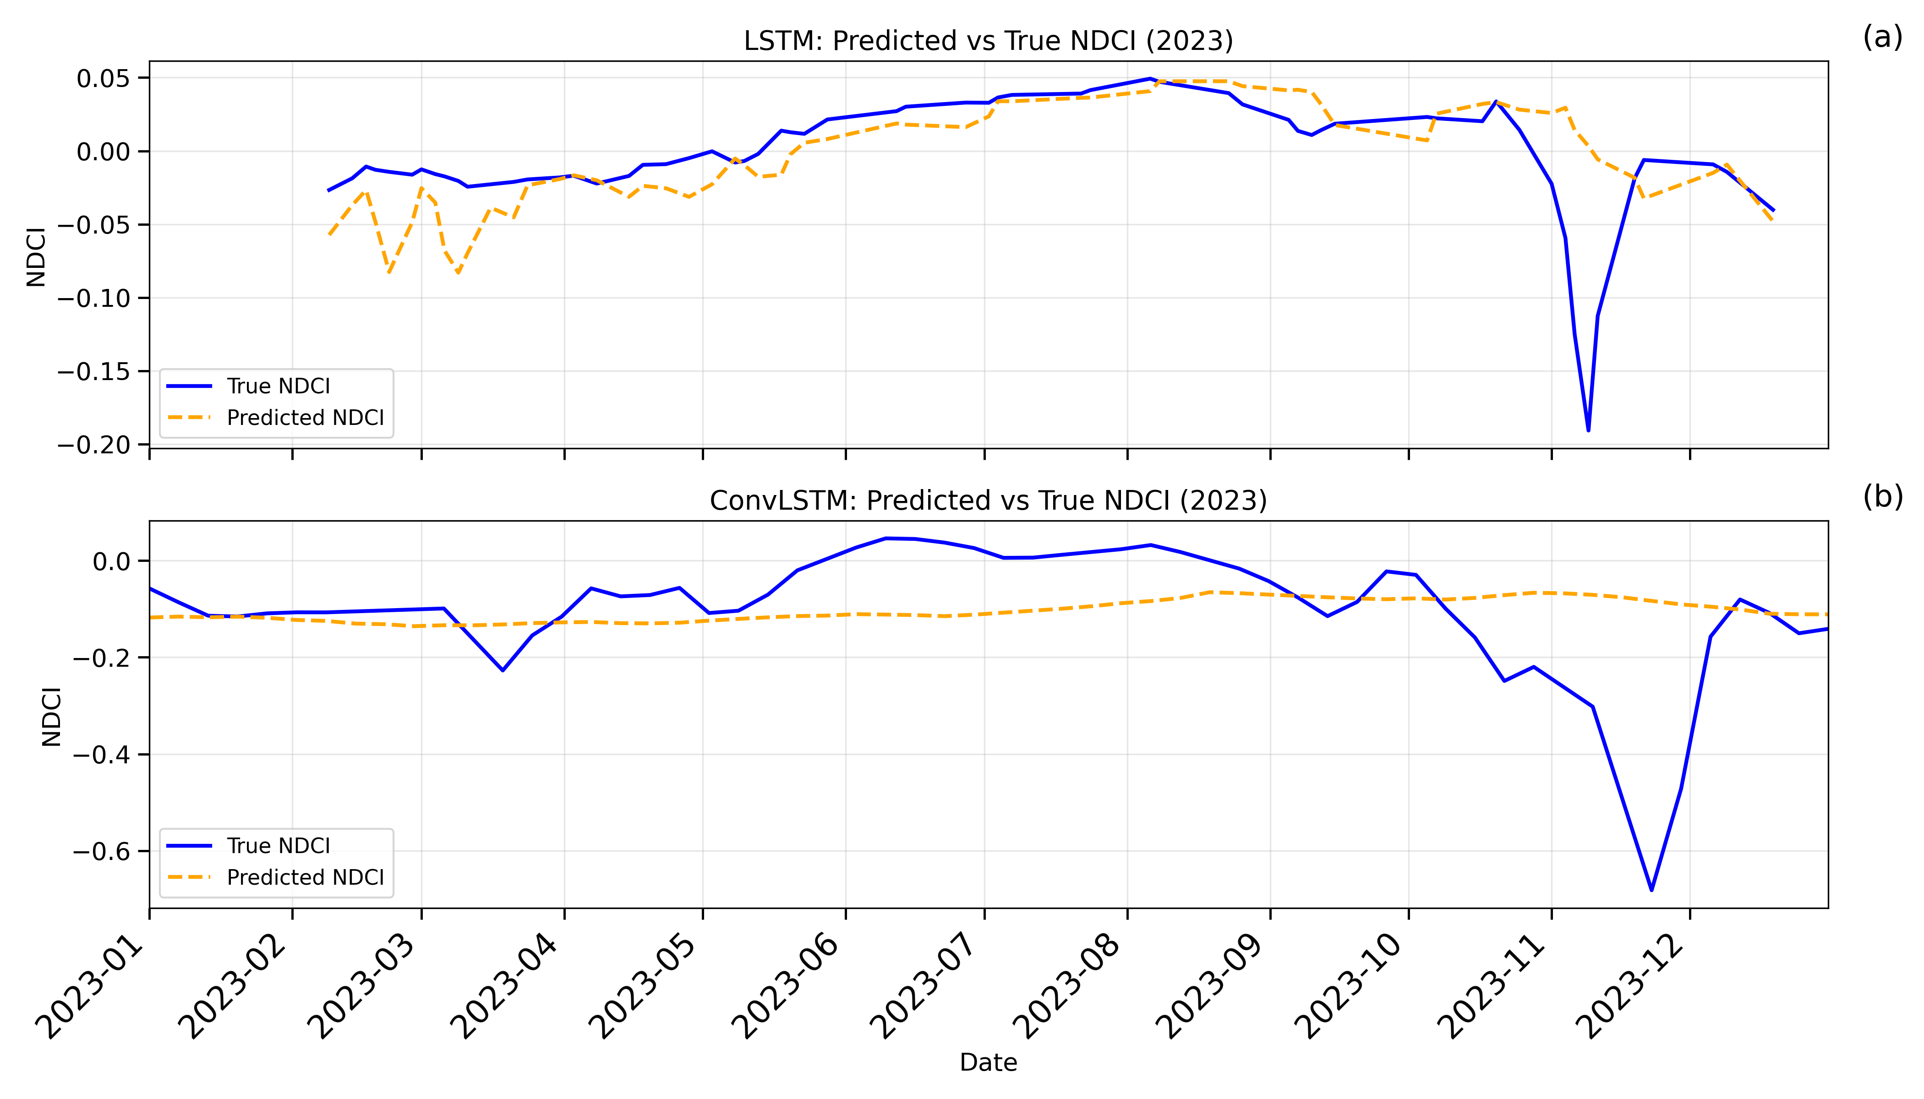

Slide 11
Sentinel-2 data filtered in Google Earth Engine
Water quality data collected from DBHYDRO
5,000 Points Randomly Generated
NDCI and FAI calculations and extractions
Data cleaning
Pairing of in situ and satellite data
Thresholding values calculated
Baseline modeling
Bloom classification
Advanced modeling
Random Forest
XGBoost
LSTM
ConvLSTM
Results

