Slide 1
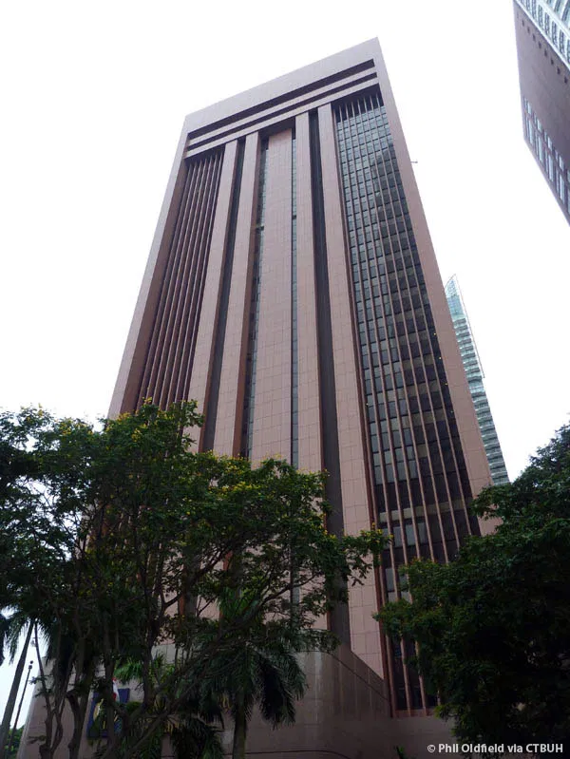
Introduction to Singapore's Monetary Policy
Singapore's monetary policy is unique, focusing on managing
the exchange rate rather than traditional interest rates.
The Monetary Authority of Singapore (MAS), acts as the central
bank, ensuring price stability for sustainable economic growth.
This approach is tailored to Singapore's small, open, and trade-
reliant economy, where the exchange rate has a more significant
impact on inflation.

Slide 2

Why Exchange Rate Instead of Interest Rates?
Singapore is a small and highly open economy, where trade
plays a dominant role.
Gross exports and imports of goods and services are more than
300% of its GDP, and domestic expenditure has a high import
content.
In such an economy, the exchange rate has a much stronger
influence on inflation than domestic interest rates.
For example, an appreciation of the Singapore dollar reduces the
cost of imported goods, thereby dampening inflation.

Slide 3
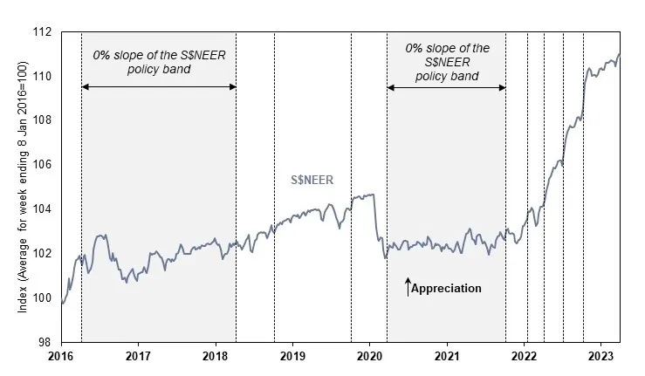
The S$NEER Policy Framework
The Singapore Dollar Nominal Effective Exchange Rate
(S$NEER) is a combined index of bilateral exchange rates.
It represents the Singapore dollar against a trade-weighted
basket of currencies of its major trading partners.
Weights are assigned based on the importance of trade
relationships with each country.
This allows the Singapore dollar to perform collectively in relation
to its major trading partners, which is crucial for general price
levels in Singapore.

Slide 4
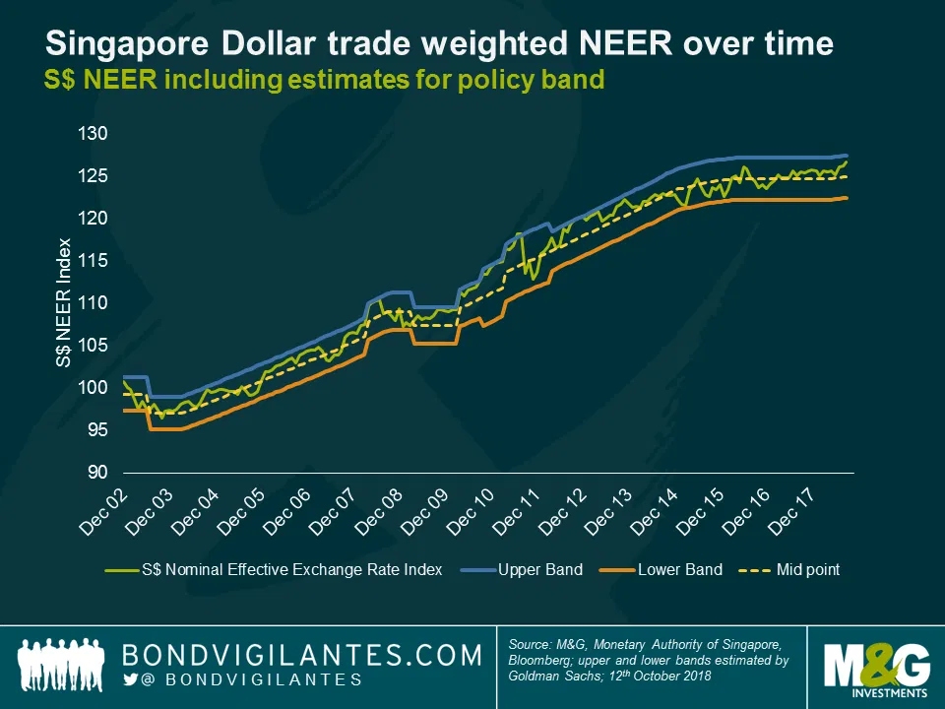
The Policy Band Mechanism
MAS does not set a precise level for the exchange rate. Instead,
the S$NEER is allowed to move within a policy band.
The exact levels of this policy band are not disclosed to the
public.
If the S$NEER moves outside this band, MAS intervenes by
buying or selling Singapore dollars.
This intervention ensures the S$NEER remains within the
desired range, maintaining price stability.

Slide 5
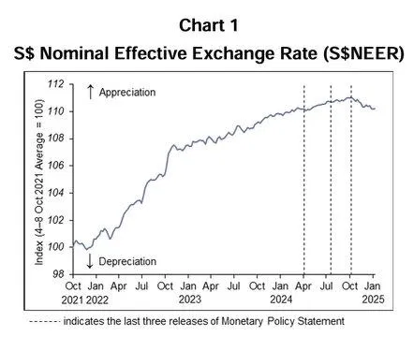
Three Policy Levers
MAS adjusts three key parameters of the S$NEER policy band:
The Slope: Influences the pace at which the Singapore dollar strengthens
or weakens.
The Level (Mid-point): Allows for an immediate strengthening or weakening
of the S$NEER, used in drastic situations like a recession.
The Width: Determines the allowable volatility of the S$NEER.
These parameters are reviewed at least twice a year, typically in
April and October, with additional reviews if conditions demand
immediate change.

Slide 6
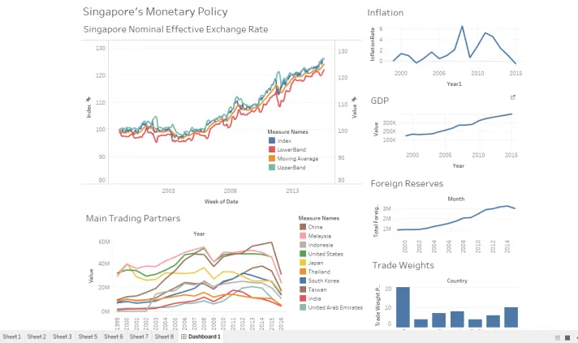
Policy Implementation
MAS implements its monetary policy primarily through
intervention operations in the spot foreign exchange (FX) market.
This involves the sale or purchase of US dollars against the
Singapore dollar, as the S$-US$ pair is the most liquid.
These operations directly influence the S$NEER to keep it within
the policy band.
The policy parameters are reviewed at least twice a year
(typically April and October), with additional reviews possible if
economic conditions warrant immediate changes.

Slide 7
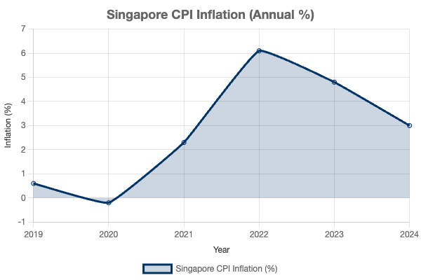
Effectiveness in Controlling Inflation
Singapore's exchange rate-centered monetary policy has been
highly effective in maintaining price stability.
By managing the S$NEER, MAS directly influences the cost of
imports, which are a significant component of domestic
consumption and production.
This approach has allowed Singapore to achieve low and stable
inflation rates over the long term, even amidst global economic
fluctuations.
International Monetary Fund (IMF) studies have consistently
affirmed the effectiveness of this unique framework in delivering
domestic price stability.

Slide 8
Advantages and Disadvantages
Advantages
Disadvantages
Effective Inflation Control: Direct impact on import prices,
Limited Interest Rate Control: Domestic interest rates are
crucial for a trade-dependent economy.
largely determined by global markets.
Price Stability: Has consistently delivered low and stable
Export Competitiveness: A stronger currency can make
inflation rates.
exports more expensive, potentially impacting
Supports Sustainable Growth: Provides a stable economic
competitiveness.
environment for businesses.
Less Direct Control over Domestic Demand: Focus on
exchange rate means less direct influence on domestic
spending.

Slide 9
Conclusion
Singapore's monetary policy stands out globally due to its exchange rate-centered approach.
The S$NEER policy band, managed by MAS, is the primary tool for maintaining price stability in a highly open economy.
This unique framework, with its three adjustable levers (slope, level, and width), has proven highly effective in controlling inflation and
fostering sustainable economic growth.
While it differs from traditional interest rate policies, it is well-suited to Singapore's economic structure and has consistently delivered its
objectives.

