Slide 1
Problem Solving with Data Structures using Java: A Multimedia Approach
Chapter 14: Using an Existing Simulation Package
Download greenfoot and install it right now if you haven’t! http://www.greenfoot.org

Slide 2
After This Class You Will…
Be able to explain…
What simulations let you do
How all the object stuff you have been learning relates to simulations
The difference between Discrete vs. Continuous simulations
Be able to build some simulations on your own using Greenfoot*
*but not video games (look at Chapter 14 in your book for that)
Download greenfoot and install it right now if you haven’t! http://www.greenfoot.org

Slide 3
Simulations
“A simulation is a representation of a system of objects in a real or fantasy world. The purpose of creating a computer simulation is to provide a framework in which to understand the simulated situation, for example, to understand the behavior of a waiting line, the workload of clerks, or the timeliness of service to customers. A computer simulation makes it possible to collect statistics about these situations, and to test out new ideas about their organization.”
Adele Goldberg & David Robson, Smalltalk-80: The Language and Its Implementation (Addison-Wesley, 1989)
Download greenfoot and install it right now if you haven’t! http://www.greenfoot.org

Slide 4
Simulations and Objects
Object-oriented programming was invented, in part, to make simulations easier to build!
The characteristics of objects make them more like real world objects, e.g.,
Each thing knows some stuff and knows how to do some stuff.
Objects get things done by asking each other to do things.
Your internals are private, unless you want to make them otherwise.

Slide 5
Continuous vs. Discrete Simulations
Two main kinds of simulations in the world.
Continuous: Each moment of time is simulated.
When every moment counts.
Discrete: Skip to the important moments.
Want to simulate 100 years?

Slide 6
Where we are…
You already know…
Simulations let you explore interesting ideas computationally
Objects often naturally map to the parts of your computation
The difference between Discrete vs. Continuous simulations is whether every moment is modeled (continuous) or only specific events (discrete)
Be able to build some simulations on your own using Greenfoot

Slide 7

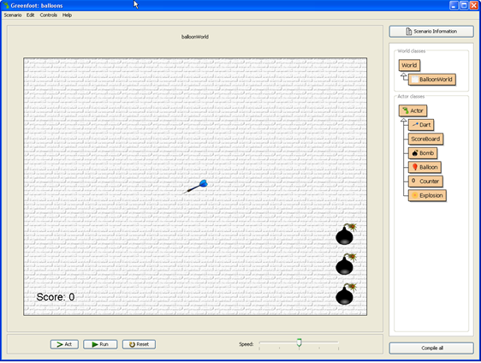
Start Greenfoot
Click on the Greenfoot icon to start it
The first time it will ask if you want to do the tutorial
After that it will open the last scenario
Click on Scenario and open to open another one
Like balloons
Like wombat
Notes:
The Greenfoot Tutorial is always available from the Help menu.

Slide 8
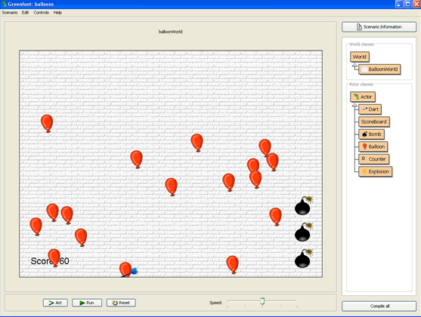
Objects and Classes
Classes define what objects know and can do
There is one Balloon class
Objects do the action
There can be many objects of the same class
There are many balloon objects
Objects
Classes

Slide 9
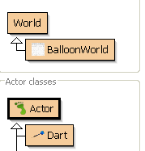
Worlds and Actors
Greenfoot has two main classes
World
Place to hold and display actors
Has a width and height and cell size
Of type integer (int)
Has a background image
Actor
Actors know how to act
Actors have a x and y location in the world

Slide 10
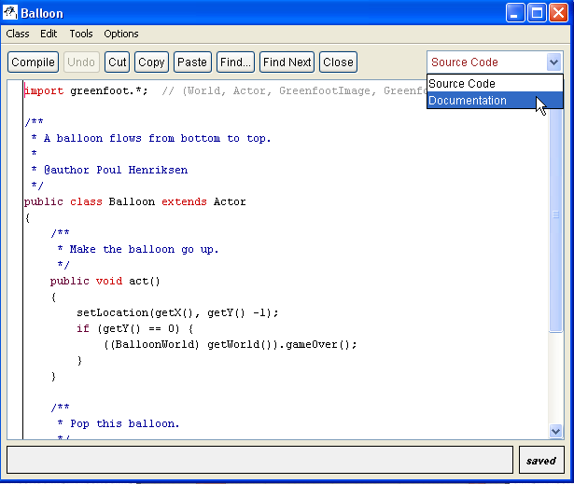
Balloon Code and Doc
Double-click on the Balloon class
Select Documentation on the right
You can switch between the source code and documentation

Slide 11
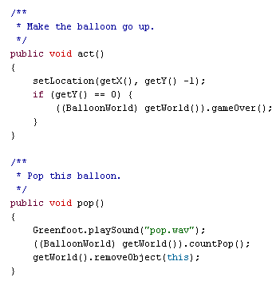
Methods
Just like the methods you’re already familiar with
But now they can be invoked by the simulation
Act() is a special method
Notes:
Select “Source Code” for the Balloon to see the source code.

Slide 12
Hint: I am going to ask you questions like this on the next slide
If I were to ask you a question about how this ballon code works, would you be able to look a the code and figure out the answer?
Say I wanted to change the “pop” noise that plays when a balloon is popped. Do you see how I might go about figuring out where that happens?

Slide 13
Questions:
What class contains the code that makes the balloons rise?
If I wanted to make the score increase to 50 points/balloon, where would I make that change?
Where is the code that makes the balloons appear on the bottom of the screen?
1. Scoreboard
2. BalloonWorld
3. Balloon
4. Actor
5. Dart

Slide 14
Questions:
a) What class contains the code that makes the balloons rise?
Balloon.act()
b) If I wanted to make the score increase 50 points/balloon, where would I make that change?
BalloonWorld.countPop()
Where is the code that makes the balloons appear on the bottom of the screen?
BalloonWorld.act()

Slide 15
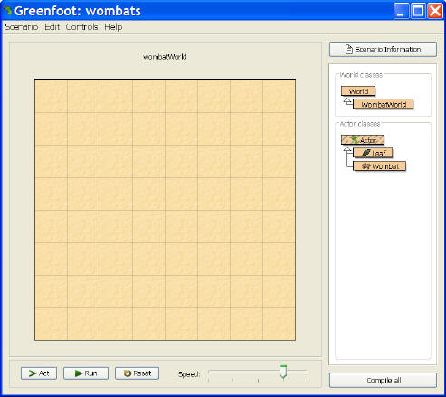
Open the Wombat Scenario
You may need to click the Compile button to update everything if classes looked “hashed”

Slide 16
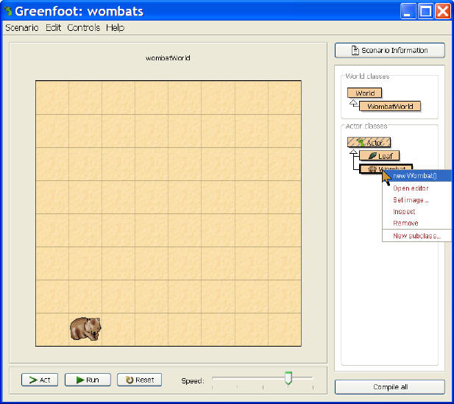
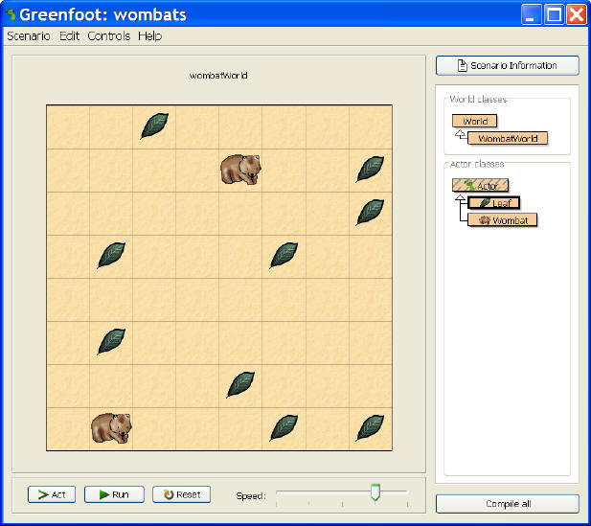
Make a Wombat, and some Leaves
Right click on Wombat class,
Choose New Wombat()
Now, have the wombat act()

Slide 17
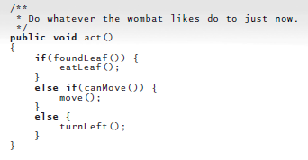
Current Wombat act() method
Can you see why the Wombat won’t necessarily find all leaves?

Slide 18
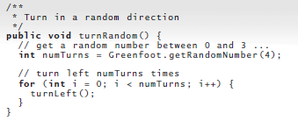
Create a new method for random walk

Slide 19
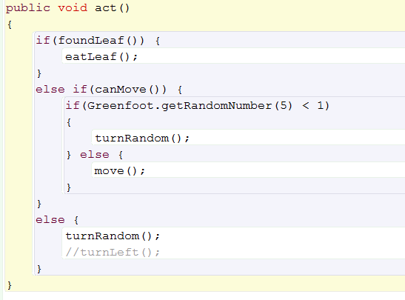
New Wombat act() method

Slide 20
Greenfoot worlds
World class
Abstract
Subclass it to create a new class
Actor class
Subclass it to create Wombats and Balloons

Slide 21
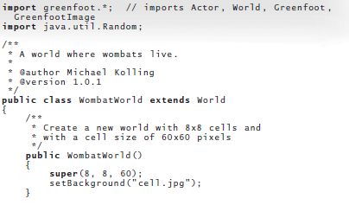
WombatWorld Class

Slide 22
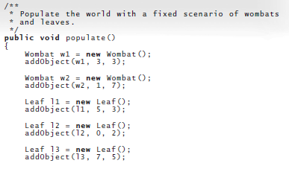

Slide 23
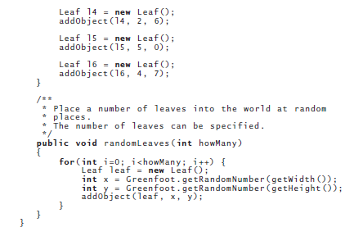

Slide 24
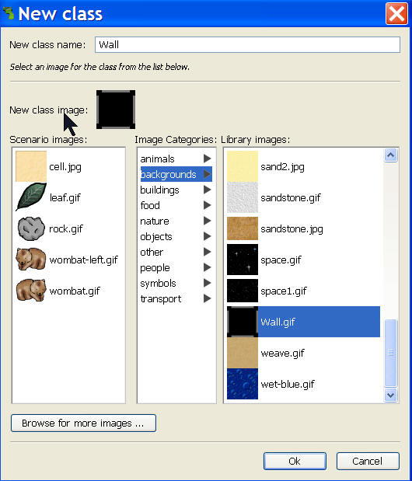
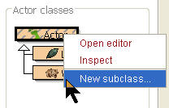
Making a Wall class

Slide 25
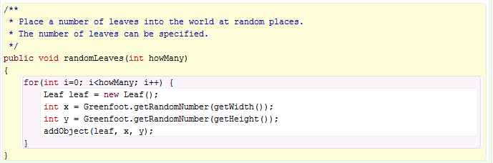
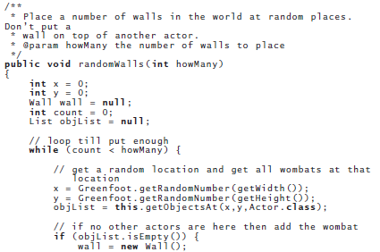
Use the randomLeaves method as starting place
Create a randomWalls method that creates random walls
If you finish early, try to modify your code it so it won’t put a wall where there is already a wombat

Slide 26

New randomWalls
Say we wanted the game to start with a few walls..

Slide 27
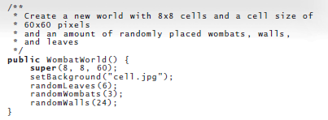
New WombatWorld Constructor
Say we wanted the wombat to avoid walls..

Slide 28
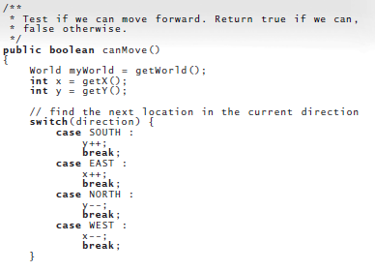
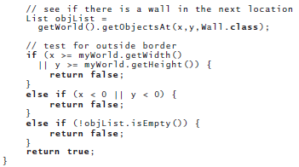
Teach wombats to avoid walls

Slide 29
Additional fun
Code a wombat that always turns and moves directly towards a leaf if there is a leaf one square away (hint – Make that wombat a subclass of your existing wombat. Then you can easily share code between them.)

Slide 30
Where we are…
You already know…
Simulations let you explore interesting ideas computationally
Objects often naturally map to the parts of your computation
The difference between Discrete vs. Continuous simulations is how time is modeled
You’ve built some simulations on your own using Greenfoot
(Maybe) Explore the relationship between objects and simulations even further, to get you ready for next class when you step outside greenfoot

Slide 31
A simulation is an executed model
Setting up a simulation is a process of modeling the world (real or fantasy) to be simulated.
That model is realized in terms of objects.
We want our model to:
Reflect the world.
Be easy to extend and change.
Some of our modeling techniques:
Aggregation
Generalization and specialization

Slide 32
Aggregation
Some objects are made up of other objects.
Cars have engines
People have livers and lungs
These internal things are objects, too!
Livers don’t directly mess with the innards of lungs!
We call this aggregation
Putting references to some objects inside of other objects.

Slide 33
Generalization and Specialization
There are general and specialized forms of real world objects.
Cells are biological objects that have membranes and a nucleus and mitochondria and…
Blood, lung, and liver cells are all cells but have specialized functions.
The superclass-subclass relationship is a way of modeling general forms of objects and specialized forms of objects

Slide 34
Actors: Those that act in the simulations
Actors do things, take time, and request and use resources.
In continuous simulations, actors are told to act().
In discrete event simulations, actors do something, then reschedule themselves in the simulation.

Slide 35
Resources
Resources are points of coordination in a simulation.
Examples: A cashier, a library book, a parking space on a ferry, a jelly bean.
Some resources are fixed and others are produced and consumed.
Some resources are renewable and shared.
Others are coordinated.
Example: For a surgeon to do a surgery, the patient must meet the surgeon at the operating table (the resource)

Slide 36
When an object has to wait…
What happens if you (or your proxy object) need a resource and it’s not available?
You wait in a queue
A list that is first-in-first-out (FIFO)

Slide 37
Where we’ve been…
I hope you have an idea of why simulation might be exciting or useful to you in your individual fields.
I hope you’re beginning to get ideas for how you might use objects to design your own simulations (though there will be more on this in the coming weeks)
I hope you feel like you could begin to use greenfoot to successfully build a simulation or two if you needed it

Slide 38
Please give me feedback
Even if you found the lecture boring or hard to follow
My email is hewner@gatech.edu if you’d like to email me.
My slides are slightly modified from the ones that may be online. I will email them to Mark and they should be up in a day or two.

