Slide 1
Does Not Compute 5: DFA/NFA Equivalence Turing Machines
In which we prove that DFAs are equivalent to NFAs, and discover the conversion is more brute force than pure elegance
Then we introduce a new machine, which has great power, but with great power comes a new and terrible problem.

Slide 2
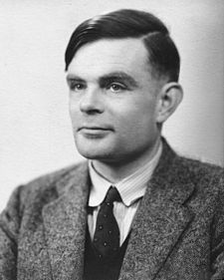
Alan Turing

Slide 3
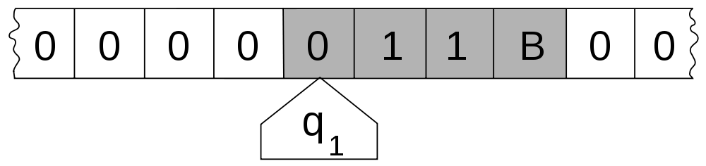
Our New Machine
A 7-tuple (Q, E₁, E₂,T, q₀, F₁, F₂)
Q is a finite set of states
E₁ is a finite set called the alphabet (usually {0, 1} or {a,b}) not containing the special blank symbol □
E₂ is a finite set called the alphabet containing the special blank symbol □, E_{1,} and maybe a few odds and ends
T : Q x E₂ → Q x E₂ x {L,R} is the transition function
q₀ is the start state
F₁ is the accept states
F₂ is the reject states

Slide 4
To Come In The Second Half
Some extremely cool stuff:
The Turing-Church Hypothesis, which touches on the fundamental question of “What is Computing?”
The existence of well-defined mathematical problems no machine can compute solutions for (including modern computers)
Efficiency, discussed at long last, including P/NP problem which is one of the great unsolved questions of modern mathematics
Even more fun playing with interesting machines

Slide 5
Feedback From You
1. What is one thing you particularly liked about the class so far?
2. What is one thing that could be improved about the class so far?
3. Sum of your feeling about the class in 1 or 2 short sentences.

