Slide 1
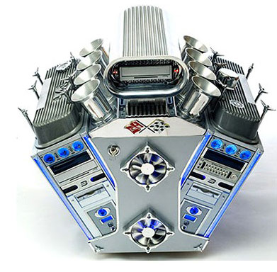
What if you could build a trinary computer?

Slide 2

Why Take This Class?
“I used to think using the computer was hard. Then I realized that modern computers are computationally equivalent to a 3-dimensional 16-color cellular automata! Now I totally have my own Facebook page and even made my grandmother a card for her birthday. Thanks ‘Does Not Compute’!”
-previous satisfied student

Slide 3
Goals for this Class
You will be able answer that question about binary/trinary computers, and a bunch more way harder questions in that vein.
You will learn a set of tools you can use to reason mathematically about computation.
You will design your own sort of computational “machine”, and be able to articulate how it is both similar a different that existing machines (real and imagined). I hope this will make you think about things like computers and programming in a more flexible way.

Slide 4
What We Will Be Studying
Computation
I define computation as the ability for a machine to answer specific questions like “what is the square root of 77?”
You may note that this definition is neither very philosophical nor mathematically rigorous. Also what do I mean by machine?

Slide 5
What We Will Be Studying
Computation
I define computation as the ability for a machine to answer specific questions like “what is the square root of 77?”
Computational Power
I define computational power as the question of whether a type of machine can be built to answer a specific kind of question.

Slide 6
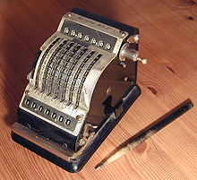
Examples
Computational Power
I define computational power as the question of whether a type of machine can be built to answer a specific kind of question.
This is a mechanical adding machine. Is it possible to build a similar, purely mechanical machine that could compute square roots?

Slide 7
Our Basic Plan
We will start with some sort of really really simple machine
We will play around with it to see what it can do and if we can design better, cooler, machines
Once we get a couple of these simple machines under our belt, we’ll step back and try to tell us what this means for the idea of computation in general

Slide 8



Right rule
Much more complex
?????
Group’s Choice

Slide 9
