Slide 1
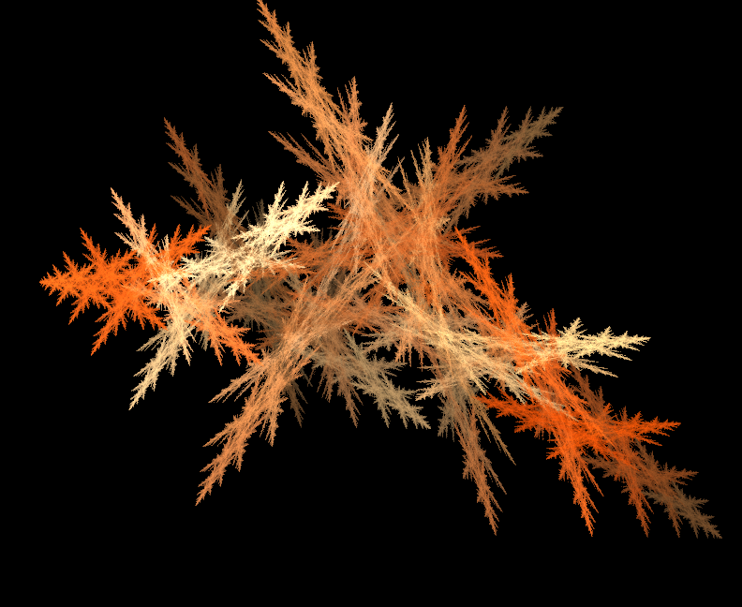
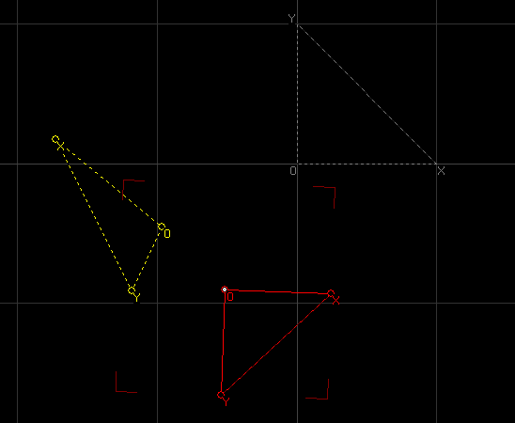


Imagine you were playing around with Apophysis when some other GHP Math student student came up behind you and said “Gee that’s pretty! What is that a picture of? How do the triangles and numbers relate to the picture?”
Hint: You might help your friend understand by explaining the idea of an invariant. You might even illustrate that idea using a simpler example like the Sierpinski Gasket or the Cantor Set.

Slide 2
The Story Thus Far
IFS Fractals
The idea of a fractal as a picture of an invariant
Hints of Fractal Dimension
Infinite Perimeter/No Area
“Has a topological dimension that is less than it’s Hausdorff dimension”
Scaling stuff

Slide 3
Where we’re going
Who Cares About Dimension Anyway?
Can’t We Just Call Things That Have Two Coordinates 2-D and stop *stressing*?
A New Strange Fractal

Slide 4
A Brief Aside Fractals as a Research Project
My ideas:
You could attempt to understand how some of the non-linear transforms make different kinds of fractals
You could attempt to draw fractals using an algorithm of your own design
You could look into what kinds of fractals exist using systems we won’t be studying in detail (e.g. L-systems, chaotic systems)
Obviously, feel free to ask me if you have any other ideas

Slide 5
Why Do We Care What Dimension Things Are Anyway?

Slide 6
Mapping infinities
Multiplying sets
Cantor set boundries

Slide 7
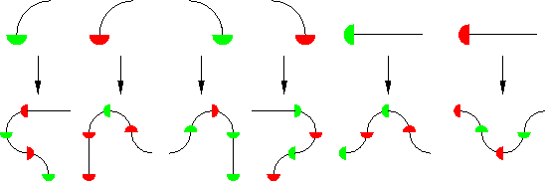
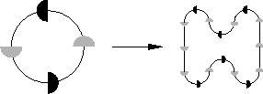
A New Strange Fractal

Slide 8


Slide 9
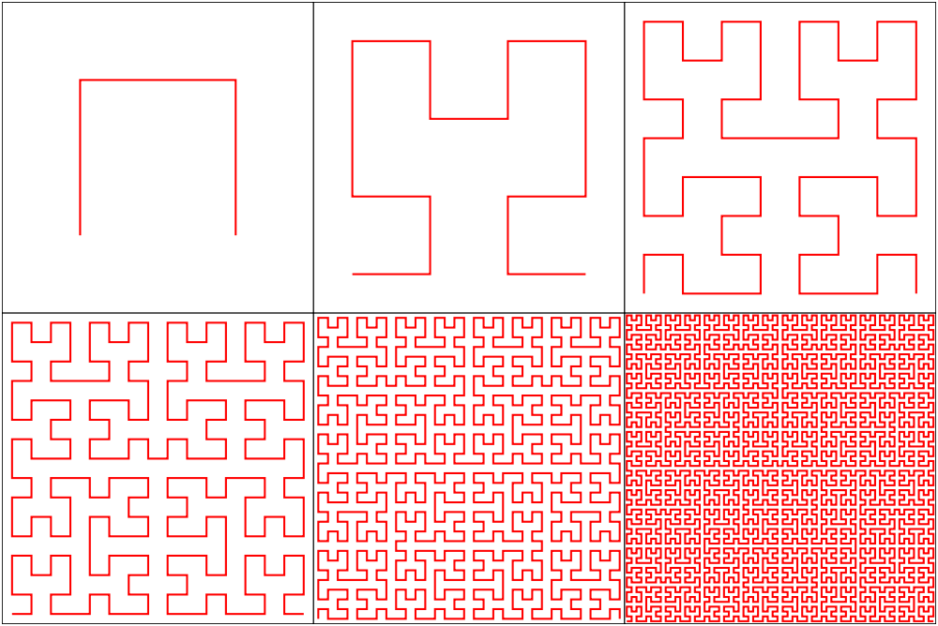
Hilbert Curve

Slide 11
The Other Direction?

Slide 12
Another Space Filling Curve?

Slide 13
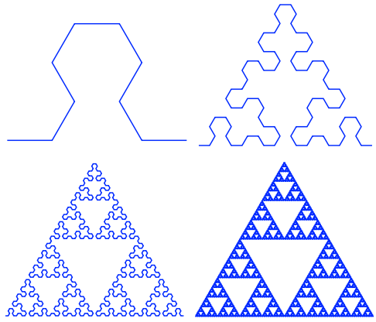
I Must Make My Own Space Filling Curve
Lindenmayer system (really called L-systems)
“Does Not Compute” folks, take notice

Slide 14
Self-Similarity Dimension
Given a reduction factor s and the number of pieces a into which the structure can be divided:
or
Koch Curve
Gasket
Carpet
Reduction factor (s) = ½
Number of pieces (a) = 4
Notes:
Gasket = log 3/ log 2 = 1.585
Cantor Set = log 2 / log 3 = .6309
Sierpinski carpet = log 8 / log 3 =1.8928
Koch curve = log 4/ log 3 = 1.26

Slide 15
Fractal Dimension in Real Life
Stupid real world shapes not being self-similar
Measuring coast with compass
Box counting dimension

