Slide 1
The Mathematical Kevin Bacon Game
Choose your favorite positive integer A between 1 and 100
If A = 1, then STOP
If A is even, replace A by A/2 and go to step 2
If A is odd, replace A by 3A + 1 and go to step 2
Count How Many Steps it takes. Your goal is to find the A that gives you the biggest number of steps.

Slide 2
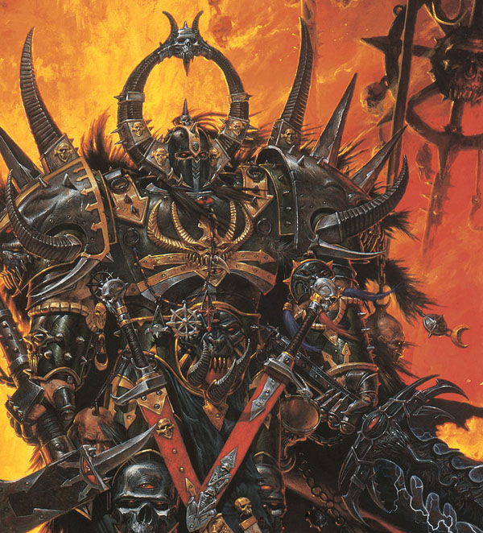
Fractals (Part 2): The Geometry of Feedback
In which I speculate about a strange alternative-history for mathematics
But an initially rosy picture turns dark as the terrible clouds of Chaos loom on the horizon.
Chaos Warrior

Slide 3
What you should know after today
You should be able to explain what a “feedback system” is
You have a 1st idea of what “Chaos” means and how Chaos makes simulation on Computers difficult

Slide 4
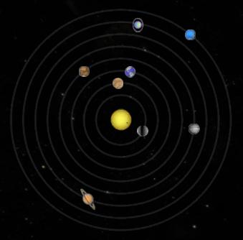

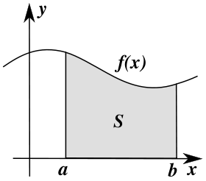
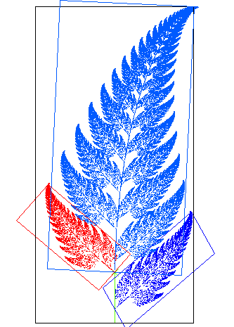
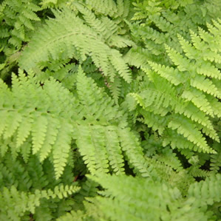
?

Slide 5
What is a feedback system?
X_{n}
X_{n+1}
function

Slide 6
Can Fractals Really Arise Naturally?

Slide 7
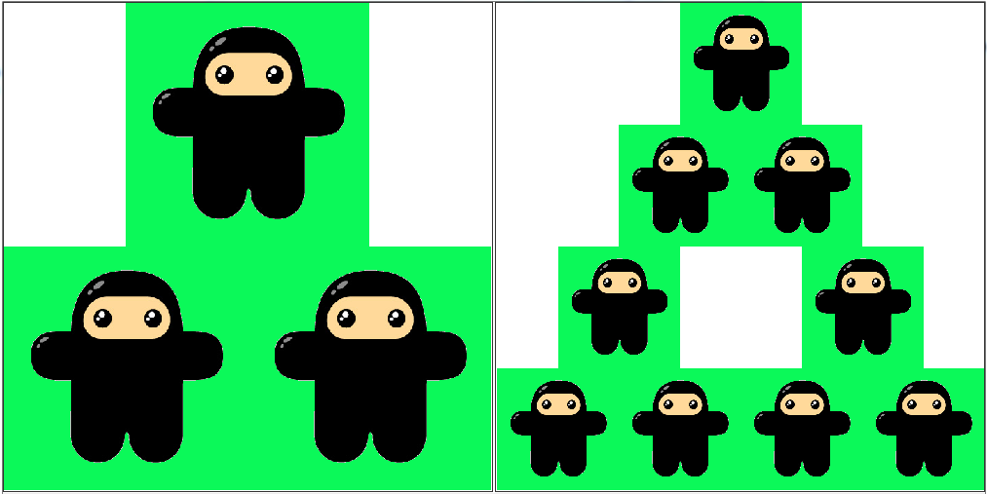
Fractals – The Geometry of Feedback Systems

Slide 8
An Example Feedback System
The environment can only support so many ninjas! Especially due to rampant destruction of natural ninja habitats.
Number of ninjas
Max ninjas the environment can support
Growth Rate
Should be proportional to this

Slide 10
MWHAHAHAHAHA!

Slide 11
So What’s the Deal With Chaos?
Small deviations expand, so errors multiply
Eventually the noise overwhelms the signal
Because computers can only represent numbers with limited precision, they are very vulnerable to chaos

Slide 12
Questions
What is an example of a feedback system?
Chaos has to do with errors multiplying. Since computers can add/subtract/multiply/divide perfectly, why is there a problem with chaos on computers?

