Slide 1
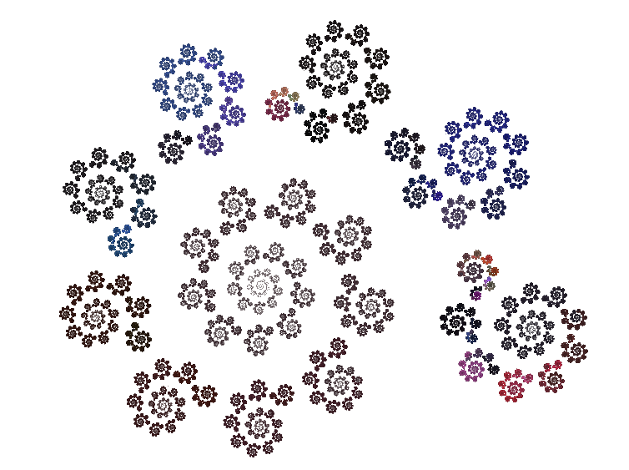
Fractals
Part 1: In which we attempt to describe what a fractal is, because people will ask (but perhaps they will not really want to know the answer).
Then I introduce the 2nd most photogenic fractal of the class, and attempt to convince you it is cool anyways.

Slide 2
About Me
BS and MS in Computer Science from the University of Illinois at Urbana-Champaign (not the sort of education where you learn a lot about obscure kinds of geometry)
But fractals are awesome…

Slide 3
By The End of the Course…
You will be able to explain what fractals really are. Including how fractals touch on a lot of really interesting weird parts of math.
You will be able to make some really cool pictures (even cooler pictures because you understand what’s going on)
You’ll explore and understand fractal stuff on your own, and maybe a few of you will teach me some new stuff about different kind of fractals (maybe as part of your final project)

Slide 4
By the end of this class…
You’ll have a definition for what a fractal is. Though that definition will be slightly unsatisfying at this point.
We will talk about the Sierpinski Gasket
We may even get to the point of visualizing the Sierpinski Gasket on the computer

Slide 5
Fractal (according to Wikipedia)
It has a fine structure at arbitrarily small scales
It is too irregular to easily be described in traditional Euclidean geometric language
It is self-similar
It has a Hausdorff dimension which is greater than its topological dimension
Hey, these 4 items would be a cool thing to record in your notebook…just saying

Slide 6
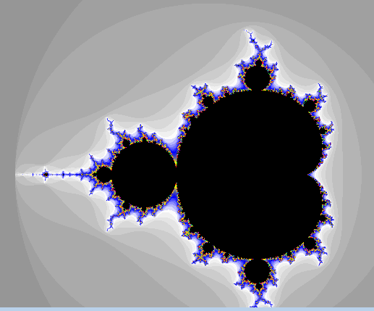
It has a fine structure at arbitrarily small scales
One picture is not enough to do the Mandelbrot Set justice

Slide 7
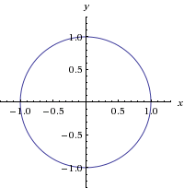
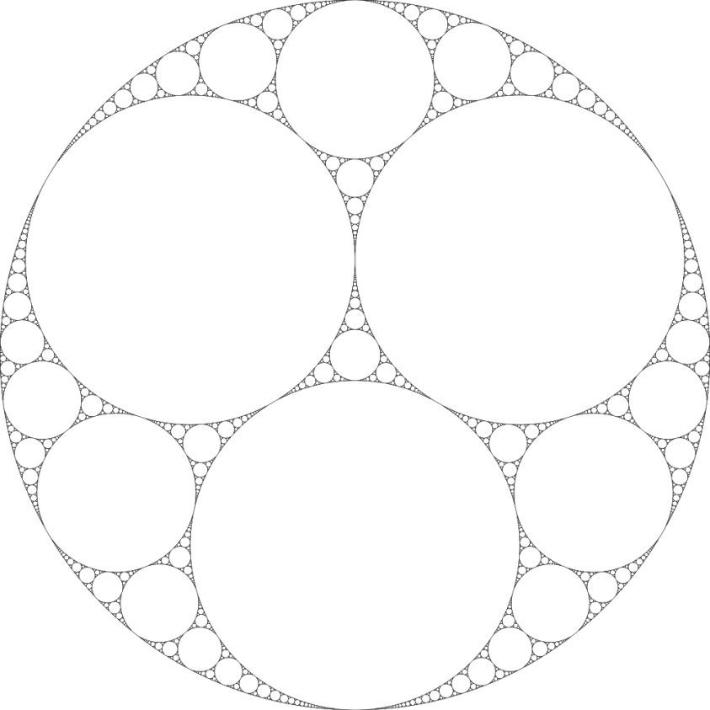
It is too irregular to easily be described in traditional Euclidean geometric language

Slide 8
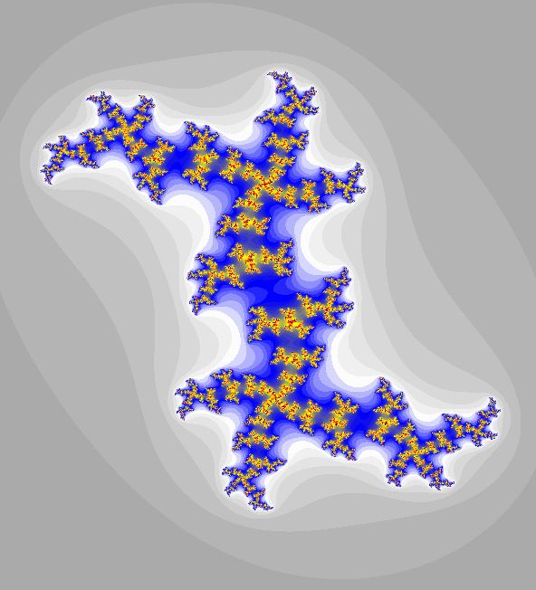
It is self-similar

Slide 9
It has a Hausdorff dimension which is greater than its topological dimension
?

Slide 10

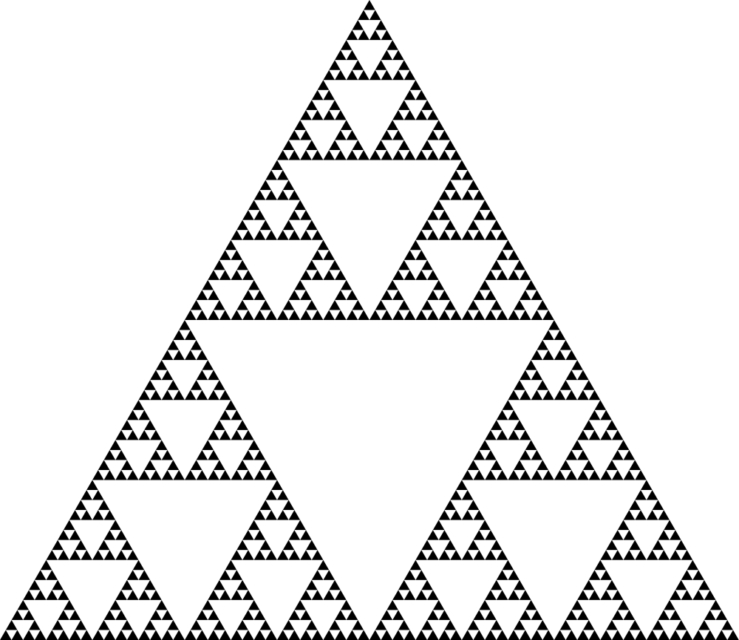
Sierpinski Gasket (also Sierpinski Triangle)

Slide 11
QUESTION A. The area of the gasket is…
0
Less than 1/10th the area of a equally sized triangle
More than 1/10th the area of a equally sized triangle
Infinite
QUESTION B. If you were to travel every edge of the gasket. It’s “perimeter” would be…
0
Less than 30 times the perimeter of a equally sized triangle
More than 30 times the perimeter of a equally sized triangle
Infinite

Slide 12
Two More Questions about the Gasket
Labeling scheme
Doubling an edge.

