Slide 1

CS Education Research, Qualitative Approaches, and Student Decision Making
Dr. Michael Hewner
Check out hewner.com for more details about me hewner.com/iitb-talk for the slides of this talk

Slide 2
What We’ll Cover
CS Education Research – super high-level overview
Qualitative Research in CS Ed
My own work in student course choices
My background:
B.S. and M.S. in Computer Science from UIUC
~3 years as a professional programmer for Amazon.com
Ph.D. in Human-Centered Computing from Georgia Tech
Currently an Assistant Prof. at Rose-Hulman – a competitive teaching engineering school

Slide 3
What does CS education research do?
I’ll talk about 3 areas right now:
Research into problems specific to CS (e.g. programming)
Research into tools for solving CS specific problems
Research into pedagogical approaches designed for CS

Slide 4
How much do students know about programming?
Rainfall problem: user enters in a series of numbers, enters a negative number to compute the average and start a new calculation
McCracken working group: arithmetical calculator using either: postfix, infix no operator precedence, or parenthesis precedence
E. Soloway, “Learning to program = learning to construct mechanisms and explanations,” CACM, 1986.
Simon, "Soloway's Rainfall Problem Has Become Harder," Learning and Teaching in Computing and Enginering, 2013

Slide 5
McCraken et Al Results
Average score for 210 students at 4 schools 23/110
Later studies suggest that a lot of this initially bad result has to do with the way students are scaffolded
McCracken, et. Al, “A multi-national, multi-institutional study of assessment of programming skills of first-year CS students,” SIGCSE Bull, 2001
Ian Utting, et. Al, “A fresh look at novice programmers' performance and their teachers' expectations,” ITiCSE working group reports, 2013

Slide 6
Much much more work goes on…
Understanding how students read code (not write it)
Understanding how students’ design
Understanding the effect of language
Designing reliable assessment tools

Slide 7
Where we are
CS Education Research – super high-level overview
Understanding CS-specific problems
Pedagogical Technology
Pedagogical Methods
Qualitative Research in CS Ed – a few highlights
My own work in student course choices
Just Finished: Understanding CS-specific problems
Next: Pedagogical Technology

Slide 8
Environments that Teach programming
How can we help students?
Maybe give them context sensitive hints: Cognitive tutors
Maybe help them structure the program correctly: GPC editor
Maybe help them visualize program state: Genie
And more…
John R. Anderson, et Al, “Cognitive Tutors: Lessons Learned,” Journal of the Learning Sciences, 1995
Mark Guzdial, “Programming Environments for Novices”, Computer Science Education Research, 2004

Slide 9
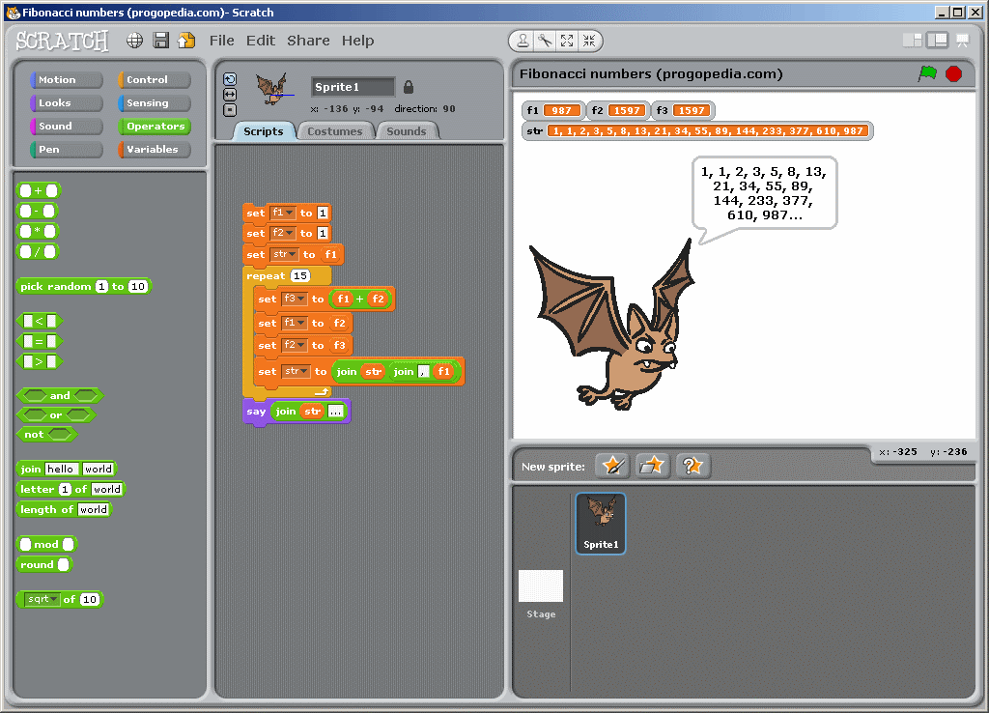
Environments that Motivate
Logo to Scratch

Slide 10
Why no one-true path?
Great difficulty comparing approaches in an apples to apples way
Various goals of education
Technological change, difficulty of getting enough resources

Slide 11

Much much more work goes on…
Visualizations
Tools for specific pedagogical purposes
Many learner oriented IDEs

Slide 12
Where we are
CS Education Research – super high-level overview
Understanding CS-specific problems
Pedagogical Technology
Pedagogical Methods
Qualitative Research in CS Ed – a few highlights
My own work in student course choices
Just Finished: Pedagogical Technology
Next: Pedagogical Methods

Slide 13
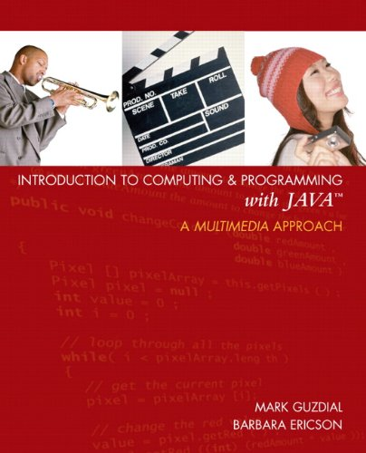

Pedagogy + Technology for Intro Courses
Media Computation
Scheme Approach

Slide 14
Pair Programming (generally very good results for this BTW)
Active Learning
Problem Based Learning
Specific educational approaches for more advanced classes (not really enough of this though)

Slide 15

Interested in more?
I personally like this book: Computer Science Education Research (edited by Sally Fincher, Marian Petre)
ICER conference
SIGCSE conference

Slide 16
Where we are
CS Education Research – super high-level overview
Understanding CS-specific problems
Pedagogical Technology
Pedagogical Methods
Qualitative Research in CS Ed – a few highlights
My own work in student course choices
Just Finished: My altogether too brief overview of all CS ed research
Next: Qualitative Research in CS ed

Slide 17
Why Qualitative at All?
All of the studies we’ve talked about have generally had nice statistical evidence – significant results, experimental design

Slide 18
Hypothetical
Imagine I think students have trouble learning about linked lists. So I build a fancy IDE plugin to help them visualize linked lists.
I teach the same class twice, with 2 different groups. One group gets the plugin, one doesn’t.
Compare their exam grades – results significant!
What’s wrong with this picture?

Slide 19
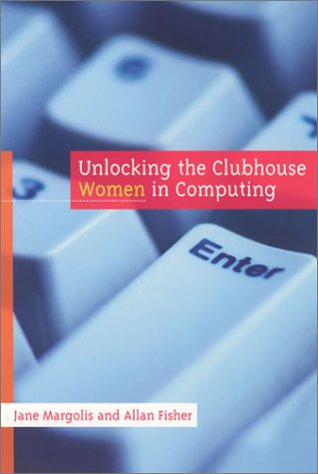
Qualitative Research: Good at Getting the Big Picture
Unlocking the Clubhouse by Margolis and Fisher
Based on interviews with undergrad female CS students at Carnegie Mellon

Slide 20
Lecia Jane Barker et Al “Defensive climate in the computer science classroom,” SIGCSE 2002
Based on observations of a CS classroom
Identifies ways that instructors’ lectures/class interaction style implicitly
conveyed the impression that poorer performing students were not valued
encouraged negative classroom behaviors

Slide 21
Where we are
CS Education Research – super high-level overview
Understanding CS-specific problems
Pedagogical Technology
Pedagogical Methods
Qualitative Research in CS Ed
A few highlights
Rigor
My own work in student course choices
Just Finished: My altogether too brief overview of all CS ed research
Next: Qualitative Research in CS ed

Slide 22
Rigor in Qualitative Work
Usually not concerned with establishing statistical representativeness
Instead with accurately understanding the experience of a few subjects, in detail
Majority of the work is understanding your participants ways of thinking
Thinking outside beyond one’s usual patterns is an essential part of the work – augmented by techniques

Slide 23
Following a specific qualitative method
The fact that you followed a specific method doesn’t automatically make your work good
The key is being about to defend your methodological decisions
My process is grounded theory – focused on adaptation
Adjusting your questions as you learn
Interviewing different folks and dealing with heterogeneous data
Continuing the process until you’re confident of the results

Slide 24
Novelty
Part of how qualitative work is evaluated

Slide 25
Where we are
CS Education Research – super high-level overview
Understanding CS-specific problems
Pedagogical Technology
Pedagogical Methods
Qualitative Research in CS Ed
A few highlights
Rigor
My own work in student course choices
Just Finished: Qualitative research in CS ed
Next: My Work

Slide 26
The Initial Questions
How do CS undergraduates think about the field of CS?
Do they understand enough about CS to make good decisions about their future courses?
Answer: In my work I actually identified 3 different viewpoints of Computer Science: Theory View, Programming View, and Broad View. I won’t be talking about them in detail in this talk though.
Answer: It’s complicated

Slide 27
No Detailed Knowledge of Subfields of CS
“Like I was signing up for fall classes. Okay, do I want to take processer design or [an] operating systems class? And, to be honest, that stuff looks very similar to me from my shoes, right. I don't know anything about either one, so how am I supposed to distinguish them?”
-Junior, Georgia Tech
Given this, how do students make educational decisions?

Slide 28
Goal-Based Decision Making
Requires reasoning based on detailed conceptions of CS
“Well, I got interested in robotics. I was enjoying the class. Things were going well…but I wasn't sure exactly what I should go to towards learning robotics on my own and in the classroom. So I went to my robotics professor and asked him for some direction, and one of the things I asked was simply what threads would you choose…when I chose the threads I'm working with now, it was more where do I want to go and how do I get there that made me choose them.”
-Junior, Georgia Tech

Slide 29
Two Modes of Student Decision Making
Exploratory Decision Making
No concrete goals
Abdicating responsibility to the curriculum
Goal-Based Decision Making
Requires reasoning based on conceptions

Slide 30
Two Modes of Student Decision Making
Exploratory Decision Making
No concrete goals
Abdicating responsibility to the curriculum
???
Goal-Based Decision Making
Requires reasoning based on conceptions

Slide 31
Enjoyment
“[I was in] an architecture class. And I got there and I was like, `I don't understand any of this. I don't really like it.’…And I was kind of hesitant at first when I talked to my - the advisor in the CS department, because I was like, `[The People thread] really isn't as good for a career in video game animation and special effects or whatever I decided to go into.’ She was like, `It's not.’ I was like, `Well, I'm just going to with [the People thread].’”
-Senior, Georgia Tech

Slide 32
Enjoyment
Strong contrasting enjoyment experiences trigger educational decisions
Students use enjoyment to measure their affinity with particular subdisciplines, even when they know that other factors apply

Slide 33
How Students Make Educational Decisions
Exploratory Decision Making
No concrete goals
Abdicating responsibility to the curriculum
Did I have a contrasting enjoyment experience?
Yes, and I made some key educational decisions
No, everything seems equally good to me
Goal-Based Decision Making
Requires reasoning based on conceptions

Slide 34
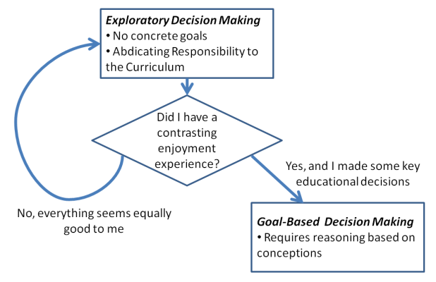
How Students Make Educational Decisions
Exploratory Decision Making
No concrete goals
Abdicating responsibility to the curriculum
Did I have a contrasting enjoyment experience?
Yes, and I made some key educational decisions
Goal-Based Decision Making
Requires reasoning based on conceptions
No, everything seems equally good to me

Slide 35
Where we are
CS Education Research – super high-level overview
Understanding CS-specific problems
Pedagogical Technology
Pedagogical Methods
Qualitative Research in CS Ed
A few highlights
Rigor
My own work in student course choices
Summary of one result: Student Class Decisions
3 Quick Implications
Just Finished: Student Class Decisions
Next: 3 Quick Implications

Slide 36
3 Quick Implications
Students rely on the curriculum to prevent them from making bad educational decisions
Enjoyment of courses is seen as evidence of an affinity for a subject area
Bad experiences in intro courses can make students decide they are poorly suited for large parts of CS

Slide 37
Questions?
CS Education Research – super high-level overview
Understanding CS-specific problems
Pedagogical Technology
Pedagogical Methods
Qualitative Research in CS Ed
A few highlights
Rigor
My own work in student course choices
Summary of one result: Student Class Decisions
3 Quick Implications
Email: hewner@rose-hulman.edu
Slides are available here: http://hewner.com/iitb-talk/

