Slide 1
Text Mining & NLP Syntactic Parsing Universal Dependencies
Ted Kwartler

Slide 2
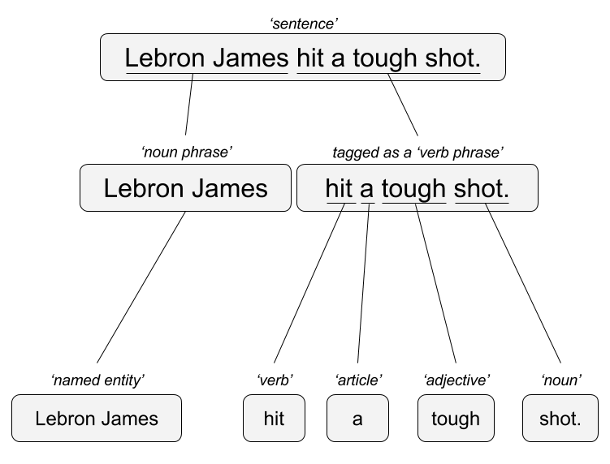

Another method for syntactic parsing.
“Lebron James hit a tough shot.”
Syntactic Parsing
Bag of Words
Lebron
a
James
hit
tough
shot
*There are other approaches usually based on DNN, that I refer to “abstractive”

Slide 3
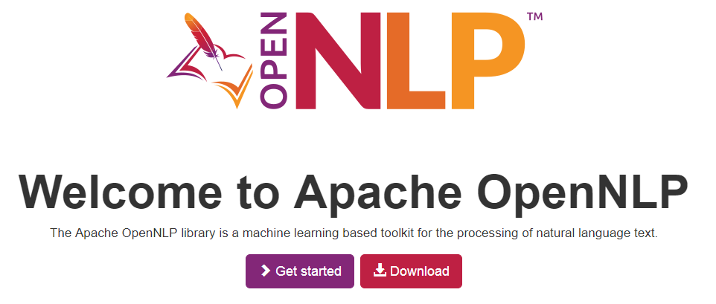

Machine Learning vs Human Made
Can you use machine learning to learn language heuristics?
All languages can be described as parent child tree networks.

Slide 4
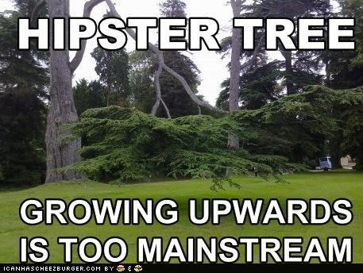
Not programmatic.
Framework for all languages
300 contributors annotate 200 “treebanks”, annotation files
100 languages covered

Slide 5
UD is a context free grammar
A phrase is made up of child or constituent words
Noun Phrase
The university

Slide 6
Context Free Grammars
A phrase is made up of child or constituent words
Noun Phrase
The university
Article constituent
Noun
the
the
university

Slide 7
Context Free Grammars
A phrase is made up of child or constituent words
Noun Phrase
The university has great coffee
Article constituent
Noun
Determiner constituent
the
university
has great coffee

Slide 8
Context Free Grammars
A phrase is made up of child or constituent words
Noun Phrase
The university has great coffee
Article constituent
Noun
Determiner constituent
the
university
has great coffee
article constituent
adjective constituent
Another noun constituent
has
great
coffee
The constituents are optional ie noun constituent starts the process over again…

Slide 9
Context Free Grammars
A phrase is made up of child or constituent words
Noun Phrase
The university has great hot coffee with cream.
Article constituent
Noun
Determiner constituent
the
university
has great
article constituent
adjective constituent
Another noun constituent
has
great
coffee
hot
with cream
adj noun constituent
Another noun constituent
The constituents are optional ie noun constituent starts the process over again…

Slide 10
Dependency View
Which word is it dependent upon (modifier)?
Grab
the
large
coffee
on
the
counter
near
the
pot

Slide 11
Dependency View
Which word is it dependent upon (modifier)?
Grab
the
large
coffee
on
the
counter
near
the
pot
Grab what? Coffee

Slide 12
Dependency View
Which word is it dependent upon (modifier)?
Grab
the
large
coffee
on
the
counter
near
the
pot
Grab what? Coffee
What about the coffee? It’s the large one

Slide 13
Dependency View
Which word is it dependent upon (modifier)?
Grab
the
large
coffee
on
the
counter
Near
the
pot
Grab what? Coffee
What about the coffee? It’s the large one
What is on the counter? Coffee

Slide 14
Dependency View
Which word is it dependent upon (modifier)?
Grab
the
large
coffee
on
the
counter
near
the
pot
Grab what? Coffee
What about the coffee? It’s the large one
What is on the counter? Coffee
“On the” is context for what? Counter

Slide 15
Dependency View
Which word is it dependent upon (modifier)?
Grab
the
large
coffee
on
the
counter
near
the
pot
Grab what? Coffee
What about the coffee? It’s the large one
What is on the counter? Coffee
“On the” is context for what? Counter
What is near the pot? Coffee

Slide 16
Dependency View
Which word is it dependent upon (modifier)?
Grab
the
large
coffee
on
the
counter
near
the
pot
Grab what? Coffee
What about the coffee? It’s the large one
What is on the counter? Coffee
“On the” is context for what? Counter
What is near the pot? Coffee
“near the” is context for what? Pot
Notes:
Good discussion on this course https://www.youtube.com/watch?v=PVShkZgXznc

Slide 17
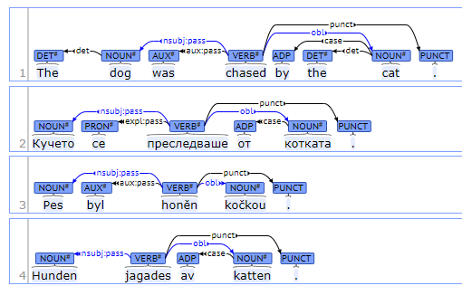
Universal Dependencies
Open Source Project w/300 Contributors
Uses annotated texts to parse to learn these tree structures
200 treebanks created
100 languages supported
“universal” in label types
Best interactive graphic: https://universaldependencies.org/introduction.html

Slide 18
Institute of formal & applied linguistics: UDPipe
Ported the use of UD into multiple software languages
UDPipe is a trainable pipeline for tokenization, tagging, lemmatization and dependency parsing of CoNLL-U (universal dependency format) files.
Most of the UD treebanks are supported
Multiple software languages: Linux, Window, OS X, C++, Python, Perl, Java, C#, API service and R
http://ufal.mff.cuni.cz/udpipe

Slide 19
UD Pipe doesn’t do NER…but the package author has created many options.
BTM: Biterm Topic Modelling: available at https://CRAN.R-project.org/package=BTM
crfsuite: Build named entity recognition models using conditional random fields: https://CRAN.R-project.org/package=crfsuite
nametagger: Build named entity recognition models using markov models: https://CRAN.R-project.org/package=nametagger
torch.ner: Named Entity Recognition using torch
word2vec: Training and applying the word2vec algorithm: https://CRAN.R-project.org/package=word2vec
doc2vec: Building paragraph vector models also known as doc2vec https://CRAN.R-project.org/package=doc2vec
ruimtehol: Text embedding techniques using Starspace: https://CRAN.R-project.org/package=ruimtehol
textrank: Text summarisation and keyword detection using textrank: https://CRAN.R-project.org/package=textrank
brown: Brown word clustering on texts
sentencepiece: Byte Pair Encoding and Unigram tokenisation using sentencepiece: https://CRAN.R-project.org/package=sentencepiece
tokenizers.bpe: Byte Pair Encoding tokenisation using YouTokenToMe: https://CRAN.R-project.org/package=tokenizers.bpe
text.alignment: Find text similarities using Smith-Waterman: https://CRAN.R-project.org/package=text.alignment
textplot: Visualise complex relations in texts: https://CRAN.R-project.org/package=textplot; https://github.com/bnosac/textplot
udpipe: Tokenization, Parts of Speech Tagging, Lemmatization, Dependency Parsing, Keyword detection and NLP processing: https://CRAN.R-project.org/package=udpipe

Slide 20
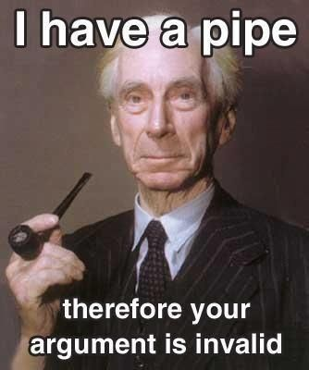
Open A_UD_syntacticParsing.R
Great use of lemmatization as a preprocessing step even if you don’t use the POS tags

