Slide 1
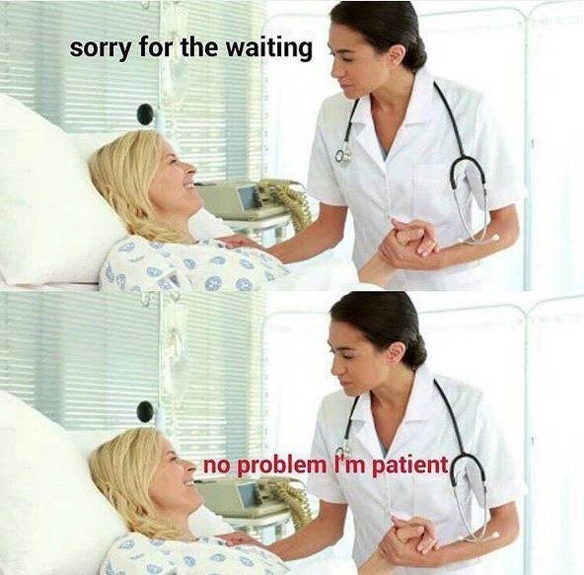
B_ElasticNetExample.R

Slide 2
In reality you would likely make an ensemble
Male/Female
Best Possible Model
Patient Factor Information
Numeric Information
Information from text
DR notes “patient exhibits…”
Height, wgt

Slide 3
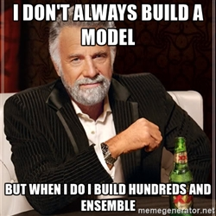
C_ElasticNetExample_ensemble.R

