Slide 1
Latent Semantic Analysis…cousin of PCA
In statistics PCA – Principal Component Analysis
High dimensional data can be approximated by “singular value decomposition” (SVD)

Slide 2
Latent Semantic Analysis
In text LSA – Latent Semantic Analysis
High dimensional data (text values) can be approximated by “singular value decomposition” (SVD)
 | Doc1 | Doc2
TermA | 10 | 6
TermB | 11 | 4
TermC | 8 | 5
TermD | 3 | 3
TermE | 2 | 2.8
TermF | 1 | 1
Doc1 Avg: 5.8
Doc2 Avg: 3.6

Slide 3
Plot the data in 2D space. In reality, text has higher dimensions.
The intersection of the two documents in space
 | Doc1 | Doc2
TermA | 10 | 6
TermB | 11 | 4
TermC | 8 | 5
TermD | 3 | 3
TermE | 2 | 2.8
TermF | 1 | 1
Doc2
Doc1 Avg: 5.8
Doc2 Avg: 3.6
Doc1

Slide 4
Shift the origin to the average

Slide 5
Shifting the origin changes value but not relative position.

Slide 6
PCA “fits” a line going through the origin

Slide 7
The points are projected onto the fit line and squared distances from the origin are summed up.
Find the line that minimizes the data point to the projected point on the line.

Slide 8
A user defines the number of PCA dimensions.
Remember this happens in hyperspace among thousands of documents.
PCA1 is a line that “mixes”
the value of Doc1 & Doc2

Slide 9
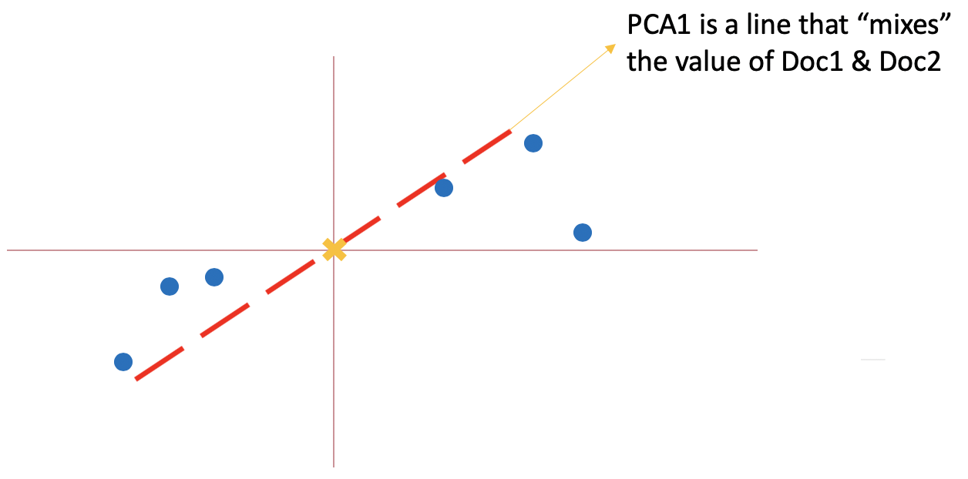
In our case, we have thousands of term vectors.
Term Vectors are paired to reduce dimensions

Slide 10
In our case, we have thousands of term vectors.
The reduced vectors are subject to more single value decompositions

Slide 11
In our case, we have thousands of term vectors.
Iteratively, these decompositions are reduced to the number of vectors you declare.
So 12 vectors were ultimately reduced to 2.

Slide 12
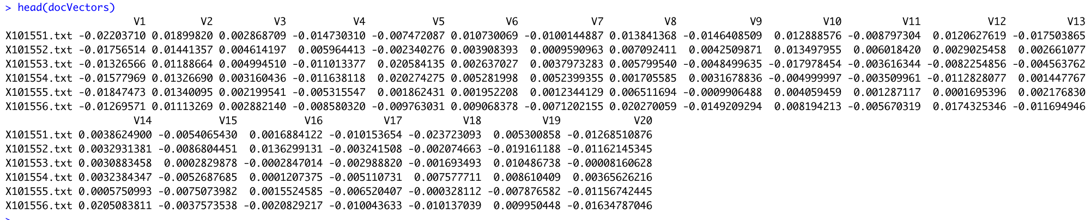
These vectors are dense, perfect for modeling.
Declared 20 vectors for all 2000 docs.

Slide 13
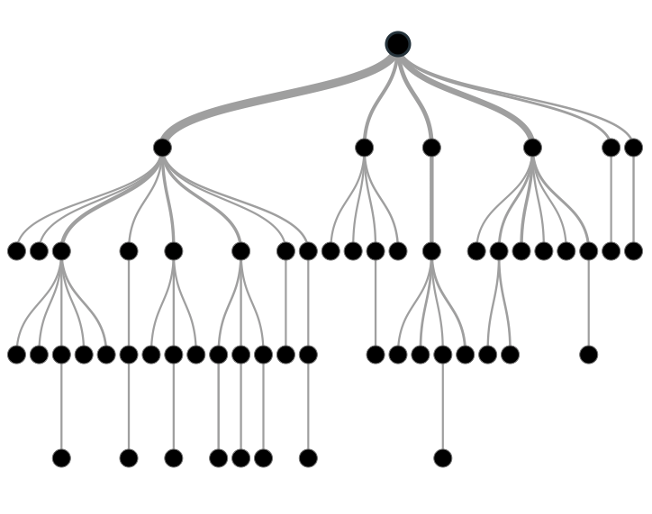

Supervised Learning
Inferring a function from labeled data.
“Learn from telling”, “Look at my data and I will tell you what to predict”
Data Setup
Method
Business Examples
Application
Marketing-Will a customer buy yes or no? How much will a customer spend?
Operations- Will an applicant default? When will a machine break?
Flat “Excel” file. Each row is a record or observation. Each column is an attribute of the record.
One column is the outcome, y or target attribute.
Modeling e.g. K-NN, linear regression, decision tree, random forest etc.
Make predictions for the target on the new data.

Slide 14
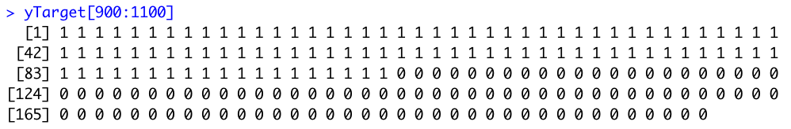
Supervised Learning
Output from LSA are “x-variables”
Data Setup
The label is ”y-variable”
Flat “Excel” file. Each row is a record or observation. Each column is an attribute of the record.
One column is the outcome, y or target attribute.

Slide 15
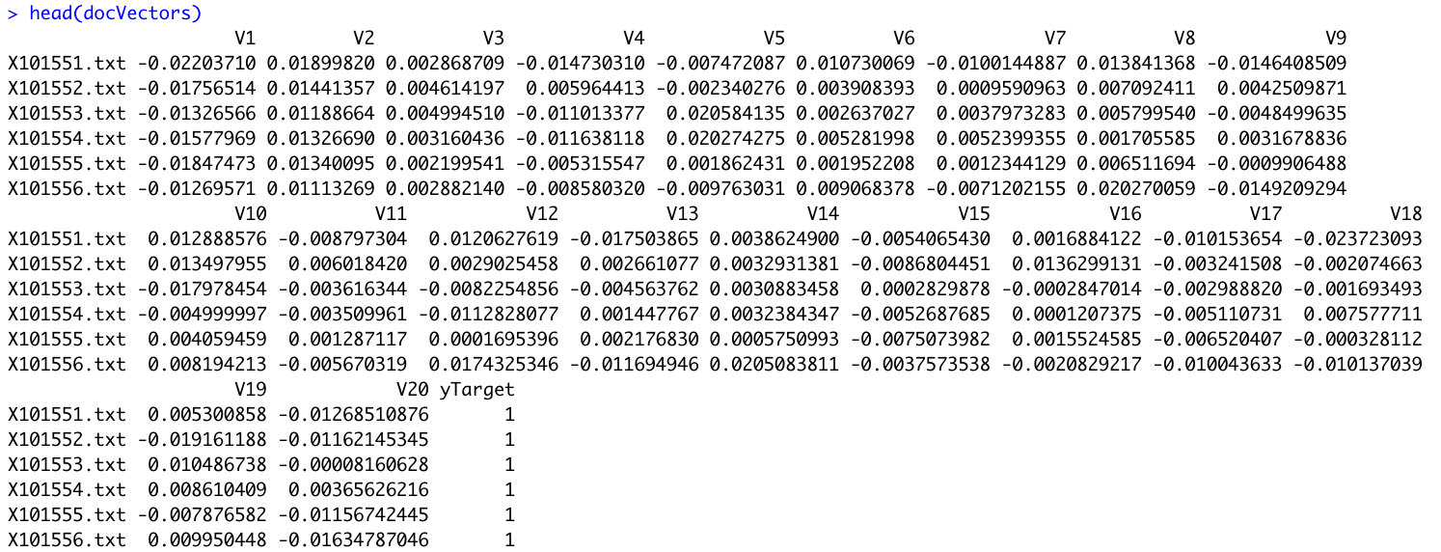
The modeling function usually needs a matrix with both.

Slide 16
Let’s open C_lsa_for modeling_glm.R

Slide 17
Creating a Bayesian Model

Slide 18
When does Bayesian Excel?
Complex Problems
Inherent Uncertainty
Integration of many sources

Slide 19
When does Bayesian Excel?
Complex Problems
Inherent Uncertainty
Integration of many sources
Spam where authors are trying to outsmart the model
Lexical Diversity
Many Authors

Slide 20

How many $100 Bills are in circulation?

Slide 21
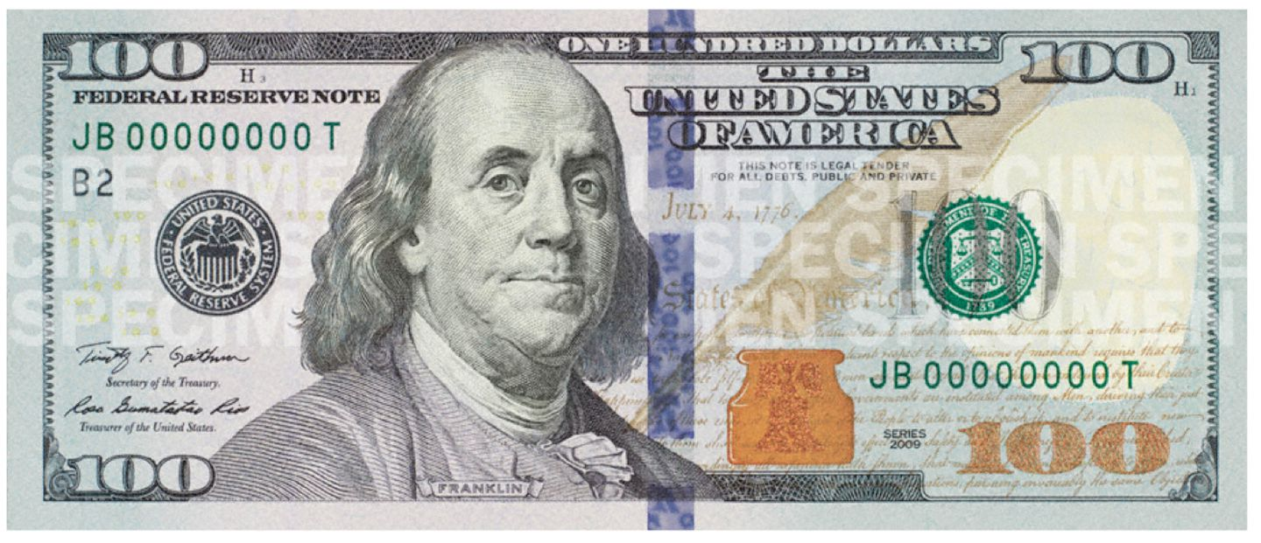
Practical Problem, Abundance Modeling
You can’t count them all
but you can get a sample

Slide 22

Practical Problem, Abundance Modeling
You can’t count them all
but you can get a sample
record the ID’s and put them in back in circulation

Slide 23
Practical Problem, Abundance Modeling
You can’t count them all
but you can get a sample
record the ID’s and put them in back in circulation
5/20 were “recaptured” in another sampling

Slide 24




How many $100 bills are in circulation?
What is the probable number of bills in the economy?
$$μ$$
Bayesian Model
$$ρ$$
Parameters
3,4,7,9,1,2,8,3…
Data
$$θ$$
$$σ$$

Slide 25
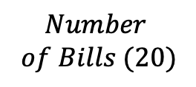
How many $100 bills are in circulation?
What is the probable number of bills in the economy?
Mark 20 Bills
Sample 20 Bills
Count the # in the resample
$$Number$$
$$of Bills (20)$$
Parameters
5 Bills
Data

Slide 26

How many $100 bills are in circulation?
What is the probable number of bills in the economy?
Mark 20 Bills
Sample 20 Bills
Count the # in the resample
$$Number$$
$$of Bills (20)$$
Parameters
5 Bills
Data
Draw a large random sample from the “prior” probability distribution on the parameters. Here, for example: num_bills: [63, 30, 167, 30,…]
Plug in each draw into the generative model which generates a vector of “fake” data.
Mark 20 Bills
Sample 20 Bills
Count the # in the resample
$$63, 30, 167, 30...$$
4, 13, 5, 15…
Data

Slide 27

How many $100 bills are in circulation?
What is the probable number of bills in the economy?
Mark 20 Bills
Sample 20 Bills
Count the # in the resample
$$Number$$
$$of Bills (20)$$
Parameters
5 Bills
Data
Draw a large random sample from the “prior” probability distribution on the parameters. Here, for example: no_bills: [63, 30, 167, 30,…]
Plug in each draw into the generative model which generates a vector of “fake” data.
Throw out those that don’t match
Mark 20 Bills
Sample 20 Bills
Count the # in the resample
$$63, 30, 167, 30...$$
4, 13, 5, 15…
Data

Slide 28

How many $100 bills are in circulation?
What is the probable number of bills in the economy?
Mark 20 Bills
Sample 20 Bills
Count the # in the resample
$$Number$$
$$of Bills (20)$$
Parameters
5 Bills
Data
Draw a large random sample from the “prior” probability distribution on the parameters. Here, for example: no_bills: [63, 30, 167, 30,…]
Plug in each draw into the generative model which generates a vector of “fake” data.
Throw out those that don’t match
Retain the parameters that matched the prior knowledge. These parameters represent the probability that the data was produced by a certain value.
Mark 20 Bills
Sample 20 Bills
Count the # in the resample
$$63, 30, 167, 30...$$
4, 13, 5, 15…
Data
Notes:
A great primer:
http://www.sumsar.net/files/academia/user_2015_tutorial_bayesian_data_analysis_short_version.pdf

Slide 29






Open D_lsa_for modeling_Bayesian.R
Let’s let R deal with it!
Likelihood Distribution
Prior Distribution
Average Liklihood

Slide 30

Optional…another popular library….
Open
E_rtexttools.R

