Slide 1
Automating Reports
Flexdashboard
Use R Markdown to publish a group of related data visualizations as a dashboard.
Support for a wide variety of components including htmlwidgets; base, ggplot2
Flexible and easy to specify row and column-based layouts.

Slide 2
Multiple Methods
R library(officer)
https://davidgohel.github.io/officer/
Docx and pptx
Flexible though clunky
Uses any static image ggplot etc
Easily allows for themes
R Studio Presentation “PowerPoint”
https://support.rstudio.com/hc/en-us/articles/360004672913-Rendering-PowerPoint-Presentations-with-RStudio
Requires knowledge of markdown
Last semester we used library officer but this time the markdown version.

Slide 3
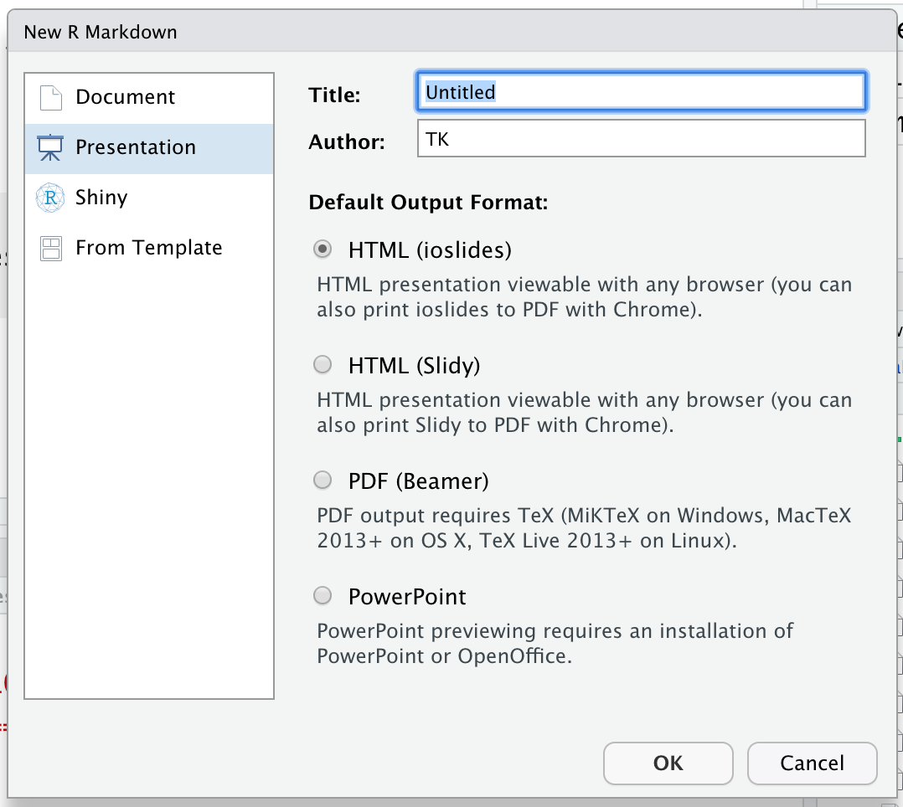
Making powerpoints
ZZ_example_pptx.Rmd
File
New File
New Markdown
Select Presentation
Select PowerPoint
https://support.rstudio.com/hc/en-us/articles/360004672913-Rendering-PowerPoint-Presentations-with-RStudio

Slide 4

Automating Reports w/FlexDashboard
I need more interesting pictures. PowerPoint gives me a headache.
Use R Markdown to publish a group of related data visualizations as a dashboard.
Support for a wide variety of components including htmlwidgets; base, ggplot2
Flexible and easy to specify row and column-based layouts.

Slide 5
Let’s practice!
A_flexdashboard.rmd
B_538_clone-ish.rmd

