Slide 1
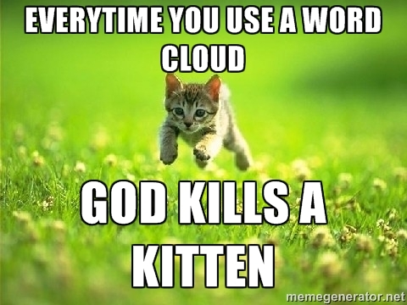

WCs are boring with a single corpus.
Single Corpus
wordcloud( )

Slide 2
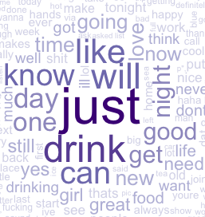
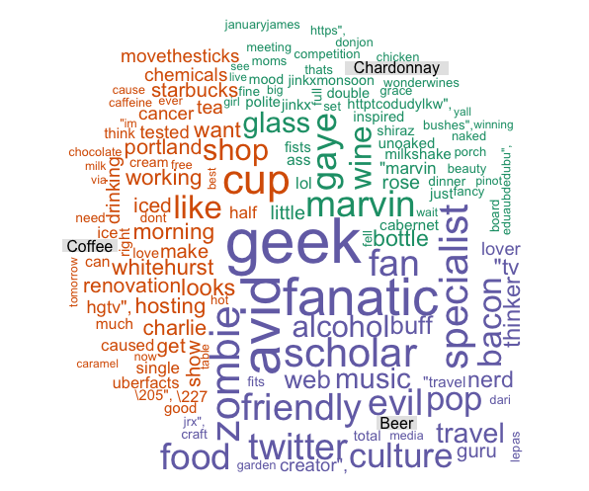
With 2+ Corpora, WCs are more insightful
Multiple Corpora
comparison.cloud( )
commonality.cloud( )
comparison.cloud( )
comparison.cloud( )

Slide 3
Dealing with many text files is tricky.
Option 1
# Read in multiple files as individuals; list.files(); dir()
txtFiles <- c('chardonnay.csv','coffee.csv','beer.csv')
for (i in 1:length(txtFiles)){
assign(txtFiles[i], read.csv(txtFiles[i]))
cat(paste('read completed:',txtFiles[i],'\n'))
}
Using a loop each file is an individual object.
REVIEW CLASS2 - dealing w/multiple files!

Slide 4
Out 3 Documents as a single list object
allDocs <- pblapply(txtFiles,read.csv)
allDocs
chardonnay.csv
coffee.csv
beer.csv

Slide 5

Out 3 Documents as a single list object
allDocs <- pblapply(txtFiles,read.csv)
allDocs
chardonnay – 1000 Tweets
chardonnay.csv
cofee – 1000 Tweets
coffee.csv
beer – 1000 Tweets
beer.csv

Slide 6
Multiple Document Collections as a single list object
allDocs <- pblapply(txtFiles,read.csv)
allDocs
allDocs[[1]]
chardonnay.csv
allDocs[[2]]
coffee.csv
allDocs[[3]]
beer.csv

Slide 7
Each list “element” is a data frame
allDocs <- pblapply(txtFiles,read.csv)
allDocs
allDocs[[1]]
chardonnay.csv
allDocs[[1]]$text
allDocs[[1]]$doc_id
allDocs[[1]][,2]
allDocs[[2]]
coffee.csv
allDocs[[3]]
beer.csv

Slide 8
Manipulating multiple corpora
Combined/Collapsed
into a 2 document corpus
CorpusA – 1000 Tweets
Clean & Collapse
CorpusB – 1000 Tweets
Clean & Collapse
When you collapse, all the information for a subject is considered one document.

Slide 9
Manipulating multiple corpora
Combined/Collapsed
into a 2 document corpus
chardonnay – 1000 Tweets
Clean & Collapse
beer – 1000 Tweets
Clean & Collapse
We now have 2 documents, not 2000. Document 1 is everything we know about chardonnay and document 2 is everything we know about beer.

Slide 10
The new WC will examine inner and disjoins
The collapses documents can be examined using set theory. “inner join”, “outer join”

Slide 11
What tokens are in common?

Slide 12
Introducing TF-IDF Term Frequency Inverse Document Frequency
So far, you have used simple term frequency to identify informative words. Chardonnay is highly frequent in the tweets, but since it appears in all documents it isn’t informative.
Term frequency * inverse-document-frequency
If a term appears often, it must be important to the corpus.
But, if a term appear in many documents, it can’t be distinctive or informative
Increasing
importance
Offsetting
importance

Slide 13
The TF of TF-IDF
Term Frequency isn’t just a count. It is normalized because unique terms will naturally increase the longer the document.
Term frequency = Term Occurrence / total unique terms in a document

Slide 14
Inverse Document Frequency
IDF is the natural log of total documents divided by the number of documents containing a specific token.
Inverse Document Frequency =
log(total documents in corpus) / number of documents with term in it
Notes:
Pg 101 in book has explanation

Slide 15
TF-IDF Simple Example
Coffee TF = 1000 will look VERY important but TFIDF = 0.69 will correctly have minimal impact for analysis.
In 1000 documents each of 10 words suppose token “coffee” occurs 1000 times
TF = 1000 / 10 #normalizes to doc length
TF = 100
IDF = log(1000) / 1000
IDF = 6.90 /1000
IDF = .0069
*Caveat – the results in R are normalized/scaled by default.
TF-IDF = 100 * .0069
TF-IDF = .69

Slide 16
Original Term Frequency
In 1000 documents suppose token “coffee” occurs 1000 times
TF = 1000

Slide 17
Applying TF-IDF to a DTM/TDM
You can pass in more than one control parameter like tokenization & weighting.
# Control Paramter
ctrl <- list(weighting = weightTfIdf)
# Apply in TDM/DTM construction
drinkTDM <- TermDocumentMatrix(allDrinks, control = ctrl)
# Change to a simple matrix
drinkTDMm <- as.matrix(drinkTDM)

Slide 18
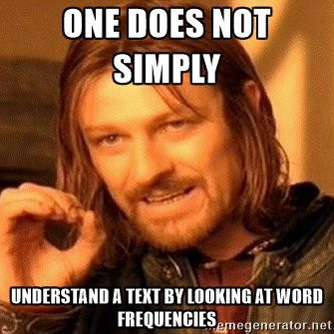
Lets make some improved word clouds
B_CommonalityCloud.R
C_CommonalityCloud.R

Slide 19
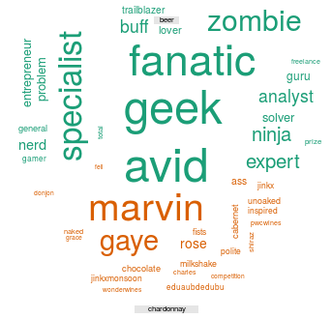
What tokens are in not in common (disjoint)?
The script adds a third corpus. Be mindful not to overwhelm your audience with many categories/subjects.

Slide 20
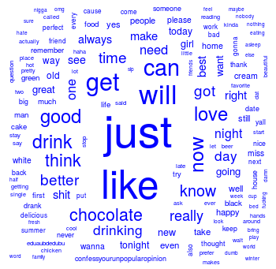
What about proportional similarities?
The problem is that if corpusA has 1 instance & corpus has 1000 they appear as shared.

