Slide 1
Latent Semantic Analysis…cousin of PCA
In statistics PCA – Principal Component Analysis
High dimensional data can be approximated by “singular value decomposition” (SVD)

Slide 2
Latent Semantic Analysis
In text LSA – Latent Semantic Analysis
High dimensional data (text values) can be approximated by “singular value decomposition” (SVD)
 | Doc1 | Doc2
TermA | 10 | 6
TermB | 11 | 4
TermC | 8 | 5
TermD | 3 | 3
TermE | 2 | 2.8
TermF | 1 | 1
Doc1 Avg: 5.8
Doc2 Avg: 3.6

Slide 3
Plot the data in 2D space. In reality, text has higher dimensions.
Doc2
Doc1

Slide 4
Shift the origin to the average

Slide 5
Shifting the origin changes value but not relative position.

Slide 6
PCA “fits” a line going through the origin

Slide 7
The points are projected onto the fit line and squared distances from the origin are summed up.
Find the line that minimizes the data point to the projected point on the line.

Slide 8
A user defines the number of PCA dimensions.
Remember this happens in hyperspace among thousands of documents.
PCA1 is a line that “mixes”
the value of Doc1 & Doc2

Slide 9
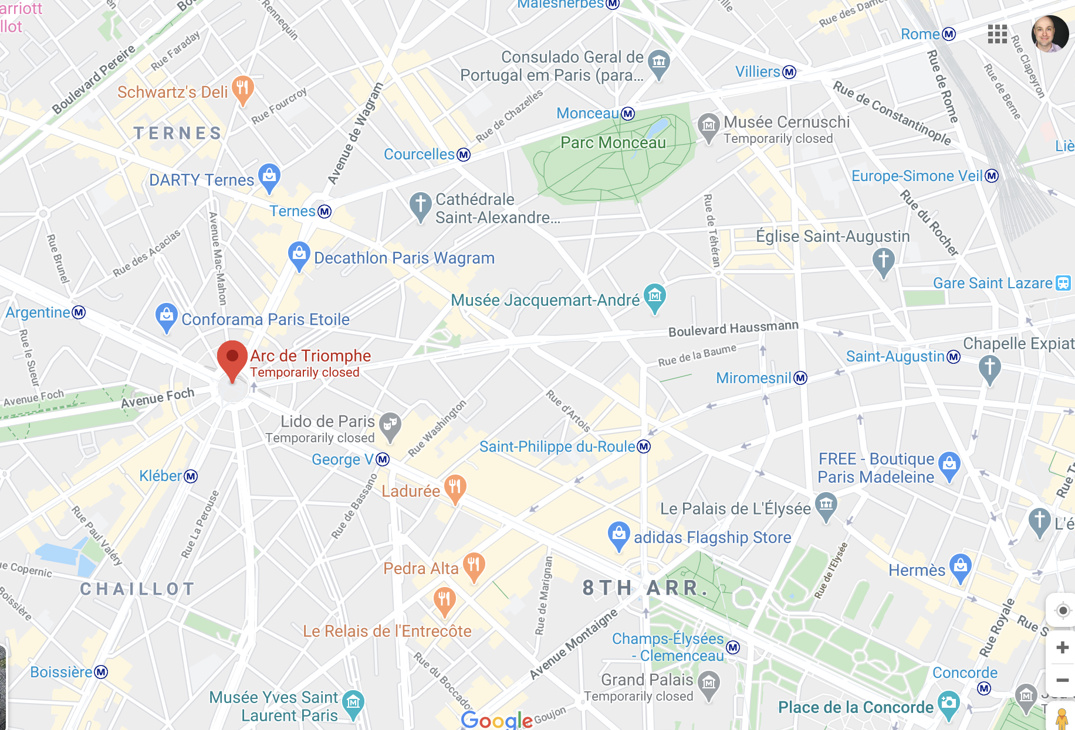
Intuitive Example of PCA Where is the Musee Jacquemart-Andre in Paris?
Exact Answer has 2 data points.
LAT: 48.874911
LON:2.310612

Slide 10
Intuitive Example of PCA Where is the Musee Jacquemart-Andre in Paris?
Exact Answer has 2 data points.
LAT: 48.874911
LON:2.310612
Quick Answer has 1 data point.
Not far from Boulevard Haussmann

Slide 11
Intuitive Example of PCA Where is the Musee Jacquemart-Andre in Paris?
Exact Answer has 2 data points.
LAT: 48.874911
LON:2.310612
Quick Answer has 1 data point.
Not far from Boulevard Haussmann
Another point can be measured this way
“Hermes is farther from Boulevard…"

Slide 12
Let’s open B_lsa.R
LSA is an unsupervised approach.
Not as informative as topic modeling or the k-series of methods next.
Often used in conjunction with supervised learning because results are dense (not sparse) data.

