Slide 1
Text Mining & NLP Syntactic Parsing - openNLP
Ted Kwartler

Slide 2
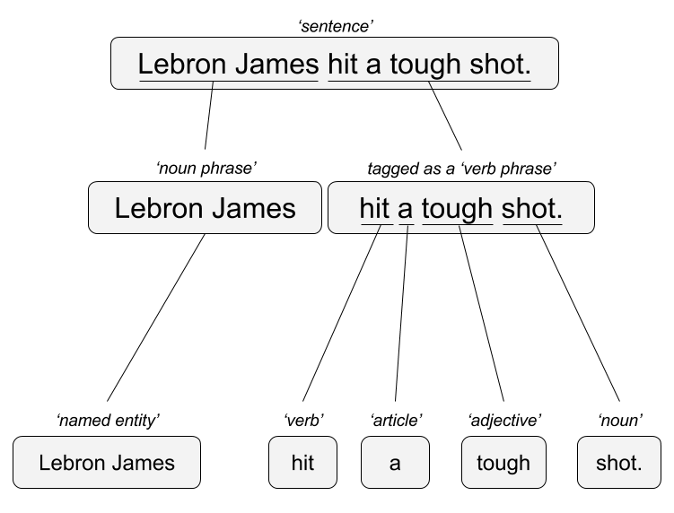

Remember this?
“Lebron James hit a tough shot.”
Syntactic Parsing
Bag of Words
Lebron
a
James
hit
tough
shot
*There are other approaches usually based on DNN, that I refer to “abstractive”

Slide 3
Instead of manually annotated tree files…
Can you use machine learning to learn language heuristics?

Slide 4

Apache NLP is a java ML open source project
R’s OpenNLP package wraps the Apache OpenNLP project. However, documentation & examples can be hard to come by.

Slide 5
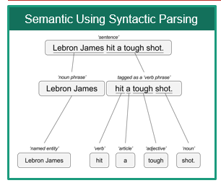
Annotation Models
Mix of Machine Learning &
Heuristics (2 words starting with capital letters may be a proper noun)
Annotations
Grammatical or POS (Part of Speech) Tagging
Sentence Tagging
Word Tagging
Named Entity Recognition
Persons
Locations
Organizations
Each Annotation is a model so this is slower than a treebank

Slide 6
Since each is a model, the output of 1 is used in the next.
His name is George. Washington is where he is from.
Without the “sentence” annotation “George Washington” could be incorrectly identified.

Slide 7
Since each is a model, the output of 1 is used in the next.
His name is George. Washington is where he is from.
Sentence
Sentence
POS
POS
NER – Person: George
NER – Location: Washington
Without the “sentence” annotation “George Washington” could be incorrectly identified.

Slide 8
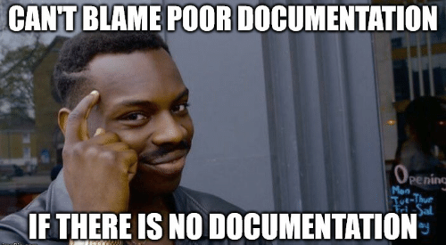
library(openNLP)
Examples are hard to come by
Documentation is not good either
https://rpubs.com/lmullen/nlp-chapter

Slide 9
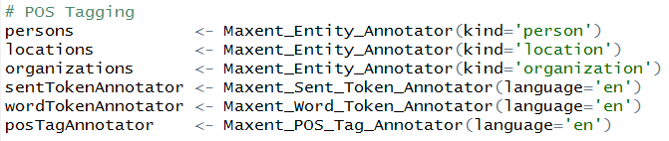
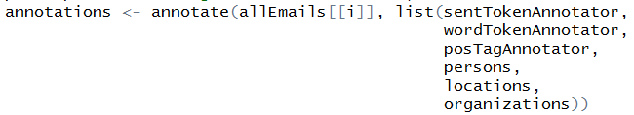
Nuances of openNLP
Load the ML models
A new class “String” (mind the caps)
Annotate the text with the models (mind the order)

Slide 10

Another TRAP!
Annotate is used in ggplot2 SO you must declare a namespace NLP::annotate(…) or ensure ggplot2 is not loaded in your environment!
p <- ggplot(mtcars, aes(x = wt, y = mpg)) + geom_point()
p + annotate("text", x = 4, y = 25, label = "Some text")
annotations <- annotate(allEmails[[i]],
list(sentTokenAnnotator,
wordTokenAnnotator,
posTagAnnotator,
persons,
locations,
organizations))

Slide 11
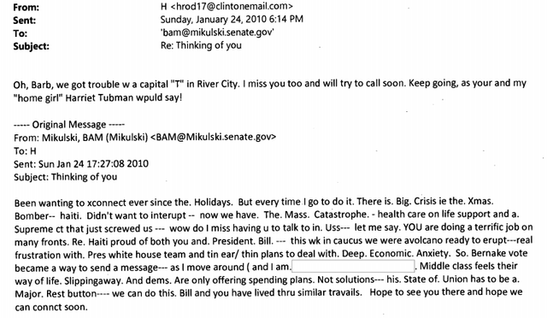
Hilary Clinton Emails
30,000 emails
Not illegal at the time to have on a non-gov server
State Department Investigation & FBI discovery
Some “classified” & sensitive emails subsequently declassified.
This specific corpus was not “leaked” but made part of the public record.
This is not meant to support/detract/address the political controversy. It is a public, large corpus with named entities throughout.

Slide 12
Let’s perform Named Entity Recognition
A_NER_syntaticParsing.R

Slide 13
Why would it be interesting to get Named Entities?
Information Retrieval
Without reading documents, identify those that may include places, people and locations
“News Feeds”
Government Document Discovery
Contextualization for global entities i.e. Amazon has different policies by location, NER can help group documents for operations and customer service.
Investigative Journalism, Academic Paper Search

Slide 14
Let’s perform Named Entity Recognition
B_using_NER.R

