Slide 1


Multiple Files Can Be Challenging
Remove Punctuation
Remove extra white space
Remove Numbers
Make Lower Case
Remove “stop” words
blogs
reviews
articles

Slide 2
Multiple Files Can Be Challenging
Remove Punctuation
Remove extra white space
Remove Numbers
Make Lower Case
Remove “stop” words
Remove Punctuation
Remove extra white space
Remove Numbers
Make Lower Case
Remove “stop” words
blogs
reviews
articles

Slide 3
Multiple Files Can Be Challenging
Remove Punctuation
Remove extra white space
Remove Numbers
Make Lower Case
Remove “stop” words
Remove Punctuation
Remove extra white space
Remove Numbers
Make Lower Case
Remove “stop” words
Remove Punctuation
Remove extra white space
Remove Numbers
Make Lower Case
Remove “stop” words
Remove Punctuation
Remove extra white space
Remove Numbers
Make Lower Case
Remove “stop” words
Remove Punctuation
Remove extra white space
Remove Numbers
Make Lower Case
Remove “stop” words
Remove Punctuation
Remove extra white space
Remove Numbers
Make Lower Case
Remove “stop” words
blogs
Remove Punctuation
Remove extra white space
Remove Numbers
Make Lower Case
Remove “stop” words
reviews
articles

Slide 4
Multiple Files Can Be Challenging
Remove Punctuation
Remove extra white space
Remove Numbers
Make Lower Case
Remove “stop” words
blogs
reviews
articles

Slide 5

Multiple Files Can Be Challenging
Remove Punctuation
Remove extra white space
Remove Numbers
Make Lower Case
Remove “stop” words
blogs
reviews
articles

Slide 6
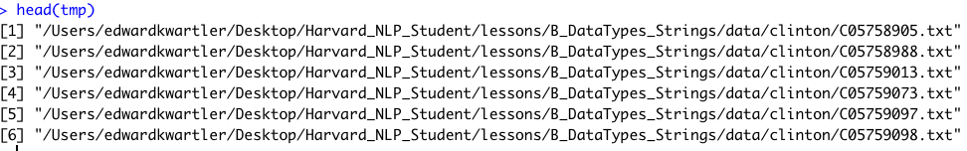
list.files & lists to the rescue!
Get a vector of all file names in the directory that match the pattern. Full names will append the path not just file name.
tmp <- list.files(path = “some working directory”,
pattern = “file name pattern to look for”,
full.names = TRUE)

Slide 7
Make a list of the files
tmp
allFiles <- lapply(tmp, readingfunction)

Slide 8
A list is a great way to store an object in the R environment
allFiles

Slide 9
List element indexing
allFiles
allFiles[[1]]
allFiles[[2]]
allFiles[[3]]
allFiles[[4]]

Slide 10

List element indexing pt2
allFiles
allFiles[[1]][,1] #1st column
allFiles[[2]][1,] #1st row
allFiles[[3]]$text #named column $text
allFiles[[4]][1,2]#1st row, 2nd column

Slide 11
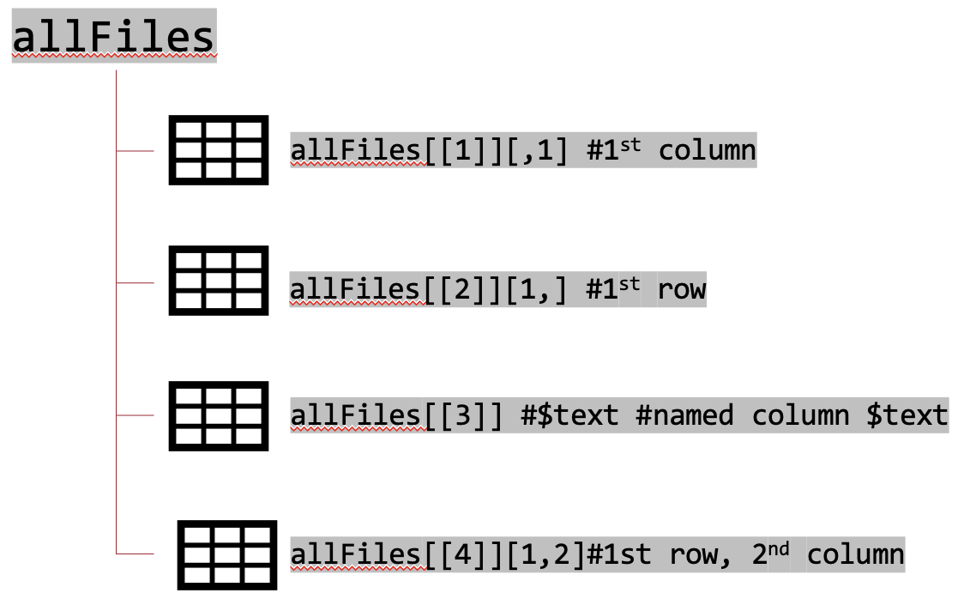
Apply the functions in a loop or w/lapply
Remove Punctuation
Remove extra white space
Remove Numbers
Make Lower Case
Remove “stop” words
blogs
reviews
articles
Cleaned results

Slide 12

E_Basics_multipleFiles.R

