Slide 1
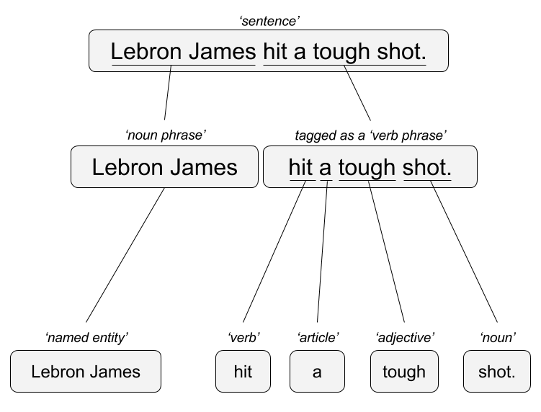

Two Three Popular Approaches
“Lebron James hit a tough shot.”
Syntactic Parsing
Bag of Words
Lebron
a
James
hit
tough
shot
*There are other approaches usually based on DNN, that I refer to “abstractive”

Slide 2
Text to Vector (text2Vec) & word2vector
A word embedding is a learned representation for text where words that have the same meaning have a similar representation.
A word occurs in a hyperspace of vectors.
It’s coordinate values along all these axis are like a serial number.
Terms with similar serial numbers have a similar or related meaning.
This is why its called a “text to vector” representation.

Slide 3
Fake Word Embedding Examples
123
789
Abstractive Meaning
Washington DC
USA
Cap. City
789-USA
Some relationship between a city & country dimension.
123 – WD.C.
123 + 789 = 912 represents Washington DC in two dimensions, City and Country

Slide 4
Fake Word Embedding Examples
123
789
782
116
Washington DC
USA
UK
What city is near 116 in the city dimension?
782 - UK
116 - London
123 Washington DC – 789 “USA-ness” + 782 “UK-ness” = 116 represents a new city

Slide 5
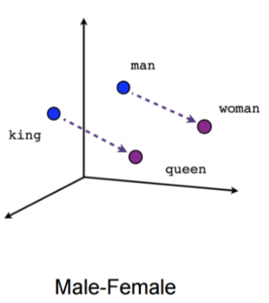
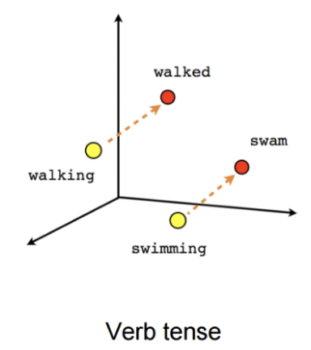
“Famous” Examples

Slide 6
Text2Vector – “Glove” Global Vectors
Uses a Term Co-occurrence Matrix not a DTM to construct these vectors or “embeddings”.
TCM is based on COUNTS in a “skip gram”.
Under the hood it’s a “weighted least squared regression”

Slide 7
TCM Counts (skip gram 1 for simplicity)
Context Clusters
I like finance.
I like to play sports.
“I like”
”I like”
“like finance”
”like to”
“…”
”to play”
“…”
”play sports”
Square Count Matrix Across all docs
 | I | like | finance | to | Play | sports
I |  | 2
like | 2 |  | 1 | 1
finance |  | 1
to |  | 1 |  |  | 1
play |  |  |  | 1 |  | 1
sports
”I” has a context of “like” twice. “play” has a context of “sports” once.
Probabilities are then calculated for how often a term appears in the context cluster. The model will predict a term’s probability for being in a context with another term.

Slide 8
What is a skip gram anyway?
Skip Gram = 1
“I like”
“like finance”
“finance and”
“and history”
I like finance and history.
Skip Gram = 2
“I like”
(no prior context)
“I like finance”
(1 before & after)
“finance and history”
(1 before & after)
I like finance and history.
It’s the “window” of terms to use in the context clusters when constructing the TCM.
Skipgram 1, finance has no context to history. Skipgram 2 finance has a context with history.

Slide 9
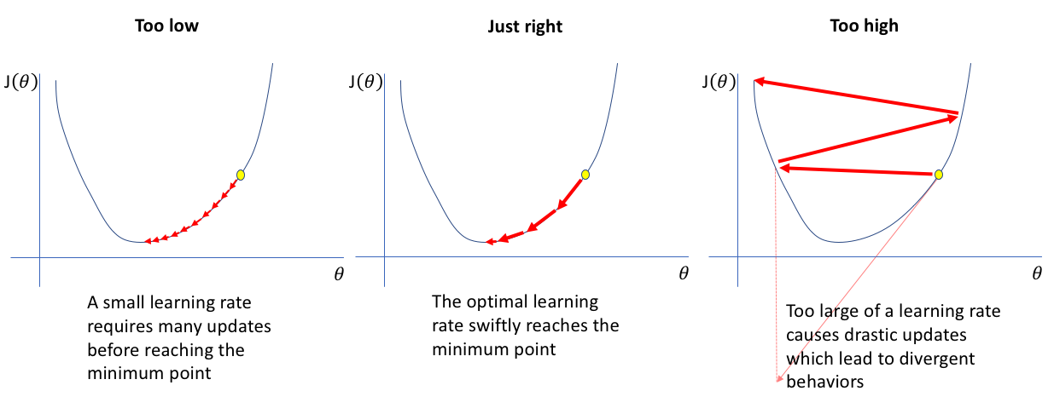
What is happening under the hood?
The model has a built in function to measure its accuracy to calculate the probability of words being in the same context cluster. It is penalized when it predicts the existence of words to be in a context cluster incorrectly. The function is called gradient dissent because it descends to a minimum.
The “weights” of the OLS regression are optimized to minimize error.
The model will work to minimize the cost function (penalty) by adjusting parameters itself to find the minimum amount of predicted probability error.

Slide 10
F_text2Vec

Slide 11
Word2Vec uses Deep Neural Networks
Not covered in class bc its conceptually the same but weights are gathered in a different method
https://cran.r-project.org/web/packages/word2vec/word2vec.pdf
https://blogs.rstudio.com/ai/posts/2017-12-22-word-embeddings-with-keras/

Slide 12
DNN, Synapse Stimulation
Stimulation
A stimulus is applied to a synapse

Slide 13
Synapse Activation
Activation
If the stimulus is strong enough, the synapse is “activated” & fires to the next synapse.

Slide 14
Carbon (brains) Vs Silicon (computers)
Synapse
Perceptron
X₁
w₁
Activation
Sum Weights
&
Activation Function
y
w₂
X₂
Deep learning is mimicking the architecture of the brain with pre-defined activations.

Slide 15
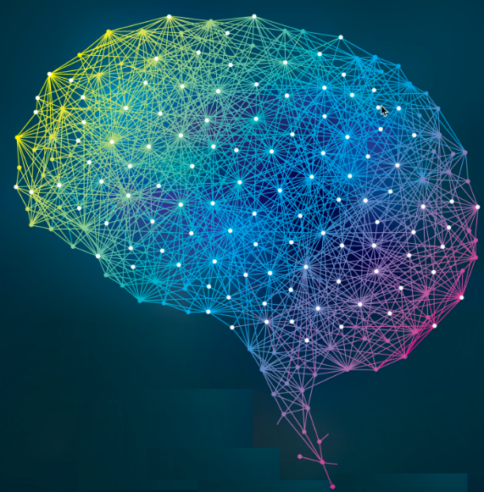
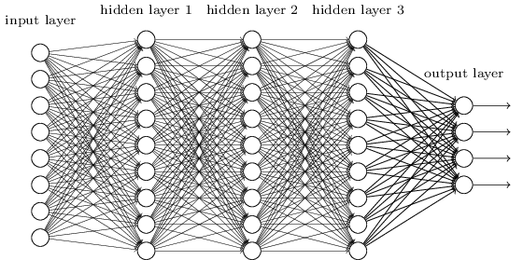
There are billions of synapses, and somewhere consciousness emerges.
A human brain has billions of networked synapses. Most DNN implementations are less than 1200 layers.
https://www.quora.com/What-is-the-largest-convolutional-neural-network-built-to-date

Slide 16

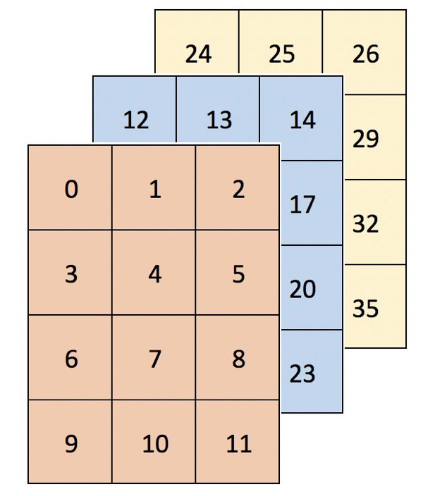
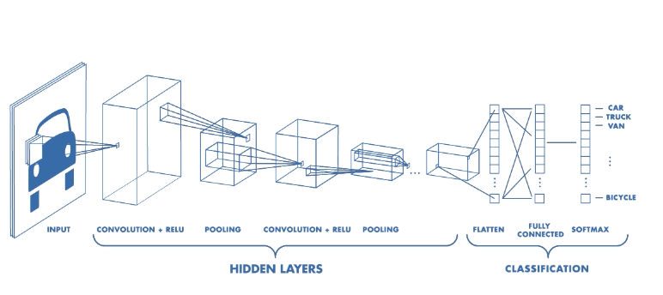
Text can be hard for DNNs
Dense Data
Each pixel has 3 RGB values.
The DNN has a lot of information to activate upon.
Text is a “sparse” data problem differing from images which is a “dense” data problem.

Slide 17
Word2Vec uses a simple “Feed Forward” DNN
A third node has another activation weight.
Term
Another node is activated by the term with a different weight.
Node is activated and carries a weight in the network.
The weights are extracted from the deep neural network as the representation of the term’s meaning.

Slide 18
Word2Vec uses a simple “Feed Forward” DNN
Node3 internal weight 0.62 = activation
Term’s “meaning” is .5, .8, .5, .62
Term
Node2 internal weight 0.5 = activation
Node0 internal weight 0.5 = activation
Node1 internal weight 0.8 = activation
The weights are extracted from the deep neural network as the representation of the term’s meaning.

