Slide 1


Incident Database CASE
CSCI E-89B Introduction to Natural Language Processing
Gordon Hew
April 1st, 2021

Slide 2
OUTLINE
Background
Objective
Data & Approach
Analysis
Conclusions

Slide 3

What are AI Incidents and why are they important?
According to the Artificial Intelligence Incident Database (AIID):
“AI incidents are events or occurrences in real life that caused or had the potential to cause physical, financial, or emotional harm to people, animals or the environment.”
-https://incidentdatabase.ai/research
AI can have unintentional and unwelcome real-world consequences:
Injustice / Inequity
Economic Loss
Death and Injury

Slide 4
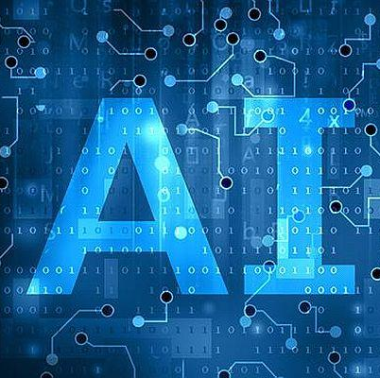
Objective
By applying NLP Techniques to the AI Incident Database data, our goals include:
Identify macro level trends in AI Incidents across time periods
Drill into interesting trends
Raise areas of concern around AI

Slide 5
Data and Approach
Data
Approach
Source: course extraction from the AI Incident Database https://incidentdatabase.ai/
Time period from 1983 – 2020
92 AI Incidents
1225 Reports
Reports consist of:
Incident ID – there can be many reports linked to a single incident
Title of the report
Source (e.g. news organization)
Body – text of the report
Divide reports into three time periods
Incidents before 2011 – Before Deep Learning and Big Data
2011 to 2015
2015 to 2020
Prepare raw data for text processing
Apply exploratory data analysis techniques:
Examine incident frequency over time
Latent Dirichlet Allocation (LDA) clustering
K-means topic clustering sentiment analysis

Slide 6
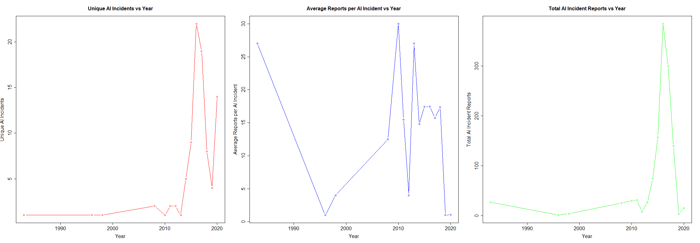
Analysis: incident and Report frequency

Slide 7

ANALYSIS: AI Incident NEWS Sources

Slide 8
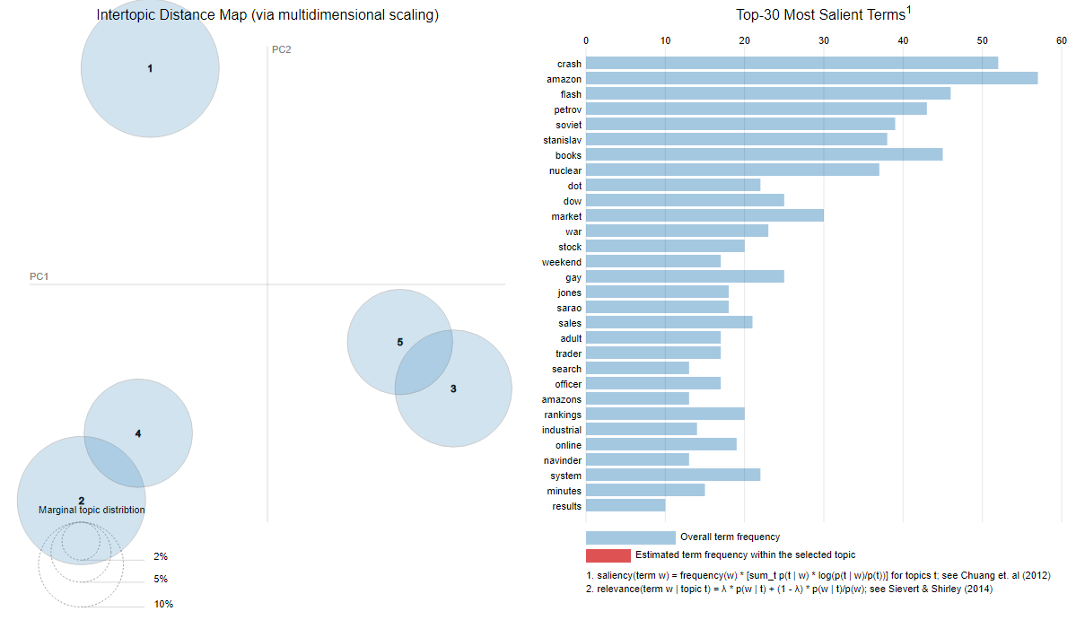
Analysis: 1983-2010 LDA Clustering analysis

Slide 9
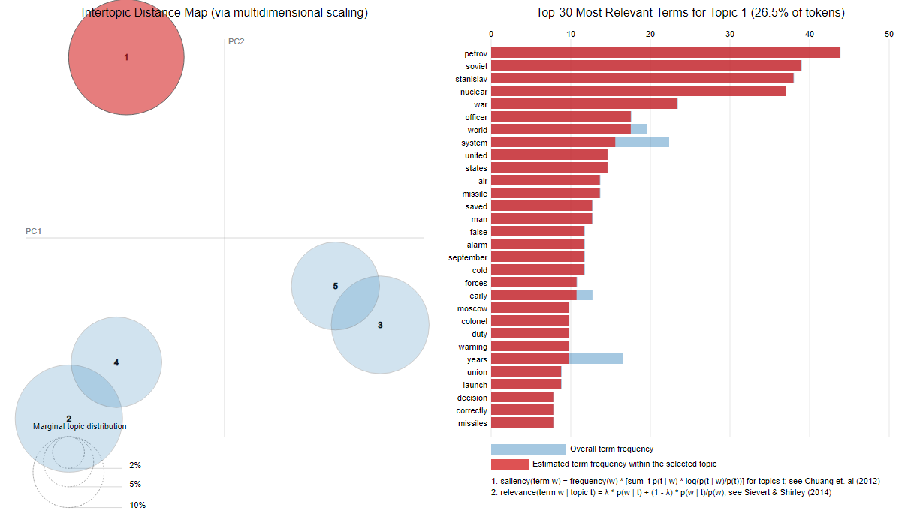
Analysis: 1983-2010 LDA Clustering analysis TOPIC 1

Slide 10
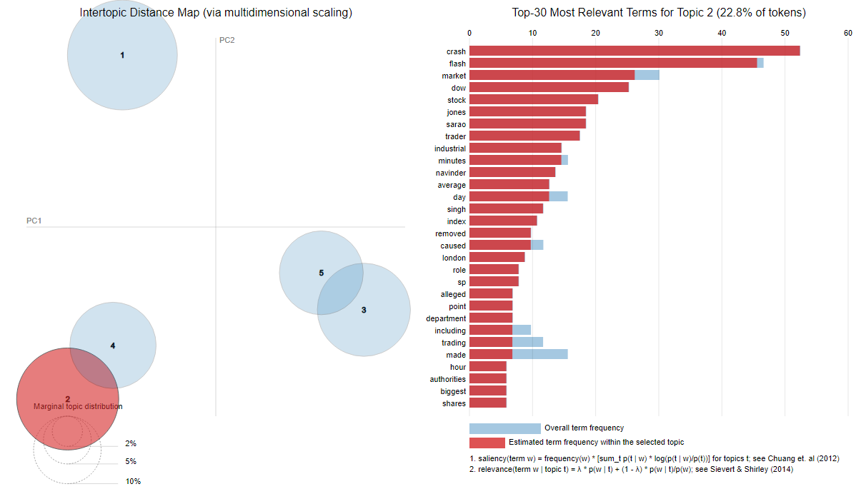
Analysis: 1983-2010 LDA Clustering analysis TOPIC 2

Slide 11
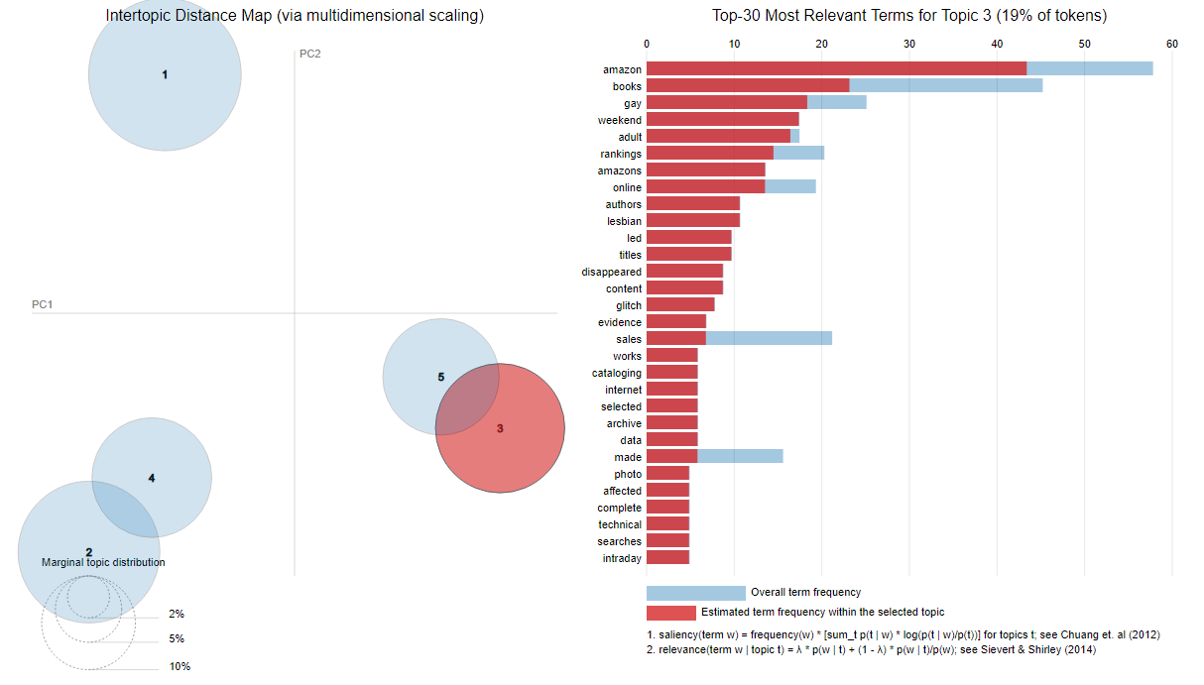
Analysis: 1983-2010 LDA Clustering analysis TOPIC 3

Slide 12
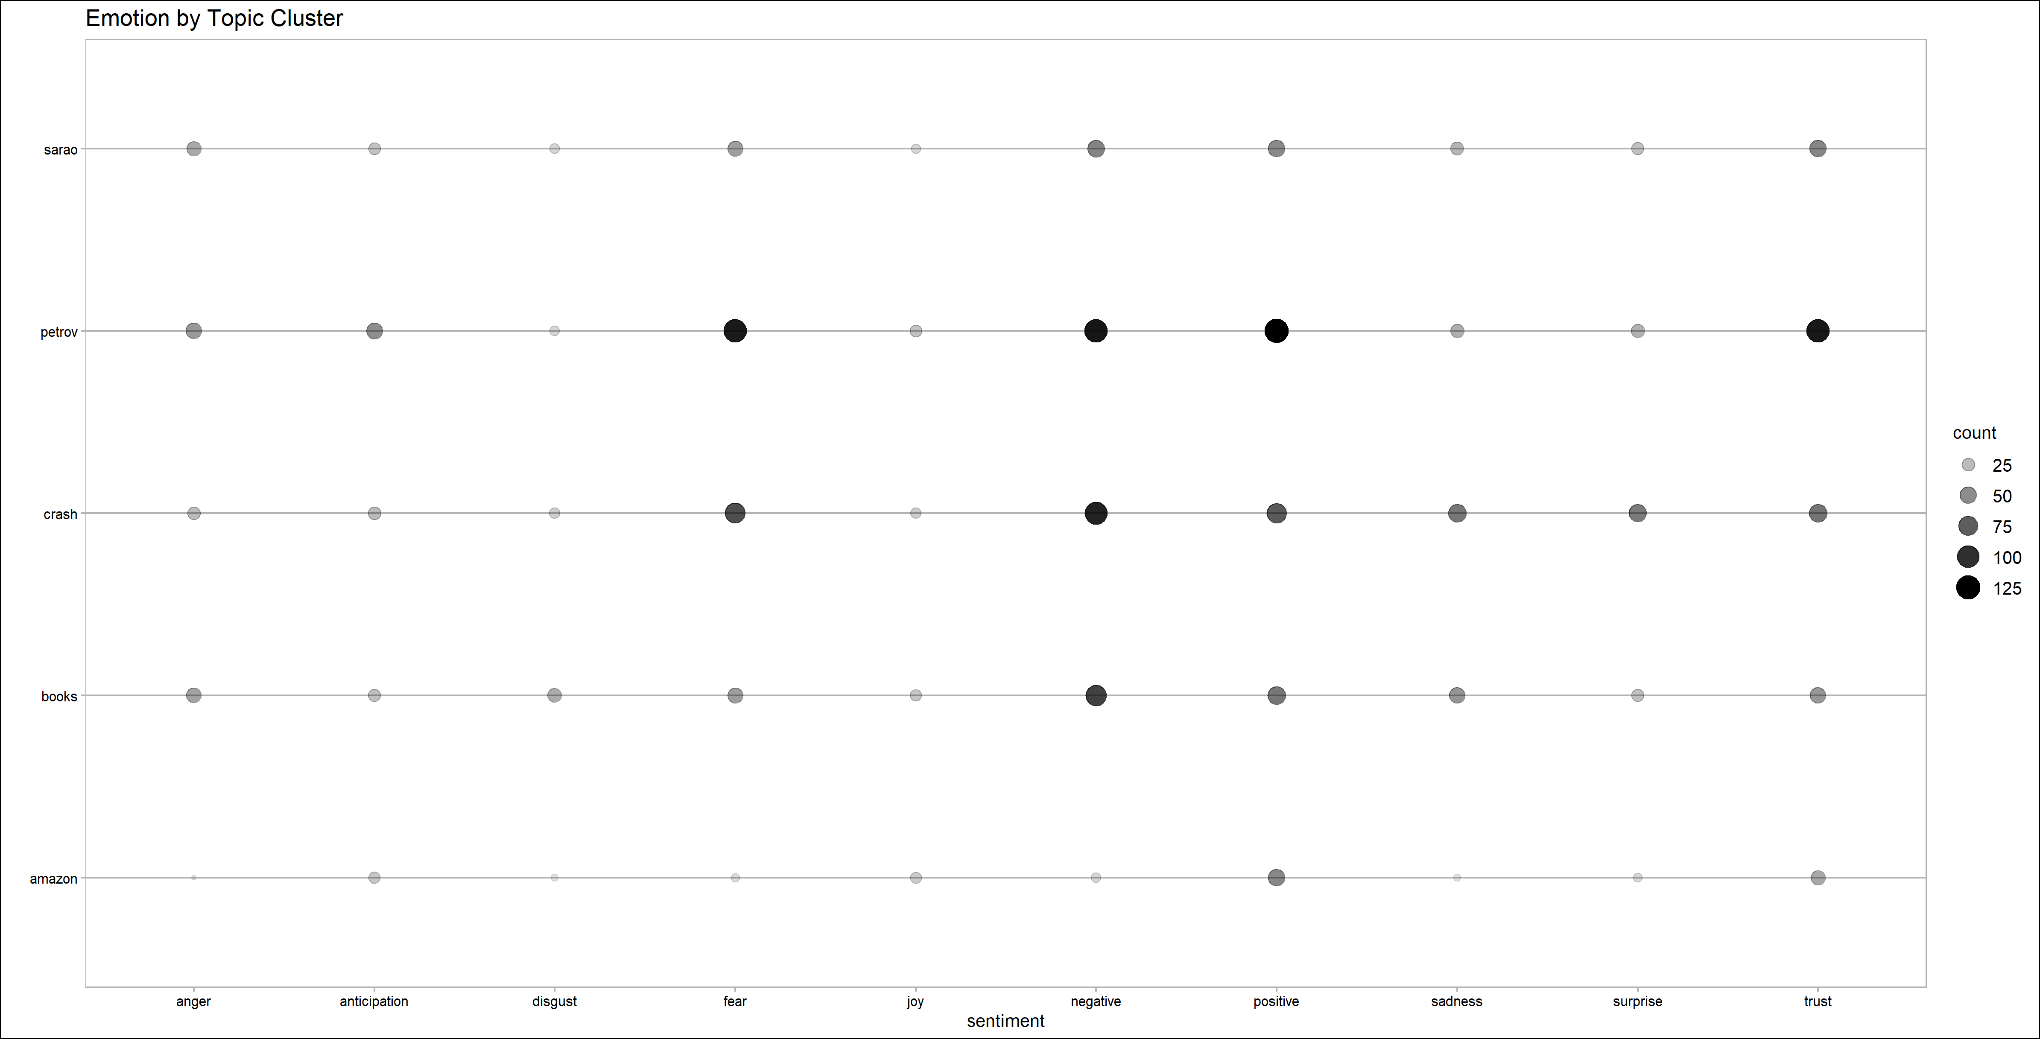
Analysis: 1983-2010 Emotion by Topic Cluster

Slide 13
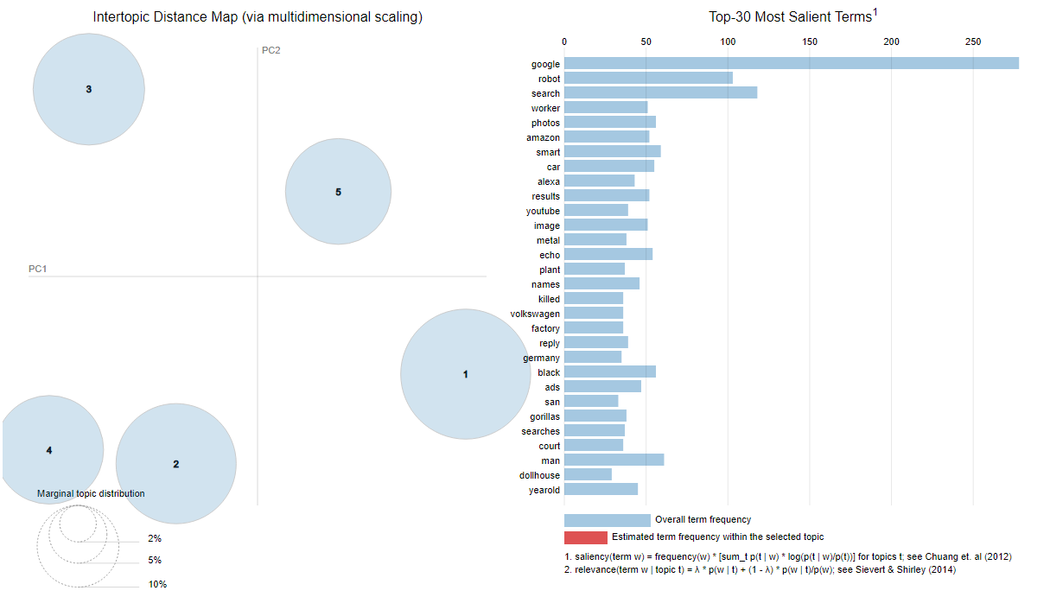
Analysis: 2010-2014 LDA Clustering analysis

Slide 14
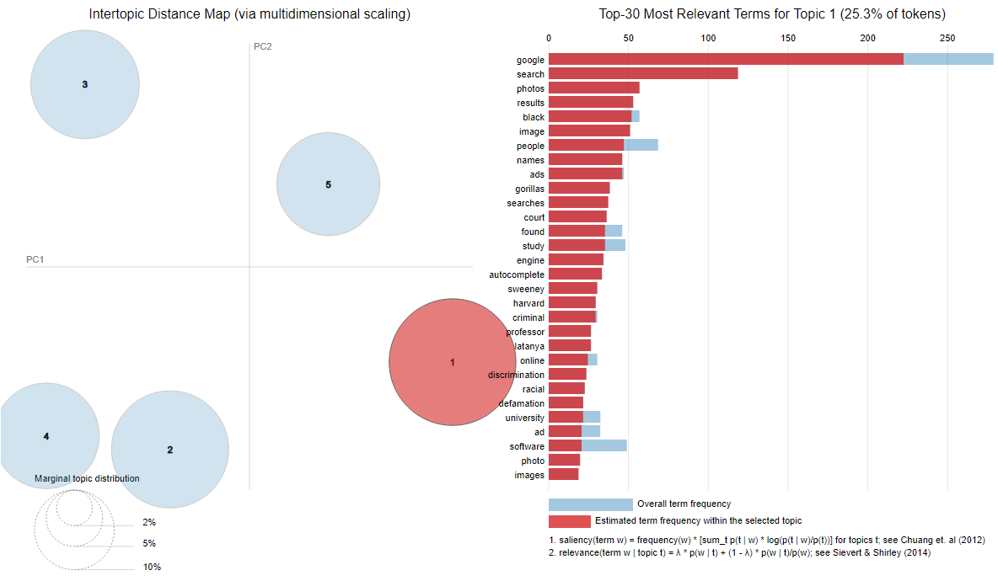
Analysis: 2010-2014 LDA Clustering analysis TOPIC 1

Slide 15
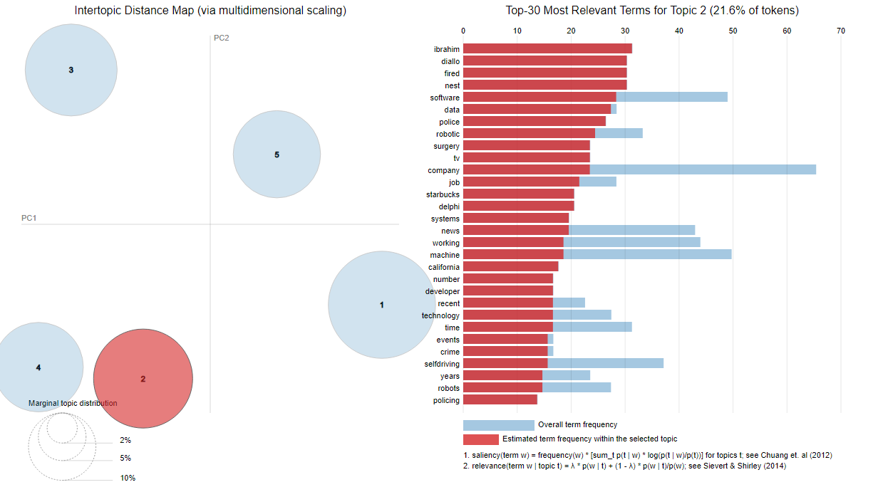
Analysis: 2010-2014 LDA Clustering analysis TOPIC 2

Slide 16
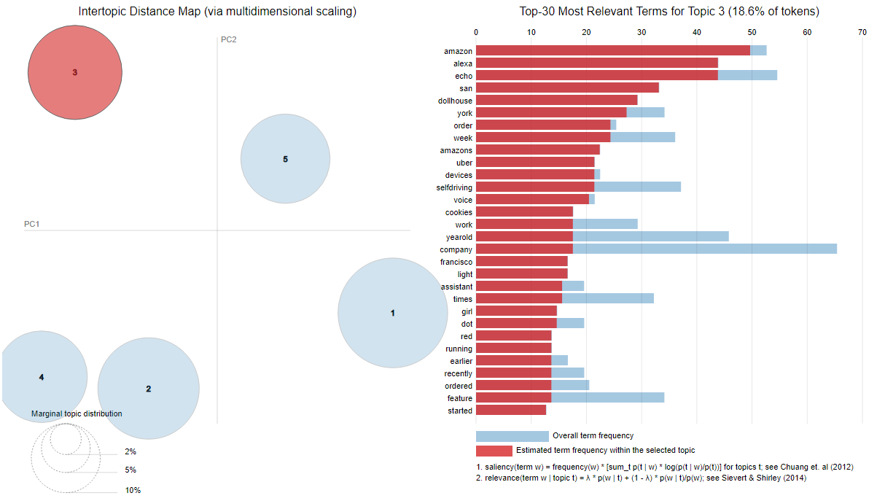
Analysis: 2010-2014 LDA Clustering analysis TOPIC 3

Slide 17
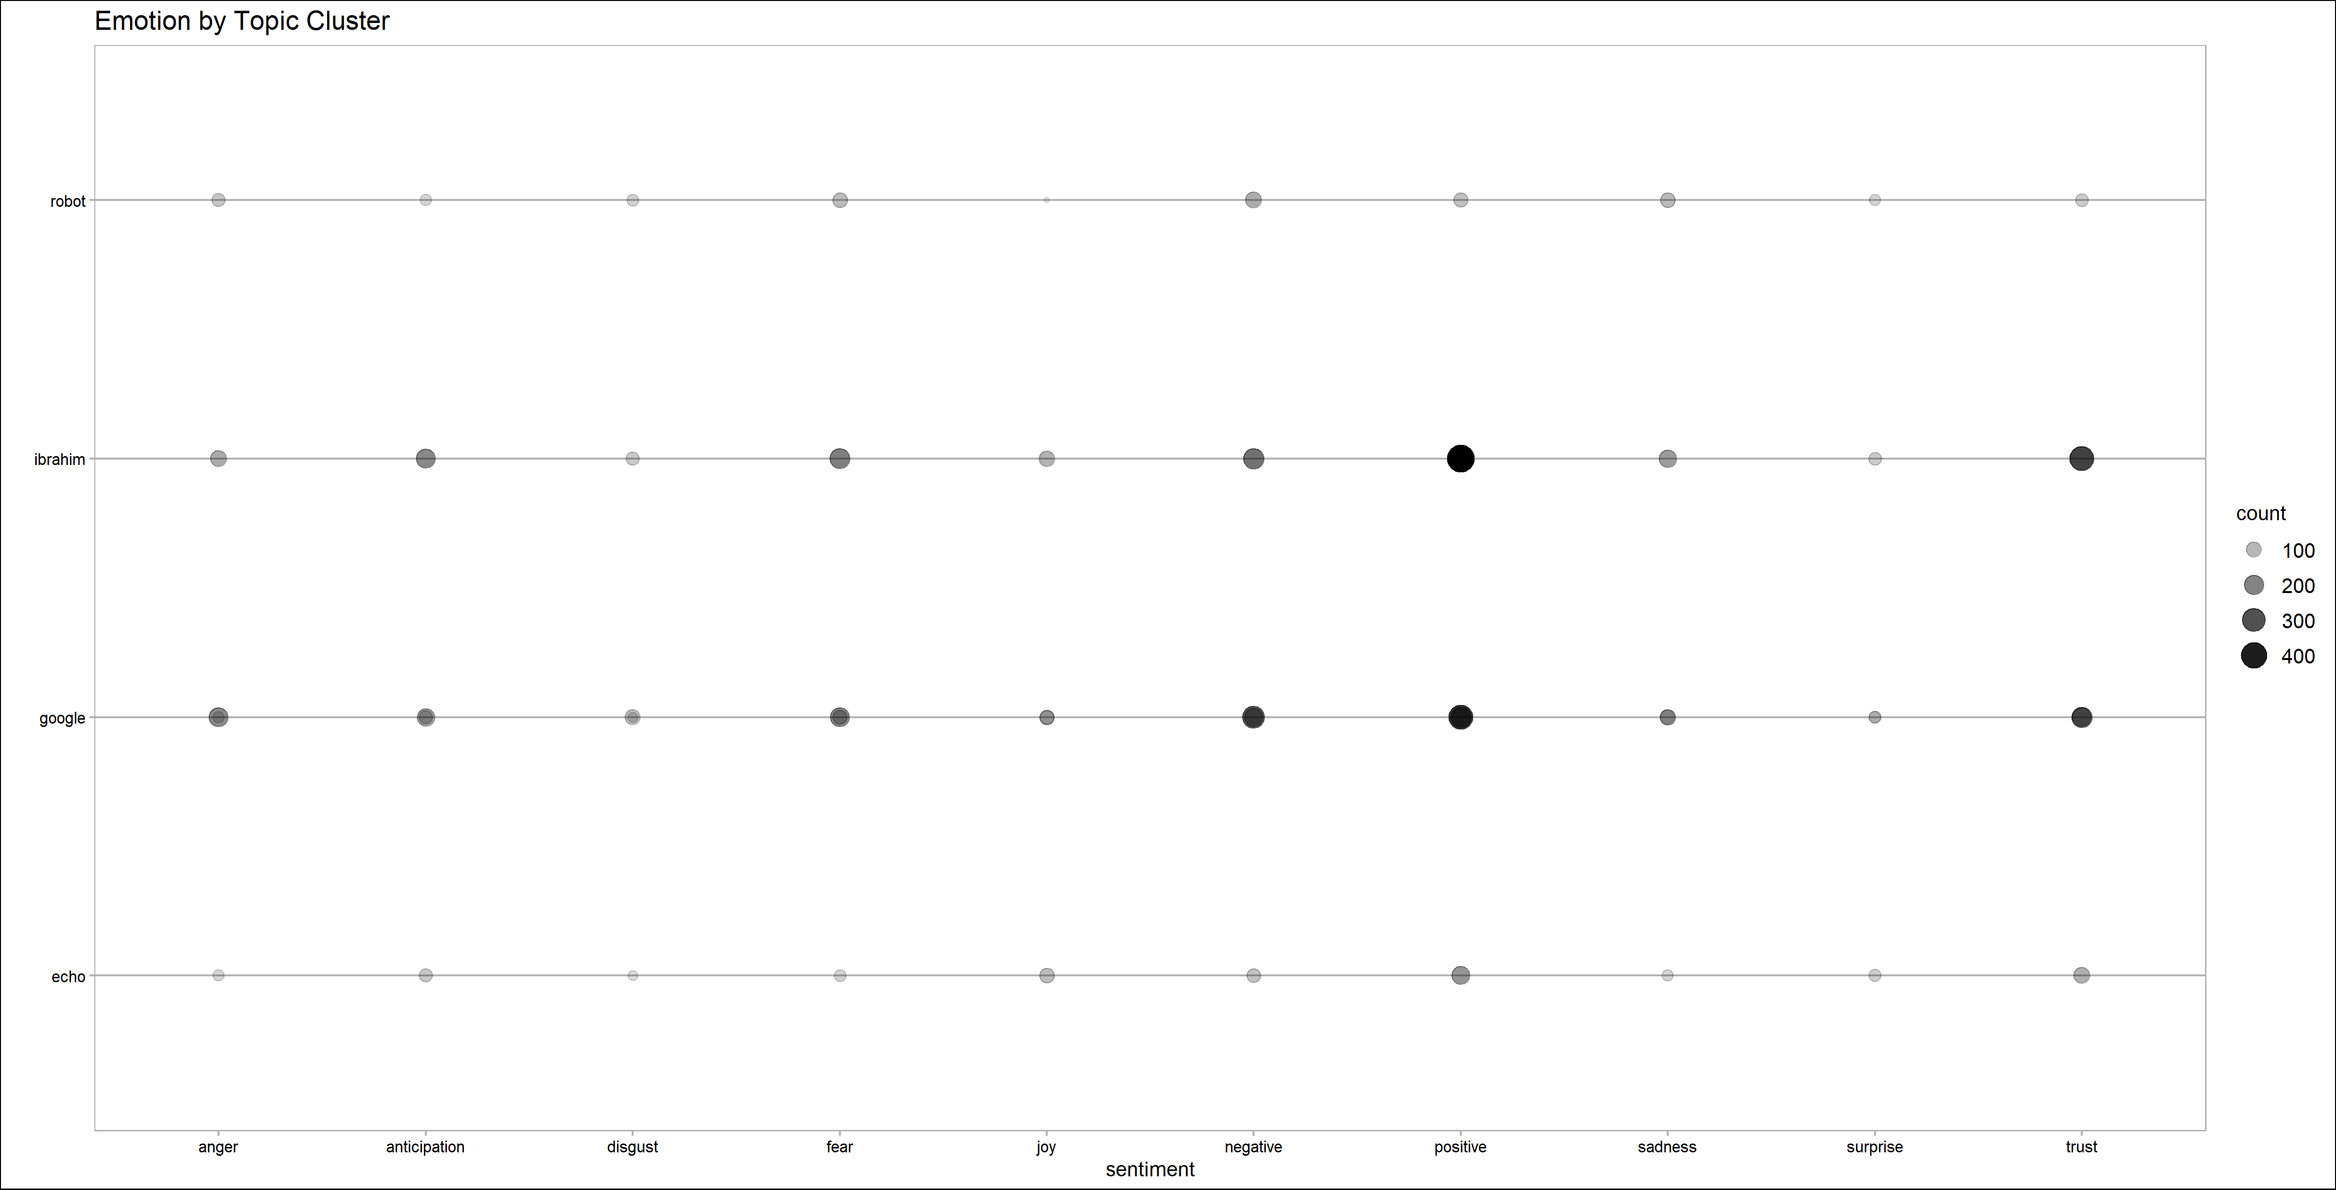
Analysis: 2010-2014 Emotion by Topic Cluster

Slide 18
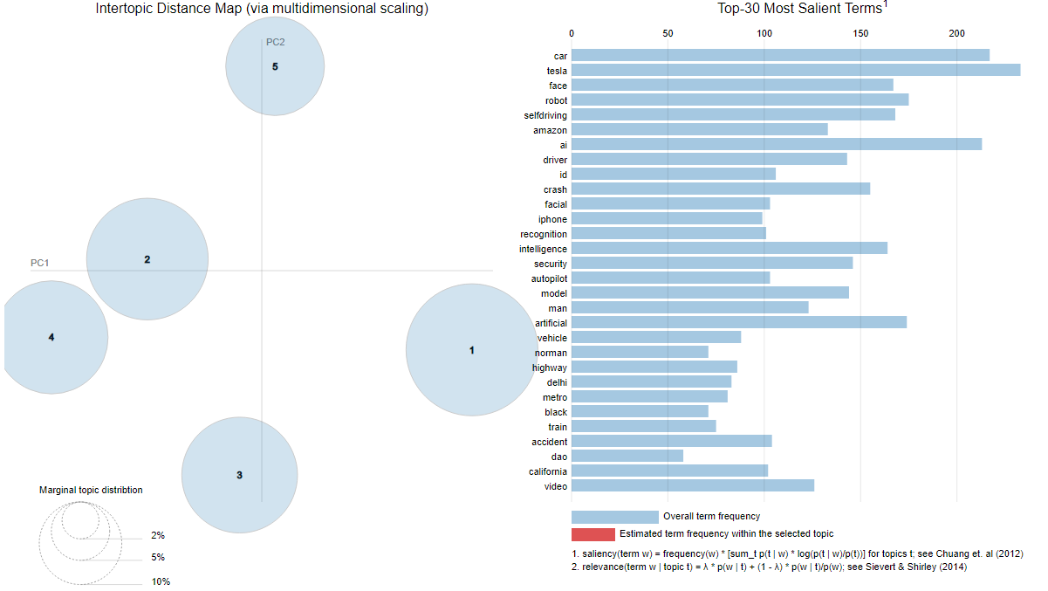
Analysis: 2015-2020 LDA Clustering analysis

Slide 19
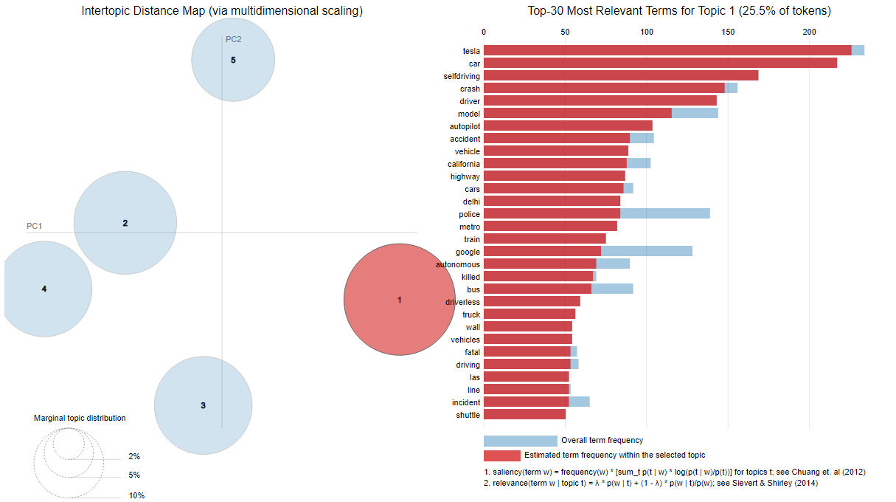
Analysis: 2015-2020 LDA Clustering analysis TOPIC 1

Slide 20
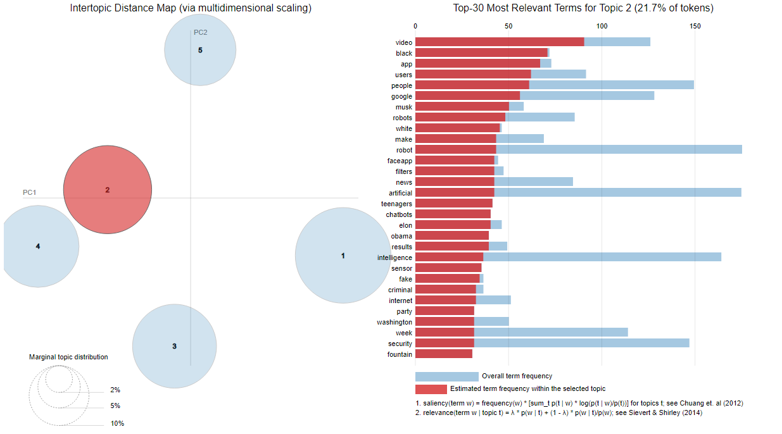
Analysis: 2015-2020 LDA Clustering analysis TOPIC 2

Slide 21
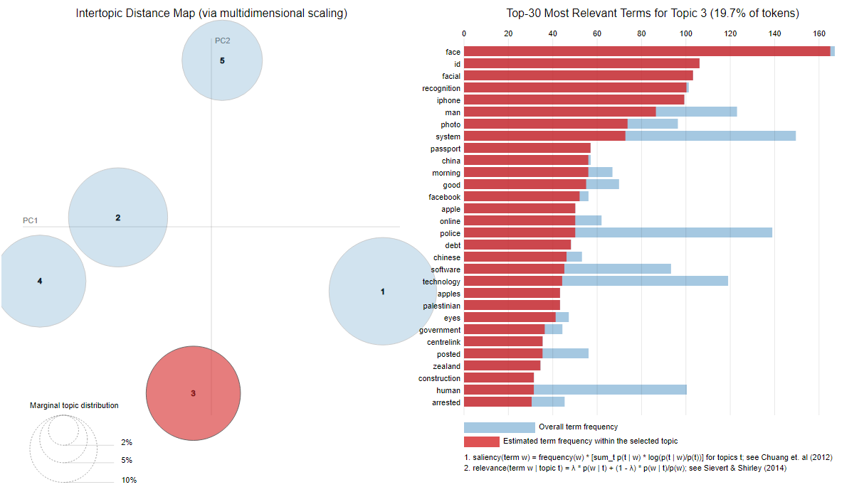
Analysis: 2015-2020 LDA Clustering analysis TOPIC 3

Slide 22
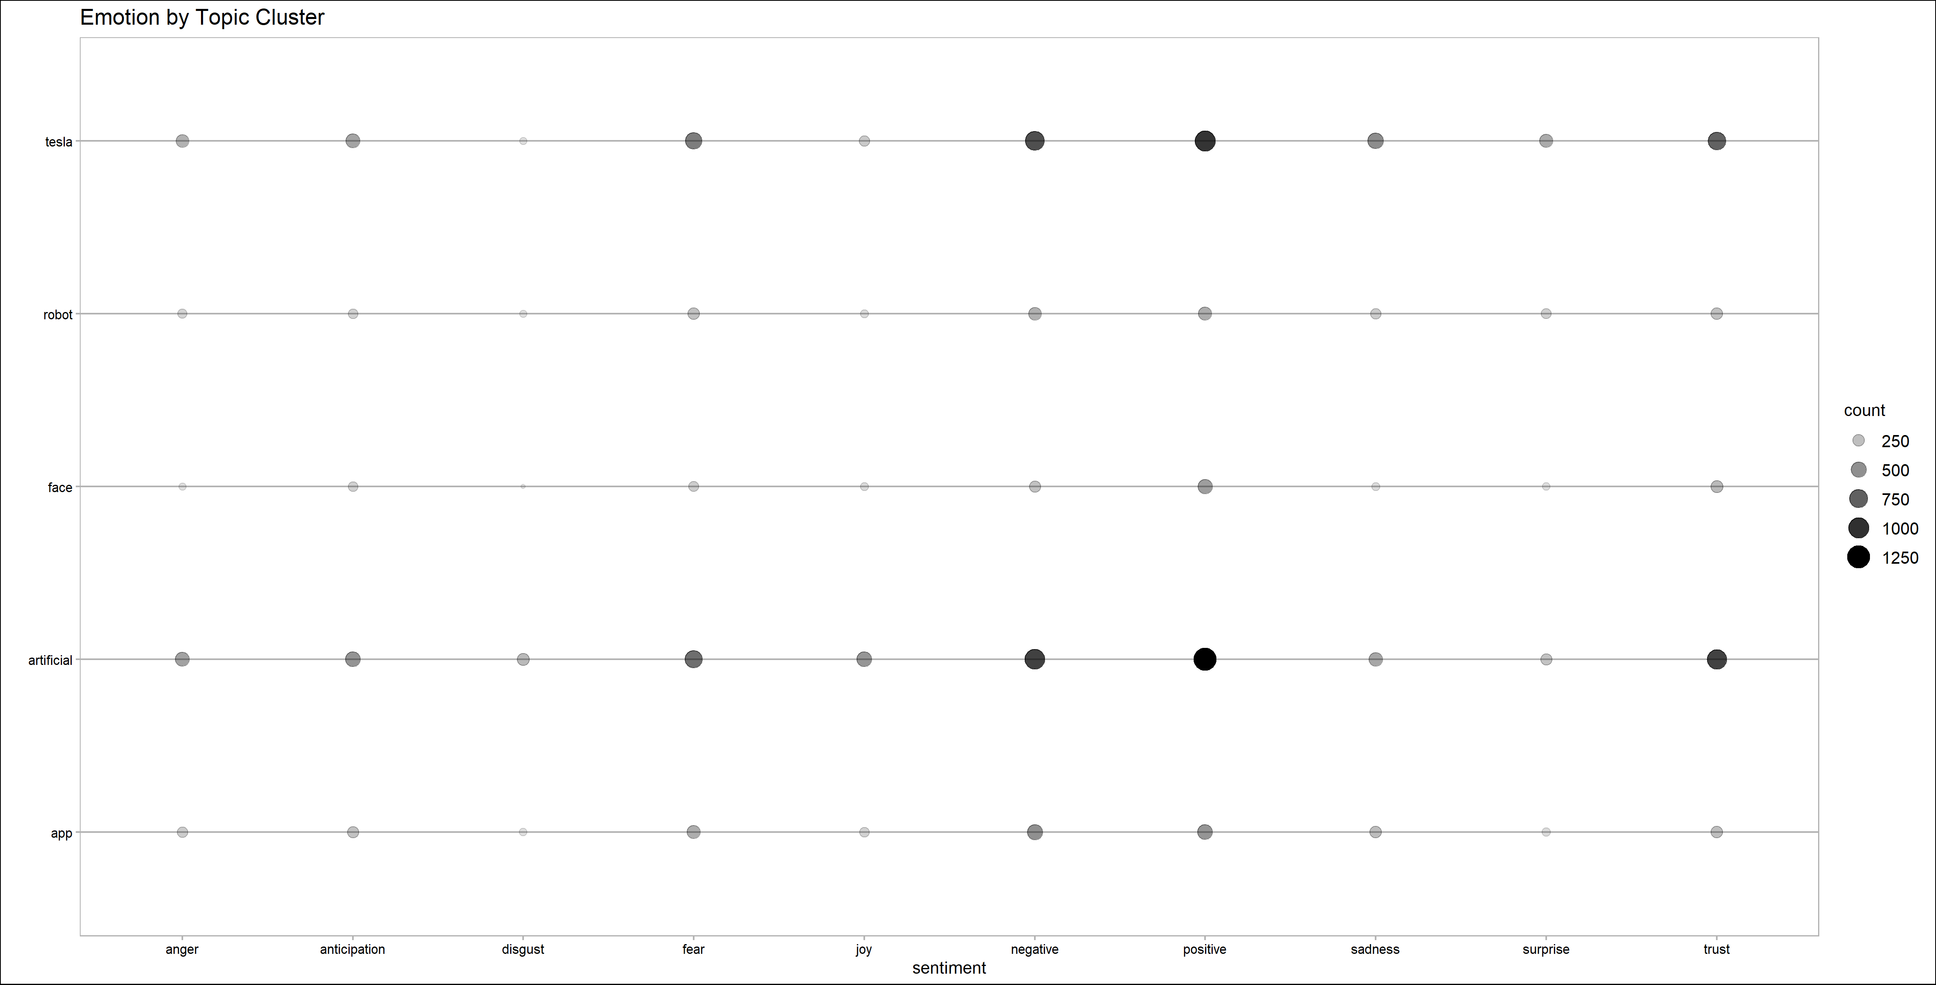
Analysis: 2015-2020 Emotion by Topic Cluster

Slide 23

Conclusions
General Trends
1983 to 2010 – Nuclear war, stock market, and Amazon
2011to 2015 – Google Search, Ibrahim?, Amazon Echo
2015 to 2020 – Tesla/Self Driving, Chatbots, Facial Recognition/Surveillance
AI and their incidents are moving away from the abstract/macro level impact to becoming interwoven into everyday life and influencing everyday decisions.
Sentiment – appears to be a mixture of positive and negative
Discussion
Expectation that AI will influence society and human behavior in increasingly intrusive yet subtle ways. Society will need to be forward looking in terms of judging what it will allow AI to do and not do on the part of the human operator.

