Slide 1
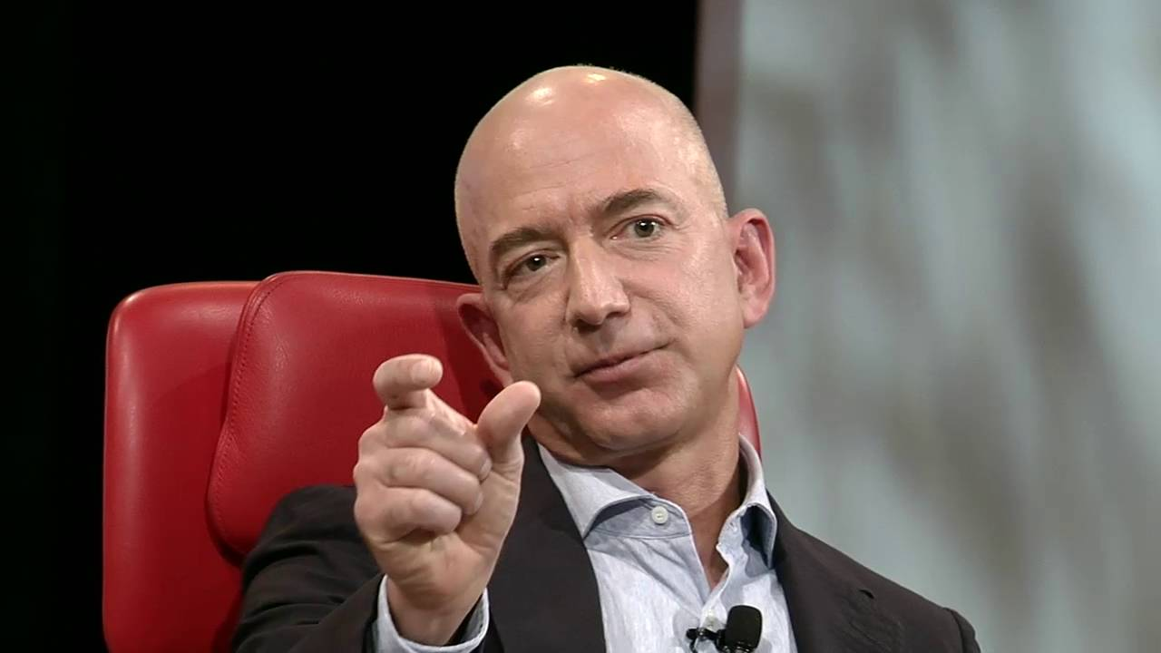
Business Example
Hey Ted I need you to service customers in social media like in an itsy bitsy tweet.
Circa Q4 2011

Slide 2
Business Example
Also, there are marketing, legal & tax risks. Do it in 12 channels in 10 months. Good luck with that.

Slide 3
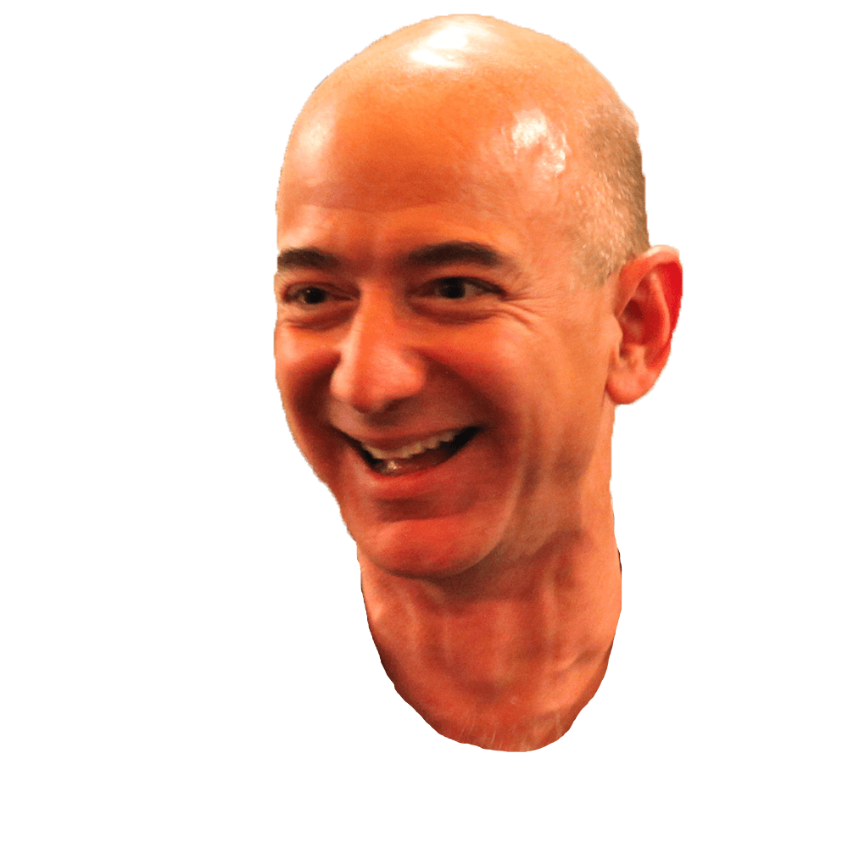
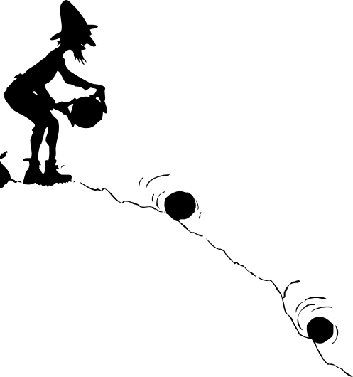

The dreaded question mark rolling downhill.
?
?
?

Slide 4
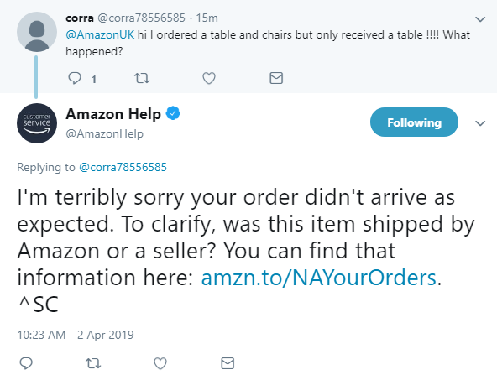
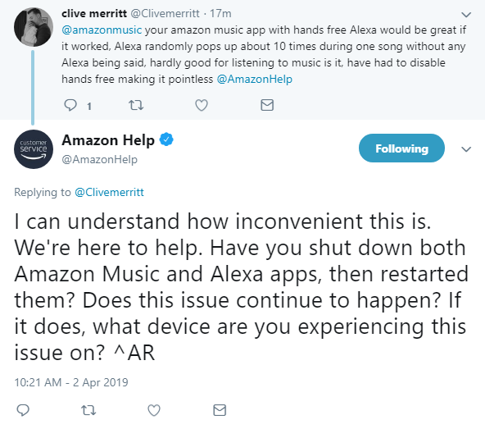
Example Complaints & Responses

Slide 5
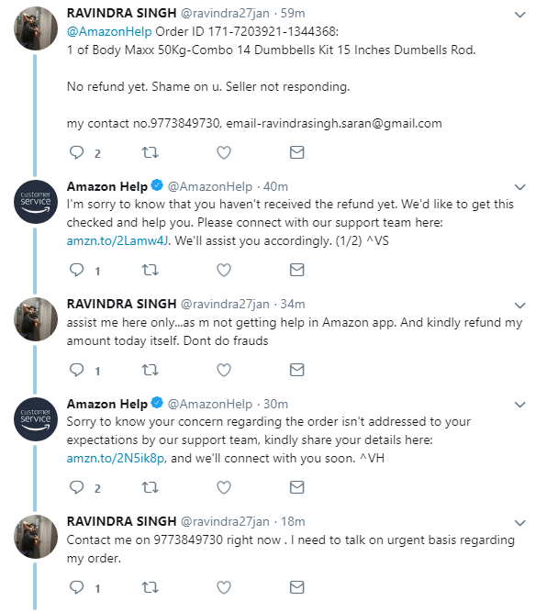
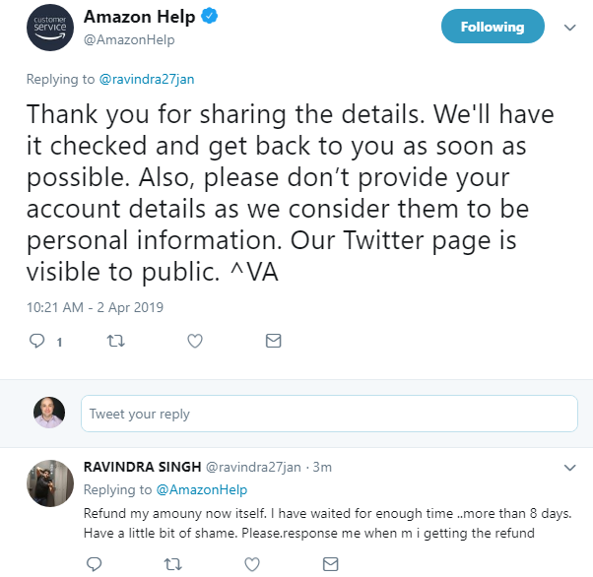
A more lengthy & public conversation!

Slide 6
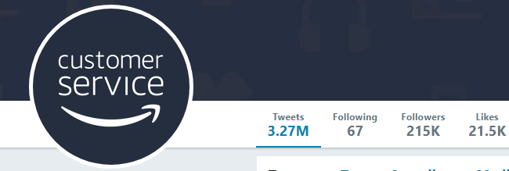
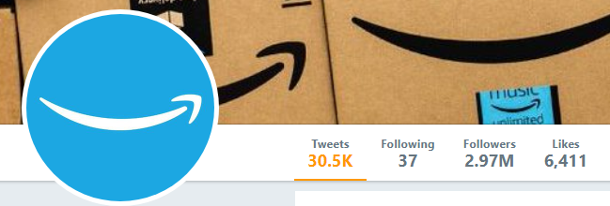
Customer Service Tweets were varied.
In 2012 #amazon was mentioned 20m times per month
Amazon Customer Service (success class) is embedded
Amazon rainforest
Amazon river
Amazon positive feedback (no need to respond)
Amazon “piggy backs” (“our product is available on amazon”)
Amazon customer service (need to identify & respond)

Slide 7
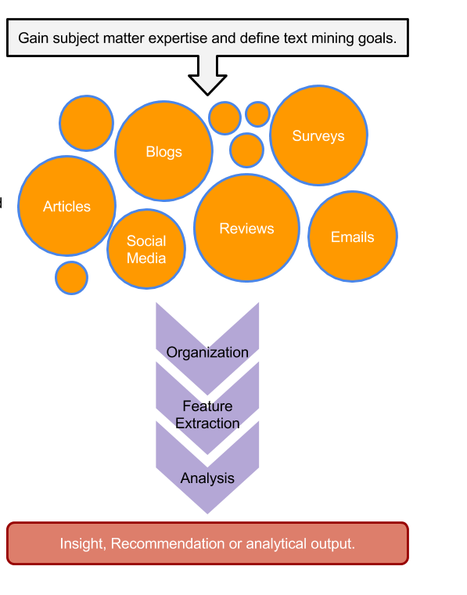
Unorganized State
Natural Language Processing & Analysis
Organized State

Slide 8


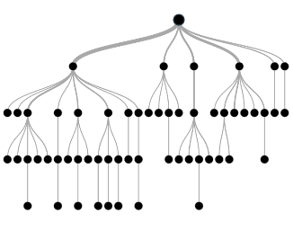
Amazon to the rescue!
amazon where is my stuff?
Unorganized State
Save the amazon!
Natural Language Processing & Analysis
Unigram, bigram, trigram
DTM modeling matrices
Organized State
Prob. of Customer Service Related

