Slide 1
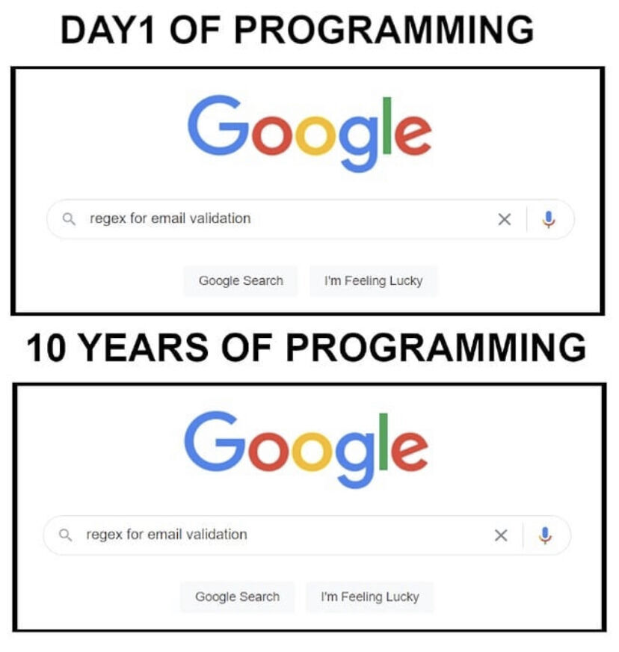

Slide 2
Getting a Word Frequency Matrix
beerFreq<-colSums(beerDTMm)
beerFreq<-data.frame(word=names(beerFreq),frequency=beerFreq)
Document Term Matrix
Word Frequency Matrix
 | Term1 | Term2 | Term3 | … | Term_n
Tweet1 | 0 | 1 | 1 | 0 | 0
Tweet2 | 0 | 1 | 0 | 0 | 0
Tweet3 | 0 | 0 | 0 | 3 | 0
… | 0 | 0 | 0 | 1 | 1
Tweet_n | 0 | 0 | 0 | 1 | 0
word | freq
Term1 | 0
Term2 | 2
Term3 | 3
… | 5
Term_n | 2

Slide 3
Open A_text_organization_REVIEW.R
Learning Objective: Review text cleaning, organization and the word frequency matrix.

Slide 4
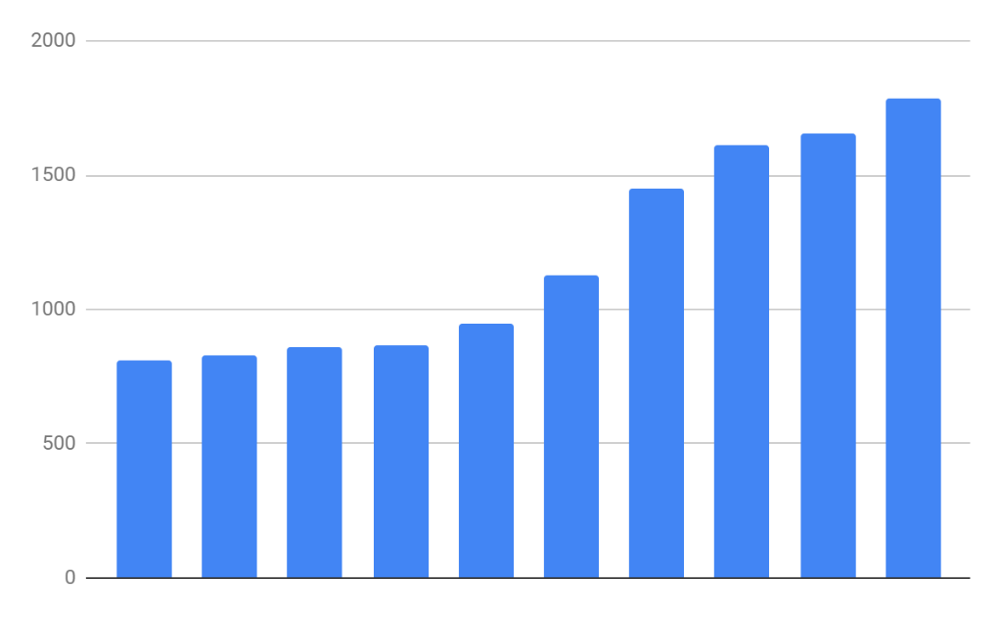
Basic Bar Charts
Rectangles are representative of frequency of term
Word Frequency Matrix
word | freq
Term1 | 0
Term2 | 2
Term3 | 3
… | 5
Term_n | 2

Slide 5
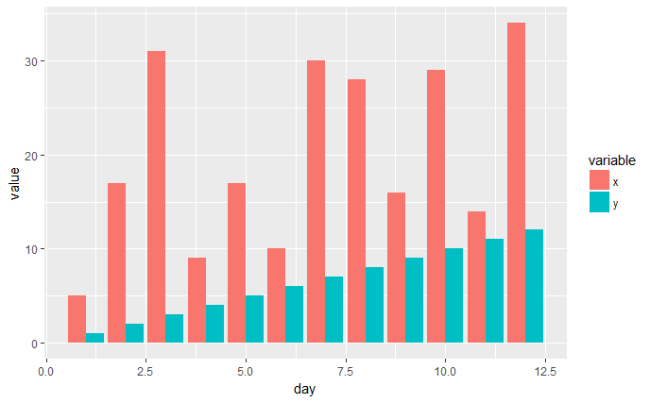
Side by Side Charts
Side by Side bar charts let you compare frequency by categoryx
You could compare two corpora but the frequency (document lengths) may make this view hard to interpret.

Slide 6
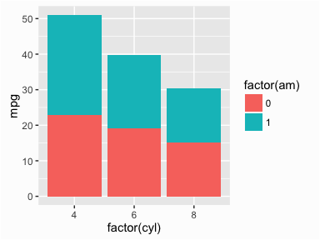
Stacked Bar Charts
Stacked bar charts lets you compare proportion within a category
This is a tough view for text because of lexical diversity and document length could impact readability.

Slide 7
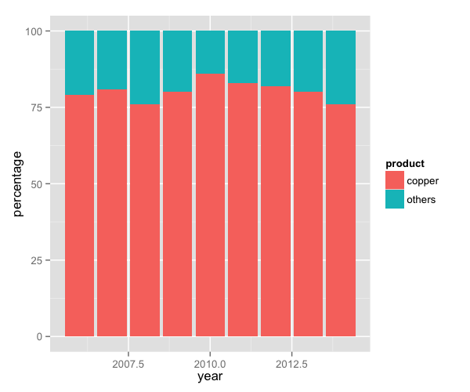
Proportional Stacked Bar Charts
Proportional stacked bar charts let you compare proportion across categories
When corpora are different length, you could make the stacked bars proportional by to terms.

Slide 8
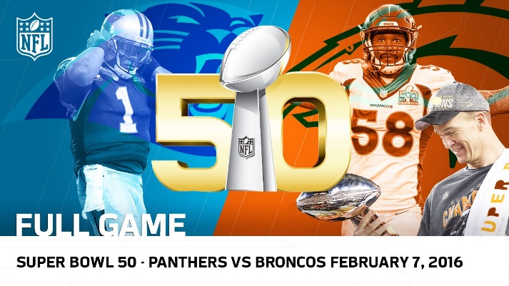
What frequency distribution should we expect?
Many words in natural language but also a steep decline in actual usage. Follows a predictable pattern.
Generally separate bars are more straightforward.

Slide 9
Top 100 terms
This predictable pattern is called “Zipf’s Law”

Slide 10
Zipf’s Law is observed in human behavior
Population density often falls into this type of distribution
Swiss Cities
UK Cities

Slide 11
Zipf’s Law is observed in business
Many industries become natural monopolies. Without this natural maturing the industry is hyper competitive “Coke vs Pepsi”
Insurance - 2016 Direct Premiums Written ($)
Tech – 2018 US Cloud Compute Mkt Share
https://www.insure.com/car-insurance/largest-auto-insurance-companies-by-market-share.html
https://www.canalys.com/newsroom/cloud-market-share-q4-2018-and-full-year-2018

Slide 12
Zipf’s Law: The frequency of a word is inversely related to its rank in a word frequency matrix.
In language this means we should expect coming words to dominate.
Observation or Word A appears N times
Word B is expected to appear N/2
Word C is expected to appear N/3
Word D is expected to appear N/4
…
…
Term Rank
https://www.worlddata.info/average-income.php

Slide 13
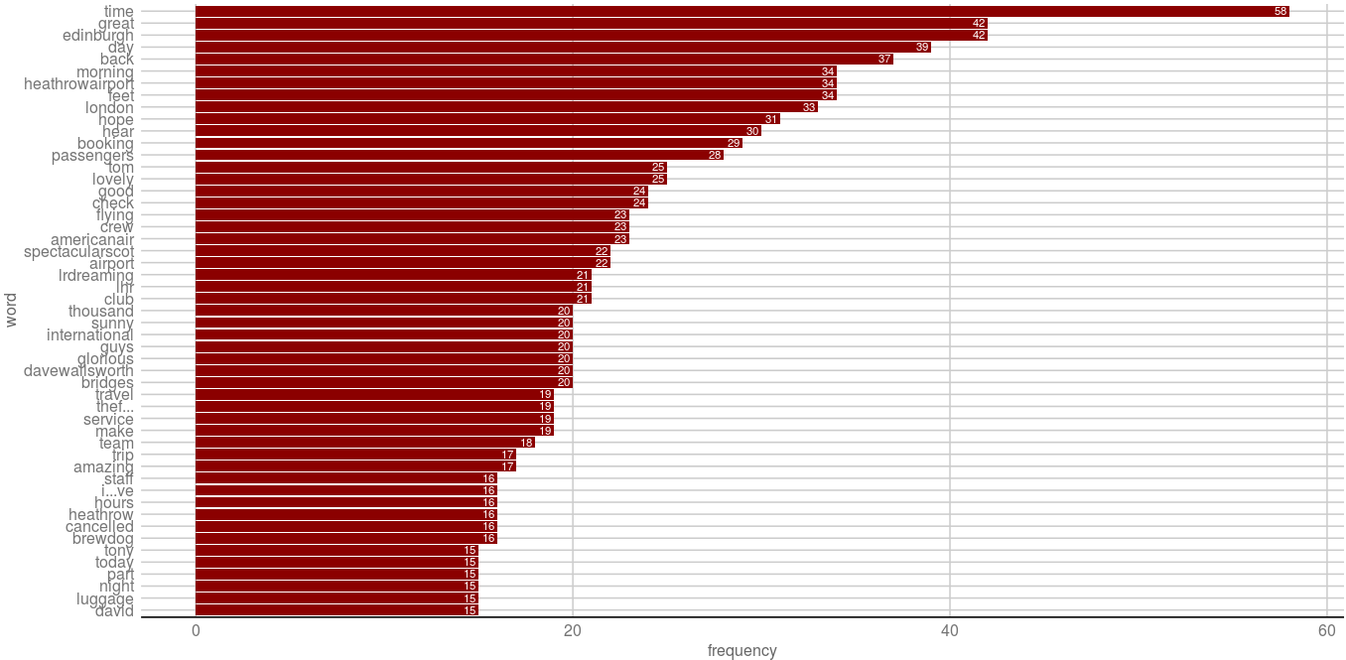
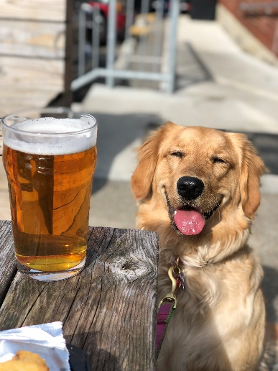
Open B_Frequency_Associations.R
Visualizing the WFM
Brewdog?! Let’s investigate

Slide 14
BrewDog!! Word Association
Tuning Parameter: Adjust 0.30 to get the terms that are associated .30 or more with the unexpected term terms.
# Inspect word associations
associations<-findAssocs(beerTDM, 'brewdog', 0.30)
Any word that appears at least 30% of the time with “brewdog” in document will be returned.
Word Association is like correlation. Unlike correlation, terms can only be positively associated. This is because there are so many terms that most everything would be negatively “correlated” ( actually associated).

Slide 15
Brewdog!! Word Association
Changing terms into factors lets ggplot2 order them
# Make a dot plot
assocDF <- data.frame(terms=names(associations[[1]]),
value=unlist(associations))
assocDF$terms <- factor(assocDF $terms, levels= assocDF $terms)
ggplot(assocDF, aes(y=terms)) +
geom_point(aes(x=value), data=assocDF, col='#c00c00') +
theme_gdocs() +
geom_text(aes(x=value,label=value),
colour="red",hjust="inward", vjust ="inward" , size=3)

Slide 16
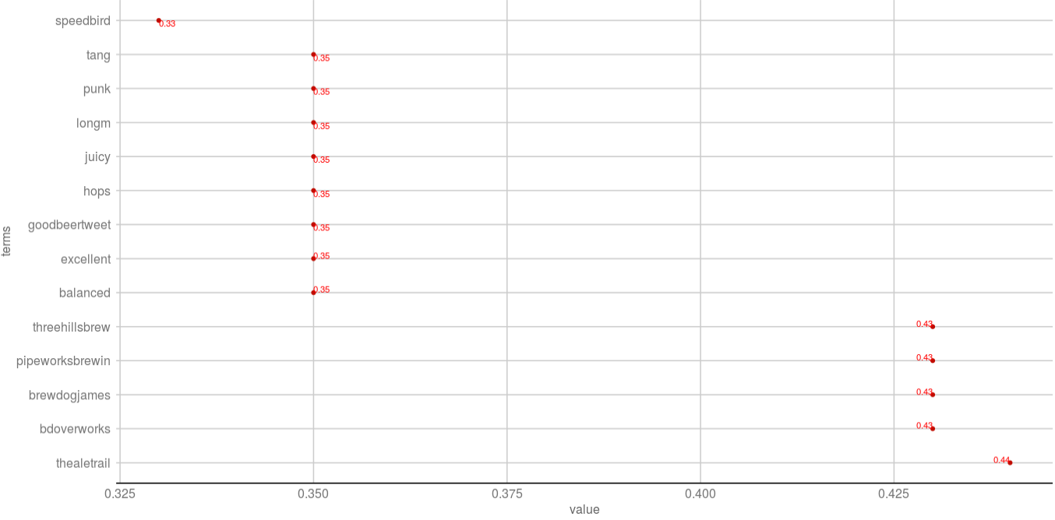

Back to B_Frequency_Associations.R
“thealetrail” has the highest word association with “brewdog”
@TheAleTrail: Worth the wait. This is excellent. @brewdog @British_Airways #Speedbird100 balanced juicy hops with a tang of bitterness…

Slide 17
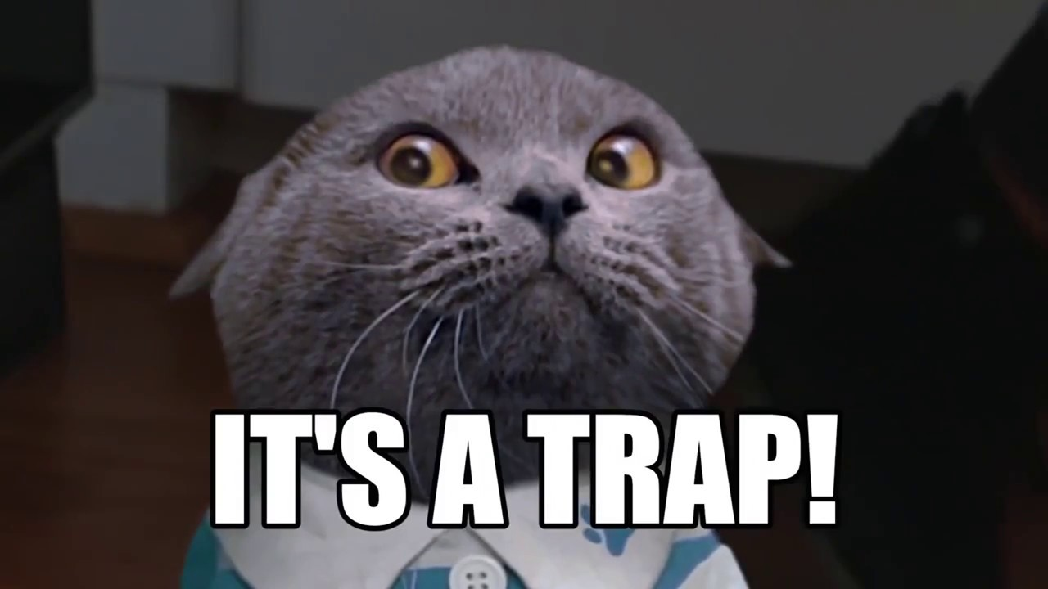
Association is NOT frequency.
“brewdog” appears 16 times
“thealetrail” is the most associated term
“thealetrail” appears 5 times. There are other, more numerous terms that appear in the corpus but just less often with “brewdog”

