Slide 1
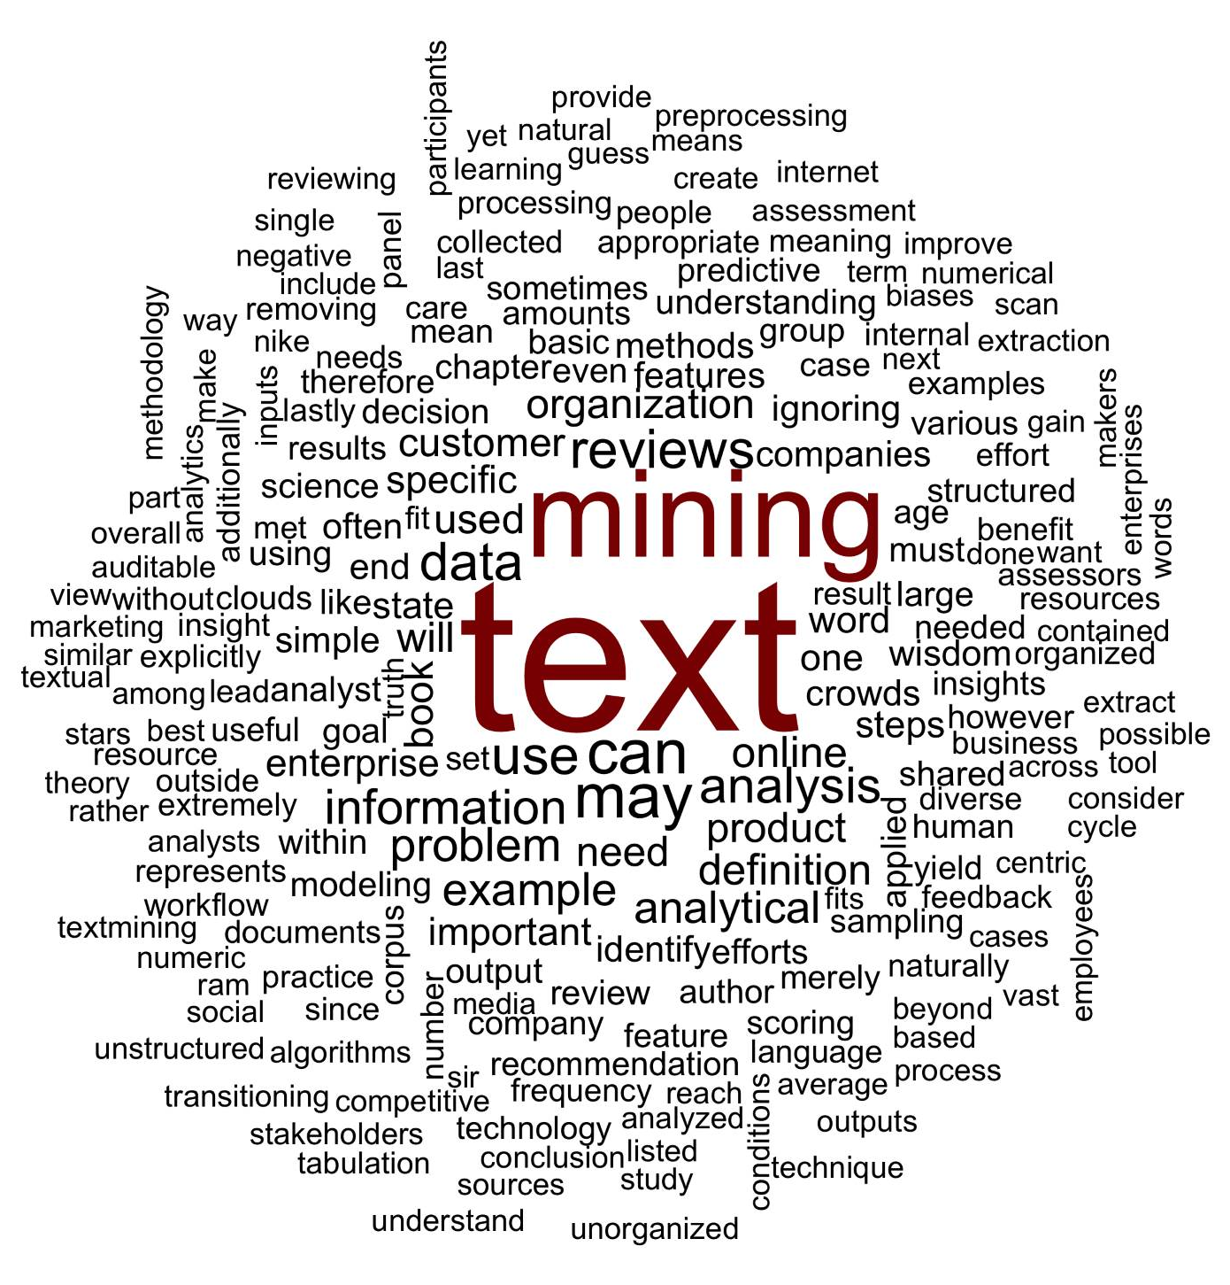
What is a word cloud?
Maligned and overused, a word cloud is a frequency visualization.

Slide 2

Unigram Tokenization
Thus far, we have performed unigram tokenization of terms.
“Text mining is so fun. So do text mining!
*with common stopwords

Slide 3
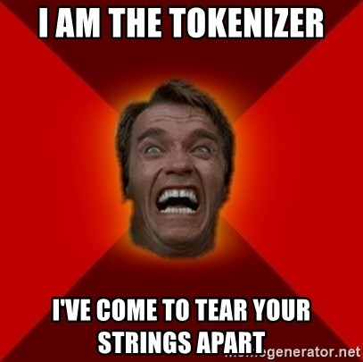
Changing Tokenization Schema
First create a function defining tokenization then add as a control parameter to TDM or DTM.
Within R
#bigram token maker
bigramTokens <-function(x)
unlist(lapply(NLP::ngrams(words(x), 2), paste, collapse = " "), use.names = FALSE)
wineTDM<-TermDocumentMatrix(txtCorpus, control=list(tokenize=bigramTokens))

Slide 4
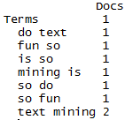
Tokenization is the process of chopping up a string into predefined units called tokens.
Now the TDM has two terms instead of one.
“Text mining is so fun. So do text mining!
#bigram token maker
bigramTokens <-function(x)
unlist(lapply(NLP::ngrams(words(x), 2), paste, collapse = " "), use.names = FALSE)
wineTDM<-TermDocumentMatrix(txtCorpus, control=list(tokenize=bigramTokens))

Slide 5
To make a wordcloud start with a WFM
# Get Row Sums & organize
wineTDMv <- sort(rowSums(wineTDMm), decreasing = TRUE)
wineDF <- data.frame(word = names(wineTDMv), freq = wineTDMv)
Term Document Matrix
Word Freq Matrix
 | Tweet1 | Tweet2 | Tweet3 | Tweet4 | … | Tweet_n
Term1 | 0 | 0 | 0 | 0 | 0 | 0
Term2 | 1 | 1 | 0 | 0 | 0 | 0
Term3 | 1 | 0 | 0 | 2 | 0 | 0
… | 0 | 0 | 3 | 0 | 1 | 1
Term_n | 0 | 0 | 0 | 1 | 1 | 0
word | freq
Term1 | 1
Term2 | 2
Term3 | 3
… | 5
Term_n | 2

Slide 6
Then sort it decreasing = TRUE
# Get Row Sums & organize
wineTDMv <- sort(rowSums(wineTDMm), decreasing = TRUE)
wineDF <- data.frame(word = names(wineTDMv), freq = wineTDMv)
word | freq
Term1 | 1
Term2 | 2
Term3 | 3
… | 5
Term_n | 2
word | freq
… | 5
Term3 | 3
Term2 | 2
Term_n | 2
Term1 | 1

Slide 7
Setting a pre-made color palette for your WC
# Review all Pallettes
display.brewer.all()
# Choose a color & drop light ones
pal <- brewer.pal(8, "Blues")
pal <- pal[-(1:2)]

Slide 8
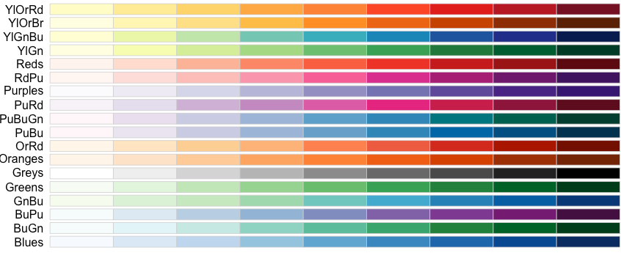
Setting a pre-made color palette for your WC
In R…

Slide 9
Let’s practice!
D_SimpleWordCloud.R

Slide 10
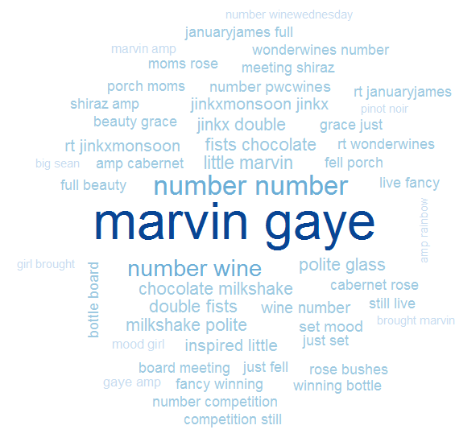
D_SimpleWordCloud.R
Bigram Tokenization has captured “marvin gaye”
A word cloud is a frequency visualization. The larger the term (or bigram here) the more frequent the term.
You may get warnings if certain tokens are to large to be plotted in the graphics device.
Be careful with your preprocessing steps!

Slide 11
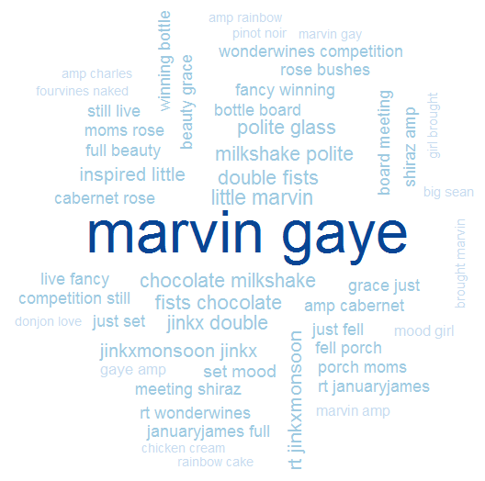
D_SimpleWordCloud.R
In cleanCorpus() the function replace_symbol() changes numeric with the generic string “number” so be careful with your preprocessing steps!

