Slide 1
STATS IMPACT
An analysis and presentation the way I used the “DATA”

Slide 2
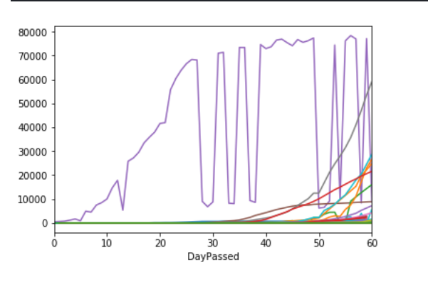
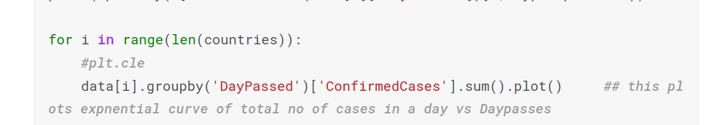
Representing original data
This is a representation of total no. of cases on a particular date for each country which hasits own unique colour.
This is to be noted that the discountinuity in data is because of lack of data or cases reported on that day as its obvious becauses no of cases can’t have such steep increase and decrease.
It can be seen as the above equation where N is no of cases in a day, W is propotionalty constant ,country specific and depends on a lot of things and T is the no. of days passed from first day of infection in that country.
***********HYPOTHESIS**********

Slide 3
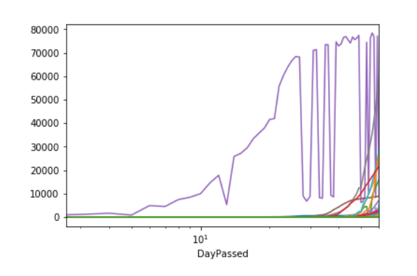
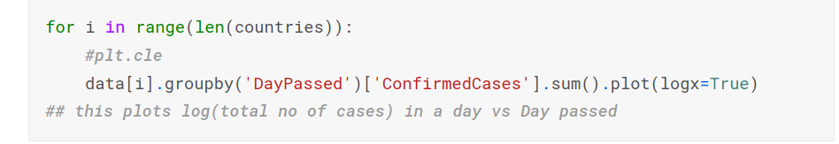
Manipulating based on Hypothesis (Applying Log on the X-Axis)
Here I have plotted log(no. Of cases ) vs Days Passed.
It can be seen if the initial pickup of each country is ignored they tend to have a constant rate.
Even Excluding some countries which had no pattern as such . The representation may look messy but plot a smaller bunch helps a lot more .
This show cases that the hypothesis is very true with no external factors interfering.

Slide 4
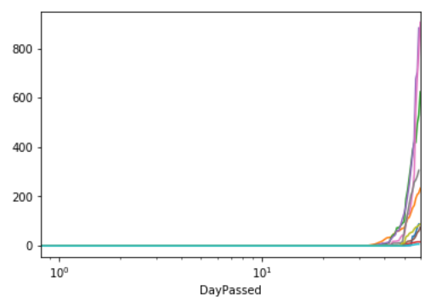
Mini Batch of The Previous Plot
This is done on a small batch of 90:100
Where it is much clearly a
Straight line
Confirming the hypothesis

Slide 5
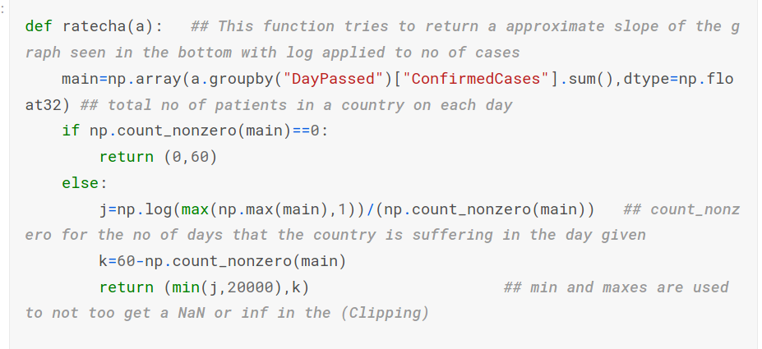
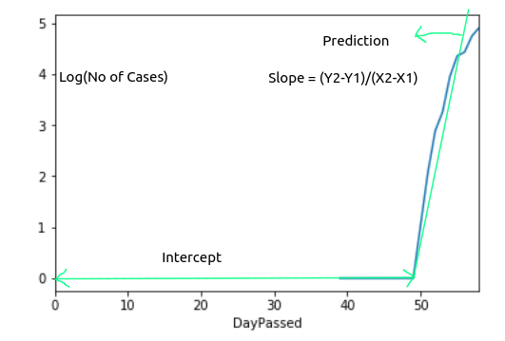
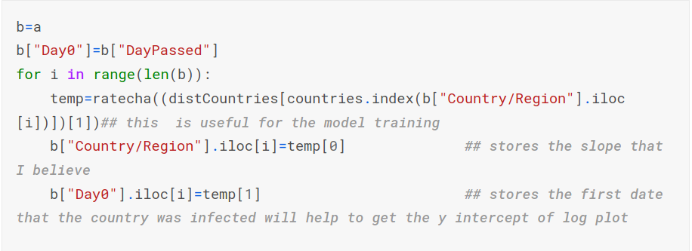
Ratecha()
I have defined a function which returns a tuple of a approximate slope of the logarithmic curve of the original which is a straight line and a y intercept.
I have used clipping as to not get NaN or inf in the data as log of zeros while return NaN and also the slope is capted at 20000 so not to get a sudden spike
Here count_nonzero returns the no of days we have had cases in that country
The intercept is just the no of days there was no cases reported so i used 60 - count_nonzero as data is only given for 60 days
Slope is calculated as
log(Maximum_no_Cases)/count_nonzero
Hence it is helpful create Extra Features

Slide 6
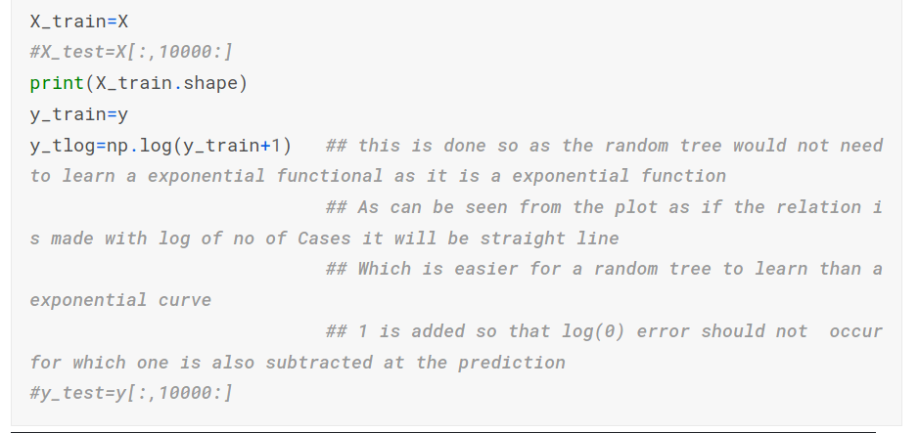
Training on log of the prediction
Here the model is trained on log of the data so the model can be simple and learn basic linear relations better, which saves a lot of computational power and also is more accurately predicted this way.
This again based on my Hypothesis.
This is to help with when the no of cases are 0 as log(0) will give NaN.
We have to remember to subtract this from the prediction we get.

Slide 7
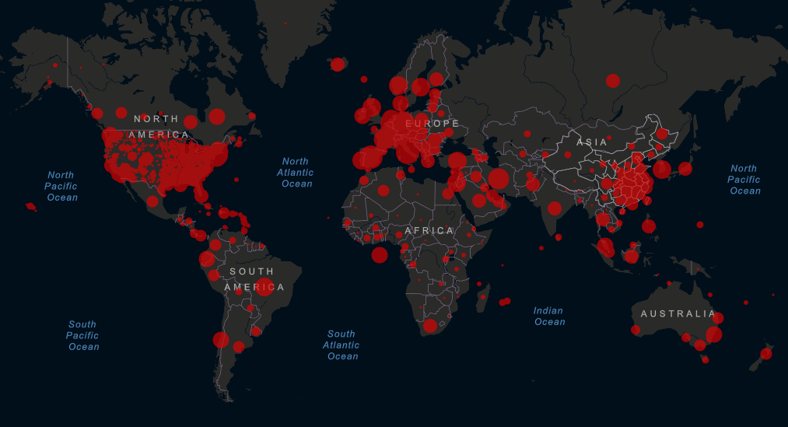
It can be there are certain hotspots around the global where the density of cases is high, So it is obvious that the density distribution can be seen to be inversely proportional to its distance from these particular places and their respective lattitude and longitude
Distance so the density distribution is the linear combination of distances from from each epicentre.
........
By using Binomial Expansion and ignoring higher order terms it will depend on
*Image Source: https://gisanddata.maps.arcgis.com/apps/opsdashboard/index.html#/bda7594740fd40299423467b48e9ecf6

Slide 8
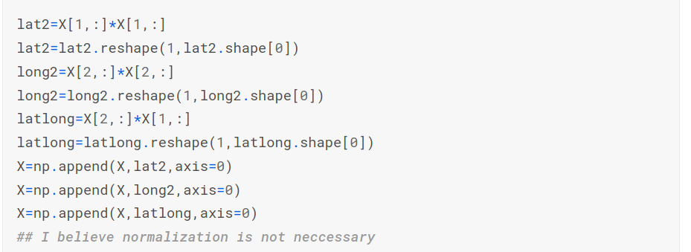
LAT2,LONG2, LATLONG
These features are added to make the corroletion more linear and easier for computation as shown in the previous slide

Slide 9
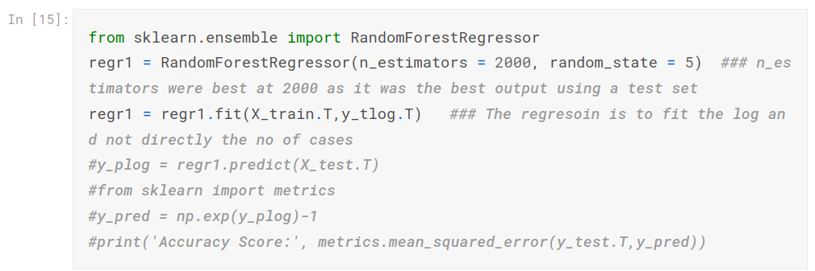
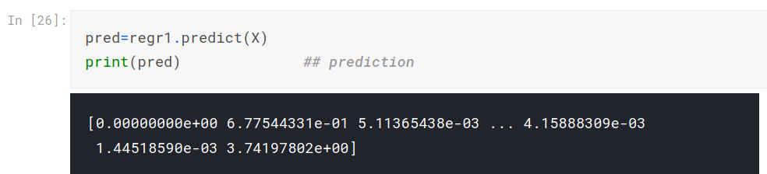
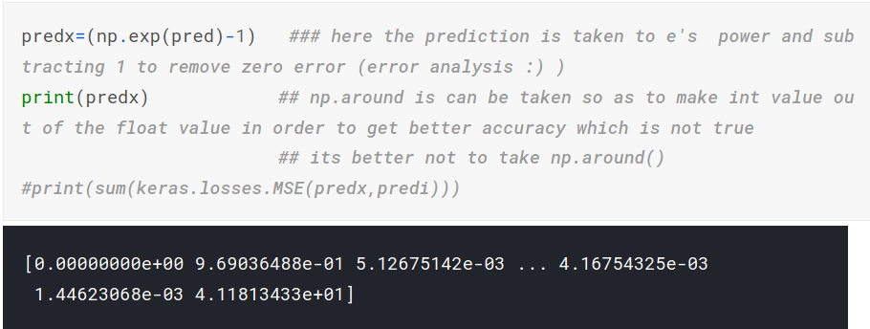
Regression Model
Here I have used a Random Forest as Regressor. I have used 2000 Decision Tree to be ensembled i believe it is very high can be reduced to get pretty much equavalent accuracy.
When the prediction is done we get not actual no of cases for which we should do the below
We apply exponent function to the prediction that we got .
Its important to subtract 1 from it as we had added 1 initially while training.

Slide 10
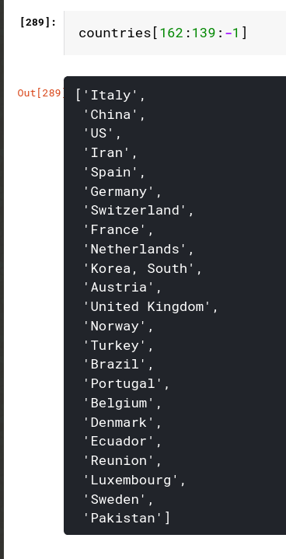
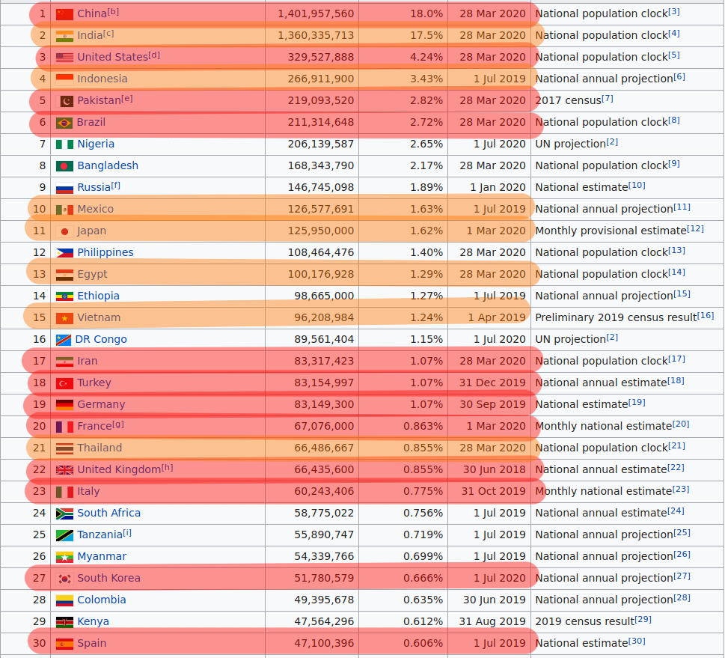
Correlation Between Data and other factors
The image on the right is rank of each country based on there rate of increase of the no of cases beacuse i had sort them based on there average rate change.
On left is the countries ranked based on there population ,The ones in red are in the top 22 of the list on right and the one in yellow are in top 32 of the list in red.
It can be seen out of the 30 countries on right 19 of them are in an ominous situation
*Source for population data : https://en.wikipedia.org/wiki/List_of_countries_and_dependencies_by_population

Slide 11
Explaning the Correlation
Hence it can be stated after the introduction of even one case in a country the rate of increase only depends on the population
The value of W which is country dependent and depends on the no of interaction that the populationhe has with each other as on a normal day it is that the no of interaction is always propotional to the population
Hence there was a correlation between the population and the Rate of increase
When a normal day passes by we have the No of Cases increase by a constant
But for any normal day the value of K is related to no of interactions.
And would be
So By reduction the interaction of people we can make value of K closer to 1.
We Can Decrease K by decrease NI, where NI is no of interaction by a infected person so Having infected people Quarantine from others is a good ways to stop more people getting infected

Slide 12
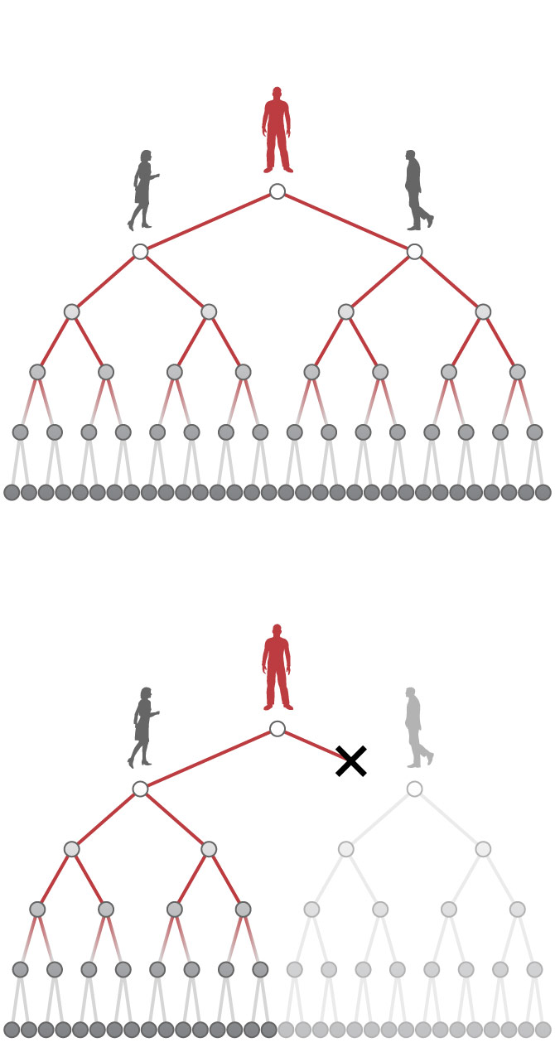
The Use Of The Predictions That My Model Can Make
By just being able to predict the rate at which no. of cases in a country proliferates can be helpful for the country to allocate resources and plan for the safe gaurd by implementing policies, and subsidies to subjects.
It would help the country/UN to be able to efficiently allocate medical facilities in the places of need.
We can also predict if the virus would enter a new country as there neighbouring countries maybe infected as that kind of correlation is seen in the given data.
It is very neccesary to decrease the value of W as to stop the increase of no of cases.
By having more datawe can make more correlations which would help track down our cause and would give us better ways to cure or stop the virus spread.

Slide 13
Thank You a presentation by, Somnath Sendhil Kumar reference to my kernel : https://www.kaggle.com/hexplex0xff/kernel5b48939214/

