Slide 1

WELA
Did the drive cause it?
Likely
Possibly
Windows Event Log Analyzer
No drive evidence
Did the SSD cause that shutdown? Every power cycle in a claim’s Windows logs — rebuilt, checked against the drive, and explained.
Can’t tell
Team walkthrough · October 2026
Notes:
Hi everyone. Today I want to walk you through WELA — the Windows Event Log Analyzer.
The short version: you point it at the event logs from a customer’s machine, and within seconds it tells you every time that machine powered off, how it powered off, and what the SSD was doing around each of those moments.
On the right are the four answers it gives to the question we care about most: did the drive cause it?
I’ll cover why we need this, how to use it, the logic behind every verdict — including where that logic can be wrong — and what I need from you to make it reliable. Stop me any time with questions.

Slide 2



Reading claim logs by hand is slow
WHY WE NEED IT
Thousands of events
Power loss is never logged
Drive clues are scattered
A week of System, Application and Storport logs is thousands of events across several files.
Windows can’t log the moment it loses power. You infer it from events 41 and 6008 and from what’s missing.
NVMe resets, retries and Storport warnings sit in other logs. Lining them up with each shutdown is manual.
The result: slow, inconsistent from one engineer to the next, and hard to defend in a claim report.
2
Notes:
Let’s start with how we do this today. When a claim comes in, someone opens Event Viewer and scrolls.
A week of logs is thousands of events, spread across System, Application and the Storport log.
The hard part: Windows never writes ‘the machine lost power’ — it can’t, it’s dead at that moment. We infer it from event 41 on the next boot, from event 6008, and from the clean-shutdown events that are missing.
And the drive clues — NVMe resets, retried I/O, Storport warnings — sit in other logs, so we line up timestamps by hand.
That makes it slow, and two engineers can reach different conclusions from the same logs. That’s what WELA fixes.

Slide 3



Three questions, answered for every power cycle
WHAT IT DOES
1
How did the machine power off?
Built to be trusted
Normal shutdown, restart, Fast Startup, sleep or hibernate — or a hard shutdown: crash, power loss, power-button long press.
No installs
Pure Python; reads .evtx with Windows’ own wevtutil
2
What was the drive doing?
Every Storport and disk event in the minute before power-off and the minute after boot.
Local only
Runs on 127.0.0.1 — no data leaves the PC
3
Did the drive cause it?
Explainable
Likely, Possibly, No drive evidence or Can’t tell — with the reasons spelled out.
Every verdict shows its evidence and what’s missing
3
Notes:
WELA answers three questions for every power cycle.
One: how did the machine power off? A normal shutdown, a restart, Fast Startup, sleep — or a hard shutdown, and if so what kind: a crash, a power loss, someone holding the power button.
Two: what was the drive doing? It pulls every Storport and disk event from the minute before power-off and the minute after boot.
Three: did the drive cause it? It gives one of four answers, with the reasons written out.
On the right are three design choices that matter for us: nothing to install on Windows; it only runs locally, so customer data never leaves the PC; and every conclusion shows the evidence behind it, so you can always check its work.

Slide 4

From customer logs to a verdict in five steps
HOW TO USE IT
1
2
3
4
5
Collect the logs
Start WELA
Point it at the logs
Review the verdicts
Export for the claim
Export them from the customer’s machine
Run run_wela.py; the app opens in your browser
Paste the folder or files and click Analyze
Start with Needs review and Drive suspected
Excel or HTML, ready to attach to the claim
Run on the customer’s machine (the Partition log adds drive model, firmware and serial):
Try it now
wevtutil epl System System.evtx
wevtutil epl Application Application.evtx
wevtutil epl Microsoft-Windows-Storage-Storport/Operational Storport.evtx
wevtutil epl Microsoft-Windows-Partition/Diagnostic Partition.evtx
Try demo data loads a made-up case with every tricky scenario.
4
Notes:
Using it takes five steps.
First, collect the logs — the four wevtutil commands at the bottom export them from the customer’s machine. The Partition log is optional, but it gives us the drive model, firmware and serial.
Second, run python run_wela.py — it opens the app in your browser.
Third, paste the folder path and click Analyze. It takes a few seconds.
Fourth, review. I suggest starting with the Needs review and Drive suspected filters.
Fifth, export. The Excel file is the one to attach to the claim.
If you want to try it before you have real logs, the Try demo data button loads a made-up case that covers every tricky scenario.

Slide 5
How WELA reads the logs
01
Turning thousands of events into a list of power cycles
Notes:
Let’s look at how WELA turns raw events into a list of power cycles. This part is about how the machine powered off — the drive comes after.

Slide 6
Seven steps from raw events to verdicts
HOW IT WORKS
1
2
3
4
5
6
7
Merge
Check
Find boots
Classify
Sleep
Drive
Verdicts
All logs on one UTC timeline
Coverage, missing records, cleared logs, clock changes
Events 12, 6005, 6009, 27 within 3 min = one boot
How did each session end?
Sleep, hibernate and Modern Standby episodes
Drive events 60 s before power-off and after boot
Cause, effect, confidence, needs review
The key idea: every boot closes the previous session. Everything between two boots is one session, and WELA decides how each session ended — cleanly or not.
6
Notes:
Here’s the pipeline in seven steps.
It merges every log into one timeline in UTC. It checks the logs themselves: is a log missing, are record numbers missing, was a log cleared, did someone change the clock.
Then it finds boots. Windows writes several events at every startup — 12, 6005, 6009 and 27 — and if they land within three minutes, that’s one boot.
Then the key idea at the bottom: every boot closes the previous session. So for each boot WELA asks: how did the session before it end?
After that it rebuilds sleep and hibernate episodes, pulls the drive events around each power cycle, and finally produces the verdicts: the drive cause and effect, a confidence score, and whether you should review it.

Slide 7
How WELA decides how the machine powered off
HOW IT WORKS
What the logs show | Verdict
Shutdown events at the end of the session: 1074, 109, 13, 6006 | Normal shutdown or restart. 1074 says which; otherwise a boot within 5 min means restart
Shutdown events, then a hybrid boot | Fast Startup — Windows hibernated the kernel (event 27, BootType=1)
41 or 6008 logged after the next boot | Hard shutdown. 41’s fields say which: crash (bugcheck code), power-button long press, power lost while asleep, or power loss / hang
Shutdown started (1074), then 41 on the next boot | Hard shutdown — the shutdown hung and never finished
No shutdown events and no 41 or 6008 | Inferred hard shutdown — 30% confidence, flagged for review
Missing records at the boundary, or the log starts at this boot | Undetermined — WELA doesn’t guess
7
Notes:
This is the heart of the shutdown classification.
If the end of a session has shutdown events — 1074 is the shutdown request, 13 and 6006 are Windows and the event log stopping — it was a clean stop. 1074 even says restart or power off; if it doesn’t, a boot within five minutes means restart. If the next boot is a hybrid boot, it was Fast Startup.
If the next boot logs 41 or 6008, the previous session ended badly, and event 41 has fields that tell us which kind: a bugcheck code means a crash, a power-button timestamp means someone held the button, a sleep flag means power was lost while asleep.
If a shutdown started but 41 still appears, the shutdown hung.
And when records are missing, WELA says Undetermined instead of guessing.

Slide 8
Every verdict carries a confidence score
HOW IT WORKS
Clean shutdown — 1074 + 13 + 6006
1074 · 0.35
13 · 0.30
6006 · 0.30
95%
Marked Needs review
< 60%
Hard shutdown — 41 + 6008
41 · 0.50
6008 · 0.40
90%
or any warning flag
Nothing logged at all
These are the items to check by hand first. Weights and the threshold are tunable.
Inferred · 0.30
30%
Needs review
Penalties: −0.25 when evidence conflicts (a clean stop and a 41) · −0.30 when records are missing at the boundary
8
Notes:
Each verdict gets a confidence score, and it’s simple: each piece of evidence adds a weight.
A clean shutdown with 1074, 13 and 6006 reaches 95%. A hard shutdown with both 41 and 6008 reaches 90%.
When nothing at all was logged — no shutdown events and no 41 — WELA infers a hard shutdown but only gives it 30%.
Conflicting evidence and missing records subtract.
Anything under 60%, or anything with a warning, is marked Needs review — those are the items to look at by hand first. All of these weights live in one config file, so we can tune them as we validate.

Slide 9
Did the drive cause it?
02
The minute either side of every power cycle
Notes:
Now the part that matters most for claims: did the drive cause the power cycle?

Slide 10
WELA checks the minute either side of each power cycle
THE DRIVE VERDICT
BEFORE POWER-OFF — the cause?
AFTER BOOT — the effect
last event logged
machine off
boot
−32 s reset
−17 s reset
+3 s drive detected
+60 s Storport warning
How each drive event is rated — most serious first
missing
reset
error
slow
warning
info
disk 157 — the drive dropped off the bus
129 — Windows reset the NVMe or SATA device
disk 7 / 11 / 51, NTFS 55 / 98 / 140
disk 153 — an I/O had to be retried
other warnings, e.g. Storport, WHEA
listed with its fields, never counted
10
Notes:
For every power cycle WELA looks at two windows. The minute before the last event Windows logged before power-off — that’s where a cause would show up. And the minute after the next boot — that’s where we see the effect.
In this example the drive retried I/O, logged Storport warnings, and was reset twice: 32 and 17 seconds before the machine went down. After boot it was detected again at plus 3 seconds and logged one more warning at plus 60.
Every event in both windows is listed — Information-level ones included — with its offset and key fields; SCSI opcodes are decoded, so Opcode 42 shows as WRITE(10).
To decide, each event gets a severity, from ‘missing’ — the drive dropped off the bus — down to ‘info’, which is shown but never counted.

Slide 11



How WELA decides whether the drive caused it
THE DRIVE VERDICT
Likely
1
Possibly
2
No drive evidence
3
Can’t tell
4
The drive reset, errored or dropped off the bus in the minute before power-off.
Or the crash code points at storage: 0x7A, 0x77, 0x7B, 0xED, 0xF4.
Slow I/O or warnings before power-off, or only WHEA hardware errors.
Or a crash code that’s sometimes storage: 0x9F, 0x24, 0xEF, 0x133, 0x154.
Logs cover that minute and the drive logged no warnings or errors.
A quiet log is not proof the drive is fine.
No log covers that minute, or the log starts at this boot.
Normal shutdowns and restarts get “No (orderly)”
Undetermined power cycle: Likely drops to Possibly
Effect on the drive is scored separately, from the minute after boot
11
Notes:
Here are the rules, checked in order — the first one that matches wins.
Likely: the drive reset, errored or disappeared in the minute before power-off, or the crash code is one that points at storage — like 0x7A, which means Windows couldn’t read memory pages back from disk.
Possibly: slow I/O or warnings, or only WHEA hardware errors — which could come from another device — or a crash code that’s sometimes storage, like 0x9F.
No drive evidence: the logs cover that minute and the drive was quiet.
Can’t tell: there’s no log for that minute.
Normal shutdowns get ‘No, orderly’. The logic is simple on purpose: a cause has to happen before the failure, so only the minute before counts toward the cause. The minute after boot is reported separately as the effect.

Slide 12
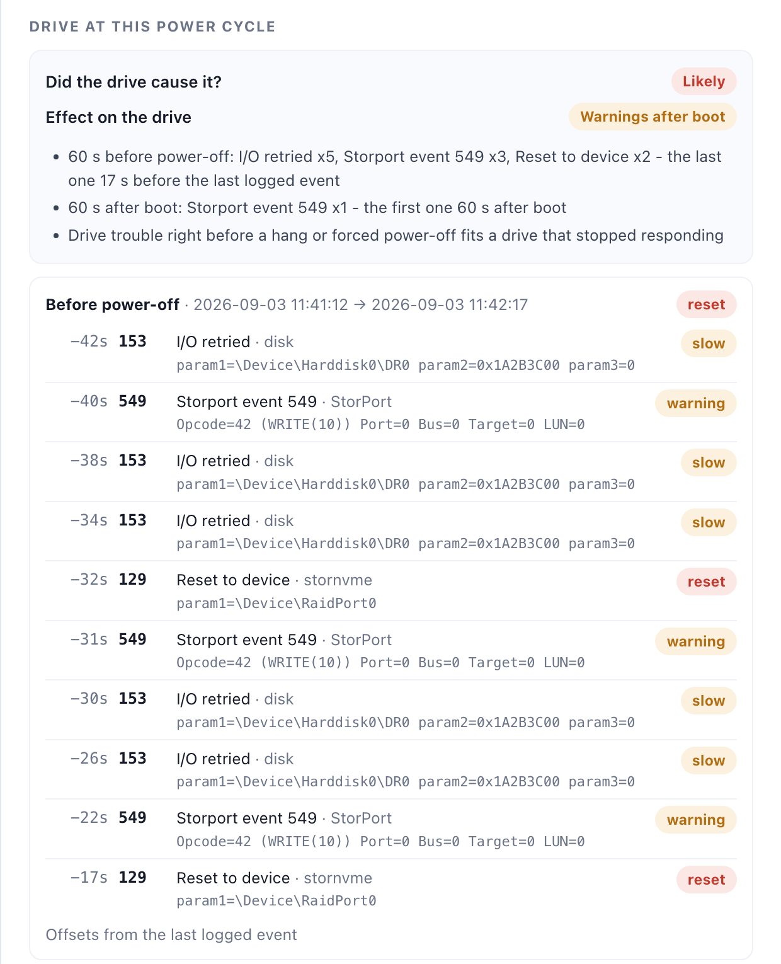
Example: a power loss right after two NVMe resets
THE DRIVE VERDICT
1
Hard shutdown at 11:42:12
No clean stop; event 41 logged on the next boot.
2
The minute before power-off
5 I/O retries, 3 Storport 549 warnings, and NVMe resets at −32 s and −17 s.
3
Worst drive event: a reset → Likely
The drive acted up right before the machine went down.
4
The minute after boot
Drive detected at +3 s, one more Storport warning at +60 s → Warnings after boot.
From WELA’s built-in demo case (made-up data).
12
Notes:
Here’s an example from the demo case — power cycle T5.
The machine died at 11:42:12 with no clean shutdown, and event 41 appeared at the next boot.
In the minute before, the drive retried I/O five times, Storport logged three warnings on write commands, and the NVMe controller was reset twice. The worst event is a reset, so the verdict is Likely.
On the right is exactly what you see in the app: the verdict, the reasons, and every event with its offset from the power cycle.
After boot the drive came back, but logged one more warning a minute later. This is the kind of case where you’d pull the drive’s own logs next.

Slide 13


What the drive verdict can’t tell you
THE DRIVE VERDICT
Timing isn’t proof
A failing power supply or battery can reset the drive and cut power at the same moment.
“No drive evidence” is not “drive cleared”
Only the last minute counts
Windows writes its logs to the system drive. If that drive freezes instantly, its last events are never saved — so a failing drive can look quiet.
Errors three minutes earlier, then silence, are missed. Widen the window in Analysis settings.
Storport is judged by severity only
Always cross-check the drive’s own
SMART and error logs.
WELA doesn’t know what each Storport ID means; an important Information-level event won’t count.
13
Notes:
Before you rely on these verdicts, here’s what they can’t tell you.
The big one: ‘No drive evidence’ does not mean the drive is fine. Windows saves its logs to the system drive. If that drive freezes instantly, Windows can’t save its last events — so a drive that failed hard can look quiet. That’s why we always cross-check with SMART and the drive’s error log.
Second, timing isn’t proof: a failing power supply can reset the drive and kill the machine at the same moment.
Third, only the last minute counts by default — you can widen it in Analysis settings.
And fourth, WELA judges Storport events only by Windows’ severity, because it doesn’t yet know what each Storport event ID means. Real logs from you will fix that.

Slide 14
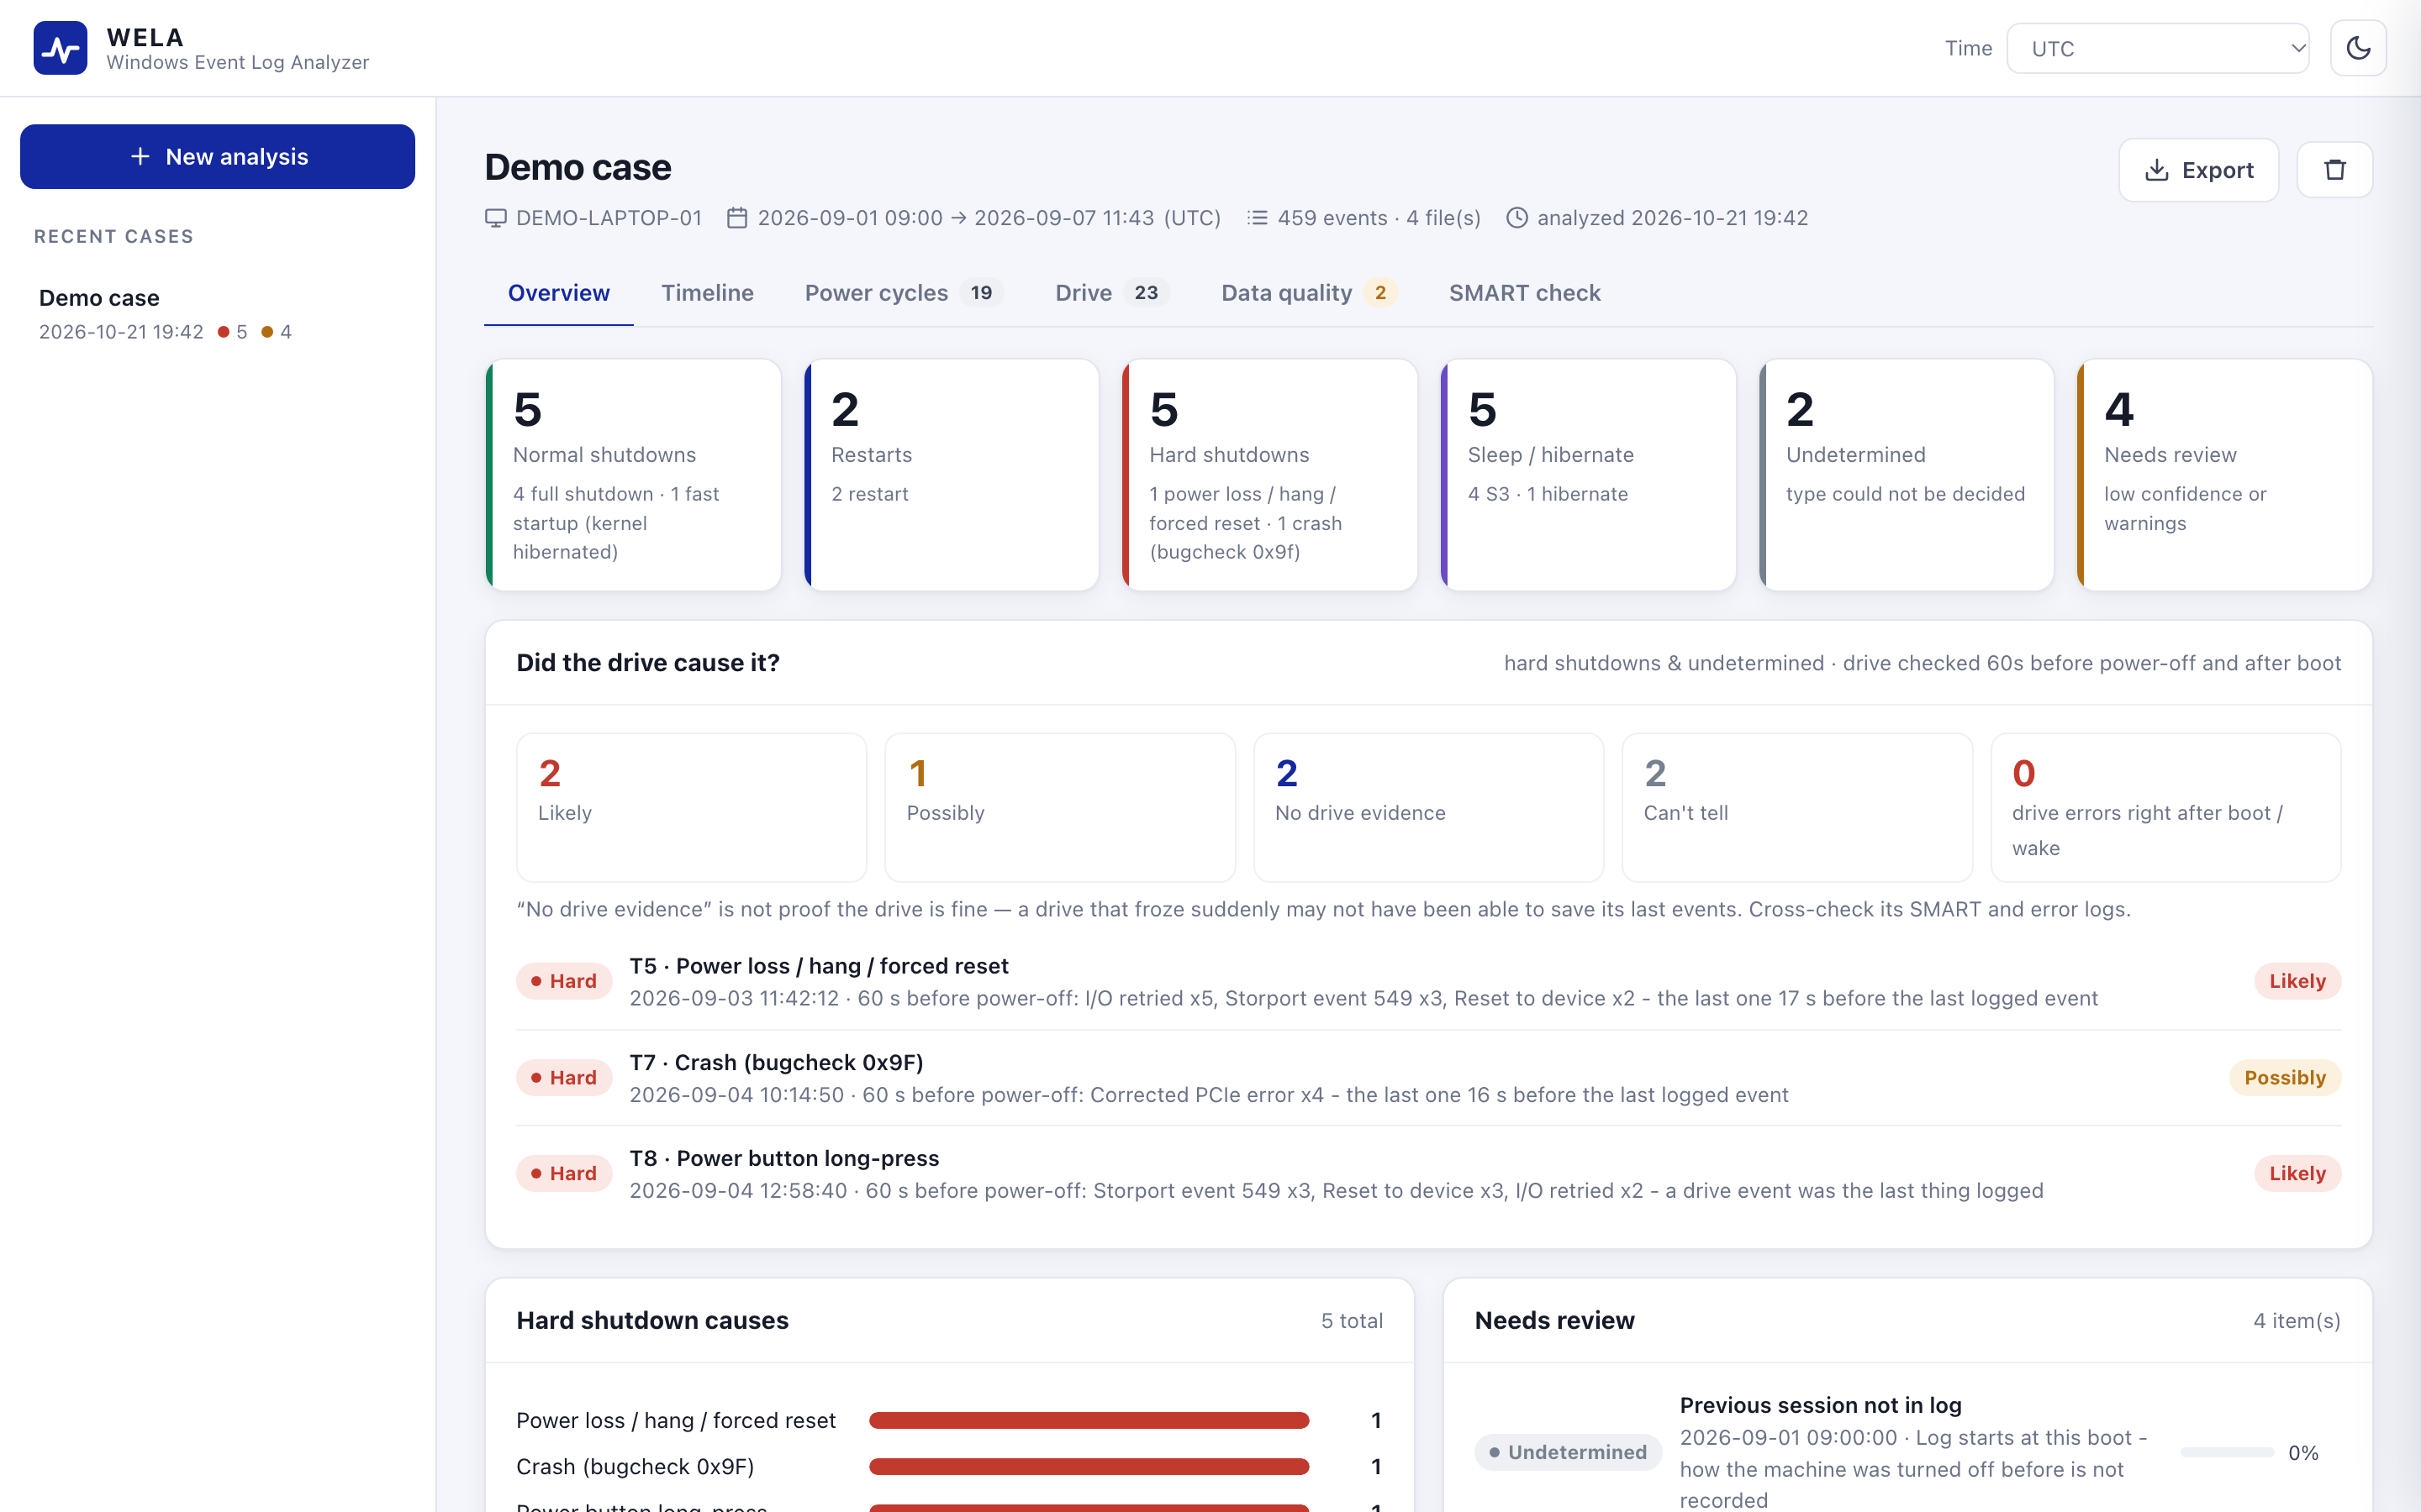
A quick tour of the app
USING IT
Overview
Counts, the drive card, hard-shutdown causes, what needs review
Timeline
Zoomable view of sessions, power cycles, sleeps and drive events
Power cycles
Filterable list — click a row for the evidence and both drive windows
Drive
Disk model, firmware, serial and every storage warning or error
Data quality
Log coverage, missing records, cleared logs, clock changes
SMART check
Compare the drive’s own counters with what the logs explain
14
Notes:
A quick tour.
The Overview shows the counts at the top, then the ‘Did the drive cause it?’ card listing the suspects, then hard-shutdown causes and what needs review.
The Timeline shows the whole log period — you can zoom and click any marker.
Power cycles is the main list; click a row and you get the evidence and both drive windows.
Drive shows the disk model, firmware and serial, and every storage warning or error.
Data quality tells you whether you can trust the logs.
And SMART check compares the drive’s own counters with the logs.

Slide 15
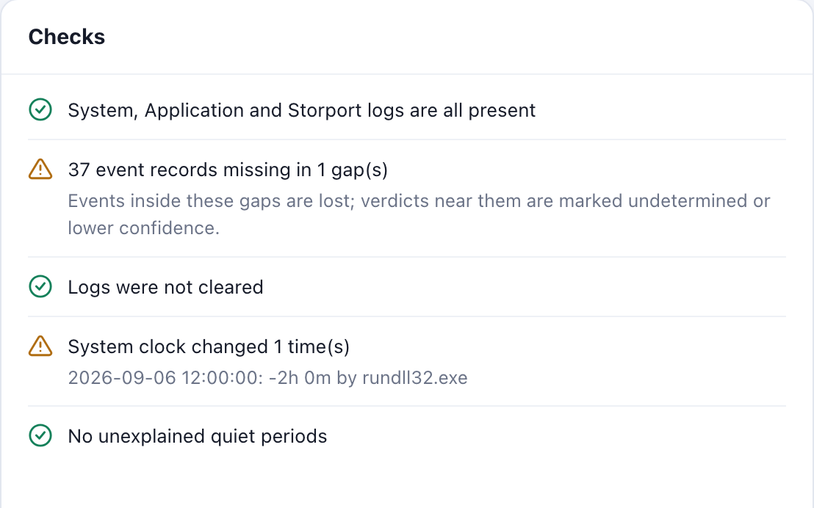
Check the data before trusting a verdict
USING IT
What WELA checks
Missing logs — ask the customer for them
Missing records — events were lost; nearby verdicts drop to Undetermined or lower confidence
Cleared logs and clock changes — treat nearby verdicts with care
Long quiet gaps inside a session — maybe an unlogged sleep
SMART cross-check
Enter how much the drive’s Power Cycles and Unsafe Shutdowns counters rose over the log period. If the drive counted more than the logs explain, events are missing from the Windows logs.
Data quality tab on the demo case.
15
Notes:
Always glance at Data quality before trusting a verdict.
If a log is missing, ask the customer for it. If record numbers are missing, events were lost — WELA lowers confidence or says Undetermined near those gaps. Cleared logs and clock changes are red flags too.
The SMART check is our independent second opinion: the drive counts power cycles and unsafe shutdowns on its own. Take how much those counters rose over the log period and enter it. If the drive counted more unsafe shutdowns than the logs explain, events are missing from the Windows logs.

Slide 16



Sharing results and tuning the rules
USING IT
Exports
Saved cases
Tuning
HTML report — one file to read and share
Excel: Summary, Power cycles, Drive windows, Storage events, Coverage
CSV and JSON for anything else
Every analysis is saved on your PC, under cases/
Reopen any case from the sidebar
Nothing is uploaded anywhere
Event IDs, weights, thresholds and crash codes live in wela/catalog.py
Override any of them with wela_config.json
Window and review threshold are in Analysis settings
UNDER THE HOOD
Python 3.9+ standard library · plain HTML/JS interface · ~3,400 lines · 20 automated tests · nothing to install on Windows
16
Notes:
For sharing: the HTML report is a single file you can open anywhere. The Excel workbook is the one for the claim — it has a summary, the power-cycle list, and a Drive windows sheet with every event from both windows of every power cycle.
Every analysis is saved locally and appears in the sidebar; nothing is uploaded.
And everything WELA knows — event IDs, weights, thresholds, crash codes — lives in one file, catalog.py, which we can override with a small JSON file without touching code.
Under the hood it’s plain Python with no dependencies, so it runs on any Windows PC with Python installed.

Slide 17
What I need from you
NEXT STEPS
1
Send me closed claims with known answers
20–30 cases where we already know what happened, to check every verdict.
2
Help run lab tests
Questions?
Pull the plug, hold the power button, force a crash, sleep and wake — does WELA call each one right?
The code
3
Share real Storport logs
github.com/hex2104/wela-app
So we can name the Storport event IDs that matter, instead of relying on severity.
Private repo — ask me for access
4
Try it on your next claim
Tell me where a verdict looked wrong or a reason was unclear.
Notes:
Here’s what I need from you.
First, closed claims where we already know the answer — 20 to 30 would let us measure how often each verdict is right.
Second, lab tests: pull the plug, hold the power button, force a crash, sleep and wake — and check that WELA calls each one correctly.
Third, real Storport logs, so we can name the Storport events that matter.
And fourth, just try it on your next claim and tell me where a verdict looked wrong or a reason was unclear.
The code is on GitHub. The repo is private, so ask me for access. Questions?

