Slide 1

A week you can actually finish.
Tempo
An AI study planner that learns how long work really takes you, and tells you on day one when a week doesn’t fit.
AI FOR STUDENT LIFE · RIT DUBAI
[Team name] · [School]
Notes:
Opening (0:00–0:10). “We’re [team name] from [school]. This is Tempo, an AI study planner for high-school students.” Then go straight into the problem.

Slide 2



No planner tells you if your week fits
01 · THE PROBLEM
We underestimate
We cram
We find out too late
Work takes longer than we predict. Psychologists call it the planning fallacy.
Spreading study over days beats one long night, but the night before is what happens.
An impossible week looks fine on Monday. You only notice on Wednesday night.
Buehler, Griffin & Ross, 1994
Cepeda et al., 2006
No planner warns you
Our survey: [X] of [Y] students said [“…”]
Notes:
Problem (0:10–0:50). “Every one of us has had a week where we didn’t realise it was impossible until Wednesday night.” Three things go wrong: we underestimate how long work takes (the planning fallacy), we cram even though spacing study out works better, and no app tells you the week doesn’t fit. Replace the survey line with your real numbers and one real quote from a classmate.

Slide 3

A busy student who won’t fill in a 20-field form
02 · WHO IT’S FOR
They need… | So Tempo…
No forms | Reads your week as you’d text it
Real time estimates | Learns your pace per subject
Plans that keep up | Re-plans instantly, says what moved
Privacy, no Wi-Fi | Local AI and offline rules
Honesty when it’s too much | Says “doesn’t fit”, offers options
Grade 10–12
4–6 subjects
Sports, clubs or a job
1–3 hours a day to study
Plans with guesswork
Notes:
Target user (0:50–1:10). A Grade 10–12 student with 4–6 subjects, after-school activities and 1–3 hours a day. They are not organised by nature. Each need on the left became a design decision on the right: no forms means plain-language input; unreliable internet and privacy mean the offline rules and the private Local AI.

Slide 4
Tell it. Check it. Let the plan keep up with you
03 · THE SOLUTION
01
02
03
04
Tell
Check
Plan
Adapt
Type or speak your week in plain words.
Confirm what the AI found. Guesses are yellow.
Sessions around activities and sleep, each with a why.
New task, moved exam, tired today: it re-plans and says what moved.
And when the week is impossible, it says so on day one and offers options it has already checked.
Notes:
Solution (1:10–1:30). “Tempo turns that message into a realistic plan, learns how long things really take you, and re-plans whenever life changes. When the week is impossible, it tells you and gives you options.” Then switch to the live demo.

Slide 5
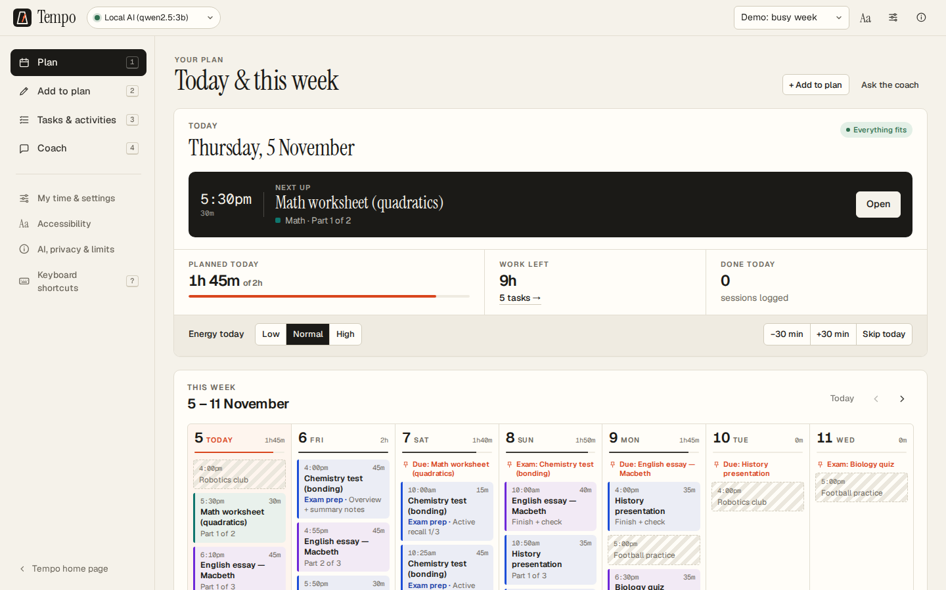
The judges’ week, planned in seconds
04 · LIVE DEMO
1 Type the week, press Understand
2 Check the yellow guesses
3 Add: see what changed
4 Open a session: why it’s there
5 Log 60 min: Math estimate rises
6 Tap Low energy: today halves
7 Exam crunch: checked options
tempo-study-planner.netlify.app/app
Notes:
Live demo (1:30–3:30). Switch to the browser. 1) Press 2 for Add, paste the example, press Understand: point out the yellow guessed fields and the questions — “the AI never invents a date.” 2) Add to my plan: the message lists what changed. 3) Open a session and read the why. 4) Mark it done but set 60 minutes instead of 45, then open a Math task: the estimate went up — “it learned I’m slow at Math.” 5) Tap Low energy: today halves and it says what moved. 6) Profile menu → exam crunch: the red card says it doesn’t fit and offers options; click one. If Wi-Fi fails, switch the engine to Offline rules: everything still works.

Slide 6




Four jobs, and the right kind of AI for each
05 · THE AI
LANGUAGE MODEL
STATISTICAL MODEL
Understand what you type
Predict how long it takes you
Local AI or Groq turns messy text into tasks, checked by code.
Learns your pace per subject from the times you log.
PLANNING ALGORITHM
LANGUAGE MODEL + RULES
Plan without breaking rules
Coach you on your plan
Deadlines first, spaced revision, buffers, sleep protected.
Answers from your plan. Safety rules run first.
Notes:
AI component (3:30–3:50). “AI does four jobs: understanding language with a language model, predicting workload with a model that learns from your logged times, planning with a scheduling algorithm, and coaching. We chose not to let the chatbot make the schedule, because a planner must never break hard rules, and we can test an algorithm.”

Slide 7

Choose privacy, speed, or no internet at all
06 · THREE ENGINES, ONE SWITCH
Engine | Runs on | Text goes to | Read a week | Coach answer
Local AI Qwen 2.5 3B | Your laptop | Nowhere | 30–90 s | ~20 s
Groq gpt-oss-120b | Groq’s cloud | Groq | 2–4 s | ~1 s
Offline rules Tempo’s parser | Your browser | Nowhere | Instant | Instant
Measured in the real app. If an engine fails, Tempo falls back to offline rules.
Notes:
For Q&A or a longer slot. The student picks the engine from a dropdown. Local AI is a 3-billion-parameter model running on the laptop’s CPU through Ollama: private, but slow. Groq runs OpenAI’s open-weight gpt-oss-120b on the free tier: fast, but text goes to Groq and the free tier allows about 3 requests a minute. Offline rules need nothing. Local AI only works when Tempo runs on your own computer, not on the website.

Slide 8

The AI never has the last word
07 · TRUST, BUT CHECK
You type
AI reads
Tempo checks
You confirm
Plan
Tempo works out the dates from your words
Every “quote” must appear in what you typed
Impossible values are rejected
“Moved” updates the old task, never a duplicate
Tasks the AI drops are recovered by rules
Guesses are yellow; missing details become questions
Notes:
Small models are bad at date arithmetic and sometimes make things up. So the model must quote the student’s own words, like “next friday” or “about 2 hours”, and Tempo’s tested rules work out the real dates and minutes. Every quote is checked against what was typed. Then the student confirms. Nothing is added without them.

Slide 9
It learns how long work takes you
08 · LEARNING YOUR PACE
m = exp( (Σ ln r + k · ln m₀) ÷ (n + k) )
r = actual ÷ planned minutes, per session
m₀ = your overall habit · k = 3
Few sessions: trust the typical time
More sessions: trust what really happened
DEMO STUDENT · MATH
45m → 1h
5 past Math sessions ran about 30% long.
Likely 55m–1h 5m · confidence high
Notes:
How to explain shrinkage in one sentence: “With little data we trust the typical time; each logged session pulls the estimate toward what really happened.” We work in log space so “twice as long” and “half as long” count equally. Every estimate shows a range and a confidence level, because it is a prediction, not a fact. The example is real output from the demo student.

Slide 10

A plan must never double-book you, run past your bedtime, or quietly drop work. A chatbot can’t promise that. An algorithm can.
09 · A DESIGN DECISION
So the AI reads and explains. The algorithm schedules, and our tests check every plan.
Experiment E1: [we asked a chatbot to plan the judges’ week; it broke X rules]
Notes:
Expect this question: “Why not just use ChatGPT?” Answer: a schedule has hard rules: no clashes with activities, no day over the limit, nothing after a deadline, nothing past bedtime. A language model can produce something that looks right and still breaks them. Our planning algorithm gives the same answer every time, explains every decision, and is checked by automated tests. Run experiment E1 from docs/AI_DEVELOPMENT_LOG.md before the event and put the real result in the footer.

Slide 11
We tested it, and it broke
10 · TESTING · LOCAL 3B MODEL, THU 5 NOV
WHAT THE MODEL RETURNED
WHAT THE STUDENT SEES AFTER TEMPO’S CHECKS
Chemistry test: Wed 18 Nov
Chemistry test: Fri 13 Nov
“Next Friday” isn’t a Wednesday
Corrected, and flagged to confirm
English essay: Tue 10 Nov
English essay: Mon 9 Nov, 2h
Monday is the 9th
Estimate kept on the right task
Task: “Robotics practice”
Robotics: Tue & Thu 4–5:30pm
It’s an activity, not homework
Once, as an activity
“I only have 2 hours on weekdays”
Study time: unchanged
The student never said this
Invented sentence ignored
The fix: every quote is checked against what was typed, and tested rules do the date maths. Now an automated test.
Notes:
Testing and improvement (3:50–4:20). Tell this story. “We typed ‘chem test next friday, english essay due monday about 2 hours, robotics tue and thu 4-5:30’ into the local model. It got both dates wrong, listed robotics as homework, and invented a sentence the student never said. We saved that exact reply as a test, changed Tempo so every quote must appear in what was typed and our own rules work out the dates, and now the test passes.” Then name one thing that still needs work (slide 14).

Slide 12

Tested on every change, and on the live site
11 · HOW WE KNOW IT WORKS
22
7/7
9
2.4s
automated tests, run before every deploy
Stage-4 judge scenarios covered by tests
problem → change → result stories, written up
for Groq to read a week on the live site
Every plan is checked: no day over its limit, no clash with an activity, nothing after a deadline or past bedtime.
Notes:
We also drove the real app in a browser: the full flow with Local AI and with Groq, and navigation on a laptop and a phone (views, keyboard shortcuts, the Back button, dialogs, the phone tab bar). Testing the live site found a real bug: Netlify’s badge covered the Coach tab on phones. All nine stories are in docs/TESTING.md.

Slide 13






Built for students, not for engagement
12 · RESPONSIBLE DESIGN
Private by default
Won’t do your homework
Kind when it’s hard
A nickname, not a name. Data stays in your browser.
“Write my essay” gets a refusal and a plan.
Low-energy days, crunch warnings, a counsellor.
Honest about limits
You stay in charge
Accessible
Ranges, confidence, and a why for every session.
You confirm every task and pick every trade-off.
Keyboard, large text, contrast, voice, read-aloud.
Notes:
Responsible AI (4:20–4:40). “Our key limitation: estimates are predictions. They start rough, so we show a range and a confidence level, and the student always confirms. There’s no account and no real name, data stays on the device, the server never stores what students type, it won’t write your essay, and it points you to a counsellor if you’re overwhelmed.” Mention the private Local AI: text never leaves the laptop.

Slide 14

What still needs work
13 · LIMITS AND NEXT STEPS
Known limits
Next
New students start with typical times until about 5 sessions per subject
The rules miss rare phrasing like “the Thursday after next”
It plans time, not how well you studied
Data lives in one browser: private, but no sync
Test with 5–8 real students: [results]
Ask “how confident do you feel?” after exam prep
Compare the AI engines on classmates’ real sentences
Optional private sync between phone and laptop
Notes:
Say these confidently: judges reward honesty. The biggest one: estimates for a brand-new student are based on typical times, so they show low confidence until the student has logged a few sessions. Fill in the user-testing results once you’ve run the sessions in docs/TESTING.md, and experiment E8 (comparing engines) from the development log.

Slide 15
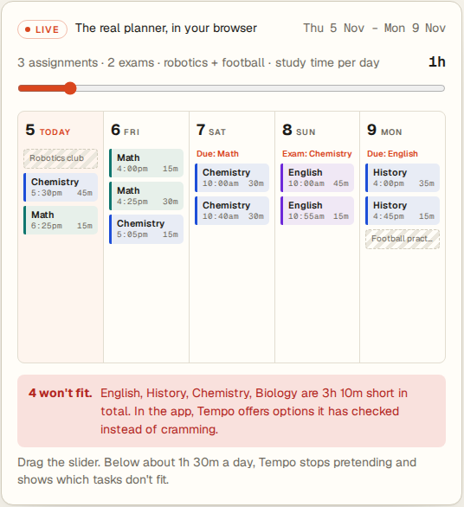
Try it now.
tempo-study-planner.netlify.app
The judges’ week is already loaded. Change something and watch it re-plan.
Code: github.com/hexa3/tempo
[Team names] · [School] · Questions?
Notes:
Close (4:40–5:00). “Tempo is live at tempo-study-planner.netlify.app, and the code is on GitHub. Thank you. We’re happy to take questions.” Keep the demo tab open for the judges’ tests: the playbook in docs/PRESENTATION.md lists what to click for each one.

