Slide 1
High-performance bulk data transfers with TCP
Matei Ripeanu
University of Chicago
Notes:
The previous talks have been on how to represent data and metadata, on how to replicate it and select the best replica. To enlarge the picture one has to think about how to transfer this data around as fast/efficient as possible.
Looks like
- transfer time
- cost efficient
high performance protocols for bulk data transfers.
Simulation studies of high-performance transfers

Slide 2
Problem
Bulk transfers
  transfer of many large blocks of data from one storage resource to another
  delivery order is not important
Parallel flows
  to accommodate to parallel end systems
Questions
  What is the achievable throughput using TCP
  Which TCP extensions are worth investigating
  Do we need another protocol?
Notes:
We are concerned about bulk transfers. Large files or large number of small files.
Large is relative
Files, objects; etc.
Because of the parallelism at the end systems it is easier to use bulk transfers.
Because the throughput for disk writes 50MB/s is much smaller than the throughput of high speed optical links n Gbits/s (and the gap seems to increase by time).
First study TCP, and its limits. Analytical models and simulations. Then extensions. Then alternatives to TCP.
Framework. Using NS. Plug in protocol and you get extensive performance reports for various environments

Slide 3
Outline
TCP review
Parallel transfers with TCP
  shared environments
  non-shared environments
Considering alternatives to TCP
Conclusion and future work
Notes:
I’m going to talk:
Why we make the distinction? Because the success criteria are different.
Non-shared environments: transfer times, efficiency
shared environments: fairness, efficiency in utilization, transfer times

Slide 4
TCP Review
Provides a reliable, full duplex, and streaming channel
Design assumptions:
  Low physical link error rates assumed
    ➔ Packet loss = congestion signal
  No packet reordering at network (IP) level
    ➔ Packet reordering = congestion signal
Design assumptions challenged today!
  Parallel networking hardware => reordering
  Dedicated links, reservations => no congestion
  Bulk transfers => streaming not needed

Slide 5
TCP algorithms
Flow control – ACK clocked
Slow start – exponential growth
Congestion Control – set sstresh to cwnd/2, slow start until sstresh then linear growth
Fast Retransmit
Fast Recovery
Notes:
Refresh your memory on TCP algorithms:
Flow control – the sending rate is controlled by the number of unACKs packets in flight. The sender is not allowed to have more than cwnd packets in flight. Cwnd is limited by receiver’s advertised window.
Slow start – initially the sender is allowed to send only one packet (initial window of 1) and for each ACK can send back two packets. This leads to doubling the sending rate each RTT. (exponential growth of the congestion window)
Congestion control – when congestion is detected (duplicate ACK or timeout) sstresh is set to half of cwnd. TCP follows slow start until cwnd reaches sstresh then the congestion window is increased with one packet each RTT.
Fast retransmit – once the sender receives 3 or more duplicate ACK for the same packet it assumes the packet got lost and sends it again.
Fast recovery – after fast retransmit congestion avoidance is followed but not fast recovery

Slide 6
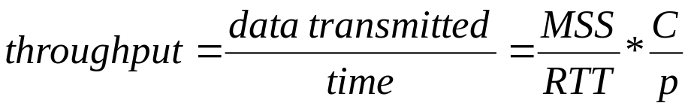
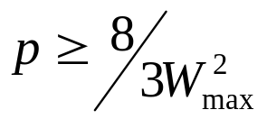
Steady state throughput model
cwnd size
(packets)
M. Mathis,
W_{max}
W
W/2
0 W/2 W 3W/2 2W Time(RTT)
Notes:
Cine a facut modeleul
Under low to moderate models analytic throughput models work fine.
In this case the behavior is driven by congestion signals.
C a constant that embeds various characteristics like delayed ACK and implementation characteristics.
Cine le-a facut modelele.
Ps = bw * rtt/mss => mss/rtt = bw/PS

Slide 7
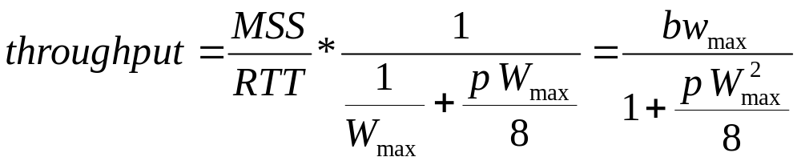

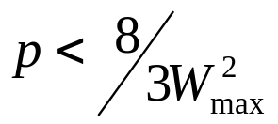

Steady state throughput model
cwnd size
(packets)
0 Time (RTT)
Notes:
Behavior driven by congestion signals rate and receiver’s advertised window

Slide 8
Parallel TCP transfers -
- shared environments
Advantages:
  More resilient to network layer packet losses
  More aggressive behavior: faster slow start and recovery
Drawbacks:
  Aggregated flow not TCP friendly! Does not respond to congestion signals (RED routers might take “appropriate” action)
  Solution: E-TCP (RFC2140)
Difficult to configure transfer properly to maximize link utilization
Notes:
Desen pt bulet-ul 1

Slide 9
Shared environments (cont)
Framework for simulation studies
  Change network path proprieties, no. of lows, loss/reordering rates, competing traffic etc.
Identify additional problems:
TCP congestion control does not scale
  Unfair sharing of the available bandwidth among flows
  Low link utilization efficiency
  If competing traffic is formed by many short lived flows, performance is even worse
Self synchronizing traffic
Burstiness
Notes:
Imbunatatiri la TCP:
- RFC 2140
Other protocols:
- rate based – au incercat altii si nu le-a mers prea bine
Automated NS process

Slide 10
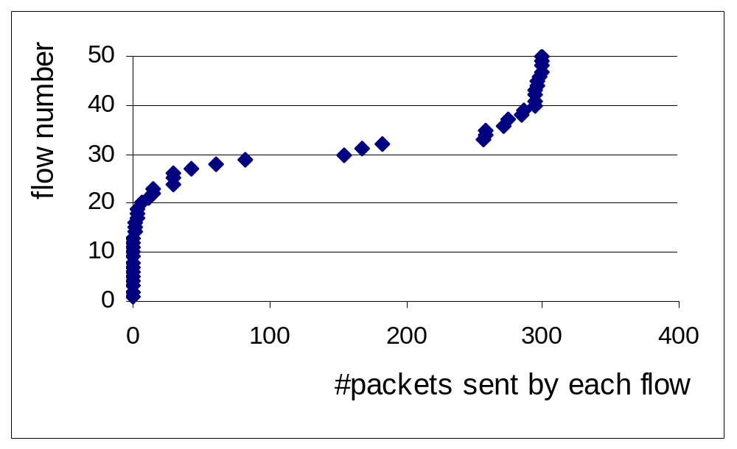
Fair
share.
50 flows try to send data over paths that has a 1 Mbps bottleneck segment. RTT=80ms and MSS=1000bytes. Router buffers: 100 packets. The graph reports the number of packets successfully sent during a 600s period.
Notes:
Pipe size here: 1Mbps*80ms/1000bytes = 1000,000 * 0.08 / 8000 = 10

Slide 11
Non-shared environments
Dedicated links or reservations
Transfer can be set up properly:
  Use TCP tools to discover: bottleneck bandwidth, MSS, RTT; pipe size PS = bw*RTT/MSS
  Set receiver’s advertised window: rwnd=PS/no_flows
  No packets will be lost due to buffer overflow
TCP design assumptions do not hold anymore
  Packet loss
  Reordering

Slide 12
Non-shared environment
Analytical models supported by simulations:
  Throughput as a function of:
    Network path proprieties: RTT, MSS, bottleneck bandwidth
    Number of parallel flows used
    Frequency of packet loss/reordering events. (On optical links link error rate is very low)
  Achievable throughput using TCP can get close to 100% of bottleneck bandwidth

Slide 13
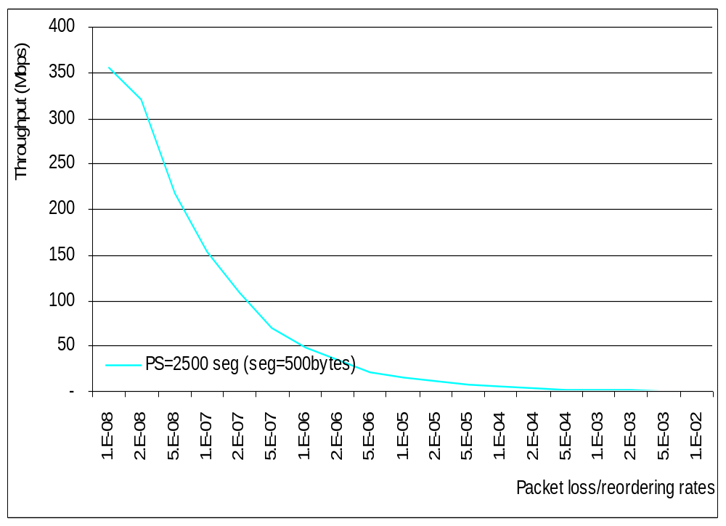
Single flow throughput as a function of loss indication rates. MSS = 500bytes
Bottleneck bandwidth=100Mbps; RTT=100ms;.

Slide 14
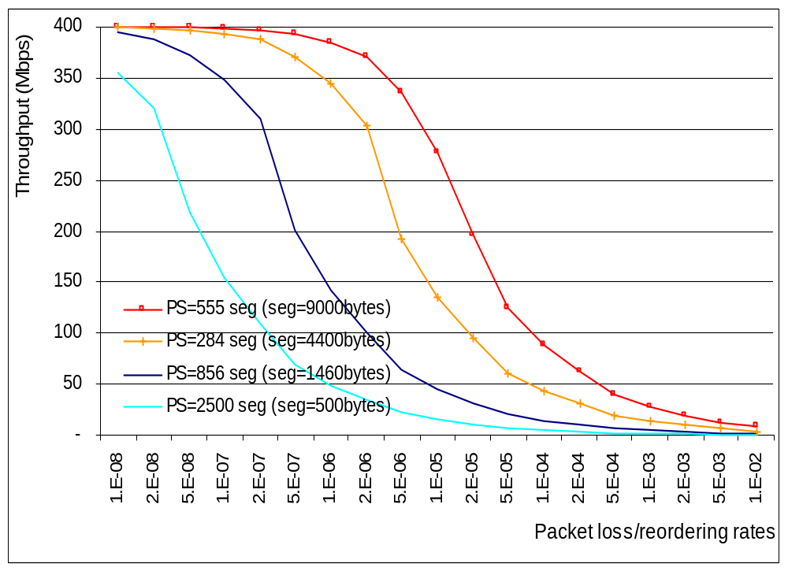
Increasing segment size: to 1460, 4400 and 9000 bytes
Single flow throughput as a function of loss indication rates for various pipe sizes for various segment sizes. Bottleneck bandwidth=100Mbps; RTT=100m.

Slide 15
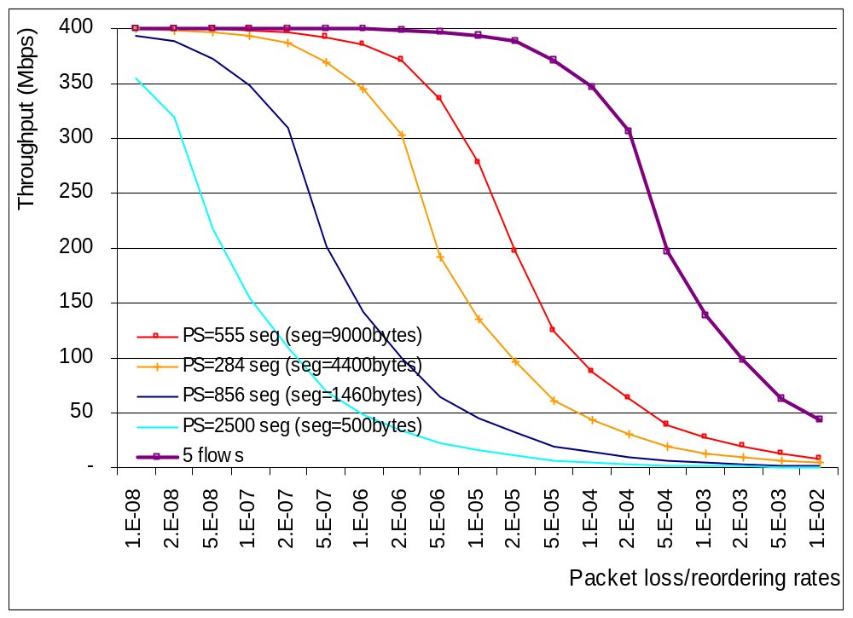
Increase the number of parallel flows. The new transfer uses 5 flows.
Bottleneck bandwidth=100Mbps; RTT=100ms;.

Slide 16
To increase throughput
Decrease pipe size for each flow:
  segment size (hardware trend)
  number of parallel flows
Detect packet reordering events; SACK (RFC2018; RFC2883) could be used to pass info
  adjust duplicate ACK threshold dynamically
  “undo” reduction of the congestion window
Skip slow start; cache and share RTT values among flows (T/TCP, …)
Notes:
What is nice is that we can play with some parameters so that we can chose the a point in the parameter that would give maximum performance:
Segment size – as long as the receiver’s adverized window sixe is not too small (we need it > 8 as a rule of thumb) we can use packets as big as the network allows. Jumbo frames and other trends.
Number of parallel flows = can adjust this to decrease the pipe size.
Important: SCAK and the like.

Slide 17
Alternatives
A rate-based protocol like NETBLT (RFC998)
Shared environments
  [Aggarwal & all ‘00] simulation studies Counterintuitive: no performance improvements
Non-shared environments
  Theoretically should be a bit faster, but …
  …needs to beat the huge amount of engineering around TCP implementations
  Requires smaller buffers at routers
  Simulation studies needed
Notes:
Recap:
Because it turns out that smoothing out the TCP bursts does make TCP detect congestion later when the network is already oversubscribed.
But the other approach should benefit by remaining in TCP mainstream.
Ce se intimpla in internet cu asta? Ce se intimpla la canale dedicate.

Slide 18
Summary and next steps
We have a framework for simulation studies of high-performance transfers.
Used it for investigating TCP performance in shared and non-shared environments.
Next:
Use simulations to evaluate SACK TCP extensions effectiveness in detecting reordering. Evaluate decisions after reordering is detected.
Simulate a rate-based protocol and compare with TCP dialects
Notes:
47 -

