Slide 1
Basic Cryptanalysis:
Dictionaries are Awesome
Daniel Vinakovsky, Zach Donato, Nick Massa
https://www.hackerrank.com/challenges/basic-cryptanalysis

Slide 2
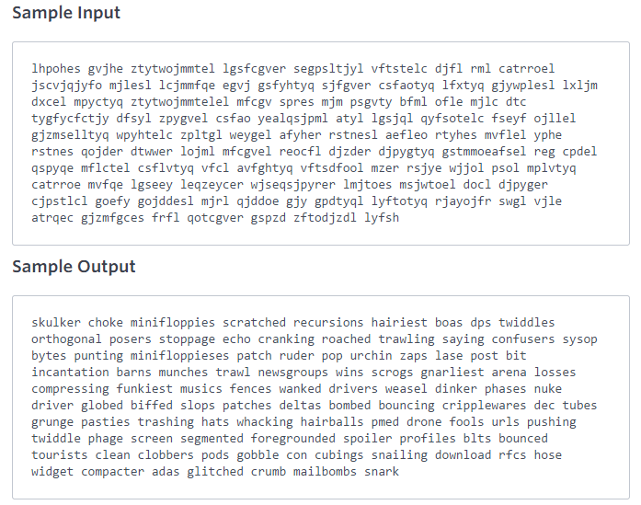
Task

Slide 3
Approach
Approach #1: Looks good until you try to code it.
GONG
LONG
TEST
ZXYZ
Approach #2: Pattern Matching
Begin with the longest length word, and work your way down
Using probability ZTYTWOJMMTEL
MINIFLOPPIES
Fill any remaining unmapped characters based on brute-forcing “almost solved” words and comparing them against the dictionary.

Slide 4
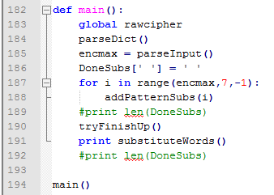
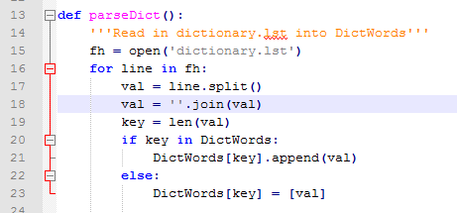
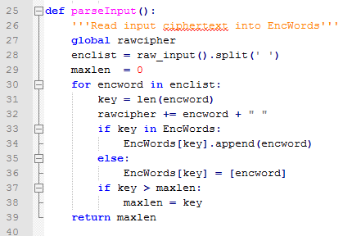
Parsing and Data Structures

Slide 5
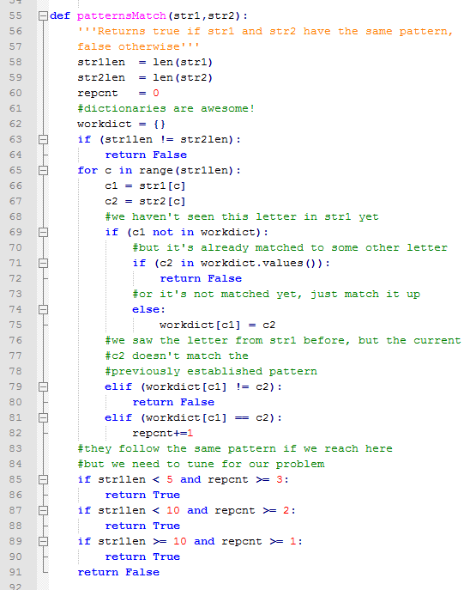
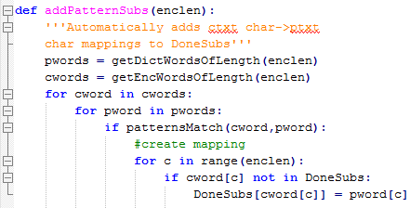
Phase I

Slide 6
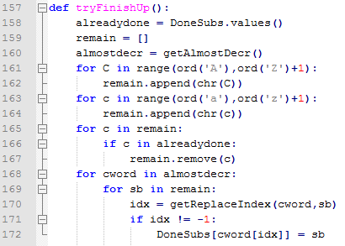
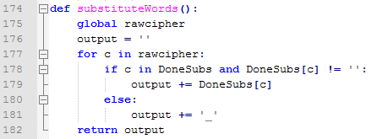
Phase II

Slide 7
Testing Example
CIPHERTEXT/INPUT:
xugsx qgxxgkv mzxzdugezvx svuaziqx jvvsx jgit sixhvt qgyed sqzuk dbbrzuv cvx bedlvu uvfxvx ygryirgade ydfjdw lvedx svvpx adiezxa jezaarv jglggex bzukvezuk egsvt kdshvex brgaavuzuk rdxzuk yhgzuzuk hgqqvevt qgeazgux srgwsvu ovrrdx tddexadsx tdfurdgtzuk gssx tdy qgzrjdqjvt px egmvx ugaiev kedp tdfu bddasezua afvgpx vcyr jdixaedshvtdu jill ahevgt keivx qgex kezutzuk yevvszuk sixh sibbvt sdpv sedkegq jzauvax tzupve adgt brgk yrdypx uvfjzvx vrvshguazuv vrmzxh yegxhvx svxxzqgrx tzuk jezaarve yegxhvt qvag uwvafdep vt bdepvt adkkrvt jvvs xvrmgkvx vezxvx xsrgax fgrtdx adkkrvx adgttvt rgiutedqga tvqdvt sdssvt bzcvx jglgge kugerzve fhgypvt jdekx xfzllrzuk xgra jdqjzuk xyevvux sedbzrv gyyiqirgadex ydqsdx ygux jgebx tdfux sibbzuk jgutfztahx pritkv
PLAINTEXT/OUTPUT:
snaps massage visionaries pentiums beeps baud pushed macro pming offline xes frozen newses calculator cowboy zeros peeks tourist brittle bazaars fingering raped gophers flattening losing chaining hammered martians playpen jellos doorstops downloading apps doc mailbombed ks raves nature grok down footprint tweaks excl boustrophedon buzz thread grues mars grinding creeping push puffed poke program bitnets dinker toad flag clocks newbies elephantine elvish crashes pessimals ding brittler crashed meta nyetwork ed forked toggled beep selvages erises splats waldos toggles toadded laundromat demoed popped fixes bazaar gnarlier whacked borgs swizzling salt bombing screens profile accumulators compos cans barfs downs puffing bandwidths kludge

Slide 8
Time for Running Code!

