Slide 1
Common Child
By Dan Vinakovsky, Zachary Donato, and Nicholas Massa
https://www.hackerrank.com/challenges/common-child

Slide 2
Problem
Given two strings a and b of equal length, what's the longest string S that can be constructed such that it is a child of both?
Where a string x is said to be a child of a string y if x can be formed by deleting 0 or more characters from y.
Example:
HARRY
SALLY
2 - The longest string S that can be formed is “AY”

Slide 3
Approach
Naïve approach ended up having a complexity of O(n!)
Final approach (dynamic programming) had a far more palatable complexity of O(n^2), with constant memory overhead of ~25MB

Slide 4
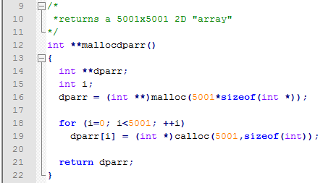
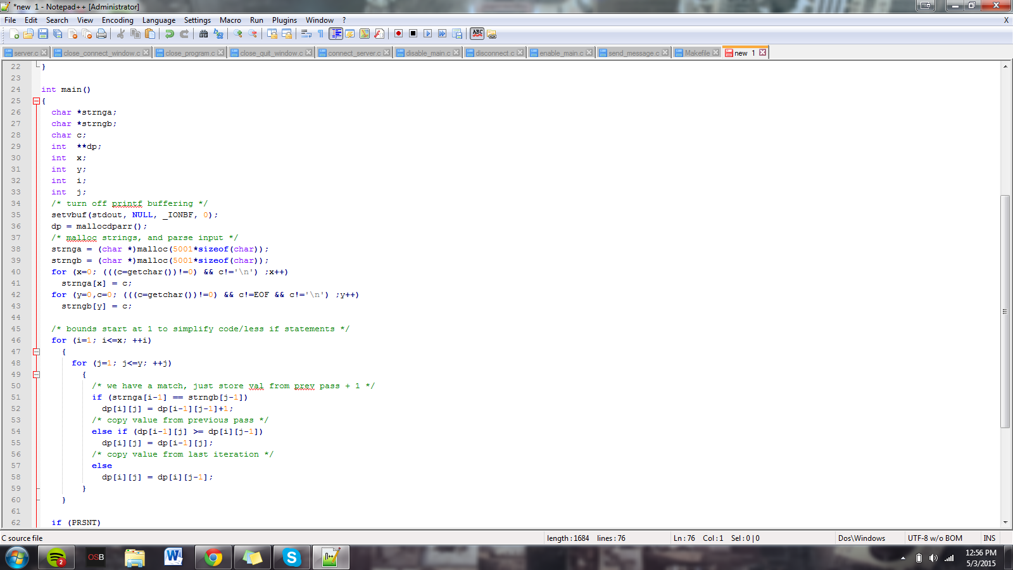
Input Parsing
Getting around HackerRank’s limit on the amount of available stack space.

Slide 5
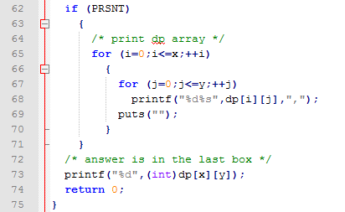
Algorithm

Slide 6
Time To Run The Code!
Questions?

