Slide 1
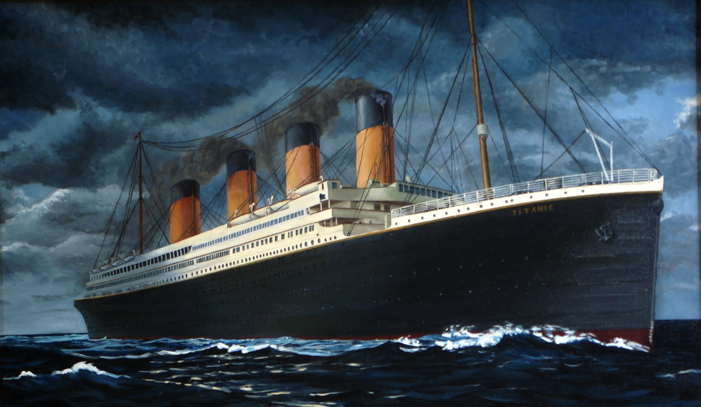
TITANIC

Slide 2
RMS Titanic was a British passenger liner operated by the White Star Line that sank in the North Atlantic Ocean on 15 April 1912, after striking an iceberg during her maiden voyage from Southampton to New York City. Of the estimated 2,224 passengers and crew aboard, more than 1,500 died, making the sinking at the time one of the deadliest of a single ship and the deadliest peacetime sinking of a superliner or cruise ship to date. With much public attention in the aftermath, the disaster has since been the material of many artistic works and a founding material of the disaster film genre.

Slide 3
RMS Titanic was the largest ship afloat at the time she entered service and was the second of three Olympic-class ocean liners operated by the White Star Line. She was built by the Harland and Wolff shipyard in Belfast. Thomas Andrews, chief naval architect of the shipyard at the time, died in the disaster.

Slide 4
Titanic was under the command of Captain Edward Smith, who went down with the ship. The ocean liner carried some of the wealthiest people in the world, as well as hundreds of emigrants from Great Britain and Ireland, Scandinavia and elsewhere throughout Europe, who were seeking a new life in the United States. The first-class accommodation was designed to be the pinnacle of comfort and luxury, with a gymnasium, swimming pool, libraries, high-class restaurants, and opulent cabins. A high-powered radiotelegraph transmitter was available for sending passenger "marconigrams" and for the ship's operational use.

Slide 5
The Titanic had advanced safety features, such as watertight compartments and remotely activated watertight doors. The ship carried 16 lifeboat davits which could lower three lifeboats each, for a total of 48 boats. However, Titanic carried only a total of 20 lifeboats, four of which were collapsible and proved hard to launch during the sinking. The carried lifeboats were enough for 1,178 people—about half the number on board, and one third of her total capacity—due to the maritime safety regulations of those days. At the time of the sinking, the lowered lifeboats were only about half-filled.

Slide 6
After leaving Southampton on 10 April 1912, Titanic called at Cherbourg in France and Queenstown (now Cobh) in Ireland, before heading west to New York. On 14 April, four days into the crossing and about 375 miles (600 km) south of Newfoundland, she hit an iceberg at 11:40 p.m. ship's time. The collision caused the hull plates to buckle inwards along her starboard (right) side and opened five of her sixteen watertight compartments to the sea; she could only survive four flooding. Meanwhile, passengers and some crew members were evacuated in lifeboats, many of which were launched only partially loaded. A disproportionate number of men were left aboard because of a "women and children first" protocol for loading lifeboats. At 2:20 am, she broke apart and foundered with well over one thousand people still aboard. Just under two hours after Titanic sank, the Cunard liner RMS Carpathia arrived and brought aboard an estimated 710 survivors.

