Slide 1
Discussion Section (Week 13) Bayesian Networks
CSCI 561 - Foundation for Artificial Intelligence
PROF WEI-MIN SHEN WMSHEN@USC.EDU

Slide 2
Two Major Components in Probability
Probability Distribution Model
Variables, Value Assignments (possible worlds)
Represented as a table or a graph
Inferences that can be made from the model
Sum rule: P(a) + P(~a) = 1
Product rule: P(ab) = P(a|b)P(b) = P(b|a)P(a) // Bayes
Conditional
Marginalization
Normalization

Slide 3
Independence
Based on the Product Rule: P(AB)=P(A)P(B|A)=P(B)P(A|B)
Absolute Independence
A and B are independent iff
P(AB) = P(A) P(B)
P(A|B) = P(A)
P(B|A) = P(B)
Conditional Independence A and B are conditional independent on C iff
P(AB | C) = P(A | C) P(B | C)
P(A | BC) = P(A | C)
P(B | AC) = P(B | C)

Slide 4
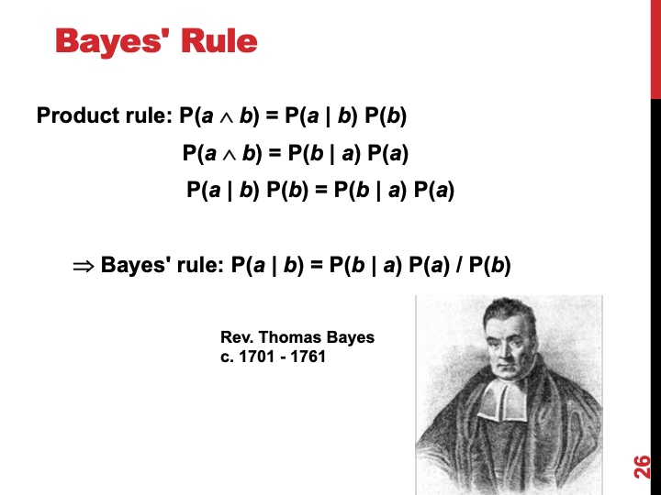
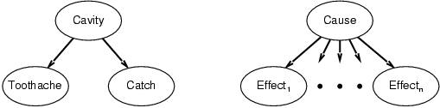
Combining Evidence (for Diagnosis)
P(Cavity | toothache,catch)
= αP(toothache ∧ catch | Cavity) P(Cavity) [Bayes’ Rule]
= αP(toothache | Cavity) P(catch | Cavity) P(Cavity) [Cond. Ind.]
This is an example of a naïve Bayes model:
P(Cause,Effect₁, … ,Effect_{n}) = P(Cause) π_{i}P(Effect_{i}|Cause)
Cost of diagnostic reasoning now grows linearly rather than exponentially in number of conditionally independent effects
Called naïve, because often used when the effects are not completely conditionally independent given the cause
Dempster-Shafer Theory

Slide 5
Combining Evidence (for Diagnosis)
P(Cavity | toothache,catch)
= αP(toothache ∧ catch | Cavity) P(Cavity) [Bayes’ Rule]
= αP(toothache | Cavity) P(catch | Cavity) P(Cavity) [Cond. Ind.]
This is an example of a naïve Bayes model:
P(Cause,Effect₁, … ,Effect_{n}) = P(Cause) π_{i}P(Effect_{i}|Cause)
Cost of diagnostic reasoning now grows linearly rather than exponentially in number of conditionally independent effects
Called naïve, because often used when the effects are not completely conditionally independent given the cause

Slide 6
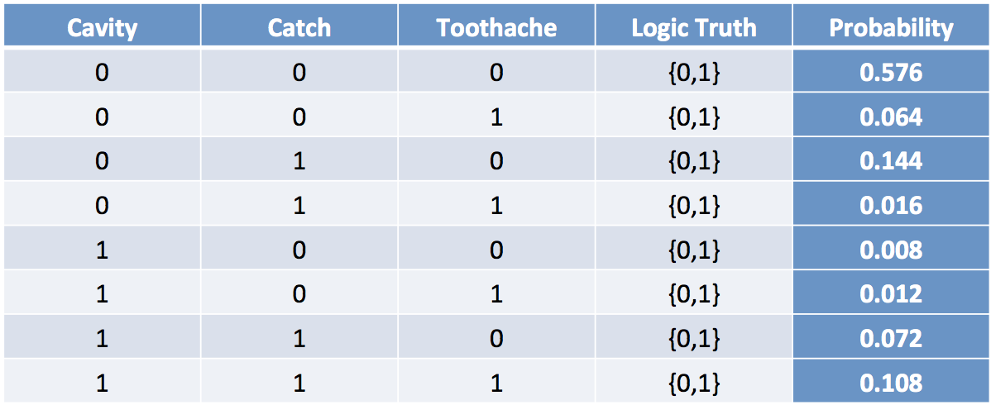
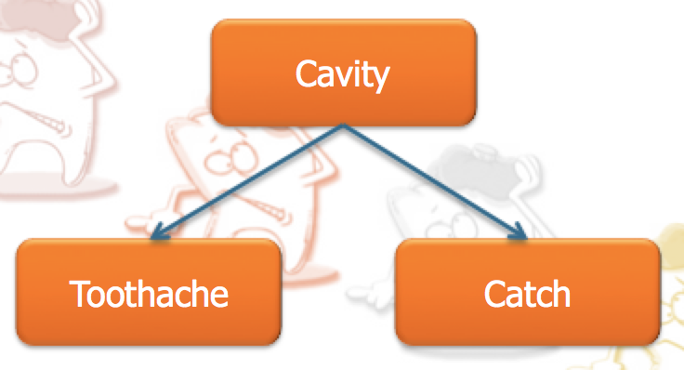

Why Need Bayesian Networks?
A better representation for the Fully Joint Probability Distribution Model
(take advantage of “variable independence”)
Fully Joint Distribution Table
Bayesian Network
🡸🡺
P(X₁, X₂, …, X_{n})
Size = O(d^{n})
d: variable domain
🡸🡺
Size = O(nd^{k})
k: # of parents
P(X₁,X₂,…,X_{n}) = P(X₁|X₂,…X_{n})P(X₂,…,X_{n})
= P(X₁|X₂,…X_{n})P(X₂|X₃,…,X_{n})P(X₃,…,X_{n}) = …
= P(X₁|X₂,…X_{n})P(X₂|X₃,…,X_{n}) … P(X_{n})

Slide 7
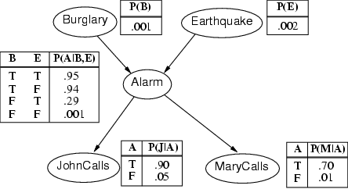
Alarm Example
Only one value needed for X_{i} in each row because, for boolean variables, P(false)=1-P(true)
All factors (possibly infinite) not explicitly mentioned are implicitly incorporated into probabilities
Bird could fly through window pane, power could fail, …
Notes:
Qualification problem

Slide 8
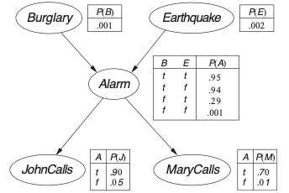
Semantics
If correct, the network represents the full joint distribution:
P(X₁, … ,X_{n}) = π_{i=1} P(X_{i} | parents(X_{i}))
n

Slide 9
P(x₁, … ,x_{n}) = π_{i=1} P(x_{i} | parents(X_{i}))
E.g., the probability of a complete false alarm (no burglary or earthquake) with two calls is:
P(j, m, a, ¬b, ¬e)
= P(j | a) P(m | a) P(a | ¬b, ¬e) P(¬b) P(¬e)
= .9 x .7 x .001 x .999 x .998 ≈ .000063
n

Slide 10
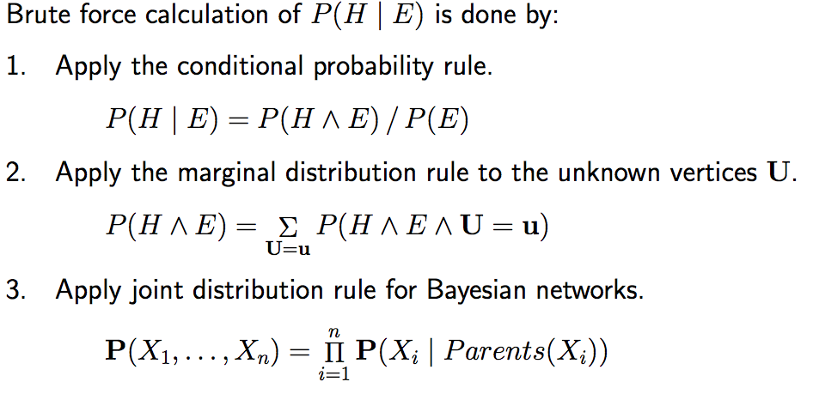
General Enumeration Algorithm
Given any query P( H | E), you can solve it by the following:
Only those dependent variables based on the net

Slide 11
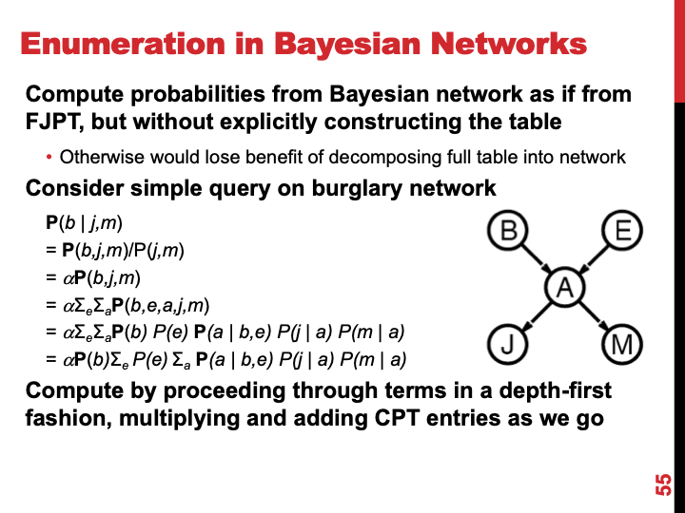

Slide 12
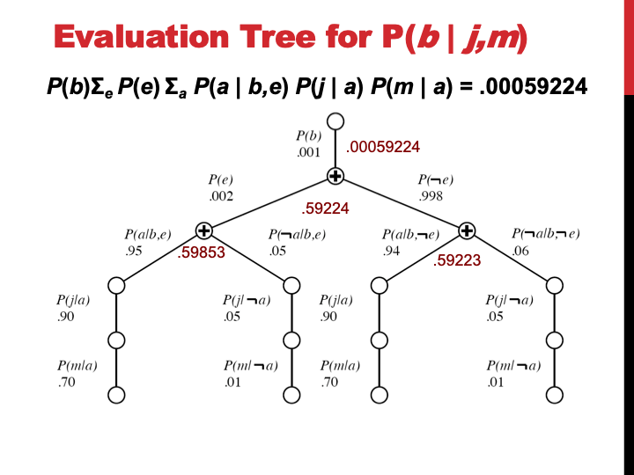
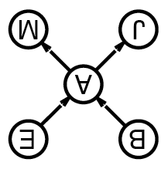
Enumeration in Bayesian Networks
Compute probabilities from Bayesian network as if from FJPT, but without explicitly constructing the table
Otherwise would lose benefit of decomposing full table into network
Consider simple query on burglary network
P(b | j,m)
= P(b,j,m)/P(j,m)
= αP(b,j,m)
= αΣ_{e}Σ_{a}P(b,e,a,j,m)
= αΣ_{e}Σ_{a}P(b) P(e) P(a | b,e) P(j | a) P(m | a)
= αP(b)Σ_{e} P(e) Σ_{a} P(a | b,e) P(j | a) P(m | a)
Compute by proceeding through terms in a depth-first fashion, multiplying and adding CPT entries as we go

Slide 13
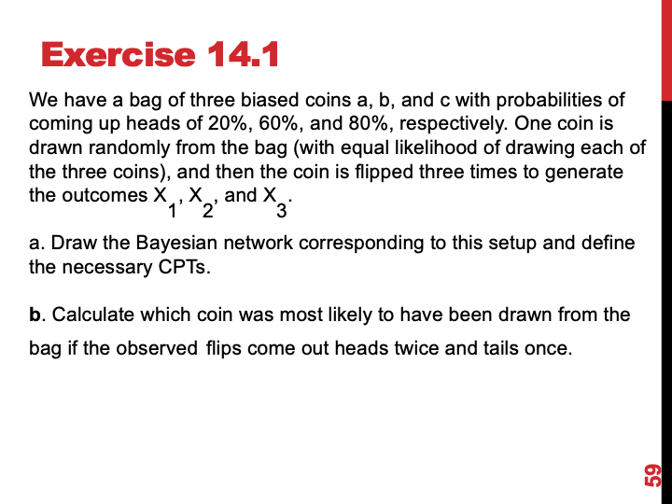

Slide 14
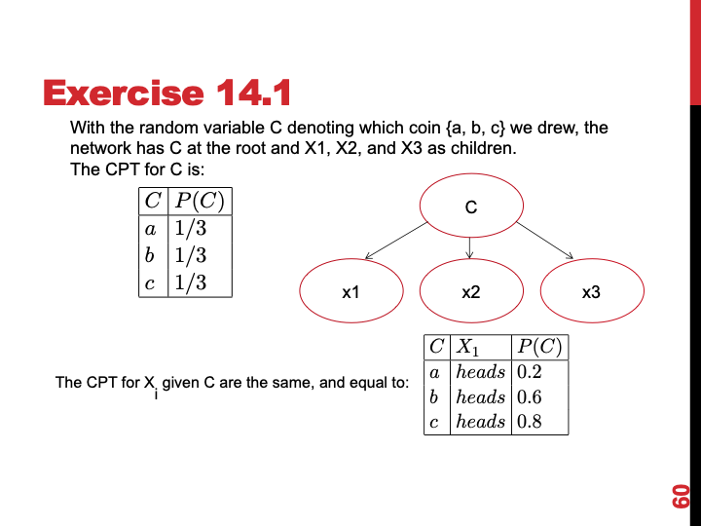

Slide 15
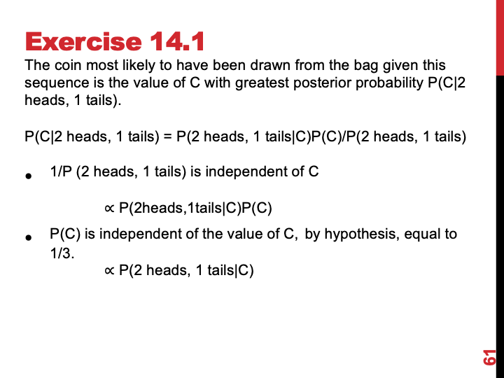

Slide 16
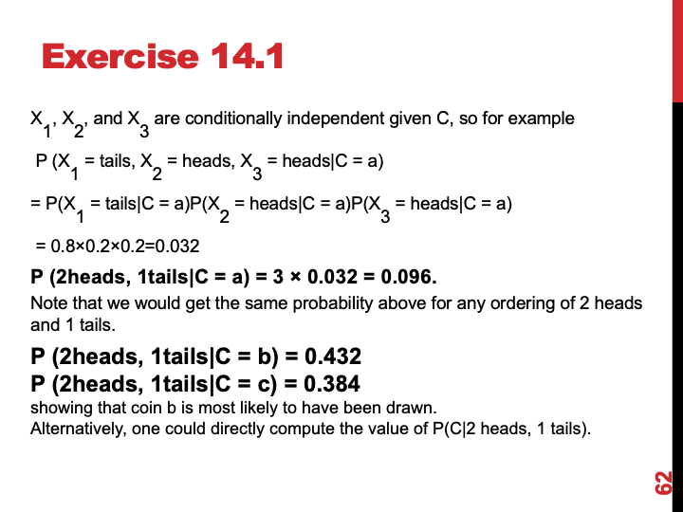

Slide 17
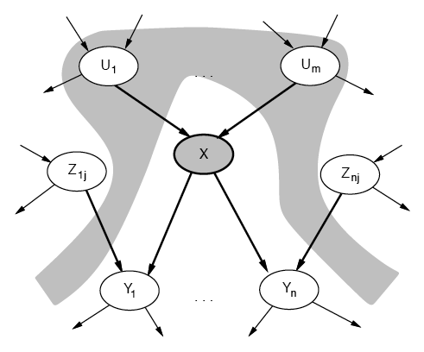
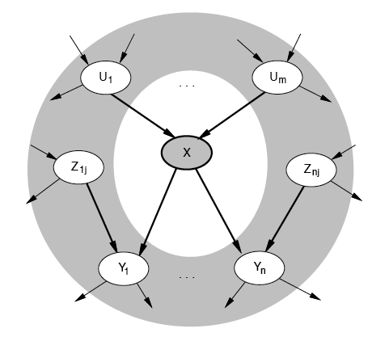
Conditional Independence of Nodes
A node is conditionally independent of its nondescendents given its parents
A node is conditionally independent of all others given its Markov blanket
Parents, children and children’s parents

Slide 18
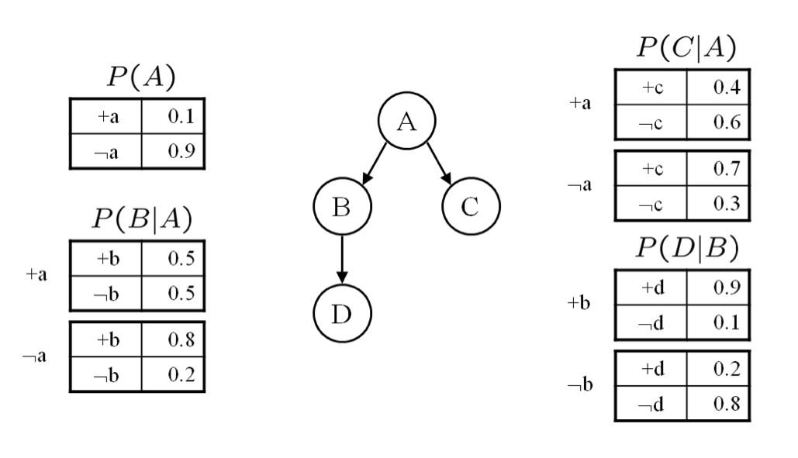
Bayesian Networks
Given this network calculate the following probabilities. Give both the formula and calculations with values. These questions are designed so that they can be answered with a minimum of computation. If you find yourself doing a copious amount of computation for each part, step back and consider whether there is simpler way to deduce the answer.
1. P(a,¬b,c,¬d)
P (a)P (¬b|a)P (c|a)P (¬d|¬b)
= 0.1 × 0.5 × 0.4 × 0.8 = 0.016

Slide 19
Bayesian Networks
2. P(b)
P(b) = ∑_{A={a,¬a}} P(A)P(b|A)
= 0.1 × 0.5 + 0.9 × 0.8 = 0.77
3. P(a|b)
P (a|b) = P (a,b)/ P (b) = P (a)P (b|a) / P (b)
= 0.1×0.5 / .77 = 0.064935

Slide 20
Bayesian Networks
4. P(d|a)
P (d|a) = ∑_{B={b,¬b}} P (d|B)p(B|a)
// think: why no P(a) here?
= 0.9 × 0.5 + 0.2 × 0.5 = 0. 55
5. P(d|a,c)
From the conditional independence properties of the graph, D ⊥ C|{A}. Hence, P(d|a,c) = p(d|a)
= 0.55
Notes:
P(d|a) = P(da)/P(a) = Sum_B P(aBd) / P(a) = Sum_B P(a)P(Bd|a) / P(a) = Sum_B P(Bd|a) = Sum_B P(B|a)P(d|Ba) = Sum_B P(B|a)P(d|B)
P(d|ac) = P(dac)/P(ac) = Sum_B P(dacB)/P(ac) = Sum_B P(a)P(c\a)P(B|a)P(d|B)/P(ac) = Sum_B P(B|a)P(d|B)

Slide 21
What you should know
Probability formulas:
Product rule: P(a ∧ b) = P(a | b) P(b) = P(b | a) P(a)
⇒ Bayes' rule: P(a | b) = P(b | a) P(a) / P(b)
Conditional probability: P(a | b) = P(a ∧ b) / P(b)
What is independence? What is conditional independence? Why are they needed for reasoning about uncertainty?
What is Bayes rule? How is this addressing combining evidence for diagnosis?
Bayesian networks provide a natural representation for (causally induced) conditional independence
Topology + CPTs = compact representation of joint distribution
Why do we need approximate inference? What are some approximate inference techniques?
Are there limits to probabilistic reasoning?
How can we reasoning probabilistic over time?

Slide 22
Want more?
Try exercise 13.4,7,8,13,15, 14.2,8 in AIMA

