Slide 1
Discussion Section (Week 14) MDP and Bayesian Learner
CSCI 561 - Foundation for Artificial Intelligence
PROF WEI-MIN SHEN WMSHEN@USC.EDU

Slide 2
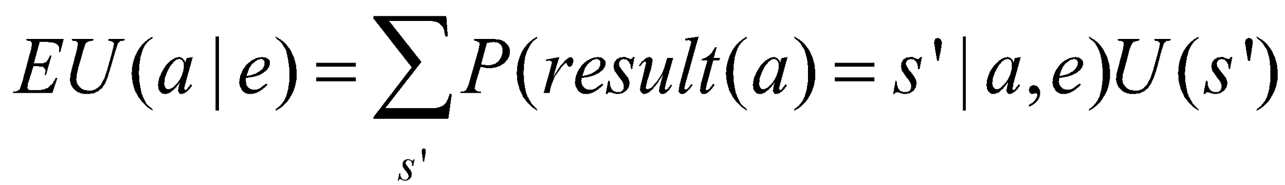
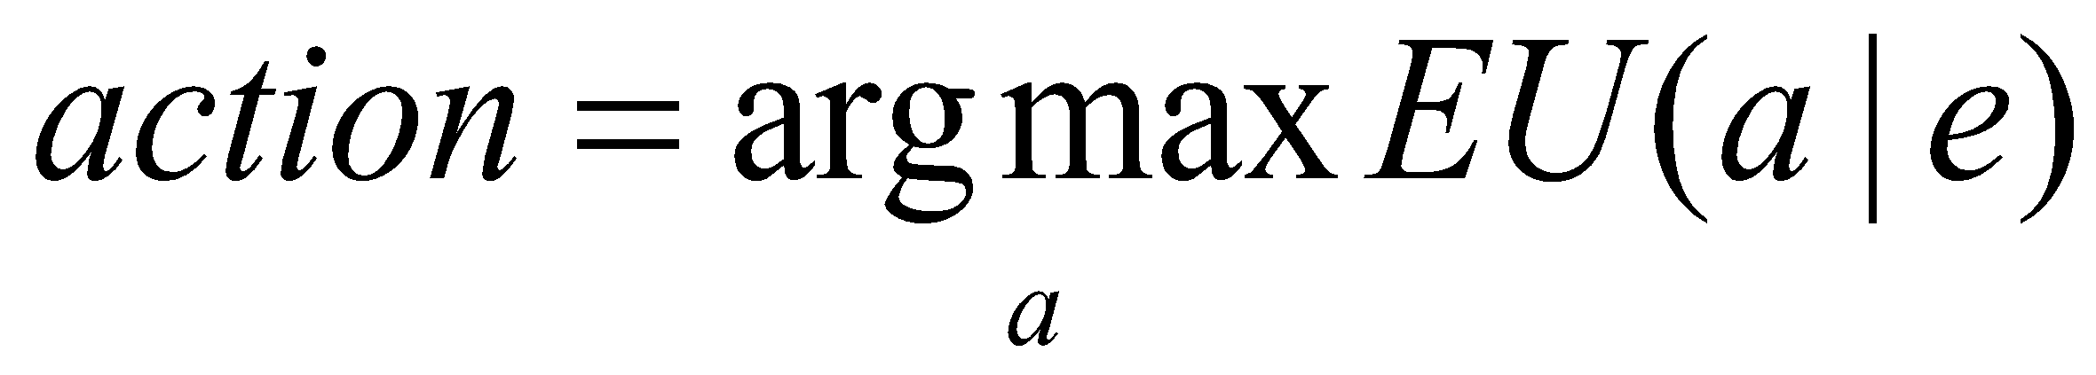
Maximum Expected Utility (MEU) and Rational Agents
Every state has a utility value U(s)
The expected utility of an action given the current evidence or observation e, is the average utility value of the outcomes, weighted by the probability that the outcome occurs:
The principle of maximum expected utility (MEU) is that a rational agent should choose the action that maximizes its expected utility:
z2
z1
s2
a1
s9
U(s2)=0.4
a1
U(s9)=0.2
a1
s7
U(s7)=0.4

Slide 3
16.15 Making Simple Decisions
Consider a student who has the choice to buy or not buy a textbook for a course. We’ll model this as a decision problem with one Boolean decision node, B, indicating whether the agent chooses to buy the book, and two Boolean chance nodes, M, indicating whether the student has mastered the material in the book, and P , indicating whether the student passes the course. Of course, there is also a utility node, U. A certain student, Sam, has an additive utility function: 0 for not buying the book and -$100 for buying it; and $2000 for passing the course and 0 for not passing. Sam’s conditional probability estimates are as follows:
P(p|b,m) = 0.9
P(m|b) = 0.9
P (p|b, ¬m) = 0.5
P (m|¬b) = 0.7
P(p|¬b, m) = 0.8
P (p|¬b, ¬m) = 0.3
You might think that P would be independent of B given M, But this course has an open- book final—so having the book helps.

Slide 4
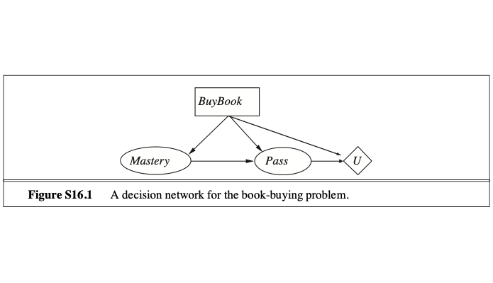
Draw the decision network for this problem.
P(p|b,m) = 0.9
P(m|b) = 0.9
P (p|b, ¬m) = 0.5
P (m|¬b) = 0.7
P(p|¬b, m) = 0.8
P (p|¬b, ¬m) = 0.3
Utility | Buy | ~Buy
Pass | 2000-100 | 2000
~Pass | 0-100 | 0+0

Slide 5
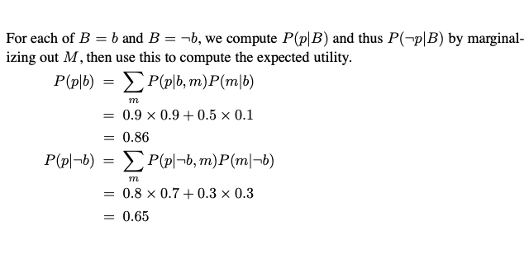
Compute the expected utility of buying the book and of not buying it.

Slide 6
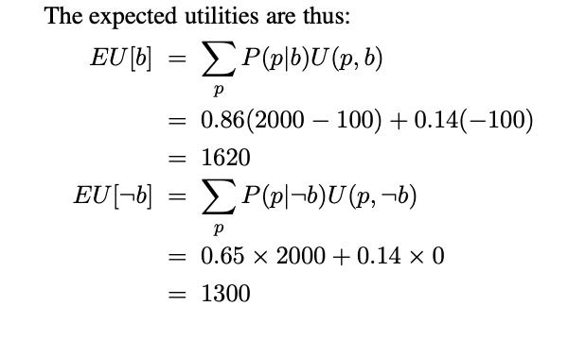

Compute the expected utility of buying the book and of not buying it.
0.35 x 0
BUY!

Slide 7
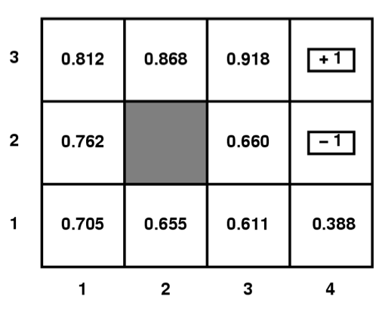
MDP
500
50
Given a Gridworld domain, where terminal states
(1,3), (4,3), and (4,2) have rewards 50, 500, and -50
respectively, the set of possible actions are
{N,E,S,W, or X for terminal states},
the agent moves deterministically,
all V and Q values for non terminal
states have been initialized to 0,
answer the questions below.
Circle the letter that corresponds to the best answer for the question.
What are the optimal values, V∗ of each state in the above grid if γ = 0.5, c(a)=0, R(s)=0 for non terminal states?
(Remember V_{t+1}(s) = R(s) + Max_{aεA} {c(a)+γΣ_{s’εS} P(s’|a,s) V_{t}(s’)} )
V_{(1,1)}=15.75, V_{(1,2)}=25, V_{(2,1)}=31.25, V_{(2,3)}=125, V_{(3,1)}=62.5, V_{(3,2)}=125, V_{(3,3)}=250, V_{(4,1)}=25
V_{(1,1)}=12.5, V_{(1,2)}=25, V_{(2,1)}=31.25, V_{(2,3)}=125, V_{(3,1)}=62.5, V_{(3,2)}=125, V_{(3,3)}=250, V_{(4,1)}=31.25
V_{(1,1)}=15.625, V_{(1,2)}=25, V_{(2,1)}=31.25, V_{(2,3)}=125, V_{(3,1)}=62.5, V_{(3,2)}=125, V_{(3,3)}=250, V_{(4,1)}=31.25
V_{(1,1)}=12.5, V_{(1,2)}=25, V_{(2,1)}=25, V_{(2,3)}=25, V_{(3,1)}=50, V_{(3,2)}=100, V_{(3,3)}=250, V_{(4,1)}=25
None of the above
-50
C
Notes:
V(1,1) = R(1,1) + max_a_in_A { 0 + 0.5*sum( P(s’|a,s) * V(s’) ) }
a=N {0 + 0.5* (1.0 * V(1,2)) = 0 + 0.5 *(1.0 * 0) = 0

Slide 8
MDP
What are the Q values of state (3,2) in the above grid if γ = 0.5, c(a)=0, R(s)=-2 for non terminal states?
(Remember Q_{t+1}(a,s) = R(s) + c(a)+γΣ_{s’εS} P(s’|a,s)max_{a’εA} Q_{t}(a’s’) )
Q_{((3,2),N)}=122, Q_{((3,2),E)}=-27, Q_{((3,2),S)}=59
Q_{((3,2),N)}=122, Q_{((3,2),E)}=-27, Q_{((3,2),S)}=27.5
Q_{((3,2),N)}=125, Q_{((3,2),E)}=-25, Q_{((3,2),S)}=62.5
Q_{((3,2),N)}=120, Q_{((3,2),E)}=-27, Q_{((3,2),S)}=31.5
None of the above
500
50
500
50
-50
-50

Slide 9
MDP
What are the Q values of state (3,2) in the above grid if γ = 0.5, c(a)=0, R(s)=-2 for non terminal states?
(Remember Q_{t+1}(a,s) = R(s) + c(a)+γΣ_{s’εS} P(s’|a,s)max_{a’εA} Q_{t}(a’s’) )
Q_{((3,2),N)}=122, Q_{((3,2),E)}=-27, Q_{((3,2),S)}=59
Q_{((3,2),N)}=122, Q_{((3,2),E)}=-27, Q_{((3,2),S)}=27.5
Q_{((3,2),N)}=125, Q_{((3,2),E)}=-25, Q_{((3,2),S)}=62.5
Q_{((3,2),N)}=120, Q_{((3,2),E)}=-27, Q_{((3,2),S)}=31.5
None of the above
50
E248
500
-50

Slide 10
MDP
What are the Q values of state (3,2) in the above grid if γ = 0.5, c(a)=0, R(s)=-2 for non terminal states?
(Remember Q_{t+1}(a,s) = R(s) + c(a)+γΣ_{s’εS} P(s’|a,s)max_{a’εA} Q_{t}(a’s’) )
Q_{((3,2),N)}=122, Q_{((3,2),E)}=-27, Q_{((3,2),S)}=59
Q_{((3,2),N)}=122, Q_{((3,2),E)}=-27, Q_{((3,2),S)}=27.5
Q_{((3,2),N)}=125, Q_{((3,2),E)}=-25, Q_{((3,2),S)}=62.5
Q_{((3,2),N)}=120, Q_{((3,2),E)}=-27, Q_{((3,2),S)}=31.5
None of the above
50
E248
500
N122
-50

Slide 11
MDP
What are the Q values of state (3,2) in the above grid if γ = 0.5, c(a)=0, R(s)=-2 for non terminal states?
(Remember Q_{t+1}(a,s) = R(s) + c(a)+γΣ_{s’εS} P(s’|a,s)max_{a’εA} Q_{t}(a’s’) )
Q_{((3,2),N)}=122, Q_{((3,2),E)}=-27, Q_{((3,2),S)}=59
Q_{((3,2),N)}=122, Q_{((3,2),E)}=-27, Q_{((3,2),S)}=27.5
Q_{((3,2),N)}=125, Q_{((3,2),E)}=-25, Q_{((3,2),S)}=62.5
Q_{((3,2),N)}=120, Q_{((3,2),E)}=-27, Q_{((3,2),S)}=31.5
None of the above
50
E248
500
N122
-50
S27.5
N59
B

Slide 12
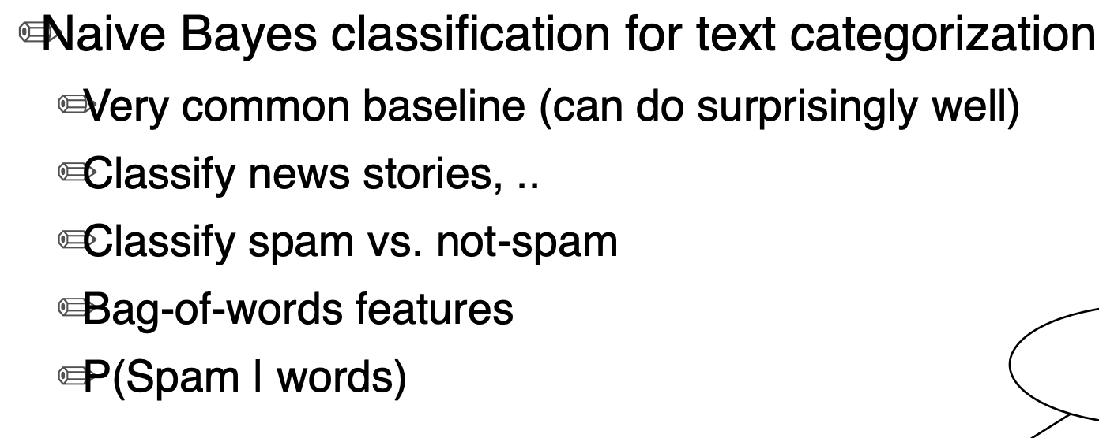
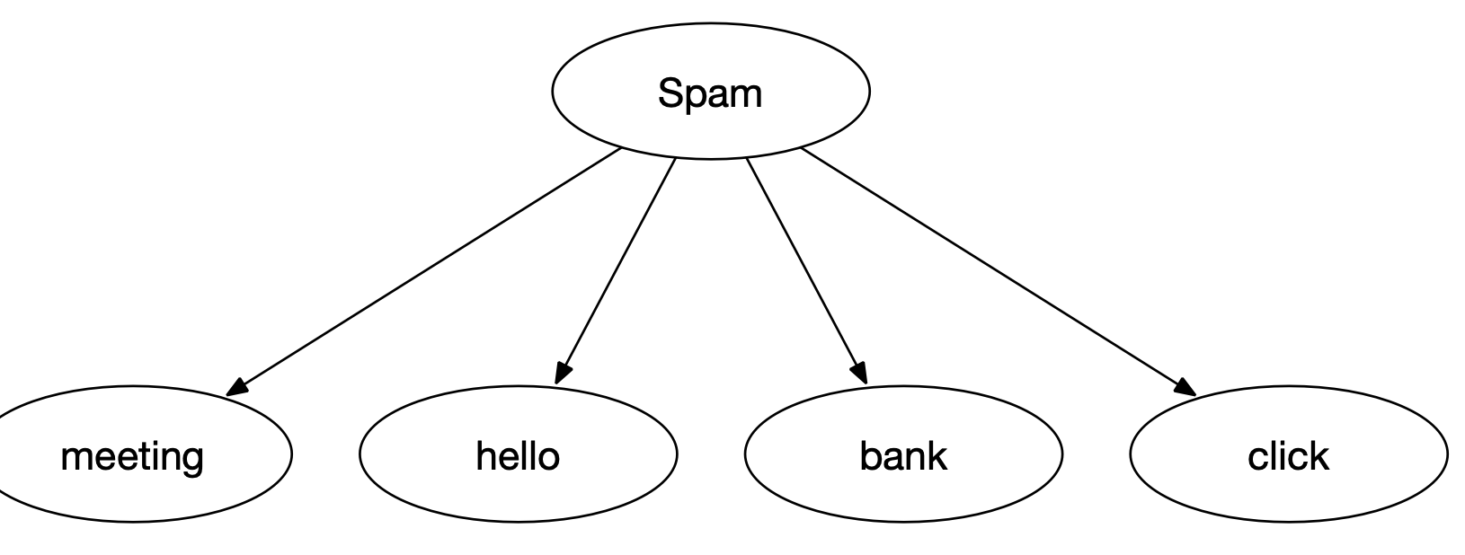
Naïve Bayes Classifier

Slide 13
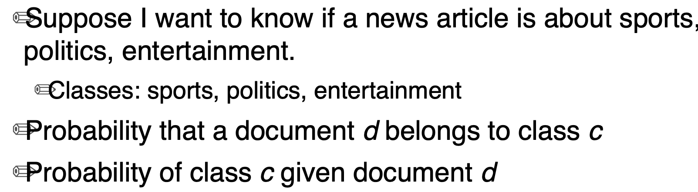
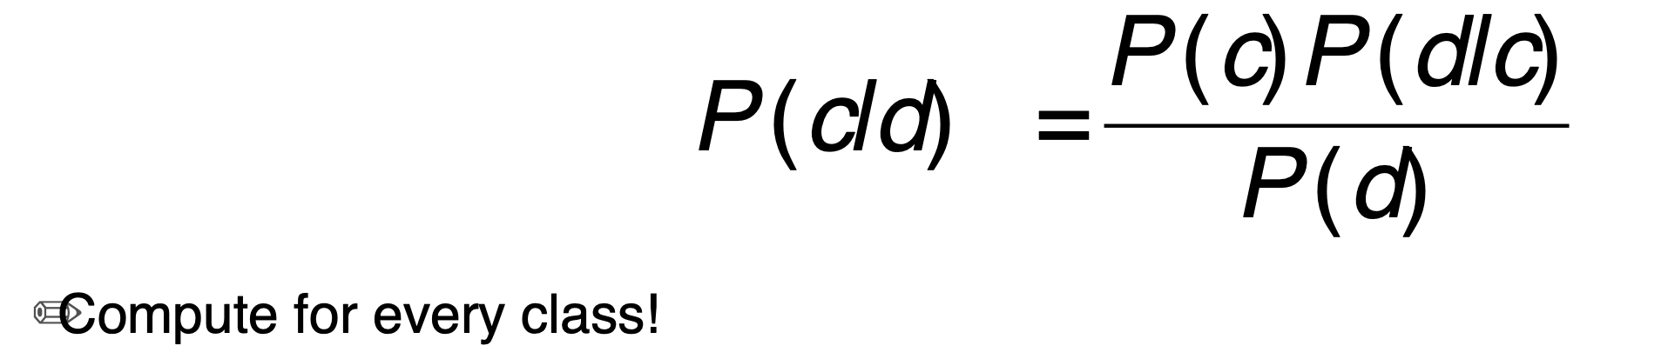
Naïve Bayes

Slide 14
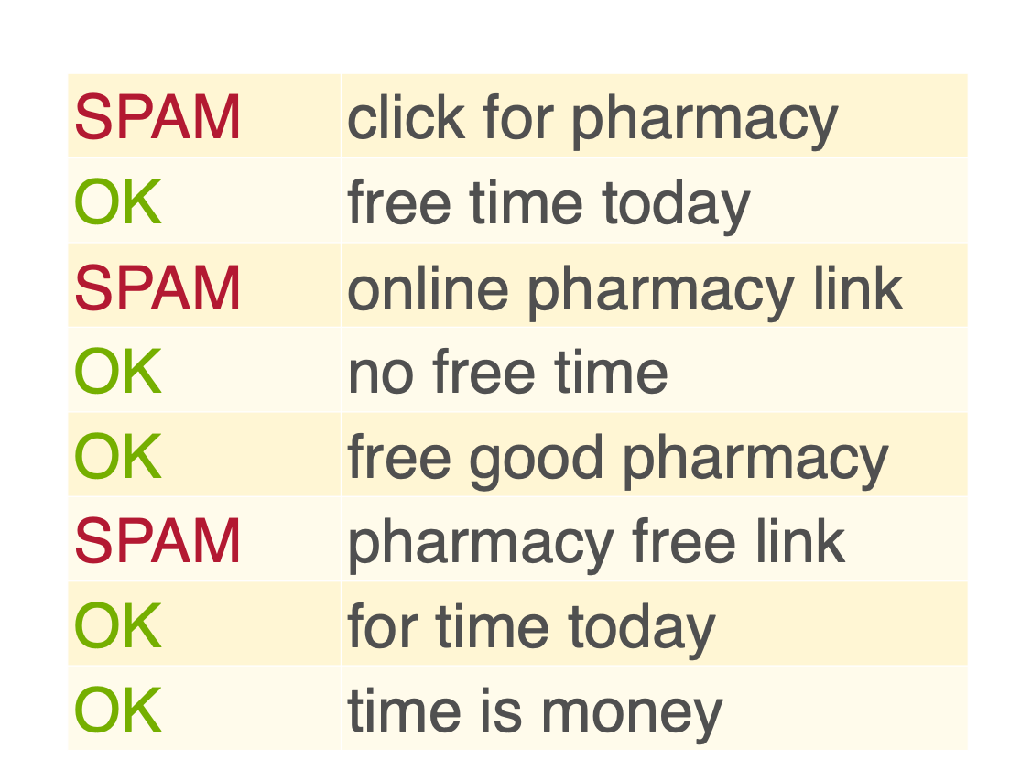
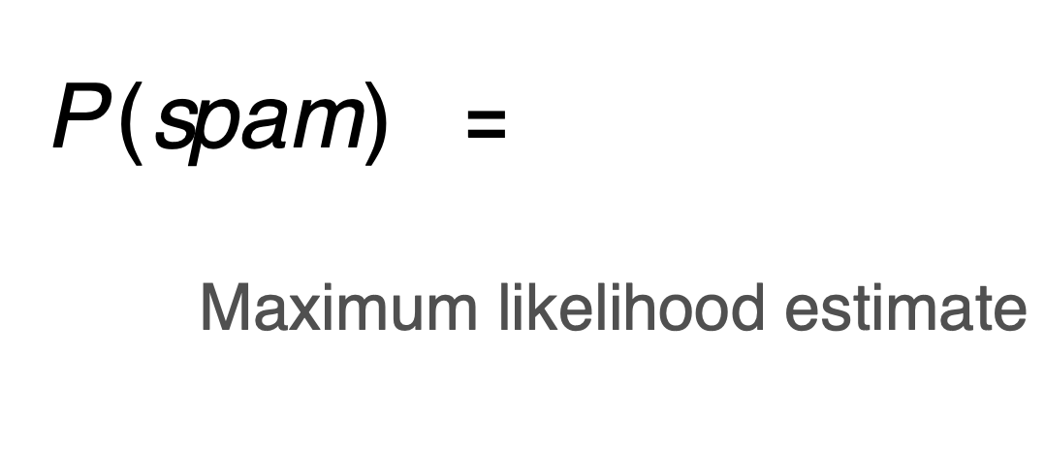
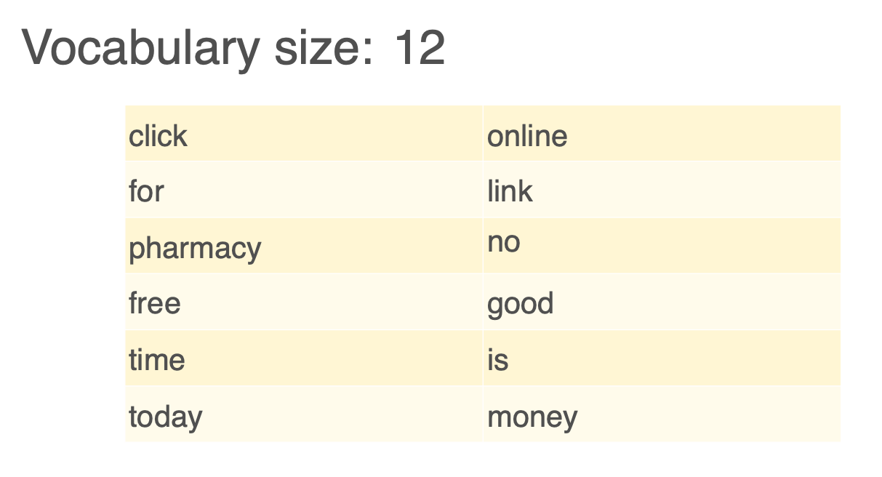
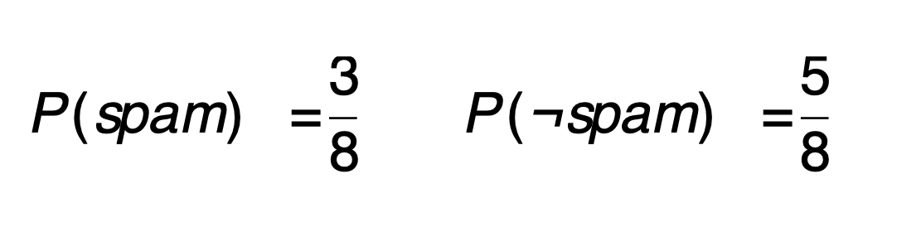

Slide 15
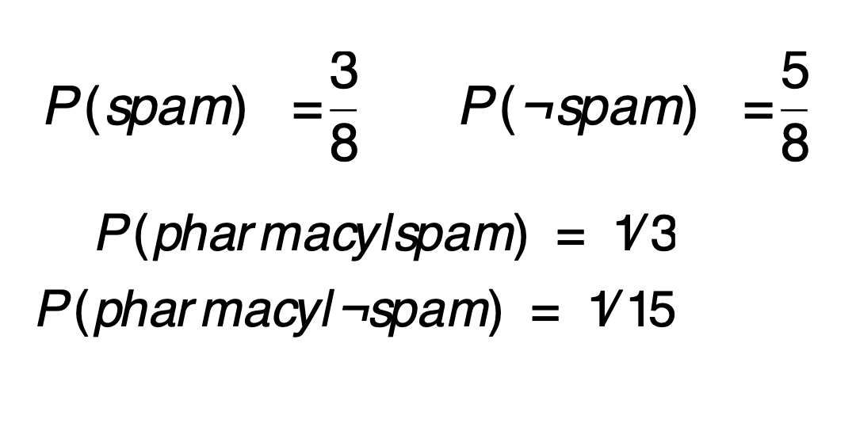
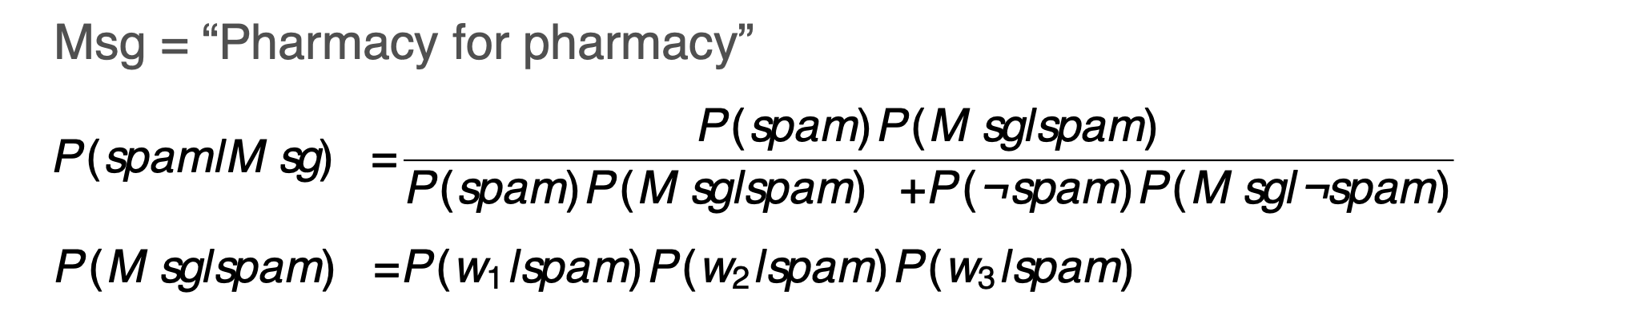

Slide 16
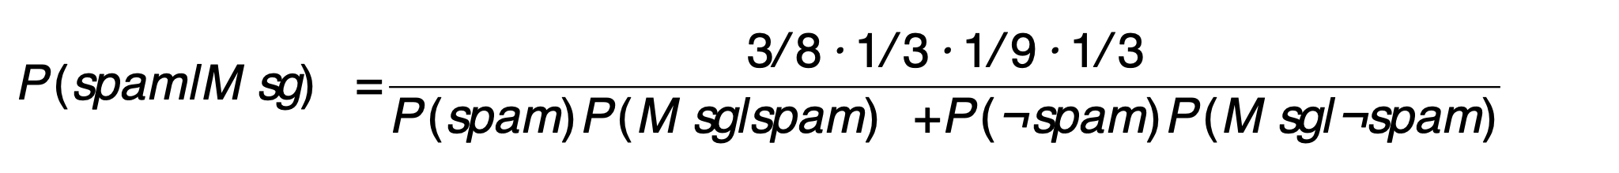

Slide 17
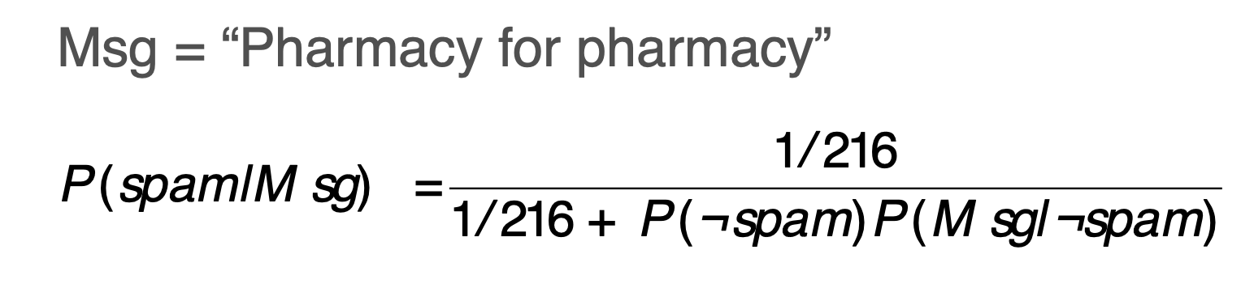
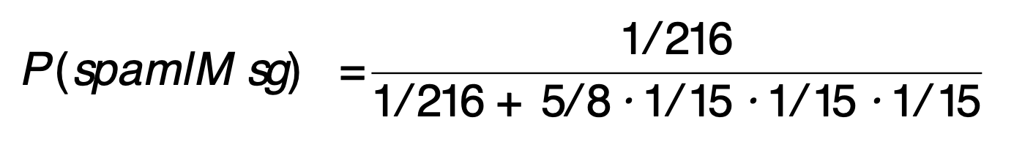

Slide 18
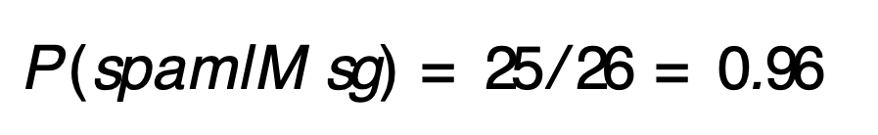

Slide 19


Slide 20
Want more?
Exercises 16.5, 17.1, 17.9, 17.10

