Slide 1
Discussion Section (Week 14) Sample Final Review
CSCI 561 - Foundation for Artificial Intelligence
PROF WEI-MIN SHEN WMSHEN@USC.EDU

Slide 2
Probability
Your doctor performs a series of medical tests. You test positive for a serious, but very rare disease. The test is 99% accurate, meaning the probability that it is positive when you do have the disease is 0.99, and the probability that it is negative if you don’t is also 0.99. The disease strikes 1 in 10,000.
What is the probability that you have the disease if your test is positive? Give both the formula and the value.
P(test|disease) = 0.99 P(¬test|¬disease) = 0.99
P(disease) = 0.0001
What the patient is concerned about is P(disease|test).
P(disease|test)
= P(test|disease)P(disease) = 0.99×0.0001 = .000099
P(test|disease)P(disease)+P(test|¬disease)P(¬disease) = 0.99×0.0001+0.01×0.9999 =.010098
= .000099 / .010098 = .009804
Notes:
Roughly speaking, the reason it is a good thing that the disease is rare is that P(disease|test) is proportional to P(disease), so a lower prior for disease will mean a lower value for P(disease|test). Roughly speaking, if 10,000 people take the test, we expect 1 to actually have the disease, and most likely test positive, while the rest do not have the disease, but 1% of them (about 100 people) will test positive anyway, so P(disease|test) will be about 1 in 100. More precisely, using the normalization equation from page 480:

Slide 3
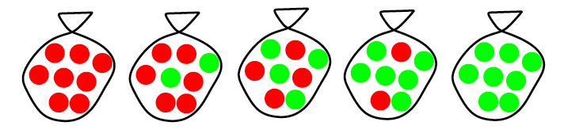

Candy Example
P(d_{j}|h_{i}) when d_{j} is a Lime
Suppose there are fives kinds of candy bags:
Then we observe candies:
What kind of bag is it? What flavor will be next?
Assume big bag so that draws are i.i.d. P(d | h_{i}) = π_{j} P(d_{j} | h_{i})
P(d | h_{i}) = P(lime | h₃) P(lime | h₃) P(lime | h₃) P(lime | h₃) P(lime | h₃) P(lime | h₃) P(lime | h₃) P(lime | h₃) P(lime | h₃) P(lime | h₃) = .5 * .5 * .5 * .5 * .5 * .5 * .5 * .5 *.5 *.5
Hypothesis | Prior | Cherry | Lime
h₁ | .1 | 100% | 0%
h₂ | .2 | 75% | 25%
h₃ | .4 | 50% | 50%
h₄ | .2 | 25% | 75%
h₅ | .1 | 0% | 100%
P(d_{j}|h₁)
P(d_{j}|h₂)
P(d_{j}|h₃)
P(d_{j}|h₄)
P(d_{j}|h₅)

Slide 4
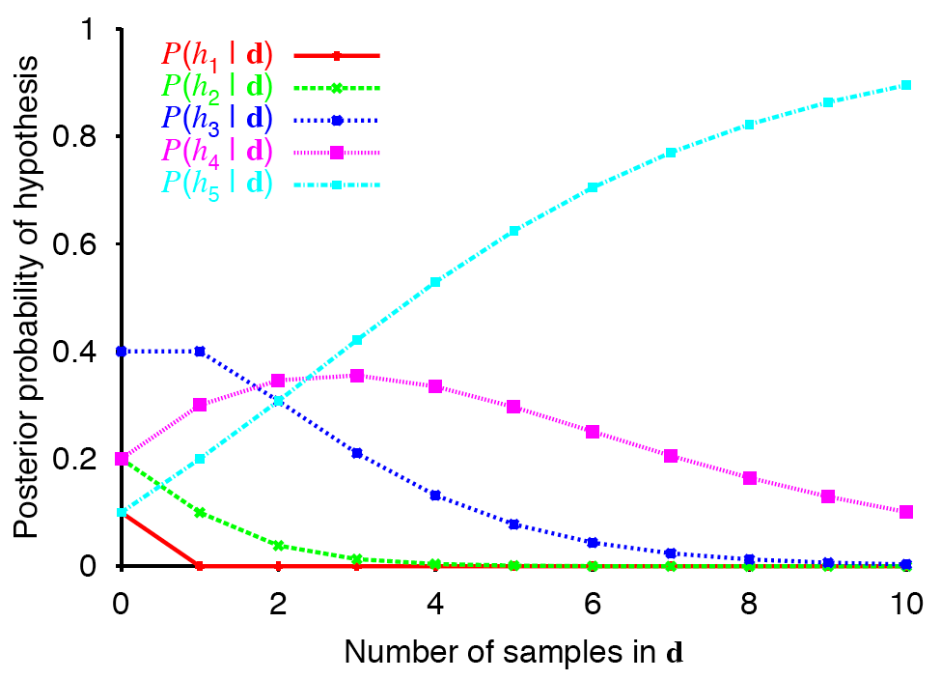
Posterior Probability of H
(all lime)
Computed as P(h_{i} | d) = απ_{j} P(d_{j} | h_{i}) P(h_{i})
Ex: P(h₃| d) = απ_{j} (.5 * .4)
Notes:
Predicted probabilities over different kinds of bags
Start at 0 with prior probabilities but shift over time based on what seen.

Slide 5
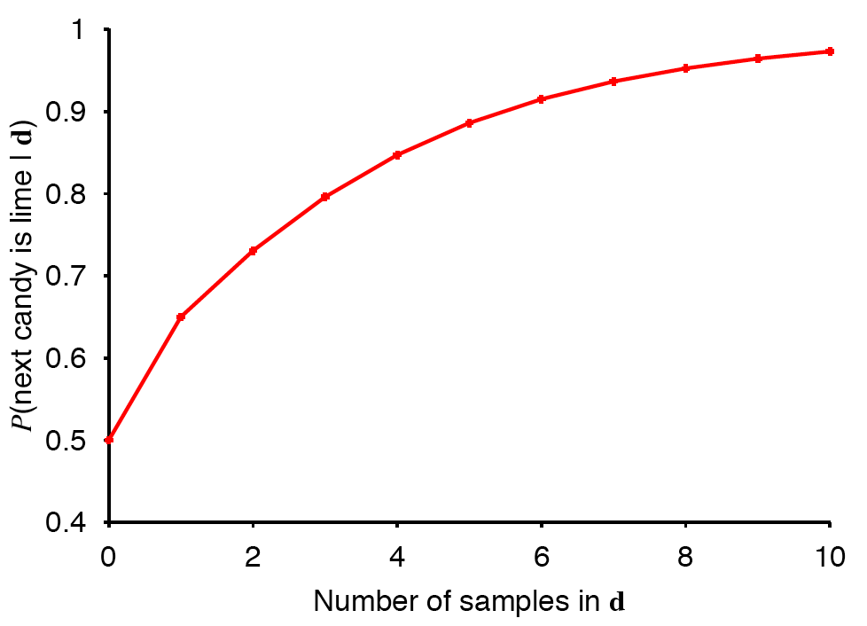
Probability of Predicting Lime
(all lime)
Computed as P(lime | d) = Σ_{i} P(lime | h_{i})P(h_{i} | d)

Slide 6
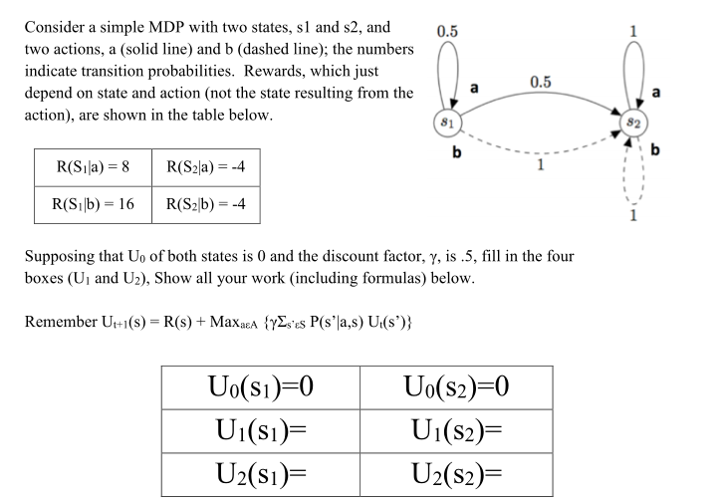
MDP
U_{t+1}(s) = Max _{aεA} { R(s,a) + γ Σ_{s’εS} P(s’|a,s) Ut(s’) }
U₁(S₁) = Max { (8 + 0.5*(0.5*0+0.5*0) ) , (16 + 0.5*1*0) } = Max (8,16) = 16
U₁(S₂) = Max ( (-4 + 0.5*1*0 ) , (-4 + 0.5*1*0) ) = Max (-4,-4) = -4
U2(S1) = Max ( (8 + 0.5*(0.5*16+0.5*-4) ) , (16 + 0.5*1*-4) ) = Max (11,14) = 14
U2(S2) = Max ( (-4 + 0.5*1*-4 ) , (-4 + 0.5*1*-4) ) = Max (-6,-6) = -6
Notes:
Ut+1(s) = + MaxaεA { R(s) + γΣs’εS P(s’|a,s) Ut(s’)}
U1( S1) = Max ( (8 + 0.5*(0.5*0+0.5*0) ) , (16 + 0.5*1*0) ) = Max (8,16) = 16
U1(S2) = Max ( (-4 + 0.5*1*0 ) , (-4 + 0.5*1*0) ) = Max (-4,-4) = -4
U2(S1) = Max ( (8 + 0.5*(0.5*16+0.5*-4) ) , (16 + 0.5*1*-4) ) = Max (11,14) = 14
U2(S2) = Max ( (-4 + 0.5*1*-4 ) , (-4 + 0.5*1*-4) ) = Max (-6,-6) = -6

Slide 7
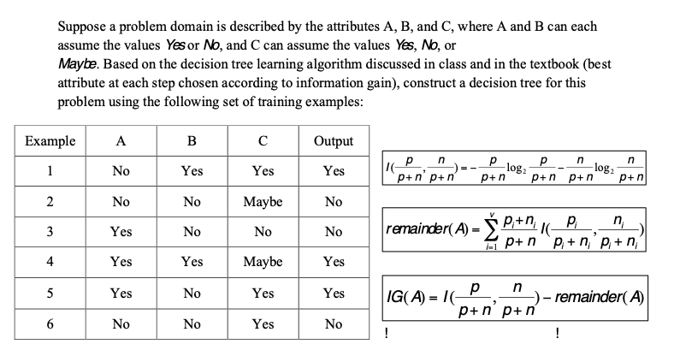
Decision Tree
At root: I(3/6 , 3/6 ) = 1 Remainder(A) = 3/6 I(2/3 ,1/3) + 3/6 I(2/3,1/3) Remainder(B) = 2/6 I(2/2 , 0 ) + 4/6 I ( 1⁄4 , 3⁄4 ) Remainder(C) = 3/6 I(2/3 , 1/3 ) + 1/6 I(1,0) + 2/6 I(1/2 , 1⁄2 ) IG(B) is the largest so it will be the root. Similarly, next one is A , and then C.
Notes:
At root: I(3/6 , 3/6 ) = 1 Remainder(A) = 3/6 I(2/3 ,1/3) + 3/6 I(2/3,1/3) Remainder(B) = 2/6 I(2/2 , 0 ) + 4/6 I ( 1⁄4 , 3⁄4 ) Remainder(C) = 3/6 I(2/3 , 1/3 ) + 1/6 I(1,0) + 2/6 I(1/2 , 1⁄2 ) IG(B) is the largest so it will be the root. Similarly, next one is A , and then C.

Slide 8
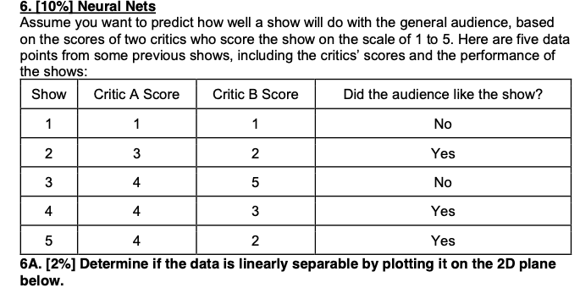

Slide 9
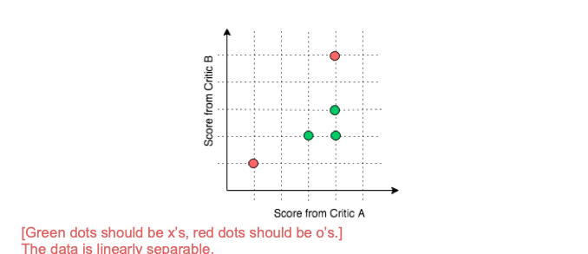

Slide 10
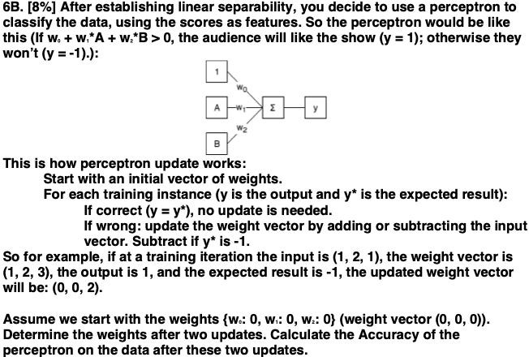


Slide 11
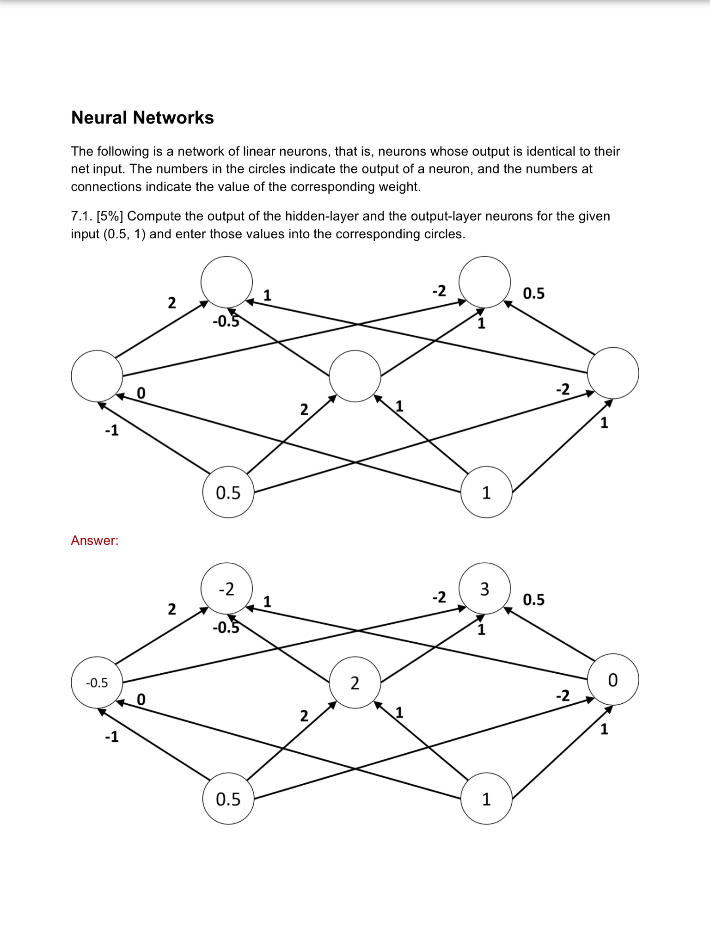

Slide 13
Short Answer
1. List 3 reasons WHY machine learning is needed?
Unknown environments
Adaptability
Lazy
Autonomous

Slide 14
Short Answer
2. What is Ockham’s razor? How is it used in neural net learning?
Bias for simplest hypothesis
Prefer fewer hidden units

Slide 15
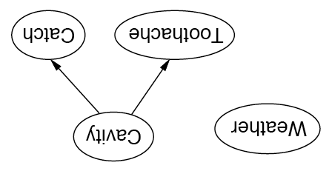
Independence in Bayesian Networks
Topology of network encodes (conditional) independence assertions:
Weather is independent of the other variables
Toothache and Catch are conditionally independent given Cavity

Slide 16
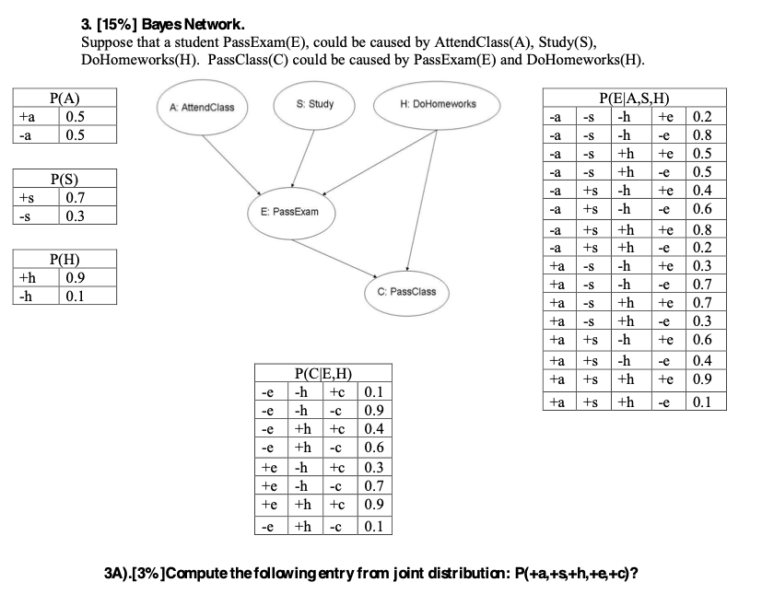

Slide 17
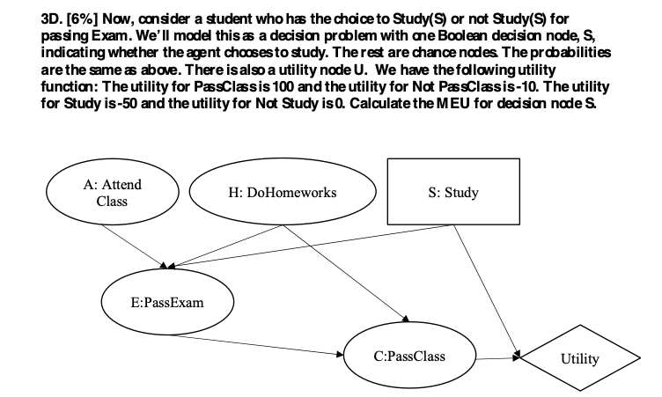

Slide 18
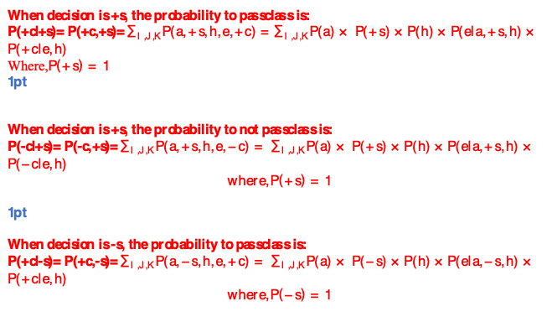
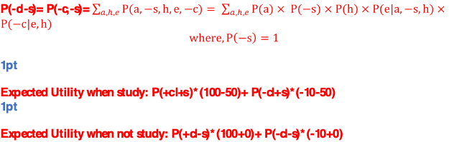

Slide 19
Neural Nets
Draw the neural network to solve the XOR function for two inputs.
Specify what type of units you are using.
(try it on paper now)

Slide 20

When input X = 0 and input Y = 0, what does the Unit A output? What does the Unit B output?
When input X = 0 and input Y = 1, what does the Unit A output? What does the Unit B output?
When input X = 1 and input Y = 0, what does the Unit A output? What does the Unit B output?
When input X = 1 and input Y = 1, what does the Unit A output? What does the Unit B output?
What Boolean function does this Neural Network compute?

