Slide 1
DISCUSSION SECTION (WEEK 2)
CSCI 561 - Foundation for Artificial Intelligence
PROF WEI-MIN SHEN SHEN@ISI.EDU

Slide 2



WHAT IS “PROBLEM SOLVING”? WHAT IS “SEARCH”?
How to design this?
Sensors
percepts
Environment
AI?
Agent
actions
Effectors

Slide 3
ESSENTIALS OF SEARCH
How to represent a “problem”?
How to construct a Search Tree/Graph?
Nodes, Goals, Initials, Links
How to find a solution “systematically” or “optimally” in your representation?
Use the uninformed algorithms you learned
Use the informed algorithms you learned

Slide 4
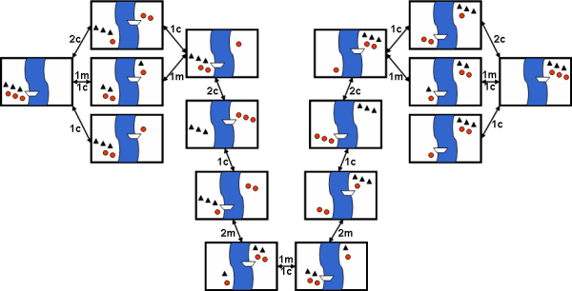
MISSIONARIES AND CANNIBALS
Did you find that there was much search involved in finding a solution?
Why do people have a hard time solving this problem?
Notes:
There are a number of constraints on solutions to this problem, for example, the boat only holds one or two people, you can never have more cannibals than missionaries on either side of the river, etc. Constraints are generally thought of as making it harder to solve a problem, but could they make it easier? How?

Slide 5
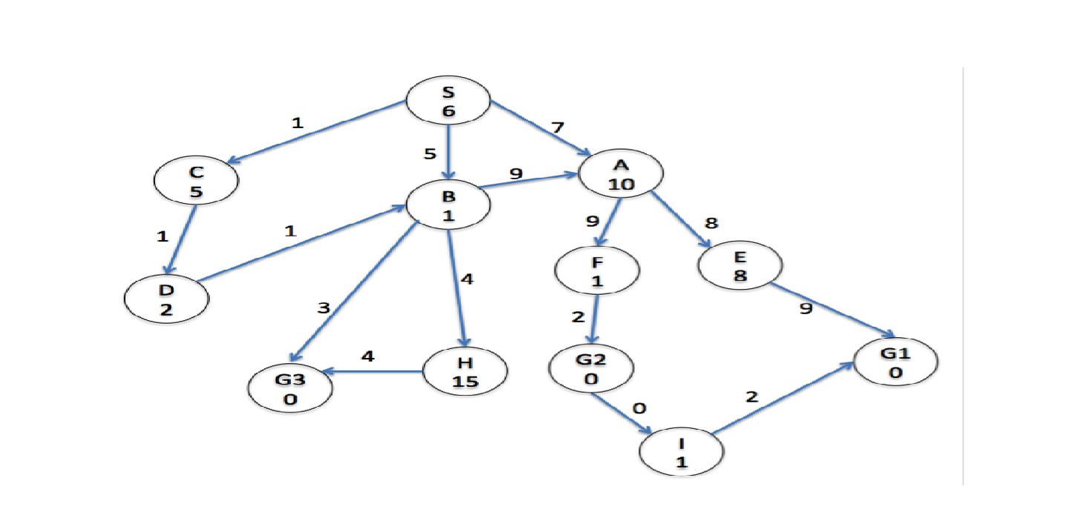
SEARCH GRAPH
Notes:
a)DFS G1 (2%) _____ S­A­E­G1 ( 8%) [No partial credit]
b)UCS G3(2%) _____ S­C­D­B­G3( 8%) [No partial credit]
c)A* G3(2%) _____ S­B­C­D­G3 OR S­B­C­D­B­G3 (8%) [No partial credit]

Slide 6
GRAPH SEARCH
function GRAPH-SEARCH(problem) return a solution or failure
frontier ← MAKE-QUEUE(MAKE-NODE(problem.INITIAL-STATE))
explored_set ← empty
loop do
if EMPTY?(frontier) then return failure
node ← REMOVE-FIRST(frontier)
if problem.GOAL-TEST applied to node.STATE succeeds
then return SOLUTION(node)
explored_set ← INSERT(node, explored_set) for each new_node in EXPAND(node, problem) do if NOT(MEMBER?(new_node, frontier)) and NOT(MEMBER?(new_node, explored_set))
then frontier ← INSERT(new_node, frontier)

Slide 7
GRAPH SEARCH
function GRAPH-SEARCH(problem) return a solution or failure
frontier ← MAKE-QUEUE(MAKE-NODE(problem.INITIAL-STATE))
explored_set ← empty
loop do
if EMPTY?(frontier) then return failure
node ← REMOVE-FIRST(frontier)
if problem.GOAL-TEST applied to node.STATE succeeds
then return SOLUTION(node)
explored_set ← INSERT(node, explored_set) for each new_node in EXPAND(node, problem) do if NOT(MEMBER?(new_node, frontier)) and NOT(MEMBER?(new_node, explored_set))
then frontier ← INSERT(new_node, frontier)
How to modify this algorithm to become the following algorithms? (important!)
BFS
DFS
UCS
A*

Slide 8
A* = BEST-FIRST (PAST + ESTIMATED FUTURE)
G₁
n=?
h(i)
c_{i}
i
now
S₀
n-1
c_{j}
j
h(j)
G₂
c_{k}
Past Cost g(n-1)
you know it
k
h(k)
A* Choses the best
g(n)+h(n)
Future Cost
Unknown
Can only be estimated by h(n)
Never over-estimate!
Is it good to have h(x)=0 for all x?
G₃
Note: Uniform-cost search
uses only g(n), no h(n).

Slide 9
“real cost” are shown on edge
“estimated future cost” are inside circle
Notes:
a)DFS G1 (2%) _____ S­A­E­G1 ( 8%) [No partial credit]
b)UCS G3(2%) _____ S­C­D­B­G3( 8%) [No partial credit]
c)A* G3(2%) _____ S­B­C­D­G3 OR S­B­C­D­B­G3 (8%) [No partial credit]

Slide 10
TIME COMPLEXITY OF BREADTH-FIRST SEARCH
Illustrates when goal check is done when node is selected for expansion
If a goal node is found on depth d of the tree, all nodes up till that depth are created and examined (note: and the children of nodes at depth d are created and queued, but not yet examined).
d
b
m
G
Thus: O(b^{d+1})

Slide 11
SPACE COMPLEXITY OF BREADTH-FIRST SEARCH
Illustrates when goal check is done when node is selected for expansion
Largest number of nodes in FRONTIER is reached on the level d+1 just beyond the goal node.
d
b
G
QUEUE contains all nodes. (Thus: 4) .
In General: b^{d+1} – b ~ b^{d+1}

Slide 12
TIME COMPLEXITY OF DEPTH-FIRST SEARCH
In the worst case:
the (only) goal node may be on the right-most branch,
d
m
b
G
Time complexity = b^{m} + b^{m-1} + … + 1 = O(b^{m})

Slide 13
SPACE COMPLEXITY OF DEPTH-FIRST
Largest number of nodes in FRONTIER is reached in bottom left-most node.
Example: m = 3, b = 3 :
G
...
FRONTIER contains all nodes. Thus: 6.
In General FRONTIER contains ((b-1) * m)
Order: O(m*b)

Slide 14
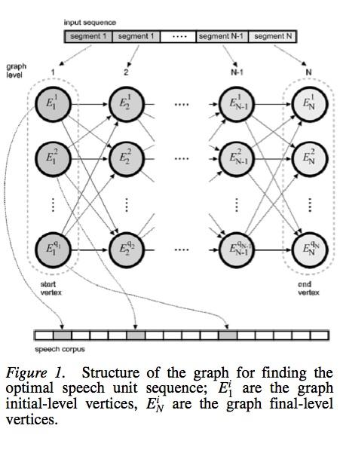
SEARCH IN AI APPLICATIONS
Is search involved in these AI applications? If so, in what part or parts of the application?
Building a driverless car that will drive down a roadway. (Leave aside the search involved in route planning.)
Building a system like Siri.
Text-to-speech synthesis

Slide 15
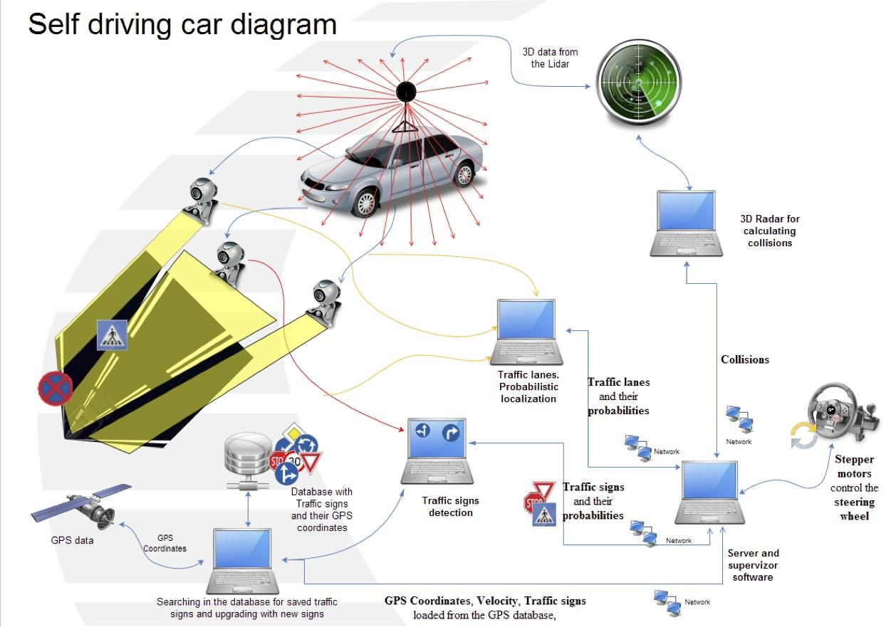

Slide 16
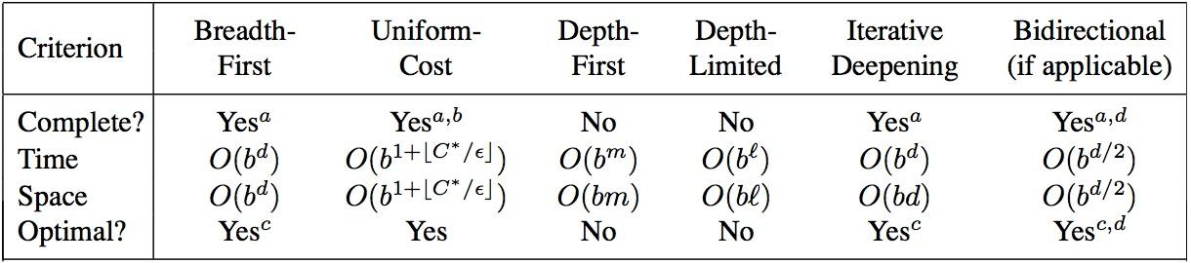
WHAT YOU SHOULD KNOW
What is the difference between uninformed and
informed search? Which ones are optimal?
What are the advantages and disadvantages of depth-first search?
Be familiar with the differences between search strategies shown in Figure 3.21
Notes:
http://cse.unl.edu/~choueiry/S03-476-876/searchapplet/
https://courses.cs.washington.edu/courses/cse473/06sp/MazeRunnerDemo/search/applet.html
http://www.briangrinstead.com/files/astar/
http://www.cs.rmit.edu.au/AI-Search/Product/

Slide 17
WANT MORE?
BigO and complexity:
https://apelbaum.wordpress.com/2011/05/05/big-o/

