Slide 1
Discussion Section (Week 4)
CSCI 561 Foundation for Artificial Intelligence
PROF WEI-MIN SHEN WMSHEN@USC.EDU

Slide 2
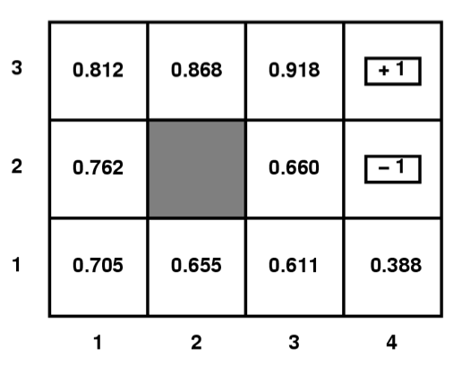
MDP
50
500
Given a Gridworld domain, where terminal states
(1,3), (4,3), and (4,2) have rewards 50, 500, and -50
respectively, the set of possible actions are
{N,E,S,W, or X for terminal states},
the agent moves deterministically,
all V and Q values for non-terminal
states have been initialized to 0.0,
answer the questions below.
Circle the letter that corresponds to the best answer for the question.
What are the optimal utilitu values V for each state in the above grid if γ = 0.5, c(a)=0, R(s)=0 for the non-terminal states?
(Remember V_{t+1}(s) = R(s) + Max_{aεA}{c(a) + γΣ_{s’εS} P(s’|a,s) V_{t}(s’)} )
V_{(1,1)}=15.75, V_{(1,2)}=25, V_{(2,1)}=31.25, V_{(2,3)}=125, V_{(3,1)}=62.5, V_{(3,2)}=125, V_{(3,3)}=250, V_{(4,1)}=25
V_{(1,1)}=12.5, V_{(1,2)}=25, V_{(2,1)}=31.25, V_{(2,3)}=125, V_{(3,1)}=62.5, V_{(3,2)}=125, V_{(3,3)}=250, V_{(4,1)}=31.25
V_{(1,1)}=15.625, V_{(1,2)}=25, V_{(2,1)}=31.25, V_{(2,3)}=125, V_{(3,1)}=62.5, V_{(3,2)}=125, V_{(3,3)}=250, V_{(4,1)}=31.25
V_{(1,1)}=12.5, V_{(1,2)}=25, V_{(2,1)}=25, V_{(2,3)}=25, V_{(3,1)}=50, V_{(3,2)}=100, V_{(3,3)}=250, V_{(4,1)}=25
None of the above
-50
C
Notes:
V(1,1) = R(1,1) + max_a_in_A { 0 + 0.5*sum( P(s’|a,s) * V(s’) ) }
a=N {0 + 0.5* (1.0 * V(1,2)) = 0 + 0.5 *(1.0 * 0) = 0

Slide 3
Q-Learning
What are the Q values of state (3,2) in the above grid if γ = 0.5, c(a)=0, R(s)=-2 for non-terminal states?
(Remember Q_{t+1}(a,s) = R(s) + c(a)+γΣ_{s’εS} P(s’|a,s)max_{a’εA} Q_{t}(a’s’) )
Q_{((3,2),N)}=122, Q_{((3,2),E)}=-27, Q_{((3,2),S)}=59
Q_{((3,2),N)}=122, Q_{((3,2),E)}=-27, Q_{((3,2),S)}=27.5
Q_{((3,2),N)}=125, Q_{((3,2),E)}=-25, Q_{((3,2),S)}=62.5
Q_{((3,2),N)}=120, Q_{((3,2),E)}=-27, Q_{((3,2),S)}=31.5
None of the above
500
50
500
50
-50
-50

Slide 4
Q-Learning
What are the Q values of state (3,2) in the above grid if γ = 0.5, c(a)=0, R(s)=-2 for non terminal states?
(Remember Q_{t+1}(a,s) = R(s) + c(a)+γΣ_{s’εS} P(s’|a,s)max_{a’εA} Q_{t}(a’s’) )
Q_{((3,2),N)}=122, Q_{((3,2),E)}=-27, Q_{((3,2),S)}=59
Q_{((3,2),N)}=122, Q_{((3,2),E)}=-27, Q_{((3,2),S)}=27.5
Q_{((3,2),N)}=125, Q_{((3,2),E)}=-25, Q_{((3,2),S)}=62.5
Q_{((3,2),N)}=120, Q_{((3,2),E)}=-27, Q_{((3,2),S)}=31.5
None of the above
50
E248
500
-50

Slide 5
Q-Learning
What are the Q values of state (3,2) in the above grid if γ = 0.5, c(a)=0, R(s)=-2 for non terminal states?
(Remember Q_{t+1}(a,s) = R(s) + c(a)+γΣ_{s’εS} P(s’|a,s)max_{a’εA} Q_{t}(a’s’) )
Q_{((3,2),N)}=122, Q_{((3,2),E)}=-27, Q_{((3,2),S)}=59
Q_{((3,2),N)}=122, Q_{((3,2),E)}=-27, Q_{((3,2),S)}=27.5
Q_{((3,2),N)}=125, Q_{((3,2),E)}=-25, Q_{((3,2),S)}=62.5
Q_{((3,2),N)}=120, Q_{((3,2),E)}=-27, Q_{((3,2),S)}=31.5
None of the above
50
E248
500
N122
-50

Slide 6
Q-Learning
What are the Q values of state (3,2) in the above grid if γ = 0.5, c(a)=0, R(s)=-2 for non terminal states?
(Remember Q_{t+1}(a,s) = R(s) + c(a)+γΣ_{s’εS} P(s’|a,s)max_{a’εA} Q_{t}(a’s’) )
Q_{((3,2),N)}=122, Q_{((3,2),E)}=-27, Q_{((3,2),S)}=59
Q_{((3,2),N)}=122, Q_{((3,2),E)}=-27, Q_{((3,2),S)}=27.5
Q_{((3,2),N)}=125, Q_{((3,2),E)}=-25, Q_{((3,2),S)}=62.5
Q_{((3,2),N)}=120, Q_{((3,2),E)}=-27, Q_{((3,2),S)}=31.5
None of the above
50
E248
500
N122
-50
S27.5
N59
B

