Slide 1
Discussion Section (Week 9)
CSCI 561 - Foundation for Artificial Intelligence
PROF WEI-MIN SHEN WMSHEN@USC.EDU

Slide 2
Material covered by Midterm2
Covers everything studied in class up to and including Planning
Lectures vs book: what to know?
- If something is covered both in the book and the slides of lecture/discussion: use the slides.
- If something is covered in the book only and was not covered at all in the lecture/discussions: you do not need to know it.
- If something is covered in the book and in the slides of lecture/discussion but with additional details provided in the book: you need to know both, and use the slides for the overlapping parts.

Slide 3
Midterm 2 Instructions:
10/26/2022, 5:00-6:50PM, join Zoom 20min before
Maximum credits/points for this midterm: 100 points
Credits/points for each question is indicated on the question
Closed book
No books or any other material are allowed
Please practice lockdown browser with zoom
Please make sure you know how to type your answers
No questions during the exam
Be brief: a few words are often enough if they are precise and use the correct vocabulary studied in class
Make sure your environment for the exam is quite/exclusive

Slide 4
Today’s Discussion Topics
Knowledge-based Agents
Logics, Reasoning, Proving
Logic programming
Knowledge Representation
Knowledge Engineering
Planning

Slide 5
Knowledge-Based Agents
Agent that uses prior or acquired knowledge to achieve its goals
Can make more efficient decisions
Can make informed decisions
Knowledge Base (KB): contains a set of representations of facts about the Agent’s environment
Each representation is called a sentence
Use some knowledge representation language, to TELL it what to know e.g., (temperature 72F)
ASK agent to query what to do
Agent can use inference to deduce new facts from TELLed facts
Domain independent algorithms
ASK
Inference engine
TELL
Knowledge Base
Domain specific content

Slide 6
Type Hierarchies
Subclasses implicitly define a type hierarchy
Also referred to as an ontology, a taxonomy, or a taxonomic hierarchy
Animals
Fish
Amphibians
Reptiles
Birds
Mammals
Robins
Eagles
Ostriches
Penguins

Slide 7
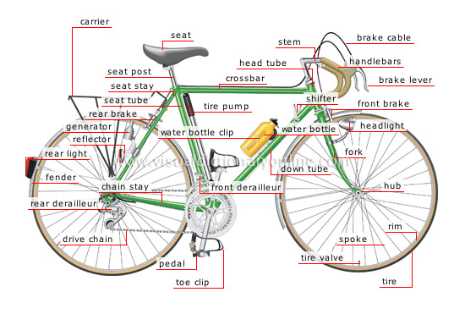
PartOf Hierarchies
As with subclasses, the PartOf relation
induces hierarchies, but of objects
Although can develop a comparable relationship between categories, for example:
CategoryPartOf(Pistons, Engines) could represent that ∀x [ x∈Engines ⇒ ∃y y∈Pistons ∧ PartOf(y,x) ]
Bicycle₁
Seat₁
Frame₁
DriveTrain₁
HandleBar₁
Gears₁
Chain₁
Wheel₁
Wheel₂

Slide 8
Logic Concepts (Exercise)
Definitions:
sentences are true in the same models
determine whether sentence entailed by KB
a possible world that defines truth values for all sentences
truth of sentences with respect to models
necessary truth of one sentence given another
sentence is true in all models
sentence is true in some model
produce only entailed sentences
formal structure of sentences
can produce all entailed sentences
Keywords:
____ Syntax
____ Semantics
____ Model
____ Entailment
____ Inference
____ Soundness
____ Completeness
____ Equivalence
____ Validity
____ Satisfiability
I
D
C
E
B
H
J
A
F
G

Slide 9
Converting to CNF

Slide 10
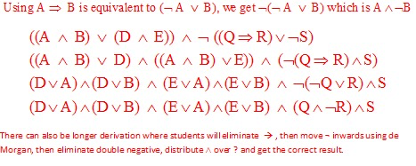
Converting to CNF

Slide 11
Inference
Use resolution and a proof by contradiction to prove D(Bob) from the following knowledge base:
~A(x) ∨ B(x)
A(x) ∨ C(x)
~B(x) ∨ D(x)
~C(x) ∨ D(x)
Please show the complete resolution proof, including all substitutions used (you will lose points for any missing step or substitution). You will get 0 if you use any other method than resolution and proof by contradiction.

Slide 12
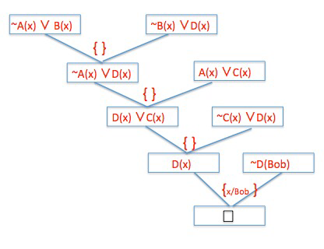
Inference
Use resolution and a proof by contradiction to prove D(Bob) from the following knowledge base:
~A(x) ∨ B(x) A(x) ∨ C(x) ~B(x) ∨ D(x)
~C(x) ∨ D(x) ~D(Bob)

Slide 13
Unification and Prolog
Answer the questions below given these two rules in Prolog for appending two lists to produce a third:
append([],Y,Y).
append([X|L], Y, [X|Z]) :- append(L,Y, Z).
When L=[A], Y=[B, C], X=[[D]] then what are the values for:
[3%] Z=
[A, B, C]
[3%] [X|Z]=
[ [[D]], A, B, C]

Slide 14
Unification and Prolog
Given: R1: append([],Y,Y).
R2: append([X|L],Y, [X|Z]) :- append(L,Y, Z).
Data: L=[A], Y=[B,C], X=[[D]]:
Prove: Z = ?, [X|Z] = ?
Unify with R2: append([[[D]]|[A]], [B,C], [[[D]]|Z]) :- append([A], [B, C], Z).
Subquery: append([A], [B,C], Z)
Unify with R2: append([A|[]], [B,C], [A|Z]) :- append([], [B,C], Z)
Subquery: append([], [B,C], Z)
Unify with R1: append([], [B,C], [B,C])
Z=[A, B, C] [X|Z]=[ [[D]], A, B, C]
[X|Z]=[[[D]], A,B,C]
Z=[A,B,C]
Z=[B,C]

Slide 15
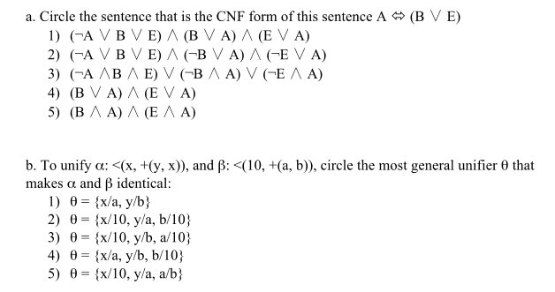
Knowledge Representation

Slide 16
Knowledge Engineering
Circle the letter that corresponds to the best answer for the question:
[4%] What substitutions result from unifying P(x, John, y) with P(Sarah, F(y), z)
These literals fail to unify.
{x/Sarah, John/F(y), y/z}
{x/John, y/Sarah, F/z}
The empty set: { }
[4%] ] Knowledge Engineering is expensive because:
Encoding knowledge in a formal system is hard
It is an iterative modeling process
Domain experts don’t know what they know
All of the above
None of the above

Slide 17
Planning
What is the plan to achieve the goal Have(Monkey, Banana)?
Action(ACTION:Go(x,y),
PRECOND: At(Monkey,x),
EFFECT: At(Monkey,y) ∧¬(At(Monkey,x)))
Action(ACTION:Push(b,x,y),
PRECOND: At(Monkey,x) ∧ Pushable(b),
EFFECT: At(b,y) ∧ At(Monkey,y) ∧¬At(b,x) ∧¬At(Monkey,x))
Action(ACTION:ClimbUp(b),
PRECOND:At(Monkey,x) ∧At(b,x) ∧ Climbable(b),
EFFECT: On(Monkey,b) ∧¬Height(Monkey,Low) ∧ Height(Monkey,High))
Action(ACTION:Grasp(o), PRECOND:Height(Monkey,h) ∧Height(o,h) ∧At(Monkey,x) ∧ At(b,x), EFFECT:Have(Monkey,o))
At(Monkey,A) ∧ At(Bananas,B) ∧ At(Box,C) ∧ Height(Monkey,Low) ∧ Height(Box,Low) ∧ Height(Bananas,High) ∧ Pushable(Box) ∧ Climbable(Box)
Start
Go(A,C)
At(Monkey,A)
Push(Box,C,B)
At(Monkey,C) ∧ Pushable(Box)
ClimbUp(Box)
At(Monkey,B) ∧At(Box,B) ∧ Climbable(Box)
Grasp(Banana)
Height(Monkey,High) ∧ Height(Bananas,High) ∧ At(Monkey,B) ∧ At(Bananas,B)
Finish
Have(Monkey, Bananas)

Slide 18
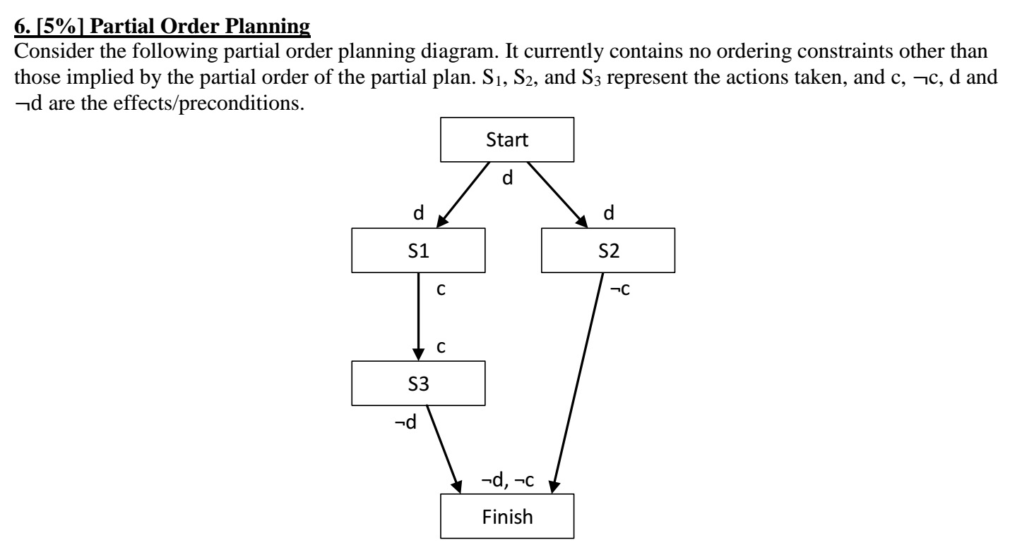
Planning

Slide 19
Planning
Describe the flaw in this partial plan. Show how you would resolve it.
The problem with the plan is that S2's effect negates S3's precondition and S3's effect negates S2's precondition. So without any ordering constraints, the plan goes wrong. [4%]
Because the effects of both S2 and S3 are needed for the finish state, and we have no other states providing them, we cannot resolve the problem with current states, even if we add ordering constraints. We need more states. [1%]"

Slide 20
Neats and scruffies
Based on page: http://en.wikipedia.org/wiki/Neats_vs._scruffies
What are the strengths and weaknesses of each approach?
Are these distinctions still relevant today?
How can considering these approaches inform how we approach building AI applications?

Slide 21
What you should know
What is Unification? How is it different than pattern matching? When is it used? What is the algorithm? Why is it important for Generalized Modus Ponens?
What is the Lifted Resolution Rule?
How does Proof by Contradiction compare to Forward Chaining? Backward Chaining? What is the differences between them?
What is planning? Situation calculus? What is the difference between fluents and atemporals?
What is the difference between total order planning and partial order planning or planning graphs?
Complete vs. Efficient? How does this relate to the discussion on Neat vs Scruffy?

Slide 22
What you should know (CH 10, 12)
What is an ontology? Why is it useful? What is inheritance? Why is it important?
Know how to create an ontology. How do you define a category?
What does it mean that logic is monotonic?
What is knowledge sharing? What are the advantages and disadvantages?
What is planning? Situation calculus? What is the difference between fluents and atemporals?
What is the difference between total order planning and partial order planning?

Slide 23
Want More?
Check out some of these exercises in the book:
8.1-3, 8.6, 8.9-10, 8.14, 8.17, 8.28
9.3, 10, 15, 20, 23

