Slide 1
9-10: Knowledge, Reasoning, Propositional Logic Discussion: Review for Midterm1
CSCI 561 Foundation for Artificial Intelligence
Professor Wei-Min Shen
University of Southern California

Slide 2
Knowledge and Reasoning
Knowledge representation
Logic and representation
Propositional (Boolean) logic
Normal forms
Inference in propositional logic
Wumpus world example

Slide 3



Agent and Environment
Knowledge Base (next slide)
Sensors
percepts
Environment
Agent
Intelligence
actions
Effectors

Slide 4
Knowledge-Based Agent
Agent that uses prior or acquired knowledge to achieve its goals
Can make more efficient decisions
Can make informed decisions
Knowledge Base (KB): contains a set of representations of facts about the Agent’s environment
Each representation is called a sentence
Use some knowledge representation language (KRL), to TELL it what to know, e.g., (temperature 72F)
ASK agent to query what to do
Agent can use inference to deduce new facts from the TELLed facts
Domain independent algorithms
ASK
Inference engine
Knowledge Base
TELL
Domain specific content

Slide 5
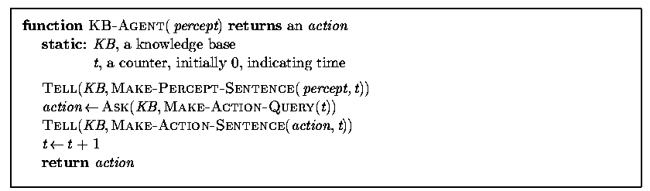
Generic Knowledge-Based Agent
TELL KB what was perceived Uses a KRL to insert new sentences, representations of facts, into KB
ASK KB what to do Uses logical reasoning to examine actions and select the best action

Slide 6
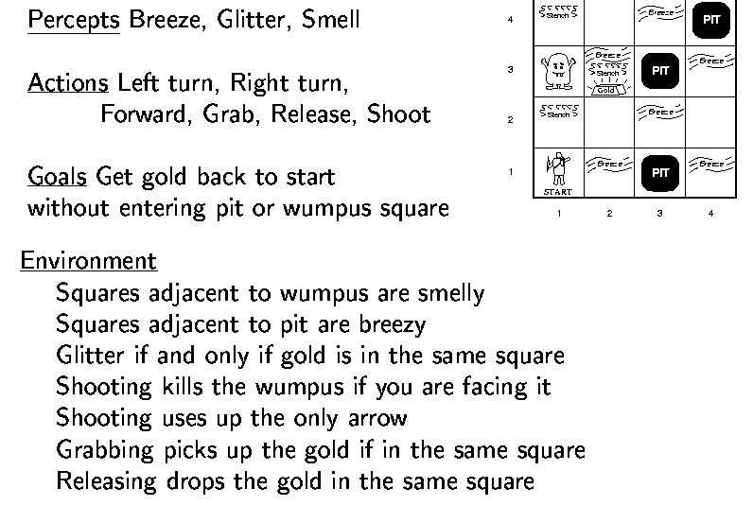

Wumpus World Example

Slide 7
Wumpus World Characterization
Deterministic?
Accessible?
Static?
Discrete?
Episodic?

Slide 8
Wumpus World Characterization
Deterministic? Yes – outcome exactly specified
Accessible? No – only local perception
Static? Yes – Wumpus and pits do not move
Discrete? Yes
Episodic? (No) – because static

Slide 9
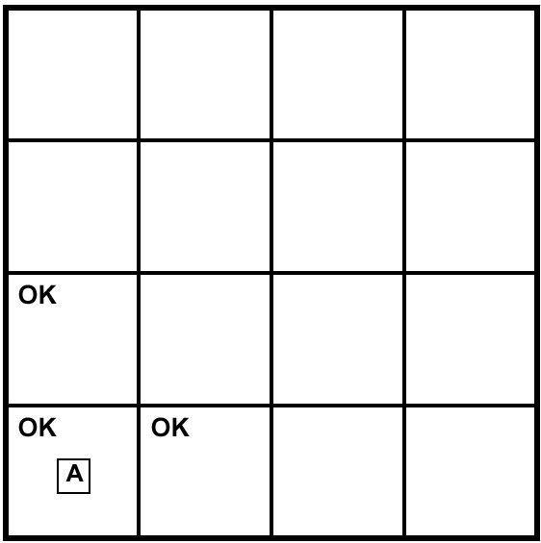
Exploring a Wumpus World
A= Agent
B= Breeze
S= Smell
P= Pit
W= Wumpus
OK = Safe
V = Visited
G = Glitter

Slide 10
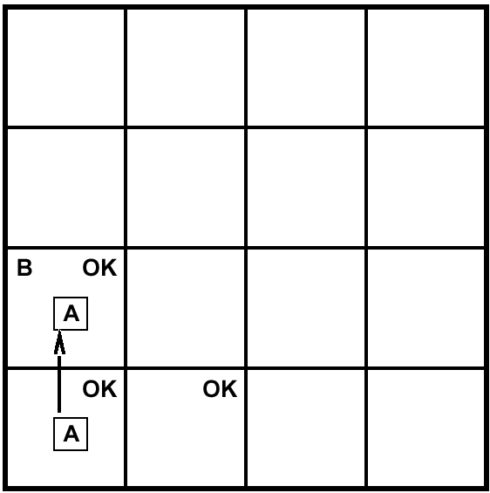
Exploring a Wumpus World
A= Agent
B= Breeze
S= Smell
P= Pit
W= Wumpus
OK = Safe
V = Visited
G = Glitter

Slide 11
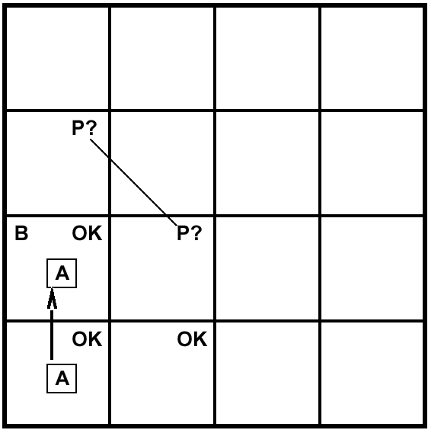
Exploring a Wumpus World
A= Agent
B= Breeze
S= Smell
P= Pit
W= Wumpus
OK = Safe
V = Visited
G = Glitter

Slide 12
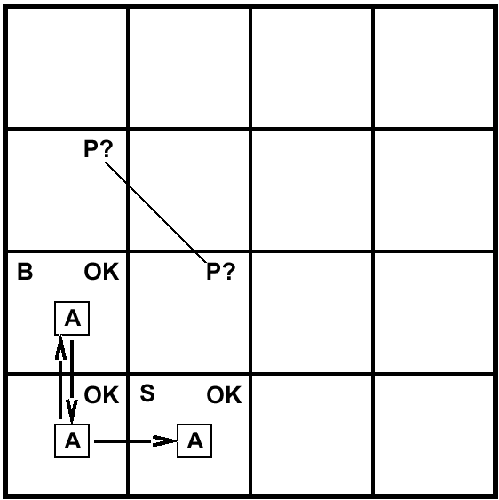
Exploring a Wumpus World
A= Agent
B= Breeze
S= Smell
P= Pit
W= Wumpus
OK = Safe
V = Visited
G = Glitter

Slide 13
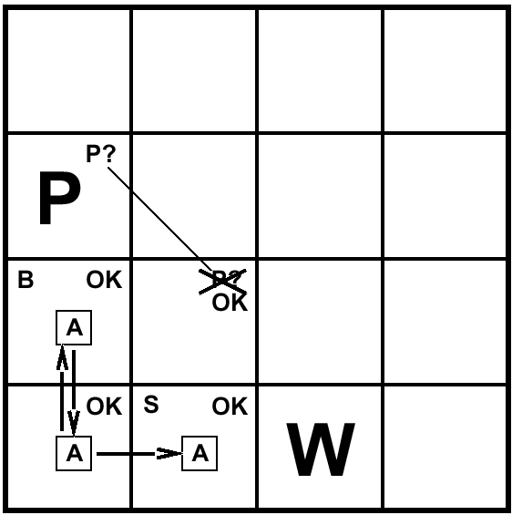
Exploring a Wumpus World
A= Agent
B= Breeze
S= Smell
P= Pit
W= Wumpus
OK = Safe
V = Visited
G = Glitter

Slide 14

Exploring a Wumpus World
A= Agent
B= Breeze
S= Smell
P= Pit
W= Wumpus
OK = Safe
V = Visited
G = Glitter

Slide 15
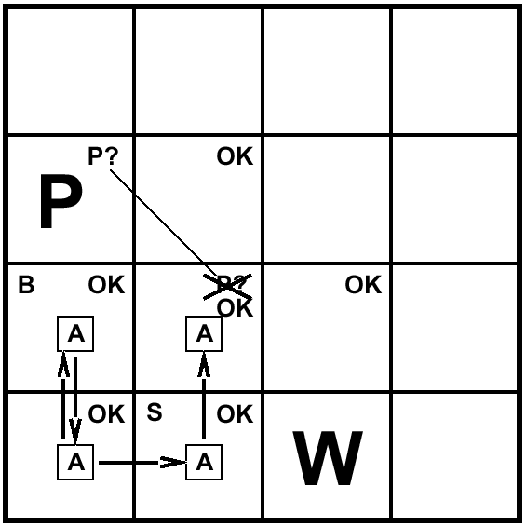
Exploring a Wumpus World
A= Agent
B= Breeze
S= Smell
P= Pit
W= Wumpus
OK = Safe
V = Visited
G = Glitter

Slide 16
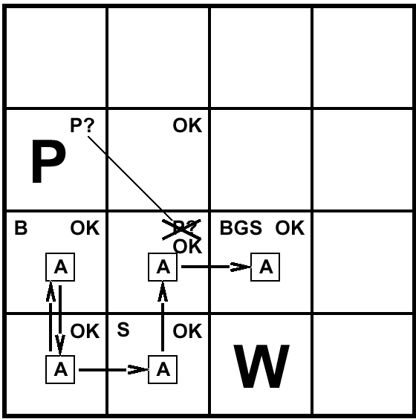
Exploring a Wumpus World
A= Agent
B= Breeze
S= Smell
P= Pit
W= Wumpus
OK = Safe
V = Visited
G = Glitter

Slide 17
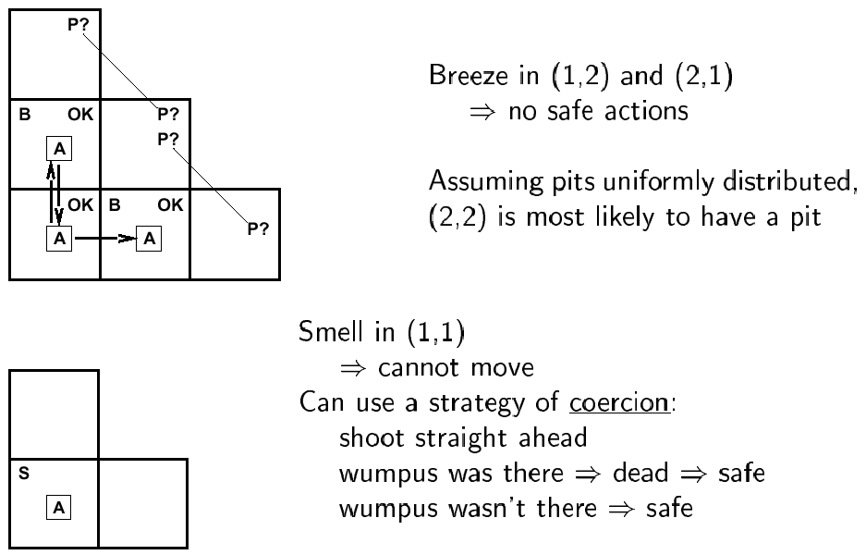
Other Tight Spots

Slide 18
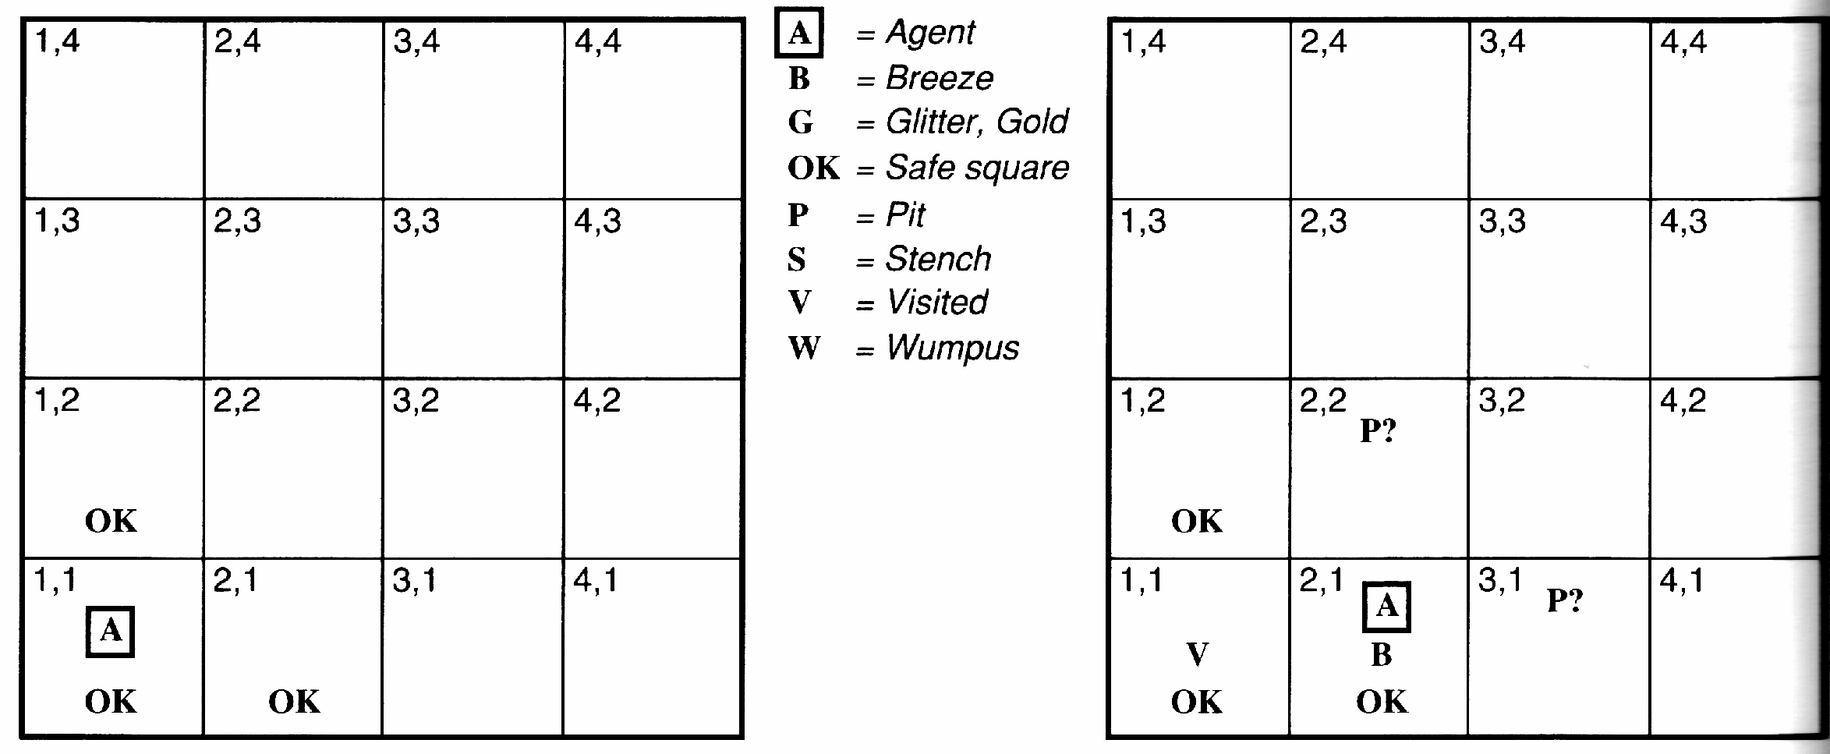
Another Example Solution
No perception 🡪 1,2 and 2,1 OK
Move to 2,1
B in 2,1 🡪 2,2 or 3,1 P?
1,1 V 🡪 no P in 1,1
Move to 1,2 (only option)

Slide 19
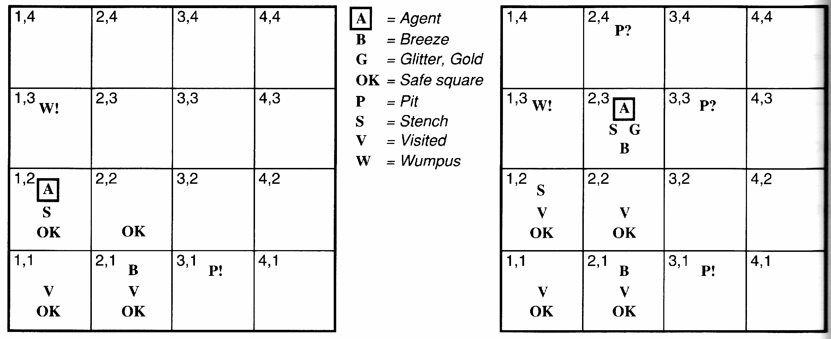
Example Solution
S and No S when in 2,1 🡪 1,3 or 1,2 has W
1,2 OK 🡪 1,3 W
No B in 1,2 🡪 2,2 OK & 3,1 P

Slide 20
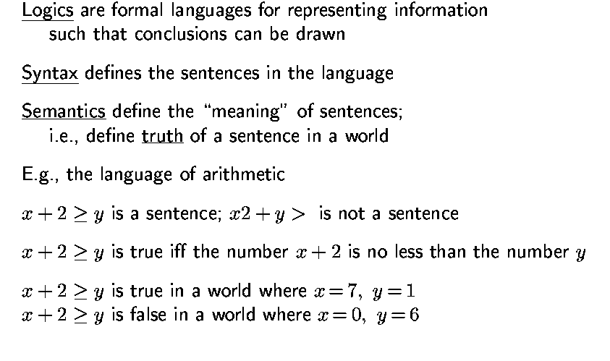
Logic in General

Slide 21
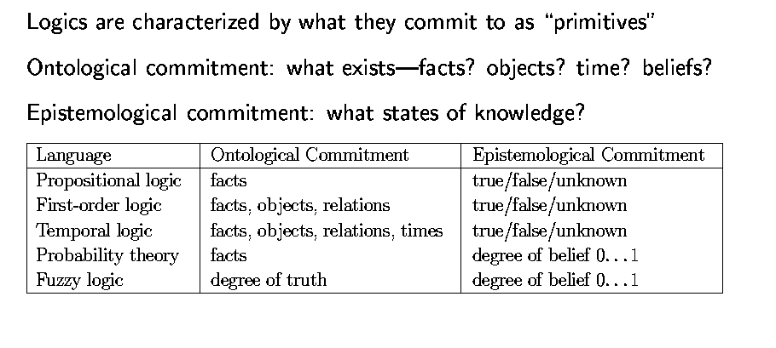
Types of Logic

Slide 22
Key Concepts of Logic
Syntax
Semantics
Entailment
Inference
Soundness
Completeness
Inference Rules
Normal Forms
Truth Tables
Reasoning

Slide 23
Logic Representation of the Real World
Symbol Systems The Real World
Objects:
+BLOCKA+
+BLOCKB+
+BLOCKC+
……
Relations:
P₁:(IS_ON +BLOCKA+ +BLOCKB+)
P₂:((IS_RED +BLOCKA+)
……
“Knowledge Base”
“Robot Brain”
“The semantic wall”
Notes:
Syntax: says what is allowed on the LHS
Semantics: says how what is on the LHS relates to what is on the RHS
Inference: says how you can manipulate (formally, i.e., with no reference to the RHS) the symbols. [remember PSSH]
Want to be able to trust the results: want whatever the inference procedure does to “respect” what’s true or what follows in the world. So this is where we’re headed; good to keep in mind as we go through all the definitions now to follow. There is a method in this madness...
algebra example (put on board): but don’t use “entails” instead convey the idea
> n m: is this true or false? don’t know
if n=3, m=5, and > has its usual meaning, then (>n m) is false
(> n m) and (> m p) entail (n p)

Slide 24
Truth Depends on Interpretation
Representation 1 World
A
B
ON(A,B) T
ON(B,A) F
ON(A,B) F A
ON(B,A) T B
Notes:
block pictures
(on A B) and on(B C) entails (on A C)
(again don’t say “entails)
for this as well as for number example jus t did, need transitivity relationships
spend time on why it matters: if build a KB want to be able to verify its answers
introduce notion of “refer” “mean” idea of mapping into world; for this slide handwave about meaning of “on(a,b)”

Slide 25
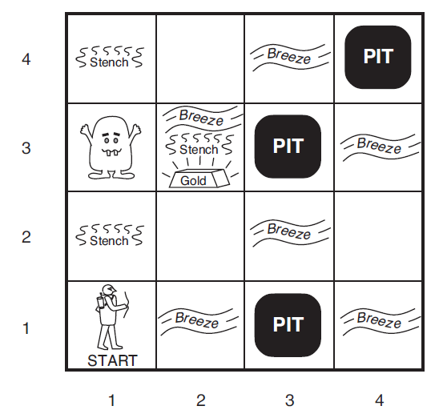
The Key Logic Concepts
Entailment ⊨
Inference ⊢

Slide 26
Break the Semantic Wall
Symbol Systems The Real World
Objects:
+BLOCKA+
+BLOCKB+
+BLOCKC+
……
Relations:
P₁:(IS_ON +BLOCKA+ +BLOCKB+)
P₂:((IS_RED +BLOCKA+)
……
“Knowledge Base”
“Robot Brain”
Notes:
Syntax: says what is allowed on the LHS
Semantics: says how what is on the LHS relates to what is on the RHS
Inference: says how you can manipulate (formally, i.e., with no reference to the RHS) the symbols. [remember PSSH]
Want to be able to trust the results: want whatever the inference procedure does to “respect” what’s true or what follows in the world. So this is where we’re headed; good to keep in mind as we go through all the definitions now to follow. There is a method in this madness...
algebra example (put on board): but don’t use “entails” instead convey the idea
> n m: is this true or false? don’t know
if n=3, m=5, and > has its usual meaning, then (>n m) is false
(> n m) and (> m p) entail (n p)

Slide 27
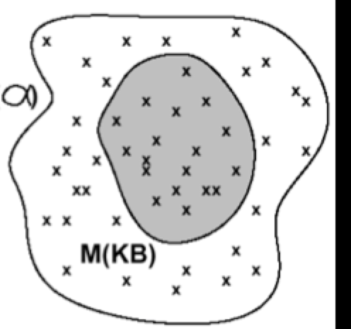
KB (“mind”) and Models (“real worlds”)
Mind
Real Worlds
ΚΒ
α
Μ(α)

Slide 28
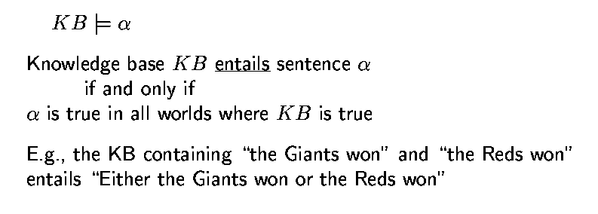
Entailment
“Entailment” is different from “Inference”

Slide 29
Logic as a Representation of the World
entails
Representation: Sentences
Sentence
Refers to
(Semantics)
follows
Fact
World
Facts

Slide 30
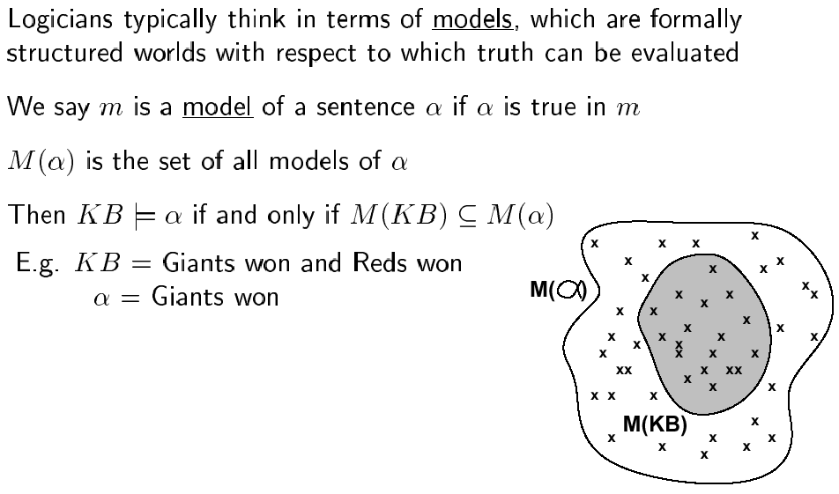
Models (the “real worlds”)
Μ(α)
α = “intelligence must have a body”
Models (possible worlds):
Earth, Mars, …...

Slide 31
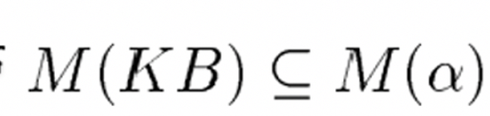
Entailment
Entailment means it is impossible for the following case to occur:
the premise (KB) is true but the consequence (α) is false

Slide 32
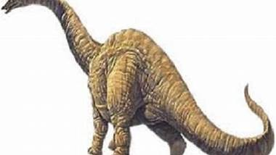
Logic as a Representation of a World
e.g., “John has three brains.”
“how many brains did Argentinosaurus had?”
entails
Representation: Sentences
Sentence
Refers to
(Semantics)
follows
Facts
World
Facts
Really? Need to do a scan of John’s head!

Slide 33
Entailment: How to Check?
KB |= α ?
Is M (KB ) a subset of M (α ) ?

Slide 34
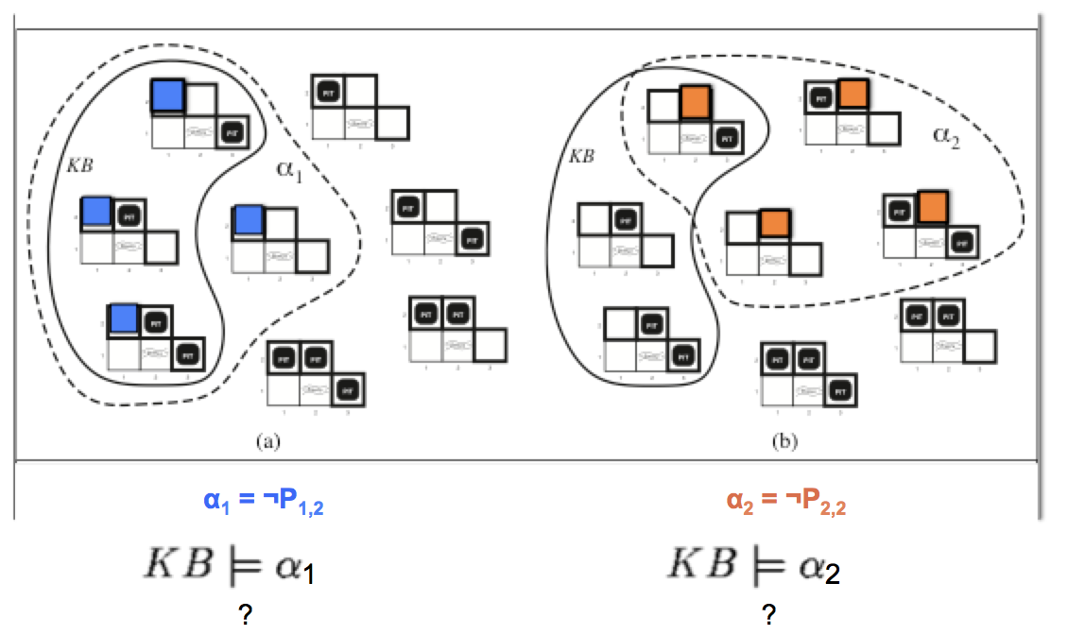
Check Entailment in Wumpus World
M(α2)
M(KB)
M(α1)
M(KB)

Slide 35
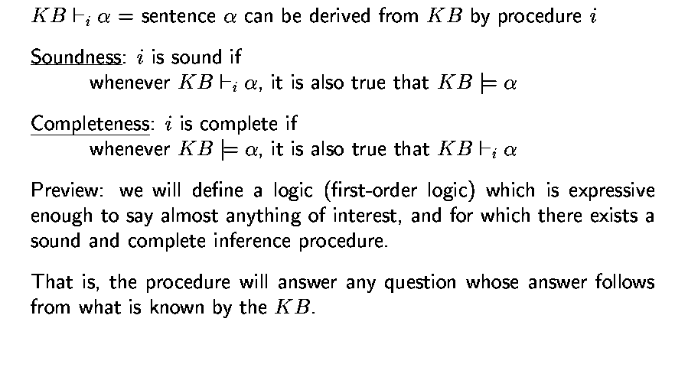
Inference

Slide 36
“Entailment” =\= “Inference”
KB inference α: derived by a procedure
In robot’s head (or on paper)
sound
complete
Mind
KB entails α
Real Worlds
Model of KB is a subset of Model of α
Models of symbols: M(KB), M(α), …
are “possible worlds”

Slide 37
Basic Symbols
Expressions only evaluate to either “true” or “false.”
P “P is true”
¬P “P is false” negation
P V Q “either P is true or Q is true or both” disjunction
P ^ Q “both P and Q are true” conjunction
P => Q “if P is true, then Q is true” implication
P ⬄ Q “P and Q are either both true or both false” equivalence

Slide 38
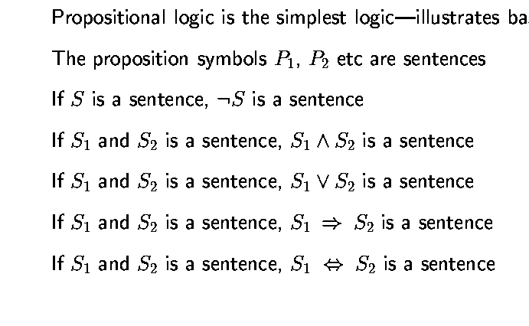
Propositional Logic: Syntax

Slide 39
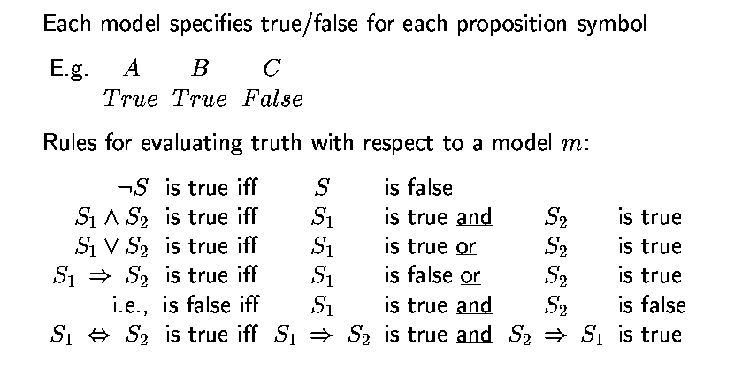
Propositional Logic: Semantics (must be checked in real worlds)

Slide 40
Truth Tables
Truth value: whether a statement is true or false.
Truth table: complete list of truth values for a statement given all possible values of the individual atomic expressions.
Example:
P Q P V Q
T T T
T F T
F T T
F F F

Slide 41
Truth tables for basic connectives
P Q ¬P ¬Q P V Q P ^ Q P=>Q P⬄Q
T T F F T T T T
T F F T T F F F
F T T F T F T F
F F T T F F T T

Slide 42
Propositional logic: basic manipulation rules
¬(¬A) = A Double negation
¬(A ^ B) = (¬A) V (¬B) Negated “and”
¬(A V B) = (¬A) ^ (¬B) Negated “or”
A ^ (B V C) = (A ^ B) V (A ^ C) Distributivity of ^ on V
A V (B ^ C) = (A V B) ^ (A V C) Distributivity of V on ^
A => B = (¬A) V B by definition
¬(A => B) = A ^ (¬B) using negated or
A ⬄ B = (A => B) ^ (B => A) by definition
¬(A ⬄ B) = (A ^ (¬B))V(B ^ (¬A)) using negated and & or
…

Slide 43
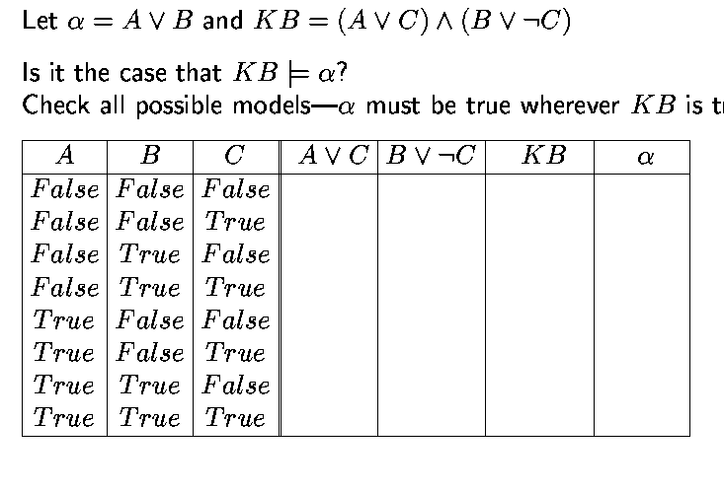
Propositional inference: enumeration method
true

Slide 44
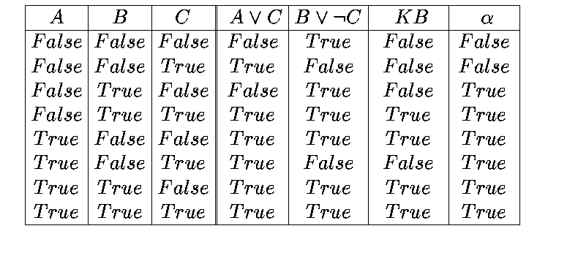
Entailment Check by Enumeration
KB |= α?
Is M(KB) a subset of M(α)?
M(α)
M(KB)

Slide 45
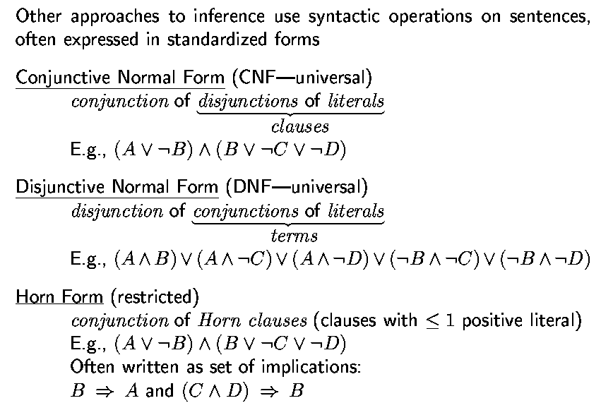
Propositional Logic: Normal Forms
“product of sums of
simple variables or
negated simple variables”
“sum of products of
simple variables or
negated simple variables”

Slide 46
Deriving expressions from functions
Given a Boolean function in truth table form, find a propositional logic expression for it that uses only V, ^ and ¬.
Idea: We can easily do it by disjoining the “T” rows of the truth table.
Example: Given a truth table for a function, how to write the results in logic?
P Q RESULT
T T F
T F T P ^ (¬Q)
F T T (¬P) ^ Q
F F F
RESULT = (P ^ (¬Q)) V ((¬P) ^ Q)
?

Slide 47
Deriving expressions from functions
Given a boolean function in truth table form, find a propositional logic expression for it that uses only V, ^ and ¬.
Idea: We can easily do it by disjoining the “T” rows of the truth table.
Example: XOR function
P Q RESULT
T T F
T F T P ^ (¬Q)
F T T (¬P) ^ Q
F F F
RESULT = (P ^ (¬Q)) V ((¬P) ^ Q)

Slide 48
A more formal approach
To construct a logical expression in disjunctive normal form from a truth table:
Build a “minterm” for each row of the table, where:
- For each variable whose value is T in that row, include
the variable in the minterm
- For each variable whose value is F in that row, include
the negation of the variable in the minterm
- Link variables in minterm by conjunctions
The expression consists of the disjunction of all minterms.

Slide 49
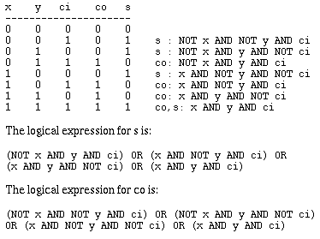
Example: adder with carry
Takes 3 variables in: x, y and ci (carry-in); yields 2 results: sum (s) and carry-out (co). To get you used to other notations, here we assume T = 1, F = 0, V = OR, ^ = AND, ¬ = NOT.
co is:
s is:

Slide 50
Tautologies
Logical expressions that are always true. Can be simplified out.
Examples:
T
T V A
A V (¬A)
¬(A ^ (¬A))
A ⬄ A
((P V Q) ⬄ P) V (¬P ^ Q)
(P ⬄ Q) => (P => Q)

Slide 51
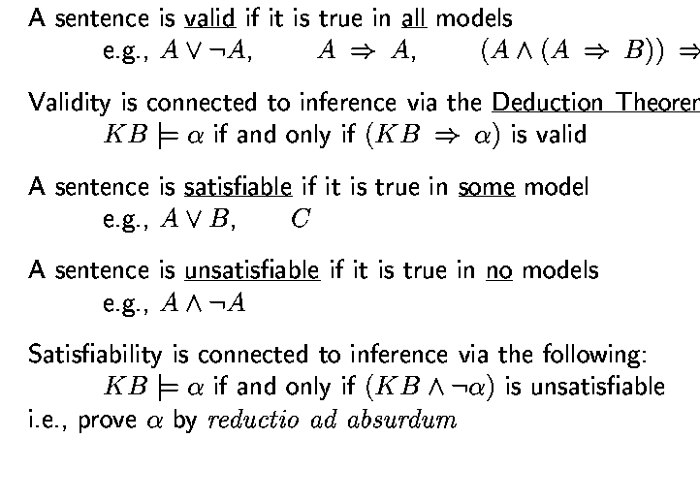
Validity and Satisfiability
B
Theorem

Slide 52
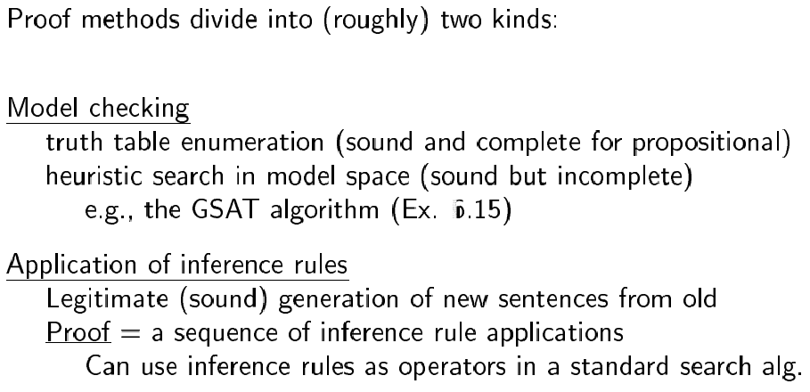
Proof methods

Slide 53
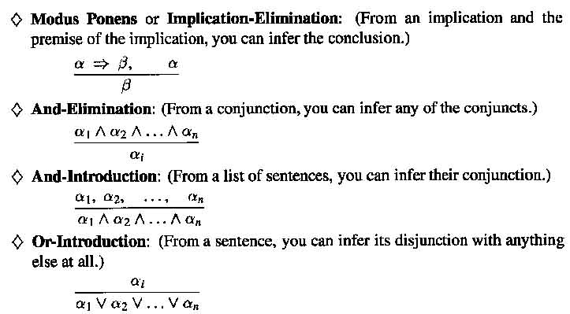
Inference Rules (1-4)

Slide 54
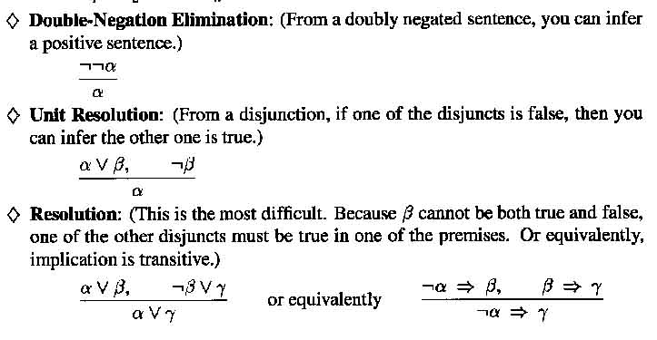
Inference Rules (5-7)

Slide 55
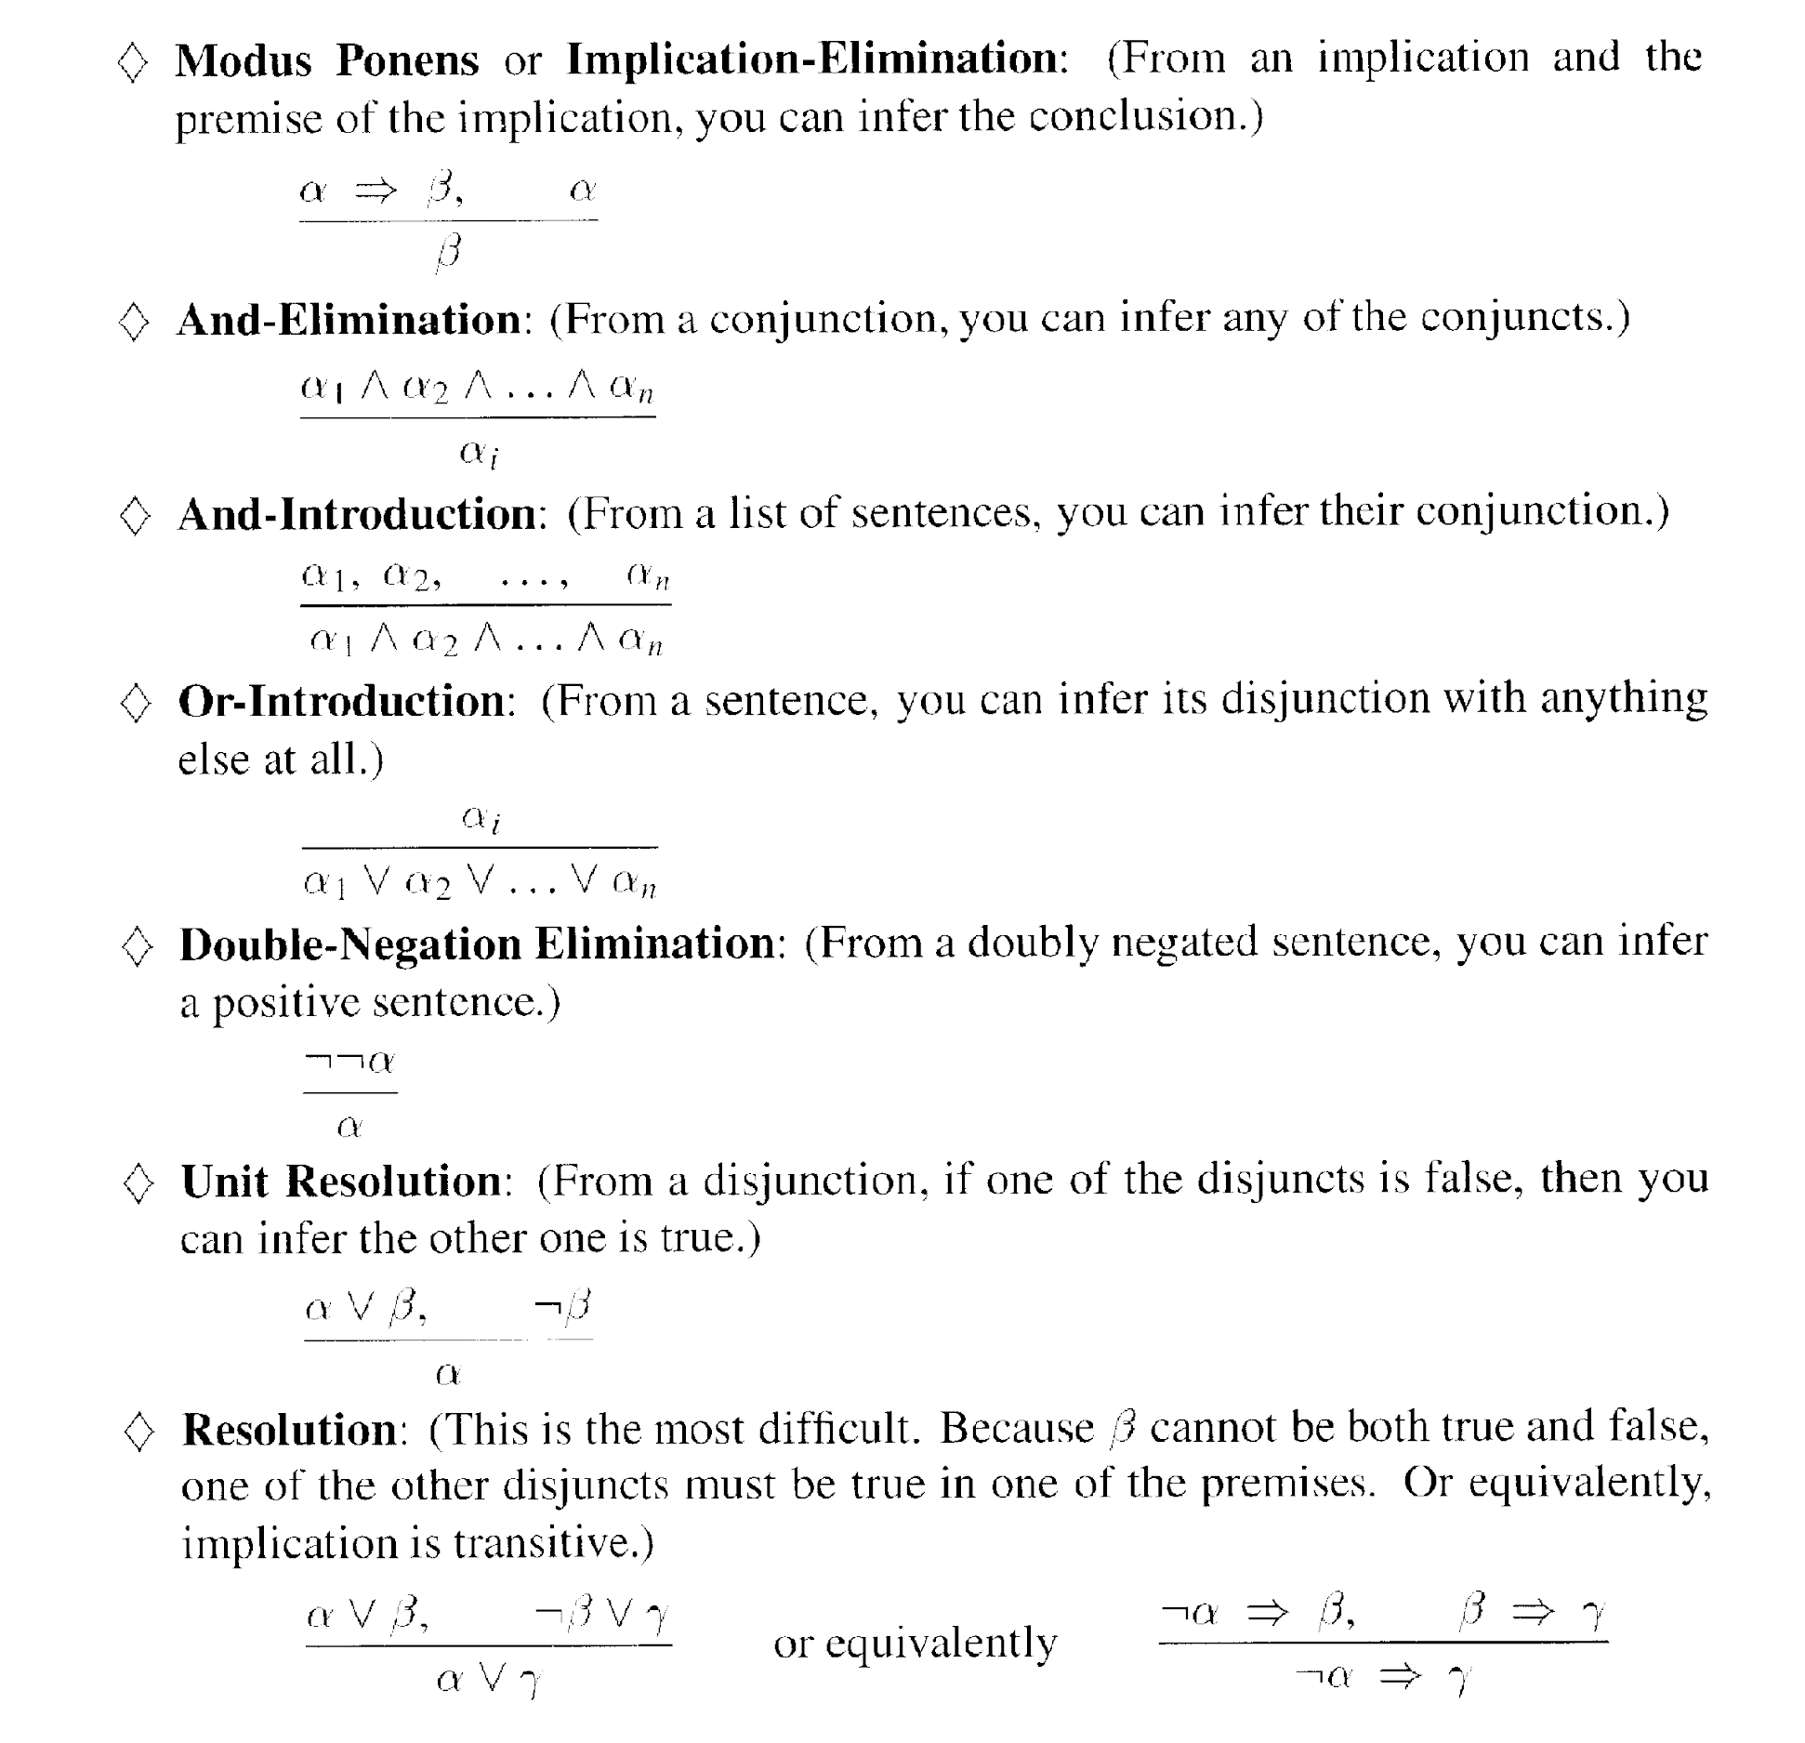
Inference Rules (1 – 7)

Slide 56
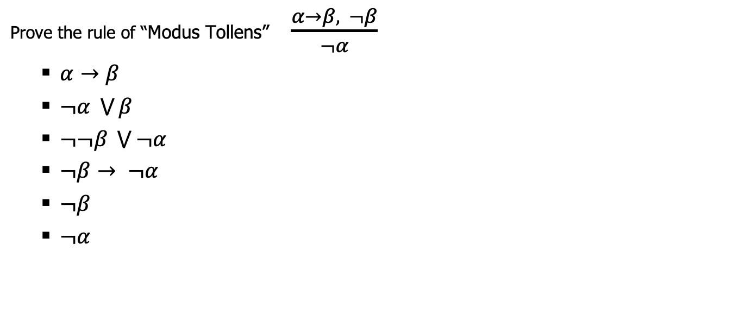
Inference Example

Slide 57
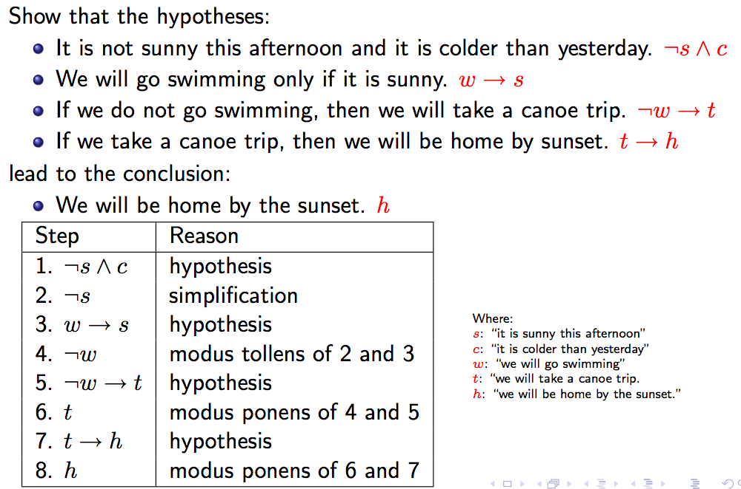
Inference example
http://www.site.uottawa.ca/~lucia/courses/2101-10/lecturenotes/04InferenceRulesProofMethods.pdf

Slide 58
Inference example
http://www.site.uottawa.ca/~lucia/courses/2101-10/lecturenotes/04InferenceRulesProofMethods.pdf

Slide 59
Inference example
http://www.site.uottawa.ca/~lucia/courses/2101-10/lecturenotes/04InferenceRulesProofMethods.pdf

Slide 60
Inference example
http://www.site.uottawa.ca/~lucia/courses/2101-10/lecturenotes/04InferenceRulesProofMethods.pdf

Slide 61
Inference example
http://www.site.uottawa.ca/~lucia/courses/2101-10/lecturenotes/04InferenceRulesProofMethods.pdf

Slide 62
Inference example
http://www.site.uottawa.ca/~lucia/courses/2101-10/lecturenotes/04InferenceRulesProofMethods.pdf

Slide 63
Inference example
http://www.site.uottawa.ca/~lucia/courses/2101-10/lecturenotes/04InferenceRulesProofMethods.pdf

Slide 64
Inference example
http://www.site.uottawa.ca/~lucia/courses/2101-10/lecturenotes/04InferenceRulesProofMethods.pdf

Slide 65
Inference example
http://www.site.uottawa.ca/~lucia/courses/2101-10/lecturenotes/04InferenceRulesProofMethods.pdf

Slide 66
Inference example
http://www.site.uottawa.ca/~lucia/courses/2101-10/lecturenotes/04InferenceRulesProofMethods.pdf

Slide 67
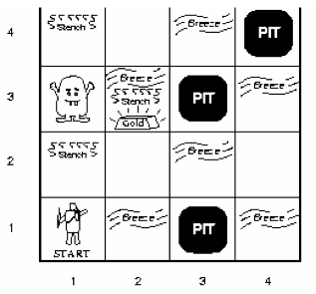
Wumpus world: example
Facts: Percepts inject (TELL) facts into the KB
[stench at 1,1 and 2,1] 🡪 S1,1 ; S2,1
Rules: if square has no stench then neither the square or adjacent squares contain the Wumpus
R1: ¬S1,1 ⇒¬W1,1 ∧ ¬W1,2 ∧ ¬W2,1
R2: ¬S2,1 ⇒¬W1,1 ∧¬W2,1 ∧ ¬W2,2 ∧ ¬W3,1
…
Inference:
KB contains ¬S1,1 then using Modus Ponens we infer ¬W1,1 ∧ ¬W1,2 ∧ ¬W2,1
Using And-Elimination we get: ¬W1,1 ¬W1,2 ¬W2,1
…

Slide 68
Limitations of Propositional Logic
1. It is too weak, i.e., has very limited expressiveness:
Each rule has to be represented for each situation: e.g., “don’t go forward if the Wumpus is in front of you” takes 64 rules
2. It cannot keep track of changes:
If one needs to track changes, e.g., where the agent has been before then we need a timed-version of each rule. To track 100 steps we’ll then need 6400 rules for the previous example.
Its hard to write and maintain such a huge rule-base
Inference becomes intractable

Slide 69
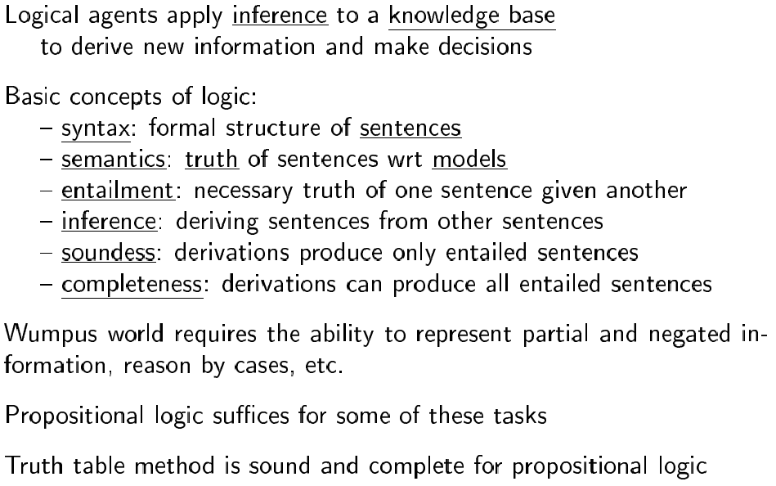
Summary

Slide 70
Summary: Logic and Reasoning
Knowledge Base (KB): contains a set of sentences expressed using a Knowledge Representation Language (KRL)
TELL: operator to add a sentence to the KB
ASK: to query the KB
Logics are KRLs where conclusions can be drawn
Syntax
Semantics
Entailment: KB |= a iff “a is true in all worlds where KB is true”
Inference: KB |–_{i} a = sentence a can be derived from KB using a procedure i
Sound: whenever KB |–_{i} a, then KB |= a is true
Complete: whenever KB |= a, then KB |–_{i} a

