Slide 1
16: Planning Systems
CSCI 561 Foundation for Artificial Intelligence
Professor Wei-Min Shen
University of Southern California

Slide 2
Planning
Search vs. Planning
STRIPS operators
Partial-order Planning

Slide 3
What we have so far
Can TELL KB about new percepts about the world
KB maintains model of the current world state
Can ASK KB about any fact that can be inferred from KB
How can we use these components to build a Planning Agent ?
i.e., an agent that constructs plans that can achieve its goals, and that then executes these plans?

Slide 4
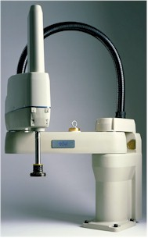
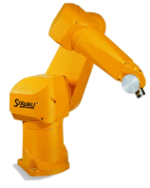
Example: Robot Manipulators
Example: (courtesy of Martin Rohrmeier)

Slide 5
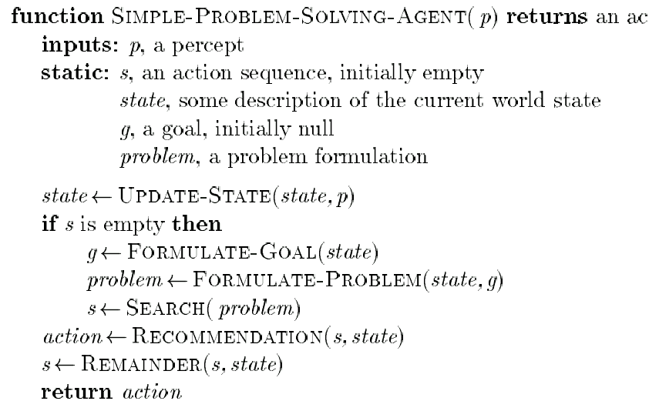
Remember: Problem-Solving Agent
tion
Note: This is offline problem-solving. Online problem-solving involves acting w/o complete knowledge of the problem and environment

Slide 6
A Simple Planning Agent
Use percepts to build model of current world state
IDEAL-PLANNER: Given a goal, algorithm generates a plan of actions
STATE-DESCRIPTION: given percept, return initial state description in a format required by the planner
MAKE-GOAL-QUERY: used to ask KB what next goal should be

Slide 7
A Simple Planning Agent
function SIMPLE-PLANNING-AGENT(percept) returns an action
static: KB, a knowledge base (includes action descriptions)
p, a plan (initially, NoPlan)
t, a time counter (initially 0)
local variables:G, a goal
current, a current state description
TELL(KB, MAKE-PERCEPT-SENTENCE(percept, t))
current ← STATE-DESCRIPTION(KB, t)
if p = NoPlan then
G ← ASK(KB, MAKE-GOAL-QUERY(t))
p ← IDEAL-PLANNER(current, G, KB)
if p = NoPlan or p is empty then
action ← NoOp
else
action ← FIRST(p)
p ← REST(p)
TELL(KB, MAKE-ACTION-SENTENCE(action, t))
t ← t+1
return action
Like popping from a stack

Slide 8
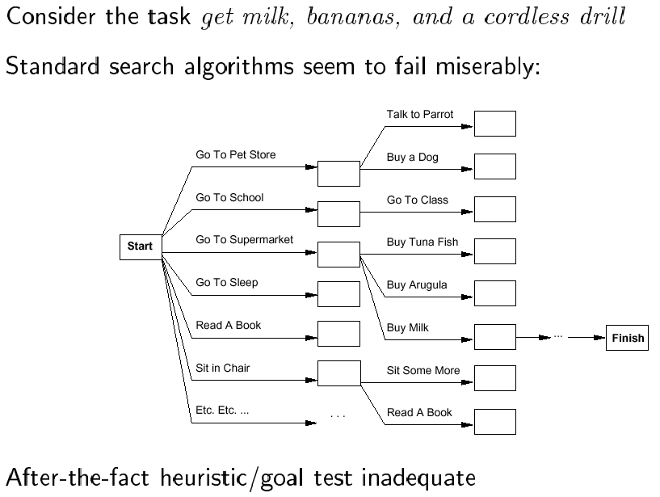
Search vs. planning

Slide 9
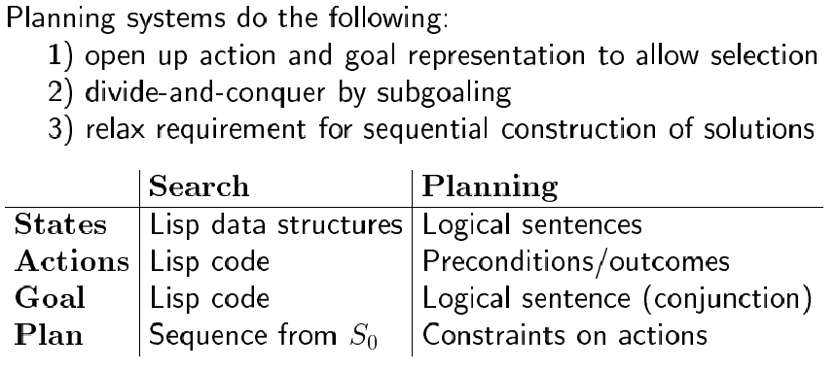
Search vs. Planning

Slide 10
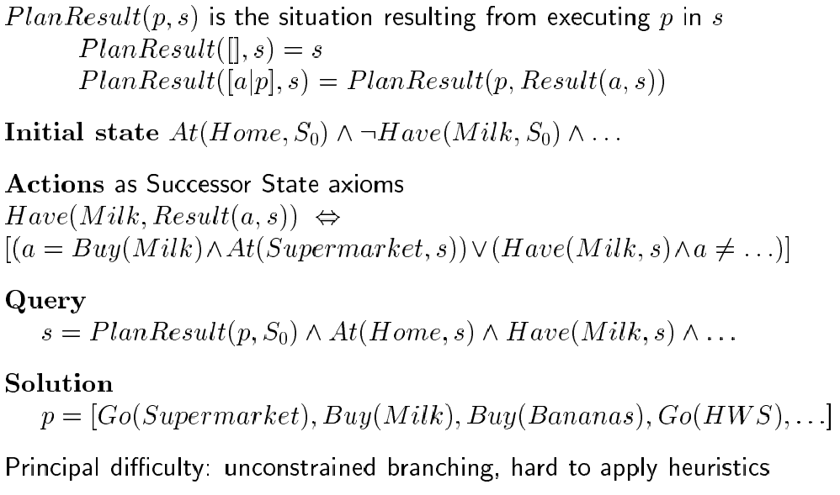
Planning in Situation Calculus (Review)

Slide 11
Basic Representation for Planning
Most widely used approach: uses STRIPS language
states: conjunctions of function-free ground literals (I.e., predicates applied to constant symbols, possibly negated); e.g.,
At(Home) ∧ ¬Have(Milk) ∧ ¬Have(Bananas) ∧ ¬Have(Drill) …
goals: also conjunctions of literals; e.g.,
At(Home) ∧ Have(Milk) ∧ Have(Bananas) ∧ Have(Drill)
but can also contain variables (implicitly universally quant.); e.g.,
At(x) ∧ Sells(x, Milk)

Slide 12
Planner vs. Theorem_Prover
Planner: ask for sequence of actions that makes goal true if executed
Theorem prover: ask whether query sentence is true given KB

Slide 13
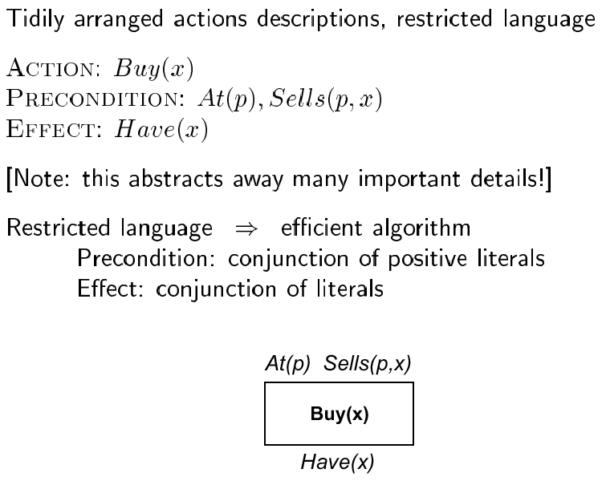
STRIPS operators
// Add list and Delete list
Graphical notation:

Slide 14
Types of Planners
Situation space planner: search through possible situations/states
Progression (forward) Planner: start with the initial state, apply operators until the goal is reached
Problem: high branching factor!
Regression (backward) Planner: start from the goal state and apply operators until the start state reached
Why desirable? usually many more operators are applicable to
the initial state than to goal state.
Difficulty: when want to achieve a conjunction of goals
Initial STRIPS algorithm: situation-space regression planner

Slide 15
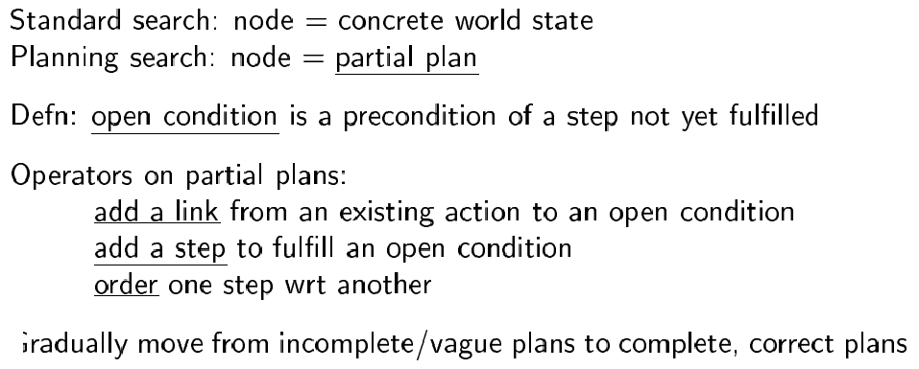
State Space vs. Plan Space
Search space of plans, rather than of states.

Slide 16
Operations on plans
Refinement operators: add constraints to partial plan
Modification operator: every other operators

Slide 17
Types of planners
Partial order planner: some steps are ordered, some are not
Total order planner: all steps ordered (thus, plan is a simple list of steps)
Linearization: process of deriving a totally ordered plan from a partially ordered plan.

Slide 18
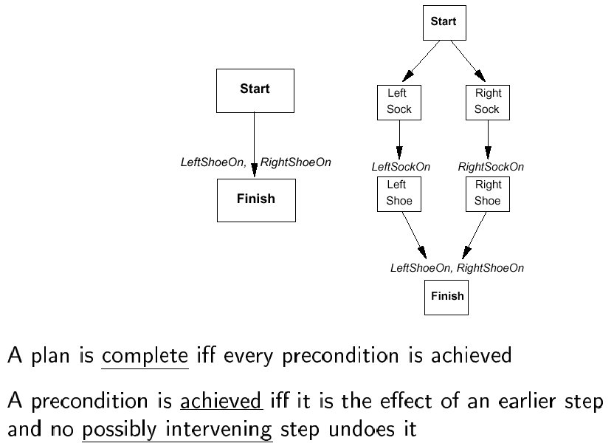
Partially ordered plans

Slide 19
Plan
We formally define a plan as a data structure consisting of:
Set of plan steps (each is an operator for the problem)
Set of step ordering constraints
e.g., A B means “A before B”
Set of variable binding constraints
e.g., v = x where v variable and x constant or other variable
Set of causal links
e.g., A B means “A achieves c for B”
c

Slide 20
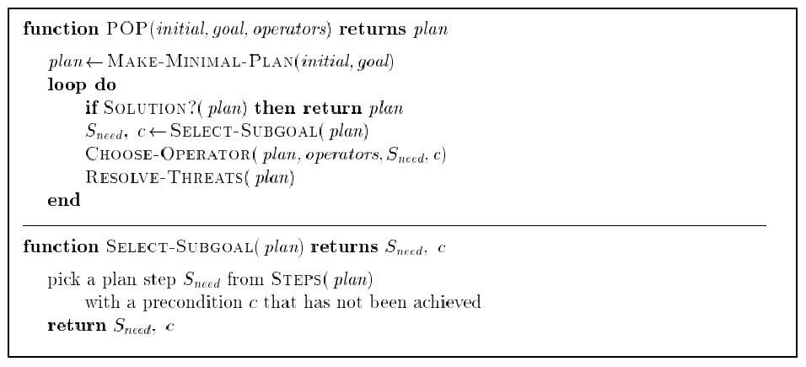
POP Algorithm (sketch)

Slide 21
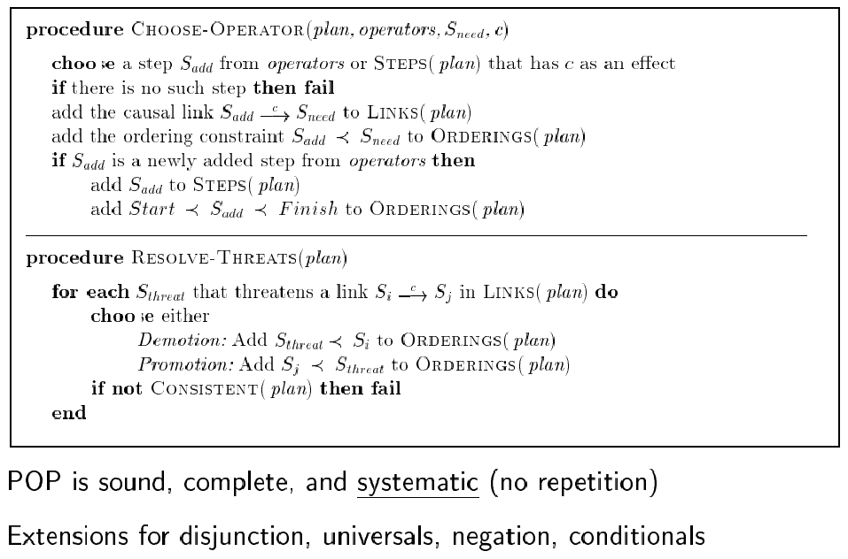
POP Algorithm (cont.)

Slide 22
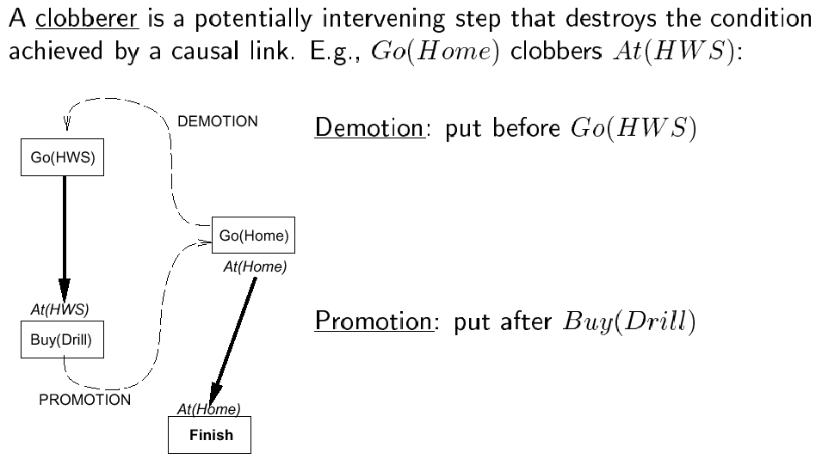
Clobbering and promotion/demotion

Slide 23
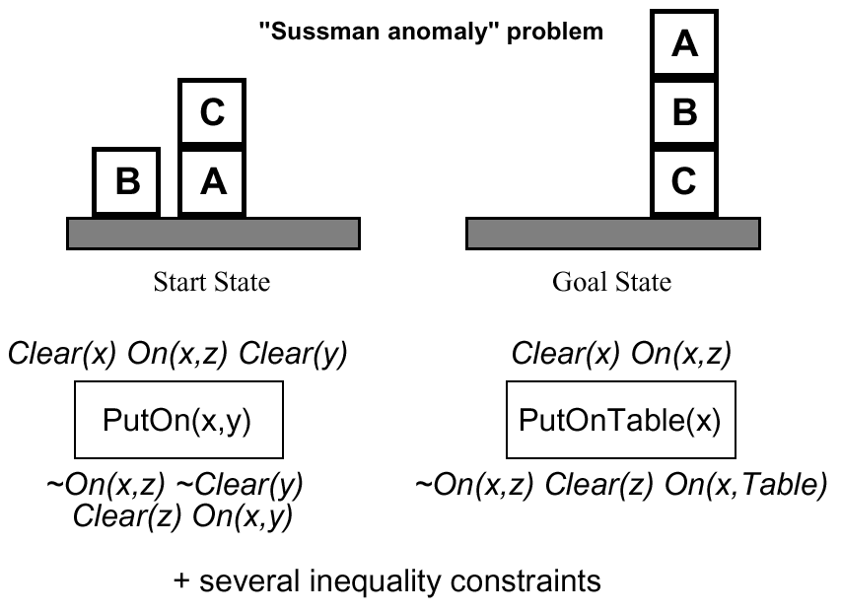
Example: block world

Slide 24
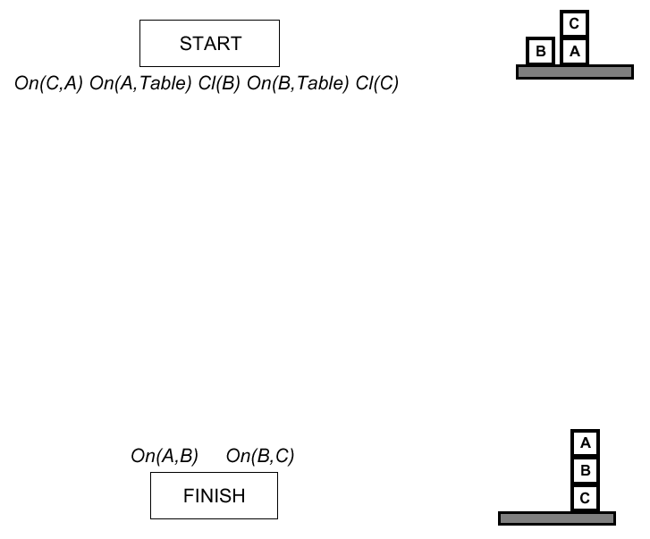
Example (cont.)

Slide 25
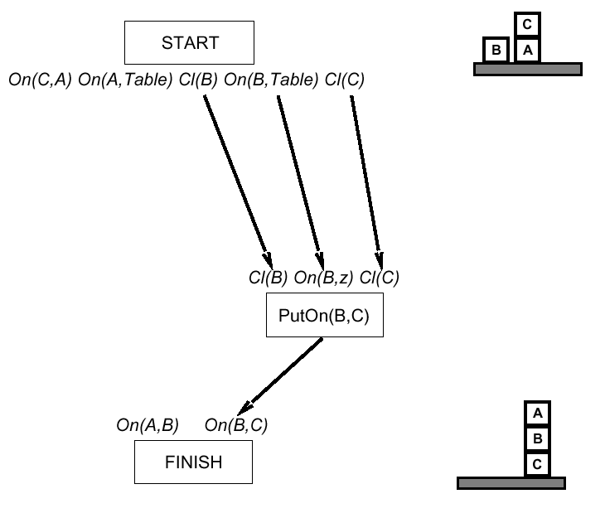
Example (cont.)

Slide 26
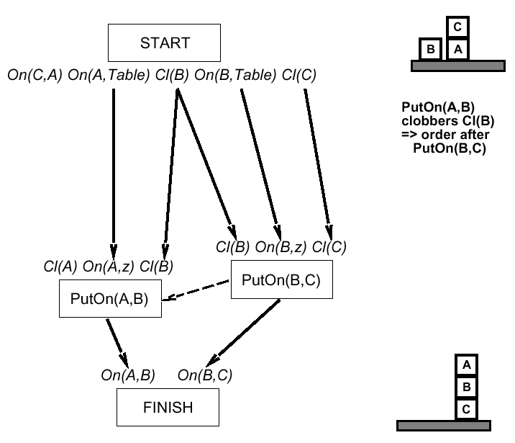
Example (cont.)

Slide 27
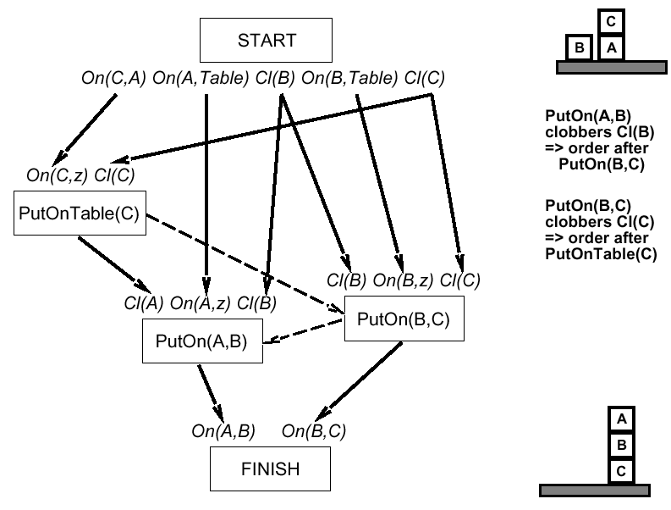
Example (cont.)

Slide 28
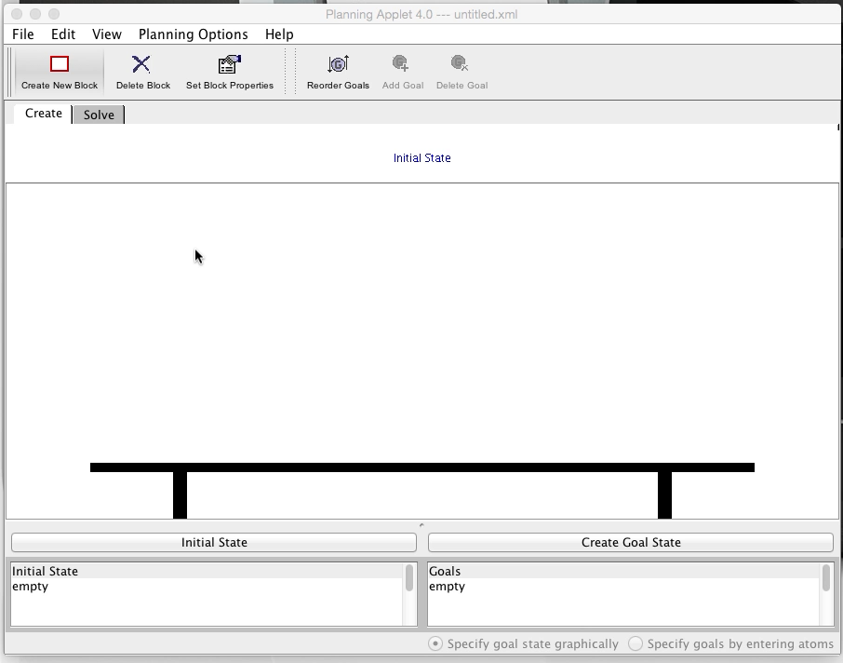
Demo

