Slide 1
17. Learning from Examples
CSCI 561 Foundation for Artificial Intelligence
Professor Wei-Min Shen
University of Southern California

Slide 2
Outline: learning from examples
Learning agents
Inductive learning
Classification and support vector machines (SVM)
Decision tree learning

Slide 3
What is learning?
“Learning denotes changes in a system that ... enable a system to do the same task more efficiently the next time.” –Herbert Simon
“Learning is constructing or modifying representations of what is being experienced.” –Ryszard Michalski
“Learning is making useful changes in our minds.” –Marvin Minsky

Slide 4
Why study learning?
Understand and improve efficiency of human learning
Use to improve methods for teaching and tutoring people (e.g., better computer-aided instruction)
Discover new things or structure previously unknown
Examples: data mining, scientific discovery
Fill in skeletal or incomplete specifications about a domain
Large, complex AI systems can’t be completely built by hand and require dynamic updating to incorporate new information
Learning new characteristics expands the domain or expertise and lessens the “brittleness” of the system
Build agents that can adapt to users, other agents, and their environment

Slide 5
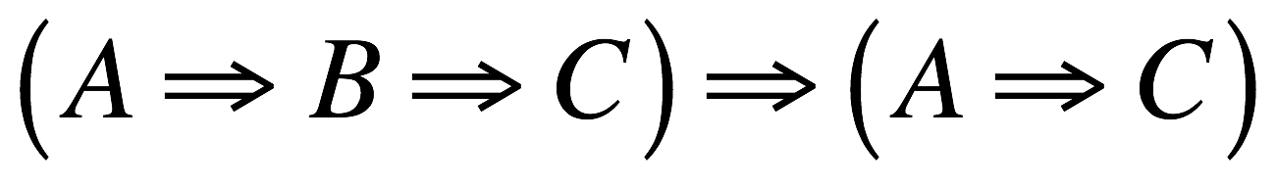
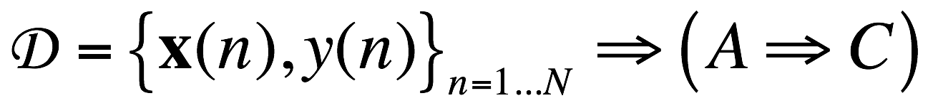
Two types of learning in AI
Deductive: Deduce rules/facts from already known rules/facts. (We have already dealt with this)
Inductive: Learn new rules/facts from a data set D.
We will be dealing with the latter, inductive learning, now

Slide 6
Learning (Essential Features)
Learning is essential for unknown environments
i.e., when the designers lack omniscience
Learning is useful as a system construction method
i.e., expose the agent to reality rather than trying to manually write the system
Learning modifies the agent's decision mechanisms to improve performance

Slide 7
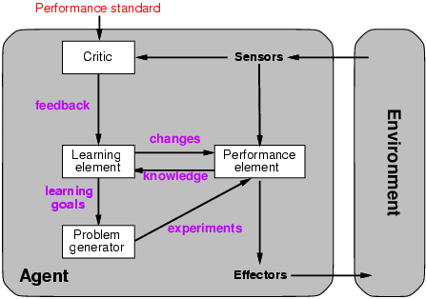
Learning agents

Slide 8
Learning element
Design of a learning element is affected by
Which components of the performance element are to be learned
What feedback is available to learn these components
What representation is used for the components
Type of feedback:
Supervised learning: correct answers for each example
Unsupervised learning: correct answers not given
Reinforcement learning: occasional rewards

Slide 9
Inductive learning
Simplest form: learn a function from examples
f is the target function
An example is a pair (x, f(x))
Problem: find a hypothesis h from a space H of possible functions
such that h ≈ f
given a training set of examples
(This is a highly simplified model of real learning:
Ignores prior knowledge
Assumes examples are given)

Slide 10
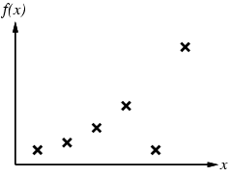
Inductive learning method
Construct/adjust h to agree with f on the training set of examples
(h is consistent if it agrees with f on all the given examples)
E.g., curve fitting:

Slide 11
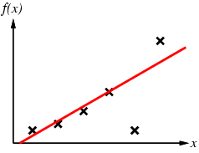
Inductive learning method
Construct/adjust h to agree with f on training set
(h is consistent if it agrees with f on all examples)
E.g., curve fitting:

Slide 12
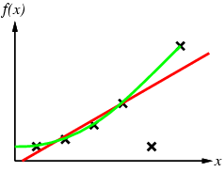
Inductive learning method
Construct/adjust h to agree with f on the training set
(h is consistent if it agrees with f on all the examples)
E.g., curve fitting:

Slide 13
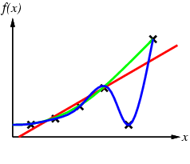
Inductive learning method
Construct/adjust h to agree with f on the training set
(h is consistent if it agrees with f on all the examples)
E.g., curve fitting:

Slide 14
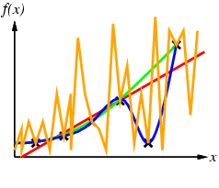
Inductive learning method
Construct/adjust h to agree with f on the training set
(h is consistent if it agrees with f on all the examples)
E.g., curve fitting:

Slide 15
Inductive learning method
Construct/adjust h to agree with f on the training set
(h is consistent if it agrees with f on all the examples)
E.g., curve fitting:
Ockham’s Razor: prefer the simplest hypothesis consistent with the data

Slide 16
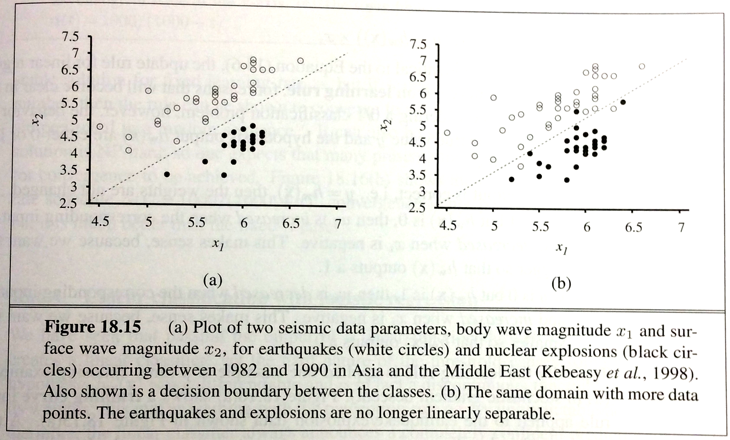
Learning to classify
In many problems we want to learn how to classify data into one of several possible categories.
E.g., face recognition, etc. Here are earthquake vs nuclear explosion:

Slide 17
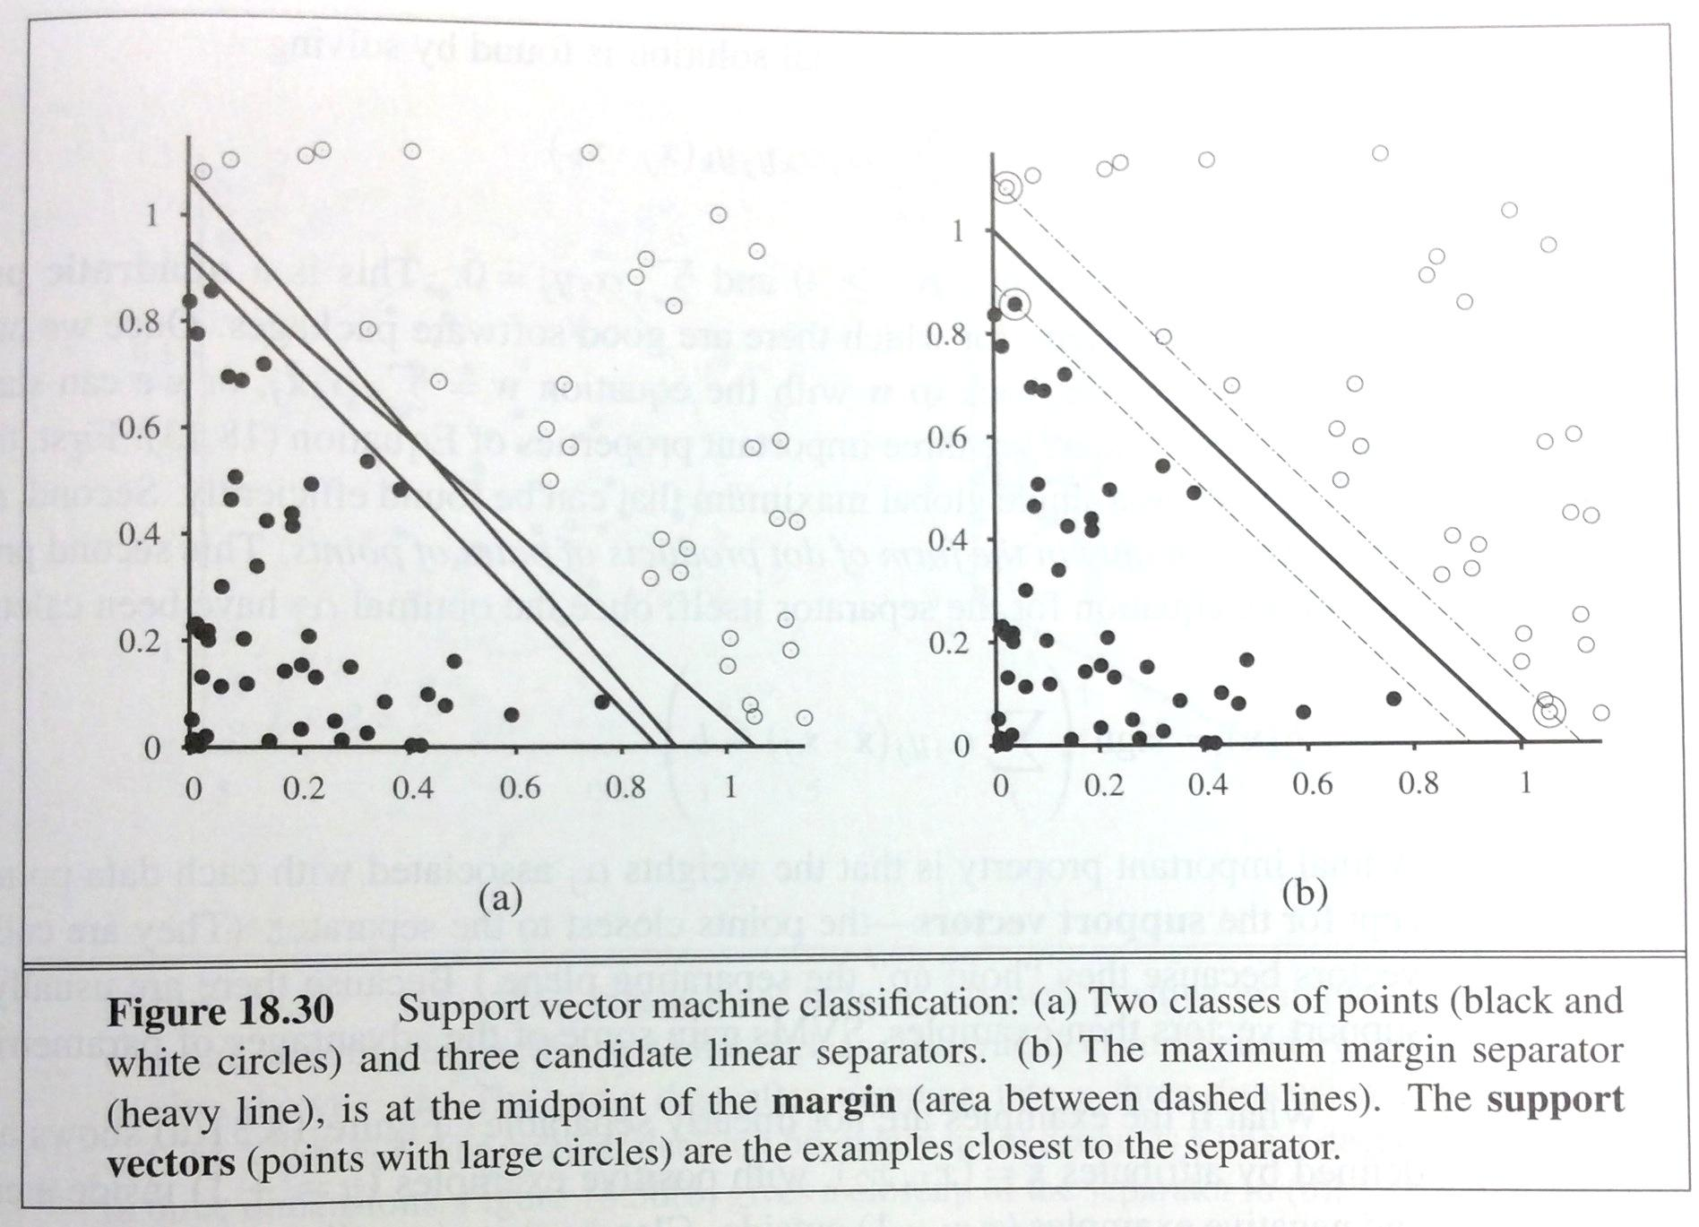
Problem: how to best draw the line?
Many methods exist. One of the most popular ones is the support vector machine (SVM): Find the maximum margin separator, i.e., the one that is as far as possible from any example point.

Slide 18
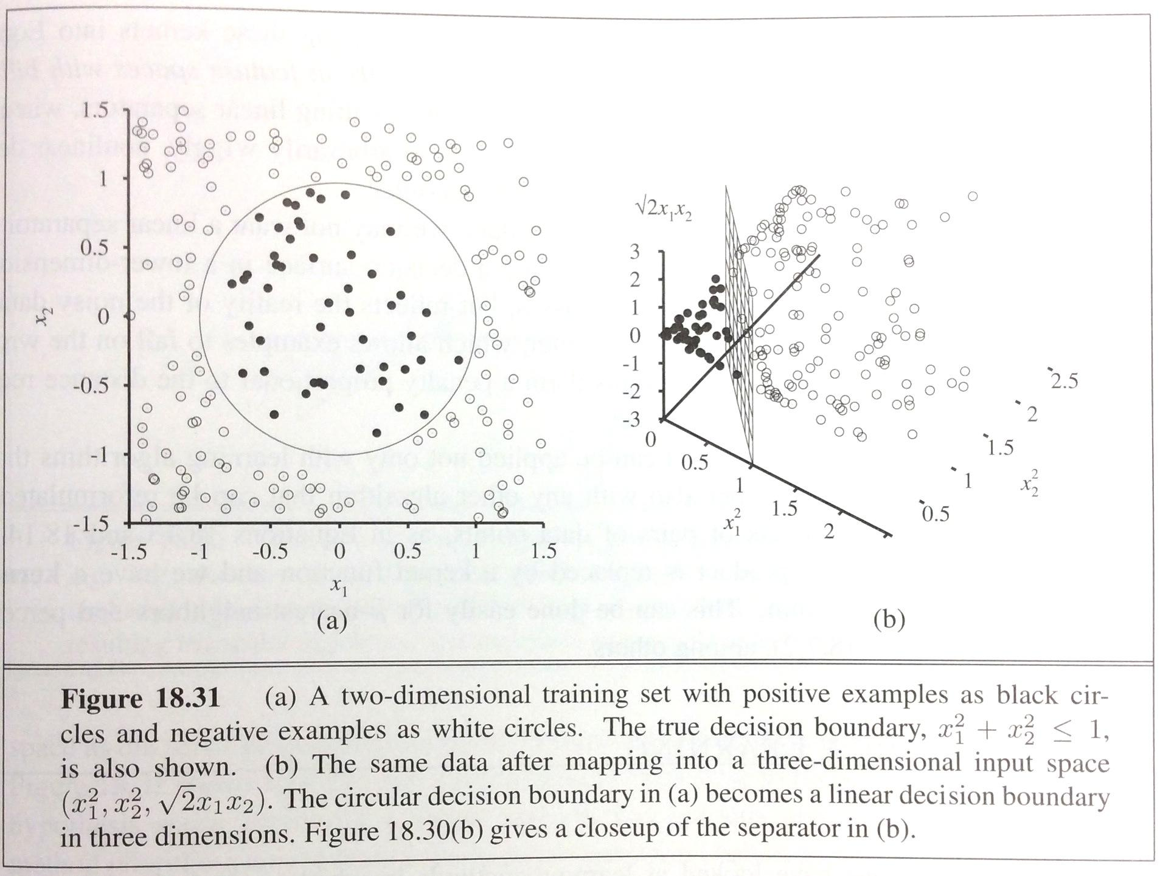
Non-linear separability and SVM
SVM can handle data that is not linearly separable using the so-called “kernel trick”: embed the data into a higher-dimensional space, in which it is linearly separable.

Slide 19
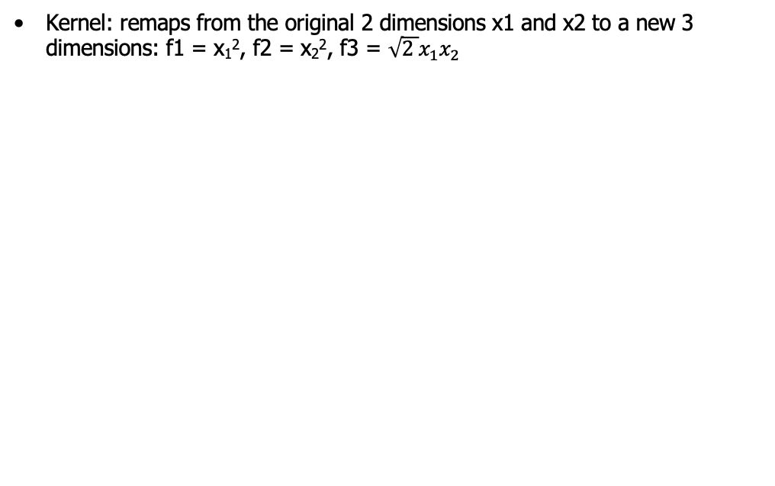
Non-linear separability and SVM
(see textbook for details on how those new dimensions were chosen)
(Read the extra hand-out material for math details)

Slide 20
Learning decision trees
In some other problems, a single A vs. B classification is not sufficient.
For example:
Problem: decide whether to wait for a table at a restaurant, based on the following attributes/features:
Alternate: is there an alternative restaurant nearby?
Bar: is there a comfortable bar area to wait in?
Fri/Sat: is today Friday or Saturday?
Hungry: are we hungry?
Patrons: number of people in the restaurant (None, Some, Full)
Price: price range ($, $$, $$$)
Raining: is it raining outside?
Reservation: have we made a reservation?
Type: kind of restaurant (French, Italian, Thai, Burger)
WaitEstimate: estimated waiting time (0-10, 10-30, 30-60, >60)

Slide 21
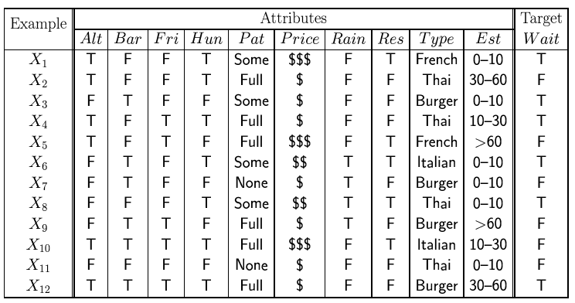
Attribute-based representations
Examples described by attribute values (Boolean, discrete, continuous)
E.g., situations where I will/won't wait for a table:
Classification of examples is positive (T) or negative (F)

Slide 22
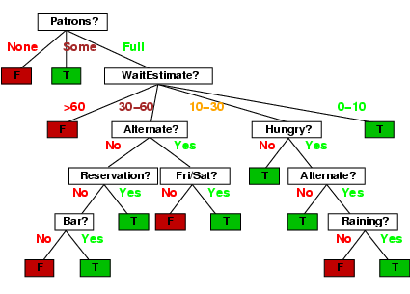
Decision trees
One possible representation for hypotheses
E.g., here is the “true” (designed manually by thinking about all cases) tree for deciding whether to wait:
Could we learn this tree from examples instead of designing it by hand?

Slide 23
Inductive learning of decision tree
Simplest: Construct a decision tree with one leaf for every example = memory based learning. Not very good generalization.
Advanced: Split on each variable so that the purity of each split increases (i.e. either only yes or only no)
Purity measured,e.g, with entropy

Slide 24
Inductive learning of decision tree
Simplest: Construct a decision tree with one leaf for every example = memory based learning. Not very good generalization.
Advanced: Split on each variable so that the purity of each split increases (i.e. either only yes or only no)
Purity measured,e.g, with entropy

Slide 25
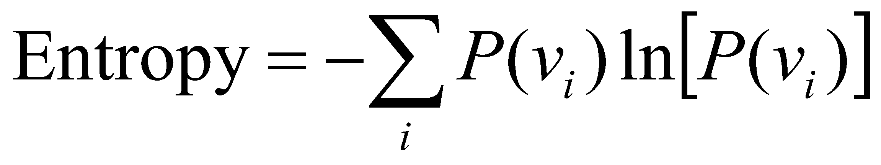
Inductive learning of decision tree
Simplest: Construct a decision tree with one leaf for every example = memory based learning. Not very good generalization.
Advanced: Split on each variable so that the purity of each split increases (i.e. either only yes or only no)
Purity measured,e.g, with entropy
General form:

Slide 26
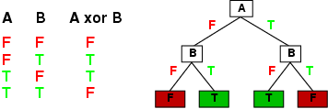
Expressiveness
Decision trees can express any function of the input attributes.
E.g., for Boolean functions, truth table row → path to leaf:
Trivially, there is a consistent decision tree for any training set with one path to leaf for each example (unless f nondeterministic in x) but it probably won't generalize to new examples
Prefer to find more compact decision trees (Ockham’s Razor)

Slide 27
Hypothesis spaces
How many distinct decision trees with n Boolean attributes?
= number of Boolean functions
= number of distinct truth tables with 2^{n} rows = 2^{2n}
E.g., with 6 Boolean attributes, there are 18,446,744,073,709,551,616 possible trees

Slide 28
Hypothesis spaces
How many distinct decision trees with n Boolean attributes?
= number of Boolean functions
= number of distinct truth tables with 2^{n} rows = 2^{2n}
E.g., with 6 Boolean attributes, there are 18,446,744,073,709,551,616 trees
How many purely conjunctive hypotheses (e.g., Hungry ∧ ¬Rain)?
Each attribute can be in (positive), in (negative), or out
⇒ 3^{n} distinct conjunctive hypotheses
The more expressive a hypothesis space is:
increases chance that target function can be expressed
increases number of hypotheses consistent with training set
⇒ may get worse predictions

Slide 29
ID3 Algorithm: Learning Decision Trees
A greedy algorithm for decision tree construction developed by Ross Quinlan circa 1987
Top-down construction of decision tree by recursively selecting “best attribute” to use at the current node in tree
Once attribute is selected for current node, generate child nodes, one for each possible value of selected attribute
Partition examples using the possible values of this attribute, and assign these subsets of the examples to the appropriate child node
Repeat for each child node until all examples associated with a node are either all positive or all negative

Slide 30
Choosing the best attribute
Key problem: choosing which attribute to split a given set of examples
Some possibilities are:
Random: Select any attribute at random
Least-Values: Choose the attribute with the smallest number of possible values
Most-Values: Choose the attribute with the largest number of possible values
Max-Gain: Choose the attribute that has the largest expected information gain–i.e., attribute that results in smallest expected size of subtrees rooted at its children
The ID3 algorithm uses the Max-Gain method of selecting the best attribute

Slide 31
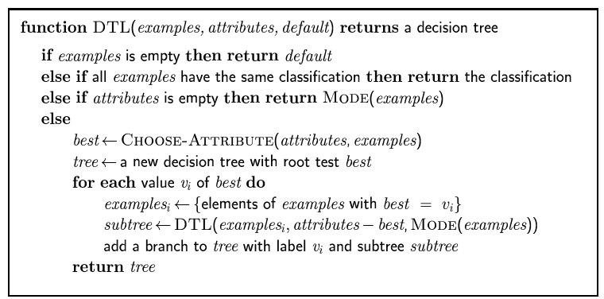
Decision tree learning
Aim: find a small tree consistent with the training examples
Idea: (recursively) choose the "most significant" attribute as the root of a (sub)tree

Slide 32
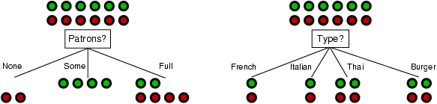
Choosing an attribute
Idea: a good attribute splits the examples into subsets that are (ideally) "all positive" or "all negative"
Patrons? is a better choice

Slide 33
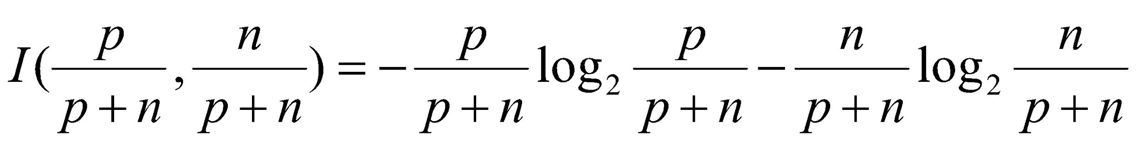
Using information theory
To implement Choose-Attribute in the DTL algorithm
Information Content (Entropy):
I(P(v₁), … , P(v_{n})) = Σ_{i=1} -P(v_{i}) log₂ P(v_{i}) // log₂, log₁₀, or log_{e}
For a training set containing p positive examples and n negative examples:

Slide 34

Information Theory 101
Information theory sprang almost fully formed from the seminal work of Claude E. Shannon at Bell Labs
A Mathematical Theory of Communication, Bell System Technical Journal, 1948.
Intuitions
Common words (a, the, dog) are shorter than less common ones (parliamentarian, foreshadowing)
In Morse code, common (probable) letters have shorter encodings
Information is measured in minimum number of bits needed to store or send some information
Wikipedia: The measure of data, known as information entropy, is usually expressed by the average number of bits needed for storage or communication.

Slide 35
Information Theory 101
Information is measured in bits
Information conveyed by message depends on its probability
With n equally probable possible messages, the probability p of each is 1/n
Information conveyed by a message is -log(p) = log(n)
e.g., with 16 messages, then log(16) = 4 and we need 4 bits to identify/send each message
Given probability distribution for n messages P = (p₁,p₂…p_{n}), the information conveyed by distribution (aka entropy of P) is:
I(P) = - [ p₁*log(p₁) + p₂*log(p₂) + ... + p_{n}*log(p_{n}) ]
probability of msg 2
information in msg 2

Slide 36
Information Theory II
Information conveyed by distribution (a.k.a. entropy of P):
I(P) = -(p₁*log(p₁) + p₂*log(p₂) + .. + p_{n}*log(p_{n}))
Examples:
If P is (0.5, 0.5) then I(P) = .5*1 + 0.5*1 = 1
If P is (0.67, 0.33) then I(P) = -(2/3*log(2/3) + 1/3*log(1/3)) = 0.92
If P is (1, 0) then I(P) = 1*log(1) + 0*log(0) = 0
The more uniform the probability distribution, the greater its information: More information is conveyed by a message telling you which event actually occurred
Entropy is the average number of bits/message needed to represent a stream of messages

Slide 37
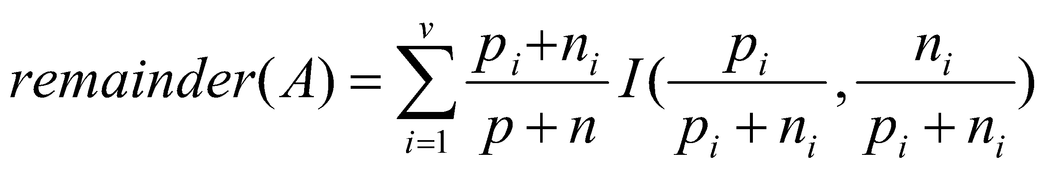
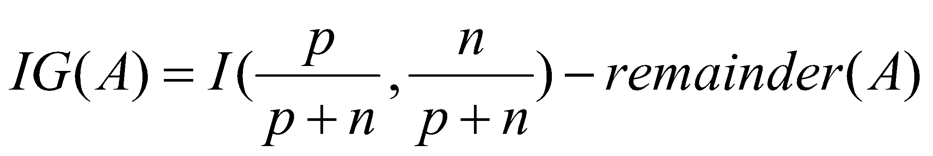
Information Gain
A chosen attribute A divides the training set E into subsets E₁, … , E_{v} according to their values for A, where A has v distinct values.
Information Gain (IG) or reduction in entropy from the attribute test:
Choose the attribute with the largest IG

Slide 38
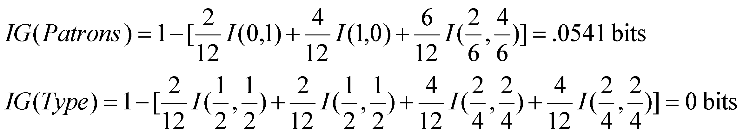
Information gain
For the training set, p = n = 6, I(6/12, 6/12) = 1 bit
Consider the attributes Patrons and Type (and others too):
Patrons has the highest IG of all attributes and so is chosen by the DTL algorithm as the root

Slide 39
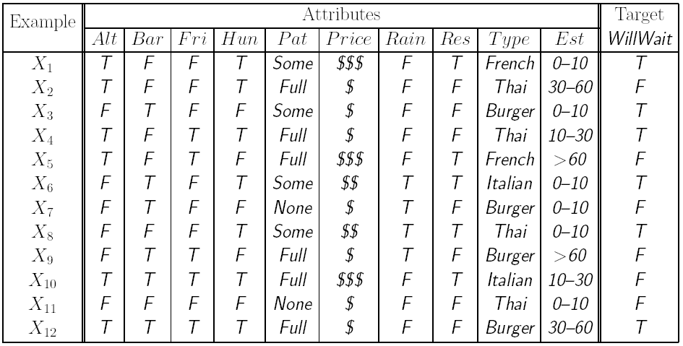
Decision tree learning example
Before split:
entropy = 0.30
Alternate?
Yes
No
3 T, 3 F
3 T, 3 F
After split:
Entropy decrease = 0.30 – 0.30 = 0
NOTE: Please replace “ln” by “log₁₀” in the above statement.

Slide 40
Decision tree learning example
Before split:
entropy = 0.30
Bar?
Yes
No
3 T, 3 F
3 T, 3 F
After split:
Entropy decrease = 0.30 – 0.30 = 0

Slide 41
Decision tree learning example
Before split:
entropy = 0.30
Sat/Fri?
Yes
No
2 T, 3 F
4 T, 3 F
After split:
Entropy decrease = 0.30 – 0.29 = 0.01

Slide 42
Decision tree learning example
Before split:
entropy = 0.30
Hungry?
Yes
No
5 T, 2 F
1 T, 4 F
After split:
Entropy decrease = 0.30 – 0.24 = 0.06

Slide 43
Decision tree learning example
Before split:
entropy = 0.30
Raining?
Yes
No
2 T, 2 F
4 T, 4 F
After split:
Entropy decrease = 0.30 – 0.30 = 0

Slide 44
Decision tree learning example
Before split:
entropy = 0.30
Reservation?
Yes
No
3 T, 2 F
3 T, 4 F
After split:
Entropy decrease = 0.30 – 0.29 = 0.01

Slide 45
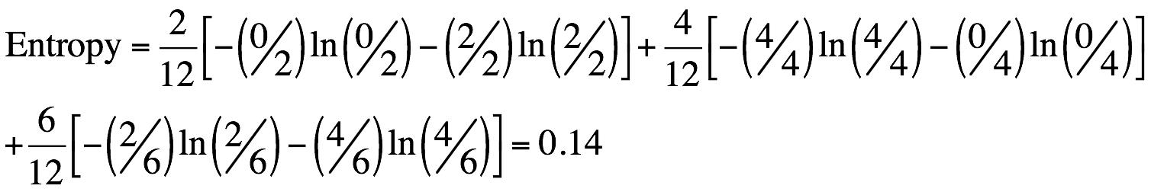
Decision tree learning example
Before split:
entropy = 0.30
Patrons?
None
Full
2 F
Some
2 T, 4 F
4 T
After split:
Entropy decrease = 0.30 – 0.14 = 0.16

Slide 46
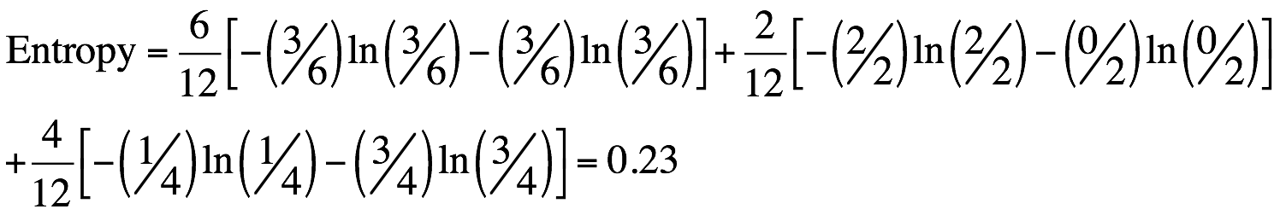
Decision tree learning example
Before split:
entropy = 0.30
Price
$
$$$
3 T, 3 F
$$
1 T, 3 F
2 T
After split:
Entropy decrease = 0.30 – 0.23 = 0.07

Slide 47
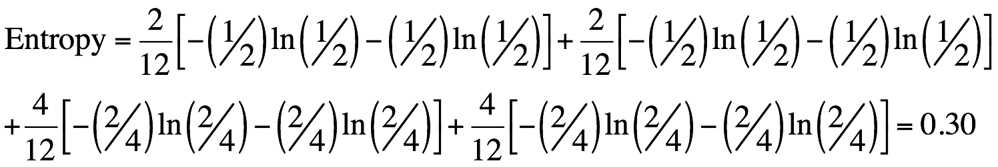
Decision tree learning example
Before split:
entropy = 0.30
Type
French
Burger
1 T, 1 F
2 T, 2 F
Italian
Thai
1 T, 1 F
2 T, 2 F
After split:
Entropy decrease = 0.30 – 0.30 = 0

Slide 48
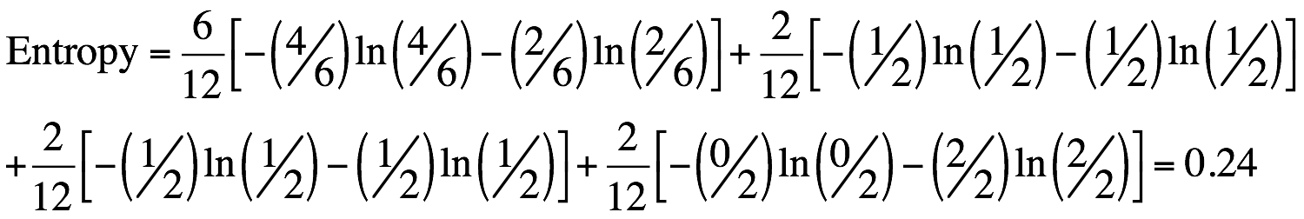
Decision tree learning example
Before split:
entropy = 0.30
Est. waiting time
0-10
> 60
4 T, 2 F
2 F
10-30
30-60
1 T, 1 F
1 T, 1 F
After split:
Entropy decrease = 0.30 – 0.24 = 0.06

Slide 49
Decision tree learning example
Patrons?
Largest entropy decrease (0.16) achieved by splitting on Patrons.
None
Full
2 F
Some
X?
2 T, 4 F
Continue like this, making new splits, always purifying nodes.
4 T

Slide 50
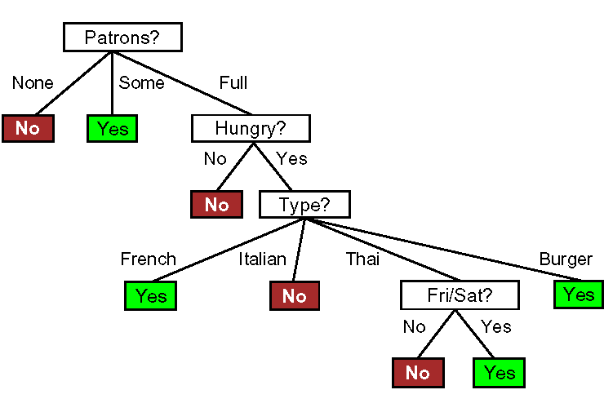
Decision tree learning example
Induced tree (from examples)

Slide 51
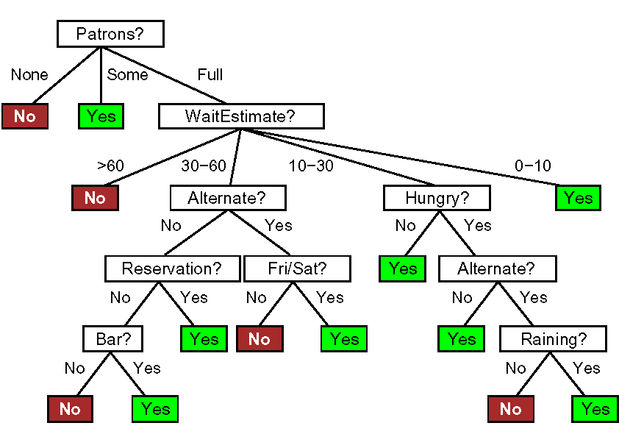
Decision tree learning example
True tree (by hand)

Slide 52
Decision tree learning example
Induced tree (from examples)
Cannot make it more complex than what the data supports.

Slide 53
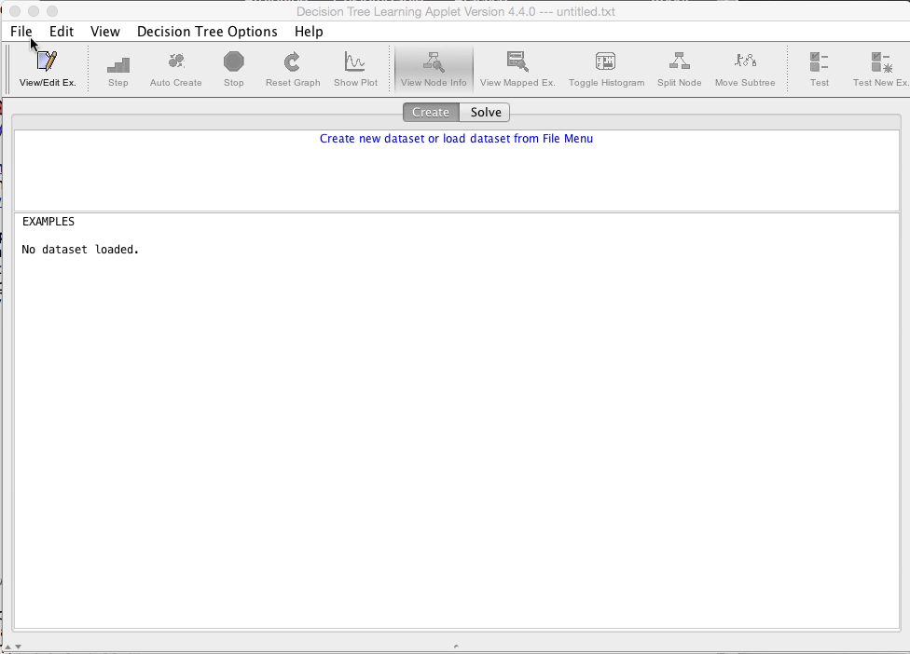
Demo

Slide 54
How do we know it is correct?
How do we know that h ≈ f ? (Hume's Problem of Induction)
Try h on a new test set of examples (cross validation)
...and assume the ”principle of uniformity”, i.e. the result we get on this test data should be indicative of results on future data. Causality is constant.
Inspired by a slide by V. Pavlovic

Slide 55
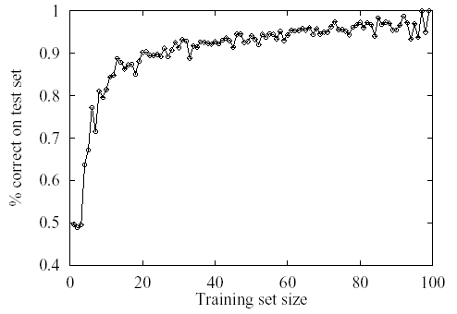
Learning curve for the decision tree algorithm on 100 randomly generated examples in the restaurant domain.
The graph summarizes 20 trials.

Slide 56
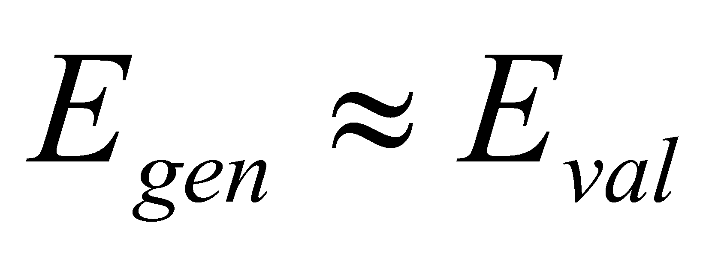
Cross-validation
Use a “validation set”.
Split your data set into two
parts, one for training your
model and the other for
validating your model.
The error on the validation
data is called “validation error”
(E_{val})
D_{train}
D_{val}
E_{val}

Slide 57
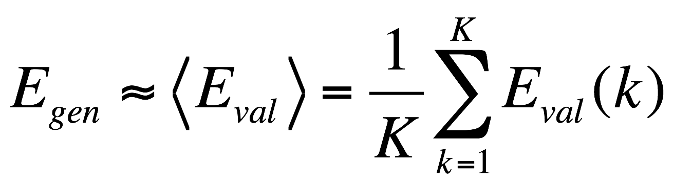
K-Fold Cross-validation
More accurate than using only one validation set.
D_{train}
D_{val}
D_{train}
D_{val}
D_{train}
D_{val}
D_{train}
E_{val}(1)
E_{val}(2)
E_{val}(3)

Slide 58
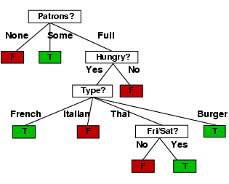
Example contd.
Decision tree learned from the 12 examples:
Substantially simpler than “true” tree---a more complex hypothesis isn’t justified by small amount of data

Slide 59
Summary
Learning needed for unknown environments, lazy designers
Learning agent = performance element + learning element
For supervised learning, the aim is to find a simple hypothesis approximately consistent with training examples
Decision tree learning using information gain
Learning performance = prediction accuracy measured on test set

