Slide 1
19. Uncertainty and Probability
CSCI 561 Foundation for Artificial Intelligence
Professor Wei-Min Shen
University of Southern California

Slide 2
Outline
Introduction to probability
Powerful tool for uncertainty reasoning
What and where is probability?
Models and probability distributions
Inferences based on probability methods

Slide 3
Example: Seeing vs Believing
You define two “logic” (random) variables for two propositions:
X: “my eyes see the object”
Y: “the object is really there”
Your real experience is as follows:
X = [1, 1, 0, 1, 0, 1, 1, 0, 0, 1, 1, 1]
Y = [1, 1, 1, 0, 0, 1, 1, 0, 0, 0, 1, 1]
Definition of probabilities
P(X): the probability of “my eyes see the object”
P(Y): the probability of “the object is really there”
P(Y^X): the probability that “the object is really there AND my eyes see the object”
P(Y|X): the probability that “the object is really there IF my eyes see the object”
Computing the probability
P(X) = 8/12, P(Y) = 7/12, P(X^Y) = P(XY) = P(X,Y) = 6/12, … (based on counting)
In common sense, “Seeing is Believing” ⬄ P(Y|X)=1.0
But in this real experience, P(Y|X) = ??? [this and others are what we will learn]

Slide 4
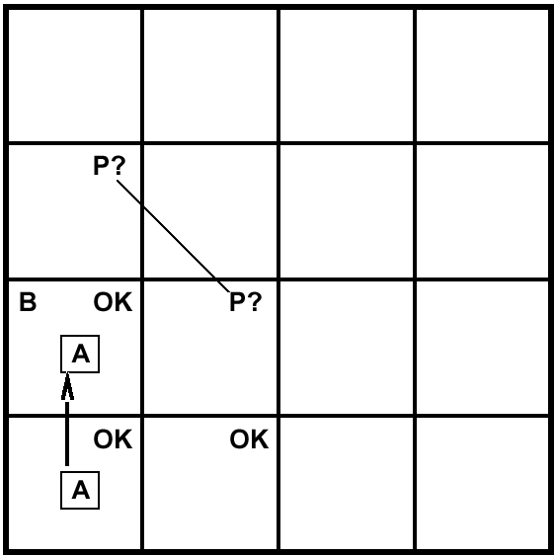
Example: Guessing a Pit
A= Agent
B= Breeze
S= Smell
P= Pit
W= Wumpus
OK = Safe
V = Visited
G = Glitter
Which one has a PIT?
B
P?
Logic can only guess randomly which of [1,3],[2,2],[3,1] has a pit
Using probability you can calculate which one is more likely have a pit than others

Slide 5
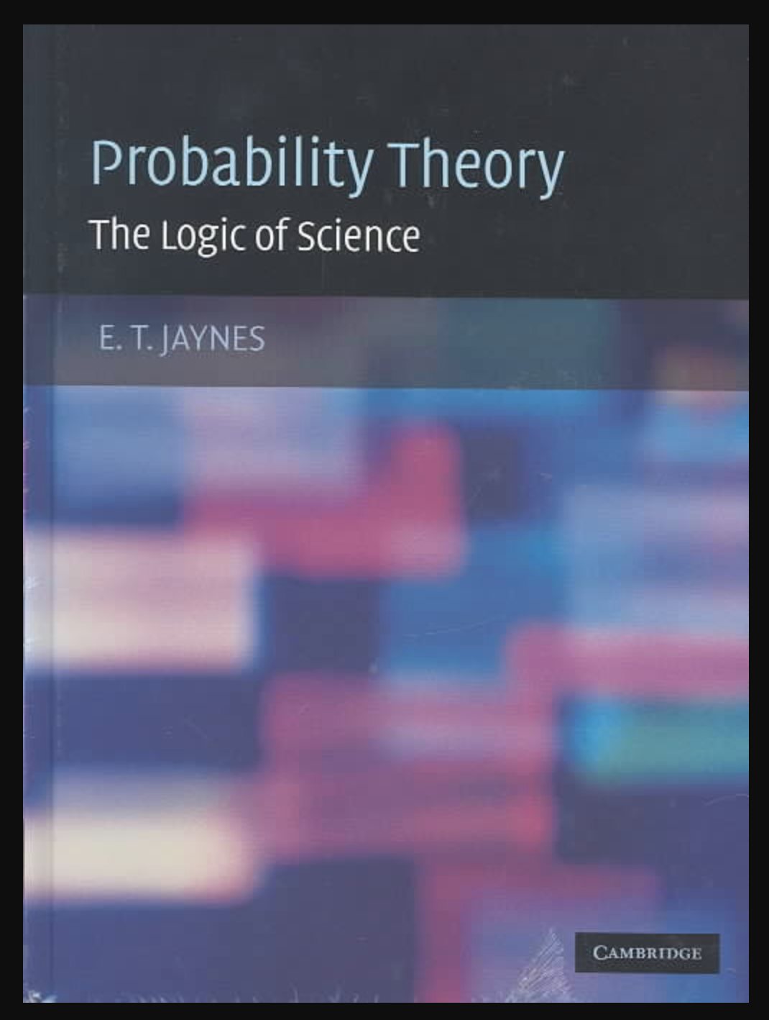
Logics and Probabilities
Not all knowledge are certain
Earlier stories of expert systems (medical, legal)
Two big challenges for logic-like approaches
Common sense (vague): “Water flows down”
Uncertainty
Probability: The Logic of Science
By E. T. Jaynes
>40 years of experience in physics
Builds upon principles (Bayes Rule)

Slide 6
Two Key Elements in Probability
Probability Distribution Model
Real World: possible worlds, atomic events, samples
Our Mind: Variables, Value assignments (“entailment”)
Inferences that can be made from the model
Sum rule
Product rule
Conditional
Marginalization
Normalization

Slide 7
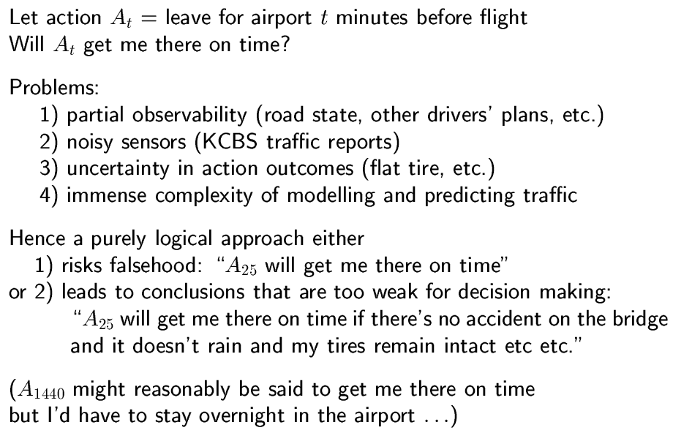
Uncertainty (Random Variables)

Slide 8
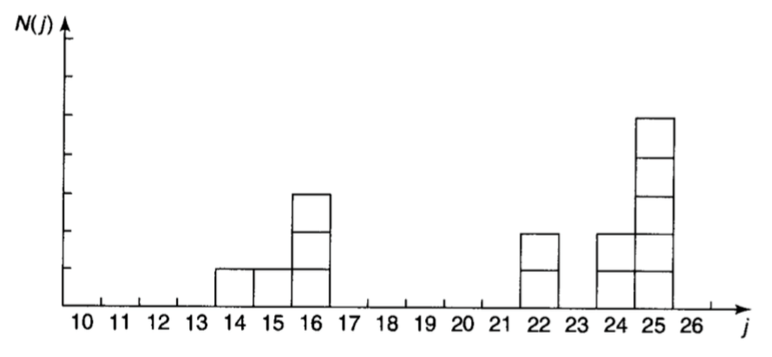
Examples of Probability
N people (e.g., N=14) with different age j
Probability P(j) = N(j)/N
Most probable? Media=? Average/Mean <j> = ?
25.0
(14+25)/2
Sum/14 = 21.0
Probability Distribution

Slide 9
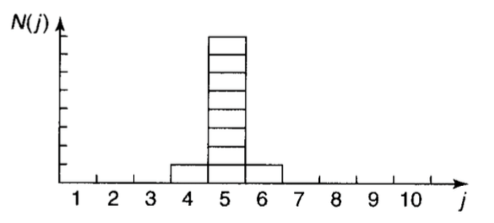
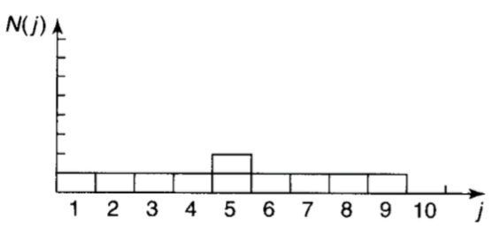
Example of Standard Deviation
Deviation shows how spread the distribution
E.g, same median, average, most probable
Variance σ² = < (Δj)² > = <j²> - <j>²
where Δj = j - <j>

Slide 10
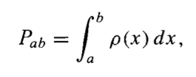
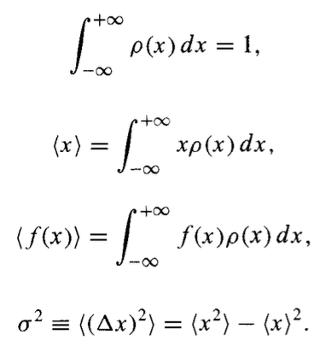

Probability Density ρ(x)
ρ(x)
ρ(x)=1/(2√hx)
1/(2h)
<x>=?, σ²=?,
h
x

Slide 11
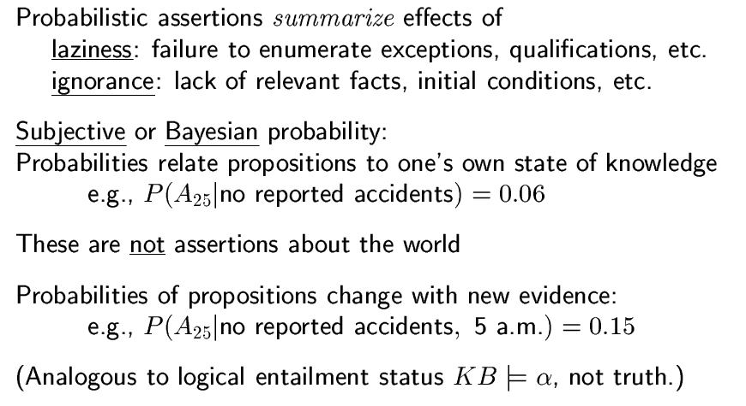
Probability
Where is Probability? In the world or in your mind?
E.g., when you are throwing a dice, …
(vs. “Objective” Probability)

Slide 12

Example: Cavity-Toothache-Catch
Cavity
???
???
???
???
Toothache
???
Catch
Other facts and interactions may exist, but they are either insignificant, unknown, or irrelevant, so we leave them out.

Slide 13
Table of “Uncertainties”
Cavity | Catch | Toothache | Logic Truth | Probability
0 | 0 | 0 | {0,1} | 0.576
0 | 0 | 1 | {0,1} | 0.064
0 | 1 | 0 | {0,1} | 0.144
0 | 1 | 1 | {0,1} | 0.016
1 | 0 | 0 | {0,1} | 0.008
1 | 0 | 1 | {0,1} | 0.012
1 | 1 | 0 | {0,1} | 0.072
1 | 1 | 1 | {0,1} | 0.108
Sum=1.000
 | Toothache |  | ~Toothache
 | Catch | ~Catch | Catch | ~Catch
Cavity | 0.108 | 0.012 | 0.072 | 0.008
~Cavity | 0.016 | 0.064 | 0.144 | 0.576

Slide 14
(Fully) Joint Probability Distribution
P(X,Y,Z)
000
001
010
011
100
101
110
111
(X,Y,Z)
“Possible worlds”
X: Cavity; Y: Catch; Z: Toothache

Slide 15
There are SO MUCH in a Distribution!
How likely you have cavity?
How likely you don’t have cavity?
How likely you have toothache and cavity?
How likely you have all three?
How likely you have none?
……
……

Slide 16
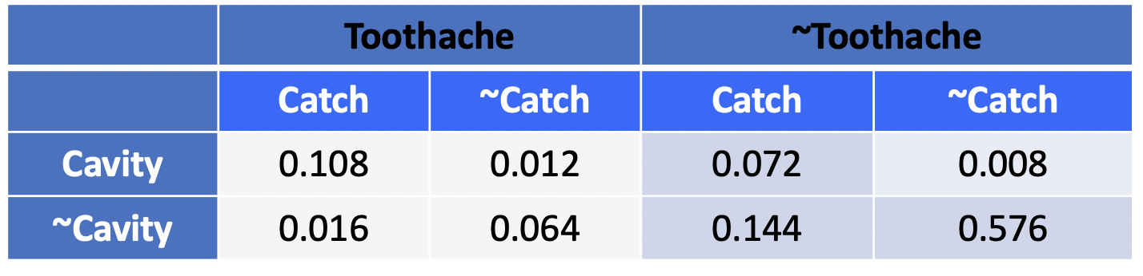
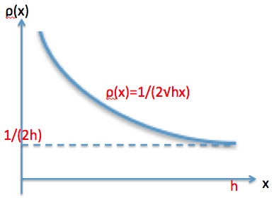
Probability Distribution Models (discrete or continuous)
P(X,Y,Z)
000
001
010
011
100
101
110
111
(X,Y,Z)
X: Cavity; Y: Catch; Z: Toothache

Slide 17
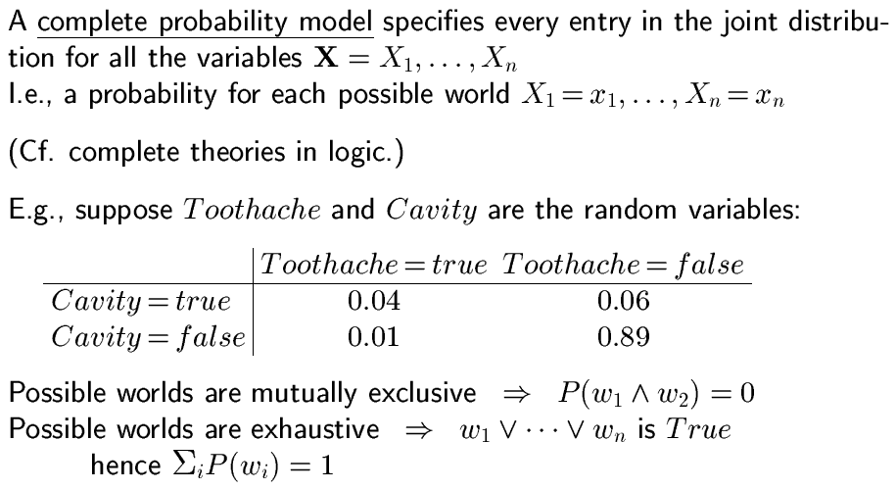
Full Joint (discrete) Distributions
Here, how many possible worlds?

Slide 18
Possible worlds in Discrete Distribution
How many possible worlds ?
For P(X,Y), where X,Y are binary variables, it is 2x2
For P(X,Y=y), it is 2x1
In general, the number of possible worlds
Is the product of the size of each variable

Slide 19
How many “possible worlds” in a discrete probability distribution?
P(X,Y,Z)
X: Cavity; Y: Catch; Z: Toothache
000
001
010
011
100
101
110
111
(X,Y,Z)
“Possible worlds”
“value assignments”
“Mutually Exclusive” & “Exhaustive”
2 x 2 x 2 = 8

Slide 20
Possible worlds in these distributions?
 | Toothache |  | ~Toothache
 | Catch | ~Catch | Catch | ~Catch
Cavity | 0.108 | 0.012 | 0.072 | 0.008
~Cavity | 0.016 | 0.064 | 0.144 | 0.576
P( Toothache | Cavity )
P(Toothache)
# of possible worlds = 2x2
# of possible worlds = 2

Slide 21
How many possible worlds in a continuous probability distribution?
There are infinite real numbers in [0,h]

Slide 22
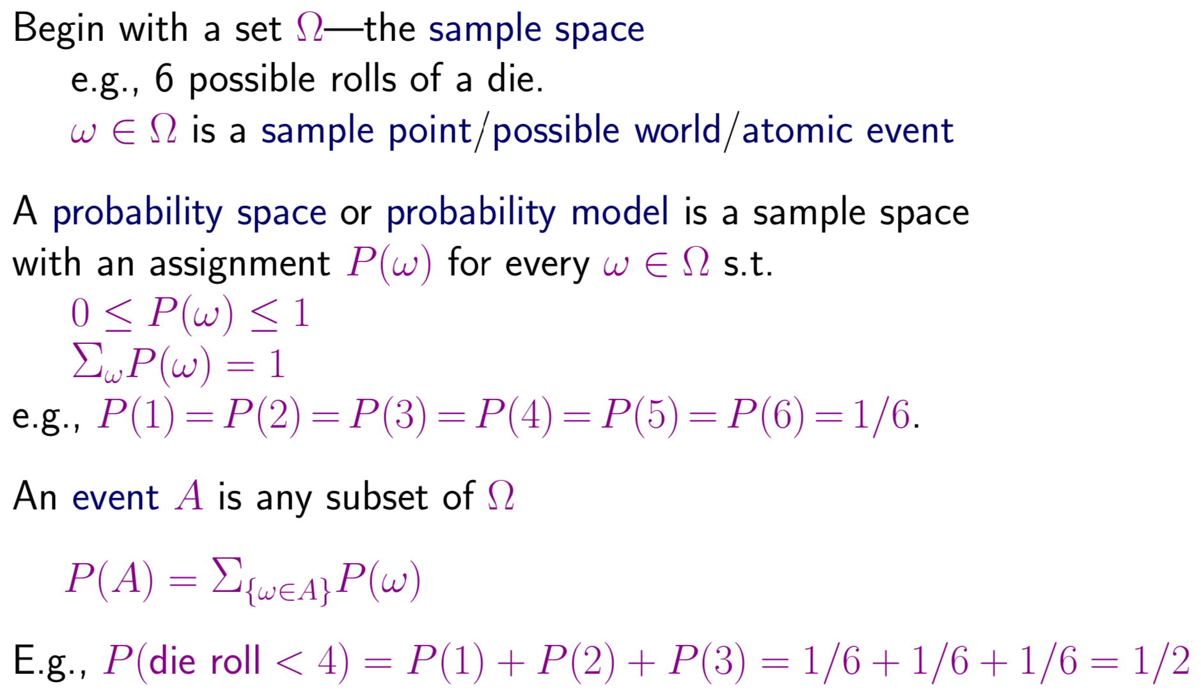
Probability Basics (Formal)

Slide 23
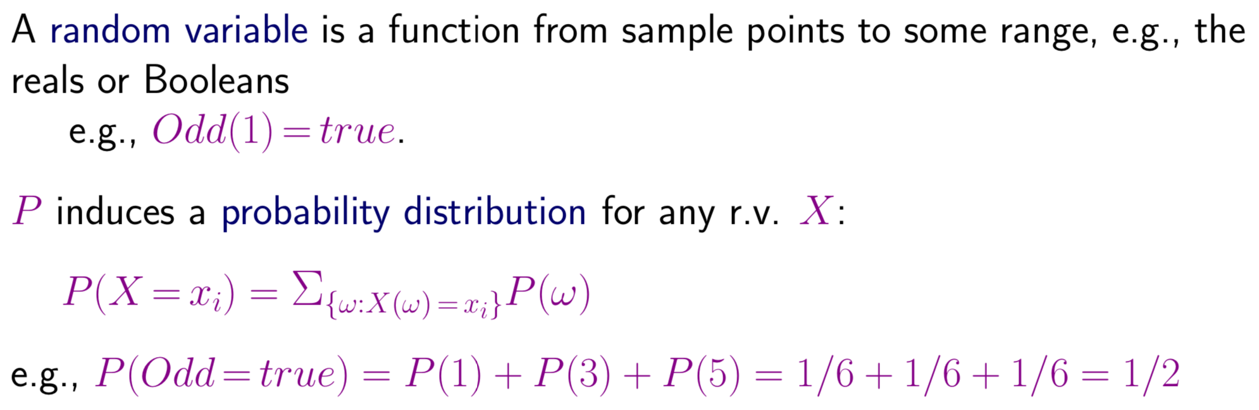
Random Variables

Slide 24
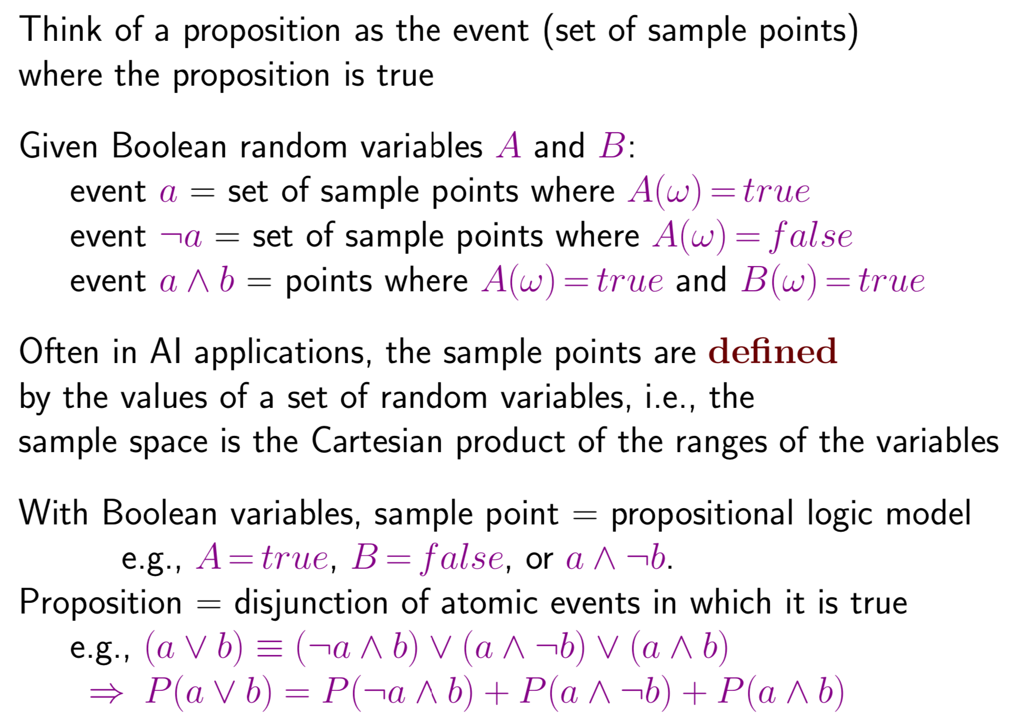
Propositions

Slide 25
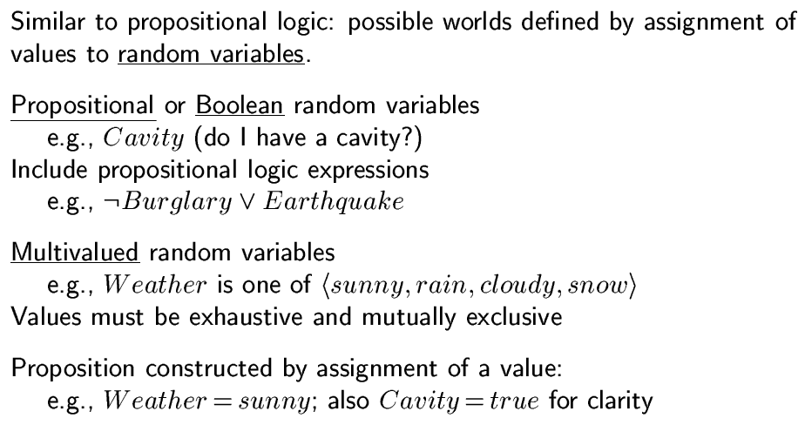
Syntax of Probability
rest?

Slide 26
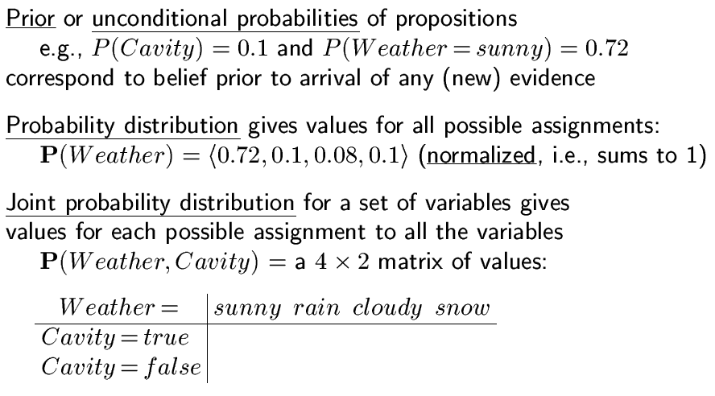
Syntax of Probability

Slide 27
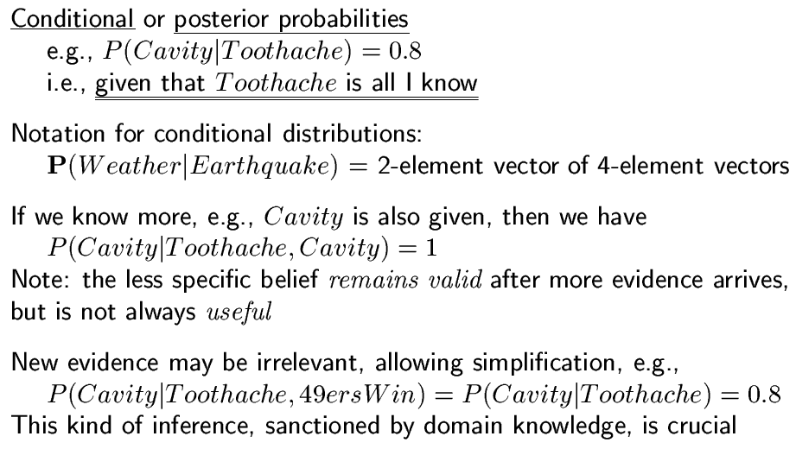
Syntax

Slide 28
Syntax Examples
Cavity | Catch | Toothache | Logic Truth | Probability
0 | 0 | 0 | {0,1} | 0.576
0 | 0 | 1 | {0,1} | 0.064
0 | 1 | 0 | {0,1} | 0.144
0 | 1 | 1 | {0,1} | 0.016
1 | 0 | 0 | {0,1} | 0.008
1 | 0 | 1 | {0,1} | 0.012
1 | 1 | 0 | {0,1} | 0.072
1 | 1 | 1 | {0,1} | 0.108
Exercises:
P(Cavity=1)=?, P(Cavity)=?, P(Catch=0)=?, P(Catch)=?, P(Toothache=1)=?, …
P(Cavity=1, Catch=1, Toothache=1)=?, P(Cavity, Catch, Toothache)=?
P(Cavity=0, Catch=0)=?, P(Cavity, Catch=0)=?

Slide 29
Two Key Elements in Probability
Probability Distribution Model
Variables, Value assignments (possible worlds)
Represented as a table or a graph
Inferences that can be made from the model
Sum rule
Product rule
Conditional
Normalization
Marginalization

Slide 30
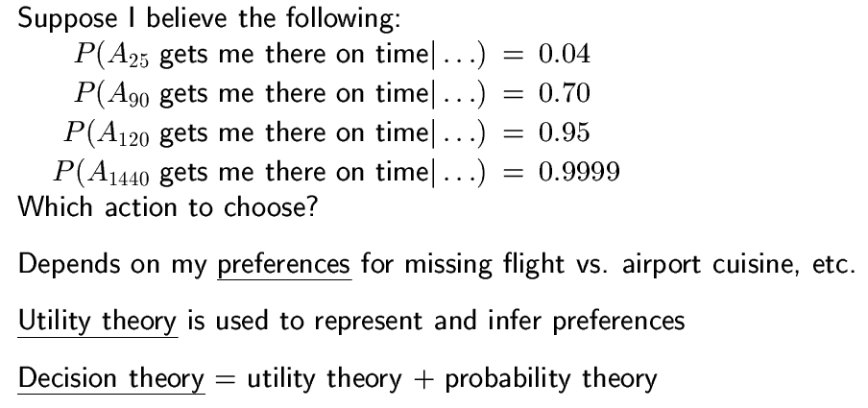
Making Decisions under Uncertainty

Slide 31
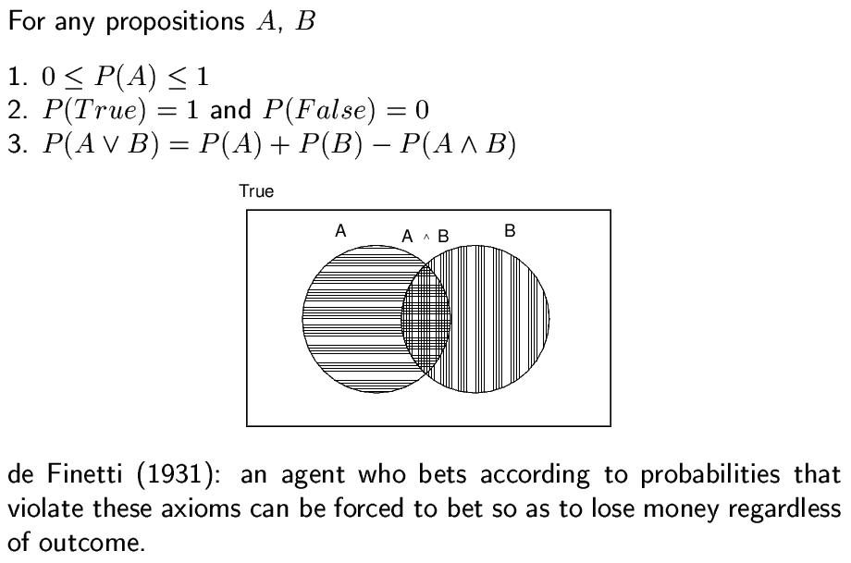
Axioms of Probability

Slide 32
Two Inference Rules (1)(2)
Rules: You only need to remember two ☺
Rule (1) Sum Rule
P(A|B) + P(~A|B) = 1
Rule (2) Product Rule for P(A^B)
Or more general: P(AB|C) = P(A|C) P(B|AC) = P(B|C) P(A|BC)
Notations
Variable X, value x_{i}, P(X=x_{i}),
P(X) denotes for all values of X as shown in the table, aka “joint probability distribution”
Mixed variables and values: P(X,Y), P(X, y)
Remember these
two rules!

Slide 33
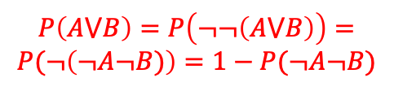
Inference for P(A v B)
Can you prove it by Sum Rule?

Slide 34
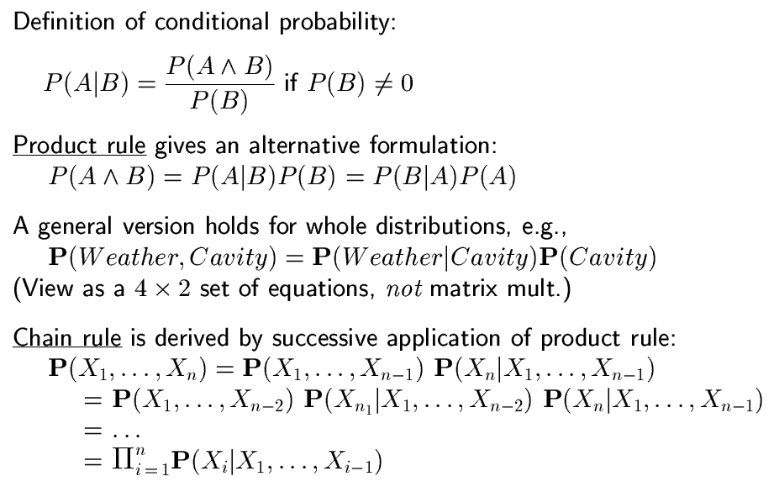
(3) Conditional Probability P(A|B)
Derivable from Product Rule
Product Rule

Slide 35
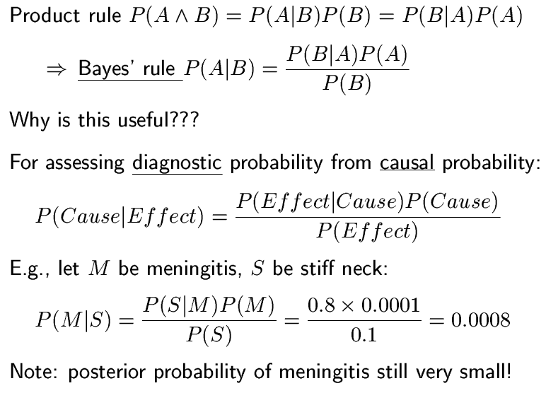
(3) Bayes’ Rule: derivable from product

Slide 36
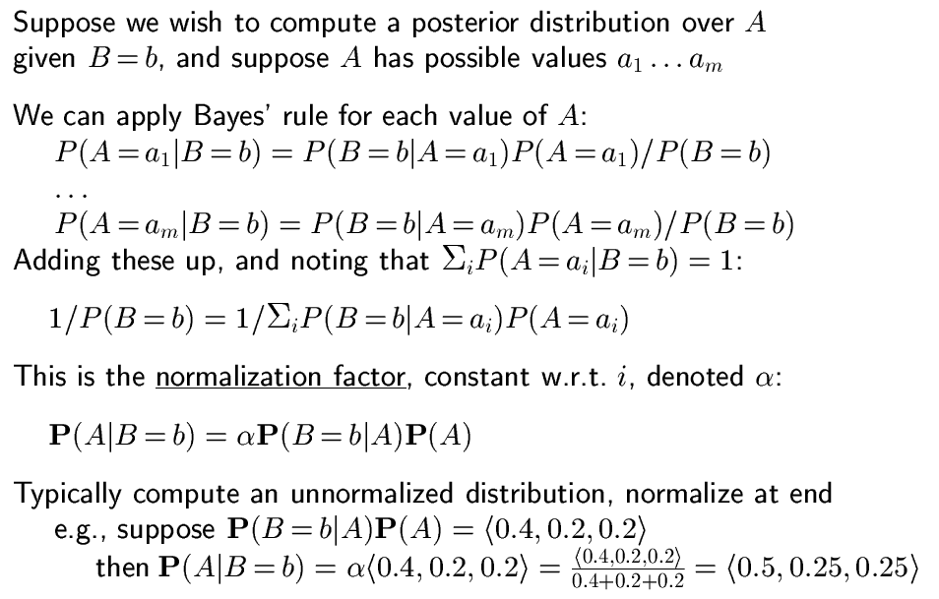
(4) Normalization (“make the distribution sum to 1”)
= α
= α P(B=b ^ A)

Slide 37
Normalization Example
Cavity | Catch | Toothache | Logic Truth | Probability
0 | 0 | 0 | {0,1} | 0.576
0 | 0 | 1 | {0,1} | 0.064
0 | 1 | 0 | {0,1} | 0.144
0 | 1 | 1 | {0,1} | 0.016
1 | 0 | 0 | {0,1} | 0.008
1 | 0 | 1 | {0,1} | 0.012
1 | 1 | 0 | {0,1} | 0.072
1 | 1 | 1 | {0,1} | 0.108
P( Toothache | Cavity=1) =
αP(Toothache ^ Cavity=1) =
α <0.108+0.012, 0.072+0.008> =
α <0.12, 0.08> =
<0.12/0.2, 0.08/0.2> =
<0.6, 0.4>
 | Toothache |  | ~Toothache
 | Catch | ~Catch | Catch | ~Catch
Cavity | 0.108 | 0.012 | 0.072 | 0.008
~Cavity | 0.016 | 0.064 | 0.144 | 0.576

Slide 38
Normalization once for all?
If you use the inference rules properly, then normalization would be preserved
For the last example, we may use the Product Rule
P(Toothache|Cavity=1) = α P(Cavity=1 ^ Toothache)
P(Toothache|Cavity=1) = P(Cavity=1^Toothache) / P(Cavity=1)
The results will be the same
Try it

Slide 39
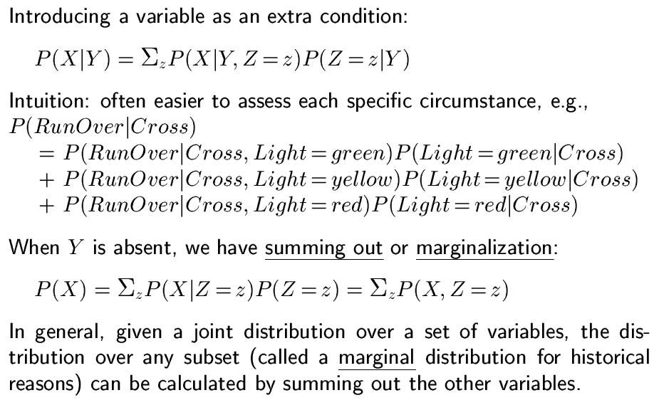
(5) Marginalization
Why? To plug in
the numbers we know
Why? To plug in
the known numbers

Slide 40
Marginalization Example
 | Toothache |  | ~Toothache
 | Catch | ~Catch | Catch | ~Catch
Cavity | 0.108 | 0.012 | 0.072 | 0.008
~Cavity | 0.016 | 0.064 | 0.144 | 0.576
P( Toothache|Cavity ) = Σ P(Toothache ^ Catch | Cavity)
= P(Toothache, Catch=1 | Cavity)
+ P(Toothache, Catch=0 | Cavity)
P(Toothache) = Σ P(Toothache ^ Cavity ^ Catch)
= P(Toothache, Cavity=1, Catch=0)
+ P(Toothache, Cavity=0, Catch=0)
+ P(Toothache, Cavity=1, Catch=1)
+ P(Toothache, Cavity=0, Catch=1)
// Insert Catch
// Insert Catch & Cavity

Slide 41
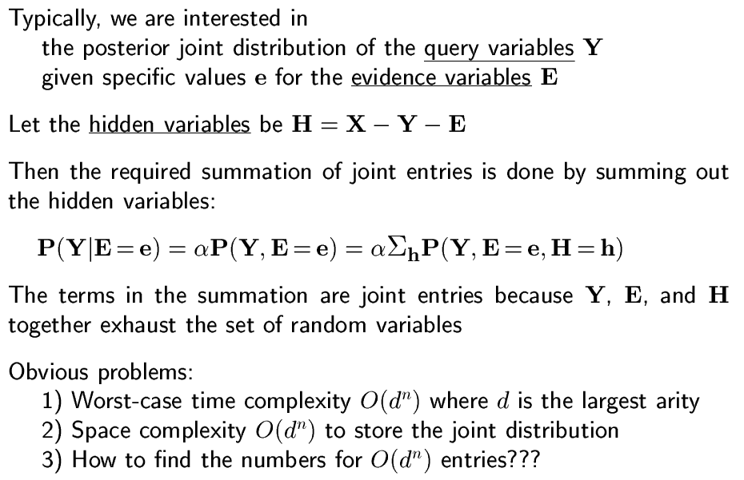
Margin from Joint Distributions
P(Y|E)
// where X denotes all variables
These are known from the joint distribution
X

Slide 42
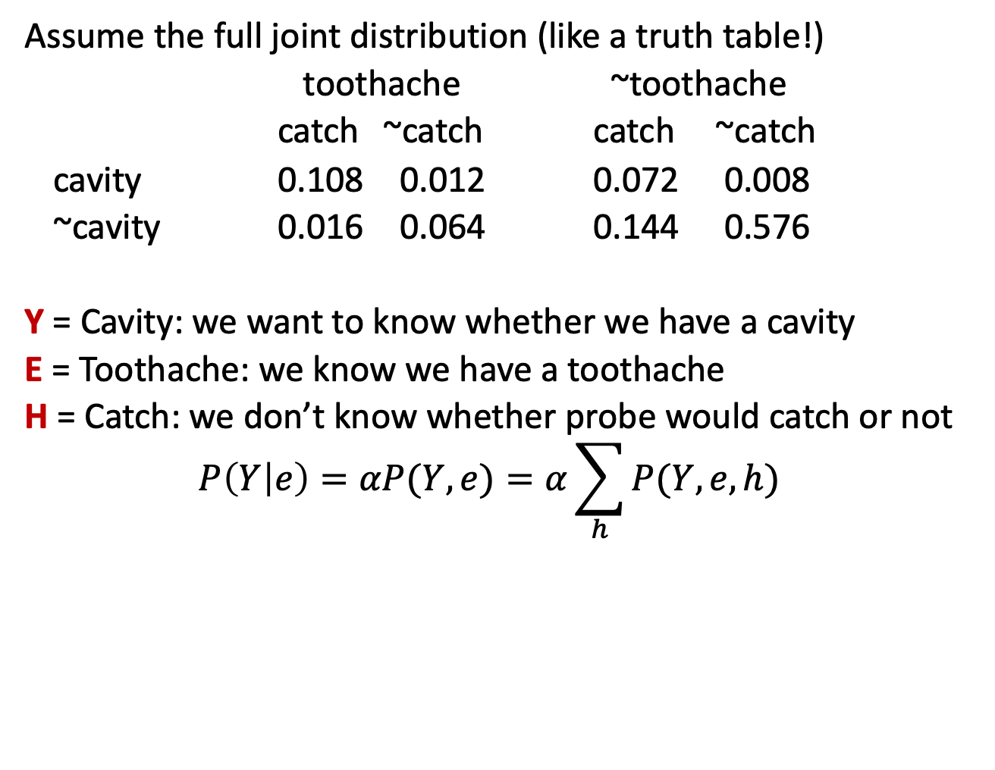
Example

Slide 43
Two Key Elements in Probability
✓
Probability Distribution Model
Variables, Value assignments (possible worlds)
Represented as a table or a graph
Inferences that can be made from the model
Sum rule
Product rule
Conditional
Normalization
Marginalization
Now we can do any general inference we like!
✓

Slide 44
General Inference for any Proposition
0 <= P(A) <= 1
P(False) = 0; P(True) = 1
P(A ^ B) = P(AB) = P(A) P(B|A) = P(B) P(A|B)
P(A v B) = P(A) + P(B) – P(A ^ B)

Slide 45
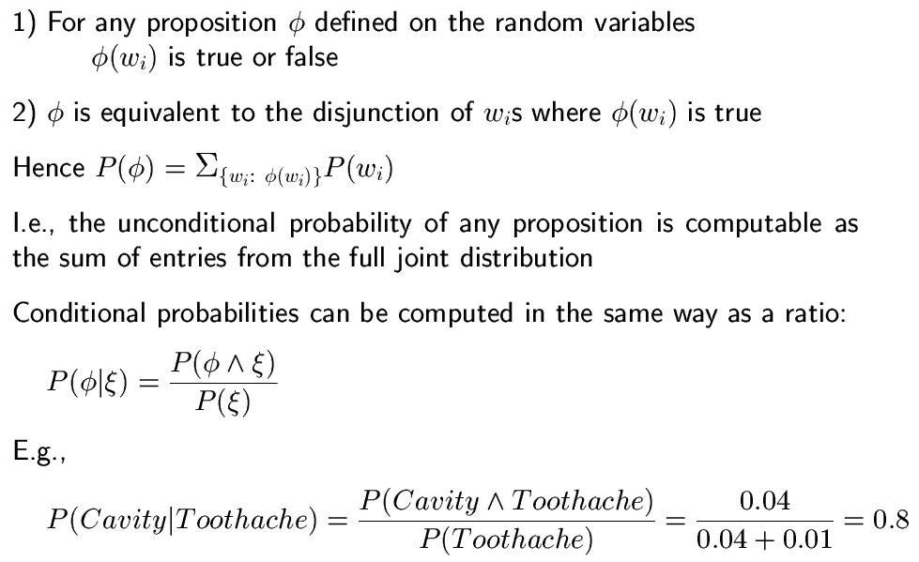
General Inference for Sentences
w_{i}
Sum Rule is for disjunction

Slide 46
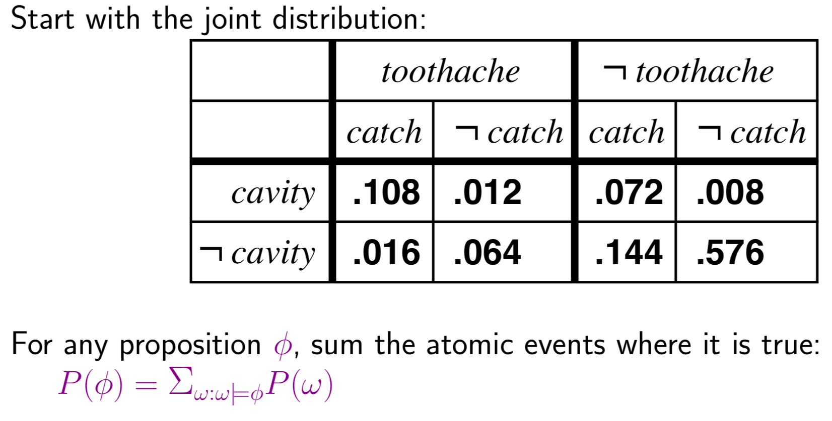
Inference by Summation (enumeration)

Slide 47
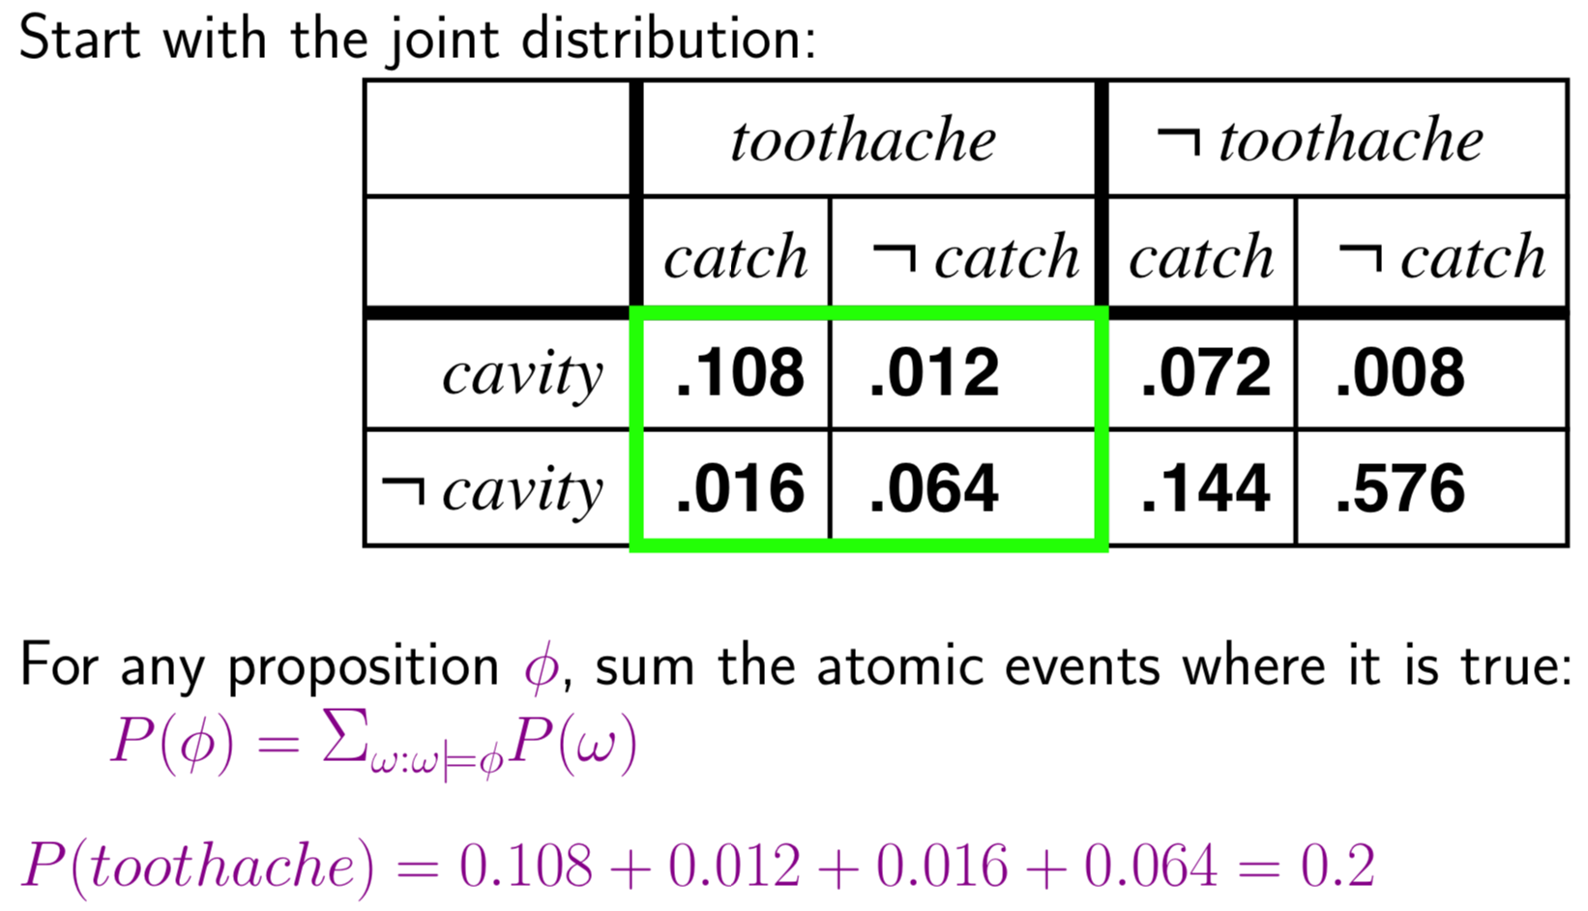
Inference by summation/enumeration

Slide 48
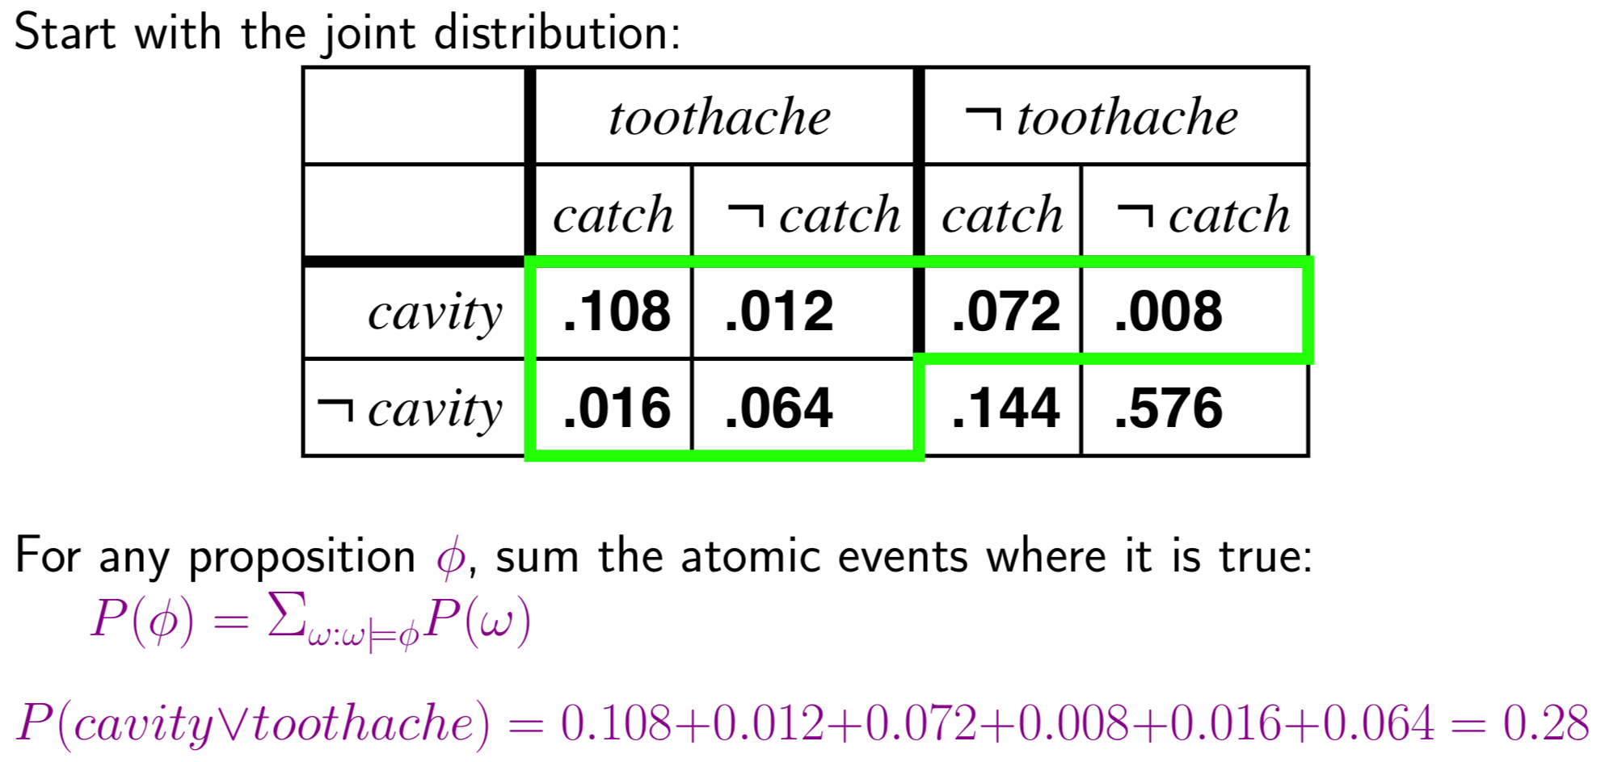
Inference by summation/enumeration

Slide 49
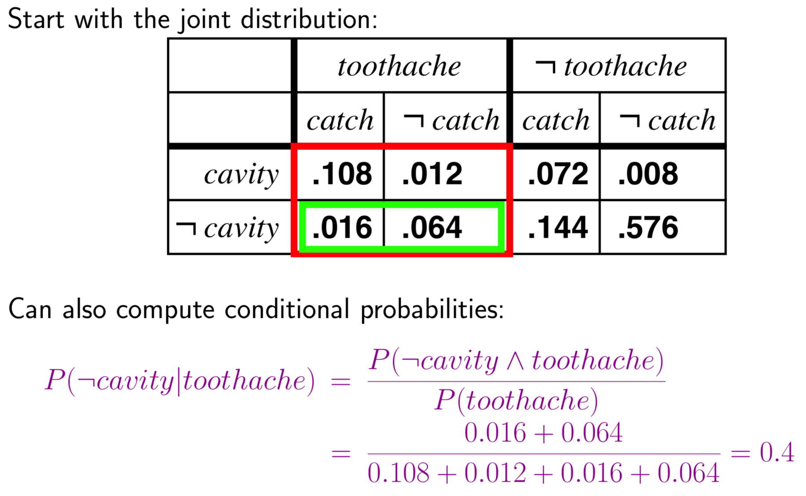
Inference by Conditional Probability

Slide 50
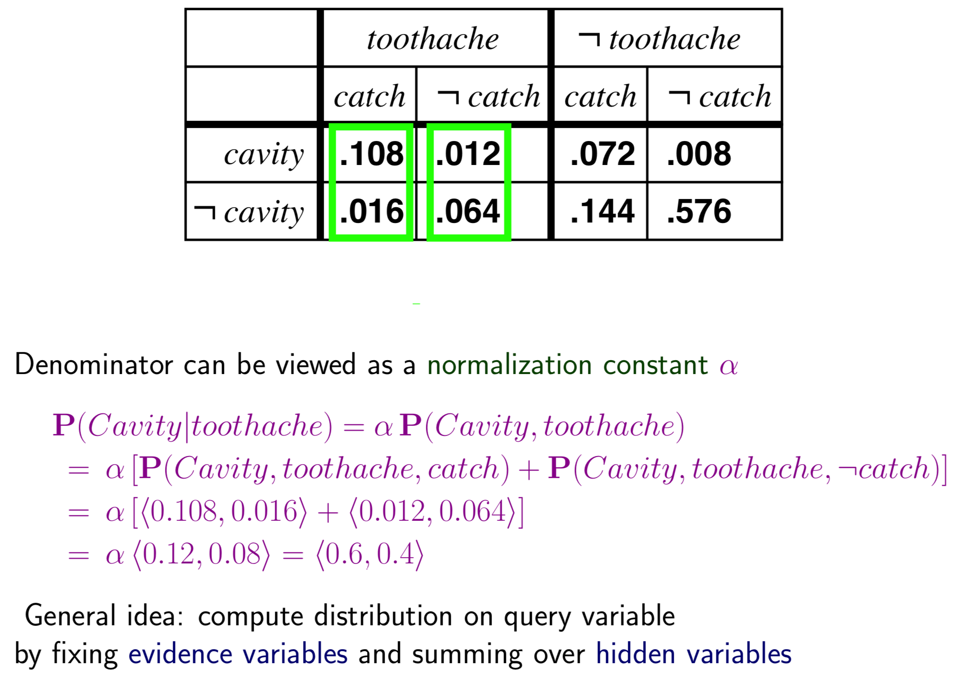
Example for General Inference

Slide 51
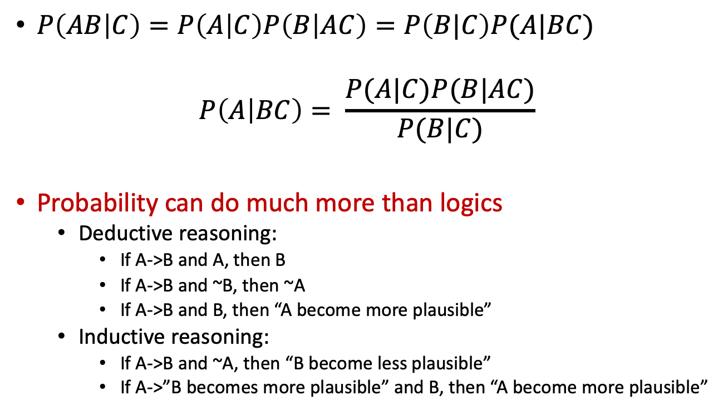
Inference of Probability vs Logic

Slide 52
Probability vs. Logic
Probability can do much more than logics
Deductive reasoning (logic and probability):
If A->B and A, then B (forward reasoning)
If A->B and ~B, then ~A (resolution)
Inductive reasoning (probability):
If A->B and ~A, then “B become less plausible”
If A->B and B, then “A become more plausible”
If A->”B becomes more plausible” and B, then “A become more plausible”
Causal Reasoning
Evidential Reasoning

Slide 53

Why Can Probability Do More?
Can you prove the following using probability?
If A->B and A, then B
If A->B and ~B, then ~A
If A->B and B, then “A become more plausible”
If A->B and ~A, then “B become less plausible”
If A->”B becomes more plausible” and B, then “A become more plausible”
These proofs are for your exercises at home
Notes:
P(B!AC) = P(A|BC)*P(B|C)/P(A|C)

Slide 54
Inferences in the Wumpus world
A= Agent
B= Breeze
S= Smell
P= Pit
W= Wumpus
OK = Safe
V = Visited
G = Glitter
Which one has
a PIT?
B
P?

Slide 55
Inferences in the Wumpus world
Logic can only guess randomly which of [1,3],[2,2],[3,1] has a pit
Using probability you can calculate which one is more likely have a pit than others

Slide 56
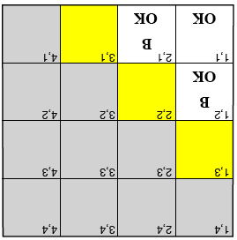
Details in Wumpus World
Any of [1,3], [2,2] or [3,1] may have a pit, but which one is riskier/safer to try, assuming pits are relatively rare?
Either [1,3] or [3,1] should be less risky than [2,2] because most probable pattern given the evidence is one pit at [2,2]
Need a probabilistic rather than a logical model
P_{ij} = true iff [i,j] contains a pit
B_{ij} = true iff [i,j] is breezy
For simplicity, will include only B₁₂,B₂₁,P₁₁,…P₄₄ in probability model
Boolean random variables

Slide 57
Construct a Probability Model (for the Wumpus world)
Construct the probability model
Select your random (binary) variables: B₁₂,B₂₁,P₁₁,…,P₄₄ (see the last slide)
Construct the full joint probability distribution (exclusive, exhaustive, sum=1)
P(B₁₂,B₂₁,P₁₁,…,P₄₄)
Use the model to compute the probabilities in interest
P(P₁₁,…,P₄₄) is the probability of pit distribution (uniformly)
Assume that pits are placed randomly with P(p_{ij})=.2 for all i,j
Assume that pits are placed independently
Then we have
P(P₁₁,…,P₄₄) = P(P₁₁)•P(P₁₂)•••••P(P₄₄)
P(B₁₂,B₂₁ | P₁₁,…,P₄₄) is the probability of breeze at [1,2] [21].
We can compute this using the product rule
P(B₁₂,B₂₁ | P₁₁,…,P₄₄) = P(B₁₂,B₂₁,P₁₁,…,P₄₄) / P(P₁₁,…,P₄₄)

Slide 58
Observations and Query
Have observed these facts:
b = b₁₂ ^ b₂₁
known = ~p₁₁ ^ ~p₁₂ ^ ~p₂₁
Our query is: P(P₁₃ | known, b)
Also want to query P₂₂ and P₃₁
Define unknown = the set of P_{ij}s other than P₁₃ & known
For inference by enumeration, we have
P(P₁₃ | known,b) = α Σ_{unknown}P(P₁₃,unknown,known,b)
Grows exponentially with number of squares

Slide 59
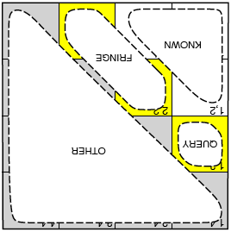
Conditional Independence to the Rescue
Basic Insight
If partition unknown variables into fringe and other, then observed breezes are conditionally independent of other variables, given known, query and fringe variables
Reformulate query into usable form
If Unknown = Fringe or Other, then
P(b | P₁₃,Known,Unknown) = P(b | P₁₃,Known,Fringe)
Use this to convert
P(P₁₃ | known,b) = αΣ_{unknown}P(P₁₃,unknown,known,b)
Into (via sequence of transformations)
α’ P(P₁₃) Σ_{fringe}P(b | known,P₁₃,fringe) P(fringe)
[where α’ = αP(known)]
Greatly reduces computation
Notes:
Use definition of conditional probability

Slide 60
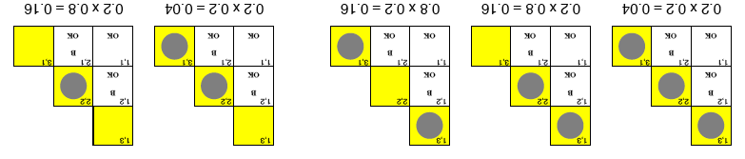
Results
P(P₁₃ | known,b) = α’ P(P₁₃) Σ_{fringe}P(b | known,P₁₃,fringe) P(fringe)
P(b | known,P₁₃,fringe) is 0 or 1 depending on if fringe is consistent with b
P(fringe) is shown in figure for situations in which fringe is consistent with b
Now need to partition action events according to whether P₁₃ is true or false
= α’[.2(.04 + .16 + .16), 0.8(.04 + .16)] = α’[.072, .16] [.31, .69]
P(P₂₂ | known,b) = [.86, .14]
P₁₃ = true
P₁₃ = false
Notes:
Fringe is only p22 and p31. Doesn’t include p13, as is query variable rather than fringe.
If p13 then three possible forms of fringe that are consistent.
If not p13 then only two forms of fringe that are consistent

Slide 61
Alternative: Using Bayesian Rule!
Can compute it nicely by comparing:
P(P₁₃ | known,b)
P(P₃₁ | known,b)
P(P₂₂ | known,b)
Let’s use Bayesian Rule
P(P₁₃|known,b)=P(P₁₃)P(known,b|P₁₃)/P(known,b)
P(P₂₂|known,b)=P(P₂₂)P(known,b|P₂₂)/P(known,b)
P(P₃₁|known,b)=P(P₃₁)P(known,b|P₃₁)/P(known,b)
Since P(P₁₃)=P(P₂₂)=P(P₃₁), only need compare
P(known,b|P₁₃)
P(known,b|P₂₂) // this is larger than the other two, why?
P(known,b|P₃₁)

Slide 62
Compare the three choices
Using chain rules
P(known,b|p₁₃)=P(known|b,p₁₃)P(b|p₁₃)
P(known,b|p₂₂)=P(known|b,p₂₂)P(b|p₂₂)
P(known,b|p₃₁)=P(known|b,p₃₁)P(b|p₃₁)
The first terms are equal
because pits are independent from each other
The second term:
P(b₁₂^b₂₁|p₁₃) < 1
P(b₁₂^b₂₁|p₂₂) = 1
P(b₁₂^b₂₁|p₁₃) < 1
Where known=~p₁₁^~p₁₂^~p₂₁, and b=b₁₂^b₂₁

Slide 63

Bayesian Rule for Learning
Bayesian Rule is a powerful tool for learning
Let A be “your theory”; B be the “new data”; and C be the “background information”
Your new theory A
after learning
from data B
Your old theory A
*
How well is your old theory A explaining the new data B
=
The likelihood of the new data B regardless of your theory

Slide 64
Summary
Probability is a rigorous formalism for uncertain knowledge
Conditional probabilities enable reasoning with uncertain evidence
A full joint probability distribution specifies the probability of every atomic event
Queries answerable by summing over probabilities of atomic events
Bayesian theorem/rule provides the basis for the most modern diagnostic reasoning in AI
Converts uncertain causal information into diagnostic conclusions
For nontrivial domains, we must find a way to reduce the size of the joint distribution
(Conditional) independence provides the tools (next lecture)

