Slide 1
21. Probabilistic Decision Making
CSCI 561 Foundation for Artificial Intelligence
Professor Wei-Min Shen
University of Southern California

Slide 2
Outline
Probabilistic decision making
Motivation
Decision Problems
Markov Decision Process (MDP)
Value Iteration
Policy Iteration
Slides contributions from: Brian C. Williams
(MIT 16.410), Manuela Veloso,
Reid Simmons, & Tom Mitchell, CMU

Slide 3
How Might a Mouse Search a Maze for Cheese?
Cheese
State Space Search?
As a Constraint Satisfaction Problem?
Goal-directed Planning?
Linear Programming?
What is missing?

Slide 4
Action and Sensor Models (review)
z2
z1
z1
z3
s23
a1
s94
1. Actions
2. Percepts (observations)
3. States
4. Appearance: states => observations
5. Transitions: (states, actions) => states
6. Current State
a1
a1
s77
What about the goals?

Slide 5
Utility Value of States ⬄ Goal Information (review)
z2
z1
1. Actions
2. Percepts (observations)
3. States
4. Appearance: states =>observations
5. Transitions: (states, actions) => states
6. Current State
7. Rewards::R(s),R(s,a),R(s,a,s’) (related to the goals, given to the agent from env)
8. Utility Value of States: U(s) (how good for the goals, must compute)
z3
z1
s23
a1
s94
U(s23)=0.4
a1
U(s94)=0.2
a1
s77
U(s77)=0.4
Note that rewards can be given from states R(s), state-action R(s,a), or transition R(s,a,s’)

Slide 6
The Key Representations
Model the environment by States, Actions, Percepts, and
Transition model φ = P(s_{t+1} | s_{t},a_{t}) may be probabilistic
Sensor Model θ = P(z|s) may be probabilistic
States may have Utility Values U(s) or V(s)
Agents may receive Reward r (implicit “goals”)
When entering a state: s 🡺 r
When performing an action in a state: (s, a) 🡺 r
When making a transition: (s,a,s’) 🡪 r
Behaviors may be represented as Policy: s 🡺 a
Objective: find the optimal policy based on utilities or rewards

Slide 7
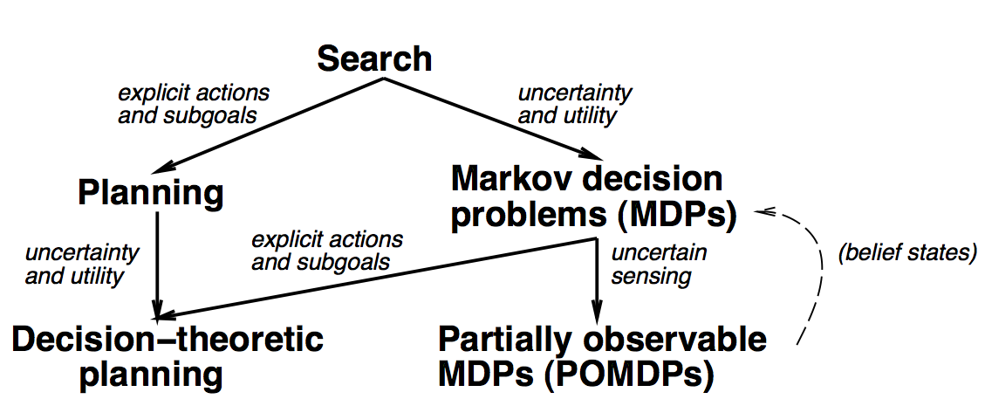
Sequential Decision Problems

Slide 8
Markov Decision Process (MDP)
A MDP consists of
States S
Actions A
Transition Model Φ(s’|s,a)
Initial/current State s₀ or Probability Distribution π
Sensor Model θ(z|s) // a typical MDP has no sensor model
A reward function R(s),R(s,a),R(s,a,s’) // we use R(s,a) in today’s lecture

Slide 9
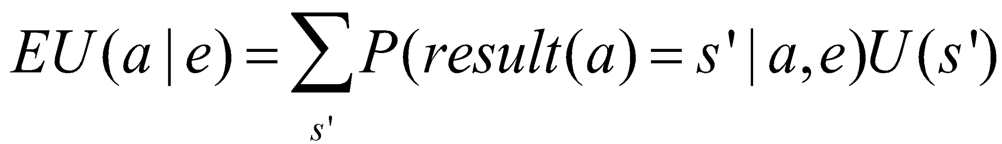
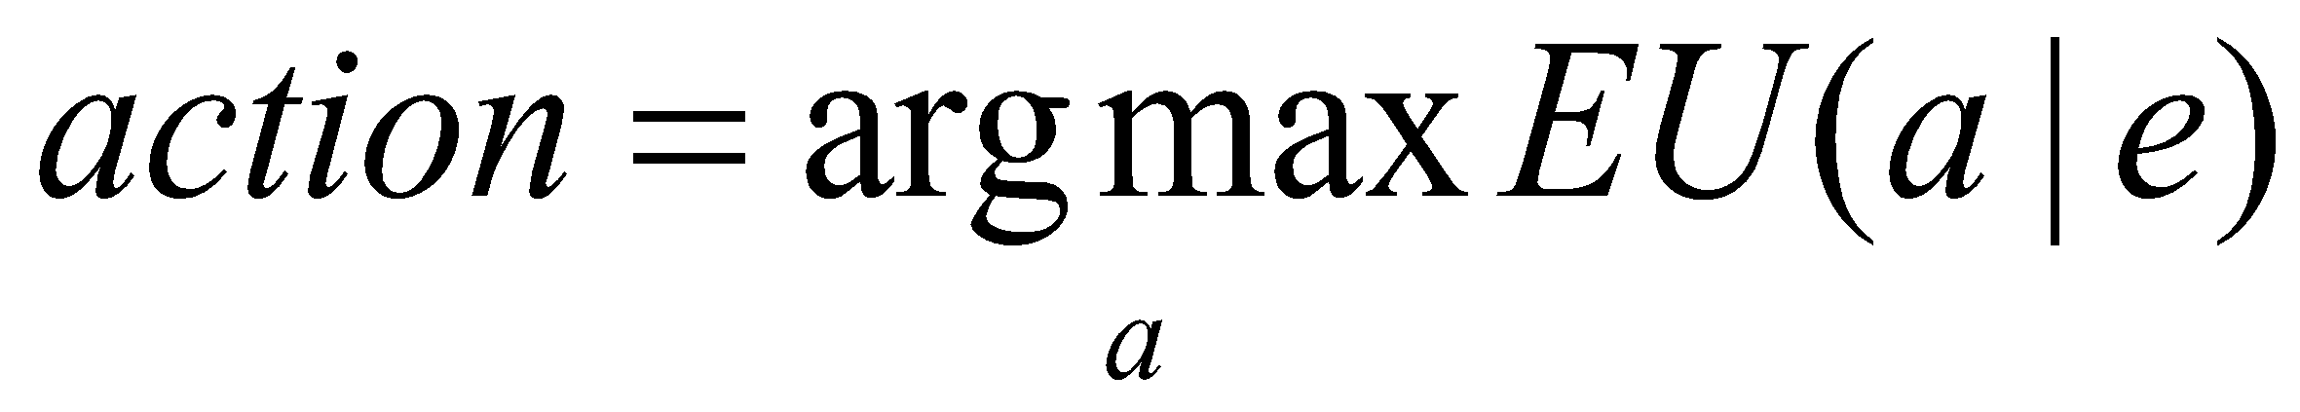
Maximum Expected Utility (MEU) and Rational Agents
Every state has a utility value U(s)
The expected utility of an action given the current evidence or observation e, is the average utility value of the outcomes, weighted by the probability that the outcome occurs:
The principle of maximum expected utility (MEU) is that a rational agent should choose the action that maximizes its expected utility:
z2
z1
s2
a1
s9
U(s2)=0.4
a1
U(s9)=0.2
a1
s7
U(s7)=0.4

Slide 10
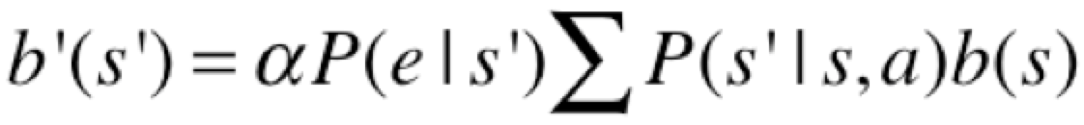
POMDP: Sensor Model, Belief States
A Partially Observable MDP (POMDP) is defined as follows:
A set of states S (with an initial state s₀)
A set of Actions: A(s) of actions in each state s
A transition model P(s’|s,a), or T(s,a,s’)
A reward function R(s), or R(s,a)
A sensor model P(e|s)
A belief of what the current state distribution is b(s)
Belief States (where am I now? What is my current state?):
If b(s) was the previous belief state, and the robot does action “a” and then perceives a new evidence “e”, then the new belief state:
s where α is a normalization constant making the belief states sum to 1

Slide 11
Goals, Rewards, Utilities, Policies (review)
Goals
Given to the agent from the problem statements
Rewards
Given to the agent, designed based on the goals
Utility values for states
Computed by the agent, based on the rewards
Policies
Computed or learned by the agent
Used by the agent to select its actions
The better a policy, the more rewards it collects

Slide 12
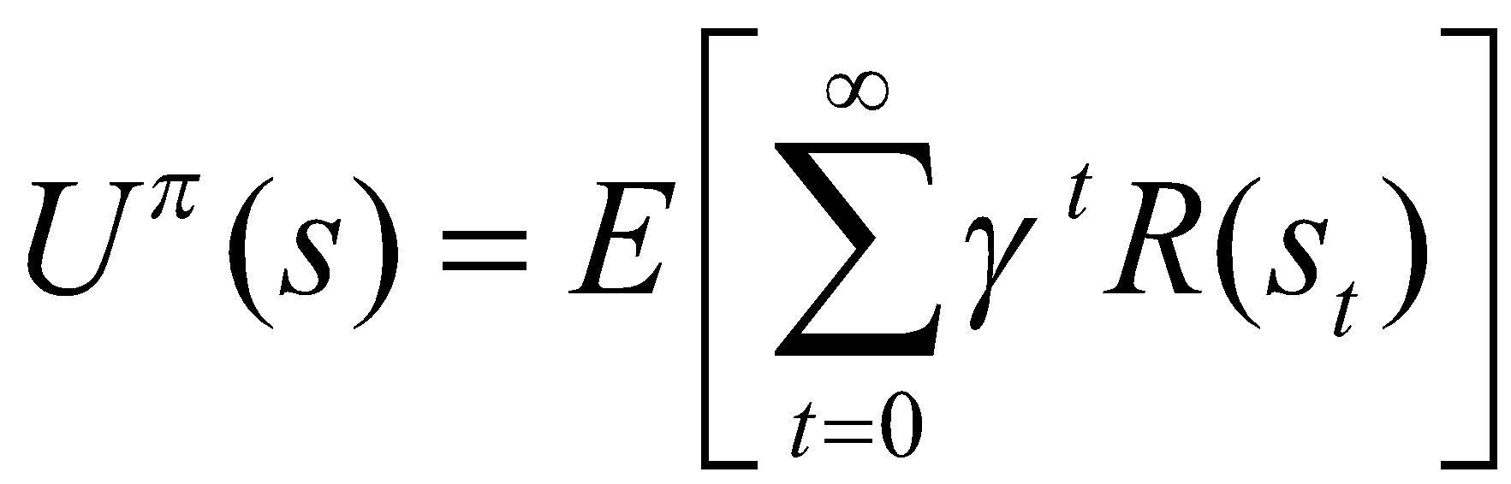
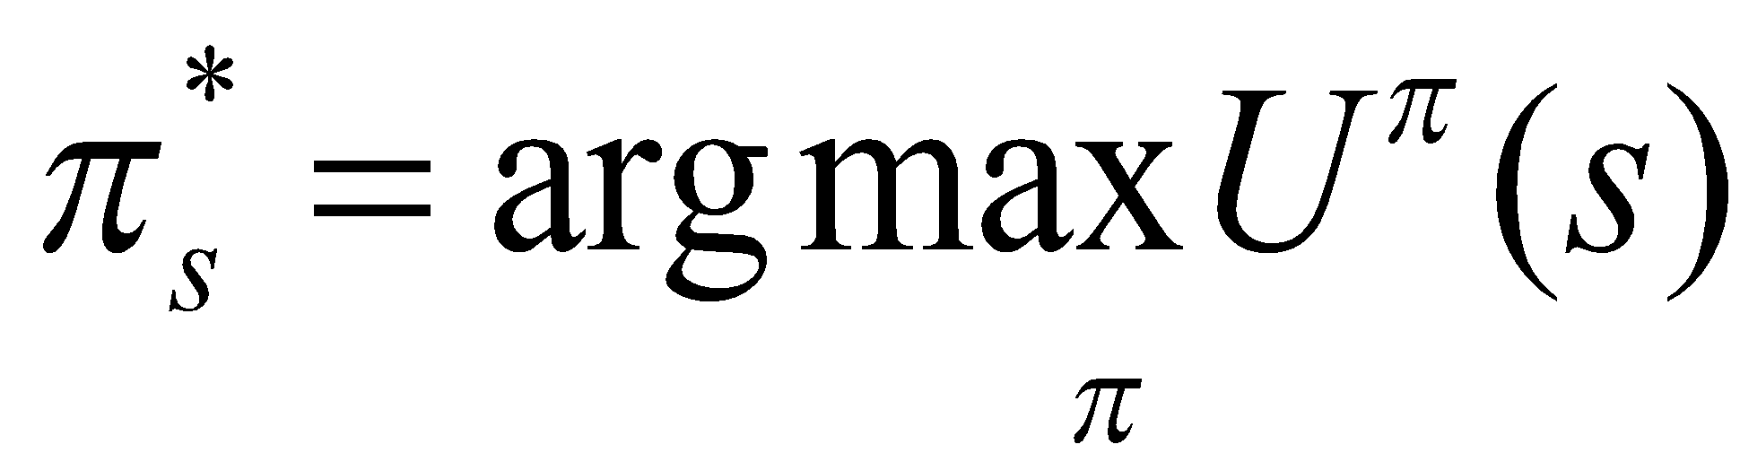
Compute Utilities from Rewards over Time
Utility Value = sum of all future rewards
Add the rewards as they are
Discount the far-away rewards in the future
The expected future utility value U^{π}(s) obtained by executing a policy π starting from s
The Optimal Policy

Slide 13
Ideas in this lecture
Problem is to accumulate rewards, rather than to achieve goal states.
Approach is to generate reactive policies for how to act in all situations, rather than plans for a single starting situation.
Policies fall out of value functions, which describe the greatest lifetime reward achievable at every state.
Value functions are iteratively approximated.

Slide 14
MDP Examples: TD-Gammon [Tesauro, 1995] Learning Through Reinforcement
Learns to play Backgammon
States:
Board configurations (10²⁰)
Actions:
Moves
Rewards:
+100 if win
- 100 if lose
0 for all other states
Trained by playing 1.5 million games against self.
Currently, roughly equal to best human player.

Slide 15
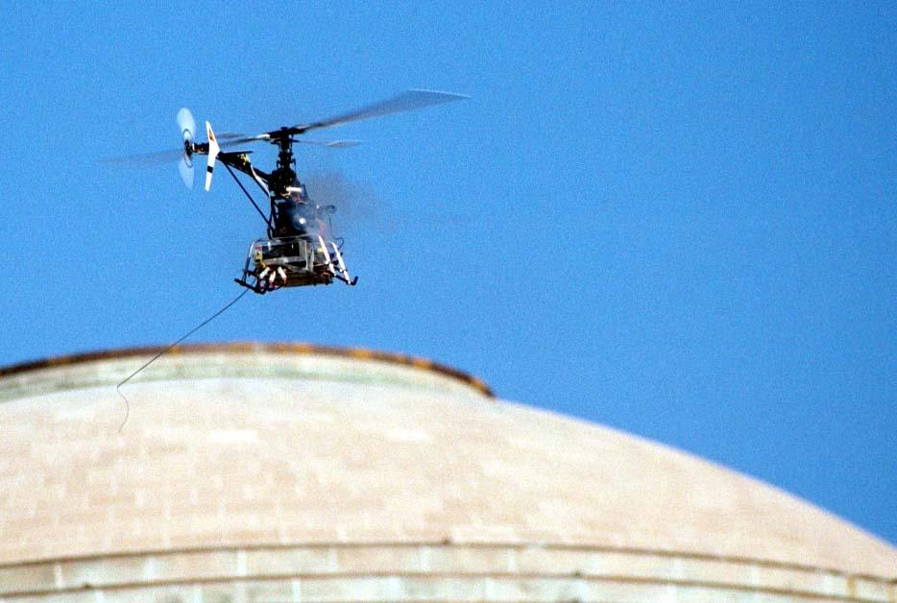
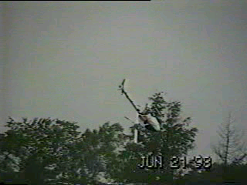
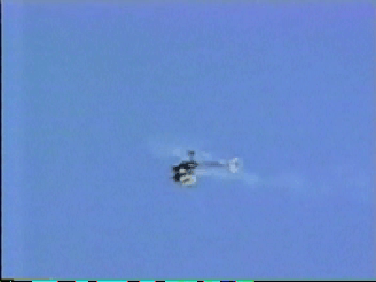
MDP Examples: Aerial Robotics [Feron et al.] Computing a Solution from a Continuous Model

Slide 16
Markov Decision Processes
Motivation
What are Markov Decision Processes (MDPs)?
Models
Lifetime Reward
Policies
Computing Policies From a Model
Summary

Slide 17
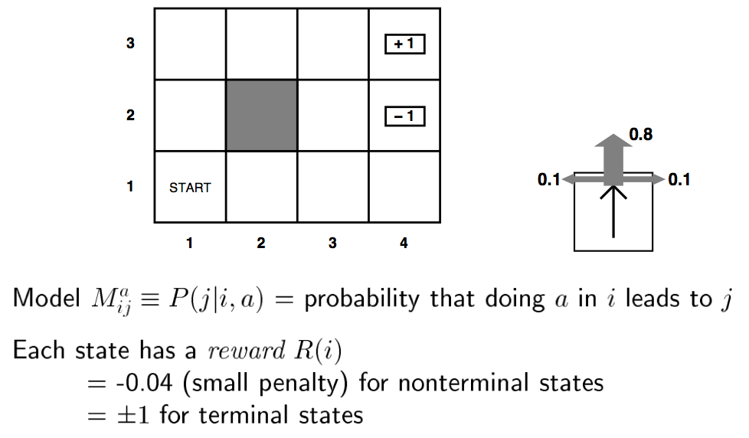
Example MDP

Slide 18
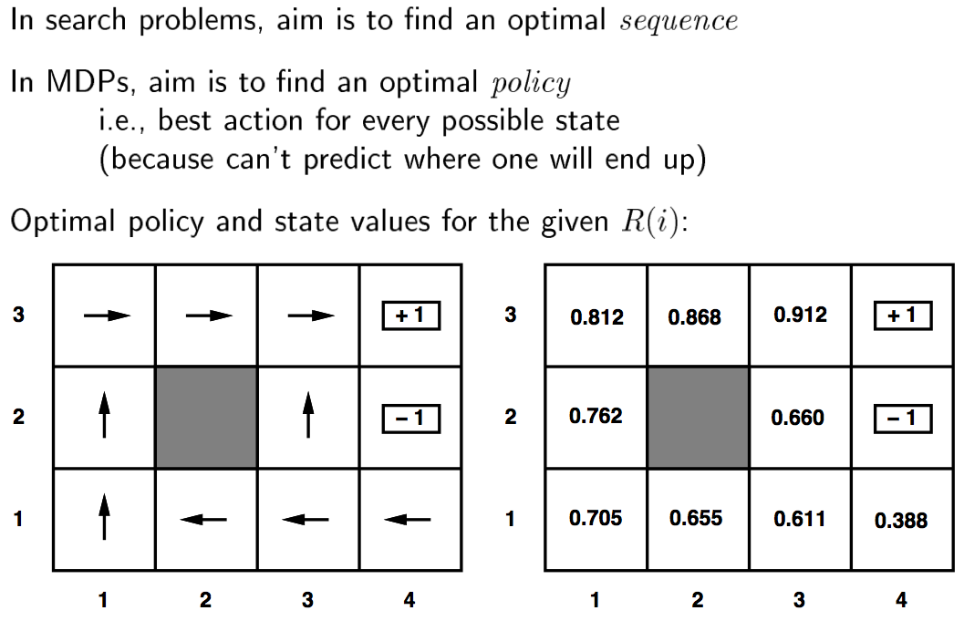
Example MDP

Slide 19
MDP Problem
Agent
State
Reward
Action
Environment
a₀
a₁
a₂
s₀
s₁
s₂
s₃
r₀
r₁
r₂
Given an environment model as a MDP create a policy for acting that maximizes lifetime reward

Slide 20
MDP Problem: Model
Agent
State
Reward
Action
Environment
a₀
a₁
a₂
s₀
s₁
s₂
s₃
r₀
r₁
r₂
Given an environment model as a MDP create a policy for acting that maximizes lifetime reward

Slide 21
Markov Decision Processes (MDPs)
Model:
Finite set of states, S
Finite set of actions, A
(Probabilistic) state transitions, δ(s,a)
Reward for each state and action, R(s,a)
Process:
Observe state s_{t} in S
Choose action a_{t} in A
Receive immediate reward r_{t}
State changes to s_{t+1}
Example:
a₀
a₁
a₂
s₀
s₁
s₂
s₃
s1
a1
r₀
r₁
r₂
10
Legal transitions shown
Reward on unlabeled transitions is 0.
G
10
10

Slide 22
MDP Environment Assumptions
Markov Assumption: Next state and reward is a function only of the current state and action:
s_{t+1} = δ(s_{t}, a_{t})
r_{t} = r(s_{t}, a_{t})
Uncertain and Unknown Environment:
δ and r may be nondeterministic and unknown

Slide 23
MDP Problem: Model
Agent
State
Reward
Action
Environment
a₀
a₁
a₂
s₀
s₁
s₂
s₃
r₀
r₁
r₂
Given an environment model as a MDP create a policy for acting that maximizes lifetime reward

Slide 24
MDP Problem: Lifetime Reward
Agent
State
Reward
Action
Environment
a₀
a₁
a₂
s₀
s₁
s₂
s₃
r₀
r₁
r₂
Given an environment model as a MDP create a policy for acting that maximizes lifetime reward

Slide 25
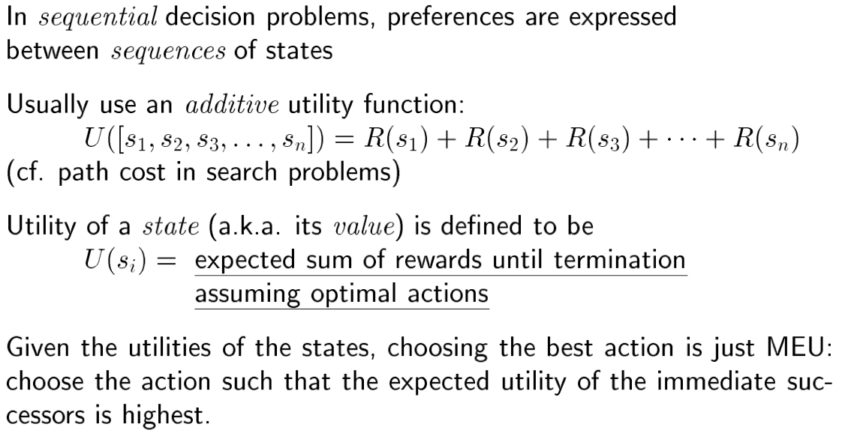
Utility (aka Value)

Slide 26
Lifetime Reward
Finite horizon:
Rewards accumulate for a fixed period:
$100K + $100K + $100K = $300K
Infinite horizon:
Assume reward accumulates forever:
$100K + $100K + . . . = infinity
Discounting:
Future rewards not worth as much (a bird in hand …)
Introduce discount factor γ $100K + γ $100K + γ ² $100K. . . converges
Will make the math work

Slide 27
MDP Problem: Lifetime Reward
Agent
State
Reward
Action
Environment
a₀
a₁
a₂
s₀
s₁
s₂
s₃
r₀
r₁
r₂
Given an environment model as a MDP create a policy for acting that maximizes lifetime reward
V = r₀ + γ r₁ + γ ² r₂ . . .

Slide 28
MDP Problem: Policy
Agent
State
Reward
Action
Environment
a₀
a₁
a₂
s₀
s₁
s₂
s₃
r₀
r₁
r₂
Given an environment model as a MDP create a policy for acting that maximizes lifetime reward
V = r₀ + γ r₁ + γ ² r₂ . . .

Slide 29
Assume deterministic world
Policy π : S => A
Selects an action for each state.
Optimal policy π* : S => A
Selects action for each state that maximizes lifetime reward.
π
π*
10
10
G
G
10
10
10
10
Note: with infinite horizon, policy is stationary and independent of start state

Slide 30
There are many policies, not all are necessarily optimal.
There may be several optimal policies.
10
10
G
G
10
10
10
10
10
A sequential decision problem for a fully
Observable stochastic environment with
Markovian transition model and additive
Rewards is called an MDP
G
10
10

Slide 31
Markov Decision Processes
Motivation
Markov Decision Processes
Computing Policies From a Model
Value Functions
Mapping Value Functions to Policies
Computing Value Functions through Value Iteration
An Alternative: Policy Iteration (appendix)
Summary

Slide 32
Value Function V^{π} for a Given Policy π
V^{π}(s_{t}) is the accumulated lifetime reward resulting from starting in state s_{t} and repeatedly executing policy π:
V^{π}(s_{t}) = r_{t} + γ r_{t+1} + γ ² r_{t+2} . . .
V^{π}(s_{t}) = ∑_{i} γ ^{i} r_{t+i} where r_{t}, r_{t+1} , r_{t+2} . . . are generated by following π, starting at s_{t} .
π
V^{π}
Assume γ = .9
9
10
9
10
G
10
10
10
10
0

Slide 33
An Optimal Policy π* Given Value Function V*
Idea: Given state s
Examine all possible actions a_{i} in state s.
Select action a_{i} with greatest lifetime reward.
Lifetime reward Q(s, a_{i}) is:
the immediate reward for taking action r(s,a) …
plus lifetime reward starting in target state V( δ(s, a) ) …
discounted by γ.
π*(s) = argmax_{a} [r(s,a) + γV*( δ(s, a) )]
Must Know:
Value function
Environment model.
δ : S x A → S
r : S x A → ℜ
π
9
10
9
10
G
10
10
10
10
0

Slide 34
Example: Mapping Value Function to Policy
Agent selects optimal action from V:
π(s) = argmax_{a} [r(s,a) + γV(δ(s, a)]
Model + V:
γ = 0.9, all rewards are 0 if not marked
90
100
100
0
G
81
90
100
100

Slide 35
Example: Mapping Value Function to Policy
Agent selects optimal action from V:
π(s) = argmax_{a} [r(s,a) + γV(δ(s, a)]
Model + V:
γ = 0.9, all rewards are 0 if not marked
a
90
100
0
100
G
a: 0 + 0.9 x 100 = 90
b: 0 + 0.9 x 81 = 72.9
select a
b
81
90
100
100
π:
G

Slide 36
Example: Mapping Value Function to Policy
Agent selects optimal action from V:
π(s) = argmax_{a} [r(s,a) + γV(δ(s, a)]
Model + V:
γ = 0.9, all rewards are 0 if not marked
90
100
0
100
G
a
a: 100 + 0.9 x 0 = 100
b: 0 + 0.9 x 90 = 81
select a
b
81
90
100
100
π:
G

Slide 37
Example: Mapping Value Function to Policy
Agent selects optimal action from V:
π(s) = argmax_{a} [r(s,a) + γV(δ(s, a)]
Model + V:
γ = 0.9
90
100
0
100
G
a: ?
b: ?
c: ?
select ?
a
b
81
90
100
100
c
π:
G

Slide 38
Markov Decision Processes
Motivation
Markov Decision Processes
Computing Policies From a Model
Value Functions
Mapping Value Functions to Policies
Computing Value Functions through Value Iteration
An Alternative: Policy Iteration
Summary

Slide 39
Value Function V* for an optimal policy π*
Example
R_{B}
B
R_{A}
R_{B}
S_{A}
S_{B}
A
B
R_{A}
A
Optimal value function for a one step horizon:
V*₁(s) = max_{ai} [r(s,a_{i})]
V*₁(S_{A})
R_{A}
S_{A}
A
S_{A}
Max
B
R_{B}
. . .
S_{B}
S_{B}
V*₁(S_{B})

Slide 40
Value Function V* for an optimal policy π*
Example
R_{B}
B
R_{A}
R_{B}
S_{A}
S_{B}
A
B
R_{A}
A
Optimal value function for a one step horizon:
V*₁(s) = max_{ai} [r(s,a_{i})]
Optimal value function for a two step horizon:
V*₂(s) = max_{ai} [r(s,a_{i}) + γV ₁*(δ(s, a_{i}))]
γ
V*₂(S_{A})
V*₁(S_{A})
A
R_{A} +
A
Instance of the Dynamic Programming Principle:
Reuse shared sub-results
Exponential saving
S_{A}
S_{A}
S_{A}
Max
B
B
R_{B}
. . .
. . .
S_{B}
S_{B}
S_{B}
V*₂(S_{B})
+ γ
V*₁(S_{B})

Slide 41
Value Function V* for an optimal policy π*
Example
R_{B}
B
R_{A}
R_{B}
S_{A}
S_{B}
A
B
R_{A}
A
Optimal value function for a one step horizon:
V*₁(s) = max_{ai} [r(s,a_{i})]
Optimal value function for a two step horizon:
V*₂(s) = max_{ai} [r(s,a_{i}) + γV ₁*(δ(s, a_{i}))]
Optimal value function for an n step horizon:
V*_{n}(s) = max_{ai} [r(s,a_{i}) + γV _{n-1}*(δ(s, a_{i}))]

Slide 42
Value Function V* for an optimal policy π*
Example
R_{B}
B
R_{A}
R_{B}
S_{A}
S_{B}
A
B
R_{A}
A
Optimal value function for a one step horizon:
V*₁(s) = max_{ai} [r(s,a_{i})]
Optimal value function for a two step horizon:
V*₂(s) = max_{ai} [r(s,a_{i}) + γV ₁*(δ(s, a_{i}))]
Optimal value function for an n step horizon:
V*_{n}(s) = max_{ai} [r(s,a_{i}) + γV _{n-1}*(δ(s, a_{i}))]
Optimal value function for an infinite horizon:
V*(s) = max_{ai} [r(s,a_{i}) + γV*(δ(s, a_{i}))]

Slide 43
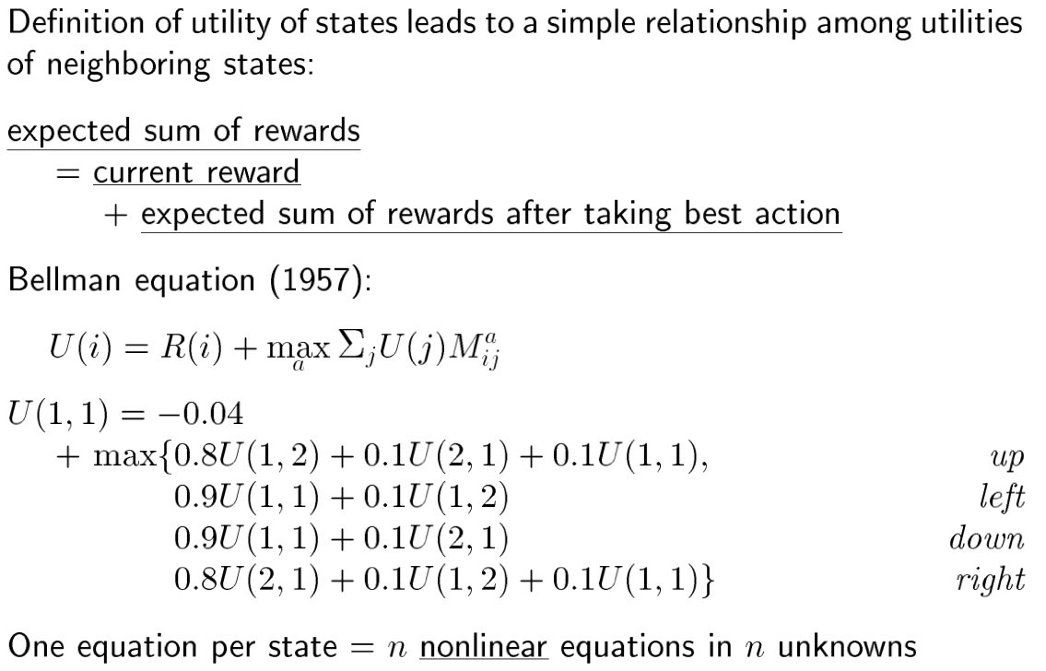
Bellman equation

Slide 44
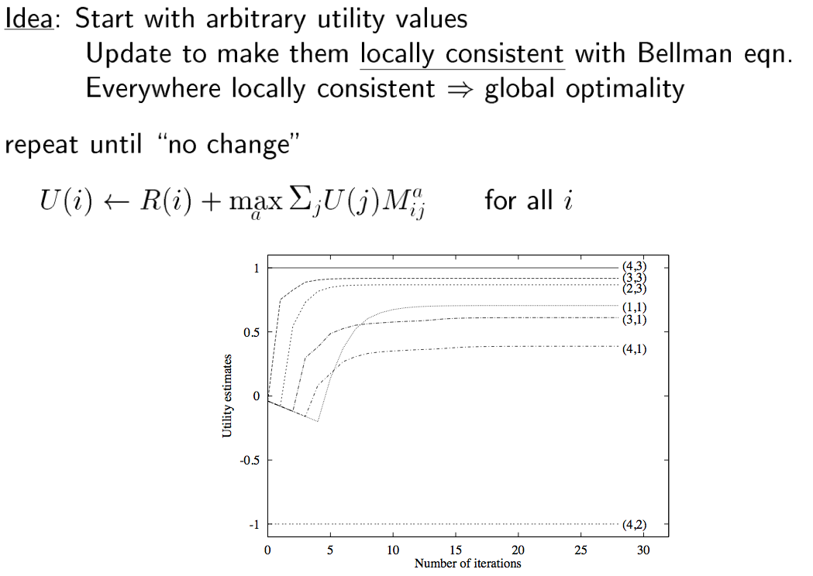
Value iteration algorithm

Slide 45
Solving MDPs by Value Iteration
Insight: Can calculate optimal values iteratively using Dynamic Programming.
Algorithm:
Iteratively calculate value using Bellman’s Equation:
V*_{t+1}(s) ← max_{a} [r(s,a) + γV* _{t}(δ(s, a))]
Terminate when values are “close enough”
|V*_{t+1}(s) - V* _{t} (s) | < ε
Agent selects optimal action by one step lookahead on V*:
π*(s) = argmax_{a} [r(s,a) + γV*(δ(s, a)]

Slide 46
Convergence of Value Iteration
If terminate when values are “close enough”
|V_{t+1}(s) - V _{t} (s) | < ε
Then:
Max_{s in S} |V_{t+1}(s) - V* (s) | < 2εγ/(1 - γ)
Converges in polynomial time.
Convergence guaranteed even if updates are performed infinitely often, but asynchronously and in any order.

Slide 47
Example of Value Iteration
V*_{t+1}(s) ← max_{a} [r(s,a) + γV* _{t}(δ(s, a))]
γ = 0.9
V* _{t}
V* _{t+1}
0
0
0
a
100
G
100
G
0
b
0
0
0
100
100
a: 0 + 0.9 x 0 = 0
b: 0 + 0.9 x 0 = 0
Max = 0

Slide 48
Example of Value Iteration
V*_{t+1}(s) ← max_{a} [r(s,a) + γV* _{t}(δ(s, a))]
γ = 0.9
V* _{t}
V* _{t+1}
0
0
0
100
G
100
G
c
a
0
100
b
0
0
0
100
100
a: 100 + 0.9 x 0 = 100
b: 0 + 0.9 x 0 = 0
c: 0 + 0.9 x 0 = 0
Max = 100

Slide 49
Example of Value Iteration
V*_{t+1}(s) ← max_{a} [r(s,a) + γV* _{t}(δ(s, a))]
γ = 0.9
V* _{t}
V* _{t+1}
0
0
0
100
G
100
G
a
0
100
0
0
0
0
100
100
a: 0 + 0.9 x 0 = 0
Max = 0

Slide 50
Example of Value Iteration
V*_{t+1}(s) ← max_{a} [r(s,a) + γV* _{t}(δ(s, a))]
γ = 0.9
V* _{t}
V* _{t+1}
0
0
0
100
G
100
G
0
100
0
0
0
0
100
100
0

Slide 51
Example of Value Iteration
V*_{t+1}(s) ← max_{a} [r(s,a) + γV* _{t}(δ(s, a))]
γ = 0.9
V* _{t}
V* _{t+1}
0
0
0
100
G
100
G
0
100
0
0
0
0
100
100
0
0

Slide 52
Example of Value Iteration
V*_{t+1}(s) ← max_{a} [r(s,a) + γV* _{t}(δ(s, a))]
γ = 0.9
V* _{t}
V* _{t+1}
0
0
0
100
G
100
G
0
100
0
0
0
0
100
100
0
0
100

Slide 53
Example of Value Iteration
V*_{t+1}(s) ← max_{a} [r(s,a) + γV* _{t}(δ(s, a))]
γ = 0.9
V* _{t}
V* _{t+1}
0
100
0
100
G
100
G
90
100
0
0
0
100
100
100
0
90
100

Slide 54
Example of Value Iteration
V*_{t+1}(s) ← max_{a} [r(s,a) + γV* _{t}(δ(s, a))]
γ = 0.9
V* _{t}
V* _{t+1}
90
100
0
100
G
100
G
90
100
0
0
90
100
100
100
81
90
100

Slide 55
Example of Value Iteration
V*_{t+1}(s) ← max_{a} [r(s,a) + γV* _{t}(δ(s, a))]
γ = 0.9
V* _{t}
V* _{t+1}
90
100
0
100
G
100
G
90
100
0
81
90
100
100
100
81
90
100

Slide 56
Markov Decision Processes
Motivation
Markov Decision Processes
Computing policies from a modelValue Functions
Mapping Value Functions to Policies
Computing Value Functions through Value Iteration
An Alternative: Policy Iteration
Summary

Slide 57
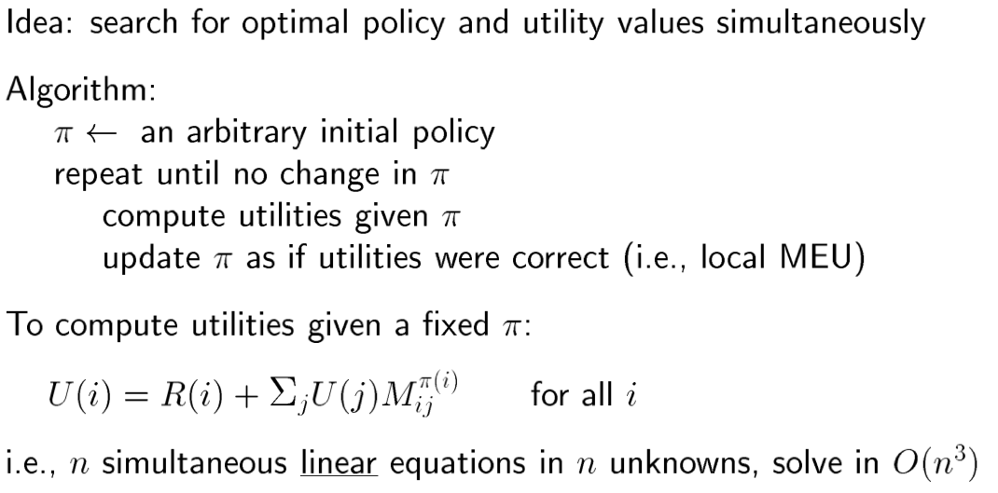
Policy iteration
Why use policy iteration? May converge faster; convergence guarantees.

Slide 58
Policy Iteration
Idea: Iteratively improve the policy
Policy Evaluation: Given a policy π_{i} calculate V_{i} = V^{πi}, the utility of each state if π_{i} were to be executed.
Policy Improvement: Calculate a new maximum expected utility policy π_{i+1} using one-step look ahead based on V_{i}.
π_{i} improves at every step, converging if π_{i} = π_{i+1}.
Computing V_{i} is simpler than for Value iteration (no max):
V*_{t+1}(s) ← r(s, π_{i}(s)) + γV* _{t}(δ(s, π_{i}(s)))]
Solve linear equations in O(N³)
Solve iteratively, similar to value iteration.

