Slide 1
Reasoning over Time Temporal Models
CSCI 561 Foundation for Artificial Intelligence
Professor Wei-Min Shen
University of Southern California

Slide 2
Outline: Temporal Models
Models with Actions and Sensors (ALFE 4-5) (aka POMDP)
Slides 1-20 are essential for you to understand the concepts
The rest will follow naturally if you do
Markov Chains
No observation, no explicit actions, transit randomly
Hidden Markov Model
No explicit actions, state transit randomly
Dynamic Bayesian Networks
No explicit actions, States are Bayesian Networks
Continuous State Model
No explicit actions, States are continuous
POMDP
Discrete states with probabilistic actions, sensors, & transitions

Slide 3
Example of Reasoning over Time
Speech Recognition
“Listening is not always equal to hearing” ☺
Traveling through rooms with colored walls
“Seeing does not always tell where you are” ☺
Room-1
Room-2
Room-3
a₀
a₁
a₂
a₃
Wall-color
Wall-color
Wall-color

Slide 4
Problem of Reasoning over Time
Given:
A model of the world (e.g., a map of rooms with colored walls)
An experience of observations and actions from time 1 to t
Compute (among others):
Which states (e.g., rooms) the robot was/is/will-be in?
Room-1
Room-2
Room-3
a₀
a₁
a₂
a₃
Wall-color
Wall-color
Wall-color

Slide 5
Example: Robot Localization
Example from Michael Pfeiffer
State X: Room
Prob
0
1
t=0 (before sensing, all states are equally likely)
Sensor model: never more than 1 mistake
Motion model: may not execute action with small prob.

Slide 6
Example: Robot Localization
Prob
0
1
t=1 (sensing: no room up or down)

Slide 7
Example: Robot Localization
Prob
0
1
t=2

Slide 8
Example: Robot Localization
Prob
0
1
t=3

Slide 9
Example: Robot Localization
Prob
0
1
t=4

Slide 10
Example: Robot Localization
Prob
0
1
t=5

Slide 11
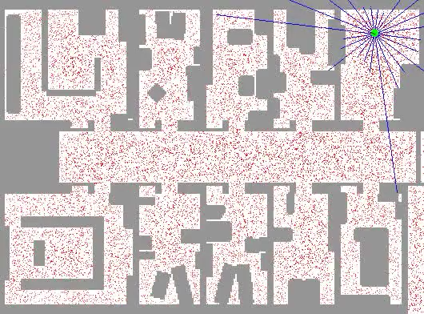
Example: Robot Localization

Slide 12


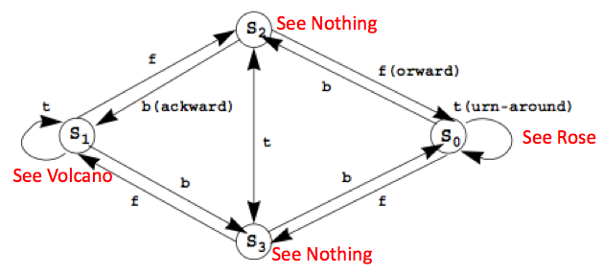
Little Prince Environment (S, A, Φ, θ, π)
Transition Probabilities Φ (ask “Action Model”)
Appearance Probabilities θ (aka “Sensor Model”)
Initial State Probabilities π (aka “Belief States”)
F | S0 | S1 | S2 | S3
S0 | 0.1 | 0.1 | 0.1 | 0.7
S1 | 0.1 | 0.1 | 0.7 | 0.1
S2 | 0.7 | 0.1 | 0.1 | 0.1
S3 | 0.1 | 0.7 | 0.1 | 0.1
B | S0 | S1 | S2 | S3
S0 | 0.1 | 0.1 | 0.7 | 0.1
S1 | 0.1 | 0.1 | 0.1 | 0.7
S2 | 0.1 | 0.7 | 0.1 | 0.1
S3 | 0.7 | 0.1 | 0.1 | 0.1
T | S0 | S1 | S2 | S3
S0 | 0.7 | 0.1 | 0.1 | 0.1
S1 | 0.1 | 0.7 | 0.1 | 0.1
S2 | 0.1 | 0.1 | 0.1 | 0.7
S3 | 0.1 | 0.1 | 0.7 | 0.1
θ | Rose | Volcano | Nothing
S0 | 0.8 | 0.1 | 0.1
S1 | 0.1 | 0.8 | 0.1
S2 | 0.1 | 0.1 | 0.8
S3 | 0.1 | 0.1 | 0.8
π | S0 | S1 | S2 | S3
 | .25 | .25 | .25 | .25
Stochastic automaton

Slide 13
Little Prince in Action
experience
E_{1:T}
{rose}, fward, {none}, …, turn, {rose}, back, {volcano}
time
states
Hidden!
S1 S2 S3 S4
S1 S2 S3 S4
S1 S2 S3 S4
S1 S2 S3 S4
……
Given: “experience” E_{1:T} (time 1 through T)
You can Infer:
P(X_{t}|E_{1:t}), where (which state) am I at now? (estimation, filtering, localization)
P(X_{t+k}|E_{1:t}), where I will be at time t+k? (prediction)
P(X_{k}|E_{1:t}), where I was at time k < t ? (smooth)
P(X_{1:t}|E_{1:t}) the probability of every state sequence that I went through? (explanation)
P(x_{1:t}|E_{1:t}) the most likely sequence of states I went through? (Viterbi algorithm)

Slide 14
Some General Problems for Temporal Models
1
k
t
t+k
time
P(X_{1:t}|E_{1:t})
compare all state sequences I might go through (”explanation”)
P(X_{t}|E_{1:t})
which state I am in now (“state estimation” “localization”)
P(X_{t+k}|E_{1:t})
which state I will be in at time t+k (“prediction”)
P(X_{k}|E_{1:t})
which state I was in at time k (k<t) (“smoothing”)
P(x_{1:t}|E_{1:t})
what is the best state sequence that I went through (”viterbi”)
P(M_{t}|E_{1:t})
How correct is my model at time t (“model learning”)

Slide 15
P(X|E) Example
Given: “experience” E_{1:2}={rose, forward, nothing}
Infer: the most likely “state sequence” X_{1:2} // by comparing all
E_{1:2}={rose, forward, nothing}
O_{1:2}={rose, nothing} // observations
A₁={forward} // action sequence
E_{1:2}=O_{1:2}A₁
E= {rose}, forward, {nothing}
Compute P(X|E):
16 possible X, which one is most likely?
{s0,s0}, {s0,s1}, {s0,s2}, {s0,s3},
{s1,s0}, {s1,s1}, {s1,s2}, {s1,s3},
{s2,s0}, {s2,s1}, {s2,s2}, {s2,s3},
{s3,s0}, {s3,s1}, {s3,s2}, {s3,s3}
S0 S1 S2 S3
S0 S1 S2 S3
Find the “best sequence of states” that support the experience !

Slide 16
P(X|E) Example in a Graph
P(X|E)
X
{s0,s0}
{s0,s1}
{s0,s2}
{s0,s3}
{s1,s0}
{s1,s1}
{s1,s2}
{s1,s3}
{s2,s0}
{s2,s1}
{s2,s2}
{s2,s3}
{s3,s0}
{s3,s1}
{s3,s2}
{s3,s3}

Slide 17


Compute P(X_{1:T}|E_{1:T})
E={rose, forward, nothing}
O={rose, nothing} // observations
A={forward} // action sequence
P(X_{1:T}|E) where E=OA
X_{1:T} is all possible sequences of states
Let x={i₁, i₂, …, i_{T}} be a sequence of states
P(x|E) = p(xE)/P(E) = P(xOA)/P(OA) = p(x|A)p(O|xA)/p(O|A)
p(x|A)=
p(O|xA)=
{s0,s0}, {s0,s1}, {s0,s2}, {s0,s3},
{s1,s0}, {s1,s1}, {s1,s2}, {s1,s3},
{s2,s0}, {s2,s1}, {s2,s2}, {s2,s3},
{s3,s0}, {s3,s1}, {s3,s2}, {s3,s3}
O = {z₁, z₂, …, z_{T}}, A = {b₁, b₂, …, b_{T-1}}, x = {i₁, i₂, …, i_{T}}

Slide 18
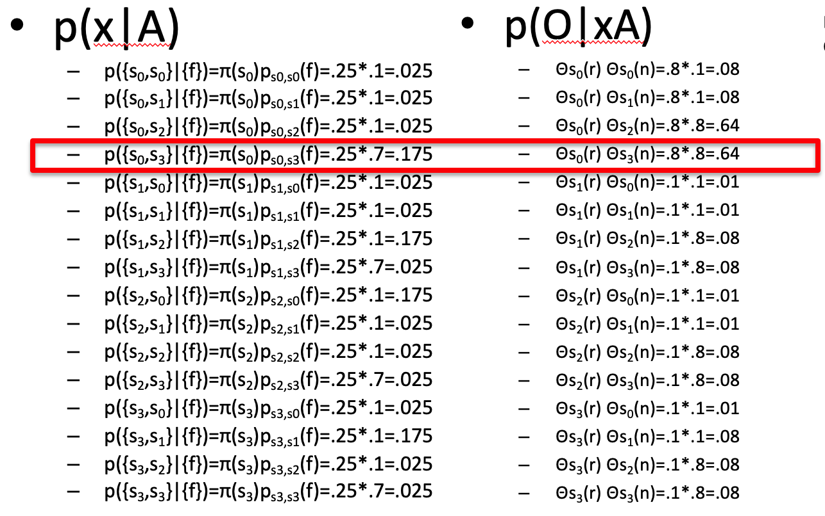
In Our Example
16 possible x
{s0,s0}, {s0,s1}, {s0,s2}, {s0,s3},{s1,s0}, {s1,s1}, {s1,s2}, {s1,s3},
{s2,s0}, {s2,s1}, {s2,s2}, {s2,s3},{s3,s0}, {s3,s1}, {s3,s2}, {s3,s3}
E={rose, forward, nothing}
O={rose, nothing}, A={forward}
Best Explanation is: {s0, s3}

Slide 19
Which Explanation is the Best?
Among all possible sequences of states, the best “explanation” is the sequence of states that gives the maximal value for
Experience:
Observations: o₁, o₂, …, o_{T-1}, o_{T}
Actions: b₁, b₂, …, b_{T-1}
Sensor models:
Action models: P_{ij}[b] = P(s_{j} | s_{i}, b)
Explanation: State sequence: i₁, i₂, i₃, …, i_{T}

Slide 20
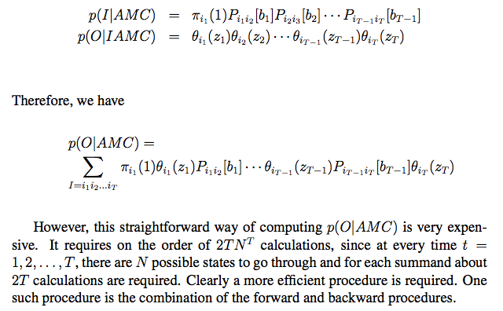
Compute Hidden State Sequence
O = {z₁, z₂, …, z_{T}}, A = {b₁, b₂, …, b_{T}}, I = {i₁, i₁, …, i_{T}}
Experience consists of both O and A
O is observation sequence and A is action sequence in experience
M is the model, C is the background information
On slide #16, we used x for I, so these two terms were written as p(x|A) and p(O|xA) there.

Slide 21
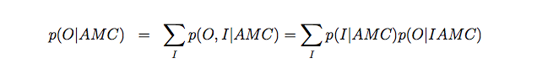
Compute Hidden State Sequence
Among all possible sequences in I, there is one with the maximal probability.

Slide 22
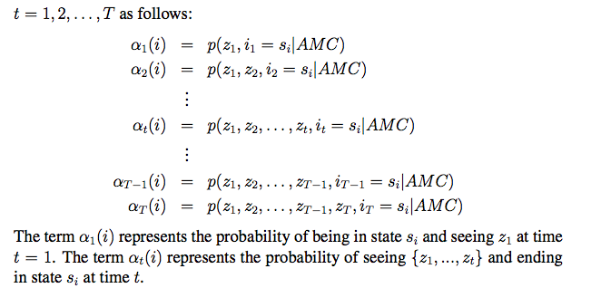
P(O|AMC) by Forward Procedure
Main idea: do not consider all possible state sequences, but every step in the experience, and compute P(O|AMC) incrementally on the time t:

Slide 23
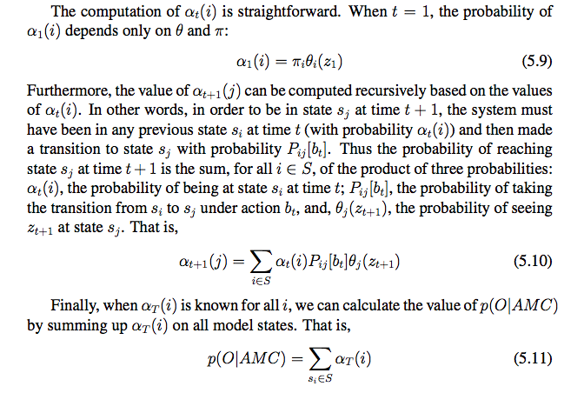
Forward Procedure
Forward Procedure
Complexity is O(TN²)

Slide 24
Forward Procedure Example
Time: t₁--------------------------------------t₂------------------------------------------ t₃-------------
E = { rose, forward, none, turn, volcano, …..}
α₂(i):
α₂(s₀) = α₁(s₀) p_{s0,s0}(f) Θs₀(n)
+ α₁(s₁) p_{s1,s0}(f) Θs₀(n)
+ α₁(s₂) p_{s2,s0}(f) Θs₀(n)
+ α₁(s₃) p_{s3,s0}(f) Θs₀(n)
α₂(s₁) = α₁(s₀) p_{s0,s1}(f) Θs₁(n)
+ α₁(s₁) p_{s1,s1}(f) Θs₁(n)
+ α₁(s₂) p_{s2,s1}(f) Θs₁(n)
+ α₁(s₃) p_{s3,s1}(f) Θs₁(n)
α₂(s₂) = α₁(s₀) p_{s0,s2}(f) Θs₂(n)
+ α₁(s₁) p_{s1,s2}(f) Θs₂(n)
+ α₁(s₂) p_{s2,s2}(f) Θs₂(n)
+ α₁(s₃) p_{s3,s2}(f) Θs₂(n)
α₂(s₃) = α₁(s₀) p_{s0,s3}(f) Θs₃(n)
+ α₁(s₁) p_{s1,s3}(f) Θs₃(n)
+ α₁(s₂) p_{s2,s3}(f) Θs₃(n)
+ α₁(s₃) p_{s3,s3}(f) Θs₃(n)
α₃(i):
α₃(s₀) = α₂(s₀) p_{s0,s0}(t) Θs₀(v)
+ α₂(s₁) p_{s1,s0}(t) Θs₀(v)
+ α₂(s₂) p_{s2,s0}(t) Θs₀(v)
+ α₂(s₃) p_{s3,s0}(t) Θs₀(v)
α₃(s₁) = α₂(s₀) p_{s0,s1}(t) Θs₁(v)
+ α₂(s₁) p_{s1,s1}(t) Θs₁(v)
+ α₂(s₂) p_{s2,s1}(t) Θs₁(v)
+ α₂(s₃) p_{s3,s1}(t) Θs₁(v)
α₃(s₂) = α₂(s₀) p_{s0,s2}(t) Θs₂(v)
+ α₂(s₁) p_{s1,s2}(t) Θs₂(v)
+ α₂(s₂) p_{s2,s2}(t) Θs₂(v)
+ α₂(s₃) p_{s3,s2}(t) Θs₂(v)
α₃(s₃) = α₂(s₀) p_{s0,s3}(t) Θs₃(v)
+ α₂(s₁) p_{s1,s3}(t) Θs₃(v)
+ α₂(s₂) p_{s2,s3}(t) Θs₃(v)
+ α₂(s₃) p_{s3,s3}(t) Θs₃(v)
α₁(i):
α₁(s₀) = π(s₀)Θs₀(r)=.25*.8=.20
α₁(s₁) = π(s₁)Θs₁(r)=.25*.1=.025
α₁(s₂) = π(s₂)Θs₂(r)=.25*.1=.025
α₁(s₃) = π(s₃)Θs₃(r)=.25*.1=.025

Slide 25
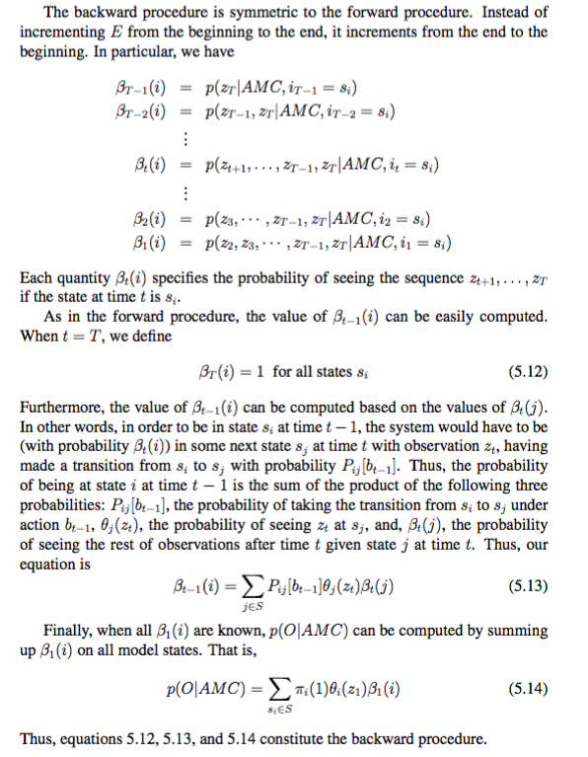
Backward Procedure
Similar to forward
But starting from the end and walking backwards
See ALFE 5.10.1

Slide 26
Inference: State Estimation
1
k
t
t+k
time
P(X_{t}|E_{1:t})
Which state I am most likely in now?
It is the state s_{i} such that α_{T}(i) is maximal
Viterbi algorithm could be used for this.

Slide 27
Inference: State Prediction
1
k
t
t+k
time
P(X_{t+k}|E_{1:t})
which state I will be in at time t+k?
Depending on your action during (t, t+k]
If you have a non-action, use that information and continue computing the future α values.
Example/exercise: compute when k=1, k=2, …

Slide 28
Inference: State Smoothing
1
k
t
t+k
time
P(X_{k}|E_{1:t})
which state I was in at time k (smoothing)
It is the state s_{i} such that α_{k}(i) P_{ij}(b_{k+1}) θ_{j}(z_{k+1}) β_{k+1}(j). is maximal
This is to say, given time 1,…,k, k+1, ...,t
(best forward from 1 to k) & (best transition from k to k+1) & (best backward to k+1 from t)

Slide 29
State Explanation
1
k
t
t+k
time
P(X_{1:t}|E_{1:t})
what states I have been through (explanation)
They are the following states:
t=1: the state s_{i} such that α₁(i) is the maximal
t=2: the state s_{i} such that α₂(i) is the maximal
t=T: the state s_{i} such that α_{T}(i) is the maximal

Slide 30
Model Learning
1
k
t
t+k
time
P(M_{t}|E_{1:t})
How correct is my model of the world (learning)
We will teach you this later.

Slide 31
Temporal Models
Models with actions and sensors (ALFE 4-5) (aka POMDP)
Markov Chains
No observation, no explicit actions, transit randomly
Hidden Markov Model
No explicit actions, state transit randomly (e.g., predicting weather)
Continuous State Model
No explicit actions, States are continuous
Dynamic Bayesian Networks
No explicit actions, States are Bayesian Networks
POMDP
Discrete states with probabilistic actions, sensors, & transitions

Slide 32
Hidden Markov Models
Markov chains not so useful for most agents
Eventually you don’t know anything anymore
Need observations to update your beliefs
Hidden Markov models (HMMs)
Underlying Markov chain over states S
You observe outputs (effects) at each time step
As a Bayes’ net:
Compared to the general
action/sensor models,
HMM does not have an explicit
action model.
Hidden States
X₁
X₂
X₃
X₄
X₅
observation
Evidence
E₁
E₂
E₃
E₄
E₅

Slide 33
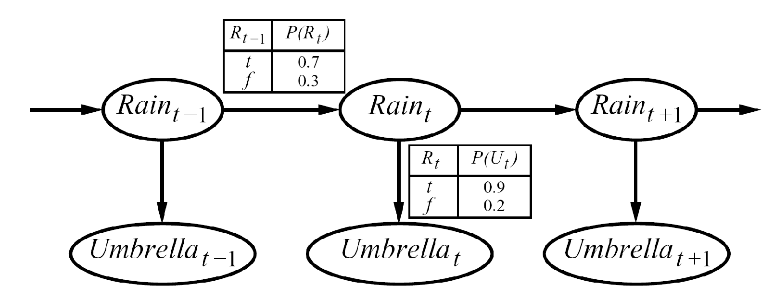
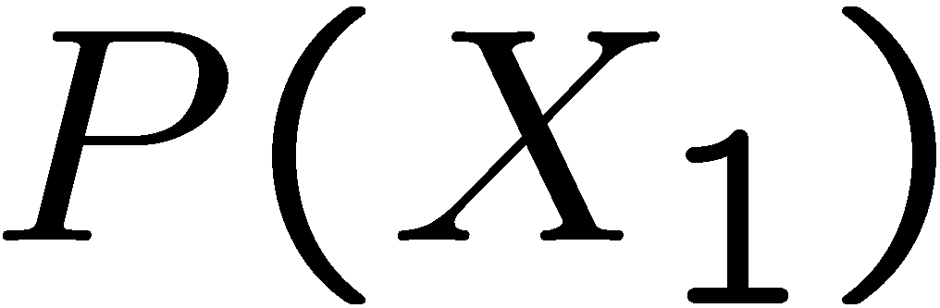
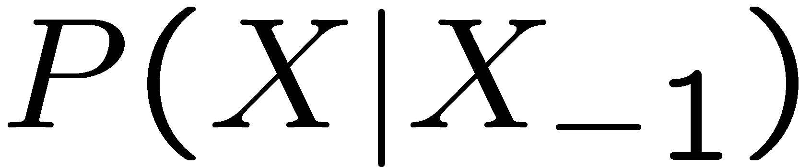
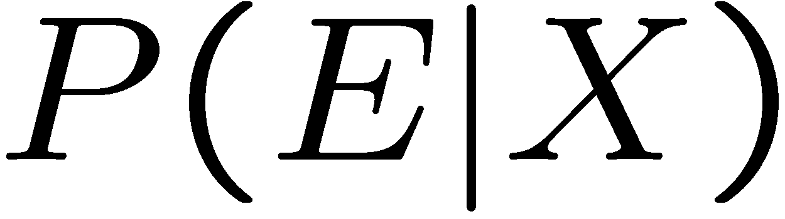
Rain/Umbrella Example in the Book
Story background:
Security guard at top-secret underground facility.
Is it raining? No direct observation.
But observe whether director has umbrella when
coming to work.
An HMM is defined by:
Initial distribution:
Transitions:
Emissions (sensor model):

Slide 34
Conditional Independence
HMMs have two important independence properties:
Markov hidden process, future depends only on the present
Current observation is independent of all else, given the current state
Quiz: does this mean that observations are independent?
[No, correlated by the hidden state]
X₁
X₂
X₃
X₄
E₁
E₂
E₃
E₄

Slide 35
Real HMM Examples
Speech recognition HMMs:
Observations are acoustic signals (continuous valued)
States are specific positions in specific words (so, tens of thousands)
Machine translation HMMs:
Observations are words (tens of thousands)
States are translation options
Robot tracking:
Observations are range readings (continuous/discrete)
States are positions on a map (continuous/discrete)

Slide 36
Localization, Filtering, Monitoring
Localization, Filtering, or monitoring, is the task of tracking the distribution P(X) (the belief state) over time
We start with P(X₁) in an initial setting, usually uniform
As time passes, 1,…,t, when we have observations, we update P(X_{t}):
P(X_{t}|E_{1:t})
P(X₁)
P(X_{k})
P(X_{t})
1
k
t
t+k
time

Slide 37
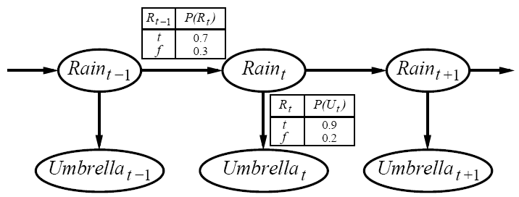
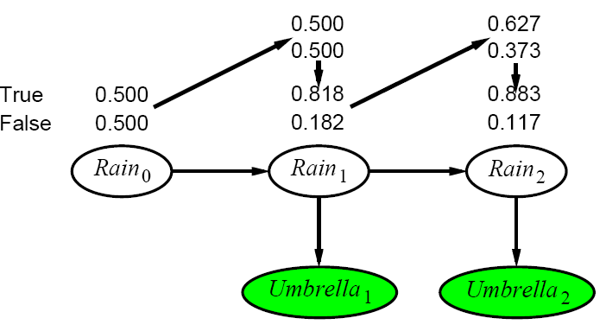
Filtering Example
Day 0:
P(R₀)=<0.5,0.5>
Day 1:
P(R₁)=P(r₀)P(R₁|r₀)
= α0.5<0.7,0.3> + α0.5<0.3,0.7>
= <0.5,0.5>
observe Umbrella appears 🡺 U₁=true
updating with evidence for t=1 gives:
P(R₁|u₁)=αP(u₁|R₁)P(R₁)=α<0.9,0.2><0.5,0.5>
=α<0.45,0.1> = <0.818,0.182>
Day 2:
P(R₂|u₁)=P(R₂|r₁) P(r₁|u₁)
=α<0.818<0.7,0.3> + 0.182<0.3,0.7>> = <0.627,0.373>
observe Umbrella appears 🡺 U₂=true
updating with evidence for t=2 gives:
P(R₂|u₁,u₂)=αP(u₂|R₂)P(R₂|u₁)=α<0.9,0.2><0.627,0.373>
=α<0.565,0.075> = <0.883,0.117>
Notes:
P(R₂ | u₁)
= P(R₂ R₁ | u₁) + P(R_{2 ,} -R₁| u₁) // R2 depends on R1, so marge on R1
= P(R₁|u₁)P(R₂ |R₁ u₁) + P(-R₁|u₁)P(R₂ |-R₁ u₁) // Product rule
= P(R₁|u₁)P(R₂ |R₁) + P(-R₁|u₁)P(R₂ |-R₁) // R2 independent on u1 given R1
= 0.818<0.7,0.3> + 0.182<0.3,0.7>
= <0.627,0.373>
P(R₂ | u₁,u₂)
= P(R₂ u₁,u₂) / P(u₁,u₂) // Product rule
= P(R₂ u₂ | u₁) P(u₁) / P(u₁,u₂) // Product rule
= P(R₂ | u₁) P(u₂ | R₂ u₁) P(u₁) / P(u₁,u₂) // Product rule
= P(R₂ | u₁) P(u₂ | R₂) P(u₁) / P(u₁,u₂) // u2 independent from u1 given R2
= α P(R₂ | u₁) P(u₂ | R₂ ) // normalization
+ P(R_{2 ,} -R₁| u₁)
P(R₂|r₁) P(r₁|u₁)

Slide 38
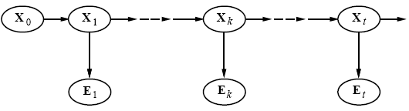
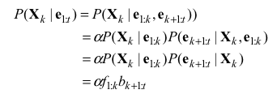

Smoothing: P(X_{k}| E_{1:T})
Divide evidence e_{1:t} into e_{1:k}, e_{k+1:t} :
Backward message computed by a backwards recursion:
Using Bayes rule
Using conditional independence
Conditioning on X_{k+1}
Using conditional independence
= Backward(b_{k+2:t},e_{k+1:t})
b_{k+1:t}=Σ_{Xt+1}(P(e_{k+1}|x_{k+1})P(x_{k+1}|X_{k}) b_{k+2:t}

Slide 39
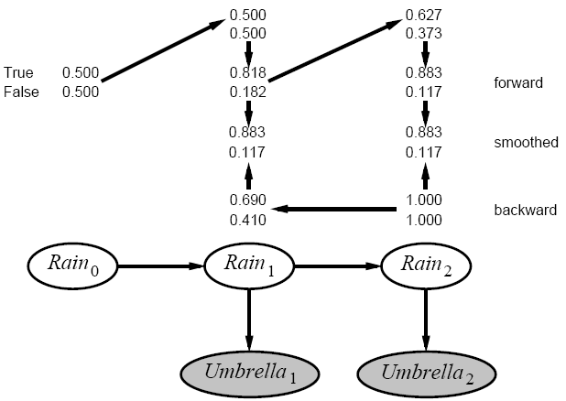
Smoothing Example
Compute estimate for rain at t=1
P(R₁|u₁,u₂)=αP(R₁|u₁)P(u₂|R₁)
P(R₁|u₁) = <0.818,0.182>
P(u₂|R₁) =Σ_{r2}P(u₂|r₂) P(|r₂) P(r₂|R₁)
=(0.9 ✕ 1 ✕ <0.7,0.3>) + (0.2 ✕ 1 ✕ <0.3,0.7>)
= <0.69,0.41>
Smoothed estimate:
P(R₁|u₁,u₂)=α<0.818,0.182> ✕ <0.69,0.41> = <0.883,0.117>
Forward-backward algorithm: cache forward messages along the way
Time linear in t (polytree inference), space O(t_{j}f_{j})

Slide 40
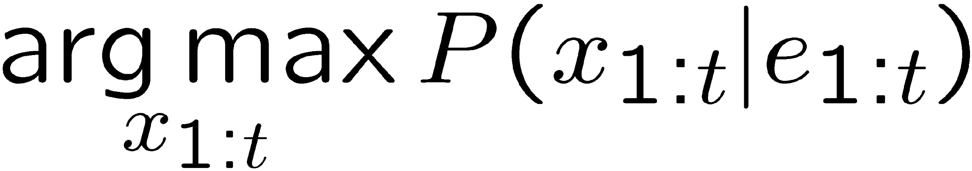
Best Explanation Queries
X₁
X₂
X₃
X₄
X₅
E₁
E₂
E₃
E₄
E₅
Query: what is the most likely sequence of states?

Slide 41
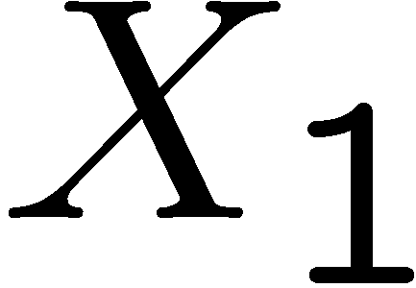
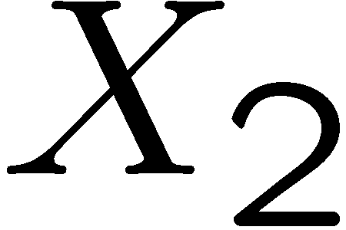

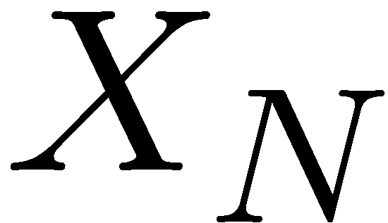
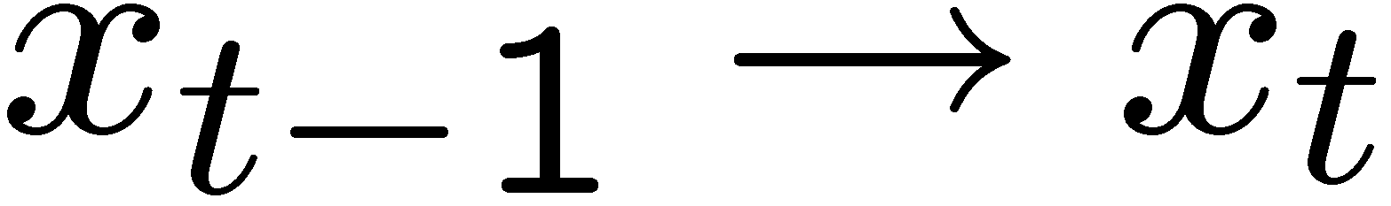
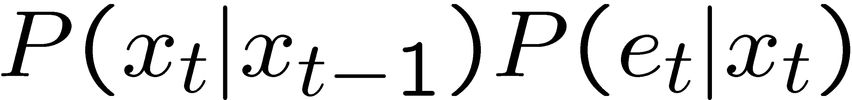
State Path Trellis
State trellis: graph of states and transitions over time
Each arc represents some transition
Each arc has weight
Each path is a sequence of states
The product of weights on a path is the seq’s probability
Can think of the Forward (and now Viterbi) algorithms as computing sums of all paths (best paths) in this graph
sun
sun
sun
sun
rain
rain
rain
rain

Slide 42
Forward Procedure Computes All α_{t}(s_{i}) on State Trellis
α₁(s₀)
α₁(s₁)
α₁(s₂)
α₁(s₃)
α₂(s₀)
α₂(s₁)
α₂(s₂)
α₂(s₃)
α₃(s₀)
α₃(s₁)
α₃(s₂)
α₃(s₃)
α_{T}(s₀)
α_{T}(s₁)
α_{T}(s₂)
α_{T}(s₃)
t₁
t₂
t₃
t_{T}
No need to compute all α_{t}(s_{i}), if we only need the best for each step
The Viterbi algorithm does this.

Slide 43
Viterbi Algorithm Computes Only the Best α_{t}(s_{i}) on State Trellis
α₁(s₀)
α₁(s₁)
α₁(s₂)
α₁(s₃)
α₂(s₀)
α₂(s₁)
α₂(s₂)
α₂(s₃)
α₃(s₀)
α₃(s₁)
α₃(s₂)
α₃(s₃)
α_{T}(s₀)
α_{T}(s₁)
α_{T}(s₂)
α_{T}(s₃)
t₁
t₂
t₃
t_{T}
No need to compute all α_{t}(s_{i}), if we only want to know the best for each step
The Viterbi algorithm does this.

Slide 44
Viterbi Algorithm: choose the best state seq. Similar to before α_{t}(s_{t}), but use max not sum
sun
sun
sun
sun
rain
rain
rain
rain
α_{t}(s_{t})
α_{t-1}(s_{t-1})

Slide 45
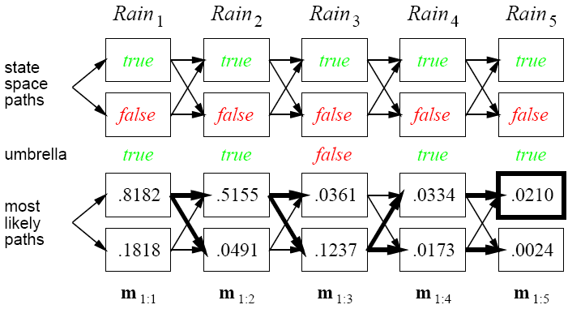
Viterbi Example

Slide 46
Viterbi Example
0.8182* 0.7 *0.9
0.5155* 0.7 *0.1
0.1237* 0.3 *0.9
0.0334* 0.7 *0.9
0.8182* 0.3 *0.2
0.5155* 0.3 *0.8
0.1237* 0.7 *0.2
0.0334* 0.3*0.2

Slide 47
Temporal Models
Models with actions and sensors (ALFE 4-5) (aka POMDP)
Markov Chains
No observation, no explicit actions, transit randomly
Hidden Markov Model
No explicit actions, state transit randomly
Dynamic Bayesian Networks
No explicit actions, States are Bayesian Networks
Continuous State Model
No explicit actions, States are continuous
POMDP
Discrete states with probabilistic actions, sensors, & transitions

Slide 48
Dynamic Bayesian Networks
{evidence}, action, {evidence}, …, action, …, {evidence}, action, {evidence}
S1 S2 S3 S4
S1 S2 S3 S4
……
S1 S2 S3 S4
S1 S2 S3 S4
………
Each time “slice” is a Bayesian Network with variables and CPTs

Slide 49
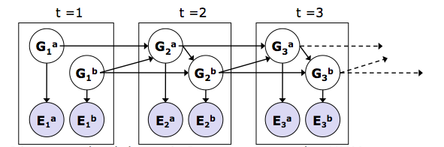
Dynamic Bayes Nets (DBNs)
We want to track multiple variables over time, using multiple sources of evidence
Idea: Repeat a fixed Bayes net structure at each time
Variables from time t can condition on those from t-1
Discrete valued dynamic Bayes nets are also HMMs

Slide 50
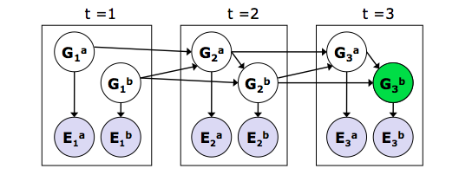
Exact inference in DBNs
Variable elimination applies to Dynamic Bayesian nets
Procedure: “unroll” the network for T time steps, then eliminate variables until P(X_{T}|e_{1:T}) is computed
Online belief updates: Eliminate all variables from the previous time step; store factors for current time only

Slide 51

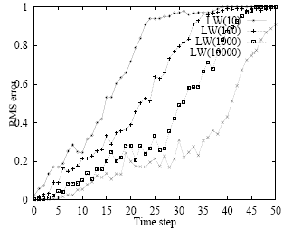
Likelihood weighting for DBNs
Set of weighted samples approximates the belief state
LW samples pay no attention to the evidence!
) fraction “agreeing” falls
exponentially with t
) num. samples required
grows exponentially with t

Slide 52
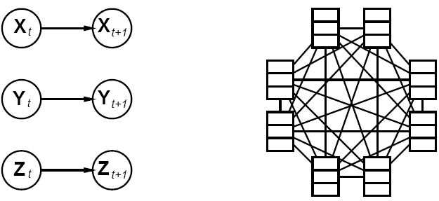
DBNs vs. HMMs
Every HMM is a single-variable DBN; every discrete DBN is an HMM
DBN: Sparse dependencies, exponentially fewer parameters;
e.g., 20 state variables, three parents each
DBN has 20x2³ =160 parameters, HMM has 2²⁰x2²⁰ =10¹²

Slide 53
Temporal Models
Models with actions and sensors (ALFE 4-5) (aka POMDP)
Markov Chains
No observation, no explicit actions, transit randomly
Hidden Markov Model
No explicit actions, state transit randomly
Dynamic Bayesian Networks
No explicit actions, States are Bayesian Networks
Continuous State Model
No explicit actions, States are continuous
POMDP
Discrete states with probabilistic actions, sensors, & transitions

Slide 54
Kalman Filters
{evidence}, action, {evidence}, …, action, …, {evidence}, action, {evidence}
S1 S2 S3 S4
S1 S2 S3 S4
……
S1 S2 S3 S4
S1 S2 S3 S4
………
In each time slice, state variables are continuous (not discrete)

Slide 55
Summary
Temporal models use states, transitions, sensors
Transitions may be related to agent’s actions, or spontaneous
Markov assumptions and stationarity assumption, so we need
- transition model P(Xt | Xt-1) or P(Xt | Xt-1, a_{t-1})
- sensor model P(Et | Xt)
Tasks: filtering, prediction, smoothing, most likely seq
all done recursively with constant cost per time step
Types of models
HMM have a single discrete state variable
Dynamic Bayes nets subsume HMMs; exact update intractable
Other models may have internal structure driven by actions

