Slide 1
Wrap-Up Topics and Final Exam Prep

Slide 2
Agenda
Support Vector Machines – Quick Intro
Neural Networks – Quick Intro
“Wrap-up” topics
Final exam logistics
Final exam topics and sample questions

Slide 3
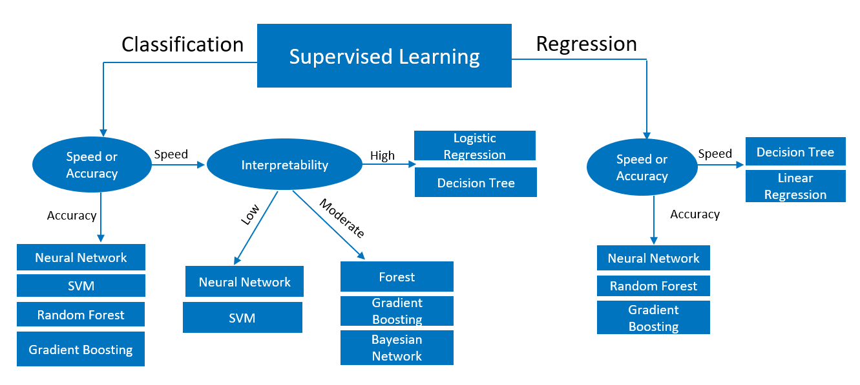
Modeling Algorithm Selection Guidelines

Slide 4
Introduction to Support Vector Machines

Slide 5
Support Vector Machines
Overview
Comes out of the computer science field (not statistics)
Considered to be one of the best ways of doing classification
Highly flexible – automatically determines any relationship between predictors and response
Don’t need to specify relationship before modeling
Tend to be “black boxes”
Used in fields such as image classification, handwriting recognition, financial decision making, and text mining

Slide 6
Support Vector Machines
Overview
Approaches two-class classification problems directly:
Attempt to find a plane that separates the classes in a feature space
If we cannot find such a plane, two techniques are used:
Soften what we mean by “separates”
Enrich and enlarge the feature space so that separation is possible

Slide 7
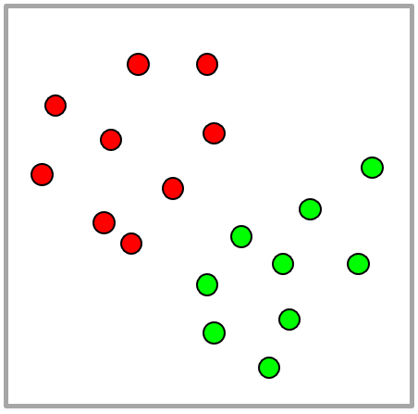
Support Vector Machines
Originally designed solely for “decisions” (classification)
Have been expanded to also provide ranks and estimates
Line is the support vector “machine”
Also called “classifier”, “classifier model”, or a “classification rule”
Binary classification model with two-dimensional input space

Slide 8
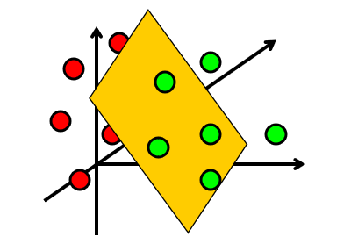
Support Vector Machines
Planes
Binary classification model with three-dimensional input space

Slide 9
Which Hyperplane is the Best One?

Slide 10
Which Hyperplane is Best?
A “Fat” Hyperplane

Slide 11

Hyperplane Definition
A hyperplane in $p$ dimensions is a flat subspace of dimension $p−1$
If $p=2$, hyperplane is a line
If $p=3$, hyperplane is a traditional plane
Hyperplane equation:
$$β_{0}+β_{1}X_{1}+β_{2}X_{2}+ …+β_{p}X_{p}=0$$

Slide 12
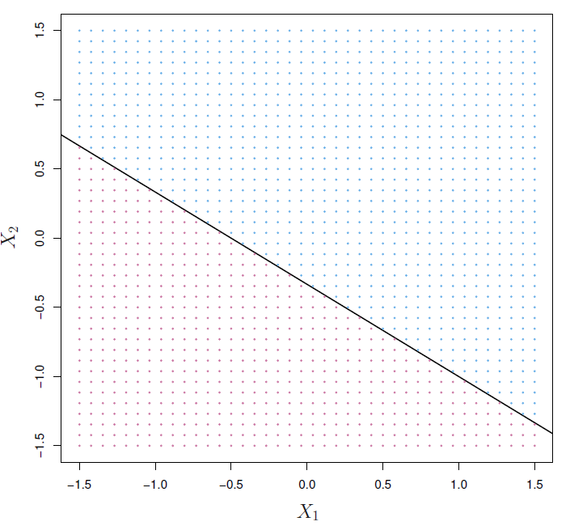



Hyperplane
Region of points with $1+2X_{1}+3X_{2}>0$
$$1+2X_{1}+3X_{2}=0$$
Region of points with $1+2X_{1}+3X_{2}<0$
$$1+2X_{1}+3X_{2}=0$$

Slide 13
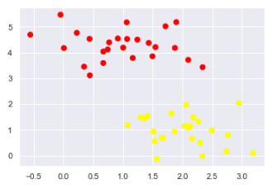
Separating Hyperplanes
Simple Example
Two clearly-separate sets

Slide 14
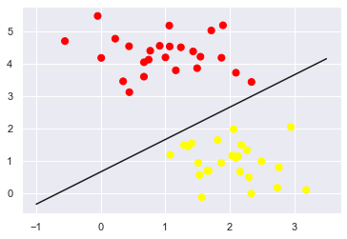
Separating Hyperplanes
Simple Example
Easy to find a line that separates them

Slide 15
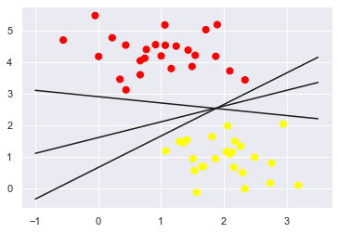
Separating Hyperplanes
Simple Example
Actually, many!

Slide 16
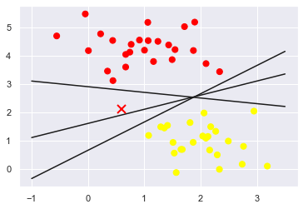
Separating Hyperplanes
Simple Example
Which can lead to confusion when predicting classifications for new observations – like the “X” here

Slide 17
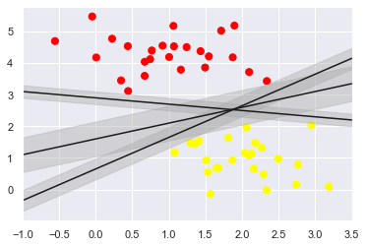
Separating Hyperplanes
Maximizing the Margin
Basic approach:
Draw a margin around each line that goes up to the nearest point
Select the line that has the largest margin

Slide 18
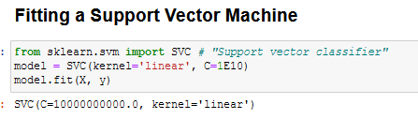

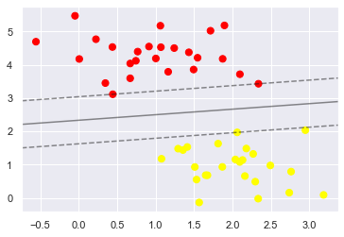
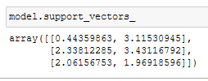
Fitting a Support Vector Machine
Note the two model parameters. We will re-visit shortly.
“Support Vectors”

Slide 19
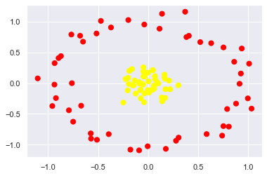
Beyond Linear Boundaries
Clearly Non-Separable Classes

Slide 20

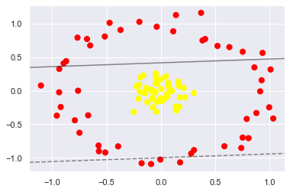
Beyond Linear Boundaries
Clearly Non-Separable Classes (Linearly)

Slide 21
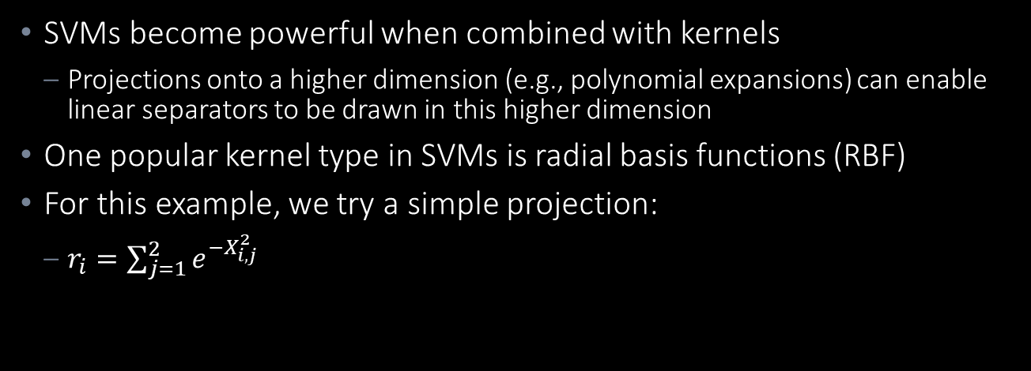
Beyond Linear Boundaries
SVMs become powerful when combined with kernels
Projections onto a higher dimension (e.g., polynomial expansions) can enable linear separators to be drawn in this higher dimension
One popular kernel type in SVMs is radial basis functions (RBF)
For this example, we try a simple projection:
$r_{i}=\sum_{j=1}^{2}{e^{−X_{i,j}^{2}}}$
Will have largest values for X values closest to 0

Slide 22
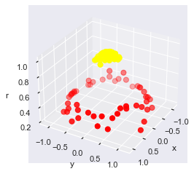
Beyond Linear Boundaries
Adding RBF Centered on 0
It’s apparent that a 2-D plane could now separate the classes

Slide 23

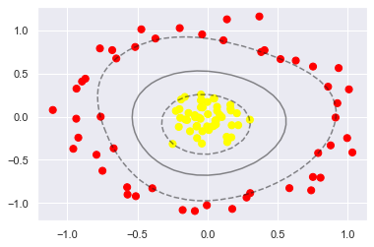
Beyond Linear Boundaries
Adding RBF Centered on 0
Software computes basis function centers at every point in dataset and identifies ideal function

Slide 24
Beyond Linear Boundaries
Softening Margins
However, this basis function “trick” only works when a perfect decision boundary exists, but what if your data has some overlap with every possible basis expansion?

Slide 25
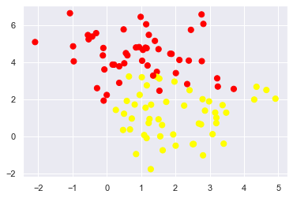
Beyond Linear Boundaries
Softening Margins
There may be no cases where the boundary can be perfectly separated, so we allow some number of points on the other side of the margin.
The “hardness” of the margin is controlled by the tuning parameter “C”

Slide 26
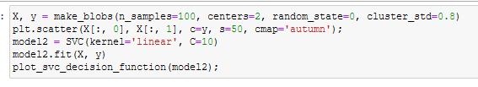

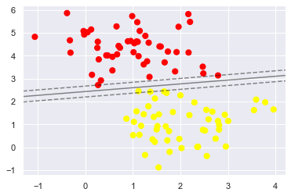
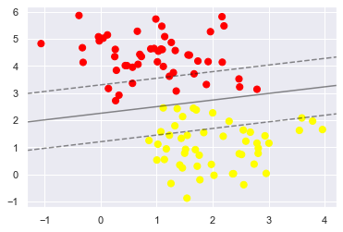
Beyond Linear Boundaries
Softening Margins
Margin “softness” controlled by C parameter

Slide 27
Parameters for SVMs for Classification
The penalty C (regularization term)
The kernel function and its parameters

Slide 28
Summary of SVM
An SVM is a hyperplane with a maximum-margin in a feature space, constructed by use of a kernel function in the input space.
Advantages:
Finds a global, unique optimum
Kernel “trick” works well
General-purpose algorithm that works well with high-dimensional data
Once the model is trained, prediction is very fast
Disadvantages:
Training can be very computationally expensive
Results are strongly dependent on “softening parameter” C
Results are not interpretable

Slide 29
Neural Networks

Slide 30


Traditional Regression Models
x has no transformation.
x
y
yes
Linear relationship?
Linear Regression Model
yes
...

Slide 31
Traditional Regression Models
x has no transformation.
x
y
yes
Linear relationship?
Linear Regression Model
no
yes
Hypothetical relationship?
yes
Parametric Nonlinear Regression Model
...

Slide 32
Traditional Regression Models
x has no transformation.
x
y
yes
Linear relationship?
Linear Regression Model
no
yes
Hypothetical relationship?
yes
no
Parametric Nonlinear Regression Model
Nonparametric Regression Model
...

Slide 33


Traditional Regression Models
Parametric Nonlinear Regression Model
Nonparametric Regression Model
Examples
no functional form or parameters
linear in parameters
nonlinear in parameters

Slide 34
Limitations of Traditional Regression Models
Parametric Nonlinear Regression Model
Nonparametric Regression Model
more difficult to estimate
requires:
functional form
an optimization method
good parameter estimates
curse of dimensionality
curse of dimensionality

Slide 35


Beyond Traditional Regression: Neural Networks
Neural Network
requires:
an optimization method
initial parameter estimates
does not require a functional form
performs well in high-dimensional spaces

Slide 36

Advantages and Disadvantages of Neural Networks
Neural Network
flexibility
lack of interpretability
need for a strong signal

Slide 37
Response to the Lack of Interpretability Objection
This is the famous black-box objection, often raised merely to disparage neural networks.
There are two ways to respond to this objection:
by admitting that neural networks are most relevant to pure prediction tasks
by applying other modeling techniques, such as decision trees, to try to help “open” the black box

Slide 38
Multilayer Perceptron (MLP)
H₁
x₁
H₂
y
x₂
H₃
input
layer
hidden
layer
target
layer

Slide 39
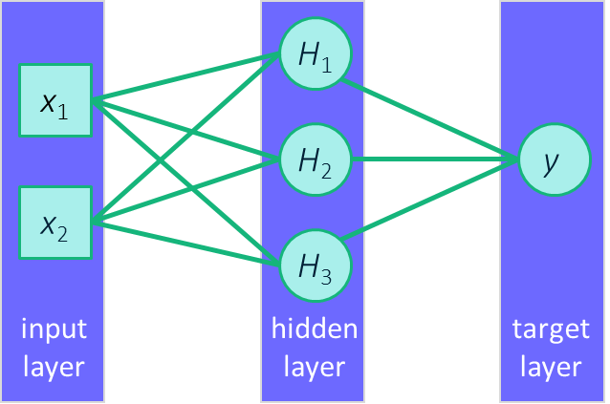

Multilayer Perceptron (MLP)
$$\hat{y}={\hat{w}}_{00}+{\hat{w}}_{01}H_{1}+{\hat{w}}_{02}H_{2}+{\hat{w}}_{03}H_{3}$$
A regression model on a set of derived inputs (outputs from the hidden layer)

Slide 40
Multilayer Perceptron (MLP)
“Neurons”

Slide 41
Multilayer Perceptron (MLP)
$$\hat{y}={\hat{w}}_{00}+{\hat{w}}_{01}H_{1}+{\hat{w}}_{02}H_{2}+{\hat{w}}_{03}H_{3}$$
Bias estimate
Weight estimates
A regression model on a set of derived inputs (outputs from the hidden layer)

Slide 42













Multilayer Perceptron (MLP)
$$\hat{y}={\hat{w}}_{00}+{\hat{w}}_{01}H_{1}+{\hat{w}}_{02}H_{2}+{\hat{w}}_{03}H_{3}$$
$$H_{1}=tanh⁡({\hat{w}}_{10}+{\hat{w}}_{11}x_{1}+{\hat{w}}_{12}x_{2})$$
$${\hat{w}}_{11}$$
$${\hat{w}}_{12}$$
$${\hat{w}}_{01}$$
$${\hat{w}}_{21}$$
$${\hat{w}}_{02}$$
$$H_{2}=tanh⁡({\hat{w}}_{20}+{\hat{w}}_{21}x_{1}+{\hat{w}}_{22}x_{2})$$
$${\hat{w}}_{22}$$
$${\hat{w}}_{03}$$
$${\hat{w}}_{31}$$
$${\hat{w}}_{32}$$
$$H_{3}=tanh⁡({\hat{w}}_{30}+{\hat{w}}_{31}x_{1}+{\hat{w}}_{32}x_{2})$$

Slide 43
Multilayer Perceptron (MLP)
$$\hat{y}={\hat{w}}_{00}+{\hat{w}}_{01}H_{1}+{\hat{w}}_{02}H_{2}+{\hat{w}}_{03}H_{3}$$
$$H_{1}=tanh⁡({\hat{w}}_{10}+{\hat{w}}_{11}x_{1}+{\hat{w}}_{12}x_{2})$$
$${\hat{w}}_{11}$$
$${\hat{w}}_{12}$$
$${\hat{w}}_{01}$$
$${\hat{w}}_{21}$$
$${\hat{w}}_{02}$$
$$H_{2}=tanh⁡({\hat{w}}_{20}+{\hat{w}}_{21}x_{1}+{\hat{w}}_{22}x_{2})$$
$${\hat{w}}_{22}$$
$${\hat{w}}_{03}$$
$${\hat{w}}_{31}$$
$${\hat{w}}_{32}$$
$$H_{3}=tanh⁡({\hat{w}}_{30}+{\hat{w}}_{31}x_{1}+{\hat{w}}_{32}x_{2})$$
Activation function

Slide 44
Multilayer Perceptron (MLP)
Can approximate virtually any association
$$\hat{y}={\hat{w}}_{00}+{\hat{w}}_{01}H_{1}+{\hat{w}}_{02}H_{2}+{\hat{w}}_{03}H_{3}$$
$$H_{1}=tanh⁡({\hat{w}}_{10}+{\hat{w}}_{11}x_{1}+{\hat{w}}_{12}x_{2})$$
$${\hat{w}}_{11}$$
$${\hat{w}}_{12}$$
$${\hat{w}}_{01}$$
$${\hat{w}}_{21}$$
$${\hat{w}}_{02}$$
$$H_{2}=tanh⁡({\hat{w}}_{20}+{\hat{w}}_{21}x_{1}+{\hat{w}}_{22}x_{2})$$
$${\hat{w}}_{22}$$
$${\hat{w}}_{03}$$
$${\hat{w}}_{31}$$
$${\hat{w}}_{32}$$
$$H_{3}=tanh⁡({\hat{w}}_{30}+{\hat{w}}_{31}x_{1}+{\hat{w}}_{32}x_{2})$$
Activation function

Slide 45
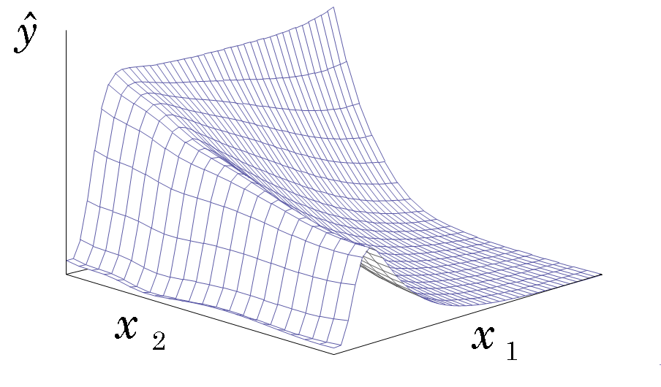
Universal Approximator
Given enough neurons and time, a neural network can model any input/output relationship, to any degree of precision.

Slide 46
Multilayer Perceptron (MLP)
Network Architecture Hyperparameters
Options:
Number of hidden layers
Number of neurons per layer
Connection types
Activation functions
H₁
x₁
H₂
y
x₂
H₃
input
layer
hidden
layer
target
layer

Slide 47
Multilayer Perceptron (MLP)
Network Architecture Hyperparameters
Options:
Number of hidden layers
Number of neurons per layer
Connection types
Activation functions
H₁
x₁
H₂
y
x₂
H₃
input
layer
hidden
layer
target
layer

Slide 48
Multilayer Perceptron (MLP)
Network Architecture Hyperparameters
Enables modeling of discontinuous input-output mappings
Increases the number of weights that need to be estimated
H₁₁
x₁
H₂₁
H₁₂
y
x₂
H₂₂
H₁₃
input
layer
hidden
layer 1
hidden
layer 2
target
layer

Slide 49
Multilayer Perceptron (MLP)
Network Architecture Hyperparameters
Adding neurons in hidden layers can improve model performance
Determining optimal number of hidden neurons is more difficult than determining optimal number of hidden layers
H₁
x₁
H₂
y
x₂
H₃
input
layer
target
layer
H₄
hidden
layer

Slide 50
Multilayer Perceptron (MLP)
Network Architecture Hyperparameters
Hidden Neurons | Result
Too many | Models noise Fails to generalize
Too few | Fails to capture the signal Fails to generalize
H₁
x₁
H₂
y
x₂
H₃
input
layer
target
layer
H₄
hidden
layer

Slide 51
Multilayer Perceptron (MLP)
Network Architecture Hyperparameters
Guidelines:
Number of hidden neurons in first layer should be approximate twice the number of input dimensions
H₁
x₁
H₂
y
x₂
H₃
input
layer
target
layer
H₄
hidden
layer

Slide 52
Multilayer Perceptron (MLP)
Network Architecture Hyperparameters
Unlike tree-based models, neural networks cannot “select” inputs
Therefore, it is a good practice to also focus on variable selection prior to finalizing the components of the input layer
H₁
x₁
H₂
y
x₂
H₃
input
layer
target
layer
H₄
hidden
layer

Slide 53
Multilayer Perceptron (MLP)
Network Architecture Hyperparameters
Hidden layer is the key to modeling non-linearities
“Activation function” introduces the nonlinearity
Original neural networks used the logit function as the activation functions
Several other options are used today.
SAS uses the hyperbolic tangent as the default activation function
H₁
x₁
H₂
y
x₂
H₃
input
layer
hidden
layer
target
layer

Slide 54
Activation Functions
1
logistic
Activation
0
tanh
−1
0
Net Input

Slide 55
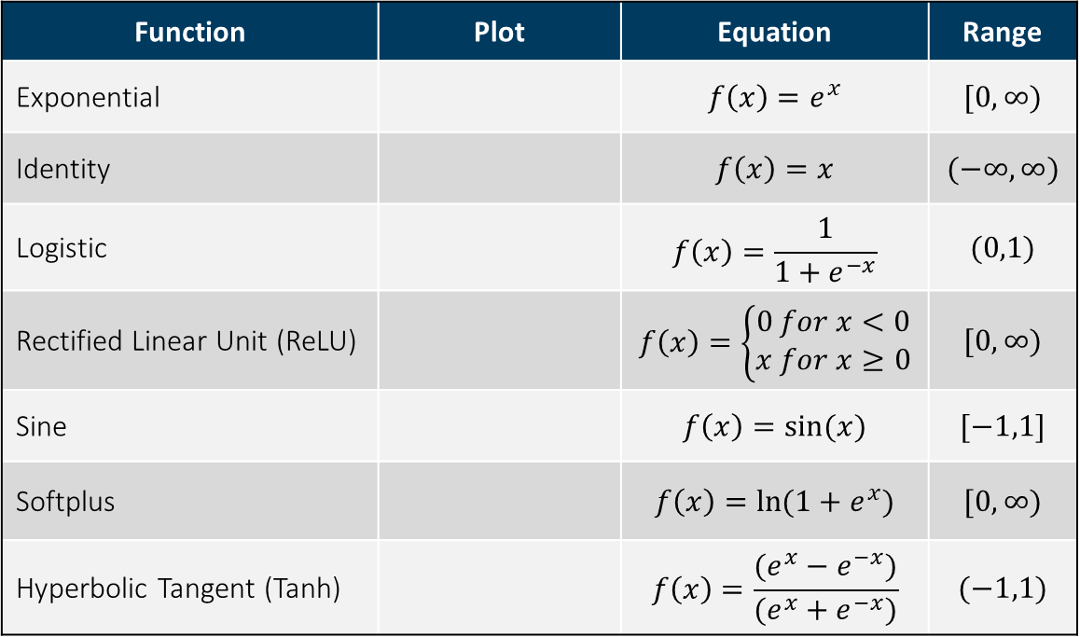
Activation Function Examples
Function | Plot | Equation | Range
Exponential |  | $$f\left(x\right)=e^{x}$$ | $$[0,∞)$$
Identity |  | $$f\left(x\right)=x$$ | $$(−∞,∞)$$
Logistic |  | $$f\left(x\right)=\frac{1}{1+e^{−x}}$$ | $$(0,1)$$
Rectified Linear Unit (ReLU) |  | $$f\left(x\right)=\left\{\begin{aligned}0 for x<0 \\ x for x≥0\end{aligned}\right.$$ | $$[0,∞)$$
Sine |  | $$f\left(x\right)=sin⁡(x)$$ | $$[−1,1]$$
Softplus |  | $$f\left(x\right)=ln⁡(1+e^{x})$$ | $$[0,∞)$$
Hyperbolic Tangent (Tanh) |  | $$f\left(x\right)=\frac{(e^{x}−e^{−x})}{(e^{x}+e^{−x})}$$ | $$(−1,1)$$

Slide 56




Optimize Model Complexity
Weight Regularization
$$\hat{y}={\hat{w}}_{00}+{\hat{w}}_{01}H_{1}+{\hat{w}}_{02}H_{2}+{\hat{w}}_{03}H_{3}$$
$$H_{1}=tanh⁡({\hat{w}}_{10}+{\hat{w}}_{11}x_{1}+{\hat{w}}_{12}x_{2})$$
$$H_{2}=tanh⁡({\hat{w}}_{20}+{\hat{w}}_{21}x_{1}+{\hat{w}}_{22}x_{2})$$
$$H_{3}=tanh⁡({\hat{w}}_{30}+{\hat{w}}_{31}x_{1}+{\hat{w}}_{32}x_{2})$$

Slide 57
Optimize Model Complexity
$$\hat{y}={\hat{w}}_{00}+{\hat{w}}_{01}H_{1}+{\hat{w}}_{02}H_{2}+{\hat{w}}_{03}H_{3}$$
Optimizing the complexity of a neural network involves controlling the magnitude of the weights
If the weights grow too large, the model will be overfit
Large weights cause the activation functions to become too steep and “adapt” to noise
The two methods of controlling overfitting are called “weight decay” and “early stopping”
$$H_{1}=tanh⁡({\hat{w}}_{10}+{\hat{w}}_{11}x_{1}+{\hat{w}}_{12}x_{2})$$
$$H_{2}=tanh⁡({\hat{w}}_{20}+{\hat{w}}_{21}x_{1}+{\hat{w}}_{22}x_{2})$$
$$H_{3}=tanh⁡({\hat{w}}_{30}+{\hat{w}}_{31}x_{1}+{\hat{w}}_{32}x_{2})$$

Slide 58


Optimize Model Complexity
Weight Decay
Recall that when estimating weights we attempt to minimize the error function:
Regularization adds “penalty terms” to this minimization:
L1 Regularization: Minimize $\frac{1}{n}\sum_{i=1}^{n}{(}{EF}_{i}+λ\left|w_{i}\right|)$
L2 Regularization: Minimize $\frac{1}{n}\sum_{i=1}^{n}{(}{EF}_{i}+{λ\left|w_{i}\right|}^{2})$
$$Error Function= −2∗\left[\sum{\log\left({\hat{p}}_{i}\right)+\sum{log⁡(1−{\hat{p}}_{i})]}}\right]$$

Slide 59
Hyperparameter Tuning
Hyperparameters include:
Number of hidden layers
Number of neurons per layer
Activation function
Network learning hyperparameters

Slide 60
“Wrap Up” Topics

Slide 61
Topics
Correlated predictors
Skew in predictor variables
“Dummy Variable Trap”
Degrees of freedom
Multinomial logistic regression

Slide 62
Correlated Predictors and Linear Models
Issues
Inference is significantly “clouded”
Confounding (one predictor is correlated with both the predictor and the response)
Increases the standard error of the model coefficient:
Increases model variance
Decreases the power of the hypothesis test (probability of correctly detecting a non-zero coefficient)

Slide 63
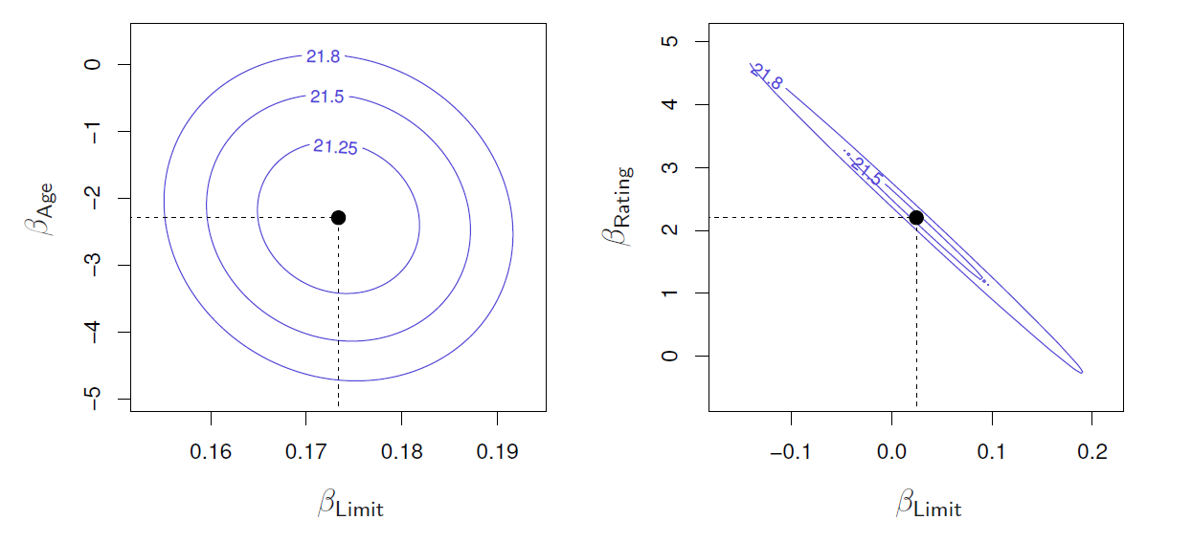
Correlated Predictors and Linear Models
RSS Contour Plots
Uncorrelated Predictors
Correlated Predictors
Coefficients with lowest RSS
ISLR Figure 3.14
Axes scaled to include possible coefficients up to 4 standard errors

Slide 64
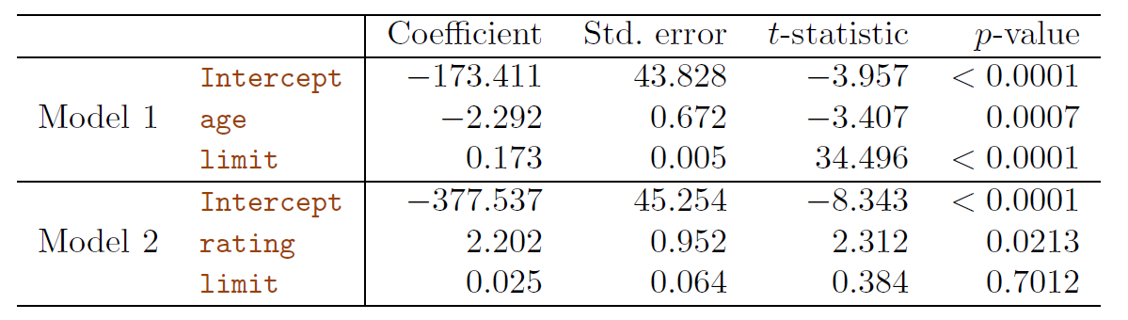
Correlated Predictors and Linear Models
Collinearity causes the standard error of the coefficient estimates
ISLR Table 3.11
The importance of the limit predictor is masked by the collinearity

Slide 65
Correlated Predictors and Linear Models
Approaches to resolving mutlicorrelation issues:
Drop one of the problematic variables
Combine two or more correlated variables into a single predictor
PCA is one technique
Both approaches are risky without using some knowledge of the data meanings and sources

Slide 66
Skewed Variables in Linear Regression
There is no assumption of normality of predictors or response in a linear model
The only assumption is that the residuals are normal
However, highly skewed variables can cause other problems
They can influence the distribution of the residuals, making them non-normal
They can significantly complicate the identification of high-leverage observations

Slide 67
When to Consider a Non-Linear Transformation?
When underlying scientific theory indicates that the expected relationship is nonlinear
For example, if you have reason to believe that the true relationship is multiplicative, taking log transforms allows the model to be treated as linear
Residuals have a skewed distribution
Heteroscedasticity
To simplify a model
For example, sometimes it can reduce or simply interaction effects
Log transforms can yield more interpretable coefficients

Slide 68

Linear Regression Coefficient Interpretations
With everything else held equal (using $\log_{10}$):
Y as a function of X: a one unit increase in X leads to a $β$ increase/decrease in Y
Log Y as a function of log X: a 1% increase in X leads to a $β\%$ increase/decrease in Y
Log Y as a function of X: a one unit increase in X leads to a $β∗100\%$ increase/decrease in Y
Y as a function of Log X: a 1% increase in X leads to a $β/100$ increase/decrease in Y

Slide 69
Reasons NOT to Use a Transform
Make outliers not look like outliers
Because all the data are positive (positivity often implies skewness but it doesn’t have to)
Because the software automatically does it

Slide 70
Degrees of Freedom
Many statistical tests and probability distributions include a value referred to as “degrees of freedom”
Concept applied to statistics calculated from sample data
Refers to the number of values free to vary after the sample statistic has been established
For example, if you are calculating a sample mean of 10 values, the Degrees of Freedom is 9 (once you know 9 samples and the sample mean, the 10th can be calculated and is not free to vary)

Slide 71

Degrees of Freedom
Degrees of freedom are used in many statistical tests to avoid bias in the sample results, for example, sample standard variance:
$$S^{2}=\frac{1}{n−1}\sum_{i=1}^{n}{{(X_{i}−\overline{X})}^{2}}$$

Slide 72
Degrees of Freedom
“Contingency Table”
A contingency table contains counts of observations in two categories:
What would be the formula for the number of degrees of freedom?
 | Category A | Category B | Category C | Total
Category I |  |  |  | xx
Category II |  |  |  | xx
Total | xx | xx | xx

Slide 73

Degrees of Freedom
Generally, not a concept data scientists are often concerned with
Statistical tests are used sparingly in data science
Data sizes are large enough it is generally insignificant ($\frac{1}{n−1}≈\frac{1}{n}$ for large $n$)

Slide 74


Degrees of Freedom
Intuition
Sample variance is an estimate of the true population variance:
$$S^{2}=\frac{1}{n−1}\sum_{i=1}^{n}{{(X_{i}−\overline{X})}^{2}}$$
$$σ^{2}=\frac{1}{n}\sum_{i=1}^{n}{{(X_{i}−μ)}^{2}}$$
On average, which is any given $X_{i}$ going to be closer to, $\overline{X}$ or $μ$?
Why the difference?

Slide 75
Degrees of Freedom
One place it comes into play is when converting a factor variable into indicator or “dummy” variables
Consider the “origin” field in the cars dataset which can have three possible values (“Asia”, “Europe”, and “USA”)
There are only 2 (not 3) degrees of freedom and there will be perfect multicollinearity (and infinite VIF) for each dummy variable
There will not be a unique solution

Slide 76

Multinomial Logistic Regression
Overview
Extension of logistic regression for multiple categories
Select a single class to serve as the baseline (here, we select K):
$$P\left(Y=k | X=x\right)= \frac{e^{(β_{k0}+β_{k1}x_{1}+…+β_{kp}x_{p})}}{1+e^{(β_{k0}+β_{k1}x_{1}+…+β_{kp}x_{p})}}$$
for k = 1, …, K-1, and
$$P\left(Y=K | X=x\right)= \frac{1}{1+e^{(β_{k0}+β_{k1}x_{1}+…+β_{kp}x_{p})}}$$

Slide 77

Multinomial Logistic Regression
Overview
Thus, for $k=1…K−1:$
$$\log\left(\frac{P\left(Y=k | X=x\right) }{P\left(Y=K | X=x\right)}\right)=β_{k0}+β_{k1}x_{1}+…+β_{kp}x_{p}$$
Note: the selection of the $K_{th}$ class is arbitrary and unimportant

Slide 78

Multinomial Logistic Regression
Inference
However, your $K_{th}$ class becomes the baseline and then a one-unit increase in $X_{j}$ is associated with a $β_{kj}$ increase in the log odds of event $k$ over event $K$

Slide 79
Final Exam Logistics

Slide 80
Final Exam
Logistics
Final exam will be administered in class on Thursday, August 11
4:00PM – 6:00PM
WILL BE ENTIRELY REMOTE
Exam will be open-book/open-notes but must be done individually

Slide 81
Final Exam
Format
Final exam will consist of short-answer questions to test your understanding of the theoretical concepts presented in module 5-9
Interpretation of model outputs and visualizations
Simple calculations that can be done manually of using Excel
Exam will be a PowerPoint file
Similar to homework assignments, you will download the PowerPoint exam file, enter your responses, save it to a PDF file format and upload it to Gradescope

Slide 82
Sample Theory Questions

Slide 83
Module 5 – Linear Model Selection and Regularization
Sample Theory Questions
Manual calculation of Adjusted R2, Cp, AIC, BIC
Difference between Lasso and Ridge Regression
Why use the third partition
General data preparation best practices
* No questions on dimension reduction

Slide 84
Module 6 – Linear Classification Models
Sample Theory Questions
Interpreting logit function
Maximum Likelihood Estimation (MLE) - basic operations
Interpreting and calculating odds ratios
Interpreting logistic regression coefficients
Confounding - basic concept
Classification model assessment statistics - calculation and interpretation
TPR/FPR/TNR/FNR/Sensitivity/Specificity/Confusion matrix

Slide 85
Module 6 – Linear Classification Models
Sample Theory Questions
ROC curve
Construction and interpretation
Lift curve and lift as a concept
Construction and interpretation
Event-based sampling - what it is and why/how to use it
Multinomial logistic regression - definition and simple calculations

Slide 86
Module 7 – Generalized Linear Models and Poisson Regression
Sample Theory Questions
Deciding when to use Poisson regression
Deciding when to treat a predictor as a category vs a measure
Interpreting residuals for a Poisson Regression model
Interpreting Poisson regression coefficients
GLM – distribution family and link function for three types of GLMs (linear, logistic, Poisson)

Slide 87
Module 8 – Moving Beyond Linearity
Sample Theory Questions
Basis function definition
Step functions - definition and implementation
Piecewise polynomials - definition and implementation
General additive models - definition

Slide 88
Module 9 – Tree-Based Models
Sample Theory Questions
Purity calculations
Tree pruning approaches
Cost complexity pruning
Advantages and disadvantages of trees
Ensemble models - definition and types (averaging and boosting)
Random forest - basic approach
AdaBoost algorithm - basic operation
Gradient Boosting algorithm - basic operation

Slide 89
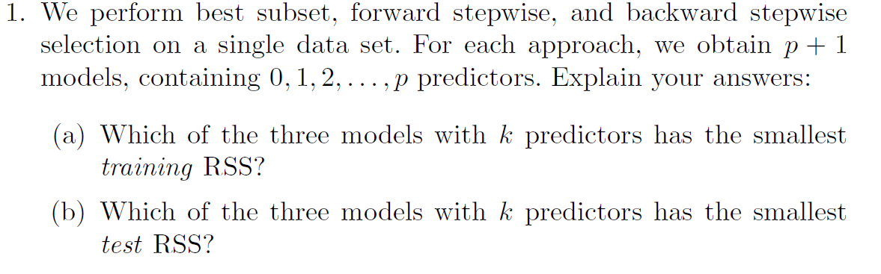
Sample Questions – Module 5
Best subset
Can’t say definitievely

Slide 90
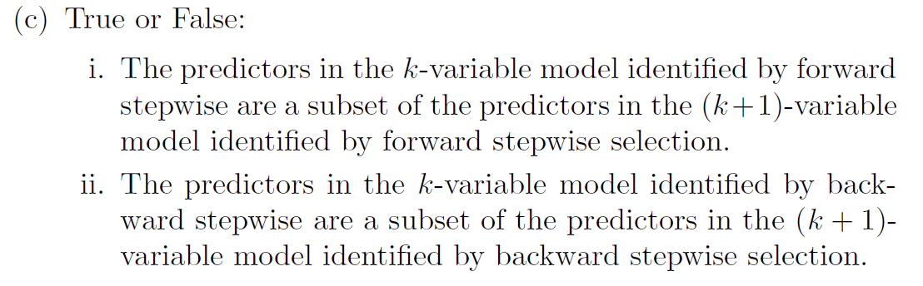
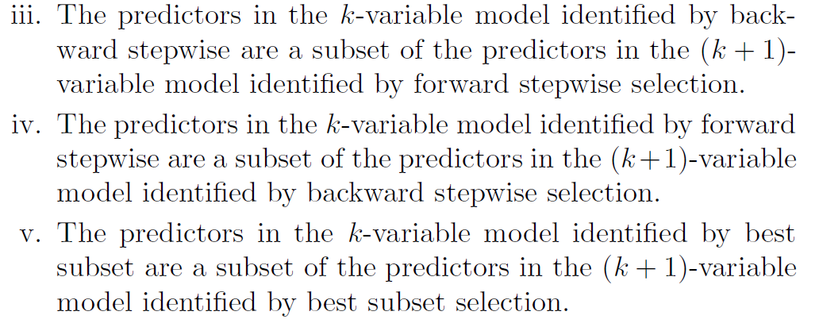
Sample Questions – Module 5
True
True
False
False
False

Slide 91
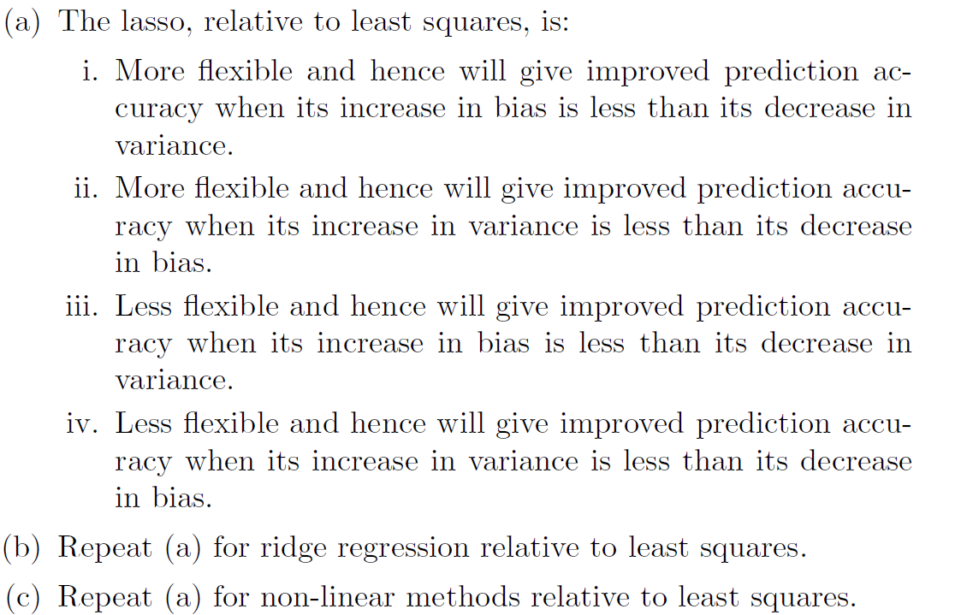
Sample Questions – Module 5
iii
iii
i

Slide 92
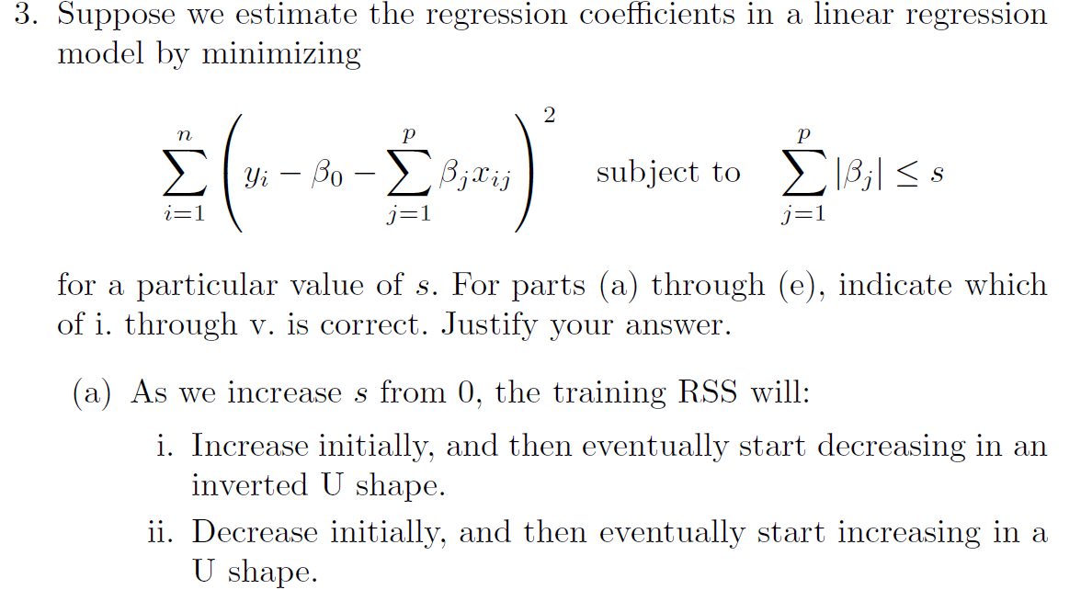
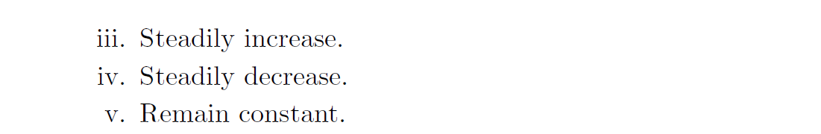
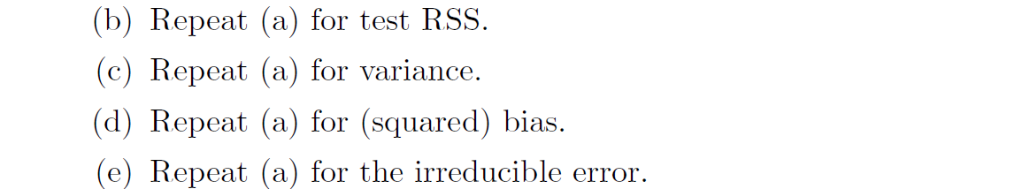
Sample Questions – Module 5
iv
ii
iii
iv
v

Slide 93
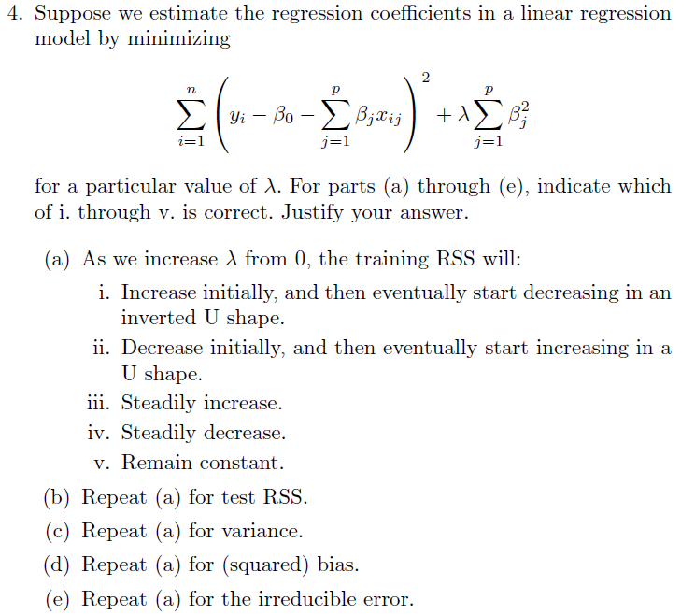
Sample Questions – Module 5
iii
ii
iv
iii
v

Slide 94
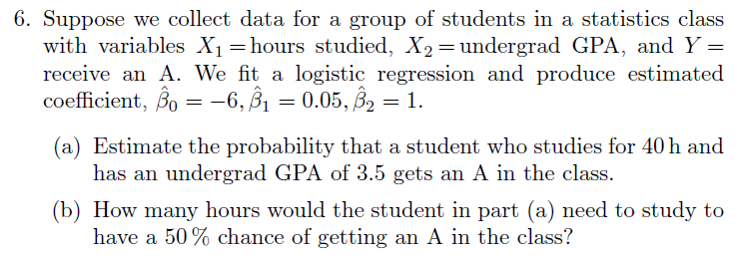
Sample Questions – Module 6

Slide 95
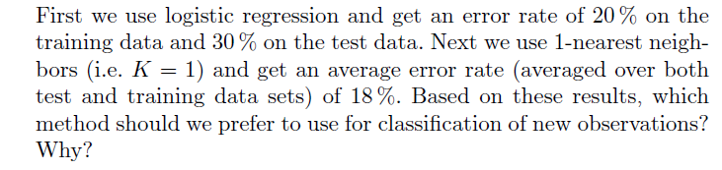
Sample Questions – Module 6

Slide 96
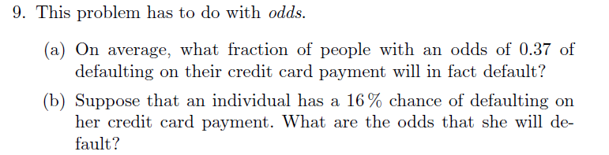


Sample Questions – Module 6
$$\frac{0.37}{1.37}$$
$$\frac{0.16}{(1−0.16)}$$

Slide 97
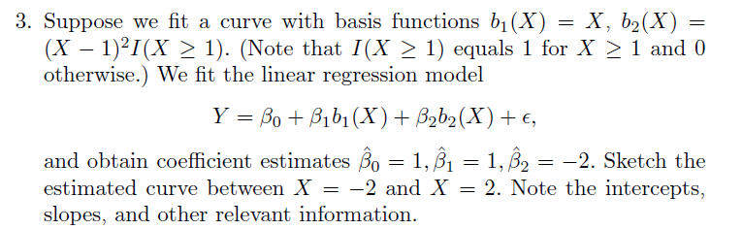
Sample Questions – Module 8

Slide 98
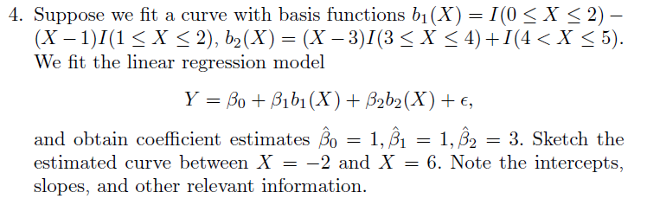
Sample Questions – Module 8

Slide 99
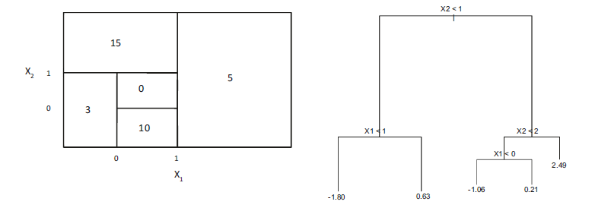
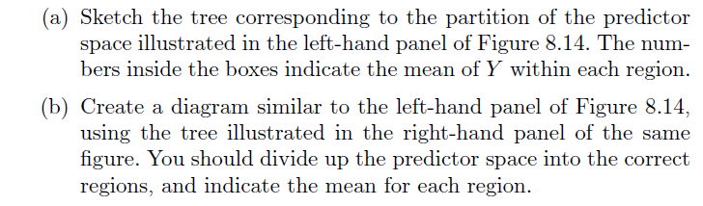
Sample Questions – Module 9

Slide 100
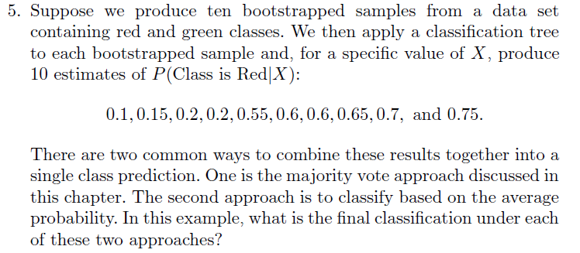
Sample Questions – Module 9

