Slide 1
ISE-529 Predictive Analytics
Midterm Preparation

Slide 2
Mid-Term
Logistics
Mid-term will be administered in class on Monday, July25
4:00PM – 5:30PM
Can be taken in class or remotely
Exam will be open-book/open-notes but must be done individually
Automated software will be used to identify identical responses
There will be a one-hour lecture after completion of the mid-term (5:45 – 6:45PM)

Slide 3
Mid-Term
Format
Mid-term will consist of short-answer questions to test your understanding of the theoretical concepts presented in module 1-4
Interpretation of model outputs and visualizations
Simple calculations that can be done manually of using Excel
Exam will be a PowerPoint file
Similar to homework assignments, you will download the PowerPoint exam file, enter your responses, save it to a PDF file format and upload it to Gradescope

Slide 4
Mid-Term
Module 1/2 Sample Question Types
Prediction vs inference - give examples and ask primary modeling objective
Matrix notation - give actual vectors and ask for components by their symbols
Bias/variance tradeoff
KNN / calculate misclassification rates

Slide 5
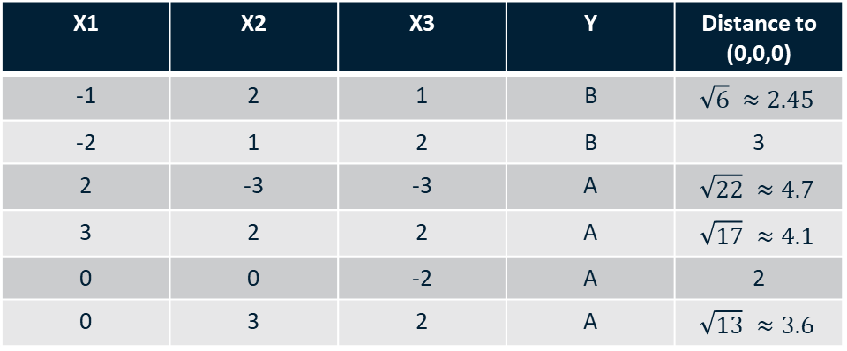
Problem 1
The training dataset for a simple KNN classification problem is given below:
X1 | X2 | X3 | Y | Distance to (0,0,0)
-1 | 2 | 1 | B | $$\sqrt{6} ≈2.45$$
-2 | 1 | 2 | B | 3
2 | -3 | -3 | A | $$\sqrt{22} ≈4.7$$
3 | 2 | 2 | A | $$\sqrt{17} ≈4.1$$
0 | 0 | -2 | A | 2
0 | 3 | 2 | A | $$\sqrt{13} ≈3.6$$
1A) Assume we are trying to use this dataset to make a prediction for Y when X1 = X2 = X3 = 0. Complete the “Distance to (0,0,0) Column” above using the Euclidian distance formula

Slide 6
Problem 1
1B) What would your prediction be with K = 1? A
1C) What would your prediction be with K = 3? B
1D) If the true decision boundary is highly non-linear (“curvy”) would you expect a higher or lower value for K to provide a better prediction? LOWER. Why? Lower values result in a closer fit to the data and a more complex model which would better fit a non-linear decision boundary. Higher values result in a “smoothed” boundary with fits best with a more linear decision boundary

Slide 7
Problem 2
You have created four regression models for a multidimensional datasets and plotted the test dataset residuals for each model on the following slides. Complete the following matrix by typing a to assess each model in terms of its relative variance and bias:
 | Low Variance | High Variance
Low Bias | F3 | F2
High Bias | F1 | F4
Of these four models, which would you select: F3

Slide 8
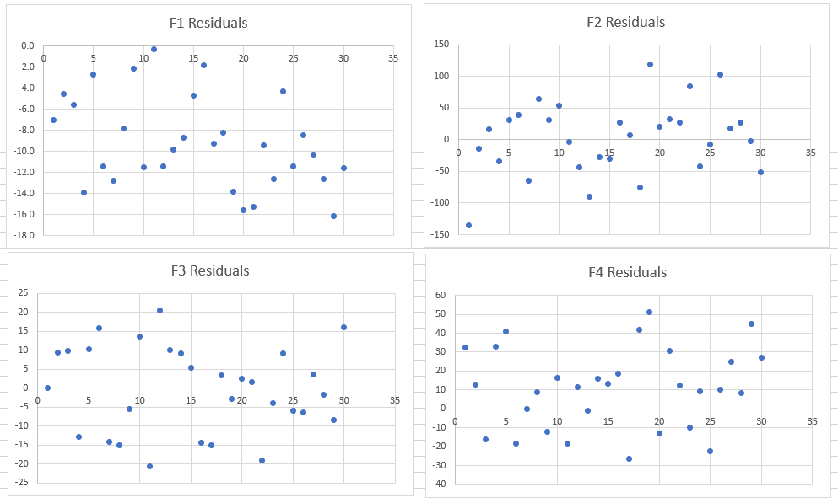
Problem 2

Slide 9
Mid-Term
Module 3 Sample Question Types
Four assumptions of a linear model
Write out equation from model coefficients
Understanding and interpreting inference issues in the presence of multicollinearity
Calculating various assessment statistics
Interpreting p-values, confidence intervals, and F-statistics from a model result
Interpreting and modeling interaction effects

Slide 10
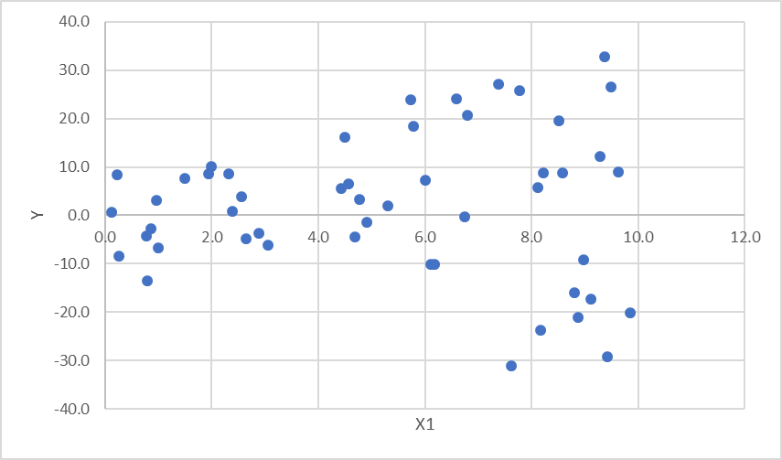
Problem 4
You are given a dataset with two inputs (X1 and X2) and one output (Y). X1 is a continuous attribute. X2 is a categorical attribute that has three possible values = “A”, “B”, or “C”. The scatter plot below shows Y plotted as a function of X1:

Slide 11
Problem 4
3A) How would you set up the equation for the linear regression?
$$Y=β_{0}+β_{1}X_{1}+β_{2}X_{2a}+β_{3}X_{2b}+ε$$

Slide 12
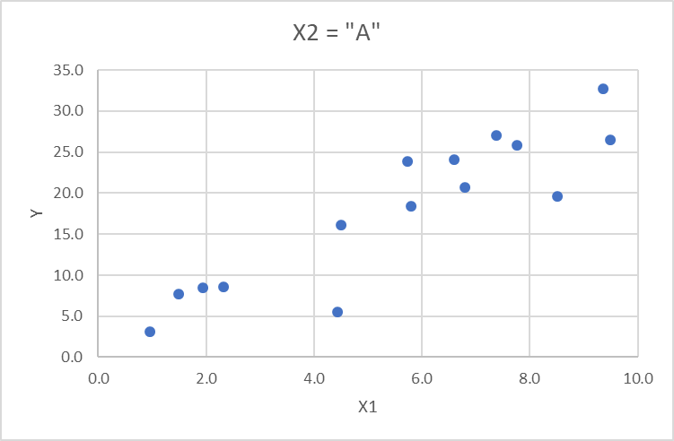
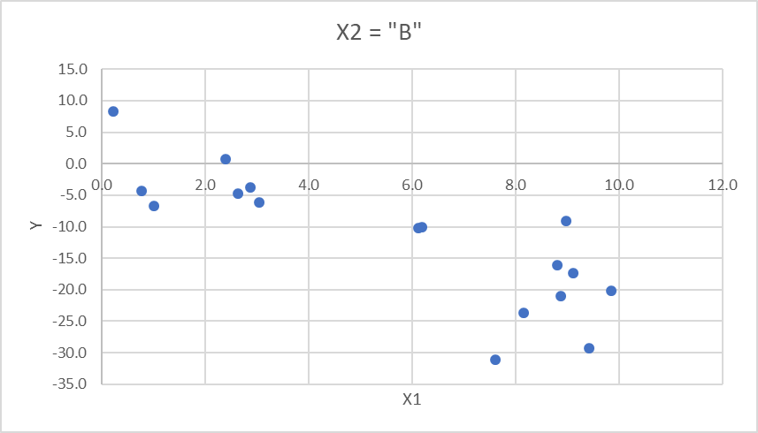
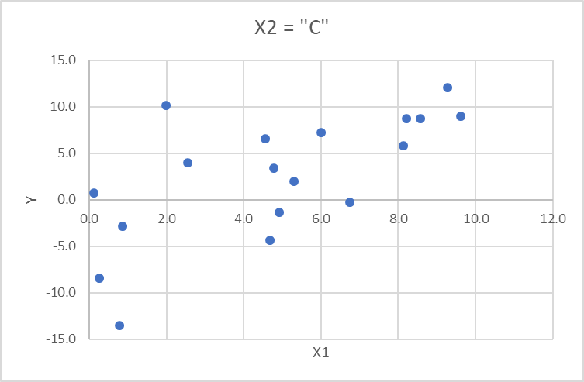
Problem 3
After tuning and evaluating your model, you are not happy with its performance. In attempt to understand what is going on, you plot scatter plots of Y plotted as a function of X1 for each of the three possible values of X2:

Slide 13
Problem 3
3B) What appears to be going on with your data?
There appears to be an interaction effect between X1 and X2
3C) How would you modify your equation for the linear regression based on this?
$$Y=β_{0}+β_{1}X_{1}+β_{2}X_{2a}+β_{3}X_{2b}+β_{4}{X_{1}X}_{2a}+β_{5}{X_{1}X}_{2b}+ε$$
Where $X_{2a}$=1 if $X_{2}$ = “A” and$X_{2b}$=1 if $X_{2}$ = “B” (and 0 otherwise)

Slide 14

Problem 4
You are evaluating the following four candidate regression functions:
F1: $Y=55,630.77+2591.30X_{1}+538.26X_{2}$
F2: $Y=79,130.07+537.38X_{1}+736.2X_{2}+19.54{X_{1}}^{2}$
F3: $Y=110,641.52−3174.0758X_{1}+561.356X_{2}+116.2{X_{1}}^{2}−0.64{X_{1}}^{3}$
F4: $Y=128,431.04−3360.13X_{1}−351.65X_{2}+118{{.62X}_{1}}^{2}−0.65{X_{1}}^{3}+9.59{X_{2}}^{2}$
The various assessment metrics for the training and test partitions are given on the following page.
Which model would you select and why? F2 – has the lowest test MSE and highest test $R^{2}$
Do any of the candidate models exhibit possible overfitting? If yes, which ones? Yes – Models F3 and F4

Slide 15
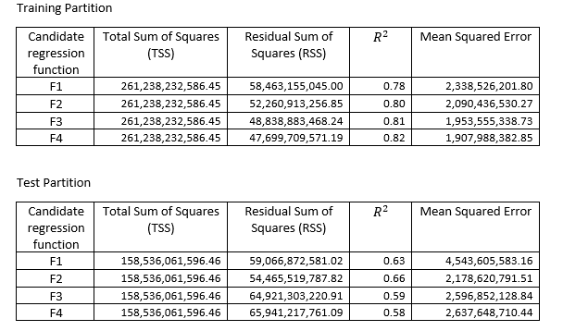
Problem 4

Slide 16
Mid-Term
Module 4 Sample Question Types
Diagnosing residuals
Interpreting residuals plots
Recommending ways to resolve
Manually calculating standard errors
Bootstrap aggregation techniques

Slide 17
Problem 2
The table below (and copied on the following page) shows a sample of 10 observations and then 10 bootstraps drawn from that sample. The mean, median, and sample standard deviation for the original sample and for each bootstrap is also provided. Use this information to complete the calculations on the following page. It may be helpful to copy this table into Excel.
Sample |  |  | Bootstrap 1 | Bootstrap 2 | Bootstrap 3 | Bootstrap 4 | Bootstrap 5 | Bootstrap 6 | Bootstrap 7 | Bootstrap 8 | Bootstrap 9 | Bootstrap 10
1 | 75 |  | 32 | 32 | 22 | 22 | 75 | 89 | 51 | 32 | 66 | 8
2 | 63 |  | 32 | 32 | 47 | 22 | 51 | 8 | 89 | 63 | 75 | 63
3 | 32 |  | 89 | 8 | 63 | 8 | 66 | 89 | 22 | 47 | 75 | 63
4 | 47 |  | 89 | 89 | 8 | 66 | 51 | 51 | 89 | 89 | 51 | 22
5 | 51 |  | 66 | 27 | 51 | 27 | 8 | 63 | 75 | 51 | 51 | 75
6 | 89 |  | 75 | 32 | 27 | 66 | 63 | 63 | 63 | 47 | 27 | 89
7 | 66 |  | 27 | 22 | 32 | 27 | 32 | 47 | 66 | 27 | 63 | 47
8 | 8 |  | 63 | 75 | 32 | 75 | 89 | 32 | 22 | 75 | 89 | 75
9 | 22 |  | 51 | 75 | 66 | 63 | 75 | 66 | 27 | 47 | 75 | 27
10 | 27 |  | 89 | 51 | 32 | 22 | 32 | 32 | 89 | 51 | 27 | 47
Mean | 48 |  | 61.3 | 44.3 | 38 | 39.8 | 54.2 | 54 | 59.3 | 52.9 | 59.9 | 51.6
Median | 49 |  | 64.5 | 32 | 32 | 27 | 57 | 57 | 64.5 | 49 | 64.5 | 55
Std Dev | 25.7 |  | 24.75 | 26.87 | 18.39 | 24.58 | 24.57 | 25.60 | 27.58 | 18.60 | 20.82 | 26.20

Slide 18
Problem 2
Sample |  |  | Bootstrap 1 | Bootstrap 2 | Bootstrap 3 | Bootstrap 4 | Bootstrap 5 | Bootstrap 6 | Bootstrap 7 | Bootstrap 8 | Bootstrap 9 | Bootstrap 10
1 | 75 |  | 32 | 32 | 22 | 22 | 75 | 89 | 51 | 32 | 66 | 8
2 | 63 |  | 32 | 32 | 47 | 22 | 51 | 8 | 89 | 63 | 75 | 63
3 | 32 |  | 89 | 8 | 63 | 8 | 66 | 89 | 22 | 47 | 75 | 63
4 | 47 |  | 89 | 89 | 8 | 66 | 51 | 51 | 89 | 89 | 51 | 22
5 | 51 |  | 66 | 27 | 51 | 27 | 8 | 63 | 75 | 51 | 51 | 75
6 | 89 |  | 75 | 32 | 27 | 66 | 63 | 63 | 63 | 47 | 27 | 89
7 | 66 |  | 27 | 22 | 32 | 27 | 32 | 47 | 66 | 27 | 63 | 47
8 | 8 |  | 63 | 75 | 32 | 75 | 89 | 32 | 22 | 75 | 89 | 75
9 | 22 |  | 51 | 75 | 66 | 63 | 75 | 66 | 27 | 47 | 75 | 27
10 | 27 |  | 89 | 51 | 32 | 22 | 32 | 32 | 89 | 51 | 27 | 47
Mean | 48 |  | 61.3 | 44.3 | 38 | 39.8 | 54.2 | 54 | 59.3 | 52.9 | 59.9 | 51.6
Median | 49 |  | 64.5 | 32 | 32 | 27 | 57 | 57 | 64.5 | 49 | 64.5 | 55
Std Dev | 25.7 |  | 24.75 | 26.87 | 18.39 | 24.58 | 24.57 | 25.60 | 27.58 | 18.60 | 20.82 | 26.20
Standard Error for Mean, calculated by the following methods:
Classical statistics: 8.13
Bootstrap: 8.26
Standard Error for Median, calculated by using the bootstrap:
14.65
80% Confidence Interval for Mean (using the bootstrap):
Lower Bound: 39.8
Upper Bound: 59.9
80% Confidence Interval for Median:
Lower Bound: 32
Upper Bound: 64.5

