Slide 1
ISE-529 Predictive Analytics
Mid-Term Examination – July 25, 2022

Slide 2
Instructions
You are to complete the exam by typing your answers into this PowerPoint as indicated.
You will have 90 minutes to complete the exam and submit it to GradeScope (in the same manner as done for homework assignments). Late submissions will be penalized.
The exam is open-book / open-notes. You may consult any resource except another person.
Good luck!

Slide 3
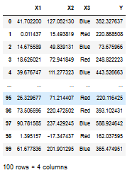
Problem 1
Linear Model Analysis
For this problem we will be working with the following dataset:

Slide 4
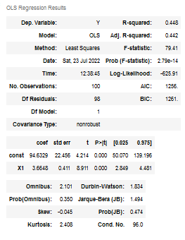
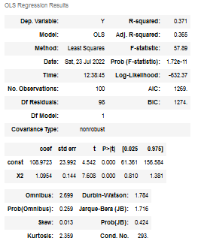
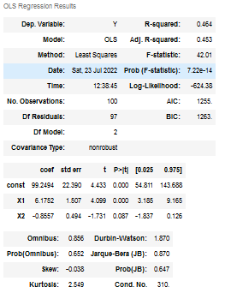
Problem 1
First, we create three models using X1, X2, and the combination of X1 & X2 to predict Y:

Slide 5
Problem 1
1A) For the two simple (single-predictor) models, are the predictors X1 & X2 significant?
1B) For the multiple regression model, which predictors are significant?
1C) How do you interpret what is going on here?

Slide 6
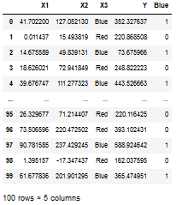
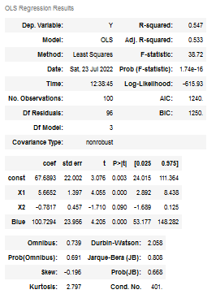
Problem 1
Now we incorporate the categorical variable into the model by creating a dummy variable “Blue” and incorporate it into the model as shown:

Slide 7
Problem 1
1D) Does adding this categorical variable to the model improve it’s overall performance? Why or why not?

Slide 8
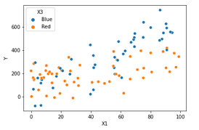
Problem 1
1E) Looking at this color-coded scatterplot of X1 vs Y, do you see any indication of an interaction effect between X1 and X3? Why or why not?

Slide 9
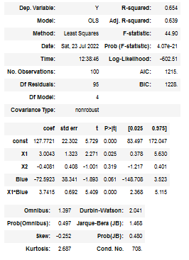
Problem 1
1E) Looking at these model results, do you see any indication of an interaction effect between X1 and X3? Why or why not?

Slide 10
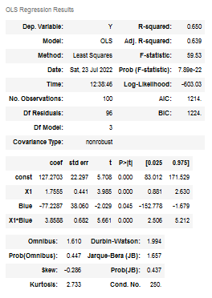
Problem 1
After completing your modeling analysis, you decide to use the model shown below:

Slide 11
Problem 1
1F) Write out the algebraic expression for this model (you do not need to include the error term):
1G) Write out the simplified algebraic expression for this model for the Blue observations
1H) Write out the simplified algebraic expression for this model for the Red observations

Slide 12

Problem 2
We have developed a model to predict the sales (in thousands of dollars) at a new store our company may decide to open in a new city and we define and fit a model with five predictors:
$X_{P}$: Population of the city (in thousands of people)
$X_{I}$: Average income of the city (in thousands of dollars per adult)
$X_{T}$: Type of store (1 for downtown store, 0 for a mall store)
$X_{PI}$: Interaction between population and average income (in thousands)
$X_{IT}$: Interaction between average income (in thousands) and store type
In the cities we are evaluating, the average income is generally less than $100,000 and the cities are in the size range of 0 – 500,000 people
After fitting this model using a linear regression, we get the following coefficients: ${\hat{β}}_{0}=10$, ${\hat{β}}_{P}=$ 20, ${\hat{β}}_{I}=$ 50, ${\hat{β}}_{T}=$ 350, ${\hat{β}}_{PI}=$ 0.05, ${\hat{β}}_{IT}=$ - 5

Slide 13
Problem 2
2a) Which answer is correct:
For a fixed value of population and average income, a downtown store would on average have greater sales than a mall store
For a fixed value of population and average income, a mall store would on average have greater sales than a downtown store
For a fixed value of population and average income, a downtown store would on average have more sales than a mall store provided that the average income is high enough
For a fixed value of population and average income, a mall store would on average have more sales than a downtown store provided that the average income is high enough
Response:

Slide 14
Problem 2
2B) What is the predicted sales for a downtown store in a city with a population of 100,000 and an average income of $50,000?
$
2C) Is this statement true or false and why: “Since the coefficient of the interaction term between population and average income is very small, there is very little evidence of an interaction effect:

Slide 15
Problem 2
2D) Which predictor has the larger impact on sales, income or city population? Explain your answer

Slide 16
Problem 3
You are assessing two candidate models (M1 through M4). You try training the models ten different times with different population samples and then assessing those models against test partitions by calculating their mean squared errors (MSE). The results of those tests are summarized on the following page.
Complete the figure on the bottom of the following page with one model for each of the four boxes.

Slide 17
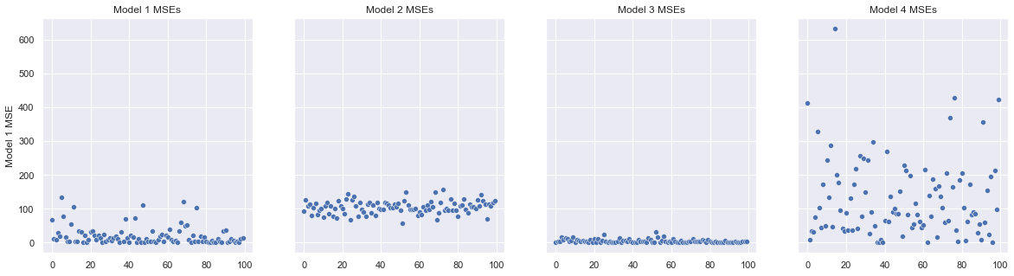
Problem 3
 | Low Variance | High Variance
Low Bias
High Bias

Slide 18
Problem 4
4A) Explain in your own words how k-fold cross-validation is implemented

Slide 19
Problem 4
4B) Provide one advantage and one disadvantage of k-fold cross validation relative to:
The validation set approach?
Advantage:
Disadvantage:
Leave-Out-One-Cross-Validation?
Advantage:
Disadvantage:

Slide 20
Problem 5
Residuals Analysis
The following pages present a residuals diagram and a residuals histogram for each of six different models. For each model, identify the apparent problem(s) with the model and provide one technique that you might use to remediate (correct) the problem.

Slide 21
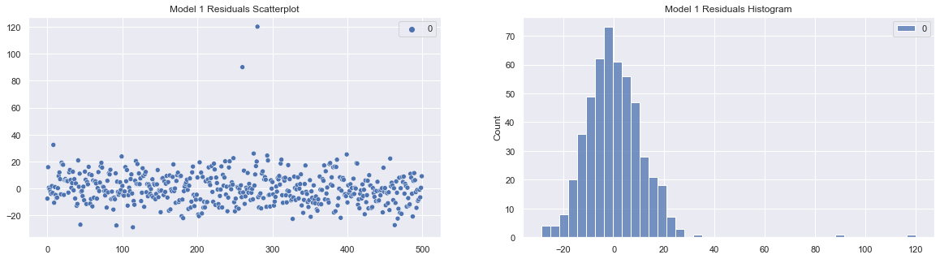
5A – Model 1
Residuals Analysis
Model Issue:
Possible remediation:

Slide 22
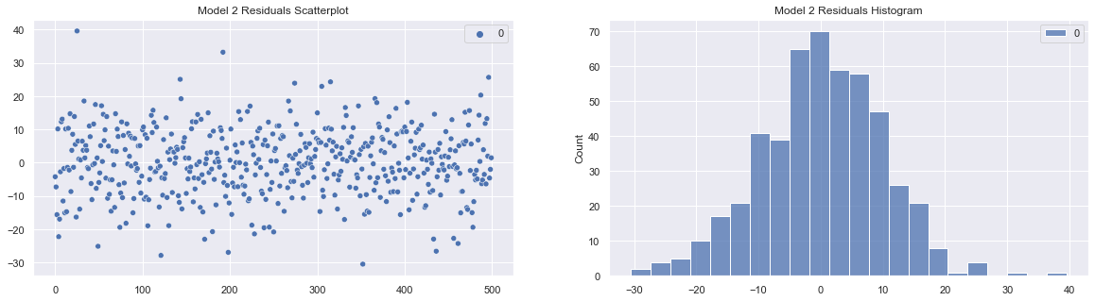
5A – Model 2
Residuals Analysis
Model Issue:
Possible remediation:

Slide 23
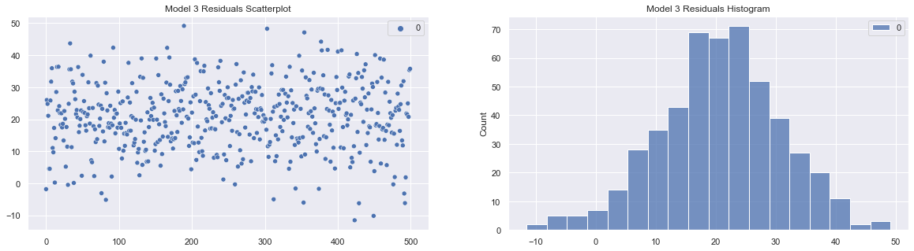
5A – Model 3
Residuals Analysis
Model Issue:
Possible remediation:

Slide 24
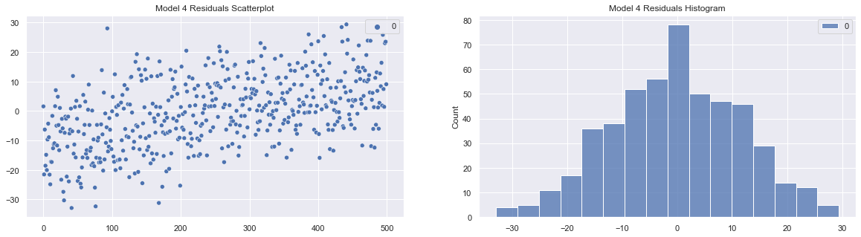
5A – Model 4
Residuals Analysis
Model Issue:
Possible remediation:

Slide 25
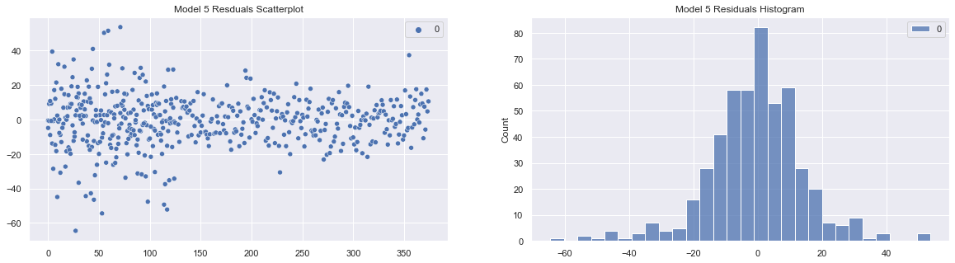
5A – Model 5
Residuals Analysis
Model Issue:
Possible remediation:

Slide 26
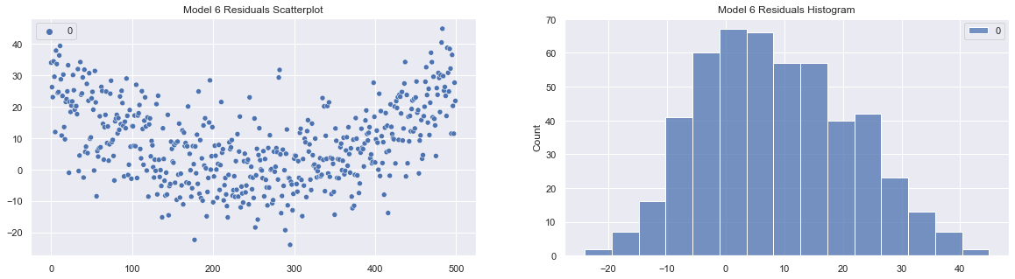
5A – Model 6
Residuals Analysis
Model Issue:
Possible remediation:

