Slide 1
ISE-529 Predictive Analytics
Mid-Term Examination – July 25, 2022

Slide 2
Instructions
You are to complete the exam by typing your answers into this PowerPoint as indicated.
You will have 90 minutes to complete the exam and submit it to GradeScope (in the same manner as done for homework assignments). Late submissions will be penalized.
The exam is open-book / open-notes. You may consult any resource except another person.
Good luck!

Slide 3
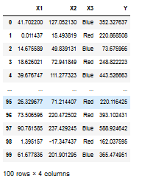
Problem 1
Linear Model Analysis
For this problem we will be working with the following dataset:

Slide 4
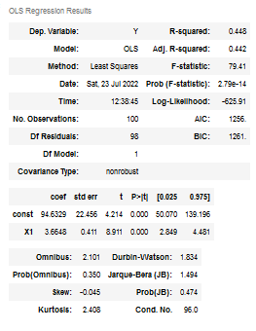
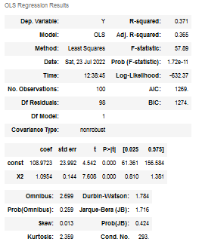
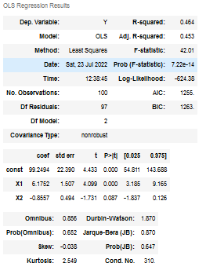
Problem 1
First, we create three models using X1, X2, and the combination of X1 & X2 to predict Y:

Slide 5
Problem 1
1A) For the two simple (single-predictor) models, are the predictors X1 & X2 significant?
Yes
1B) For the multiple regression model, which predictors are significant?
Only X1
1C) How do you interpret what is going on here?
It is likely that X1 and X2 are correlated and that X1 is the better predictor. Once the information from X1 is incorporated into the model, X2 is no longer significant

Slide 6
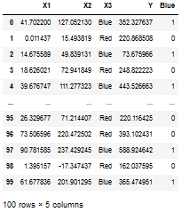
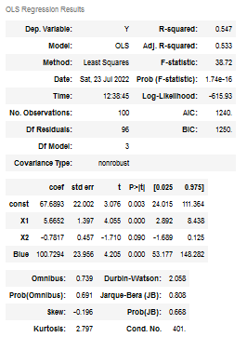
Problem 1
Now we incorporate the categorical variable into the model by creating a dummy variable “Blue” and incorporate it into the model as shown:

Slide 7

Problem 1
1D) Does adding this categorical variable to the model improve it’s overall performance? Why or why not?
Yes, we see that the model $R^{2}$ has improved from 0.464 to 0.547

Slide 8
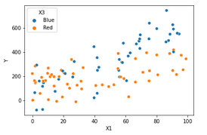
Problem 1
1E) Looking at this color-coded scatterplot of X1 vs Y, do you see any indication of an interaction effect between X1 and X3? Why or why not?
Yes, it appears that the slop of the lines for the blue and red observations may be different

Slide 9
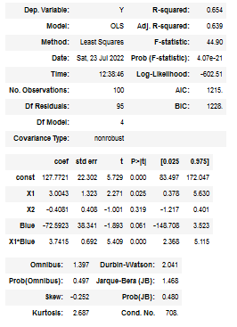
Problem 1
1E) Looking at these model results, do you see any indication of an interaction effect between X1 and X3? Why or why not?
Yes, the p-value for the interaction term is less than 0.05

Slide 10
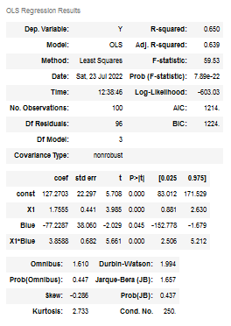
Problem 1
After completing your modeling analysis, you decide to use the model shown below:

Slide 11

Problem 1
1F) Write out the algebraic expression for this model (you do not need to include the error term):
$Y=127.3+1.76X1 −77.2∗Blue+3.86(X1∗Blue)$
1G) Write out the simplified algebraic expression for this model for the Blue observations
Y = 127.3 + 1.76X1 – 77.2 + 3.3X1
Y = 50.1 + 5.7X1
1H) Write out the simplified algebraic expression for this model for the Red observations
Y = 127.3 + 1.76X1

Slide 12

Problem 2
We have developed a model to predict the sales (in thousands of dollars) at a new store our company may decide to open in a new city and we define and fit a model with five predictors:
$X_{P}$: Population of the city (in thousands of people)
$X_{I}$: Average income of the city (in thousands of dollars per adult)
$X_{T}$: Type of store (1 for downtown store, 0 for a mall store)
$X_{PI}$: Interaction between population and average income (in thousands)
$X_{IT}$: Interaction between average income (in thousands) and store type
In the cities we are evaluating, the average income is generally less than $100,000 and the cities are in the size range of 0 – 500,000 people
After fitting this model using a linear regression, we get the following coefficients: ${\hat{β}}_{0}=10$, ${\hat{β}}_{P}=$ 20, ${\hat{β}}_{I}=$ 50, ${\hat{β}}_{T}=$ 350, ${\hat{β}}_{PI}=$ 0.05, ${\hat{β}}_{IT}=$ - 5

Slide 13
Problem 2
2a) Which answer is correct:
For a fixed value of population and average income, a downtown store would on average have greater sales than a mall store
For a fixed value of population and average income, a mall store would on average have greater sales than a downtown store
For a fixed value of population and average income, a downtown store would on average have more sales than a mall store provided that the average income is high enough
For a fixed value of population and average income, a mall store would on average have more sales than a downtown store provided that the average income is high enough
Response: D

Slide 14
Problem 2
2B) What is the predicted sales for a downtown store in a city with a population of 100,000 and an average income of $50,000?
$4,860K
2C) Is this statement true or false and why: “Since the coefficient of the interaction term between population and average income is very small, there is very little evidence of an interaction effect:
False. The scale of the interaction variable is much larger than the scales of the other predictors.

Slide 15
Problem 2
2D) Which predictor has the larger impact on sales, income or city population? Explain your answer
The population variable has a scale that is 5 times greater than the income variable. Thus, after scaling, the effect of population is approximately twice as large as income.

Slide 16
Problem 3
You are assessing four candidate models (M1 through M4). You try training the models ten different times with different population samples and then assessing those models against test partitions by calculating their mean squared errors (MSE). The results of those tests are summarized on the following page.
Complete the figure on the bottom of the following page with one model for each of the four boxes.

Slide 17
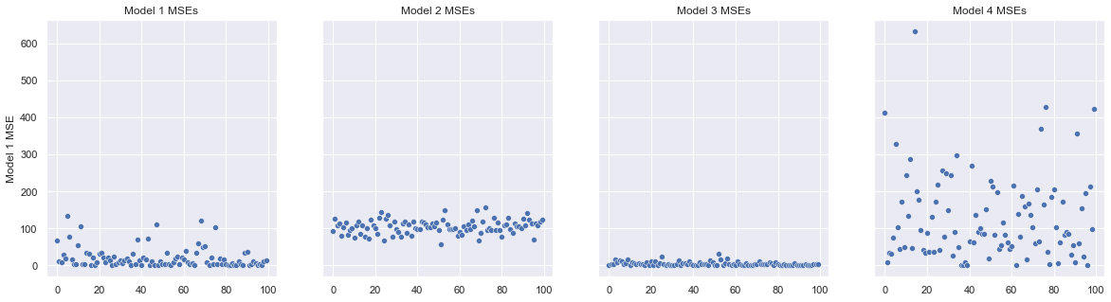
Problem 3
 | Low Variance | High Variance
Low Bias | M3 | M1
High Bias | M2 | M4

Slide 18
Problem 4
4A) Explain in your own words how k-fold cross-validation is implemented
The dataset is divided into K equal-sized parts
One at a time, one of the parts is held out for validation and the other K-1 are used for training
The overall assessment is the weighted average of each of the individual assessments

Slide 19
Problem 4
4B) Provide one advantage and one disadvantage of k-fold cross validation relative to:
The validation set approach?
Advantage: K-fold CV uses more of the available data for training (with decreased bias)
Disadvantage: K-fold CV is more computationally expensive
Leave-Out-One-Cross-Validation?
Advantage:
K-fold CV is less computationally expnsive
K-fold CV has lower model variance (because each training iteration with LOOCV uses almost the same dataset
Disadvantage: K-fold CV has greater bias due to using less data for training

Slide 20
Problem 5
Residuals Analysis
The following pages present a residuals diagram and a residuals histogram for each of six different models. For each model, identify the apparent problem(s) with the model and provide one technique that you might use to remediate (correct) the problem.

Slide 21
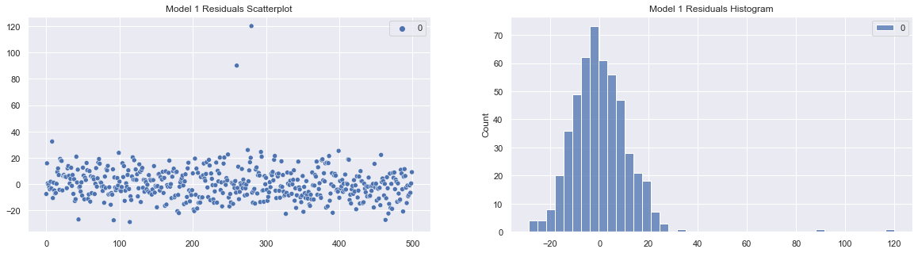
5A – Model 1
Residuals Analysis
Model Issue: Model has outliers
Possible remediation: Remove outliers or otherwise deal with them

Slide 22
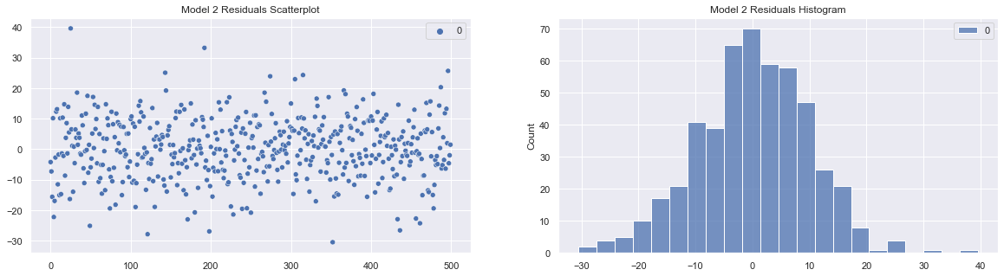
5A – Model 2
Residuals Analysis
Model Issue: No apparent issues
Possible remediation: N/A

Slide 23
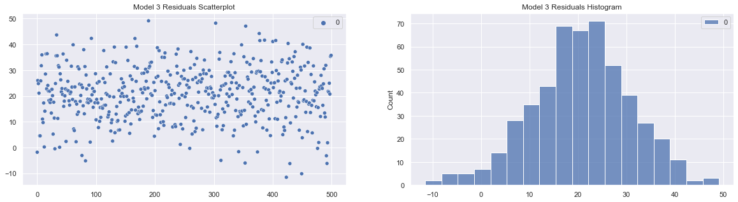
5A – Model 3
Residuals Analysis
Model Issue: Model has a positive bias term. The residuals appear to be centered at around 20 instead of 0
Possible remediation: Include missing variable or perform transformation

Slide 24
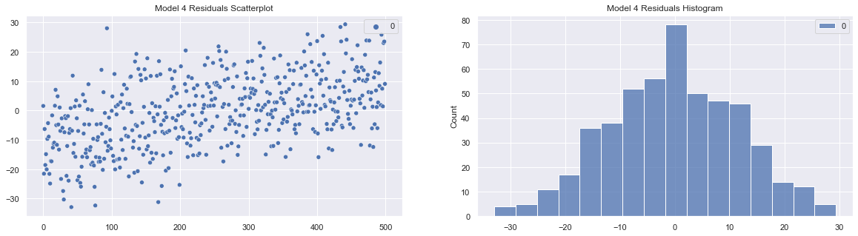
5A – Model 4
Residuals Analysis
Model Issue: Residuals are not independent (pattern to the data)
Possible remediation: Include missing variable or perform transformation

Slide 25
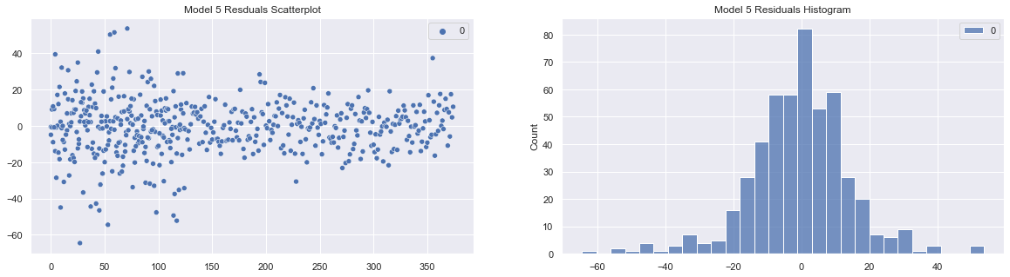
5A – Model 5
Residuals Analysis
Model Issue: Heteroscadicity
Possible remediation: Perform transformation

Slide 26
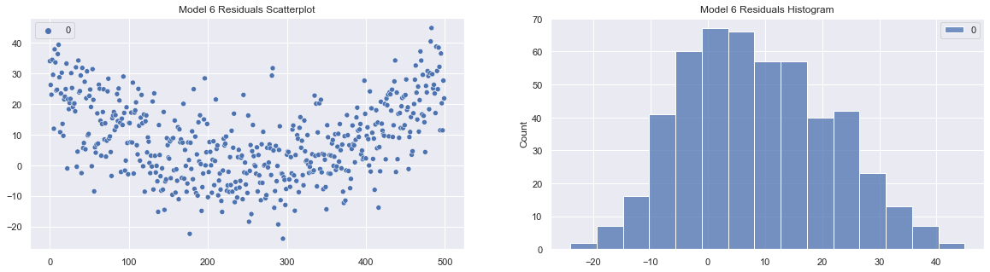
5A – Model 6
Residuals Analysis
Model Issue: Residuals are not independent (pattern to the data)
Possible remediation: Include missing variable or perform transformation

