Slide 1
Module 5: Linear Model Selection and Regularization
Material primarily drawn from ISLR Chapter 6

Slide 2
Overview
This module addresses how to identify the appropriate set of predictors to use in a model
In general, our objectives are:
Improve prediction accuracy in situations with large numbers of predictors relative to the number of observations
Improve model interpretability by removing irrelevant features
Note: these techniques are presented in the context of linear models, but they can be used with a wide range of model types

Slide 3

Overview
Linear Model Prediction Accuracy
Provided the true relationship is approximately linear, the least squares estimates will have low bias
If $n≫p$, then least squares estimates tend to have low variance
Rule of thumb is you need 10-20 times as many observations as predictors for reasonable performance
If $n$ is not much more than $p$, there can be a lot of variance resulting in overfitting and poor predictions
How about if $p>n$?
Then, there is no longer a unique least squares coefficient so the variance is infinite

Slide 4

Overview
Three Approaches
Subset selection
Identifying a subset of the $p$ predictors that we believe are best related to the response
Shrinkage methods
Use all $p$ predictors, but use techniques to shrink the estimated coefficients towards zero (also referred to as regularization)
Dimension reduction
Project the $p$ predictors into an M-dimensional subspace where $M<p$

Slide 5
Subset Selection

Slide 6
Subset Selection Approaches
Best subset selection
Stepwise selection
Choosing the optimal model

Slide 7

Best Subset Selection
Fit a separate regression model to all possible combinations of the $p$ predictors

Slide 8

Best Subset Selection
Basic Procedure
Let $ℳ_{0}$ denote the null model which contains no predictors
Thus, the model simply predicts the sample mean for every observation
For $k=1,2,…, p$:
Fit all $\left(\begin{matrix}p \\ k\end{matrix}\right)$ possible models that contain exactly $k$ predictors
Pick the best among these models (smallest training RSS or, equivalently, largest $R^{2}$) and call it $ℳ_{k}$.
Select a single best model from among $ℳ_{0},ℳ_{1},…ℳ_{p}$
Several candidate techniques for making this selection

Slide 9
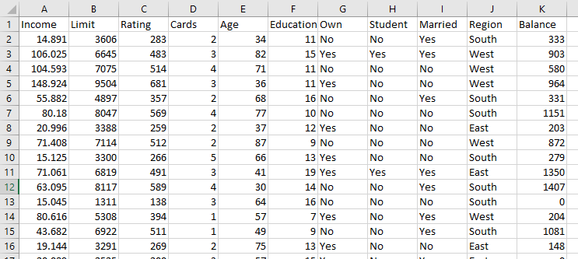


Credit Example
$$p=11$$
(Region has 3 levels, so it becomes 2 predictors
$$n=400$$

Slide 10
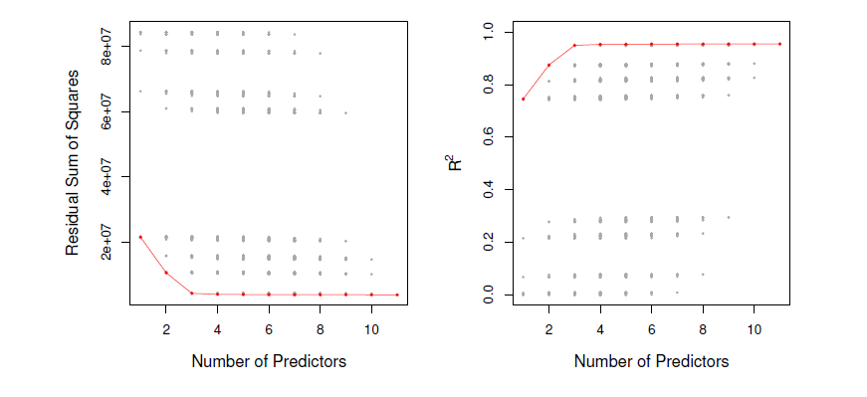

Credit Example
All possible p=4 models
$ℳ_{4}$

Slide 11


Stepwise Selection
For computational reasons, best subset selection cannot be applied with very large $p$. Why not?
Also, such a large model search space can lead to overfitting and high variance of the coefficient estimates
For both of these reasons, stepwise methods, which limit the number of models evaluated, are generally employed
$2^{p}$ possible models

Slide 12
Forward Stepwise Selection
Begins with a model containing no predictors and adds predictors to the model one at a time until all predictors are in the model
At each step, the variable that gives the greatest additional improvement to the fit is added

Slide 13

Forward Stepwise Selection
Basic Procedure
Let $ℳ_{0}$ denote the null model which contains no predictors
Thus, the model simply predicts the sample mean for every observation
For $k=1,2,…, p$:
Consider all $p−k$ models that augment the predictors in $ℳ_{k}$ with one additional predictor
Pick the best among these models (smallest training RSS or, equivalently, largest $R^{2}$) and call it $ℳ_{k+1}$.
Select a single best model from among $ℳ_{0},ℳ_{1},…ℳ_{p}$
Several candidate techniques for making this selection

Slide 14
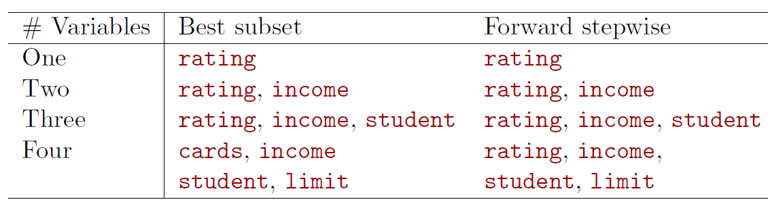
Forward Stepwise Selection
Not Guaranteed to Find Best Possible Models
Credit data set example:

Slide 15

Backward Stepwise Selection
Begins with a model containing all $p$ predictors and removes predictors from the model one at a time until all predictors are in the model
At each step, the variable that gives the least additional improvement to the fit is removed

Slide 16

Backward Stepwise Selection
Basic Procedure
Let $ℳ_{p}$ denote the full model with contains all $p$ predictors
For $k=p, p−1, …, 1$:
Consider all $k$ models that contain all but one of the predictors in $ℳ_{k}$, for a total of $k−1$ predictors
Pick the best among these models (smallest training RSS or, equivalently, largest $R^{2}$)and call it $ℳ_{k−1}$
Select a single best model from among $ℳ_{0},ℳ_{1},…ℳ_{p}$
Several candidate techniques for making this selection

Slide 17

Choosing the Optimal Model
Model containing all of the predictors will always have largest training $R^{2}$and smallest RSS
We wish to choose model with low test error, not model with low training error
Therefore, RSS and $R^{2}$ are not suitable for selecting the best model among a collection of models with different numbers of predictors

Slide 18
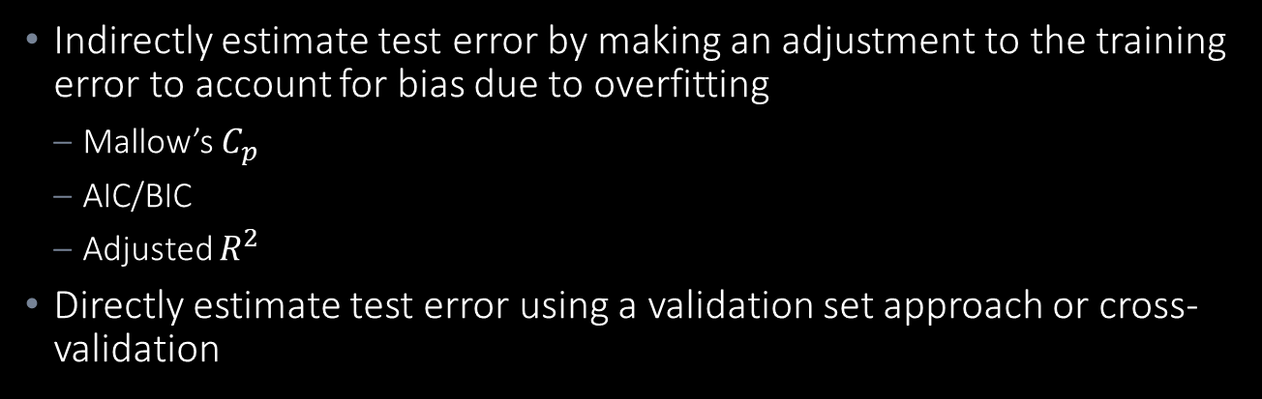
Choosing the Optimal Model
Two Approaches
Indirectly estimate test error by making an adjustment to the training error to account for bias due to overfitting
Mallow’s $C_{p}$
AIC/BIC
Adjusted $R^{2}$
Directly estimate test error using a validation set approach or cross-validation
Statistical approach that measures information loss in fitted model. Objective is to minimize.
Computational approach
Why would we ever not want to directly estimate test error??

Slide 19
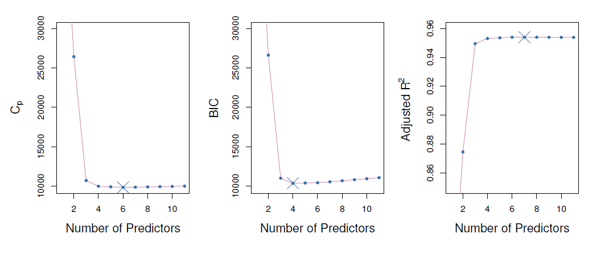
Choosing the Optimal Model
Credit Data Example - Indirect Approaches

Slide 20


Indirect Approaches
Mallow’s $C_{p}$
“Penalty” term for larger numbers of predictors
$$C_{p}=\frac{1}{n}(RSS+2d{\hat{σ}}^{2})$$
where $d$ is the total number of parameters used and ${\hat{σ}}^{2}$ is an estimate of the variance of the error $ε$ associated with each response measurement (often difficult to estimate)

Slide 21

Indirect Approaches
AIC/BIC
AIC is defined for the large class of models fit by maximum likelihood:
$$AIC=−2logL+2d$$
where $L$ is the maximized value of the likelihood function for the estimated model
Note: it can be shown for a linear model that $−2logL= \frac{RSS}{{\hat{σ}}^{2}}$, so AIC and $C_{p}$ are equivalent

Slide 22

Indirect Approaches
AIC/BIC
Similar to AIC:
$BIC=\frac{1}{n}(RSS+\log\left(n\right)d$ ${\hat{σ}}^{2})$
Note: BICC replaces the $2d{\hat{σ}}^{2}$ term in the $C_{p}$ measure with $\log\left(n\right)d$ ${\hat{σ}}^{2}$
Since $\log{n>2}$ for any $n>7$, the BIC statistic places a heavier penalty on models with many variables, generally resulting in smaller models than $C_{p}$

Slide 23

Indirect Approaches
Adjusted $R^{2}$
Reminder:
$R^{2}$ is the proportion of the variation in $Y$ that is explained by variation in $X_{1}$, $X_{2}$, …, $X_{p}$
$$R^{2}=1 − \frac{Residual Sum of Squares \left(RSS\right)}{Total Sum of Squares \left(TSS\right)}=1 − \frac{{\sum_{i=1}^{n}{(y_{i}−{\hat{y}}_{i})}}^{2}}{{\sum_{i=1}^{n}{(y_{i}−\overline{y})}}^{2}}$$
“Penalty” term for larger numbers of predictors (p)
Adjusted $R^{2}=1 − \frac{RSS/(n−p−1)}{TSS/(n−1)}$

Slide 24

Indirect Approaches
Adjusted $R^{2}$
Advantages:
Don’t need to estimate ${\hat{σ}}^{2}$
Works with models where $p>n$
Easier to understand among non-statisticians

Slide 25

Direct Approach
Validation and Cross-Validation
Generally, the preferred approach if there is enough observations relative to the number of predictors
Doesn’t require an estimate of the error variance ${\hat{σ}}^{2}$
Also, doesn’t require the number of predictors ($p$) which is significant for model types where the number of predictors is not obvious
See Module 4 PPT for details on this approach

Slide 26
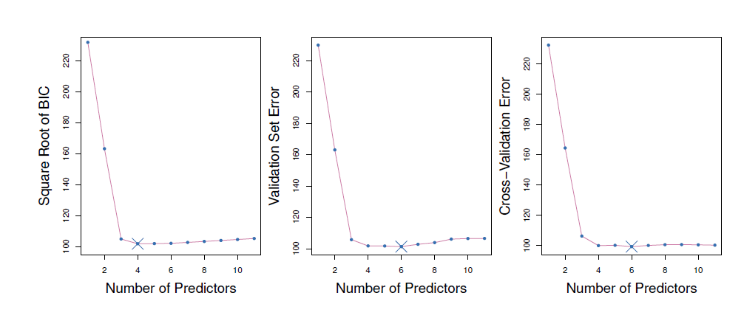
Credit Data Example

Slide 27
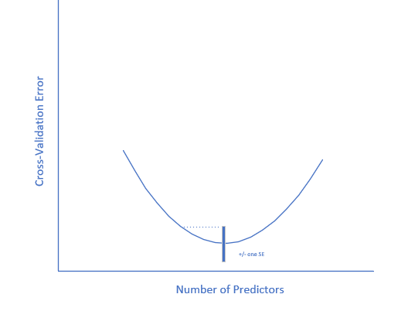
“One Standard Error Rule”
Calculate the standard error of the lowest point on the curve
Remember, for example that a 10-fold cross validation RSS score is the average of 10 estimates and we can find its standard error
Select the smallest model for which the estimated test error is within one standard error of the lowest point on the curve:
Select this model

Slide 28
Shrinkage Methods

Slide 29
Shrinkage Methods
Overview
Subset selection methods involve using least squares to fit a linear model that contains a subset of the predictors
That is, they attempt to find models with a subset of the predictors that in some manner improve on the test RSS or, equivalently, MSE
Shrinkage methods take a different approach
Objective is to reduce model variance

Slide 30

Shrinkage Methods
Background and Rationale
Two reasons for building regression models:
Prediction
Inference (understanding relationship between variables)
Measured by test MSE
Interpreted by assessing the $β_{j}$ coefficients

Slide 31

Shrinkage Methods
Background and Rationale
$β_{j}$ coefficients are themselves random variables, and thus have
Expected values
Variances (how much do our coefficient estimates change when we take a different set of training data?)
Overall model accuracy is thus influenced by the variance in the $β_{j}$ coefficients

Slide 32

Shrinkage Methods
Background and Rationale
Causes of high $β_{j}$ variance:
Correlated predictors (multicollinearity)
Large number of predictors (high dimensional data)
Shrinkage regression models attempt to reduce this variance by reducing the number of predictors
The two most popular of these techniques are ridge regression and the lasso

Slide 33
Ridge Regression and the Lasso

Slide 34
Ridge Regression and LASSO
Background
Modifications to the linear regression “loss function” (function we are trying to minimize when fitting the model) to automate the process of driving regression coefficients of high-VIF factors towards zero

Slide 35



Ridge Regression and LASSO
Loss Functions
$$Min SSE=\sum_{i=1}^{n}{{(y_{i}−{\hat{y}}_{i} )}^{2}}$$
Linear Regression
$$Min SSE=\sum_{i=1}^{n}{{(y_{i}−{\hat{y}}_{i} )}^{2}}+ λ\sum_{j=1}^{p}{{β_{j}}^{2}}$$
Ridge Regression
These terms prevent large regression coefficients
$$Min SSE=\sum_{i=1}^{n}{{(y_{i}−{\hat{y}}_{i} )}^{2}}+ λ\sum_{j=1}^{p}{|β_{j}|}$$
LASSO Regression

Slide 36
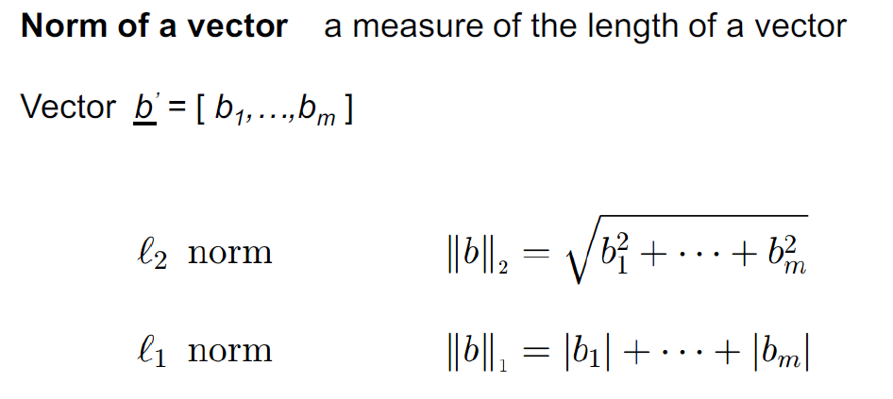
Ridge Regression and LASSO
Mathematical Background: Vector Norms

Slide 37
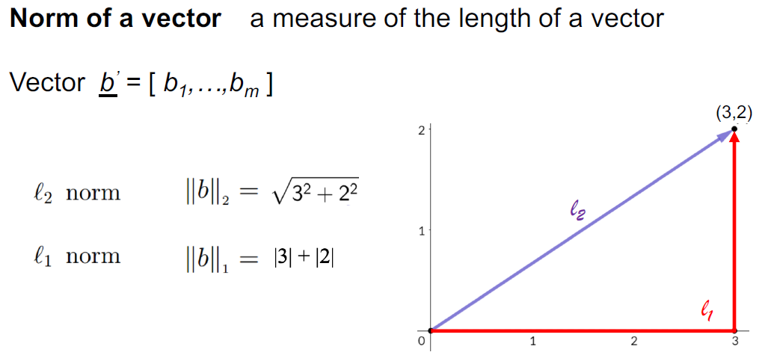
Ridge Regression and LASSO
Mathematical Background: Vector Norms

Slide 38
Ridge Regression and LASSO
Loss Functions
$$Min SSE=\sum_{i=1}^{n}{{(y_{i}−{\hat{y}}_{i} )}^{2}}$$
Linear Regression
$$Min SSE=\sum_{i=1}^{n}{{(y_{i}−{\hat{y}}_{i} )}^{2}}+ λ\sum_{j=1}^{p}{{β_{j}}^{2}}$$
Ridge Regression
“L2 Regularization”
$$Min SSE=\sum_{i=1}^{n}{{(y_{i}−{\hat{y}}_{i} )}^{2}}+ λ\sum_{j=1}^{p}{|β_{j}|}$$
LASSO Regression
“L1 Regularization”

Slide 39

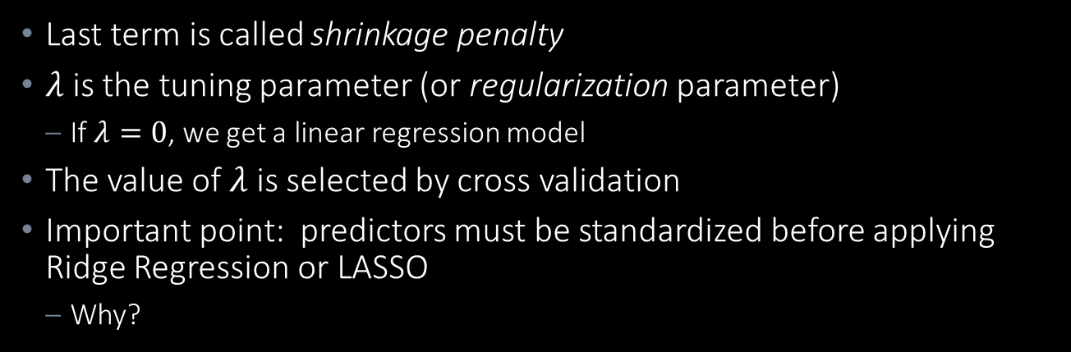
Ridge Regression and LASSO
Loss Functions
Last term is called shrinkage penalty
$λ$ is the tuning parameter (or regularization parameter)
If $λ=0$, we get a linear regression model
The value of $λ$ is selected by cross validation
Important point: predictors must be standardized before applying Ridge Regression or LASSO
Why?
Standardized by its standard deviation
$${\tilde{x}}_{ij}=\frac{x_{ij}}{\sqrt{\frac{1}{n}\sum_{i=1}^{n}{{(x_{ij}−{\overline{x}}_{j})}^{2}}}}$$

Slide 40

Background: Scaling
There are two basic types of scaling:
Normalization
Values shifted and re-scaled so they range between 0 and 1 (“min-max scaling)
$$X^{′}=\frac{X − X_{min}}{X_{max}−X_{min}}$$
Standardization
Values are centered around a mean (typically, 0) with a unit standard deviation
“Number of standard deviations from the mean:
$$X^{′}=\frac{X−μ}{σ}$$

Slide 41
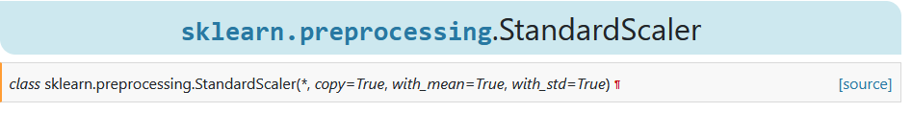
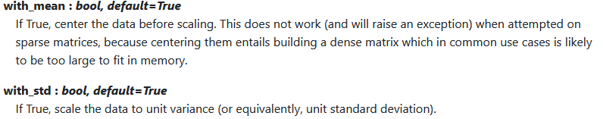
A Note on Standardization
Background on “Standardizing”
There are two basic components to standardization:
Mean removal (setting the mean = 0)
Variance scaling (scaling the variable to represent the number of standard deviations from the man)
The recently updated Scikit scaling parameter for ridge regression and Lasso has been changed from “normalize” to “StandardScalar” which has options for both of these operations:

Slide 42


A Note on Standardization
We note that the formula for standardization is given here (and in our text) as:
This scales the predictor to be the “number of standard deviations from 0”
A legitimate question is whether it is better to standardize the predictor to be the “number of standard deviations from its mean”:
$${\tilde{x}}_{ij}=\frac{x_{ij}}{\sqrt{\frac{1}{n}\sum_{i=1}^{n}{{(x_{ij}−{\overline{x}}_{j})}^{2}}}}$$
$${\tilde{x}}_{ij}=\frac{x_{ij}−{\overline{x}}_{j}}{\sqrt{\frac{1}{n}\sum_{i=1}^{n}{{(x_{ij}−{\overline{x}}_{j})}^{2}}}}$$

Slide 43
A Note on Standardization
Back to Ridge Regression
Back to the question … for Ridge Regression, should we scale the variance and subtract the mean or just scale the variance?
We need to think about what we are trying to try to accomplish:
Ensuring that the Ridge Regression loss function is “fair” – the predictors that are “shrunk” to zero or near-zero are not just driven there because of their scale being low (and, thus, their coefficients being larger)
Given this, it seems obvious that we want to standardize by the variance AND subtract the mean …

Slide 44
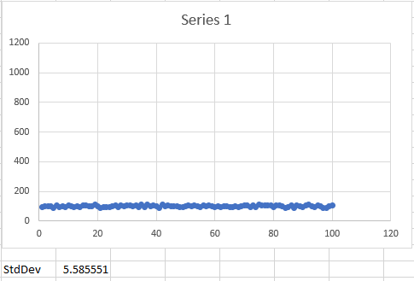
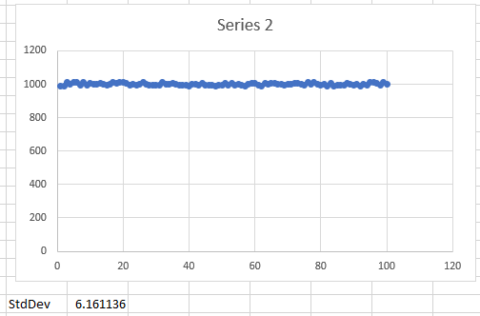
A Note on Standardization
Back to Ridge Regression
Two series with the same variance standardization, but different means
If we don’t subtract out the means, we will end up with Series 2 predictors having ten times the “weight” in the loss function as Series 1 (and, thus, much more likely to be “shrunk” out of the model

Slide 45
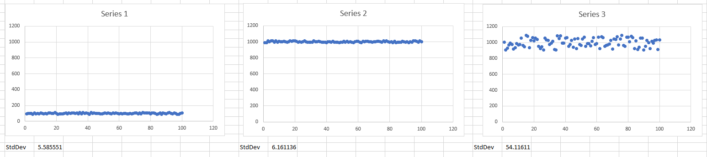
A Note on Standardization
Back to Ridge Regression
However, … if we standardize all the means to zero, we lose a lot of interpretability of the coefficients
What does it mean for a coefficient to be positive or negative??
Also, back to our example, if one predictor is scaled 10X a second predictor, would its standard deviation not also likely be scaled?

Slide 46


A Note on Standardization
Back to Ridge Regression
So, what do we do, subtract out the mean or not?
$${\tilde{x}}_{ij}=\frac{x_{ij}}{\sqrt{\frac{1}{n}\sum_{i=1}^{n}{{(x_{ij}−{\overline{x}}_{j})}^{2}}}}$$
$${\tilde{x}}_{ij}=\frac{x_{ij}−{\overline{x}}_{j}}{\sqrt{\frac{1}{n}\sum_{i=1}^{n}{{(x_{ij}−{\overline{x}}_{j})}^{2}}}}$$

Slide 47
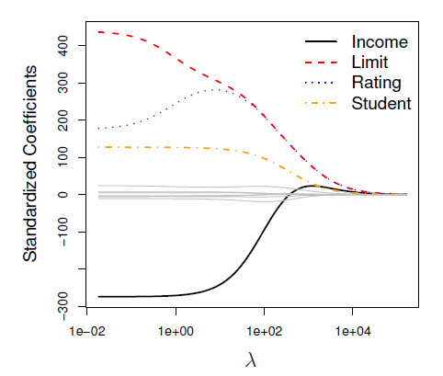
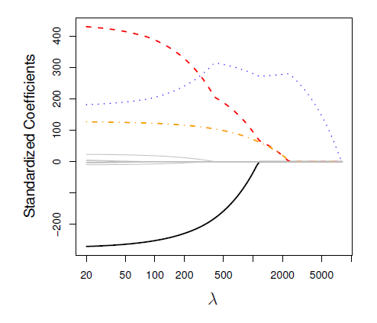


Ridge Regression and LASSO
Credit Data Example
Ridge Regression
LASSO
Higher $λ$ values drive many coefficients “towards 0”
Higher $λ$ values drive many coefficients to 0

Slide 48


Ridge Regression and LASSO
Why Does LASSO Drive Coefficients to Zero and Not Ridge Regression?
It can be shown that the ridge regression and lasso solve the problems:
$minimize\left\{\sum_{i=1}^{n}{{(y_{i}−{\hat{y}}_{i} )}^{2}}\right\}$ subject to $\sum_{j=1}^{p}{{β_{j}}^{2}<s}$
$minimize\left\{\sum_{i=1}^{n}{{(y_{i}−{\hat{y}}_{i} )}^{2}}\right\}$ subject to $\sum_{j=1}^{p}{|β_{j}|<s}$
Where $s$ is a function of $λ$

Slide 49
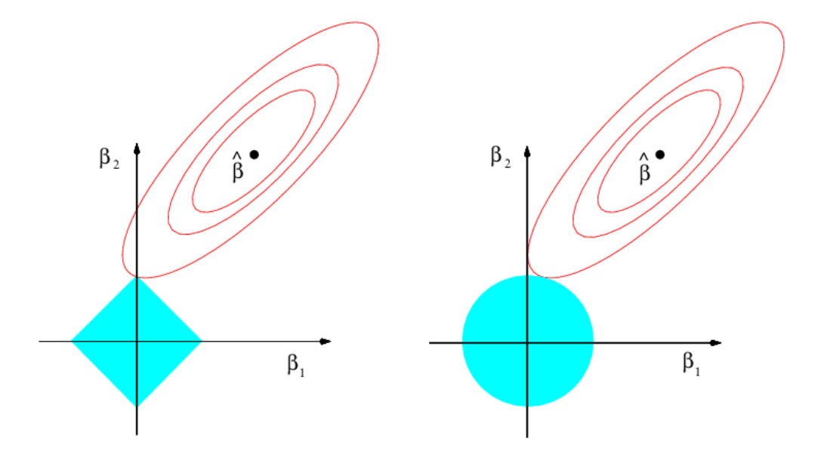


Ridge Regression and LASSO
Why Does LASSO Drive Coefficients to Zero and Not Ridge Regression?
$$\sum_{j=1}^{p}{|β_{j}|<s}$$
$\sum_{j=1}^{p}{{β_{j}}^{2}<s}$

Slide 50
Python Example

Slide 51
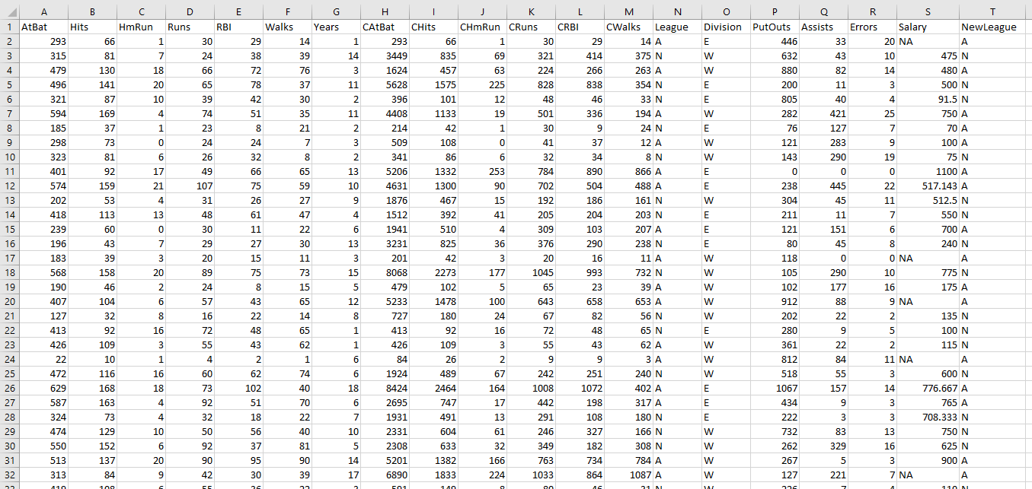
Ridge Regression Python Example
Hitters.csv Dataset
Response Variable
19 Predictors

Slide 52

Ridge Regression Python Example
Approach
Fit 100 ridge regression models with ${10}^{−2}<λ<{10}^{10}$ and plot the coefficients as a function of $λ$
Use a traditional validation partition approach to find an optimal value of $λ$
Use a cross-validation approach to find an optimal value of $λ$

Slide 53
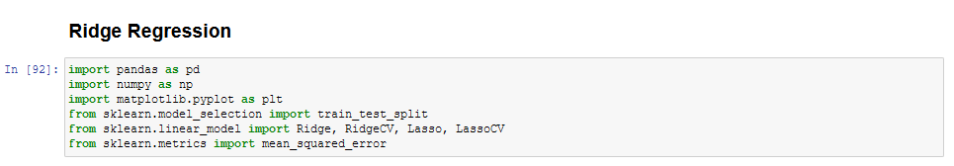
Ridge Regression Python Example
Set Up Dataframe for Modeling

Slide 54
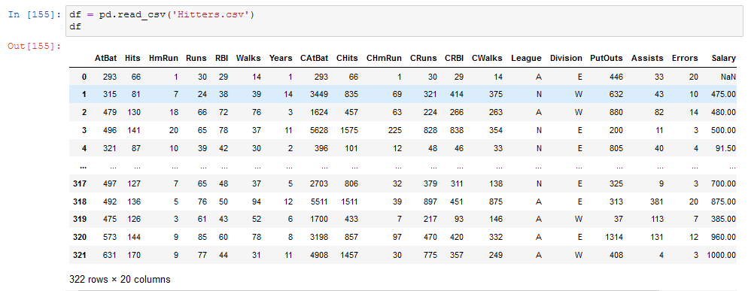
Ridge Regression Python Example
Set Up Dataframe for Modeling

Slide 55
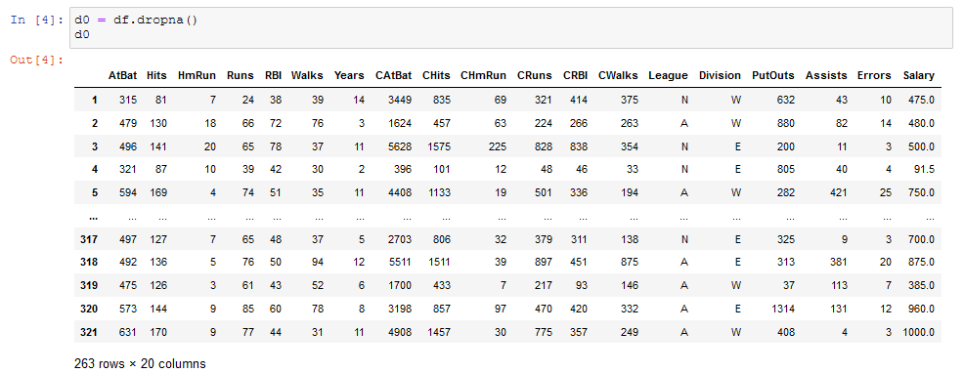
Ridge Regression Python Example
Drop Records With NaN for Salary

Slide 56
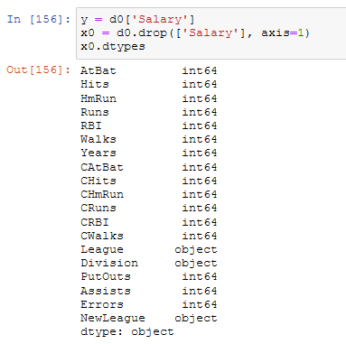
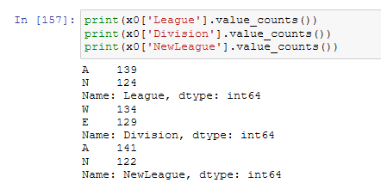
Ridge Regression Python Example
Handle Categorical Variables

Slide 57
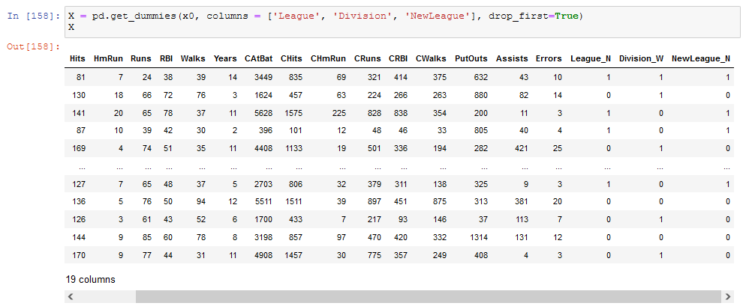
Ridge Regression Python Example
Handle Categorical Variables

Slide 58
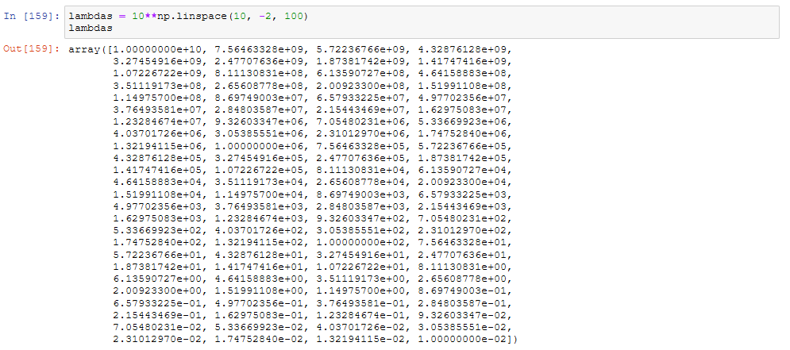
Ridge Regression Python Example
Create an Array of 100 Lambda Values from 0.01 to 10^10

Slide 59
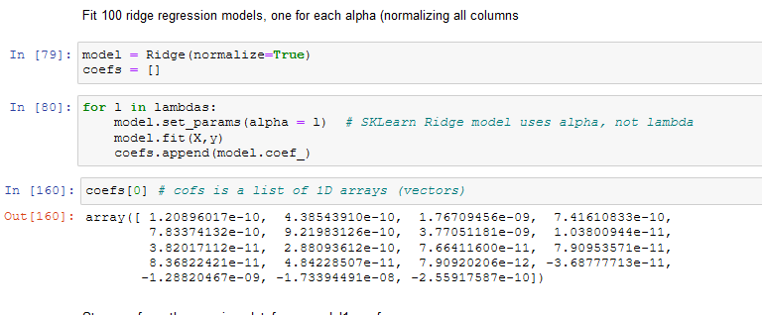
Ridge Regression Python Example
Use the Array of Lambdas to Fit 100 Models

Slide 60
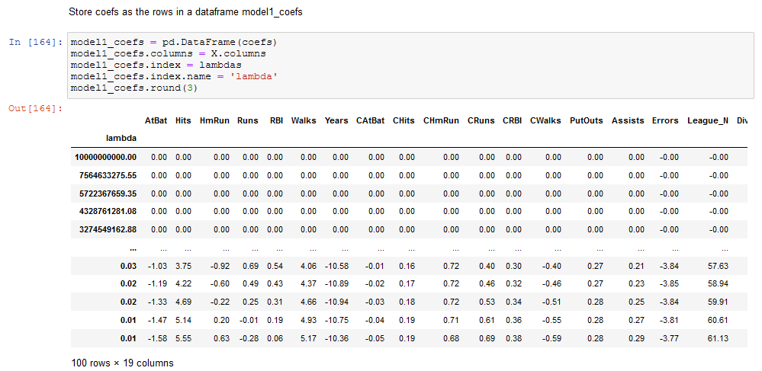
Ridge Regression Python Example
Create a Dataframe of the Model Coefficients for Each Lambda

Slide 61
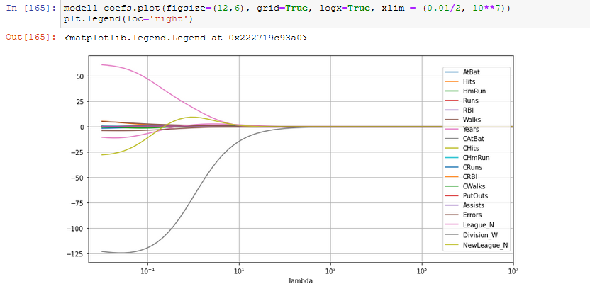
Ridge Regression Python Example
Plot the Model Coefficients as a Function of Lambda
All coefficients shrink to zero as lambda increases. Why??
19 curves – one for each predictor
“Over shrinking”

Slide 62
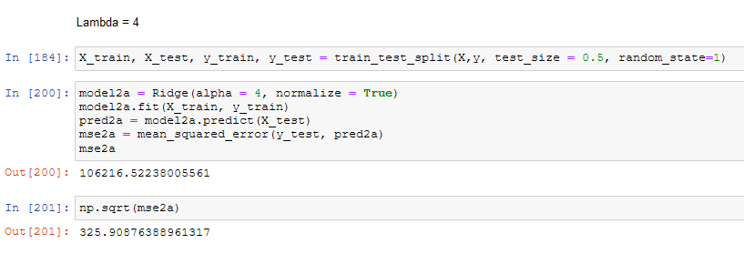
Ridge Regression Python Example
Evaluate Model With Lambda = 4
sklearn uses “alpha” terminology, not lambda

Slide 63
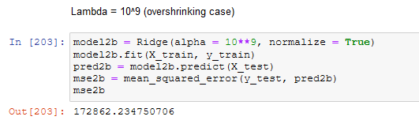
Ridge Regression Python Example
Evaluate Model With Lambda = 1,000,000,000

Slide 64
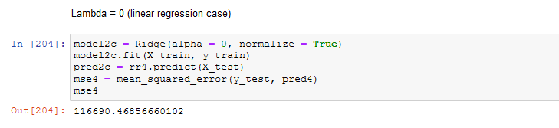
Ridge Regression Python Example
Evaluate Model With Lambda = 0

Slide 65
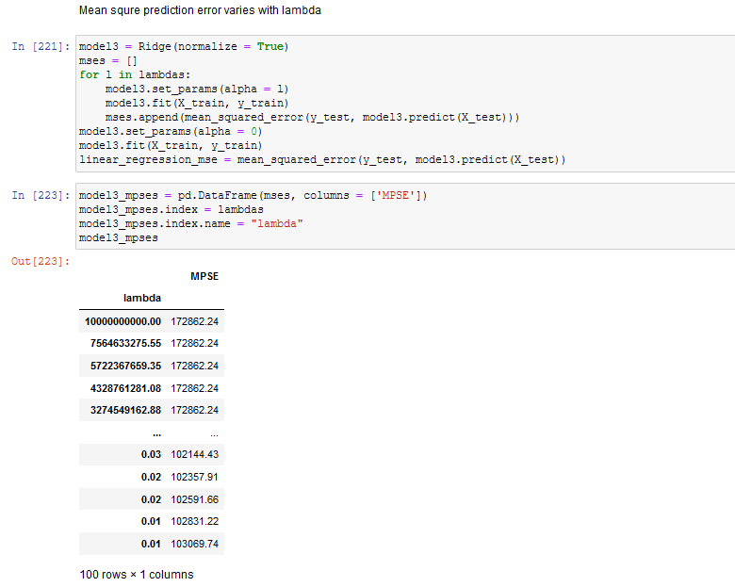
Ridge Regression Python Example
MSE as a Function of Lambda

Slide 66
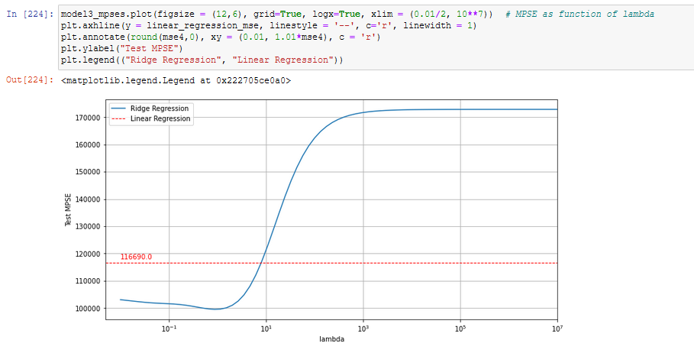
Ridge Regression Python Example
Plot MSPE as a Function of Lambda
Best Lambda

Slide 67
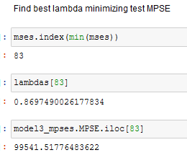
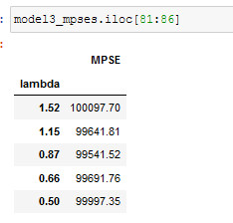
Ridge Regression Python Example
Find Best Lambda Minimizing Test MSPE

Slide 68
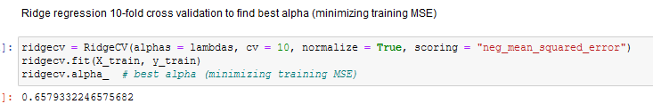
Ridge Regression Python Example
Use 10-Fold Cross Validation to Find Best Lambda

Slide 69
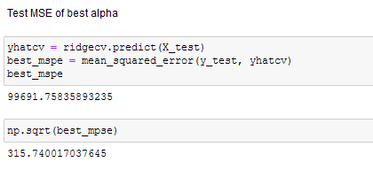
Ridge Regression Python Example
Use 10-Fold Cross Validation to Find Best Lambda

Slide 70
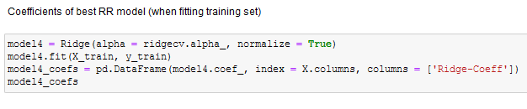
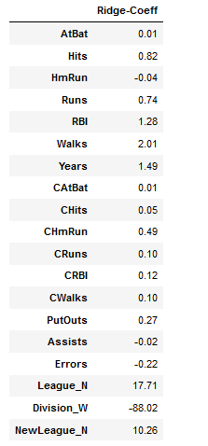
Ridge Regression Python Example
Use 10-Fold CV With Training Data to Find Best Lambda

Slide 71
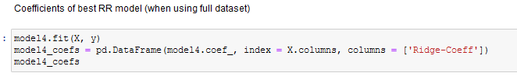
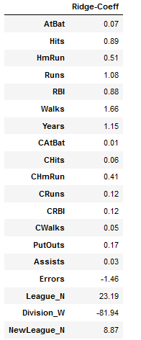
Ridge Regression Python Example
Use 10-Fold CV With Full Dataset to Find Best Lambda

Slide 72
A Note on Using Both Test/Training Partitions and CV
Although CV techniques can be used as an alternative to a simple test/training partition approach, when used to fit the hyperparameters of a model (in this case, lambda), it is a best practice to use both.
Recall that it is frequently useful to partition a dataset into three partitions:
Training partition – used to fit the model
Validation partition – used to select the best model
Test partition – used to assess the performance of the final chosen model. USED ONLY ONCE at the end of the process for assessment only

Slide 73
A Note on Using Both Test/Training Partitions and CV
It is particularly important to have the third test partition when you are using the validation data to make decisions among many different models
When we are using cross-validation to select a hyperparameter (in this case, lambda), we are doing exactly that – looking at many different models and comparing them
Thus, it is a best practice to save a final “hold-out” set as depicted in the graphics on the next two pages

Slide 74
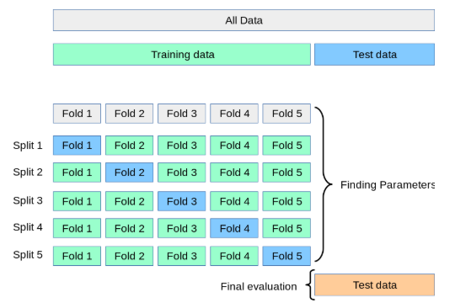
A Note on Using Both Test/Training Partitions and CV
Best Practice When Selecting Hyperparameters (Lambda)

Slide 75
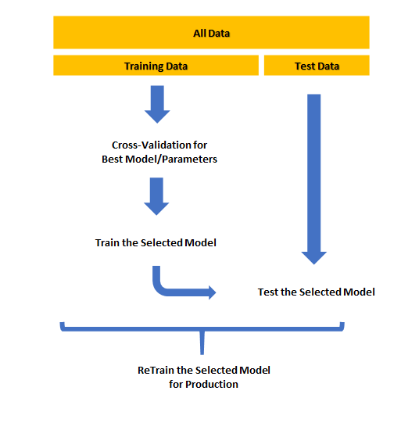
A Note on Using Both Test/Training Partitions and CV
Best Practice When Selecting Hyperparameters (Lambda)

Slide 76
Dimension Reduction

Slide 77
Dimension Reduction
As previously discussed, high dimensionality (large number of variables) that include redundant (correlated) inputs can degrade your analysis:
Destabilizes parameter estimates
Increases risk of overfitting
Confounds interpretation
Increases computation time
Increases scoring effort
Increases cost of data collection and augmention

Slide 78
Dimension Reduction
Feature Engineering - Objectives
Simplify models
Shorter training times
Improved generalization
Greater ability to visualize feature space

Slide 79
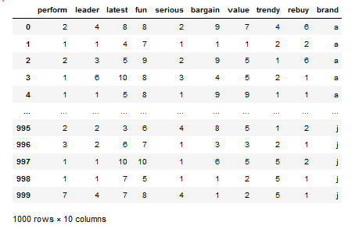
Reducing Data Complexity
Introductory Example – brand_ratings.csv
Consumer brand perception survey results on coffee brands
Scores of 1 to 10 on questions such as “How trendy is brand a”?

Slide 80
Brand Rating Example
Survey Questions
Perceptual Adjective (Column Name | Survey Question
Perform | Brand has strong performance
Leader | Brand is a leader in the field
Latest | Brand is fun
Fun | Brand has the latest products
Serious | Brand is serious
Bargain | Brand products are a bargain
Value | Brand products are a good value
Trendy | Brand is trendy
Rebuy | I would buy from Brand again

Slide 81

Reducing Data Complexity
Brand Rating Example

Slide 82

Brand Rating Example
Rescaling the Data
Good practice to rescale the raw data by subtracting the mean and dividing by the standard deviation.

Slide 83

Brand Rating Example
Correlation Matrix
Order the variables by “similarity”

Slide 84

Brand Rating Example
Aggregate Mean Ratings by Brand

Slide 85

Brand Rating Example
Aggregate Mean Ratings by Brand
Which brand attributes appear to be similar when viewed across brand averages?

Slide 86
Brand Rating Example
Motivating Objective
Given that there appear to be three basic underlying attributes, how can we summarize and quantify these underlying attributes in a way that retains most of the important information but reduces the number of dimensions from nine to three?

Slide 87
Dimension Reduction
Feature Engineering Techniques
Feature engineering (or feature extraction) creates new features (predictors) from the initial set of data. The objective is to encapsulate the central properties of a dataset and represent it in a low-dimensional space
Principal Components Analysis (PCA)
Singular Value Decomposition
Exploratory Factor Analysis (EFA)
Clustering

Slide 88
Principal Components Analysis

Slide 89
Principal Components Analysis
Introduction
A classic statistical technique invented in 1901
In data science, it is used to reduce the dimensionality (number or relevant attributes) of a dataset for visualization and modeling purposes
Attempts to identify attributes that have significance covariance and use those relationships to reduced the number of dimensions in the data while minimizing the loss of information. For example:
In the CARS dataset, there is high covariance between length and weight
High covariance is expected between restaurant checks and tips

Slide 90
Principal Components Analysis
Objectives
Combine multiple numeric predictor variables into a smaller set of variables which are a linear combination of or the original sets
Smaller set of variables are referred to as “principal components”
Objective is to select this smaller set so as to “explain” most of the variability in the full set
Basic idea is that each of the $n$ observations lies in a $p$-dimensional space, but not all of these dimensions are equally interesting.
PCA attempts to find a lower-dimensional representation of the data that contains the maximum amount of “interesting” information

Slide 91

Principal Components Analysis
Basic Principle

Slide 92
Principal Components Analysis
Approach
The first principal component ($Z_{1}$) of a set of attributes $X_{1}, X_{2}, …, X_{p}$ is the normalized set of features
$$Z_{1}=φ_{11}X_{1}+φ_{21}X_{2}+…+φ_{p1}X_{p}$$
that has the largest variance
by normalized we mean that $\sum_{j=1}^{p}{{φ_{j1}}^{2}}=1$
The elements $φ_{11},…,φ_{p1}$ are referred to as the loadings of the first principal component

Slide 93

PCA Example
Second principal component line
First principal component line
For the first principal component, we are looking for the line that minimizes the sum of the squared distances from the line to each point
The second and subsequent principal components are similarly defined with the additional constraint that it must be uncorrelated with the other previously defined principal components

Slide 94

PCA Example

Slide 95

First Principal Component
First principal component is highly correlated with both population and ad spending, and thus summarizes these two predictors well

Slide 96

Second Principal Component
Very little relationship with the second principal component

Slide 97
Data Preparation Best Practices

Slide 98
Data Preparation Best Practices
Common Data Problems
Data Problem | Best Practice

