Slide 1
Module 7: Generalized Linear Models
ISE-529
Material largely drawn from ISLR Chapter 4.6

Slide 2
Generalized Linear Models
Overview
Thus far, we have considered two types of response variables:
Quantitative (measures)
Qualitative (categories)
Not all types of models fit neatly into these two categories

Slide 3
Generalized Linear Models
Overview
We will look at the Bikeshare data set
Response variable: “bikers” – number of hourly users of a bike sharing program in Washington, DC
Predictors:
month (month of the year)
hr (hour of the day from 0-23)
temp (normalized temperature in Celsius)
weathersit (qualitative variable with one of four possible values – “clear”, “misty or cloudy”, “light rain or light snow”, “heavy rain or heavy snow”

Slide 4
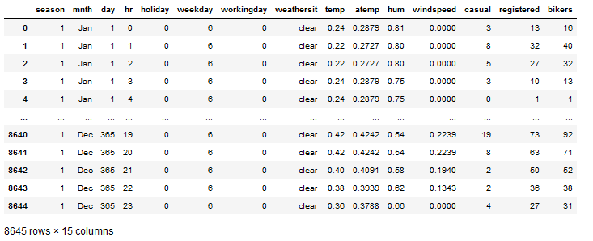
Generalized Linear Models
Bikeshare Dataset
Predictor variables
Response variable

Slide 5
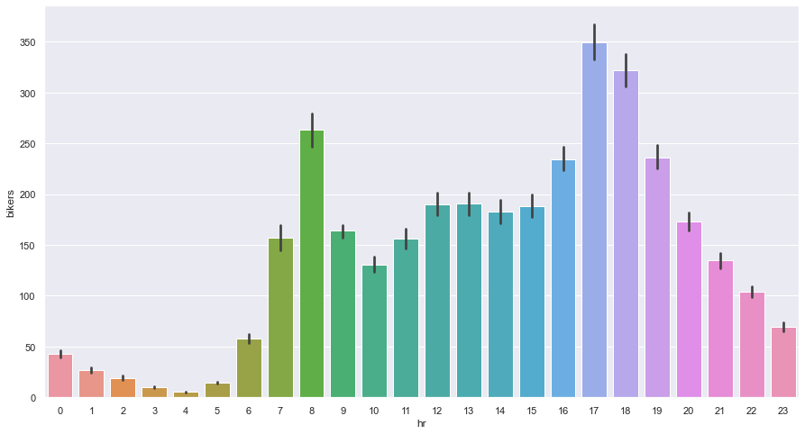
Bikeshare Dataset
Set Up Linear Regression Model
Would you treat “hour” as a category or a measure?

Slide 6
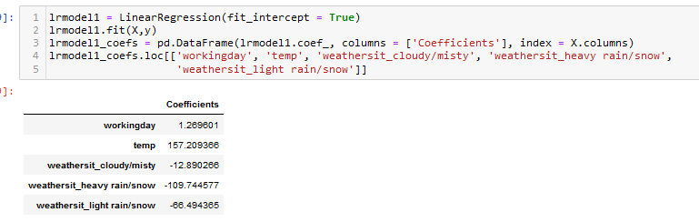
Bikeshare Dataset
Linear Regression Model
Does this look reasonable?

Slide 7
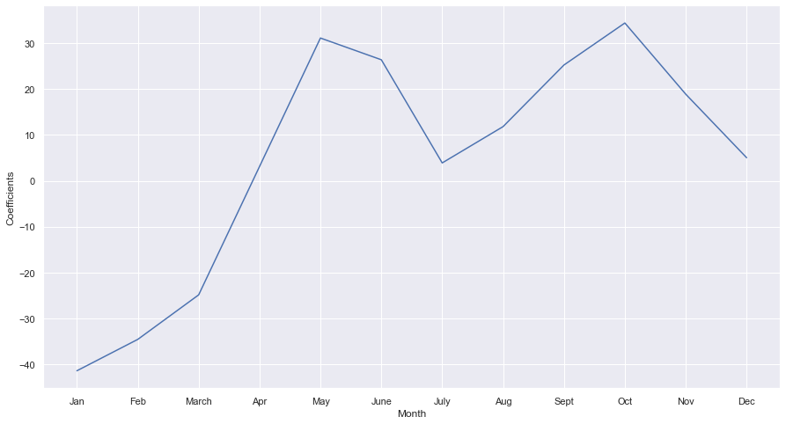
Bikeshare Dataset
Linear Regression Model – Month Coefficients
Does this look reasonable?

Slide 8
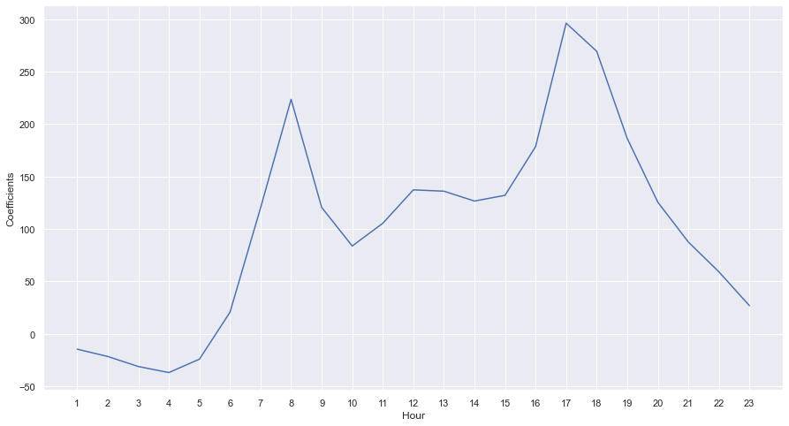
Bikeshare Dataset
Linear Regression Model – Hour Coefficients
Does this look reasonable?

Slide 9
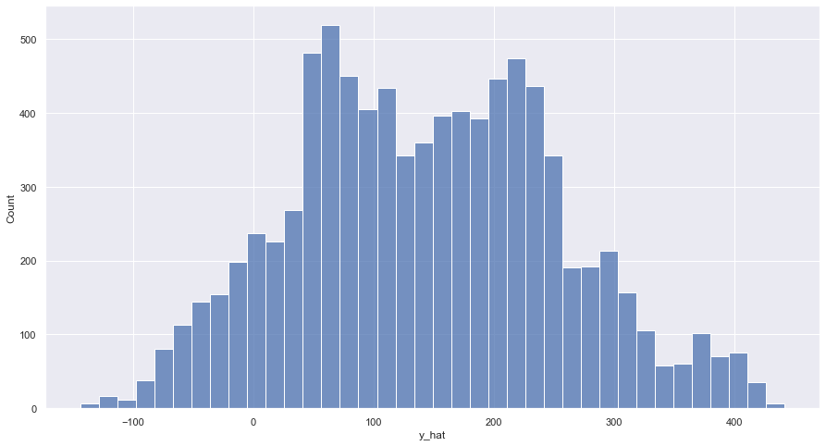
Bikeshare Data
Linear Regression Model - Predictions Histogram
What issue do you see?

Slide 10
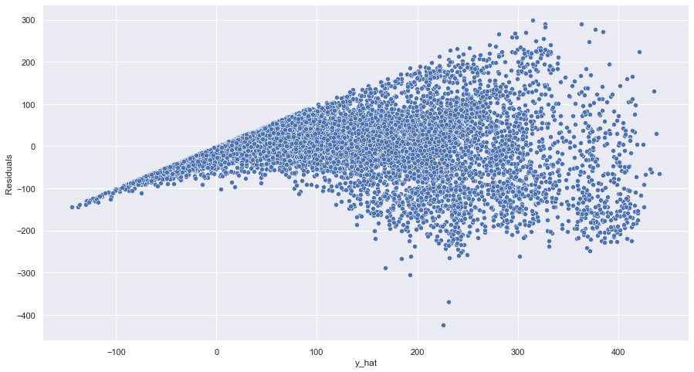
Bikeshare Data
Linear Regression Model - Residuals
What issue do you see?

Slide 11
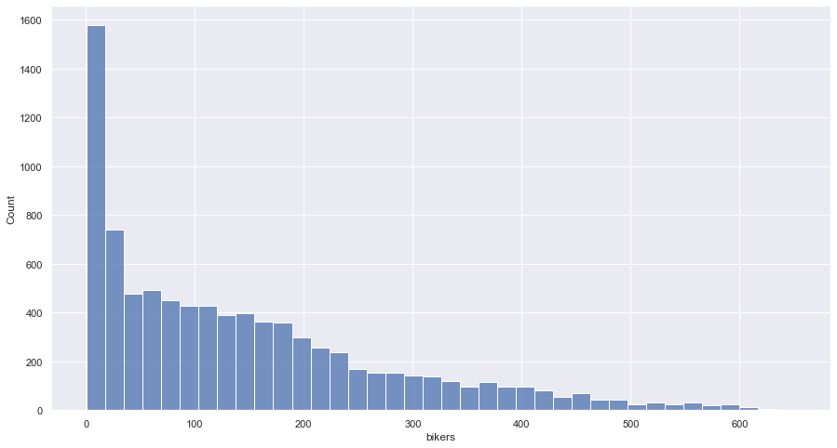
Bikeshare Data
Try Transforming the Response Variable
Looking at the response variable, we find that it is significantly skewed:

Slide 12
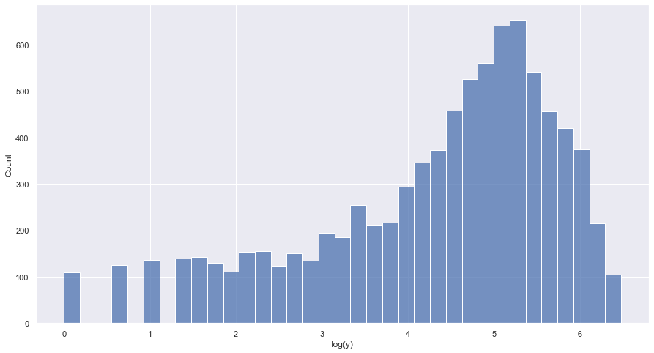
Bikeshare Data
Try Transforming the Response Variable
A log transform significantly improves the skew:

Slide 13
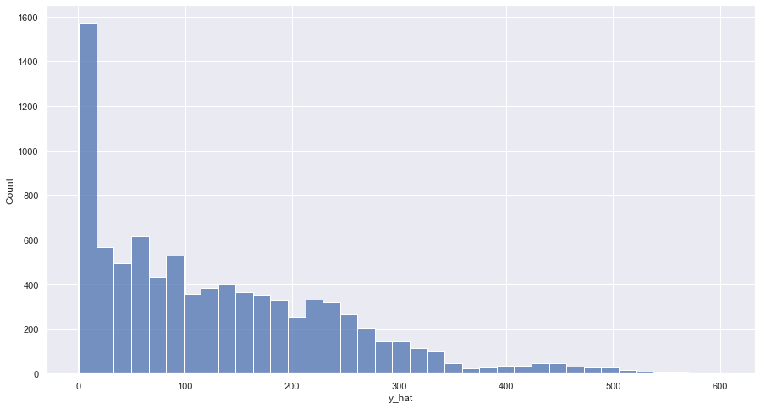
Bikeshare Data
Linear Regression Model With Transformed Response

Slide 14
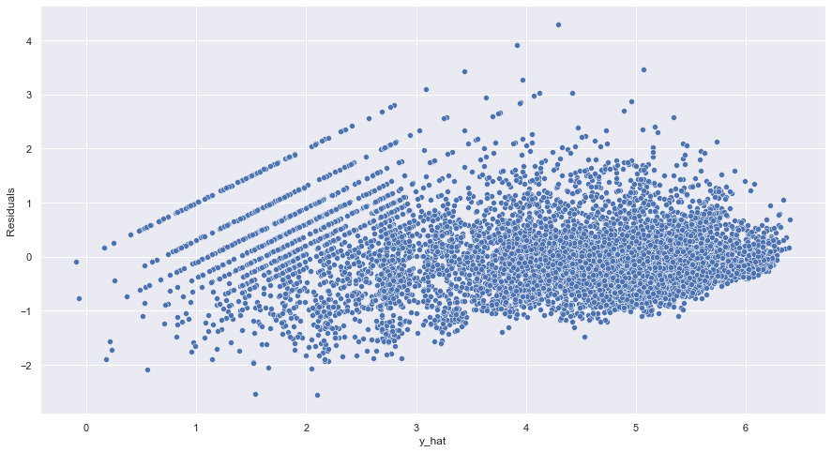
Bikeshare Data
Linear Regression Model With Transformed Response

Slide 15

Poisson Regressions
A Better Approach
Reminders: Poisson distribution
A discrete, non-negative distribution that is often used to model counts
$P\left(Y=k\right)= \frac{e^{−λ}λ^{k}}{k!}$ for $k=0,1,2,…$

Slide 16

Poisson Regression
Reminders, for Poisson distributions:
$E\left(Y\right)= λ$
If we model bikers with a Poisson distribution with $E\left(Y\right)=λ=5$, then for a particular hour:
$P\left(Y=0\right)=\frac{e^{−5}5^{0}}{0!}=$ $e^{−5}$ = 0.0067
$P\left(Y=1\right)=\frac{e^{−5}1}{1!}=$ ${5e}^{−5}$ = 0.034
$P\left(Y=2\right)=\frac{e^{−5}2}{2!}$ = 0.084
…
However, we expect the mean number of users in an hour to vary as a function of the hour of the day, month of the year, weather conditions, etc.

Slide 17

Poisson Regression
Basic Approch
Rather than modeling the number of bikers as a Poisson distribution with a fixed mean value (such as $λ=5$), we model the mean as a function of the predictor variables:
$$log⁡(λ\left(X_{1}, …, X_{p}\right)= β_{0}+β_{1}X_{1},…,β_{p}X_{p}$$
or, equivalently:
$$λ\left(X_{1}, …, X_{p}\right)=x^{β_{0}+β_{1}X_{1},…,β_{p}X_{p}}$$

Slide 18
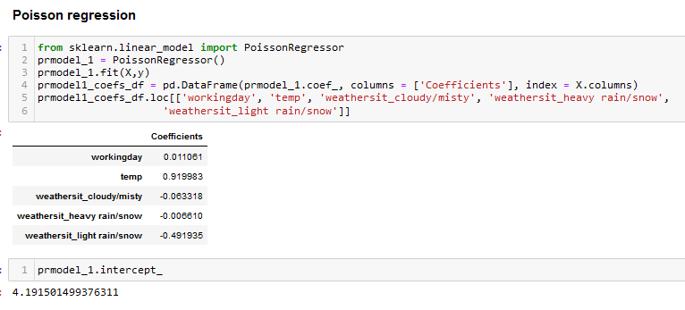
Poisson Regression
Modeling the Bikeshare Dataset

Slide 19
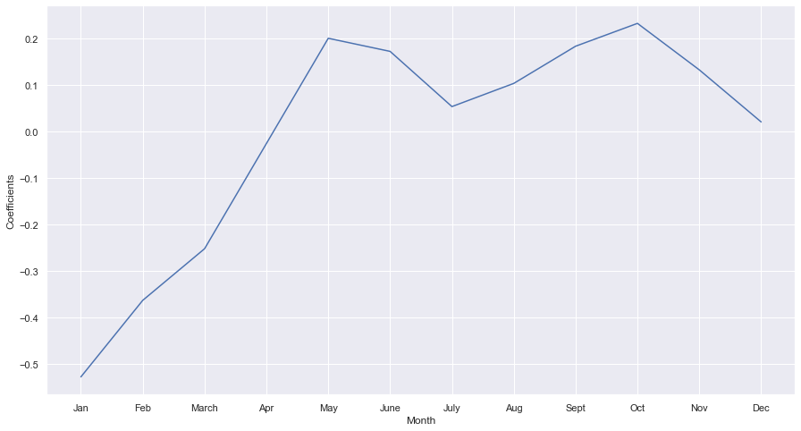
Poisson Regression
Modeling the Bikeshare Dataset

Slide 20
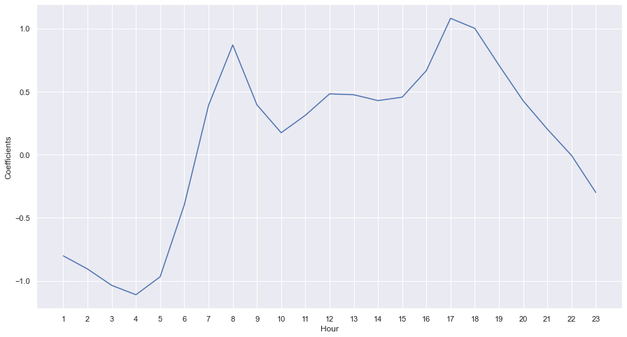
Poisson Regression
Modeling the Bikeshare Dataset

Slide 21

Poisson Regression
Inference
Reminder: $λ\left(X_{1}, …, X_{p}\right)=e^{β_{0}+β_{1}X_{1}+,…,+β_{p}X_{p}}$
Thus, an increase by 1 in any predictor value $j$ causes an increase in the mean value of the response variable by a factor of $e^{j}$ (holding all other predictors constant)
A change from clear to cloudy weather changes the mean bike usage by a factor of $e^{−.06}$ = 0.94. On average only 94% as many people use bikes on a cloudy day compared to when it is clear
A change from clear to light rain changes the mean by a factor of $e^{−0.5}$ = .607 (only 60% as many use bikes on a rainy day than a clear day)

Slide 22

Poisson Regression
Mean-Variance Relationship
In a Poisson distribution, $Var\left(Y\right)= λ$
By using this distribution, the assumption is that variance increases as the mean increases
Different from linear regression models where the assumption is that the variance is constant and independent of the mean
Thus, the Poisson regression is able to handle the mean-variance relationship generally seen in count variables in a natural way

Slide 23
Generalized Linear Models

Slide 24
Linear Model Types
We have now looked at three types of linear models
Linear regression
Logistic regression
Poisson regression

Slide 25

Linear Model Types
Commonality of the three approaches:
Each uses predictors $X_{1}, …, X_{p}$ to predict a response $Y$
We assume that conditional on $X_{1}, …, X_{p}$, $Y$ belongs to a certain family of distributions:
Model | Distribution Family for Y
Linear regression
Logistic regression
Poisson regression

Slide 26
Linear Model Types
Commonality of the three approaches:
Each uses predictors $X_{1}, …, X_{p}$ to predict a response $Y$
We assume that conditional on $X_{1}, …, X_{p}$, $Y$ belongs to a certain family of distributions:
Model | Distribution Family for Y
Linear regression | Gaussian (normal)
Logistic regression | Bernoulli
Poisson regression | Poisson

Slide 27
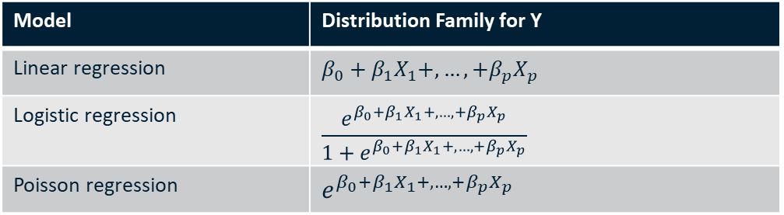
Linear Model Types
Commonality of the three approaches:
Each models the mean of Y as a function of the predictors
Model | Distribution Family for Y
Linear regression | $$β_{0}+β_{1}X_{1}+,…,+β_{p}X_{p}$$
Logistic regression | $$\frac{e^{β_{0}+β_{1}X_{1}+,…,+β_{p}X_{p}}}{1+e^{β_{0}+β_{1}X_{1}+,…,+β_{p}X_{p}}}$$
Poisson regression | $$e^{β_{0}+β_{1}X_{1}+,…,+β_{p}X_{p}}$$

Slide 28
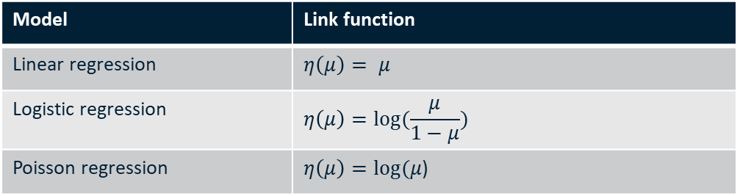

Linear Model Types
Link Functions
Each of these three equations can be expressed using a “link function”:
$$η\left(E(Y|X_{1}, …, X_{p}\right)=β_{0}+β_{1}X_{1}+,…,+β_{p}X_{p}$$
Thus, we have these link functions:
Model | Link function
Linear regression | $$η\left(μ\right)= μ$$
Logistic regression | $$η\left(μ\right)=log⁡(\frac{μ}{1−μ})$$
Poisson regression | $η\left(μ\right)=log(μ$)

Slide 29
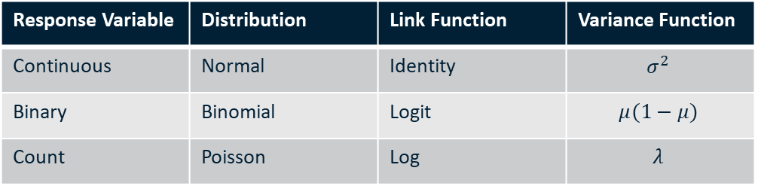
Generalized Linear Model
Generalizes the linear regression model with two options:
Link function
Probability distribution of Y
Response Variable | Distribution | Link Function | Variance Function
Continuous | Normal | Identity | $$σ^{2}$$
Binary | Binomial | Logit | $$μ(1−μ)$$
Count | Poisson | Log | $$λ$$

Slide 30

Generalized Linear Model
Other Types of GLMs
Gaussian, Bernoulli and Poisson distributions are all members of a class of distributions known as exponential distributions
Other well-known exponential distributions are the exponential distribution, Gamma distribution, and negative binomial distribution
GLMs model the response $Y$ as coming from a particular member of the exponential family and then transforming the mean of the response so that the transformed mean is a linear function of the predictors
Other examples of GLMs are Gamma regression and negative binomial regressison

Slide 31
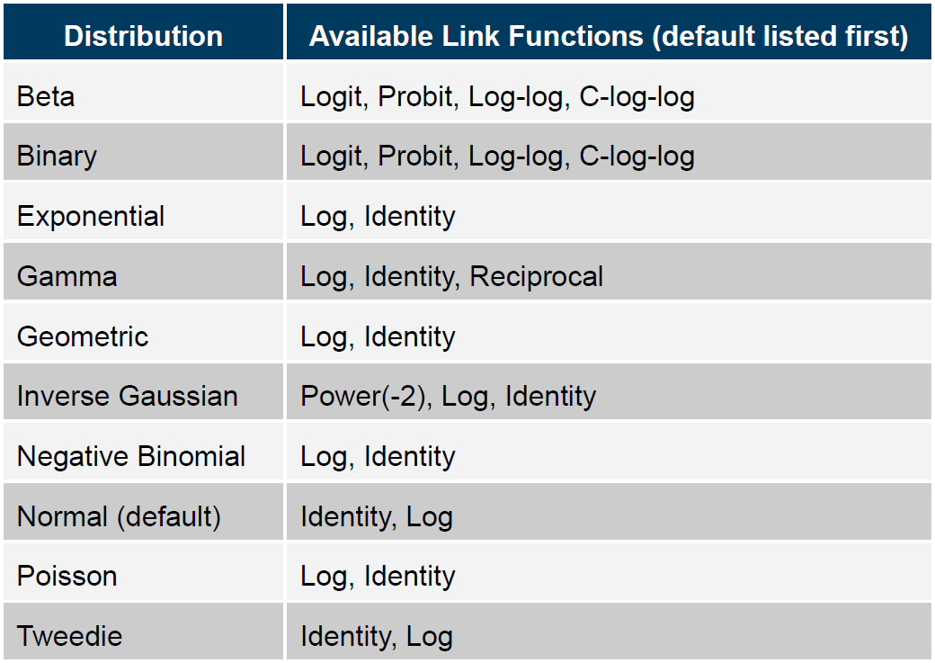
Generalized Linear Models
Supported Linear Distributions (SAS)

