Slide 1
Module 8: Beyond Linearity
Content based on ISLR Chapter 7.1 – 7.7

Slide 2
Moving Beyond Linearlity
The two types of regression functions that we have looked at (linear and logit) are surprisingly effective with many types of models and have advantages of interpretability.
However, the underlying structure of the data is sometimes too non-linear to be effectively modeled with these equations and more complex models must be considered.

Slide 3
Moving Beyond Linearity
Outline
Non-linear Regression Overview
Basis Functions
Polynomial Regression
Piecewise-Constant Regression Models (Step Functions)
Regression splines
Local regression
General Additive Models

Slide 4

Basis Functions
A general approach to extending the linear regression and classification approaches involves the use of basis functions
Instead of calculating regression coefficients on the explanatory attributes, we apply them to a function of the explanatory attributes:
$$Y=β_{0}+β_{1}X_{1}+β_{2}X_{2}+β_{3}X_{3}+…+ε$$
$$Y=β_{0}+β_{1}b_{1}(X_{1})+β_{2}b_{2}(X_{2})+β_{3}b_{3}(X_{3})+…+ε$$
where $b_{1}(∙)$ is the basis function applied to the explanatory attribute

Slide 5

Polynomial Regression
Already covered in Module 3 as a simple extension of the linear model
As previously noted, this is still a linear model and we can use all of the linear regression techniques by simply creating a new transformed attributes (${X_{1}}^{2}$, ${X_{1}}^{3}, …)$
Polynomial regression is one example of the use of a basis function approach where the basis function is given as: $b_{j}\left(X_{1}\right)=X_{1}^{j}$
$$Y=β_{0}+β_{1}X_{1}+β_{2}{X_{1}}^{2}+β_{3}{X_{1}}^{3}+…+ε$$

Slide 6
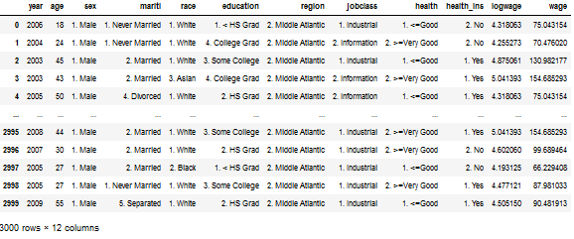
Wage Example
Polynomial Regression

Slide 7
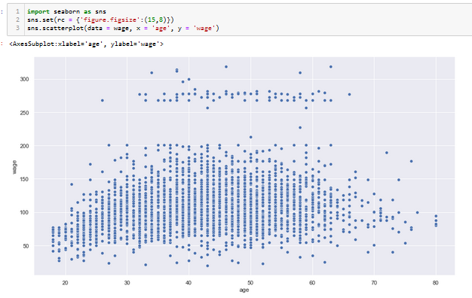
Wage Example
Polynomial Regression

Slide 8
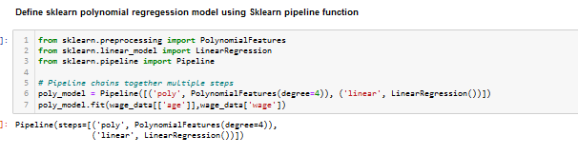
Wage Example
Polynomial Regression

Slide 9
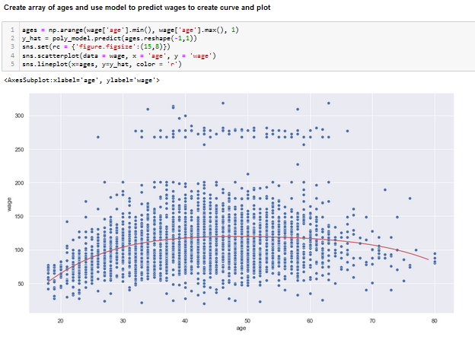
Wage Example
Polynomial Regression

Slide 10
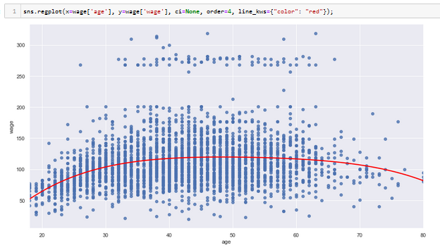
Wage Example
Polynomial Regression

Slide 11
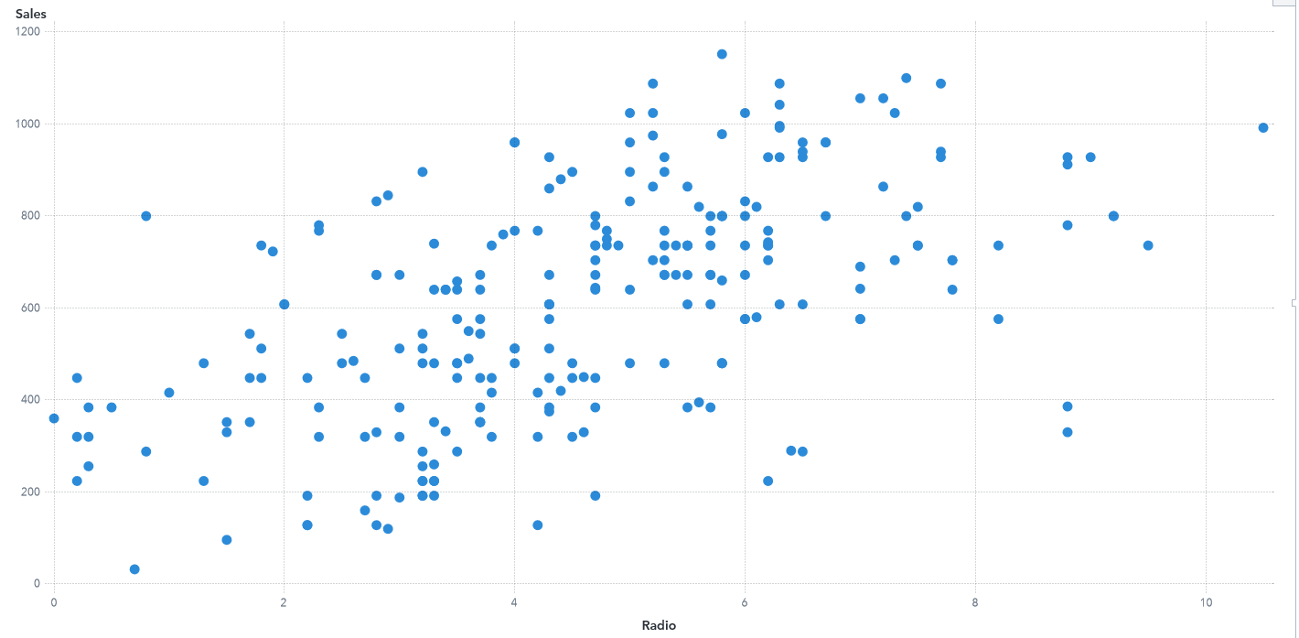
Piecewise-Constant Regression Models
"Step Functions"
Instead of imposing a global polynomial structure on model, we cut the variable into distinct regions and fit with piecewise constants:

Slide 12

Step Function
Model is easily fit by creating Indicator Functions $I\left(∙\right)$ that return 1 if the condition is true and 0 otherwise)
To create the step function model in our example, we need three step functions:
$C_{1}\left(Radio\right)=I(Radio<2)$
$C_{2}\left(Radio\right)=I(2≤ Radio≤4)$
$C_{3}\left(Radio\right)=I(Radio>4)$
Then, we use standard least squares to fit a linear model with these the indicators as predictors:
$$Sales= β_{0 }+β_{1}C_{1}\left(Radio\right)+β_{2}C_{2}\left(Radio\right)+β_{3}C_{3}\left(Radio\right)$$

Slide 13
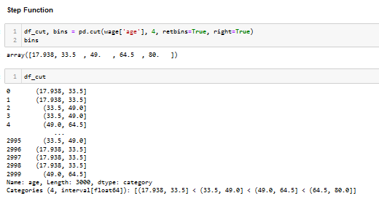
Step Function
Wage Example

Slide 14
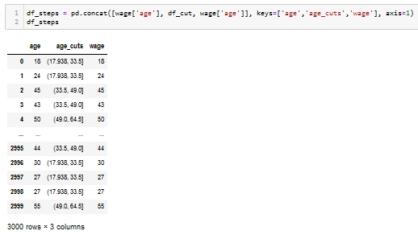
Step Function
Wage Example

Slide 15
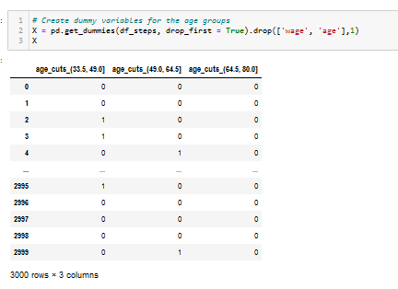
Step Function
Wage Example

Slide 16
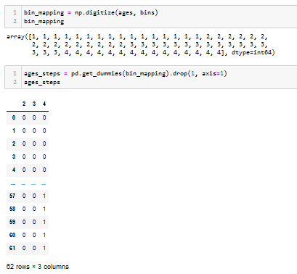
Step Function
Wage Example

Slide 17
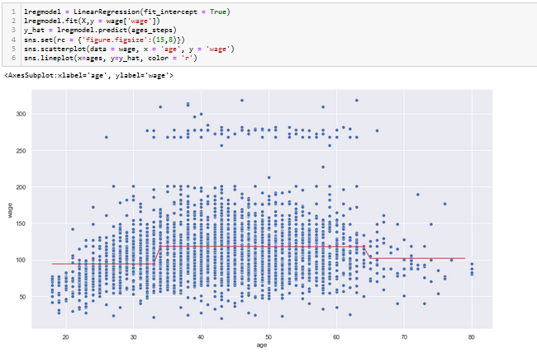
Step Function
Wage Example

Slide 18

Step Functions - Summary
Special case of a basis function where:
$b_{j}\left(X_{1}\right)=I(c_{j}≤X_{1}≤$ $c_{j+1})$
Easy to work with and interpret
Works well when there are natural cutpoints (or knots) to work with
The discontinuous step function can introduce significant issues

Slide 19

Piecewise Polynomials
Overview
Instead of a single polynomial in X over its whole domain, we can rather use different polynomials in regions defined by knots. For example, a piecewise cubic polynomial with one knot at $c$:
$$y_{i}=\left\{\begin{matrix}β_{01}+β_{11}x_{i}+β_{21}{x_{i}}^{2}+β_{31}x^{3}+ε_{i} if x_{i}<c \\ β_{01}+β_{11}x_{i}+β_{21}{x_{i}}^{2}+β_{31}x^{3}+ε_{i} if x_{i}≥c\end{matrix}\right.$$
In general, we also add constraints to the polynomials for continuity

Slide 20
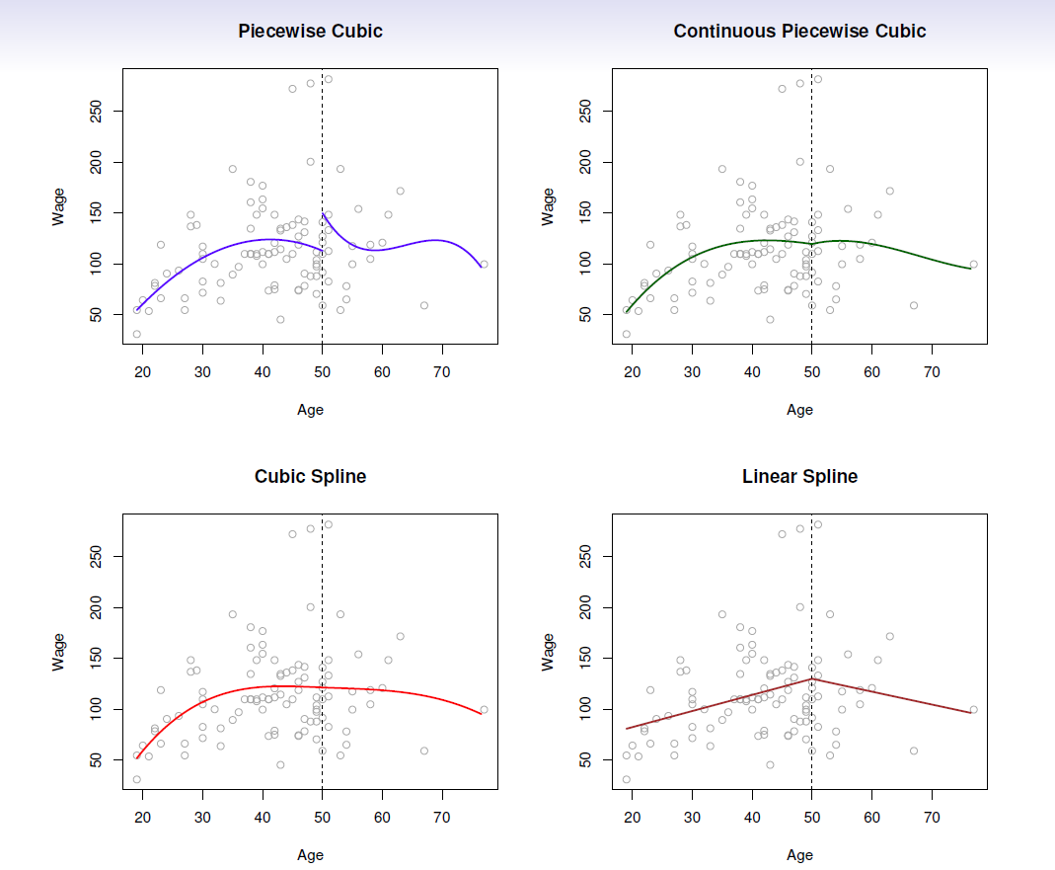
Piecewise Polynomial Examples
Discontinuity at the cut-point is undesirable
Adding a constraint that curve must be continuous
Adding constraints that first and second derivatives must be continuous
Piecewise polynomial of order 1

Slide 21
Piecewise Polynomials
Overview
Piecewise polynomials improve on the "global" polynomial regression because we are able to use lower-order polynomials resulting in less risk of overfitting
Note: the step function is thus a piecewise polynomial of degree 0

Slide 22

Linear Splines
A linear spline with knots at $ξ_{k}, k=1,…K$ is a piecewise linear polynomial continuous at each knot
We can represent this model with basis functions:
$$y_{i}=β_{0}+β_{1}b_{1}\left(x_{i}\right)+β_{2}b_{2}\left(x_{i}\right)+…+β_{K+1}b_{K+1}\left(x_{i}\right)+ε_{i}$$
where the $b_{k}$ functions are basis functions:
$$b_{1}\left(x_{i}\right)= x_{i} \\ b_{k+1}\left(x_{i}\right)= {(x_{i}−ξ_{k})}_{+}, k=1,…,K$$
“Positive part”: returns 0 if value is negative

Slide 23
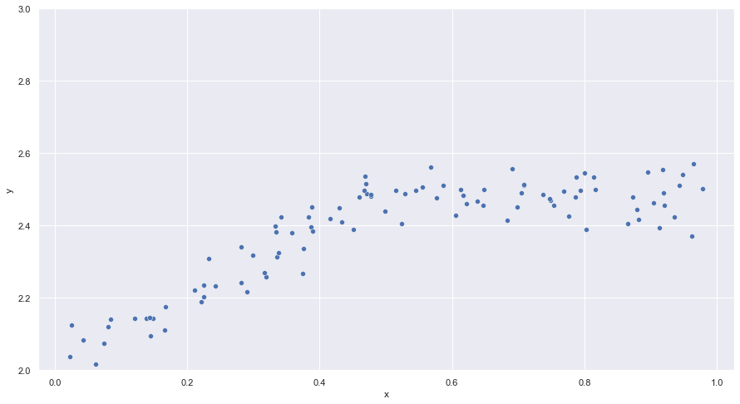
Linear Splines

Slide 24
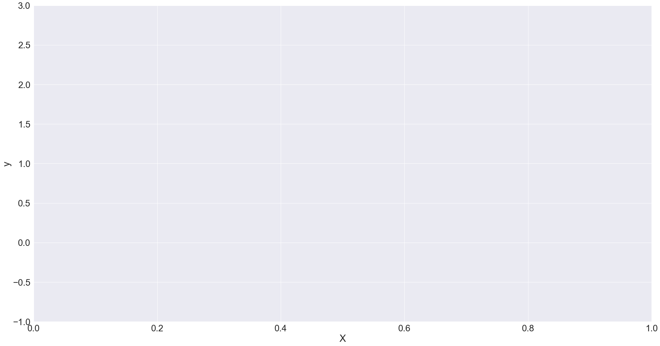


Linear Splines
$$β_{0}+β_{1}b_{1}(x)$$
$$β_{2}b_{2}(x)$$

Slide 25

Linear Splines
$$β_{0}+β_{1}b_{1}\left(x\right)+β_{2}b_{2}(x)$$

Slide 26
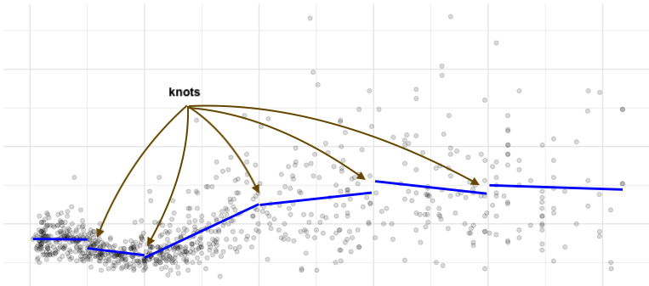
Piecewise Linear Regression Models

Slide 27

Cubic Splines
A linear cubic with knots at $ξ_{k}, k=1,…K$ is a piecewise cubic polynomial with continuous derivatives up to order 2 at each knot
Again, we can represent this model with truncated basis functions:
$$y_{i}=β_{0}+β_{1}b_{1}\left(x_{i}\right)+β_{2}b_{2}\left(x_{i}\right)+…+β_{K+3}b_{K+3}\left(x_{i}\right)+ε_{i}$$
where:
$$b_{1}\left(x_{i}\right)=x_{i} \\ b_{2}\left(x_{i}\right)={x_{i}}^{2} \\ b_{3}\left(x_{i}\right)={x_{i}}^{3} \\ b_{k+3}\left(x_{i}\right)= {{(x_{i}−ξ_{k})}_{+}}^{3}, k=1,…,K$$

Slide 28
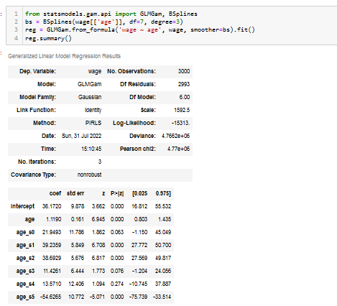
Cubic Splines
Wage Example

Slide 29
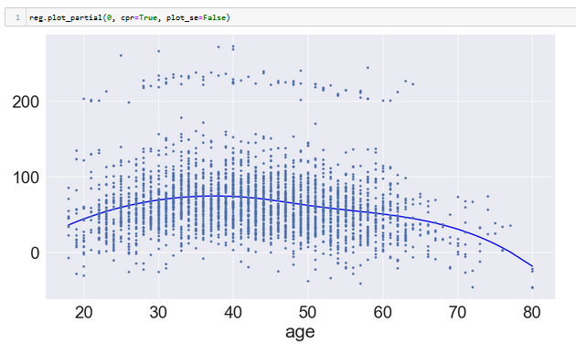
Cubic Splines
Wage Example

Slide 30
Regression Splines
Regression splines are defined to be piecewise polynomials there are continuous at the knots (cut-points). That is, the end points where segments meet are constrained to be equal (upper right)
We can also add constraints that the first and second derivatives at the end points meet are also constrained to be equal, giving a smooth curve

Slide 31
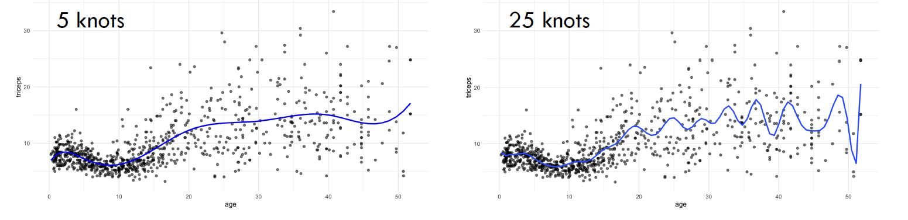
Cubic Splines – Knot Selection

Slide 32
Knot Placement
One strategy is to decide K, the number of knots, and then place them at appropriate quantiles of the observed X
A cubic spline with K knots has K+4 parameters (or degrees of freedom)

Slide 33
Generalized Additive Models

Slide 34

Generalized Additive Models
Overview
Extension of multiple linear regression models which replaces each linear component ($β_{j}x_{ij}$) with a smooth nonlinear function $f_{j}(x_{ij})$.
Linear regression model then is generalized from this:
$$y_{i}=β_{0}+\sum_{j=1}^{p}{β_{j}x_{ij}}+ε_{i}$$
to this: $$y_{i}=β_{0}+\sum_{j=1}^{p}{f_{j}{(x}_{ij})}+ε_{i}$$

Slide 35
Generalized Additive Models
Overview
Allows combination of regression splines, smoothing splines, and local regression models to deal with multiple predictors in one model
Modeler can decide which method to use for every feature

Slide 36
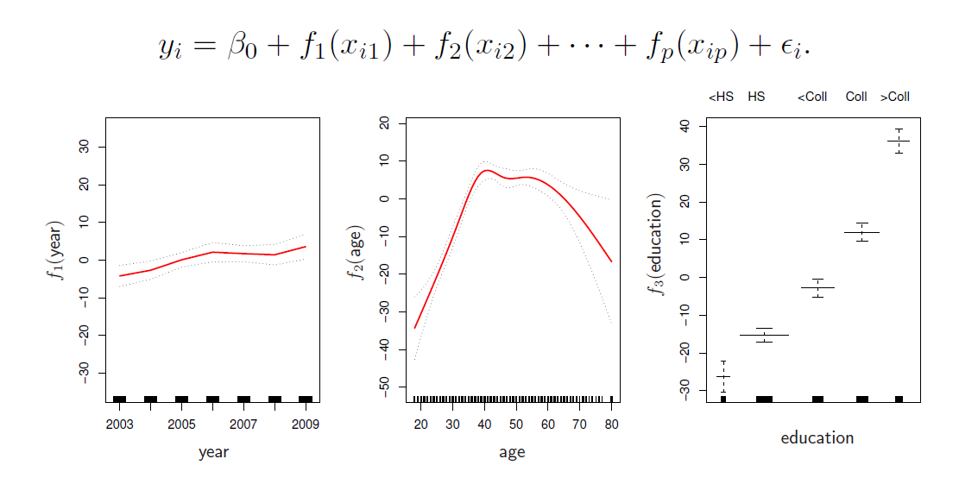
General Additive Models
Extending and Generalizing to Multi-Variable Models

